Slide 1
EdMoneyBall
SIRUI FENG
TURAB HASSAN
VI NGUYEN
CS 122 Project
MSCAPP ‘17

Slide 2
Goal
To visualize CPS’s (primary schools) data:
Diversity: Income indicator, Ethnicity distribution
Performance: Math/Reading Attainment & Growth
Expenditures: Key categories per student
To help parents find primary schools that are open to them and best-fit their criteria.

Slide 3
Overview of the System
Database
School Performance Data
School Expenditure Data
School Demographic Data
School & Zone Geo-location Data
Attainment Score
Growth Percentile
Free/Reduced Lunch
Ethnicity
Polygons
Notes:
we take different parts together to visualize, compare, and recommend schools.

Slide 4
Challenge: Integration
Bootstrap
HTML/ Javascript
Google API
User Inputs
Python
Django Framework
SQL Database
Plotly

Slide 5
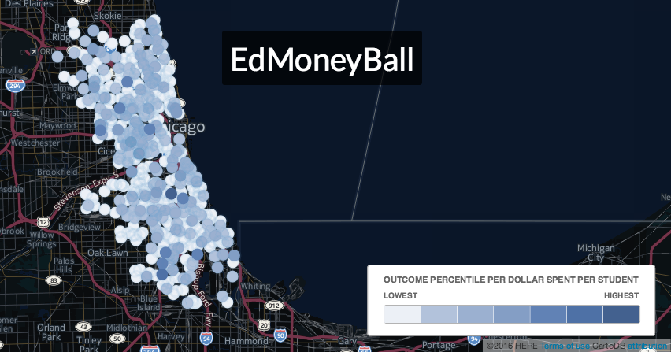
Demo

Slide 6
Surprising Aspects of Implementation or Data
Google API: Cool!
Determining whether a point is in a polygon on a sphere: Difficult
Recommendation: Complicated
Charter school expenditure: Unknown
Visualization: Powerful

Slide 7
The End
High five!
Comments/Questions?

