Slide 1
Interface Segregation
Clients should not be forced to depend upon interfaces that they don't use.

Slide 2
?
“Fat”
Polluted
Tend to do a lot of work
Such interfaces are not cohesive (composable)
Notes:
Not cohesive.

Slide 3
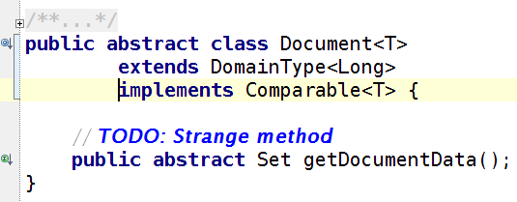
Example #1
Notes:
Used only in DocumentDataBeanBase.
All 38 implementation just returns null.
The implementation of retrieving document data was moved to separate manager. All concrete implementations of DocumentDataBeanBase use that manager.

Slide 4
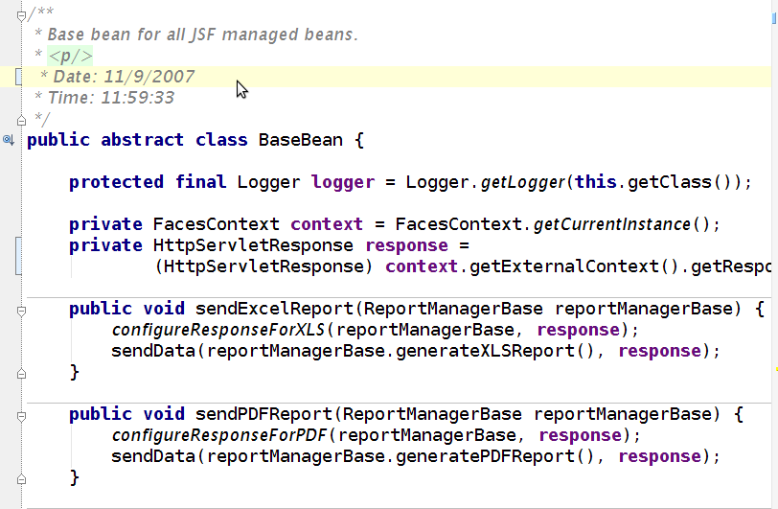
Example #2
Notes:
The problem here is that this class has 101 subclasses. Only those related with reports need functionality to send PDF and Excel data.

Slide 5
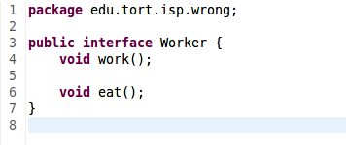
Example #3 - Worker
Suppose we have a workers that can work and eat

Slide 6
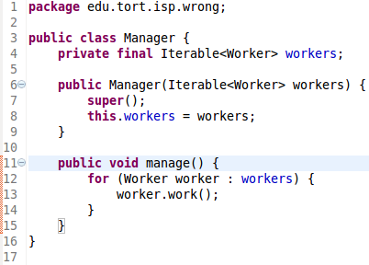
Example #3 - Worker
And we have a manager, to manage them

Slide 7
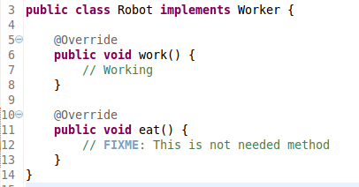
Example #3 - Worker
And then some of them are replaced with robot

Slide 8


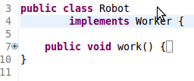
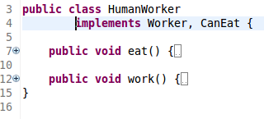
Solution - Separate Interfaces

Slide 9
Reasons
Retrofitted code
Not obeying other SOLID principles
CanEat
Worker
HumanWorker
RobotWorker

Slide 10
Open-Closed Principle
Software entities (classes, modules, functions) should be open for extension, but closed for modification.

Slide 11
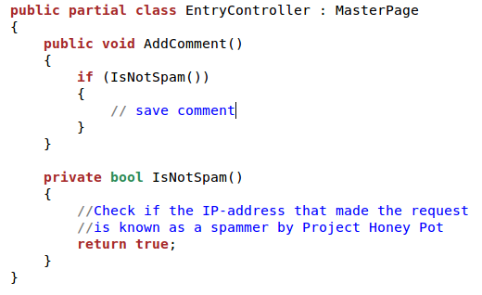
The Problem

Slide 12
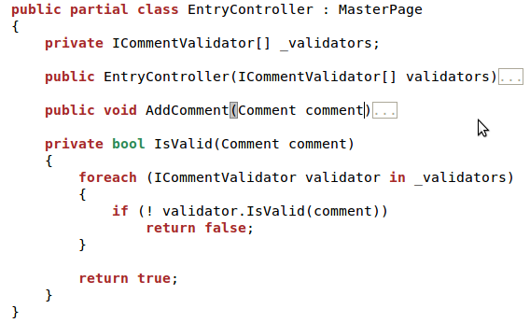
Abstraction is the Key

Slide 13
It's Like a Sale
Break one – get a few others for free

Slide 14
Avoid Overengineering
Ты видел, как он код пишет? Если ему нужно будет создать класс Пользователь, он начнёт с класса Человек, причём предусмотрит возможность существования как углеродной, так и кремнийорганической формы жизни.

Slide 15
Always Consider Context
A “HelloWorld” program will never grow into a Mission Control Center software
… but accounting/bookkeeping system will certainly do

