Slide 1


A Practical Introduction to Python
Part 1
Lewys Brace
l.brace@Exeter.ac.uk

Slide 2
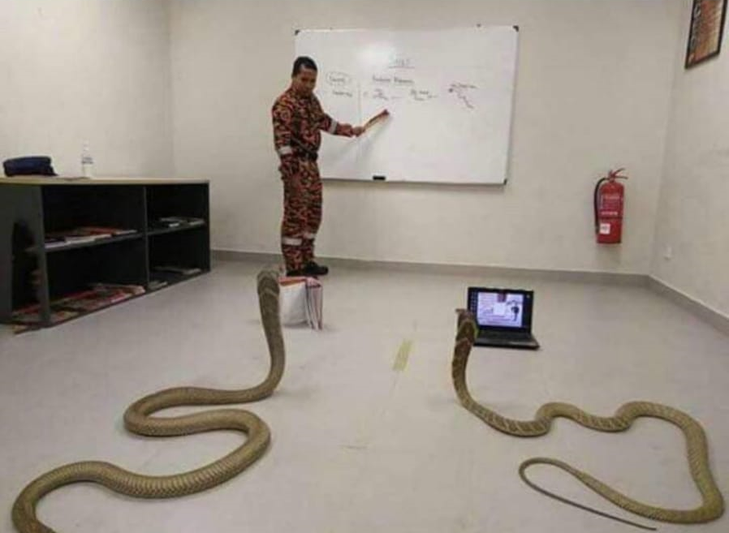
An introduction to coding with Python
An introductory coding course with Python…

Slide 3
Interpretive vs compiled languages
Python is an interpretive language.
This means that your code is not directly run by the hardware. It is instead passed to a virtual machine, which is just another programme that reads and interprets your code. If your code used the ‘+’ operation, this would be recognised by the interpreter at run time, which would then call its own internal function ‘add(a,b)’, which would then execute the machine code ‘ADD’.
This is in contrast to compiled languages, where your code is translated into native machine instructions, which are then directly executed by the hardware. Here, the ‘+’ in your code would be translated directly in the ‘ADD’ machine code.

Slide 4
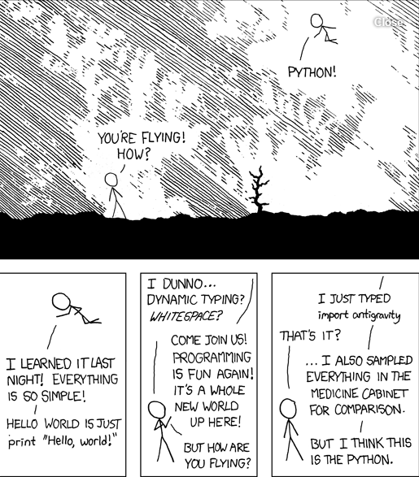
Advantages of Python?
Because Python is an interpretive language, it has a number of advantages:
Automatic memory management.
Expressivity and syntax that is ‘English’.
Ease of programming.
Minimises development time.
Python also has a focus on importing modules, a feature that makes it useful for scientific computing.

Slide 5
Disadvantages
Interpreted languages are slower than compiled languages.
The modules that you import are developed in a decentralised manner; this can cause issues based upon individual assumptions.
Multi-threading is hard in Python

Slide 6
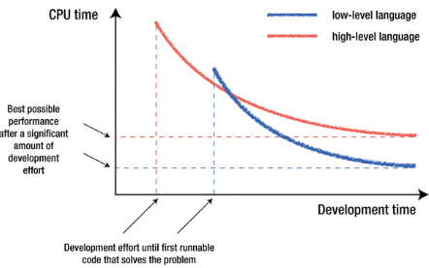
Which language is the best
No one language is better than all others.
The ‘best’ language depends on the task you are using it for and your personal preference.

Slide 7
Versions of Python
There are currently two versions of Python in use; Python 2 and Python 3.
Python 3 is not backward compatible with Python 2.
A lot of the imported modules were only available in Python 2 for quite some time, leading to a slow adoption of Python 3. However, this not really an issue anymore.
Support for Python 2 will end in 2020.

Slide 8

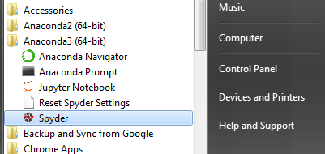
The Anaconda IDE…
The Anaconda distribution is the most popular Python distribution out there.
Most importable packages are pre-installed.
Offers a nice GUI in the form of Spyder.
Before we go any further, let’s open Spyder:

Slide 9
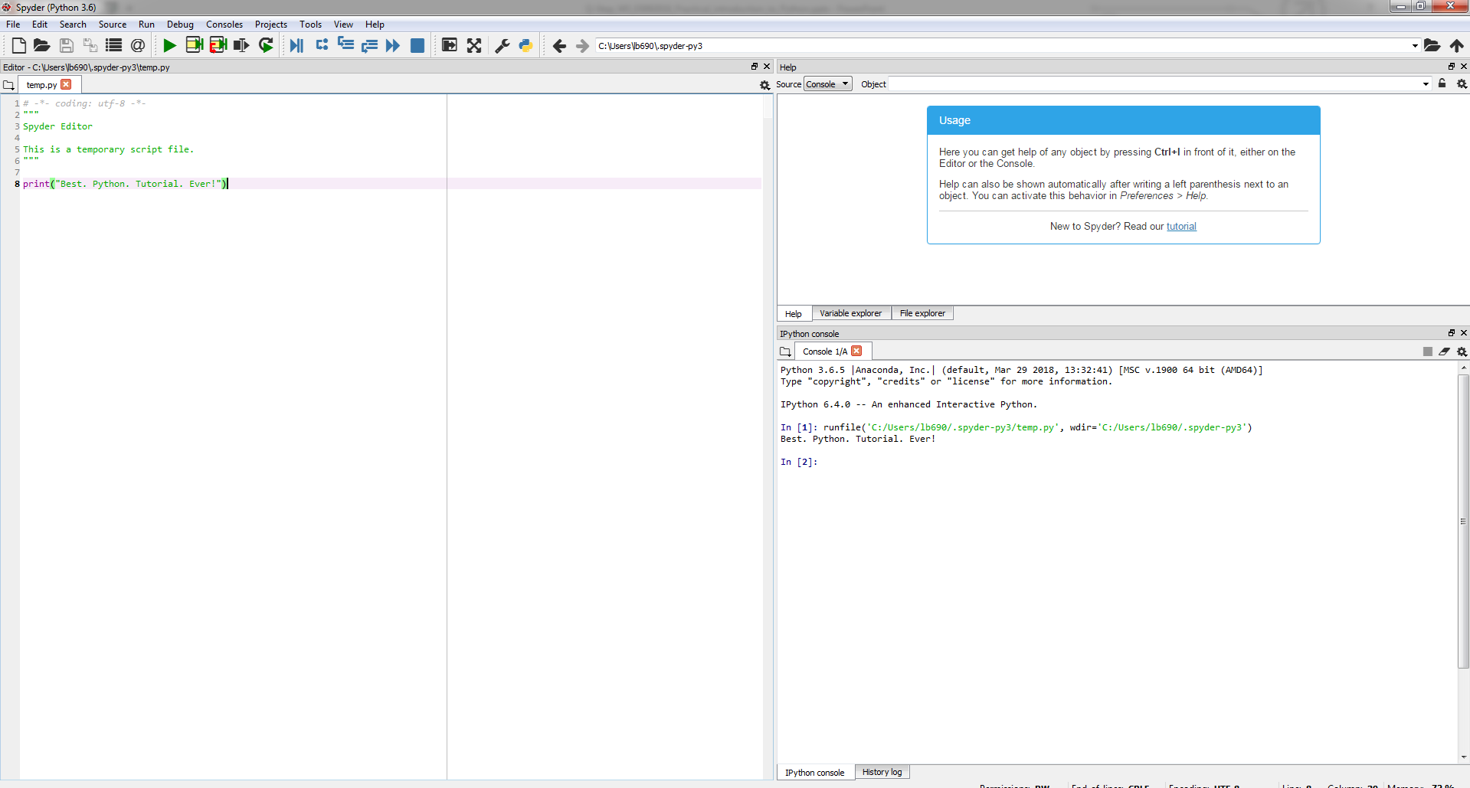

Slide 10
Variables
Variables in python can contain alphanumerical characters and some special characters.
By convention, it is common to have variable names that start with lower case letters and have class names beginning with a capital letter; but you can do whatever you want.
Some keywords are reserved and cannot be used as variable names due to them serving an in-built Python function; i.e. and, continue, break. Your IDE will let you know if you try to use one of these.
Python is dynamically typed; the type of the variable is derived from the value it is assigned.

Slide 11
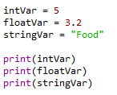

Variable types
A variable is assigned using the = operator; i.e:
Integer (int)
Float (float)
String (str)
Boolean (bool)
Complex (complex)
[…]
User defined (classes)
In:
Out:
The print() function is used to print something to the screen.
Create an integer, float, and string variable.
Print these to the screen.
Play around using different variable names, etc.

Slide 12

You can always check the type of a variable using the type() function.
In:
Out:
Check the type of one of your variables.

Slide 13


Variables can be cast to a different type.
In:
Out:

Slide 14


Arithmetic operators
The arithmetic operators:
Addition: +
Subtract: -
Multiplication: *
Division: /
Power: **
Write a couple of operations using the arithmetic operators, and print the results to the screen.
In:
Out:

Slide 15
A quick note on the increment operator shorthand
Python has a common idiom that is not necessary, but which is used frequently and is therefore worth noting:
x += 1
Is the same as:
x = x + 1
This also works for other operators:
x += y # adds y to the value of x
x *= y # multiplies x by the value y
x -= y # subtracts y from x
x /= y # divides x by y

Slide 16
Boolean operators
Boolean operators are useful when making conditional statements, we will cover these in-depth later.
and
or
not

Slide 17
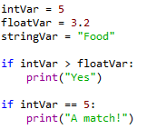

Comparison operators
Write a couple of operations using comparison operators; i.e.
Greater than: >
Lesser than: <
Greater than or equal to: >=
Lesser than or equal to: <=
Is equal to: ==
In:
Out:

Slide 18
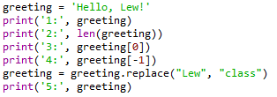



Working with strings
In:
Out:
Create a string variable.
Work out the length of the string.

Slide 19
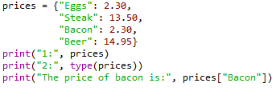

Dictionaries
Dictionaries are lists of key-valued pairs.
In:
Out:

Slide 20




Indexing
Indexing in Python is 0-based, meaning that the first element in a string, list, array, etc, has an index of 0. The second element then has an index of 1, and so on.
In:
Out:
You can cycle backwards through a list, string, array, etc, by placing a minus symbol in front of the index location.
In:
Out:

Slide 21



In:
Out:
In:
Out:
Create a string that is 10 characters in length.
Print the second character to the screen.
Print the third to last character to the screen.
Print all characters after the fourth character.
Print characters 2-8.

Slide 22


Tuples
Tuples are containers that are immutable; i.e. their contents cannot be altered once created.
In:
Out:
In:
Out:

Slide 23


Lists
Lists are essentially containers of arbitrary type.
They are probably the container that you will use most frequently.
The elements of a list can be of different types.
The difference between tuples and lists is in performance; it is much faster to ‘grab’ an element stored in a tuple, but lists are much more versatile.
Note that lists are denoted by [] and not the () used by tuples.
In:
Out:
Create a list and populate it with some elements.

Slide 24


Adding elements to a list
Lists are mutable; i.e. their contents can be changed. This can be done in a number of ways.
With the use of an index to replace a current element with a new one.
In:
Out:
Replace the second element in your string with the integer 2.

Slide 25


You can use the insert() function in order to add an element to a list at a specific indexed location, without overwriting any of the original elements.
In:
Out:
Use insert() to put the integer 3 after the 2 that you just added to your string.

Slide 26


You can add an element to the end of a list using the append() function.
In:
Out:
Use append() to add the string “end” as the last element in your list.

Slide 27


Removing elements from a list
You can remove an element from a list based upon the element value.
Remember: If there is more than one element with this value, only the first occurrence will be removed.
In:
Out:

Slide 28


It is better practice to remove elements by their index using the del function.
In:
Out:
Use del to remove the 3 that you added to the list earlier.

Slide 29
For loops
The for loop is used to iterate over elements in a sequence, and is often used when you have a piece of code that you want to repeat a number of times.
For loops essentially say: “For all elements in a sequence, do something”

Slide 30
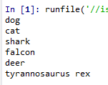
An example
We have a list of species:
The command underneath the list then cycles through each entry in the species list and prints the animal’s name to the screen. Note: The i is quite arbitrary. You could just as easily replace it with ‘animal’, ‘t’, or anything else.

Slide 31
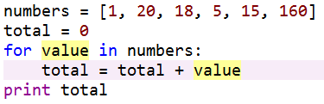

Another example
We can also use for loops for operations other than printing to a screen. For example:
Using the list you made a moment ago, use a for loop to print each element of the list to the screen in turn.

Slide 32






The range() function
The range() function generates a list of numbers, which is generally used to iterate over within for loops.
The range() function has two sets of parameters to follow:
range(stop)
stop: Number of integers
(whole numbers) to generate,
starting from zero. i.e:
range([start], stop[, step])
start: Starting number of the sequence.
stop: Generate numbers up to, but not including this number.
step: Difference between each number in the sequence
i.e.:
Note:
All parameters must be integers.
Parameters can be positive or negative.
The range() function (and Python in general) is 0-index based, meaning list indexes start at 0, not 1. eg. The syntax to access the first element of a list is mylist[0]. Therefore the last integer generated by range() is up to, but not including, stop.

Slide 33
Create an empty list.
Use the range() and append() functions to add the integers 1-20 to the empty list.
Print the list to the screen, what do you have?
Output:

Slide 34
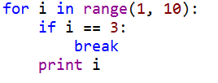

The break() function
To terminate a loop, you can use the break() function.
The break() statement breaks out of the innermost enclosing for or while loop.

Slide 35

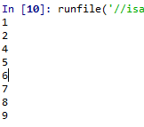
The continue () function
The continue() statement is used to tell Python to skip the rest of the statements in the current loop block, and then to continue to the next iteration of the loop.

Slide 36
While loops
The while loop tells the computer to do something as long as a specific condition is met.
It essentially says:
“while this is true, do this.”
When working with while loops, its important to remember the nature of various operators.
While loops use the break() and continue() functions in the same way as a for loop does.

Slide 37
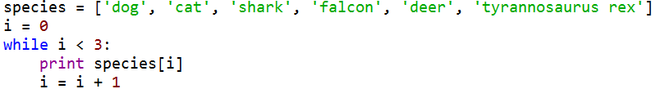

An example

Slide 38
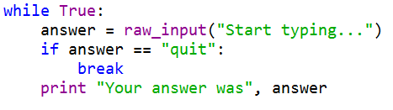
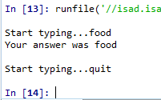
Another example

Slide 39

A bad example

Slide 40



Create a variable and set it to zero.
Write a while loop that states that, while the variable is less than 250, add 1 to the variable and print the variable to the screen.
In:
Out:
Replace the < with <=, what happens?

Slide 41
For loop vs. while loop
You will use for loops more often than while loops.
The for loop is the natural choice for cycling through a list, characters in a string, etc; basically, anything of determinate size.
The while loop is the natural choice if you are cycling through something, such as a sequence of numbers, an indeterminate number of times until some condition is met.

Slide 42

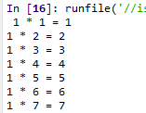
Nested loops
In some situations, you may want a loop within a loop; this is known as a nested loop.
What will the code on the right produce?
Recreate this code and run it, what do you get?
In:
Out:

Slide 43


Conditionals
There are three main conditional statements in Python; if, else, elif.
We have already used if when looking at while loops.
In:
Out:
In:
Out:

Slide 44
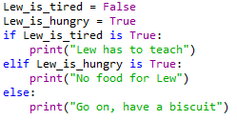
An example of elif
In:
Out:

Slide 45
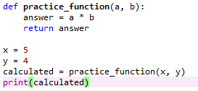

Functions
A function is a block of code which only runs when it is called.
They are really useful if you have operations that need to be done repeatedly; i.e. calculations.
The function must be defined before it is called. In other words, the block of code that makes up the function must come before the block of code that makes use of the function.
In:
Out:

Slide 46

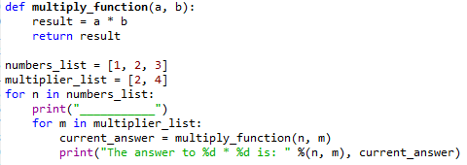
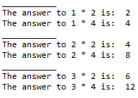
Create a function that takes two inputs, multiplies them, and then returns the result. It should look some like: def function_name(a, b): do something return something
Create two different lists of integers.
Using your function, write a nested for loop that cycles through each entries in the first list and multiples it by each of the entries in the second list, and prints the result to the screen.
In:
Out:

Slide 47
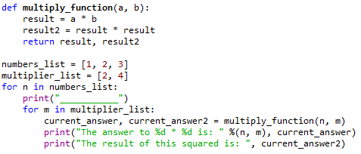
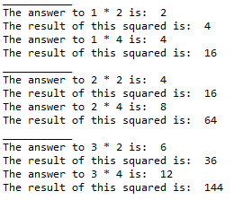
Multiple returns
You can have a function return multiple outputs.
In:
Out:

Slide 48
Any questions?

