Slide 1


A practical introduction to Python
Part 2
Lewys Brace
l.brace@Exeter.ac.uk

Slide 2
Reading and writing to files in Python: The file object
File handling in Python can easily be done with the built-in object file.
The file object provides all of the basic functions necessary in order to manipulate files.
Open up notepad or notepad++. Write some text and save the file to a location and with a name you’ll remember.

Slide 3
The open() function
Before you can work with a file, you first have to open it using Python’s in-built open() function.
The open() function takes two arguments; the name of the file that you wish to use and the mode for which we would like to open the file
By default, the open() function opens a file in ‘read mode’; this is what the ‘r’ above signifies.
There are a number of different file opening modes. The most common are: ‘r’= read, ‘w’=write, ‘r+’=both reading and writing, ‘a’=appending.
Use the open() function to read the file in.

Slide 4
The close() function
Likewise, once you’re done working with a file, you can close it with the close() function.
Using this function will free up any system resources that are being used up by having the file open.

Slide 5

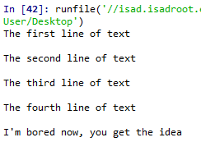
Reading in a file and printing to screen example
Using what you have now learned about for loops, it is possible to open a file for reading and then print each line in the file to the screen using a for loop.
Use a for loop and the variable name that you assigned the open file to in order to print each of the lines in your file to the screen.
In:
Out:

Slide 6
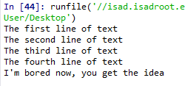


The read() function
However, you don’t need to use any loops to access file contents. Python has three in-built file reading commands:
1. <file>.read() = Returns the entire contents of the file as a single string:
2. <file>.readline() = Returns one line at a time:
3. <file>.readlines() = Returns a list of lines:

Slide 7


The write() function
Likewise, there are two similar in-built functions for getting Python to write to a file:
1. <file>.write() = Writes a specified sequence of characters to a file:
2. <file>.writelines() = Writes a list of strings to a file:
Important: Using the write() or writelines() function will overwrite anything contained within a file, if a file of the same name already exists in the working directory.

Slide 8
Practice – writing to a file in Python
Part 1:
Open the file you created in the last practice and ready it for being written to.
Write a string to that file. Note: this will overwrite the old contents.
Remember to close the file once you are done.
Part 2:
Create a list of strings.
Use the open() function to create a new .txt file and write your list of strings to this file.
Remember to close the file once you are done.

Slide 9
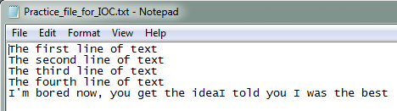

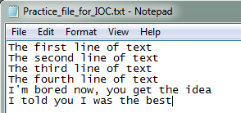
The append() function
If you do not want to overwrite a file’s contents, you can use the append() function.
To append to an existing file, simply put ‘a’ instead of ‘r’ or ‘w’ in the open() when opening a file.

Slide 10
Practice – appending to a file in Python
Open the text file you created in part two of the writing to a file practice, and ready it for appending.
Define a string object.
Appending this new string object to the file.
Remember to close the file once you are done.

Slide 11

A word on import
To use a package in your code, you must first make it accessible.
This is one of the features of Python that make it so popular.
In:
There are pre-built Python packages for pretty much everything.
In:

Slide 12
Plotting in Python
Before creating an plots, it is worth spending sometime familiarising ourselves with the matplotlib module. It will save a lot of time later on.

Slide 13

Some history….
Matplotlib was originally developed by a neurobiologist in order to emulate aspects of the MATLAB software.
The pythonic concept of importing is not utilised by MATLAB, and this is why something called Pylab exists.
Pylab is a module within the Matplotlib library that was built to mimic the MATLAB style. It only exists in order to bring aspects of NumPy and Matplotlib into the namespace, thus making for an easier transition for ex-MATLAB users, because they only had to do one import in order to access the necessary functions:
However, using the above command is now considered bad practice, and Matplotlib actually advises against using it due to the way in which it creates many opportunities for conflicted name bugs.

Slide 14

Getting started
Without Pylab, we can normally get away with just one canonical import; the top line from the example below.
We are also going to import NumPy, which we are going to use to generate random data for our examples.

Slide 15
Different graph types
A simple line graph can be plotted with plot().
A histogram can be created with hist().
A bar chart can be created with bar().
A pie chart can be created with pie().
A scatter plot can be created with scatter().
The table() function adds a text table to an axes.
Plus many more….

Slide 16

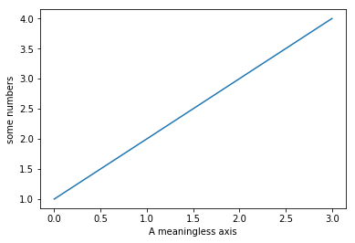
Our first plot
You may be wondering why the x-axis ranges from 0-3 and the y-axis from 1-4.
If you provide a single list or array to the plot() command, Matplotlib assumes it is a sequence of y values, and automatically generates the x values for you.
Since python ranges start with 0, the default x vector has the same length as y but starts with 0.
Hence the x data are [0,1,2,3].

Slide 17
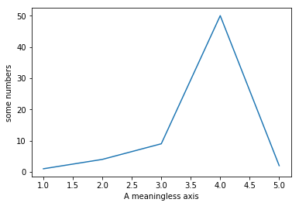

The plot() function
The plot() argument is quite versatile, and will take any arbitrary collection of numbers. For example, if we add an extra entry to the x axis, and replace the last entry in the Y axis and add another entry:

Slide 18
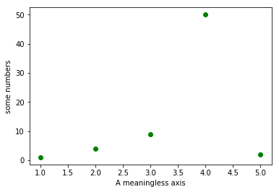
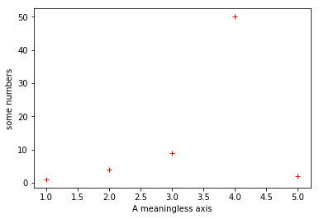
The plot() function
The plot() function has an optional third argument that specifies the appearance of the data points.
The default is b-, which is the blue solid line seen in the last two examples. The full list of styles can be found in the documentation for the plot() on the Matplotlib page

Slide 19


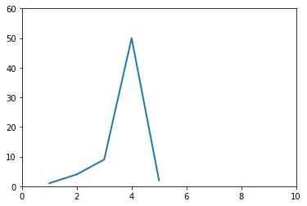
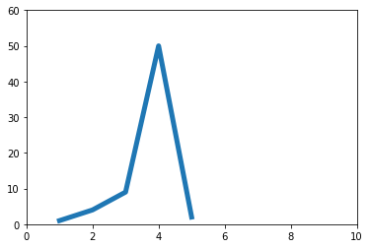
The plot() function
You can quite easily alter the properties of the line with the plot() function.

Slide 20
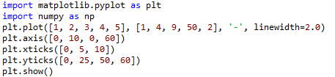
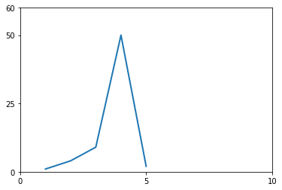
Altering tick labels
The plt.xticks() and plt.yticks() allows you to manually alter the ticks on the x-axis and y-axis respectively.
Note that the tick values have to be contained within a list object.

Slide 21
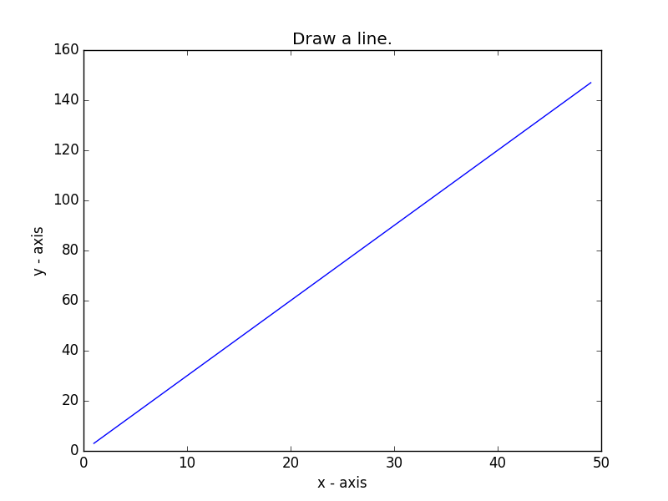
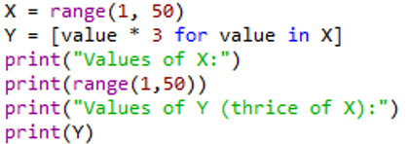

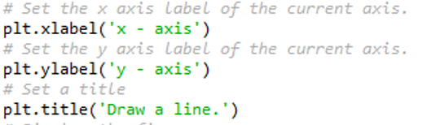

Practice - Basic line graph
Let’s write a Python program to draw a line graph with suitable labels for the x-axis and y-axis. Include a title.

Slide 22
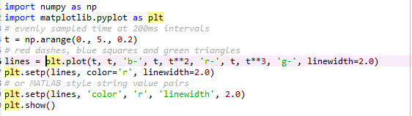
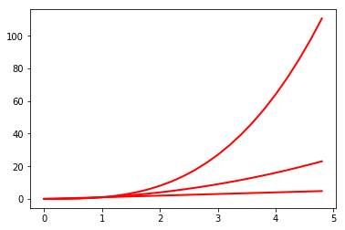
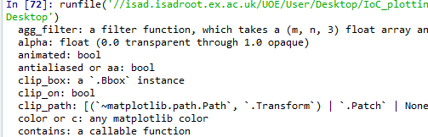
The setp() function
The setp() allows you to set multiple properties for a list of lines, if you want all the lines to be matching.
You can use the setp() function along with either the line or lines function in order to get a list of settable line properties.

Slide 23
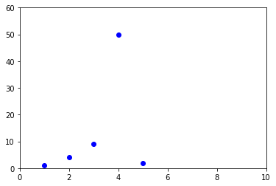

The axis() function
The axis() function allows us to specify the range of the axis.
It requires a list that contains the following:
[The min x-axis value, the max x-axis value, the min y-axis, the max y-axis value]

Slide 24
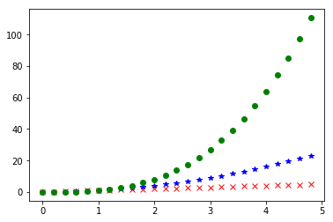
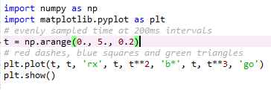
Matplotlib and NumPy arrays
Normally when working with numerical data, you’ll be using NumPy arrays.
This is still straight forward to do in Matplotlib; in fact all sequences are converted into NumPy arrays internally anyway.

Slide 25
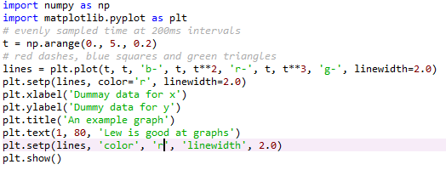
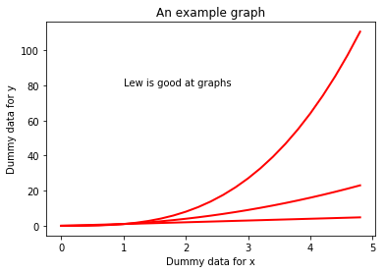
Working with text
There are a number of different ways in which to add text to your graph:
- title() = Adds a title to your graph, takes a string as an argument
- xlabel() = Add a title to the x-axis, also takes a string as an argument
- ylabel() = Same as xlabel()
- text() = Can be used to add text to an arbitrary location on your graph. Requires the following arguments: text(x-axis location, y-axis location, the string of text to be added)
Matplotlib uses TeX equation expressions. So, as an example, if you wanted to put in one of the text blocks, you would write plt.title(r'$\sigma_i=15$').

Slide 26
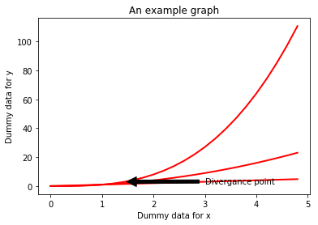
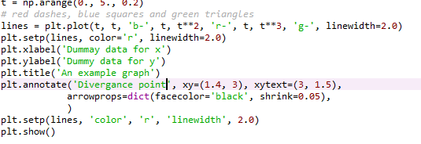
Annotating data points
The annotate() function allows you to easily annotate data points or specific area on a graph.

Slide 27
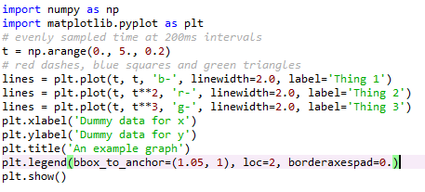
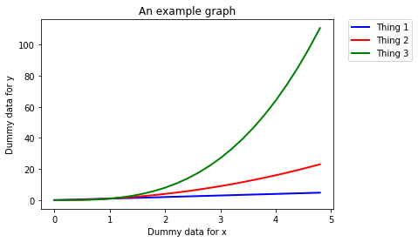
Legends
The location of a legend is specified by the loc command. There are a number of in-built locations that can be altered by replacing the number. The Matplotlib website has a list of all locations in the documentation page for location().
You can then use the bbox_to_anchor() function to manually place the legend, or when used with loc, to make slight alterations to the placement.

Slide 28
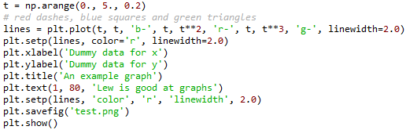
Saving a figure as a file
The plt.savefig() allows you to save your plot as a file.
It takes a string as an argument, which will be the name of the file. You must remember to state which file type you want the figure saved as; i.e. png or jpeg.
Make sure you put the plt.savefig() before the plt.show() function. Otherwise, the file will be a blank file.

Slide 29

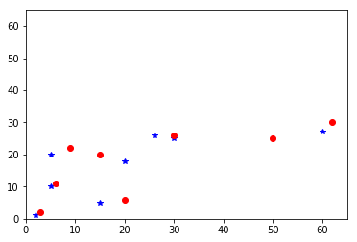
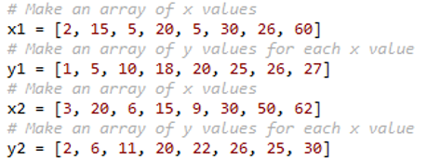


Scatter plot exercise
Let’s write a Python program to plot quantities which have an x and y position; a scatter graph.

Slide 30
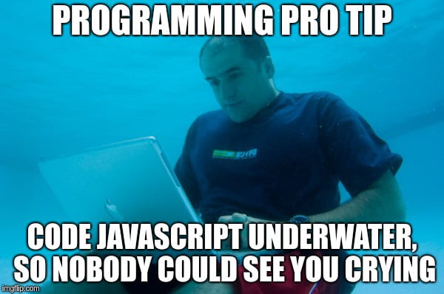
Debugging
Debugging is in fundamental aspect of coding, and you will probably spend more time debugging than actually writing code.
EVERYONE has to debug, it is nothing to be ashamed of.
In fact, you should be particularly concerned if you do write a programme that does not display any obvious errors, as it likely means that you are just unaware of them.
There are a number of debugging programmes available to coders. However, debugging the most common issues that you’ll encounter when developing programmes can be done by following a few key principles.
However, always remember that sometimes fixing a bug can create new bugs.

Slide 31
Print everything
When debugging, the most important function at your disposal is the print command. Every coder uses this as a debugging tool, regardless of their amount of experience.
You should have some sense as to what every line of code you have written does. If not, print those lines out. You will then be able to see how the values of variables are changing as the programme runs through.
Even if you think you know what each line does, it is still recommended that you print out certain lines as often this can aid you in realising errors that you may have overlooked.

Slide 32
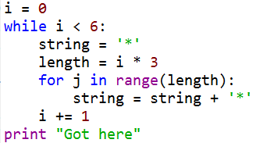



Print examples
Did this chunk of code run?
I want the value of variable to be 10 upon completion of the for loop. Did the for loop work correctly?
No.
Yes, it did.

Slide 33
Run your code when you make changes
Do not sit down and code for a hour or so without running the code you are writing. Chances are, you will never get to the bottom of all of the errors that your programme reports when it runs.
Instead, you should run your script every few minutes. It is not possible to run your code too many times.
Remember, the more code you write or edit between test runs, the more places you are going to have to go back an investigate when your code hits an error.

Slide 34
Read your error messages
Do not be disheartened when you get an error message. More often than not, you’ll realise what the error is as soon as you read the message; i.e. the for loop doesn’t work on a list because the list is empty.
This is particularly the case with Python, which provides you with error messages in ‘clear English’ compared to the cryptic messages given by offered by other languages.
At the very least, the error message will let you know which lines is experiencing the error. However, this may not be the line causing the error. Still, this offers a good starting point for your bug search.

Slide 35
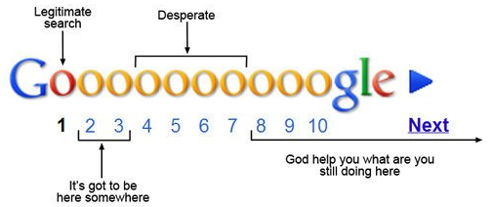
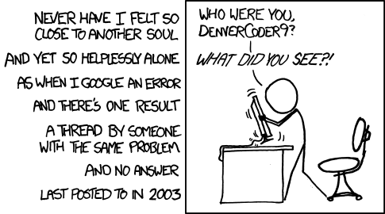
Google the error message
If you cannot work out the cause of an error message, google the error code and description.
This can sometimes be a bit of a hit-or-miss, depending on the nature of the error.
If your error is fairly specific, then there will nearly always be a webpage where someone has already asked for help with an error that is either identical or very similar to the one you are experiencing; stackoverflow.com is the most common page you’ll come across in this scenario.
Do make sure that you read the description of the problem carefully to ensure that the problem is the same as the one you are dealing with. Then read the first two or three replies to see if page contains a workable solution.

Slide 36
Comment out code
You can often comment out bits of code that are not related to the chunk of code that contains the error.
This will obviously make the code run faster and might make it easier to isolate the error.

Slide 37
Binary searches
This method draws upon a lot of the methods we have already covered.
Here, you want to break the code into chunks; normally two chunks, hence this method’s name.
You then isolate which chunk of code the error is in.
After which, you take the chunk of code in question, and divide that up, and work out which of these new chunks contains the error.
So on until you’ve isolate the cause of the error.

Slide 38
Walk away
If you have been trying to fix an error for a prolonged period of time, 30 minutes or so, get up and walk away from the screen and do something else for a while.
Often the answer to your issue will present itself upon your return to the computer, as if by magic.

Slide 39
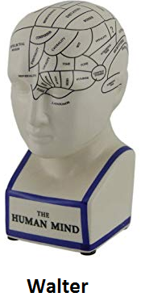
Phrase your problem as a question
Many software developers have been trained to phrase their problem as a question.
The idea here is that phrasing your issue in this manner often helps you to realise the cause of the problem.
This often works!

Slide 40
Ask someone
If all else fails, do not hesitate to ask a colleague or friend who is a coder and maybe familiar with the language for help.
They may not even need to be a specialist, sometimes a fresh pair of eyes belonging to someone who is not invested in the project is more efficient at helping you work out your issue than spending hours trying to solve the issue on your own or getting lost the internet trying to find a solution.

Slide 41
Any questions?

