Slide 1


Data wrangling with Pandas and NumPy
Lewys Brace
l.brace@Exeter.ac.uk

Slide 2
Numerical Python (NumPy)
NumPy is the most foundational package for numerical computing in Python.
If you are going to work on data analysis or machine learning projects, then having a solid understanding of NumPy is nearly mandatory.
Indeed, many other libraries, such as pandas and scikit-learn, use NumPy’s array objects as the lingua franca for data exchange.
One of the reasons as to why NumPy is so important for numerical computations is because it is designed for efficiency with large arrays of data. The reasons for this include:
- It stores data internally in a continuous block of memory, independent of other in-built Python objects.
- it performs complex computations on entire arrays without the need for for loops.

Slide 3
What you’ll find in NumPy
ndarray: an efficient multidimensional array providing fast array-orientated arithmetic operations and flexible broadcasting capabilities.
Mathematical functions for fast operations on entire arrays of data without having to write loops.
Tools for reading/writing array data to disk and working with memory-mapped files.
Linear algebra, random number generation, and Fourier transform capabilities.
A C API for connecting NumPy with libraries written in C, C++, and FORTRAN. This is why Python is the language of choice for wrapping legacy codebases.

Slide 4
The NumPy ndarray: A multi-dimensional array object
The NumPy ndarray object is a fast and flexible container for large data sets in Python.
NumPy arrays are a bit like Python lists, but still very different at the same time.
Arrays enable you to store multiple items of the same data type. It is the facilities around the array object that makes NumPy so convenient for performing math and data manipulations.

Slide 5
Ndarray vs. lists
By now, you are familiar with Python lists and how incredibly useful they are.
So, you may be asking yourself: “I can store numbers and other objects in a python list itself and do all sorts of computations and manipulations through list comprehensions, for-loops etc. What do I need a NumPy array for?”
There are very significant advantages of using NumPy arrays overs lists.

Slide 6


Creating a NumPy array
To understand these advantages, lets create an array.
One of the most common, of the many, ways to create a NumPy array is to create one from a list by passing it to the np.array() function.
In:
Out:

Slide 7
Differences between lists and ndarrays
The key difference between an array and a list is, arrays are designed to handle vectorised operations while a python list is not.
That means, if you apply a function it is performed on every item in the array, rather than on the whole array object.

Slide 8




Let’s suppose you want to add the number 2 to every item in the list. The intuitive way to do it is something like this:
In:
Out:
That was not possible with a list, but you can do that on an array:
In:
Out:

Slide 9
Another characteristic is that, once a Numpy array is created, you cannot increase its size. To do so, you will have to create a new array. But such a behaviour of extending the size is natural in a list.
That said, there are so many more advantages.

Slide 10


Create a 2d array from a list of list
You can pass a list of lists to create a matrix-like a 2d array.
In:
Out:

Slide 11


The dtype argument
You can specify the datatype by setting the dtype argument.
Some of the most commonly used numpy dtypes are: float, int, bool, str, and object.
In:
Out:

Slide 12
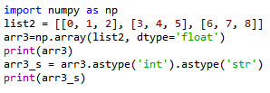
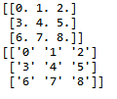
The astype argument
You can also convert it to a different datatype using the astype method.
In:
Out:
Remember that, unlike list, all items in an array have to be of the same type.

Slide 13

dtype=‘object’
However, if you are uncertain about what datatype your array will hold, or if you want to hold characters and numbers in the same array, you can set the dtype as 'object'.
In:
Out:

Slide 14

The tolist() function
You can always convert an array into a list using the tolist() command.
In:
Out:

Slide 15
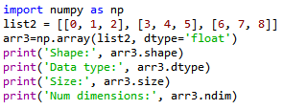

Inspecting a NumPy array
There are a range of functions built into NumPy that allow you to inspect different aspects of an array:
In:
Out:

Slide 16


Extracting specific items from an array
You can extract portions of the array using index, much like when you’re working with lists.
Unlike lists, however, arrays can optionally accept as many parameters in the square brackets as there is number of dimensions
In:
Out:

Slide 17


Boolean indexing
A boolean index array is of the same shape as the array-to-be-filtered and it contains only True and False values. The values corresponding to True positions are retained in the output.
In:
Out:

Slide 18




Reversing rows and the whole array
To reverse only the row positions:
In:
Out:
To reverse both row and column positions:
In:
Out:

Slide 19
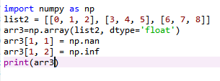

Missing values in arrays
Missing values can be represented using np.nan object. Similarly, infinite can be represented using np.inf :
In:
Out:

Slide 20




Computing minimum and maximum values
The ndarray has the following methods form computing the minimum and maximum values for the whole array:
In:
Out:
If you want to compute these row or column rise:
In:
Out:

Slide 21
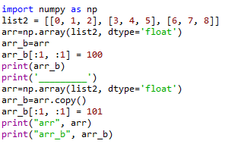
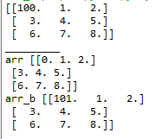
Creating a new array from an existing one
If you just assign a portion of an array to another array, the new array you just created actually refers to the parent array in memory.
Therefore, any changes you make to this new array will be reflected in them original, parent, array as well.
In order to avoid altering the original array, we use the copy() method.
In:
Out:

Slide 22
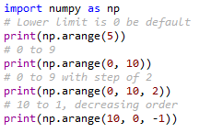

Creating sequences, repetitions and random numbers
We are going to be using NumPy a lot in this course in order to create data sequences for our analysis.
Indeed, the np.arrage() function is one that you are likely to use regularly in order to create customised number sequences as an ndarray.
In:
Out:

Slide 23
The np.arrange() allows you to set the starting and end positions.
But if you are concerned with the number of items in the array, you will have to manually calculate the appropriate step values.
For example, if you wanted an array of 10 numbers between 1 and 50, you could compute the step value.
You could also is np.linspace() instead.
In:
Out:
Note: because I explicitly forced the dtype to be int, the numbers are not equally spaced because of the rounding.

Slide 24



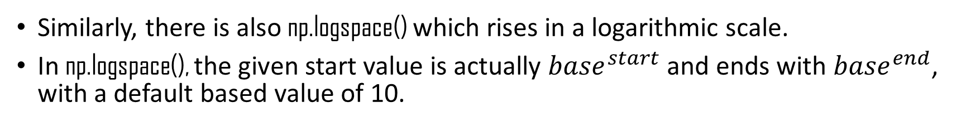
Similarly, there is also np.logspace() which rises in a logarithmic scale.
In np.logspace(), the given start value is actually ${base}^{start}$ and ends with ${base}^{end}$, with a default based value of 10.
In:
Out:
The np.zeros and np.ones functions lets you create arrays of desired shape where all the items are either 0’s or 1’s.
In:
Out:

Slide 25


Creating repeating sequences
The np.tile() will repeat a whole list or array n times.
In comparison, np.repeat() repeats each item n times.
In:
Out:

Slide 26


Generating random numbers
You will probably use the random module a lot.
We’ll be using it a lot in this course to generate random numbers and statistical distributions.
In:
Out:

Slide 27
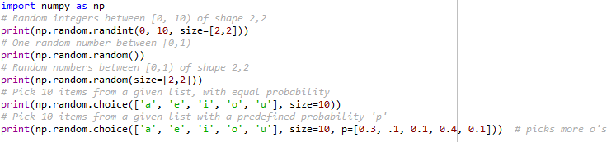
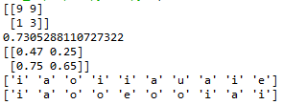
In:
Out:

Slide 28
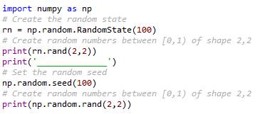

Every time you use any of the above functions, you will get a different set of random numbers.
So, if you want to repeat the same set of random numbers every time, you need to set the seed or random state.
The seed can be any number.
Once np.random.RandomState is created, all the functions of the np.random module becomes available to the created randomstate object.
In:
Out:

Slide 29
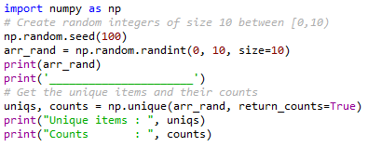

The np.unique() function
The np.unique() method can be used to get the unique items. If you want the repetition counts of each item, set the return_counts parameter to True.
In:
Out:

Slide 30
Pandas
Pandas, like NumPy, is one of the most popular Python libraries for data analysis.
It is a high-level abstraction over low-level NumPy, which is written in pure C.
Pandas provides high-performance, easy-to-use data structures and data analysis tools.
There are two main structures used by pandas; data frames and series.

Slide 31


Indices in a pandas series
A pandas series is similar to a list, but differs in the fact that series associate a label with each element. This makes it look like a dictionary.
If an index is not explicitly provided by the user, pandas creates a RangeIndex ranging from 0 to N-1.
Each series object also has a data type.
In:
Out:

Slide 32




As you may suspect by this point, a series has attributes to extract ways to extract both all of the values in the series and individual elements by index.
In:
Out:
You can also provide an index manually.
In:
Out:

Slide 33
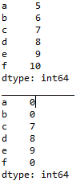

It is easy to retrieve several elements of a series by their indexes or make group assignment.
Out:
In:

Slide 34
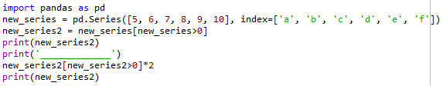
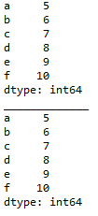
Filtering and maths operations
Filtering and maths operations are easy with pandas as well.
In:
Out:

Slide 35
Pandas data frame
Simplistically, a data frame is a table, with rows and columns.
Each column in a data frame is a series object.
Rows consist of elements inside series.

Slide 36
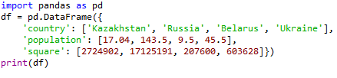

Creating a pandas data frame
Pandas data frames can be constructed using Python dictionaries.
In:
Out:

Slide 37
You can ascertain the type of a column with the type() function.
In:
Out:

Slide 38
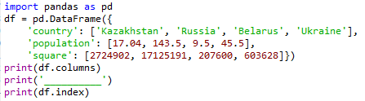

A pandas data frame object as two indices; a column index and row index.
Again, if you do not provide one, pandas will create a RangeIndex from 0 to N-1.
In:
Out:

Slide 39
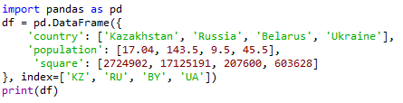

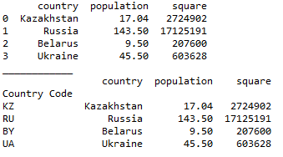
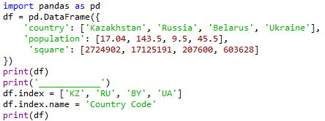
There are numerous ways to provide row index explicitly.
For example, you could provide an index when creating a data frame.
In:
Out:
or do it on during runtime.
I also name the index ‘country code’.
Out:
In:

Slide 40

Row access using index can be performed in several ways.
First, you could use .loc() and providing an index label.
In:
Out:
Second, you could use .iloc() and providing an index number
Out:
In:

Slide 41


Selection of particular rows and columns can be performed this way.
In:
Out:
You can feed .loc() two arguments, index list and column list, slicing operation is supported as well:
In:
Out:

Slide 42

Filtering
Filtering is performed using so-called Boolean arrays.

Slide 43



Deleting columns
You can delete a column using the drop() function.
In:
Out:
In:
Out:

Slide 44
Reading from and writing to a file
pandas supports many popular file formats including CSV, XML, HTML, Excel, SQL, JSON, etc.
Out of all of these, CSV is the file format that you will work with the most.
You can read in the data from a CSV file using the read_csv() function.
Similarly, you can write a data frame to a csv file with the to_csv() function.

Slide 45
Pandas has the capacity to do much more than what we have covered here, such as grouping data and even data visualisation.
However, as with NumPy, we don’t have enough time to cover every aspect of pandas here.

Slide 46
Any questions?

