Slide 1


Graphical exploratory data analysis in Python
Lewys Brace
l.brace@Exeter.ac.uk

Slide 2
Exploratory data analysis (EDA)
Exploring your data is the a crucial step in data analysis. It involves:
Organising the data set
Plotting aspects of the data set
Maybe producing some numerical summaries; central tendency and spread, etc.
“Exploratory data analysis can never be the whole story, but nothing else can serve as the foundation stone.” - John Tukey.

Slide 3
Let’s get data
Before we do anything, we’re going to need data to play with.
Go to the following link, click “clone or download”, and then click “download ZIP”:
https://github.com/LewBrace/Python_for_EDA_workshop
Extract the data sets to a folder that you’re going to remember the location of.

Slide 4
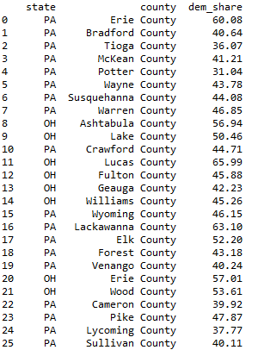
An example: 2008 US swing state election results
In:
Out:
Here, we are only looking at the columns of immediate interest: the state, the country, and the share of votes that went the democratic Obama.
We could spend time staring at these numbers, but that is unlikely to offer us any form understanding.
We could begin by conducting all of our statistical tests.
However, a good field commander does not go into battle without first doing a recognisance of the terrain…

Slide 5
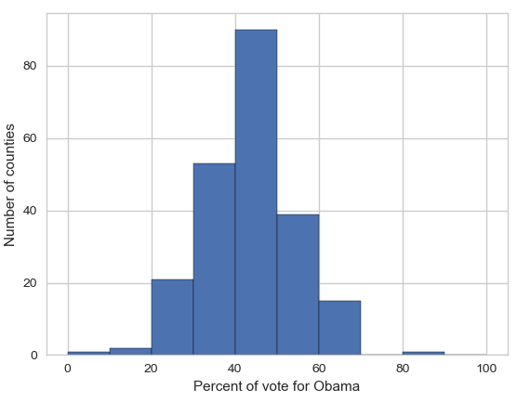
This is exactly what EDA is intended for.
Graphical data analysis involves taking data presented in a tabular form and representing it graphically.
As an example, lets take the democratic share of the vote in the counties of all three swing states and plot them as a histogram.
The height of each of the bars is the number of counties that had a given level of support for Obama.
Because there is more area in the histogram to the left of 50%, we can see that more people voted for John McCain than Obama.

Slide 6
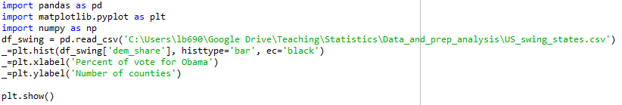
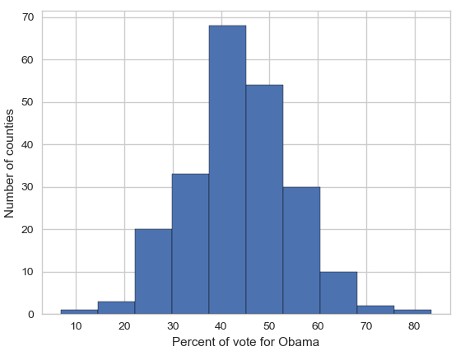
Plotting a histogram in Python
In:
Out:

Slide 7
Bins
You may have noticed the two graphs we’ve seen so far look different.
This is because they have different binnings.
The left graph used the default bins generated by plt.hist(), while the one on the right used bins that I specified.

Slide 8
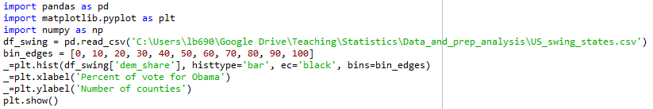
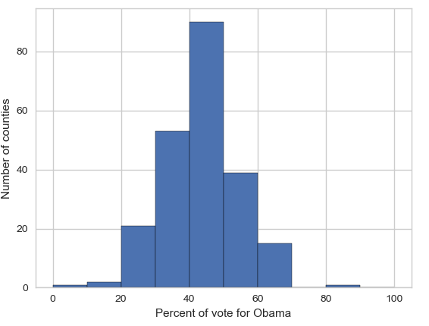
I specified where the edges of the bars of the histogram are; the bin edges.
In:
Out:

Slide 9
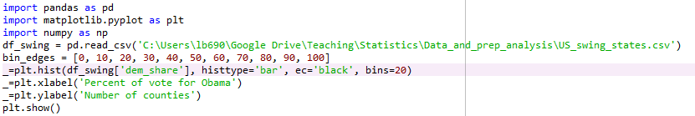
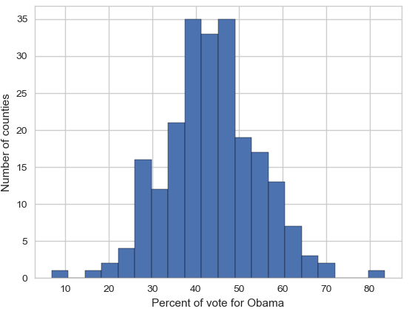
You could specify the number of bins, and Matplotlib will automatically generated 20 evenly spaced bins.
In:
Out:
Note: plt.plot() returns three arrays that we are not interest in here, we only want the plot. We therefore assign a dummy variable of _ to them. This is common practice in Python.

Slide 10
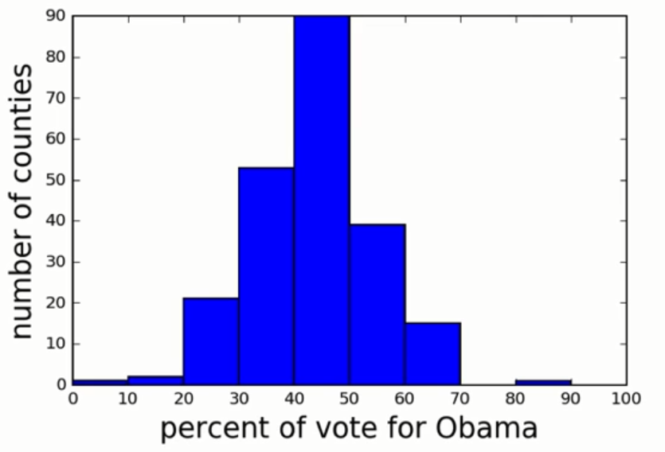
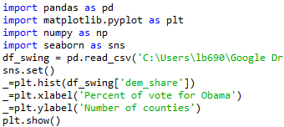
Seaborn
It’s still quite common for people to plot graphs using Matplotlib’s default style settings; i.e. left graph.
Seaborn is a relatively new, Matplotlib-based statistical visualisation package; i.e. right graph.
We set the script to use Seaborns default style settings with sns.set().

Slide 11
Practice: histogram
For this exercises in this section, you will use a classic data set collected by botanist Edward Anderson and made famous by Ronald Fisher, one of the most prolific statisticians in history.
Anderson carefully measured the anatomical properties of samples of three different species of iris, Iris setosa, Iris versicolor, and Iris virginica.
You will be working with the measurements of petal length.

Slide 12
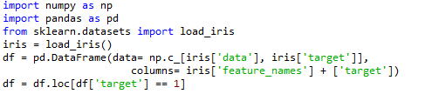
Import the data set
This dataset comes as a default dataset in the scikit-learn package.
We are first going to import the data set from this package and turn it into a Pandas data frame.
We are then going to create a sub-dataframe, so that we have a dataframe that only contains the entries that are part of the versicolor family.
In:

Slide 13
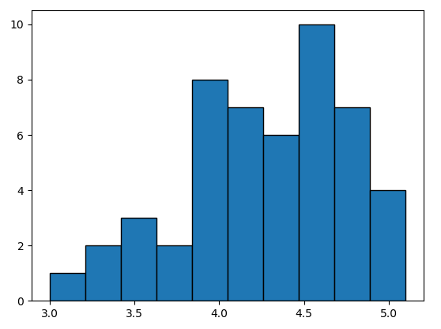
Plot the histogram
Plot a histogram of the petal lengths of his 50 samples of Iris versicolor.
Use matplotlib/seaborn's default settings. Recall that to specify the default seaborn style, you can use sns.set(); where sns is the alias that seaborn is imported as.
You view the headers of the dataframe by using print list(df).

Slide 14
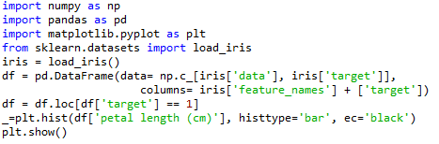
Answer
In:
Out:

Slide 15
Practice: axis labels
In the last graph, we commit a cardinal sin of data analysis… We didn’t label our axis.
Let’s do that now.
The x-axis should read ‘Petal length (cm)’ and the y-axis should read ‘Count’.
Assign both axis to the dummy variable of _.

Slide 16
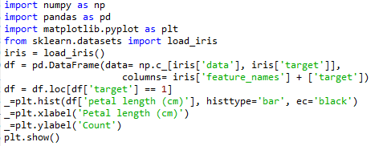
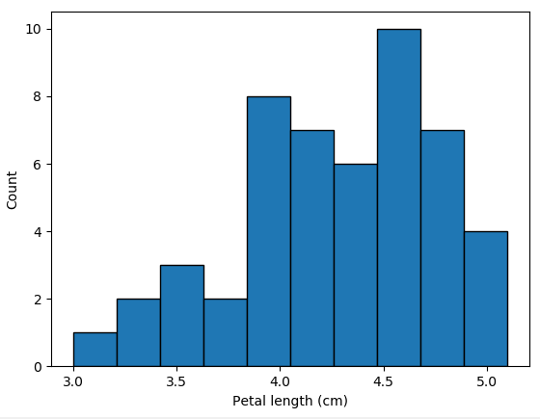
Answer
In:
Out:

Slide 17
Practice: bins
The histogram you just made had ten bins. This is the default of matplotlib.
However, the "square root rule" is a commonly-used rule of thumb for choosing number of bins.
Choose the number of bins to be the square root of the number of samples and plot the histogram again.
Remember two things:
1. You specify the number of bins using the bins keyword argument of plt.hist()
2. Numpy will probably be able to calculate a square root for you.

Slide 18
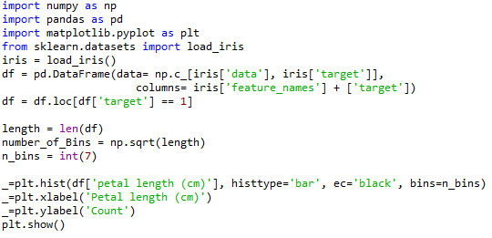
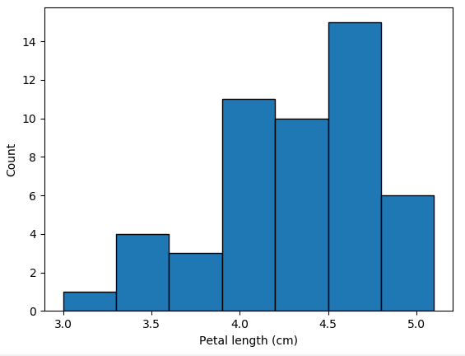
Answer
In:
Out:

Slide 19
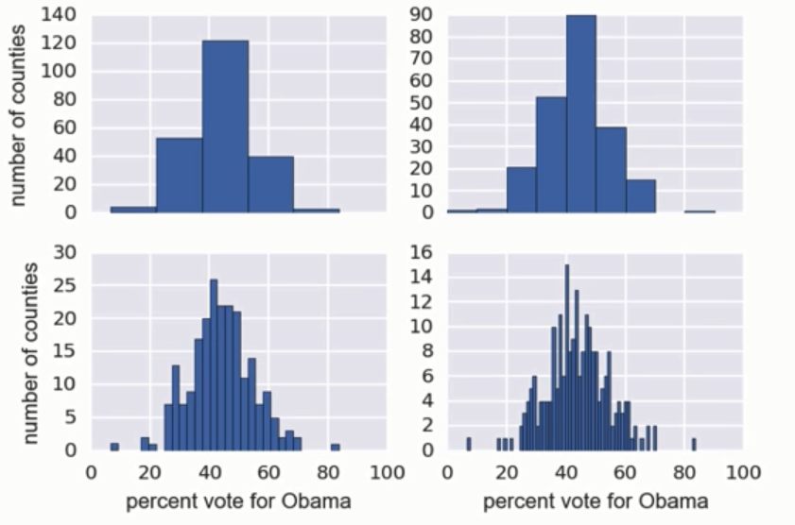
An issue with histograms
Histograms have two issues. First, we are not plotting all of the data.
Second, histograms can plot the same data, and yet, look very different depending on how the bins are set.
We have encountered the "square root rule" for calculating bins, but bin choice is still very much arbitrary.
This leads to…

Slide 20
Binning bias
You may interpret your data different for two different choices of bins.
To remedy these two issues, we can use a….

Slide 21
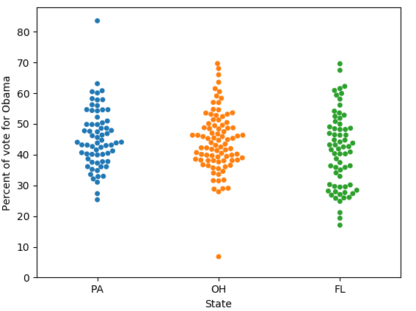
Bee swarm plot
Here, we see a plot of the vote totals in each of the three swing states.
Each point in the plot represents the share of the vote that Obama got in a single county.
The position along the y-axis is the quantitative information.
The data position along the x-axis is presented the way it is merely to make the graph readable; it does not provide any information.

Slide 22
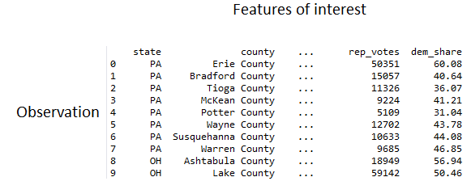
A requirement for swarm plots
In order to plot one, bee swarm plots require your data to be in a well organised data frame, where:
Each column is a feature and
Each row an observation

Slide 23
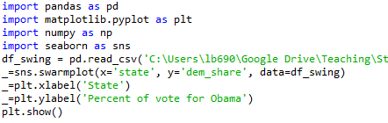
Plotting a bee swarm plot
In:
Out:
Again, we can see that Obama got less than 50% of the votes in each of the three swing states.

Slide 24
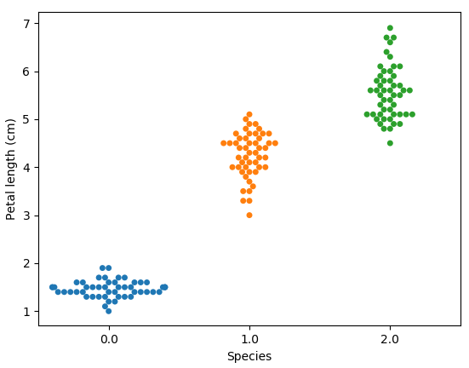
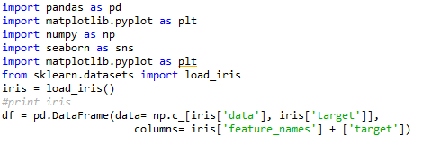
Practice: Bee swarm plot
Make a bee swarm plot of the iris petal lengths.
Your x-axis should contain each of the three species, and the y-axis the petal lengths.
The data frame lists the species as 0.0, 1.0, and 2.0. This is how they’ll appear in your plot. Don’t worry about that for the time being.
Remember to convert the data to a pandas data frame. If you need to do it again, the code is:

Slide 25
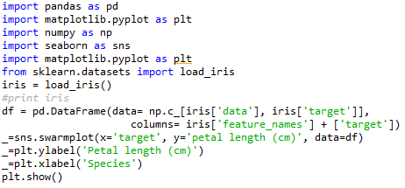
Answer
In:
Out:

Slide 26
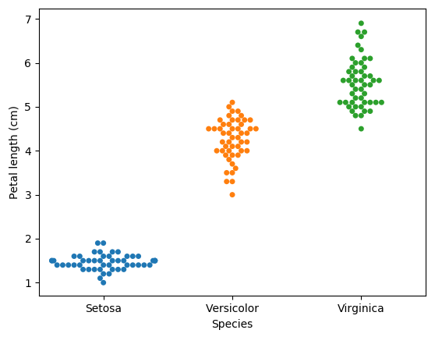
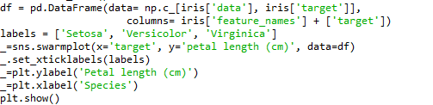
Editing ticks
‘Ticks’ refers to the number or word scales on the y-axis and x-axis.
In the graph we just produce, the x ticks were 0.0, 1.0, and 2.0.
We can manually alter tick values in Seaborn/matplotlib:
In:
Out:

Slide 27
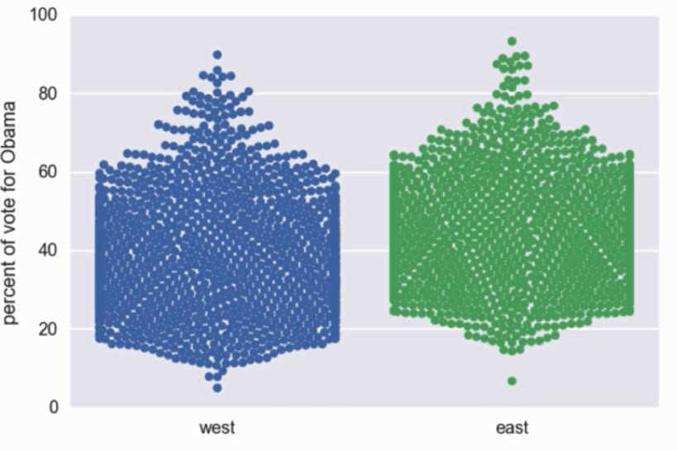
Limits of bee swarm plots
Bee swarm plots are clearly useful.
However, they do have their limitations.
For example, if we were to plot of the county level voting data for all states east of the Mississippi River and all states west.
We create the same plot as before, but with a data frame that features all states, with each state being classified as east or west of the river.
The overlapping data points in the resulting graph obscures much of the information that could be gained from the data.

Slide 28
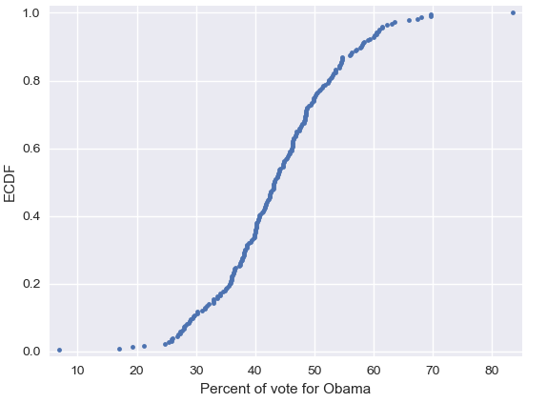
Plotting all data: Empirical cumulative distribution functions (ECDFs)
As an alternative, we could calculate an ECDF.
Here we have an ECDF that shows the percentage of swing state votes that went to Obama.
An x value of an ECDF is the quantity you are measure; i.e. percentage of votes.
The y value is the fraction of data points that have a value smaller than the corresponding x value. For example…

Slide 29
75% of counties had 50% or less vote for Obama.
20% of counties had 36% or less vote for Obama.

Slide 30
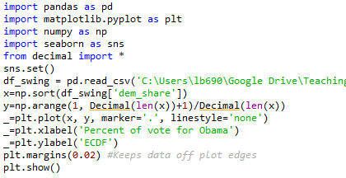
Plotting an ECDF
In:
Out:
Note: If using Python 3, you will not need to include the ‘Decimal()’ around the variables or include ‘from decimal import *’ in the preamble. This is library was only developed in order to deal with an issue that early version of Python had when dealing with decimals.
Notes:
The y-axis is evenly spaced data points with a maximum of 1.

Slide 31
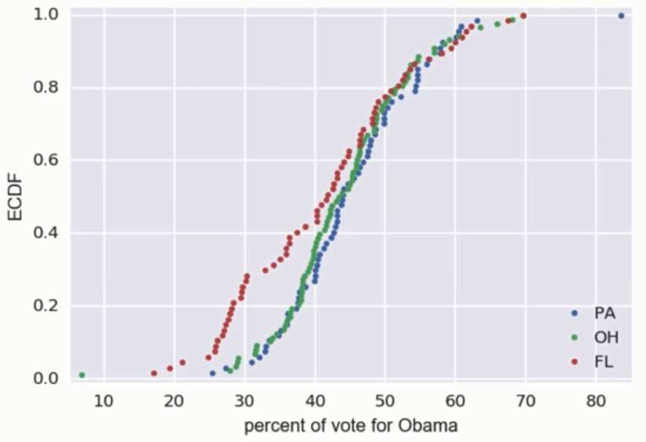
You can also plot multiple ECDFs on the same plot.
As an example, here with have an ECDF for each of the three swing states.
We can see here that Florida had a greater number of republican counties.

Slide 32
The usefulness of ECDFs
It often quite useful to plot the ECDF first as part of your workflow.
This is because it shows all the data and gives a complete picture as to how the data are distributed.

Slide 33

Practice: ECDFs
In this exercise, you will write a function that takes as input a 1D array of data and then returns the x and y values of the ECDF.
You will use this function over and over again throughout the remainder of this course. So make sure that you save it a copy.
You can write your own function, foo(x,y) according to the following skeleton:
The function foo() takes two arguments a and b and returns two values x and y. The function header def foo(a,b): contains the function signature foo(a,b), which consists of the function name, along with its parameters.

Slide 34
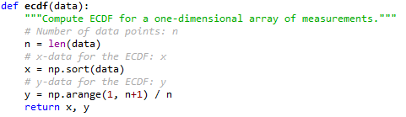
Answer

Slide 35
Practice: Plotting an ECDF
You will now use you ecdf() function for the petal lengths of Anderson's Iris versicolor flowers.
You will then plot the ECDF.
Recall that your ecdf() function returns two arrays so you will need to unpack them. An example of unpacking for the foo() function is:

Slide 36
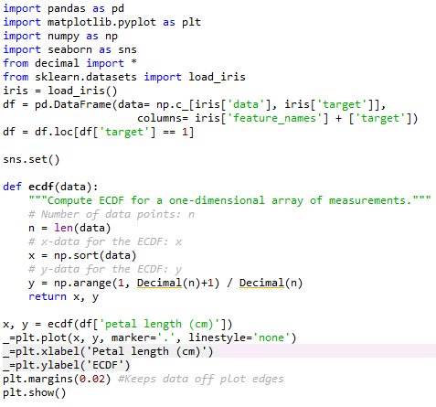
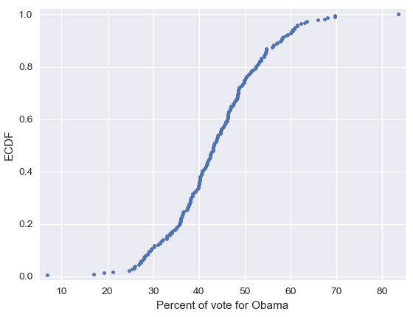
Answer
In:
Out:

Slide 37
Practice: Comparison of ECDFs
ECDFs also allow you to compare two or more distributions, although plots do get cluttered if you have too many.
Here, you will plot ECDFs for the petal lengths of all three iris species.
You already wrote a function to generate ECDFs so you can put it to good use!
To overlay all three ECDFs on the same plot, you can use plt.plot() three times, once for each ECDF.
Remember to include marker='.' and linestyle='none' as arguments inside plt.plot().

Slide 38
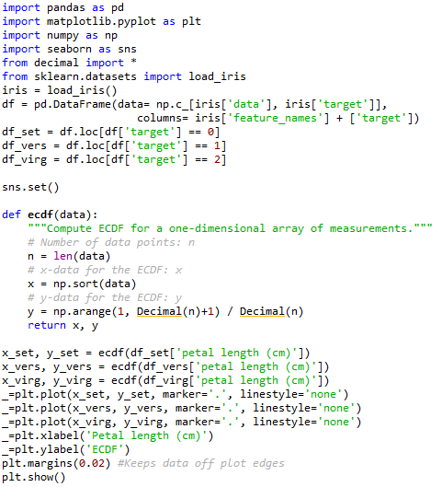
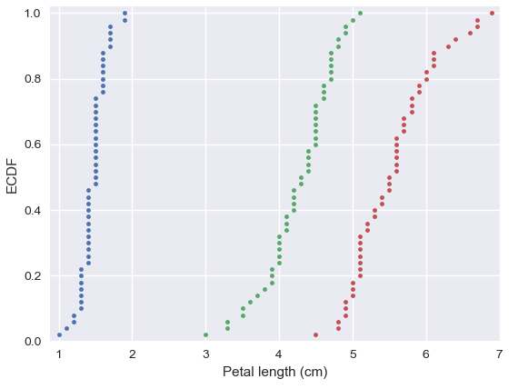
Answer
In:
Out:

Slide 39
Any questions?

