Slide 1
An Empirical Examination of Introductory Financial Management Classes: Video Gaming, Social Media, and Academic Performance
James C. Brau
Department of Finance
Brigham Young University
Logan B. Nielsen
Department of Computer Science
Brigham Young University
S. Isaac St.Clair
Department of Statistics
Brigham Young university

Slide 2
Literature
A lot of work has been done in the area of factors of academic grades.
Harris (1940) reviews 328 articles that covered the span of 1930-1937:
Intelligence
High school grades
Study Habits
Teaching methods
Incentives
Motivation
Coursework taken
Extracurricular activities
More recently Robbins et al. (2004) review 109 articles:
Academic self-efficacy (Individual belief/conviction that they can achieve)
Achievement motivation

Slide 3
More Recently
In a Principles of Marketing class Brau, Brau, Owen, and Swenson (2016) find variables:
Positive
Age
GPA, ACT/SAT score
Self-reported marketing skill
Attendance
Percentage of reading completed
Hours spent studying during exam week
Negative
Total hours studied
Time to sleep
Hours spent working/serving in community
Transfer student

Slide 4
Even More Recently
In a Principles of Finance class Brau, Brau, Owen, and Swenson (2017) find variables:
Positive
Intelligence
Drive
Testing Preference
Finance Assessment
Math Assessment
Class Size Equal Performance
College Finance Class Prior
Individual Effort
Negative
Self-Belief (over-confidence)
Trauma During Semester
Working a Paid Job
Taking Exam on the Last Day

Slide 5
Video Games Specifically
Two sides of a coin:
Heads: Video Games help academic performance
Playing strategic video games increased problem solving skills, which in turn increased GPA (Adachi and Willoughby 2013).
Tails: Video Games hurt academic performance
Negative correlation between the amount of time teenagers spent playing video games and measures of academic performance, like grade point average and standardized aptitude test scores (Anand 2007, see also Burgess et al. 2012; Hauge and Gentile 2003).
Edge of Coin: Video games neither help nor hurt academic performance on average
Spoiler alert: This is the hypothesis we find support for!!

Slide 6
Video Games Specifically
Video gaming is now a prevalent component of daily routines for youth and young adults, with 90% of teenagers reporting that they play videogames (Anderson and Jiang 2018).
For example, the Anand (2007) study above linking time spent playing video games with lower GPAs and SAT scores fails to take into account known correlates of academic performance like personality (Noftle and Robins 2007), sleep (Kelly et al. 2001), and socio-economic factors (Betts and Morell 1999), among many others.
What many studies unfortunately neglect is nomological completeness in their models (Burgess et al. 2012; Hauge and Gentile 2003).
Our study explicitly controls for these omitted variables.

Slide 7
Social Media Specifically
Videogaming is now almost inextricably intertwined with social media platforms.
Many games are delivered through social media platforms or leverage socal media integration in some other way.
Videogaming has taken a large step away from being a solo, antisocial activity (Dominick 1984) to being a social enabler (Burroughs 2014; Kirman et al. 2009).
Therefore, any contemporary study that makes claims about the effects of videogaming will find it prudent to consider media effects (Leung 2015; Mingle and Adams 2015).
Thus, we include social media usage variables too.

Slide 8
Methods
We use the same survey questionnaire as Brau et al. (2016, 2017) and append approximately 50 questions dealing with video games and social media.
Video game questions are expansive ranging from the macro-level question, “Do you play video games” to micro-level questions such as gaming console, time spent, emotional state when playing, and even particular video games, among many others.
Survey was beta tested with a group of TAs and RAs. Adjustments were made to survey after beta tests.
Students were given extra credit to complete the survey. We had two questions during survey to test their level of engagement. Our final dataset contained 1505 responses, which was an 80% response rate.
Data was collected in Fin 201, Introduction to Financial Management in Fall 2019 and Winter 2020 semesters. Results are robust between the two semesters – a check on COVID-19 impact.

Slide 9
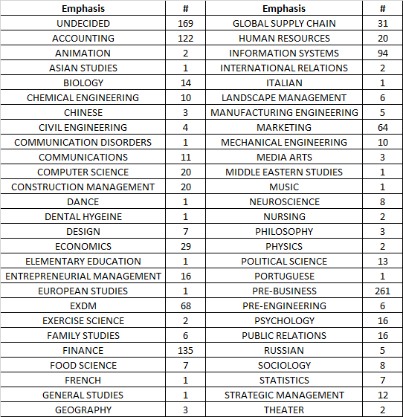
Methods (Majors)

Slide 10
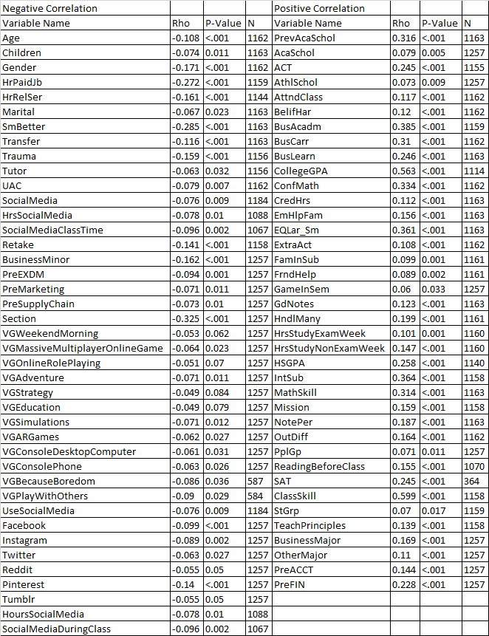
Correlations (Spearman)

Slide 11

Correlations (Spearman)

Slide 12
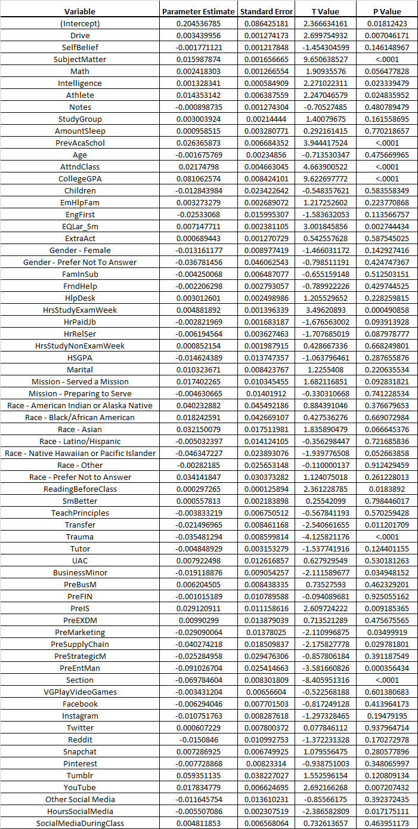
Regression

Slide 13
Results
Variables Significant in the Model:
Drive +
Subject Matter +
Intelligence +
Previous Academic Scholarship +
Class Attendance +
College GPA +
Large and Small Class Preference +
Number of Hours Study (Exam Week) +
Reading Before Class +
Transfer Student -
Trauma -
Pre-Information Systems Major +
Pre-Marketing -
Pre-Supply Chain -
Pre-Entrepreneurial Management -
Section -
YouTube +
Hours of Social Media (Daily) -

Slide 14
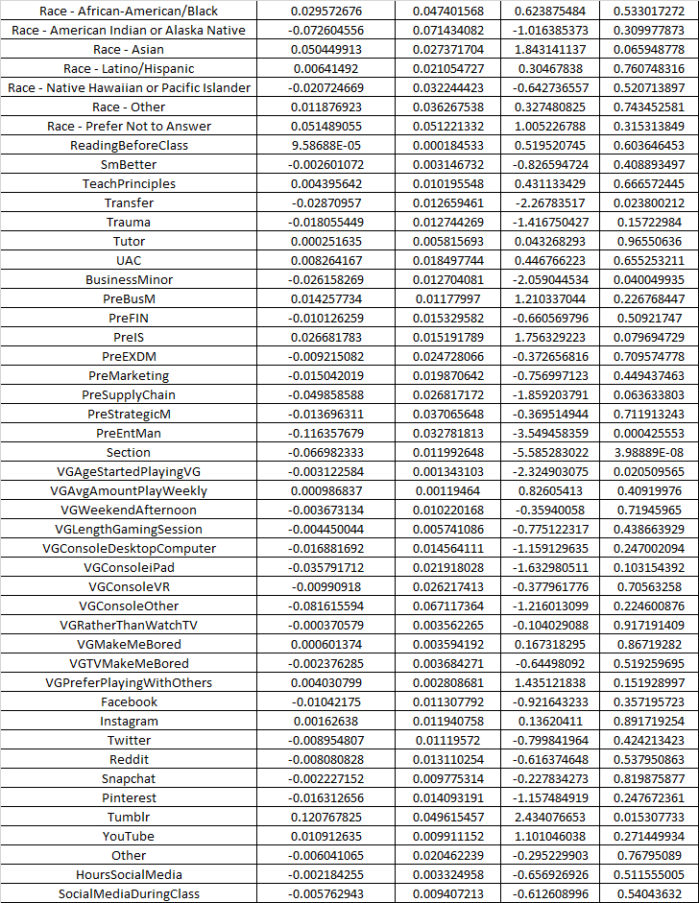
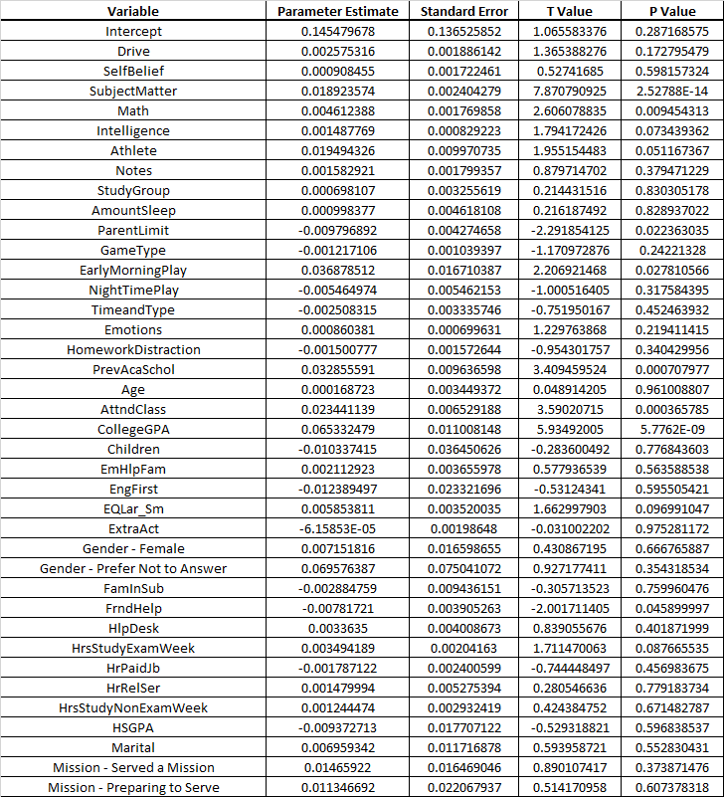
Regression (Of Gamers)

Slide 15
Results
(Video Game) Variables Significant in the Model:
Age Started Playing Video Games (p-value of 0.0205)

Slide 16
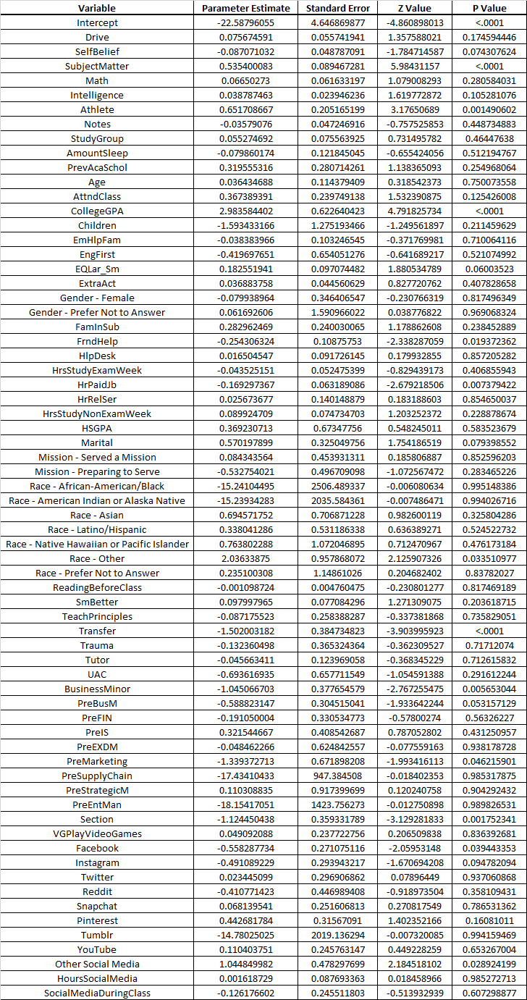
Logit Regression
What Changed?
Hours of Social Media
Drive
Video Games did NOT change

Slide 17
Questions

