Slide 1
Warm-core vs. cool-core vortices Combining the prior concepts of: thermal wind and vorticity Background first, then Assignment: slides 22-38
ATM 561, fall 2019
Brian Mapes, Univ of Miami

Slide 2
The big idea of it
In the thermal wind lab, you learned about how the slope of pressure surfaces (indicating the PGF) balances the Coriolis force in geostrophic flow
You also learned how thickness (between pressure surfaces) is proportional to T
This gave you a 3D view of T around wind jets.
But wind always blows in circuits (circulations), so it is often more useful to think of vortices (with vorticity as the budget equation) as the fundament of flow.
Then T is understood in terms of warm and cool cores.

Slide 3
p surfaces on a z-coordinate diagram
for NH westerly jet stream in thermal wind balance
→
z
150 mb
thinner mass (Δp) layers,
cooler compared to
← that
big thickness of mass (Δp)
layers: warm compared to that →
200 mb
300 mb
Jet stream
into page
PGF is “downhill”
Coriolis force to R
500 mb
small thickness of
mass (Δp) layers:
cooler, compared to that→
same mass (Δp) layers
are thicker: warmer than
← that
700 mb
1000 mb
North
South

Slide 4
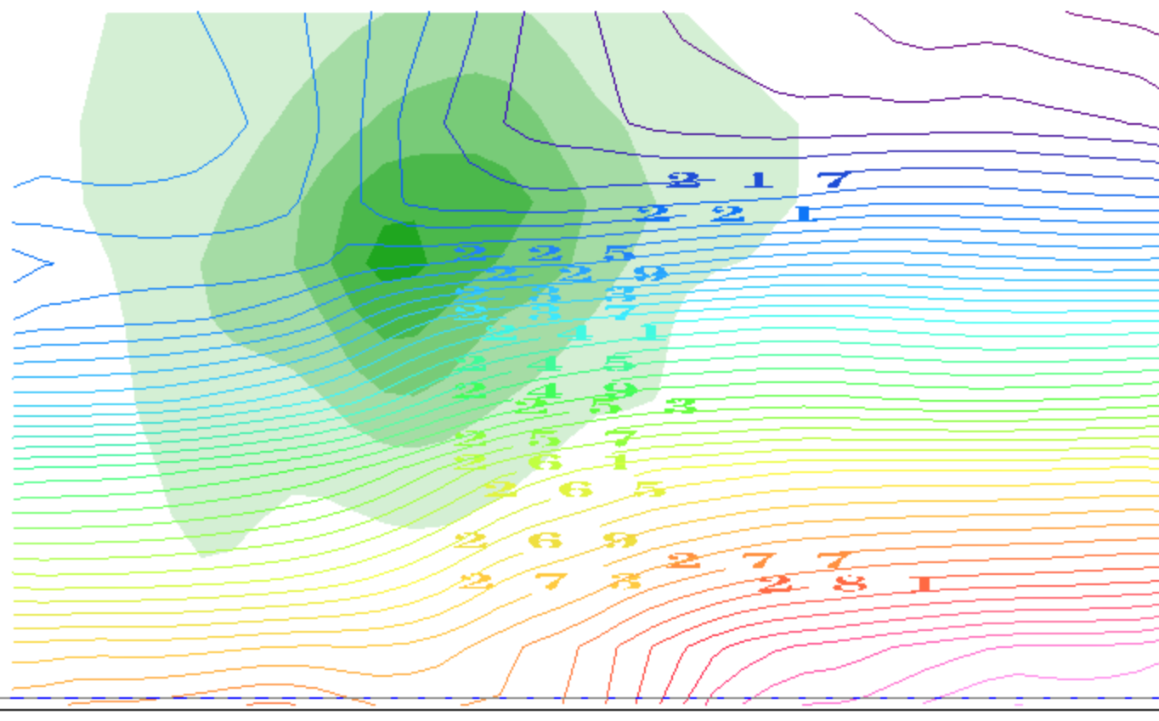
contours of T(K): it decreases with height
(plus the horizontal gradients due to TWB)
thinner mass (Δp) layers,
cooler compared to
← that
big thickness of mass (Δp)
layers: warm compared to that →
small thickness of
mass (Δp) layers:
cooler, compared to that→
same mass (Δp) layers
are thicker: warmer than
← that
North
South

Slide 5
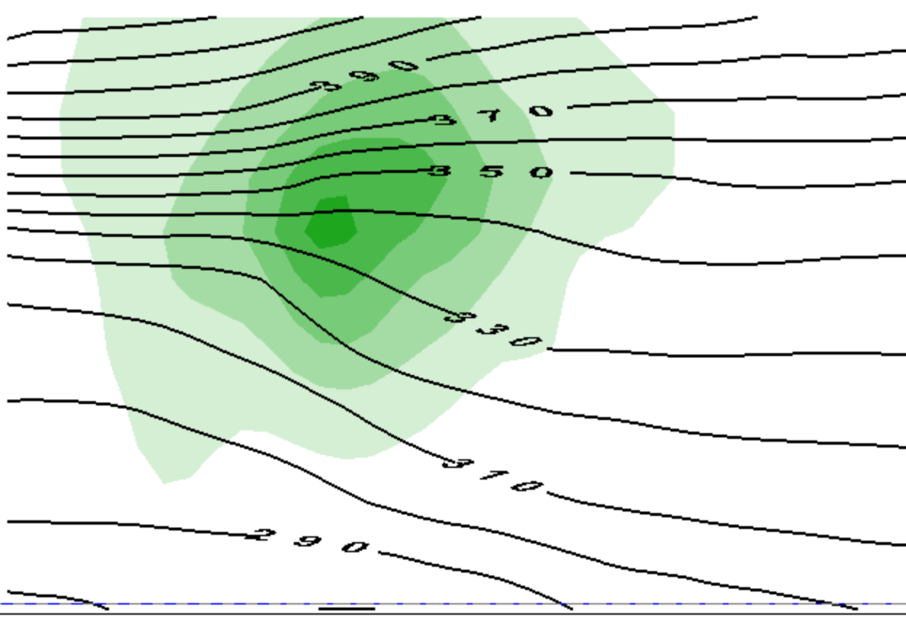
contours of θ(Κ): it increases with height
(plus the horizontal gradients due to TWB)
thinner mass (Δp) layers,
cooler compared to
← that
big thickness of mass (Δp)
layers: warm compared to that →
small thickness of
mass (Δp) layers:
cooler, compared to that→
same mass (Δp) layers
are thicker: warmer than
← that
North
South

Slide 6

That view emphasized jet streams as the unit of flow
OK, suppose we want to think in those terms.
What is a jet made of?
momentum, or ½ its square KE
per unit mass
What equation governs momentum?

Slide 7
That view emphasized jet streams as the unit of flow
To predict vector momentum V_{h}, need Φ
But that drags thermo into our equation set
must predict T, not just guess its structure by TWB
We work hard to avoid that with vorticity

Slide 8

Holy grail of dynamics: get div & ω
Gotta avoid dragging thermo into this via Φ.
Get rid of Φ at any cost. Curl to the rescue!
Ker-CHING!
We are Masters of the Universe with our sexy vector identities!
The grail is in the bag!
Notes:
\nabla \times (\frac{D}{Dt} \vec V_h) = \nabla \times (-f \hat k \times \vec V_h) - \nabla \times (\nabla_p \Phi)

Slide 9
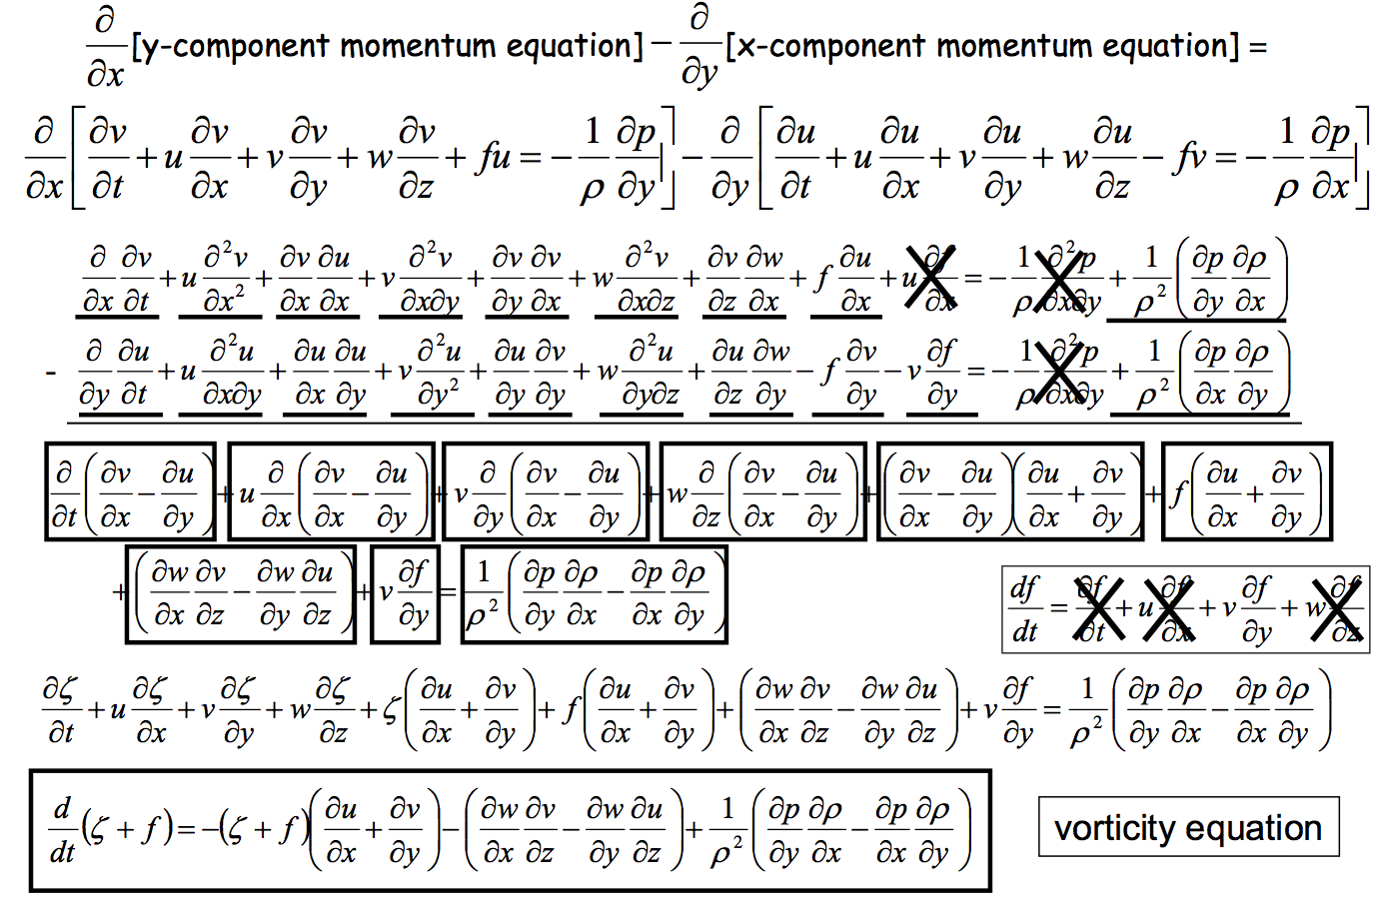
Heh heh ... did I say "any cost"... ? gulp
Can we scrape back some of these cobwebs?
Wait a sec, what's this??

Slide 10
This view emphasizes vortices as the unit of flow
To predict vorticity, we just need vorticity
induced wind drops like 1/distance
vorticity itself is advected by wind like a tracer
plus complications
advection of planetary vorticity f →Rossby waves
divergence term can be rolled up into potential vorticity

Slide 11
So what’s the TWB structure of a vortex?
In this case, one near the tropopause (like the jet stream)

Slide 12
This is only half the story of a vortex
cooler than
← that
warmer than
that →
cooler than
that→
warmer than
← that

Slide 13
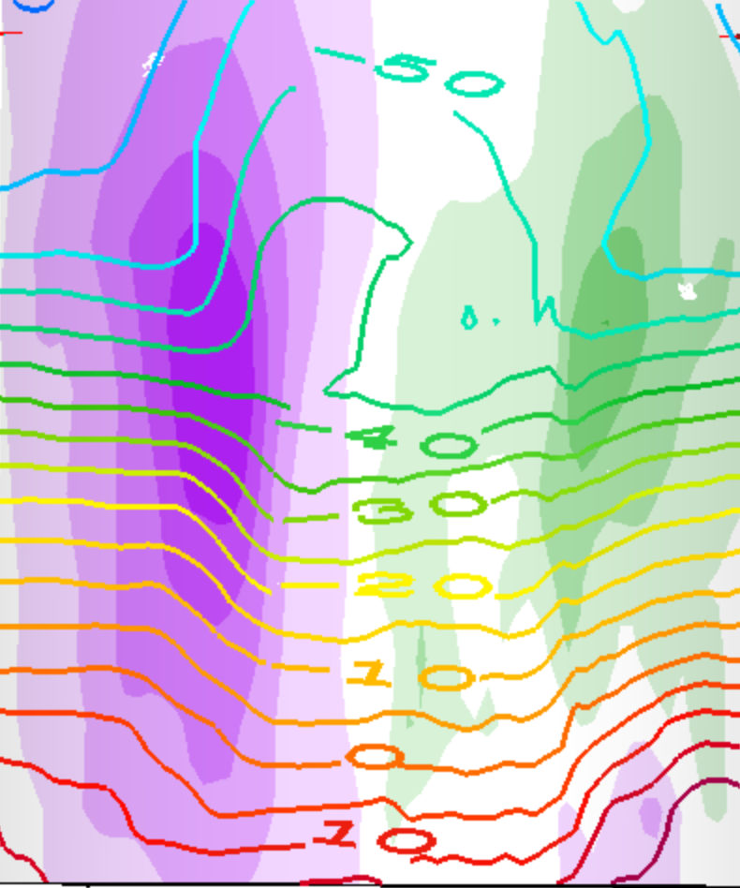
This is a whole vortex (two jets)
T(K) contours
cooler than
that →
warmer than
← that
cooler than
← that
warmer than
that →
warmer than
that →
cooler than
← that
cooler than
that→
warmer than
← that

Slide 14
This is a whole vortex (two jets)
T(K) contours
warmer than
← that →
above the core
cooler than
← that →
below the core

Slide 15
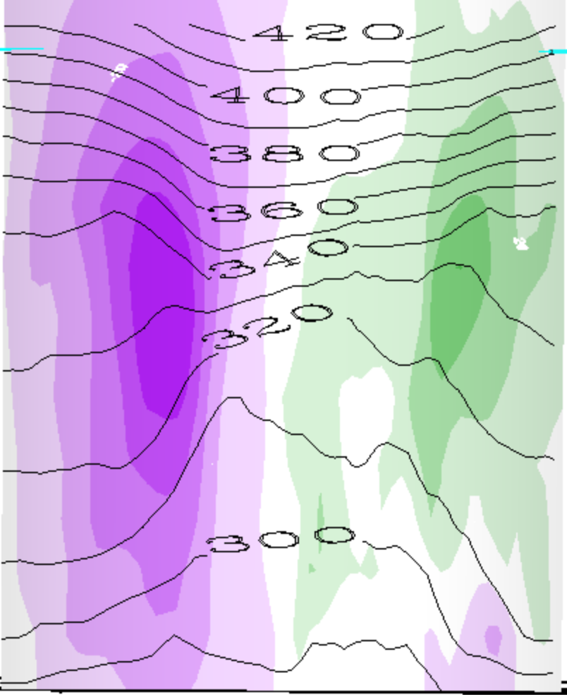
This is a whole vortex (two jets)
θ(K) contours
warmer than
← that →
above the cyclone
cooler than
← that →
below the cyclone

Slide 16
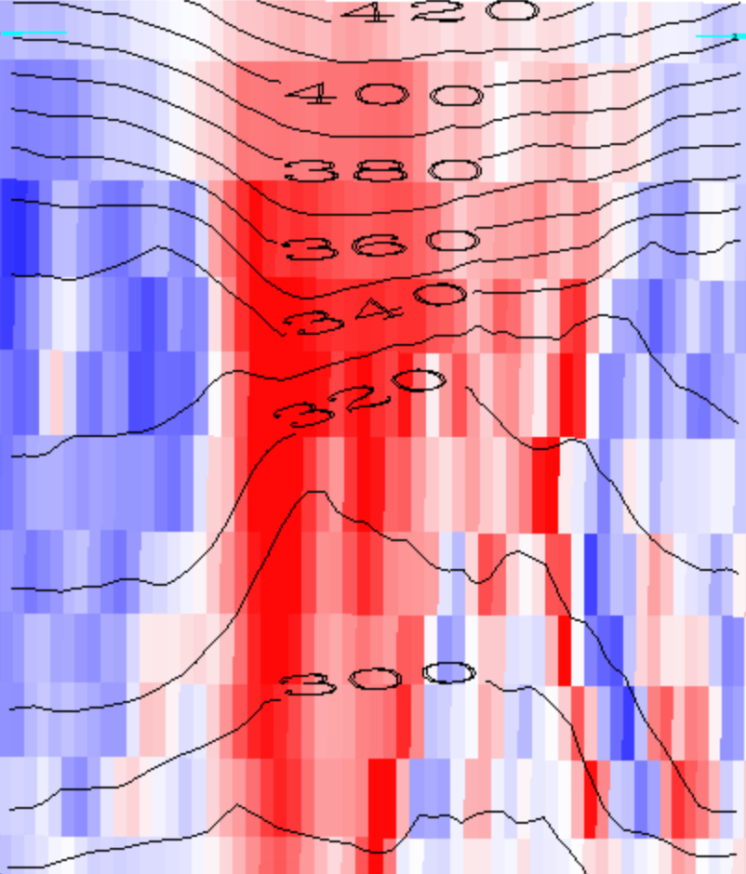
Red is positive vorticity , θ(K) contours
warmer than
← that →
above the cyclone
cooler than
← that →
below the cyclone

Slide 17
Red is positive vorticity , θ(K) contours
warmer than
← that →
above the cyclone
Cyclonic Vortex
cooler than
← that →
below the cyclone

Slide 18
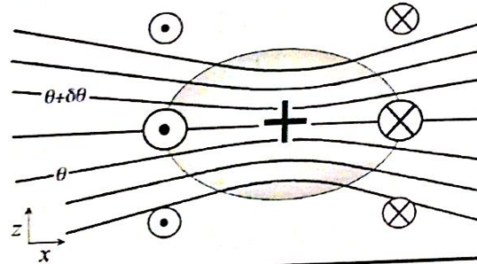
Generalization: PV
1. We will see that every cyclonic vortex obeying vertical (hydrostatic) and horizontal (geostrophic or other) balance looks similar to this (maybe stretched or shrunk):
PV > 0

Slide 19
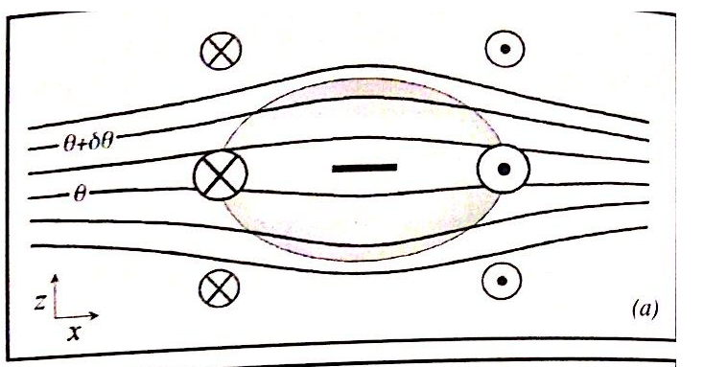
Balanced anticyclones exist too...
Just the opposite of a cyclone...
PV < 0

Slide 20
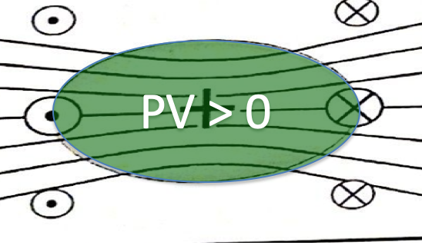
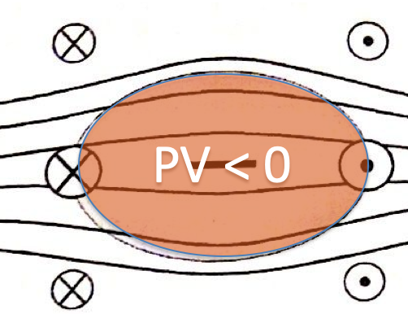
Vorticity (or PV) blobs
Where do they come from?
How do they interact?
(this we studied, in the horizontal plane)
Do they get destroyed?
(Soon: tackling the complications)

Slide 21
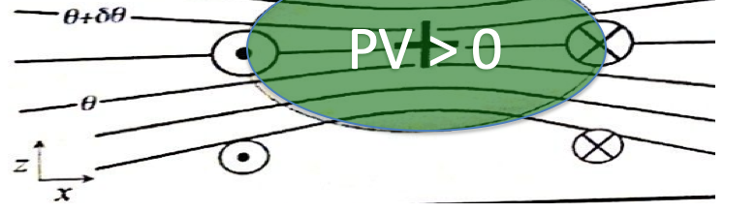
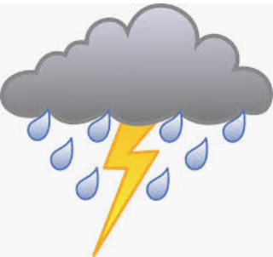
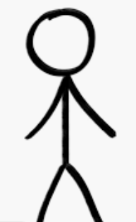
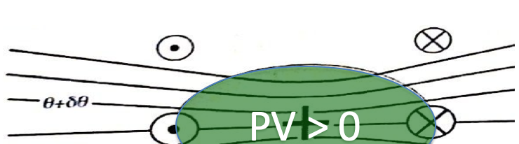
Since our main weather concern is in the lower troposphere (where water is),
This is called a cool core cyclone:
This is called a warm core cyclone:

Slide 22
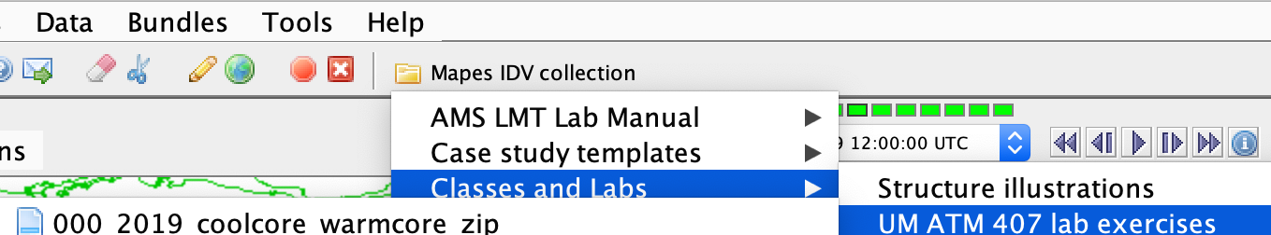
IDV lab assignment -- part 1
Open Mapes IDV → UM ATM407…
0000_coolcore_warmcore…
Explore ALL of its displays, at ALL of its times (loop the animation). Learn to use the IDV. The Help menu has pan-zoom help on top. A mouse is a HUGE help for 3D views.

Slide 23
IDV lab assignment -- part 1
In the following slides, make and label and explain nice clear illustrations like slides 13-17, but for
a warm core anticyclone
a warm core cyclone
a cool core anticyclone

Slide 24
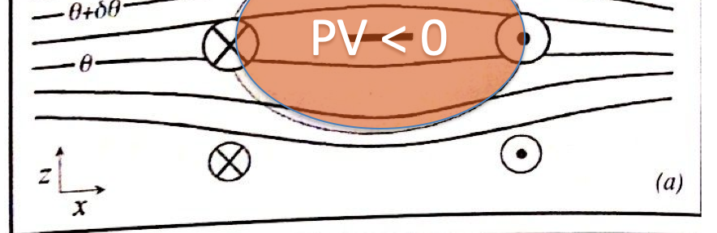
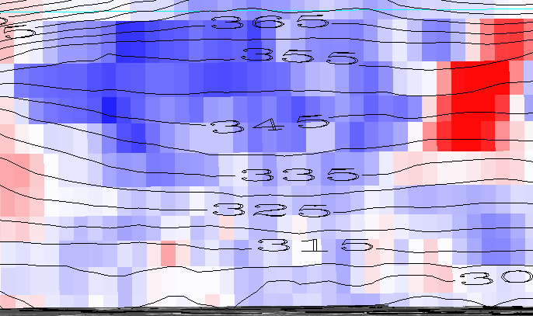
A warm core anticyclone
A warm core occurs on the bottom-half of an anticyclone vortex. The anticyclone vortex is in between two cyclonic vortices, both of which have cooler temperatures at the lower half than the anticyclone. Thus, the anticyclone has a warm bottom core.

Slide 25
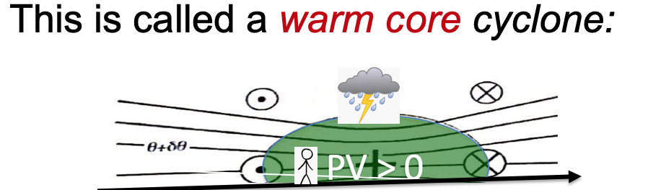
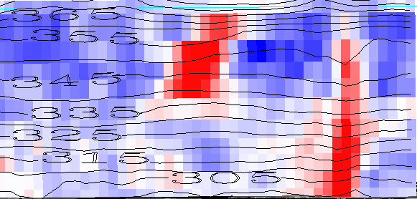
A warm core cyclone
A warm core cyclone occurs on the upper-half of a cyclonic vortex. Air sinks in the center of the vortex and warms through compression.

Slide 26
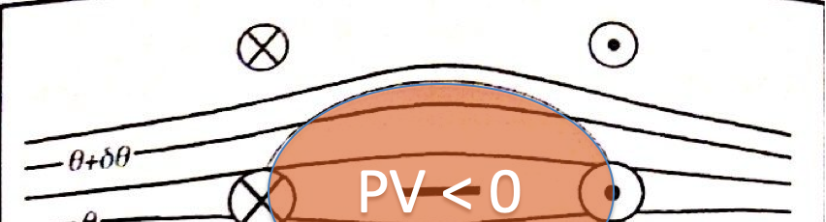
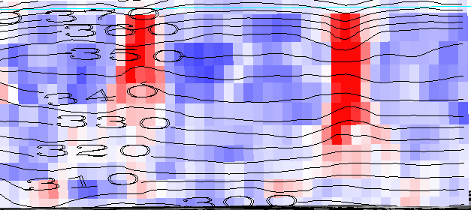
A cool core anticyclone
A cool core anticyclone occurs on the upper-half of the anticyclonic vortex. The vortex is in between two cyclonic vortices with comparatively warmer temperatures. Thus, the anticyclone has an upper cool core.

Slide 27
Isentropic surfaces
Isentrope contours on the cross sections above are slices of isentropic surfaces
surfaces of constant entropy
or potential temperature, or dry static energy C_{p}T + gz
Let’s learn to see isentropic surfaces
They are almost like material surfaces
because Dθ/Dt = 0 for adiabatic flow
(plus nonadiabatic or “diabatic” complications)
Their vertical motion is air vertical motion!
the holy grail, for clouds+rain (weather)

Slide 28
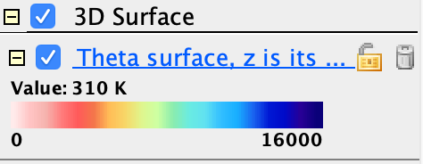

IDV Lab assignment part 2
In the same bundle, activate (check) the display called “Theta surface, z is its color”
Adjust the value (310K, 330K, 360K)
Use vorticity isosurfaces and cross sections in an illustrated description of its topography.
Is there a mean north-south slope? hint:
What vorticity features (Part I) explain dimples?
What vorticity features (Part I) explain peaks?

Slide 29
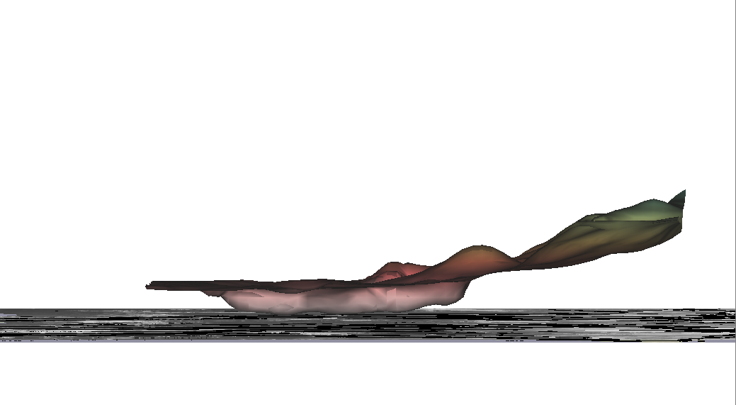
Mean slope of the 310K isosurface
Slope is increasing towards the North

Slide 30
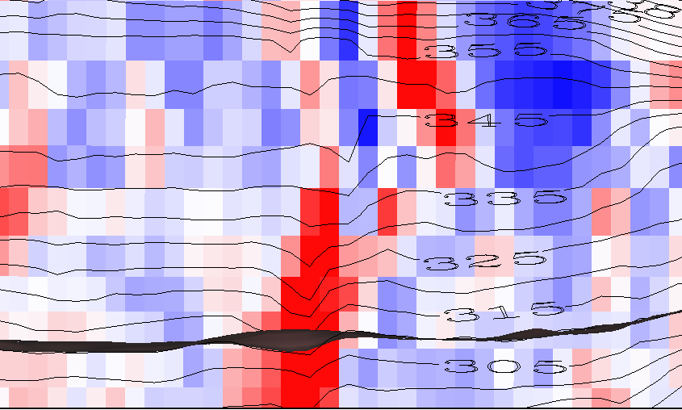
A depression in the 310K surface
Air following the isentrope sinks along the depression which is located at the warm core of a cyclonic vortex. Sinking air warms through compression.

Slide 31
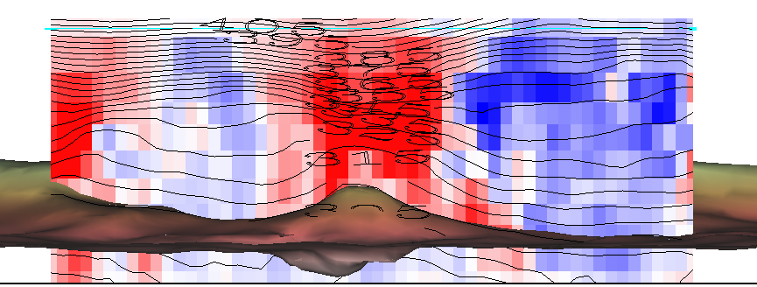
A peak on the 310K isosurface
Isosurface peaks in the warm core of a cyclonic vortex. This makes sense as isentropes converge towards a cyclonic vortex, and air rises following the isosurface.

Slide 32
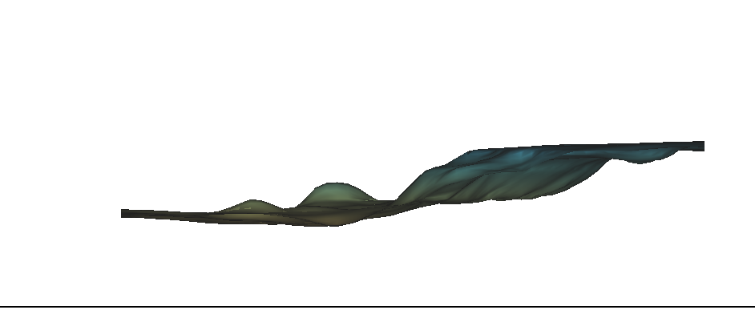
Mean slope of the 330K isosurface
Positive slope that increases towards the North

Slide 33
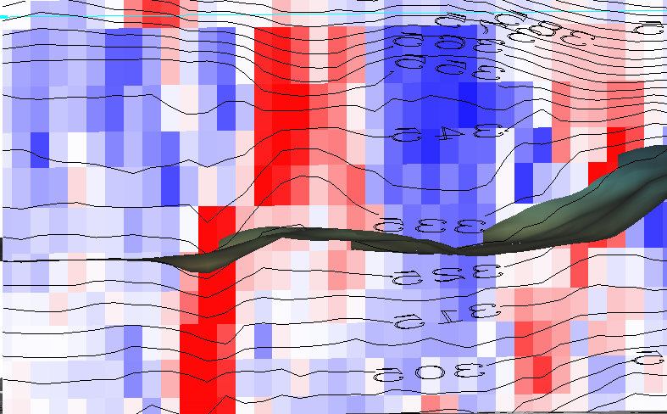
A depression in the 330K surface
The depression coincide with warm cores of both cyclonic and anticyclonic vortices.

Slide 34
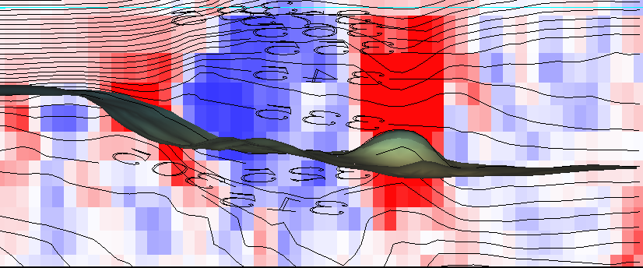
A peak on the 330K isosurface
Isosurface peaks are collocated with cyclonic vortices. As air follows the 330K isosurface, it rises along the peak.

Slide 35
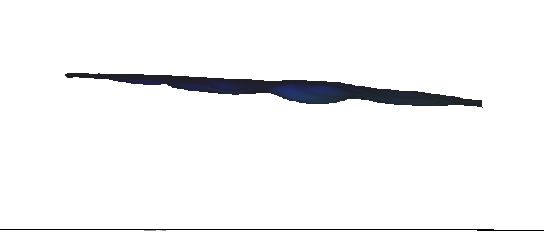
Mean slope of the 360K isosurface
A slight negative slope towards the North

Slide 36
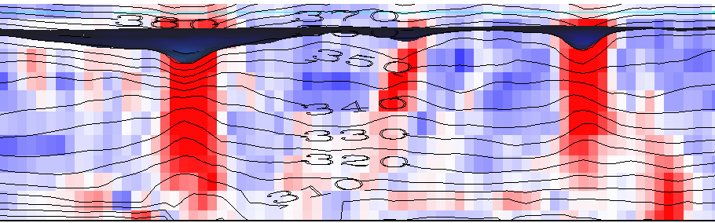
A depression in the 360K surface
The depression coincide with warm cores of cyclonic vortices.

Slide 37
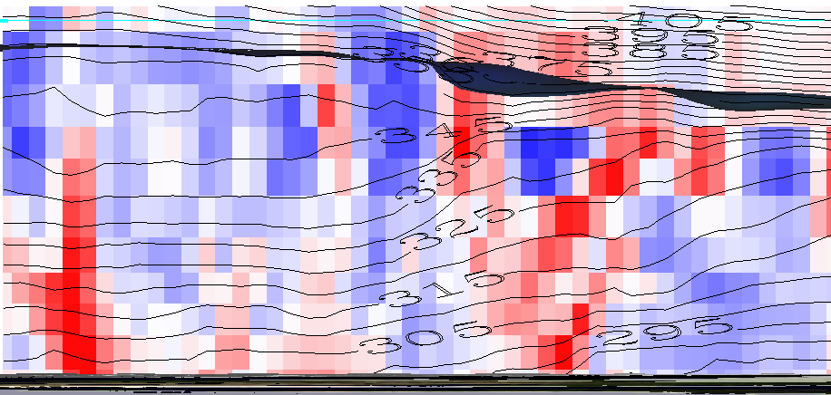
A peak on the 360K isosurface
The peaks coincide with cold core cyclonic vortex where air rises and cools.

Slide 38
Use the Print facility of Powerpoint
to put a PDF of this into your class Github repository
so we can look them over in class

