Slide 1
Attitude Determination
- Using GPS

Slide 2
Table of Contents
Definition of Attitude
Attitude and GPS
Attitude Representations
Least Squares Filter
Kalman Filter
Other Filters
The AAU Testbed
Results
Conclusion

Slide 3
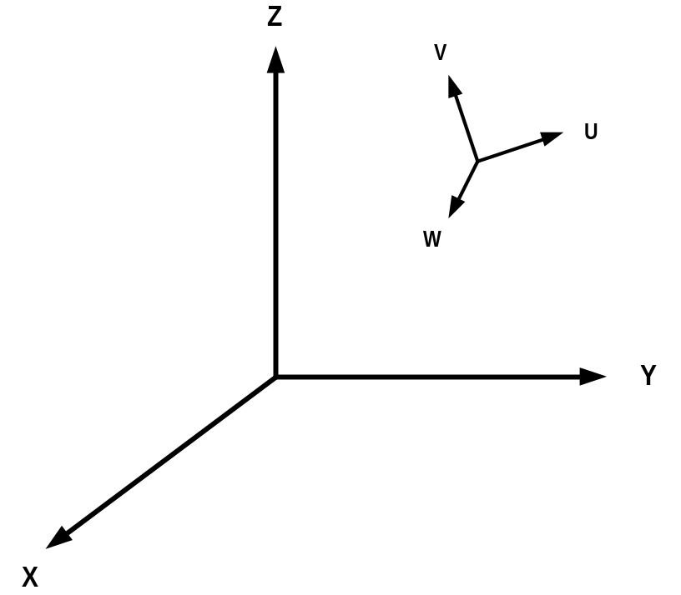
What is Attitude?
Orientation of a coordinate system (u,v,w) with respect to some reference system (x,y,z)

Slide 4
When is Attitude information needed?
Controlling an Aircraft, Boat or Automobile
Onboard Satellites
Pointing of Instruments
Pointing of Weapons
Entertainment industri (VR)
Etc...

Slide 5
Attitude sensors
Currently used sensors include:
Gyroscopes
Rate gyros (+integration)
Star trackers
Sun sensors
Magnetometers
GPS

Slide 6
Advantages of GPS
Adding new functionality to existing equipment
No cost increase
No weight increase
No moving parts (solid-state)
Measures the absolute attitude
Disadvantages
Mediocre accuracy (0.1 - 1º RMS error)
Low bandwidth (5-10 Hz maximum)
Requires direct view of satellites

Slide 7
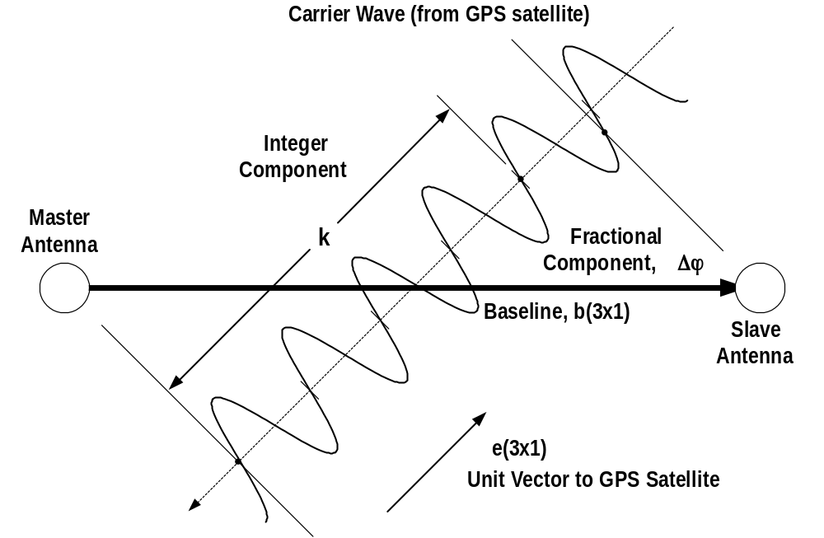
Interferometric Principle

Slide 8


Interferometric Principle
Measurement equation:
The full phase difference is the projection of the
baseline vector onto the LOS vector:

Slide 9
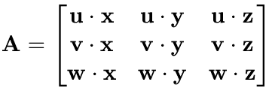
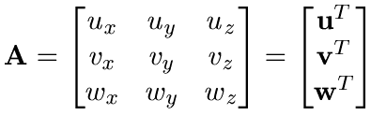
Attitude Matrix
9 parameters needed:
When (x,y,z) is a reference
system:

Slide 10


Properties of “A”
“A” rotates a vector from the reference system
to the body system
The transpose of “A” rotates in the opposite
direction (back again)

Slide 11
Properties of “A”
Rotation does not change the size of the vectors:
Every rotation has a rotation-axis (and a rotation-
angle)
The rotation-angle is the eigenvalue of “A”

Slide 12
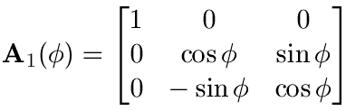
Euler sequences
A sequence of rotations by the angles (φ,θ,ψ) about
the coordinate axes of the reference system
Single axis:
Multiple axes:

Slide 13

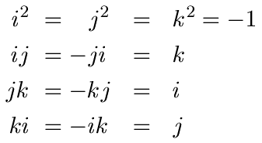
Quaternions
A quaternion consists of four composants
Where i,j and k are hyperimaginary numbers

Slide 14
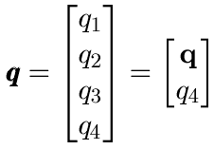

Quaternions
A quaternion can be thought of as a 4 dimensional
vector with unit length:

Slide 15
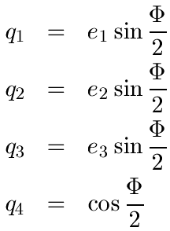
Quaternions
Quaternions represent attitude as a rotation-axis
and a rotation-angle

Slide 16


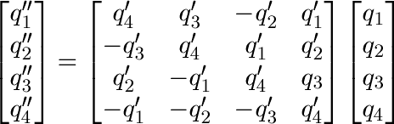
Quaternions
Quaternions can be multiplied using the special
operator defined as:

Slide 17
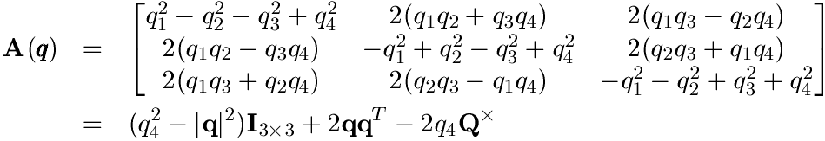
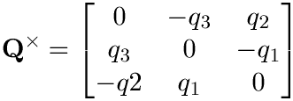
Quaternions
The attitude matrix can be formed from the
quaternion as:
Where

Slide 18
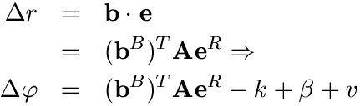

Least Squares Solution
Including attitude information into the
measurement equation
Linearization of the attitude matrix

Slide 19
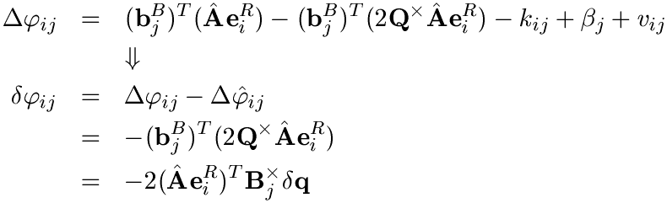
Least Squares Solution
Forming the phase residual

Slide 20
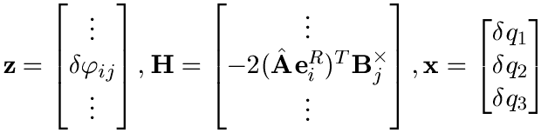
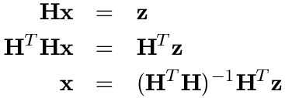
Least Squares Solution

Slide 21
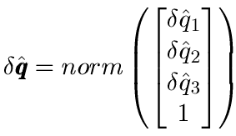

Least Squares Solution
Estimate update

Slide 22
Extended Kalman Filter
A Kalman filter consists of a model equation
and a measurent equation

Slide 23


Extended Kalman Filter
And their linearized counterparts….
And

Slide 24
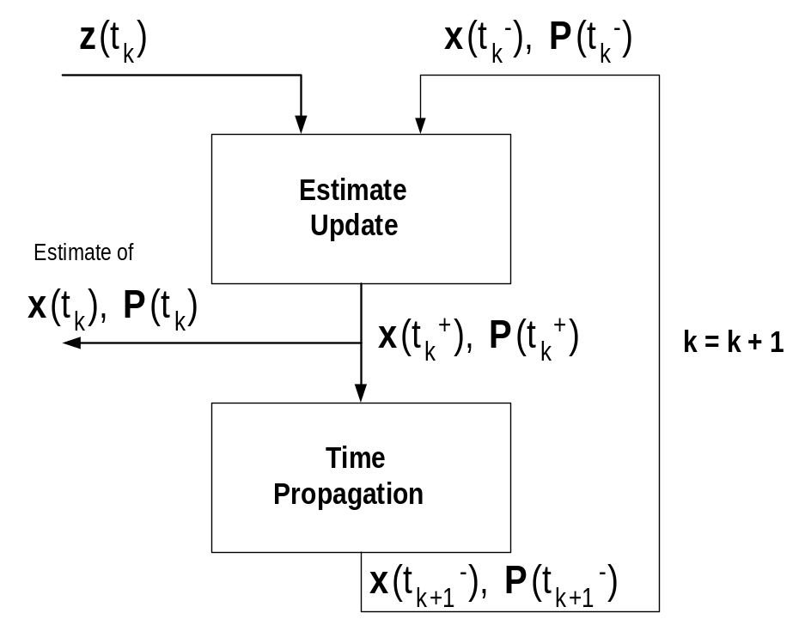
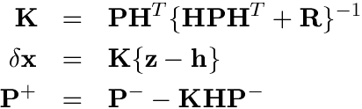

Extended Kalman Filter
Algorithm

Slide 25
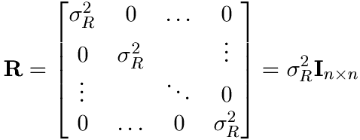
Extended Kalman Filter
Tuning of the filter
Noise variance determined experimentally

Slide 26
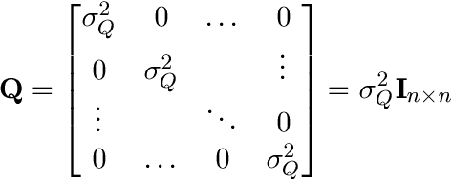
Extended Kalman Filter
Tuning of the filter
Noise variance determined by ‘trial-and-error’

Slide 27
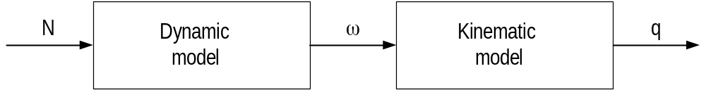
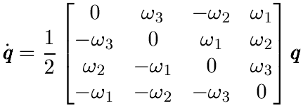

Extended Kalman Filter
Determining the system model

Slide 28
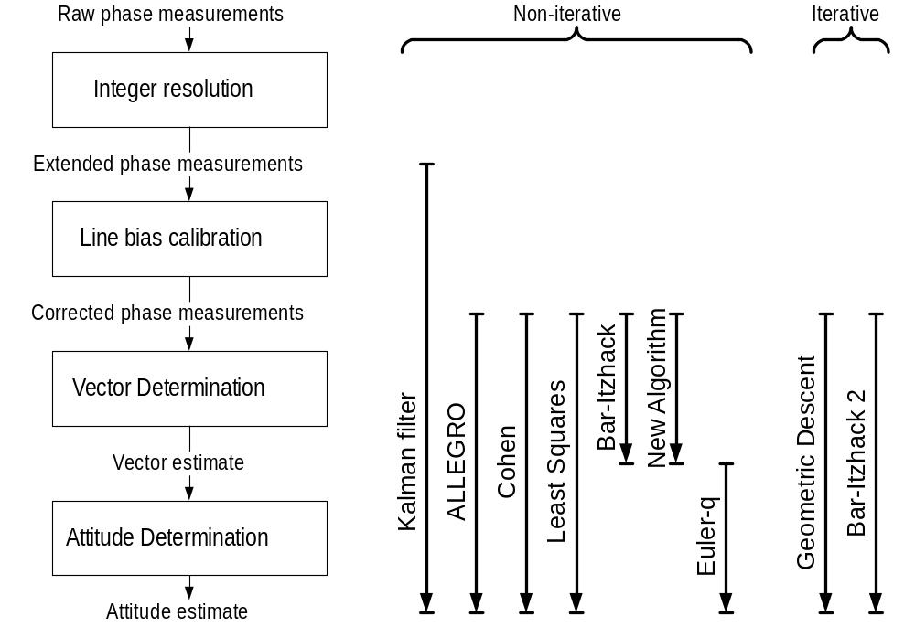
Other Filters

Slide 29
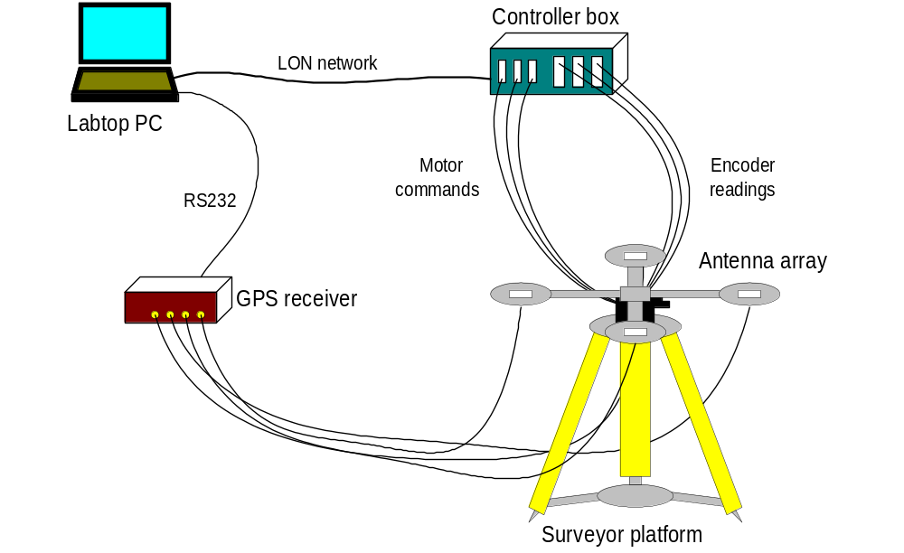
Testbed

Slide 30
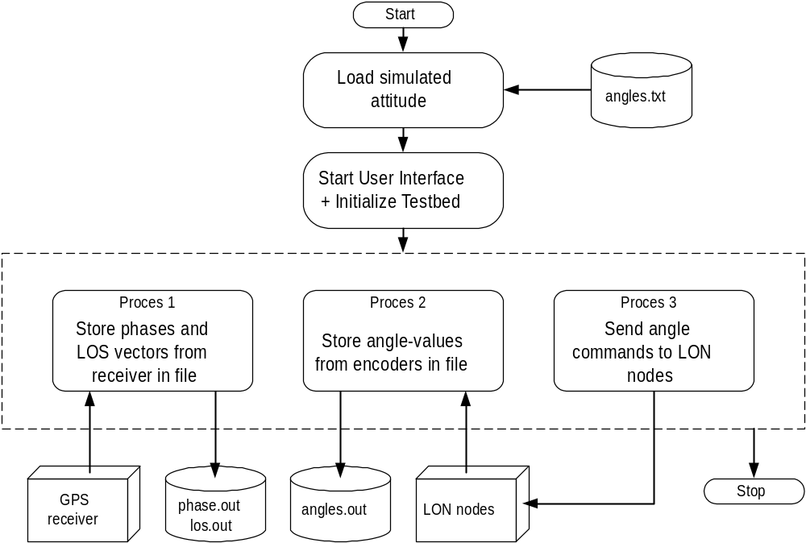
Software

Slide 31
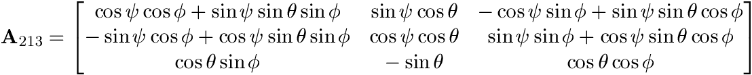
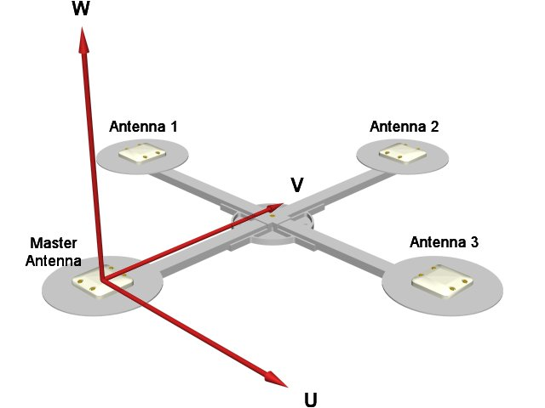
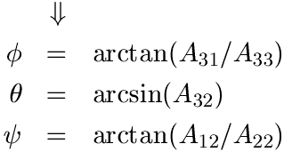
Motor Control

Slide 32
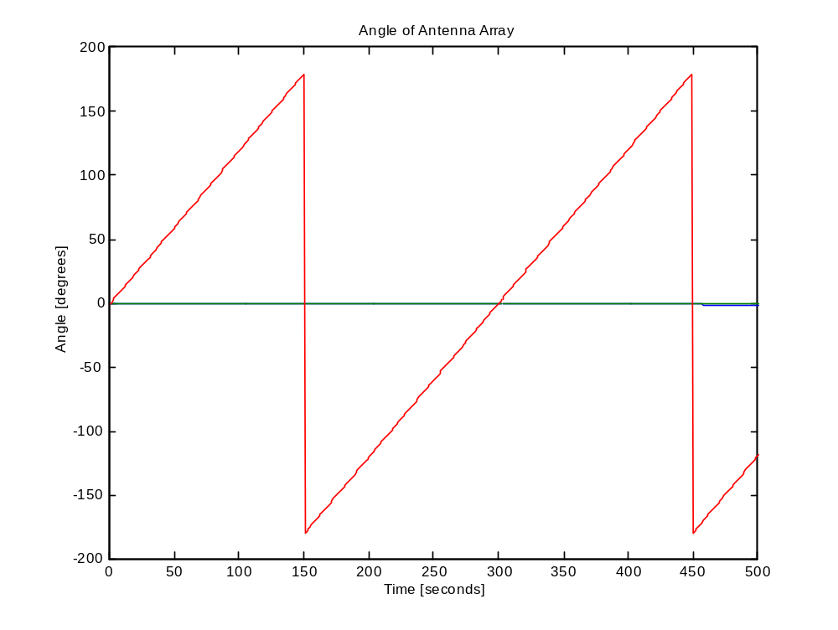
Motor Angles

Slide 33
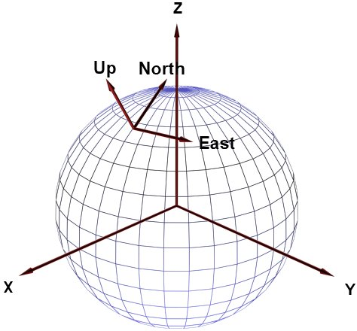
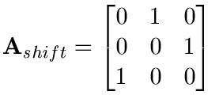
Local Horizontal System

Slide 34
Results
Based on actual and simulated data, the following
performance parameters were evaluated
Accuracy
Computational efficiency
Ability to converge

Slide 35
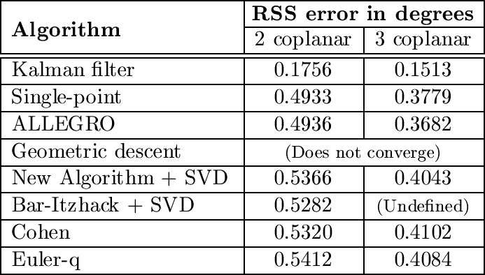
Accuracy

Slide 36
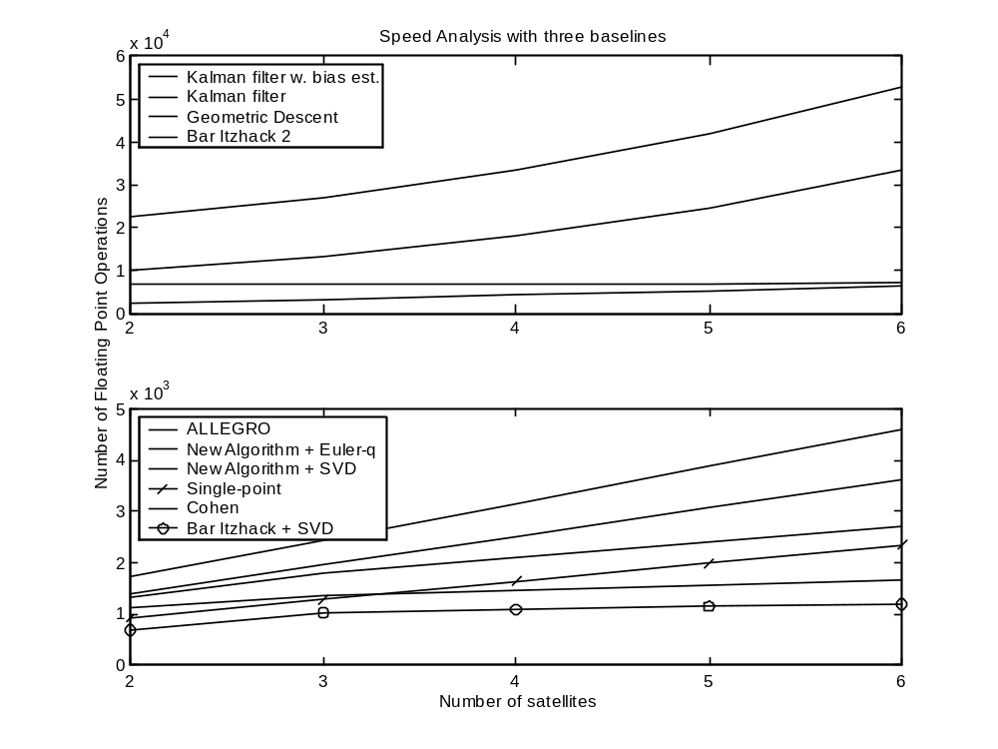
Speed

Slide 37
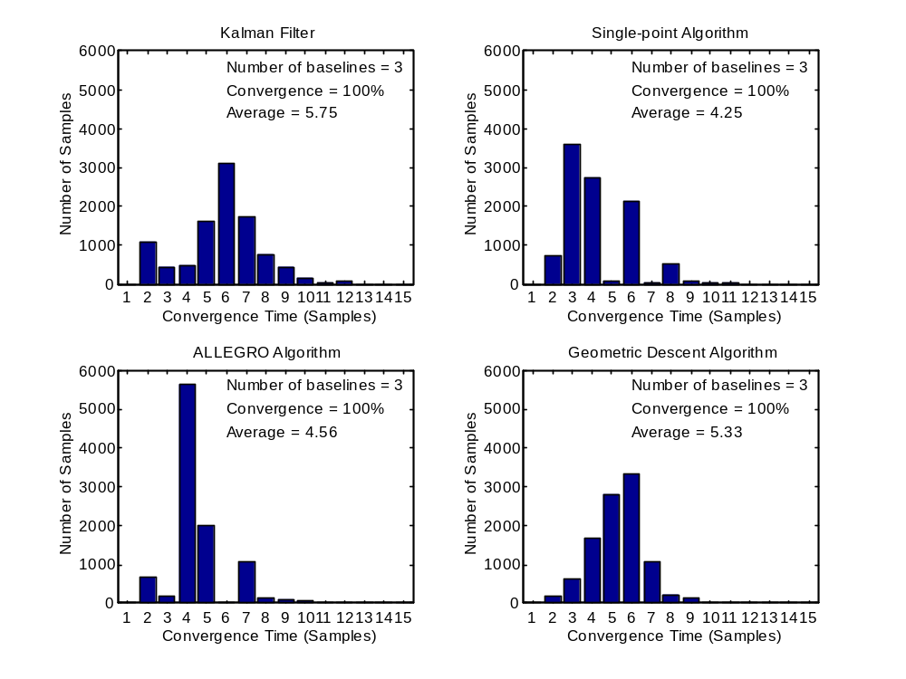
Convergence

Slide 38
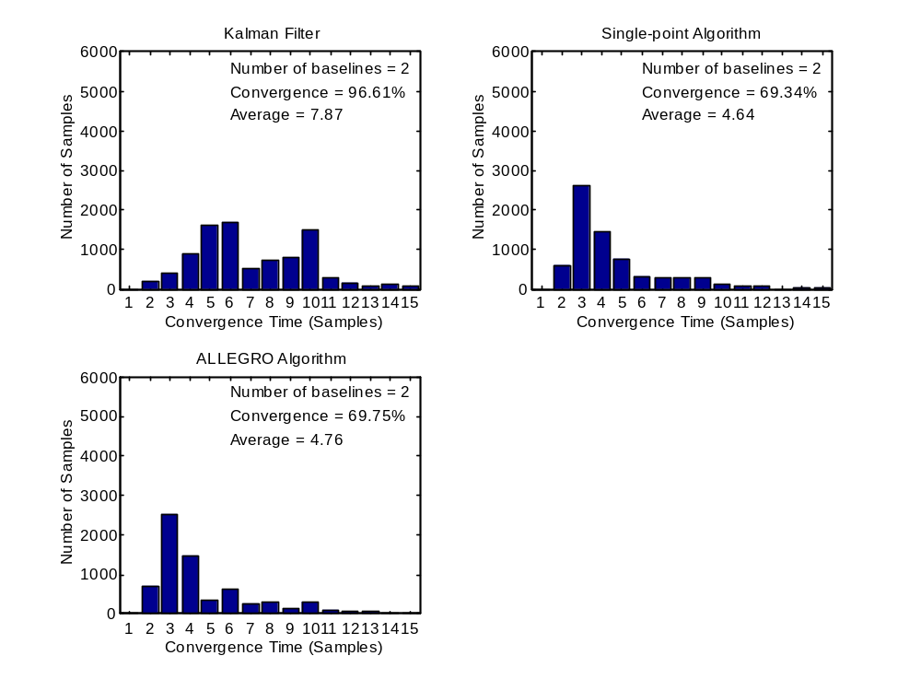
Convergence

Slide 39
Conclusion
Kalman filter is by far most accurate, but also computationally very heavy
Single-point (LSQ) offers good accuracy + high speed
Vector matching algorithms has the lowest accuracy but does not suffer from convergence problems
Performance depend on satellite constellation
Results were affected by mechanical problems with levelling of the testbed

