Slide 1
DESIGN OF
A SINGLE FREQUENCY GPS SOFTWARE RECEIVER
Peter Rinder
Nicolaj Bertelsen

Slide 2
Peter Rinder
Basic GPS receiver structure
- Design and implementation

Slide 3
Project Goal
Design and implement
a single frequency GPS software receiver

Slide 4
GPS signals
Navigation data
Pseudo-random noise sequences
Carrier wave

Slide 5
Navigation data
Satellite orbit information (ephemerides)
Satellite clock information
Satellite health and accuracy
Satellite orbit information (almanac)
Bit-rate of 50bps
Repeated every 12.5 minutes

Slide 6
Pseudo-random noise sequences
Spreading sequences (C/A)
Length of 1023 chips
Chipping rate of 1.023Mcps
1 sequence lasts 1ms
32 sequences to GPS satellites
Satellite identification
Separate signals from different satellites

Slide 7
Carrier wave
Signal transmission
Two frequencies: L1=1575.42MHz L2=1227.60MHz
C/A code on L1
Bipolar phase-shift keying (BPSK) modulation

Slide 8
GPS signal
Carrier
wave
1 data bit
Navigation
data
1ms
Carrier
and data
20ms

Slide 9
GPS signal
Carrier
and data
PRN code
Resulting
signal

Slide 10
Important tasks of a GPS receiver
Prepare received signals for signal processing
Find satellites visible to the receiver
For each satellite
  Find coarse values for C/A code phase and carrier frequency
  Find fine values for C/A code phase and carrier frequency
  Keep track of the C/A code phase and carrier frequency as they change over time
  Obtain navigation data bits
  Decode navigation data bits
  Calculate satellite position
  Calculate pseudorange
Calculate position

Slide 11
Receiver overview
Prepare received signals for signal processing
RF
front-end
A/D
converter
Acquisition
Receiver
channel
Position
calculation
Receiver
channel
Receiver
channel
Receiver
channel
Receiver
channel
Receiver
channel
Receiver
channel
Receiver
channel

Slide 12
Receiver overview
Find satellites visible to the receiver
  Find coarse values for C/A code phase and carrier frequency
  for each satellite
RF
front-end
A/D
converter
Acquisition
Receiver
channel
Position
calculation
Receiver
channel
Receiver
channel
Receiver
channel
Receiver
channel
Receiver
channel
Receiver
channel
Receiver
channel

Slide 13
Receiver overview
Find fine value for C/A code phase
Find fine value for carrier frequency
Keep track of the C/A code phase and carrier
frequency as they change over time
Code tracking
Carrier
Tracking
Bit syn-chronization
Decode
nav. data
Calculate
satellite position
Calculate
pseudo-range
Receiver channel

Slide 14
Receiver overview
Obtain navigation data bits
Code tracking
Carrier
Tracking
Bit syn-chronization
Decode
nav. data
Calculate
satellite position
Calculate
pseudo-range
Receiver channel

Slide 15
Receiver overview
Decode navigation data bits
Code tracking
Carrier
Tracking
Bit syn-chronization
Decode
nav. data
Calculate
satellite position
Calculate
pseudo-range
Receiver channel

Slide 16
Receiver overview
Calculate satellite position
Code tracking
Carrier
Tracking
Bit syn-chronization
Decode
nav. data
Calculate
satellite position
Calculate
pseudo-range
Receiver channel

Slide 17
Receiver overview
Calculate pseudorange
Code tracking
Carrier
Tracking
Bit syn-chronization
Decode
nav. data
Calculate
satellite position
Calculate
pseudo-range
Receiver channel

Slide 18
Receiver overview
Calculate position
RF
front-end
A/D
converter
Acquisition
Receiver
channel
Position
calculation
Receiver
channel
Receiver
channel
Receiver
channel
Receiver
channel
Receiver
channel
Receiver
channel
Receiver
channel

Slide 19
Implemented parts
Prepare received signals for signal processing
Acquisition
Code tracking
Carrier tracking
Bit synchronization
Decode navigation messages
Calculate satellite positions
Calculate pseudoranges
Calculate receiver position
✓
✓
✓
✓
✗
✗
✗
✗
✗

Slide 20
Signal conditioning
Purpose of signal conditioning
  Remove possible disturbing signals by filtering
  Amplify signal to an acceptable amplitude
  Down-sample signal to an intermediate frequency
Antenna
signal
Intermediate
frequency
signal
Mixer
Amplifier
Filter
Filter
Local
oscillator

Slide 21
Acquisition
Acquisition purpose
  Estimate coarse value of PRN code phase
  Estimate coarse value of carrier frequency
Operates on 1ms blocks of data
  Corresponds to the length of a complete PRN code

Slide 22
Acquisition
Code phase estimation
PRN code characteristics
  Maximum autocorrelation at lag 0
  Minimum auto-correlation in all other cases
  Minimum cross-correlation in all cases
Generate local PRN code
Perform circular correlation to obtain code phase
Code phase is the circular shift of the local code that gives maximum correlation

Slide 23

Acquisition
Incoming
code
Generated
code
Correlation
0 1 2 3 4 5 6 7

Slide 24
Acquisition
Carrier frequency estimation
Generate local carrier
Adjust frequency until highest correlation is obtained

Slide 25
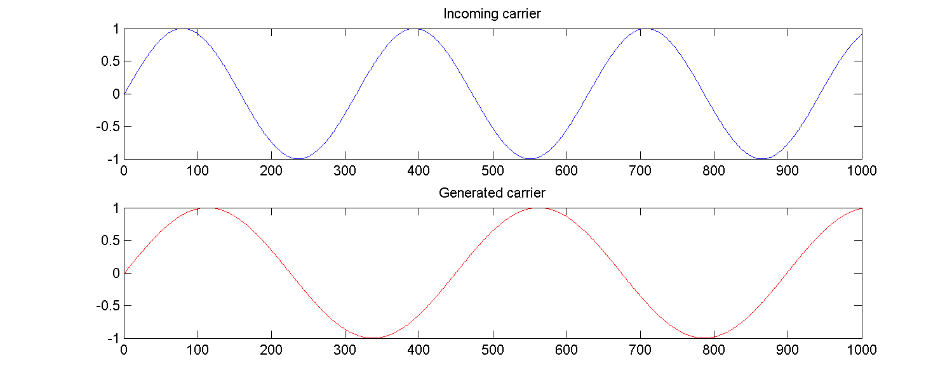
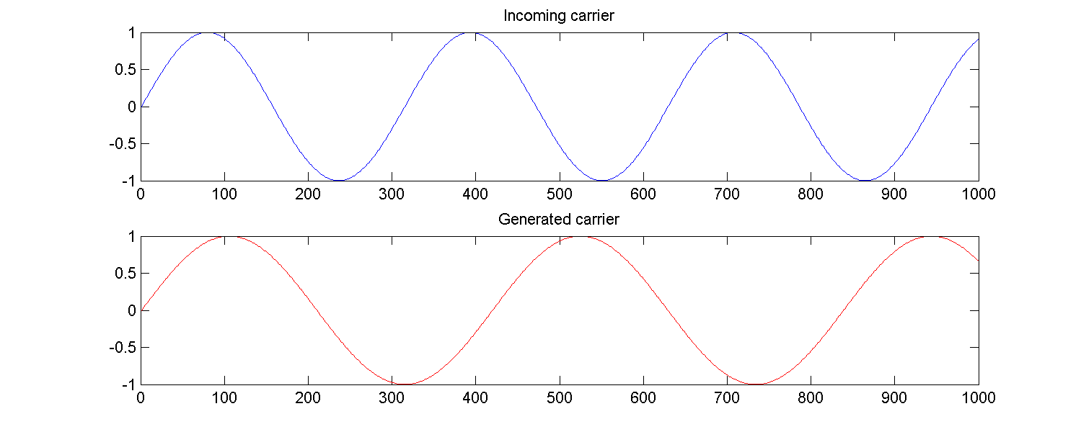
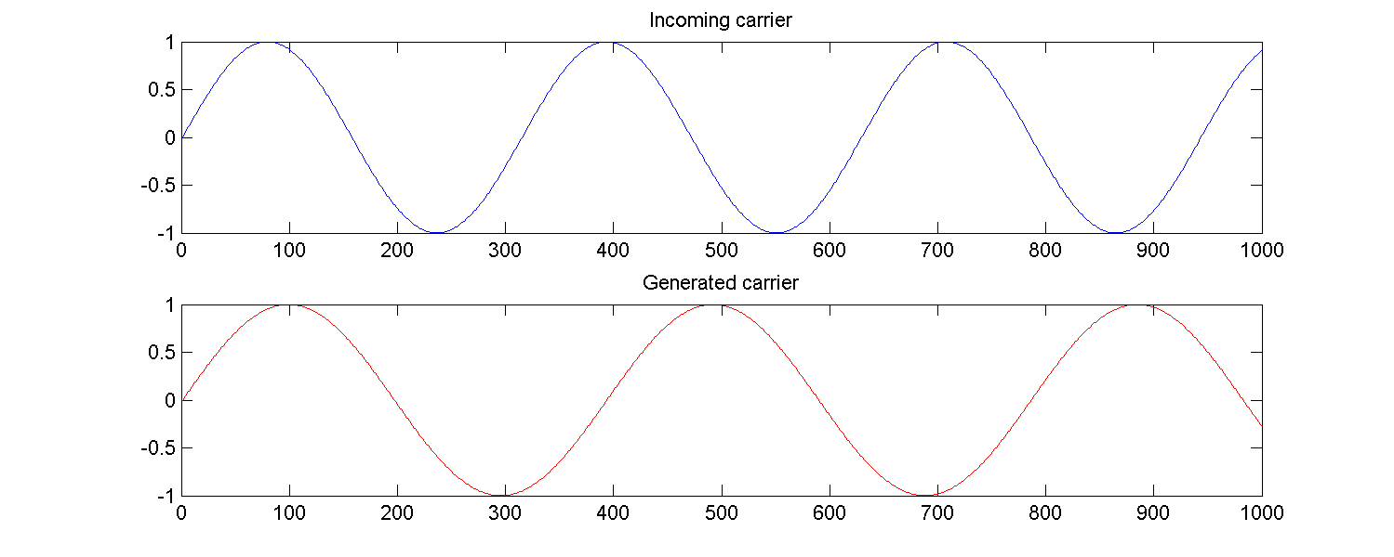
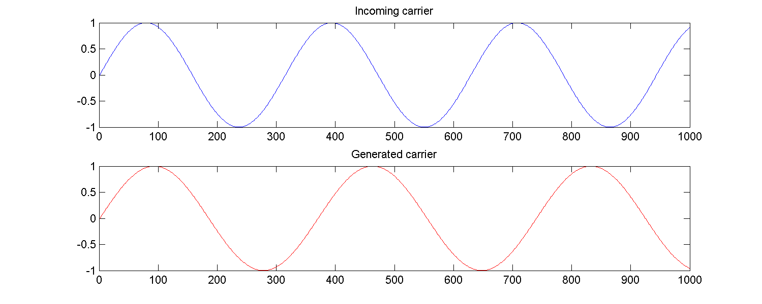
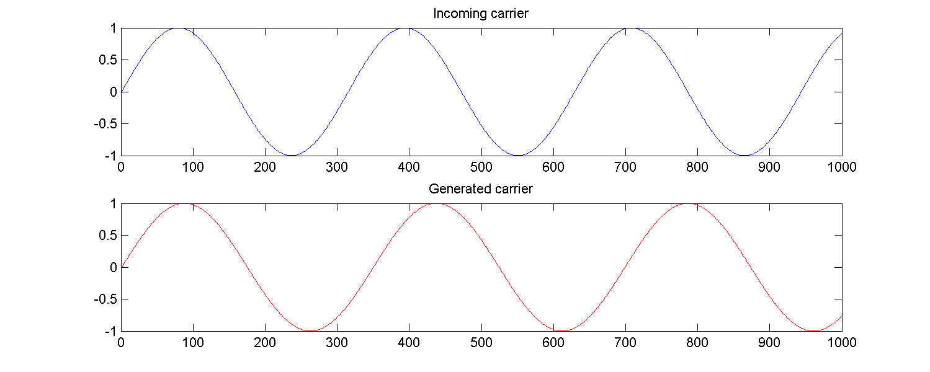
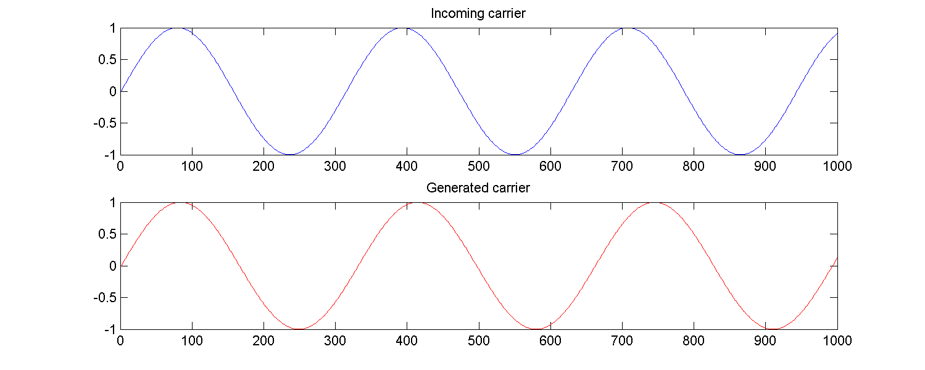
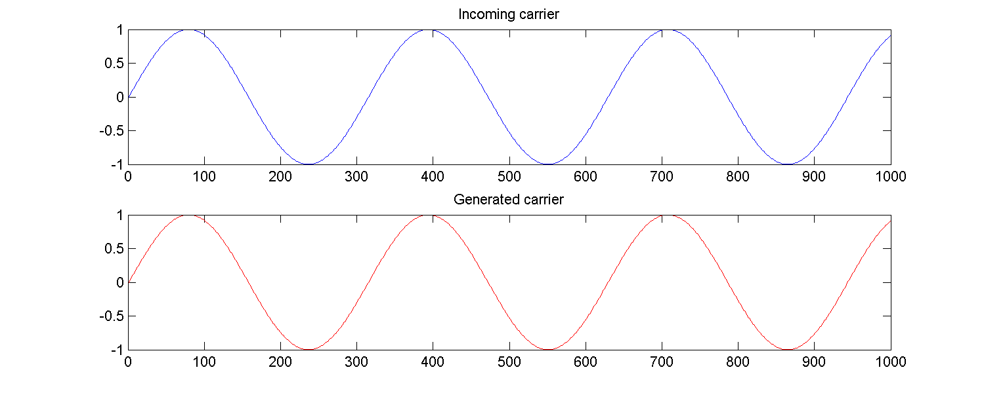
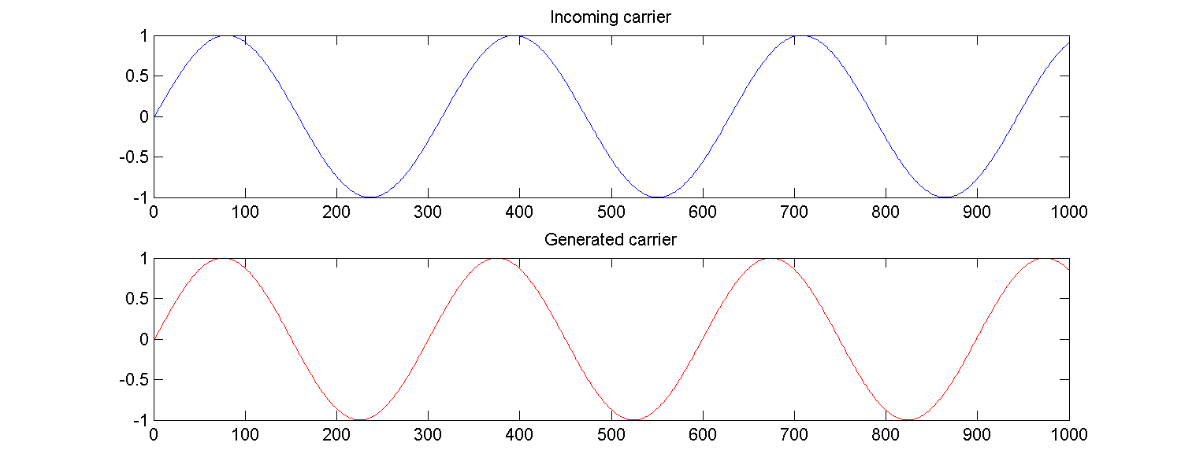
Acquisition
Correlation
1 2 3 4 5 6 7 8

Slide 26
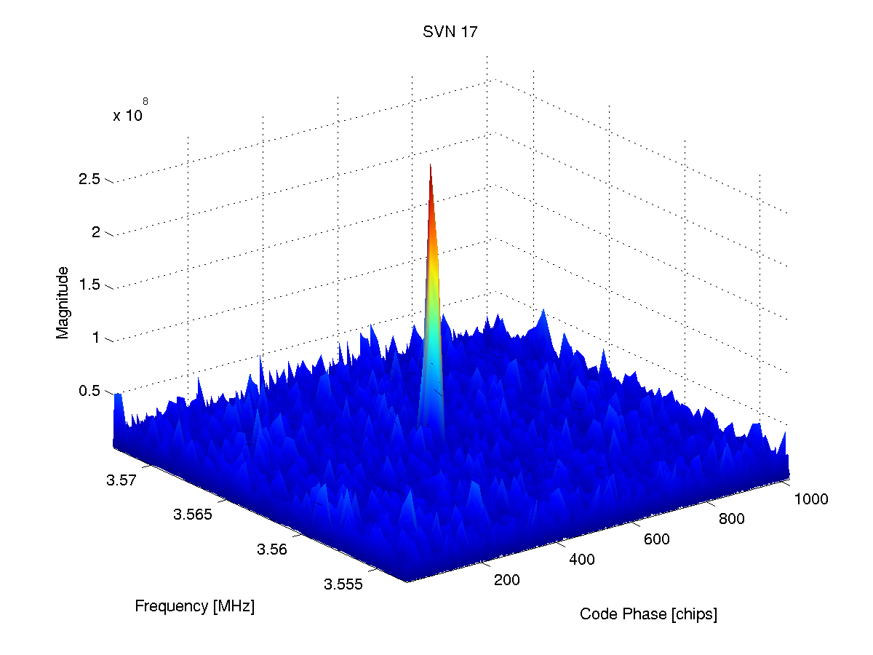
Acquisition
Correct value for code phase and carrier frequency
gives a peak

Slide 27
Code tracking
Enhance the accuracy of code phase obtained by acquisition
Generate three local PRN codes 0.5 chips apart
  Early
  Prompt
  Late
Correlate the local codes with incoming code
Adjust code phase according to result of correlation

Slide 28




Code tracking
Incoming code
Early
Prompt
Late
Correlation
1
0.5
0
Delay in chips
-1
-0.5
0
0.5
1

Slide 29
Carrier tracking
Enhance the accuracy of the carrier frequency obtained
by acquisition
Generate local carrier signal
Measure the phase error between incoming carrier and local carrier signal
Adjust frequency until phase and frequency becomes stable
PRN code
Incoming
signal
Phase
discriminator
Loop
filter
NCO carrier
generator

Slide 30
Nicolaj Bertelsen
Design and implementation of
remaining functionalities

Slide 31
Status at report submission
✓ Acquisition
✓ Code tracking
✓ Carrier tracking
✗ Bit synchronization
✗ Decode navigation messages
✗ Calculate satellite positions
✗ Calculate pseudoranges
✗ Calculate receiver position

Slide 32
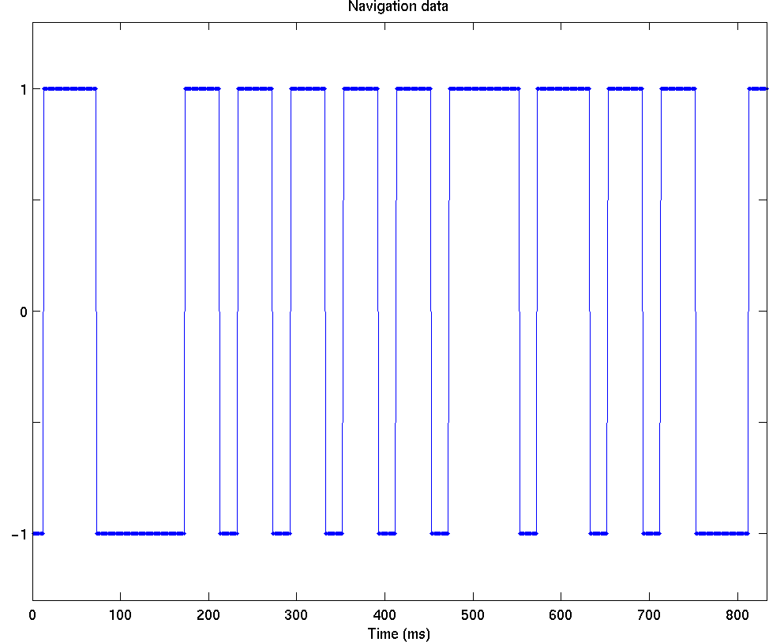
Bit synchronization
Output from the tracking loop is -1 or 1 every millisecond

Slide 33
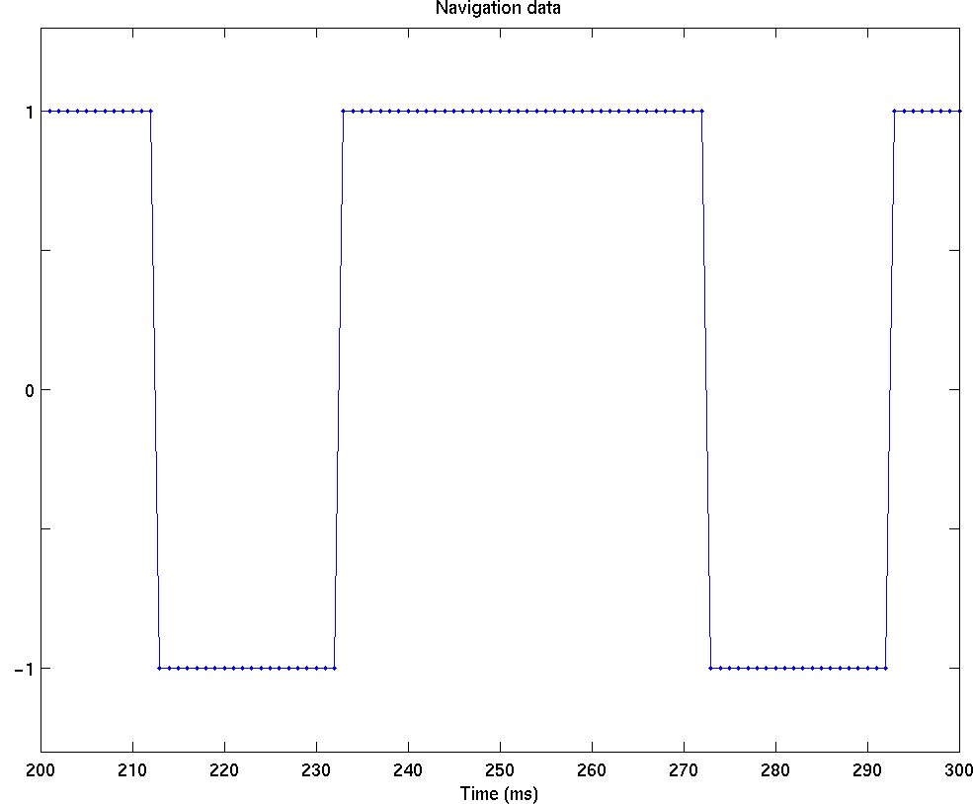
Bit synchronization
Output from the tracking loop is -1 or 1 every millisecond
Output from bit syncronization is -1 or 1 every 20 ms
1 -1 1 1 -1 1

Slide 34
Status at report submission
✓ Acquisition
✓ Code tracking
✓ Carrier tracking
✗ Bit synchronization
✗ Decode navigation messages
✗ Calculate satellite positions
✗ Calculate pseudoranges
✗ Calculate receiver position
✓ Acquisition
✓ Code tracking
✓ Carrier tracking
✓ Bit synchronization
✗ Decode navigation messages
✗ Calculate satellite positions
✗ Calculate pseudoranges
✗ Calculate receiver position

Slide 35
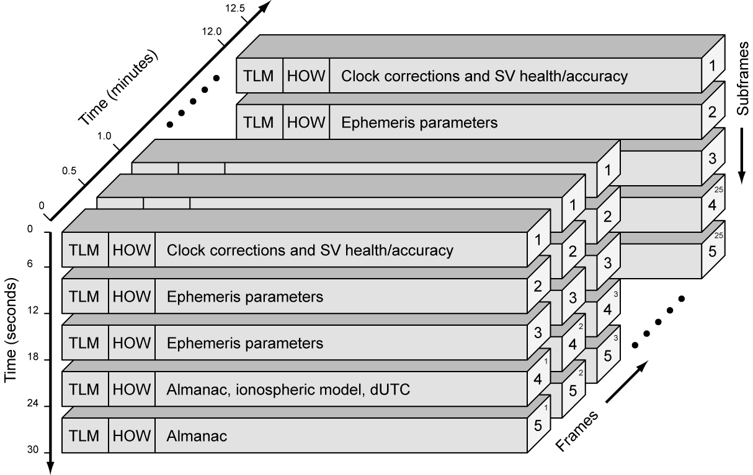
Decode navigation messages
The navigation messages contain satellite information
Subframe 1-3 is needed to calculate the satellite position

Slide 36
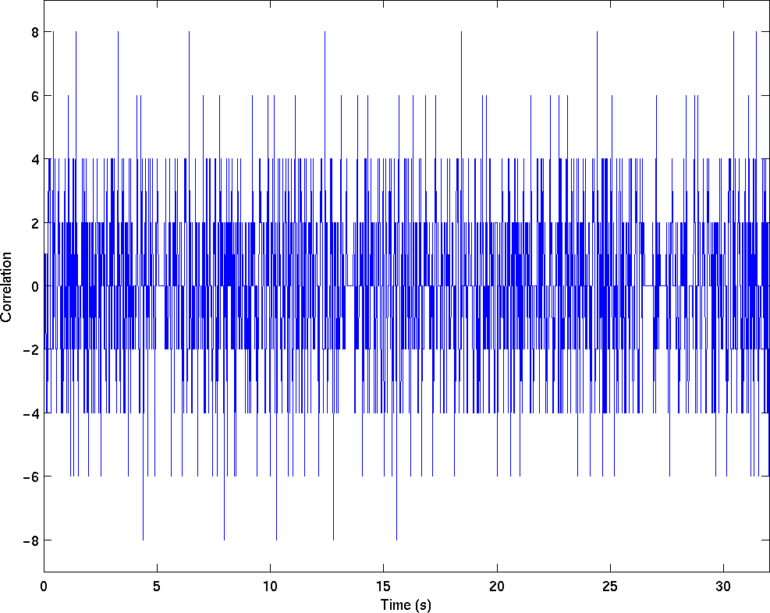
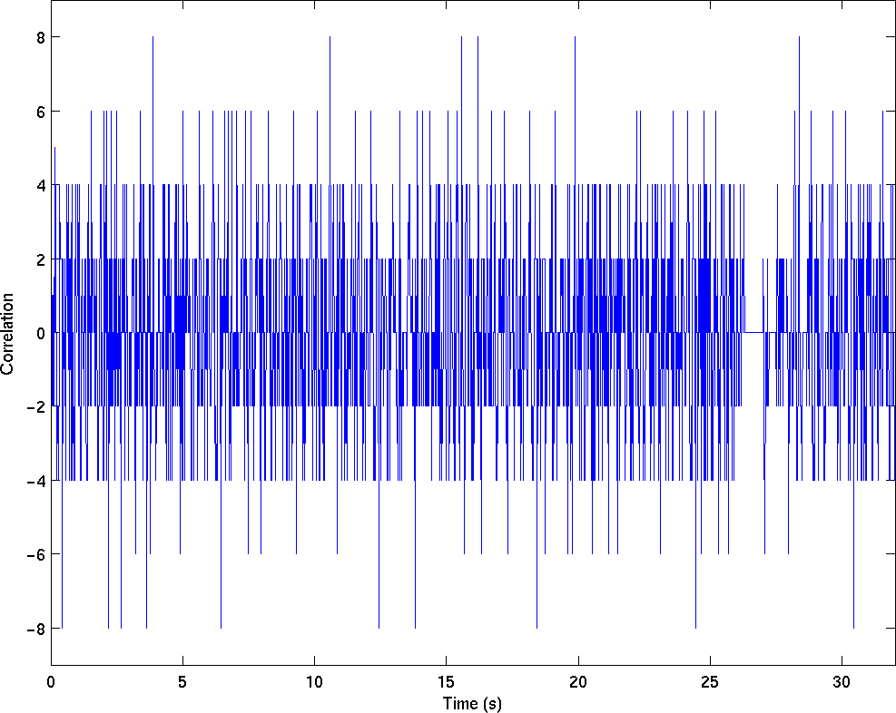
Decode navigation messages
Find the subframes in the navigation message
Preamble (TLM word) 1 0 0 0 1 0 1 1
Correlation between navigation bits and preamble

Slide 37
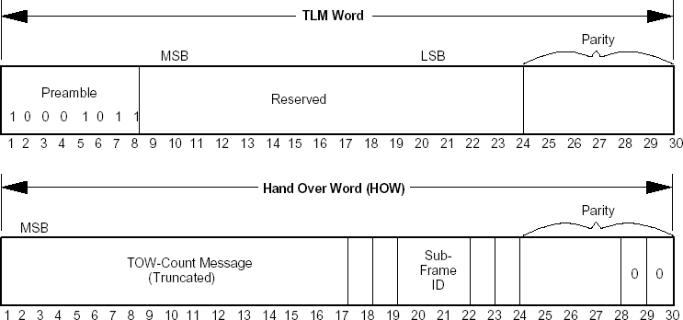
Decode navigation messages
Parity check of the subframe
Find the subframe id (1-5)
Decode each subframe (1-3)

Slide 38
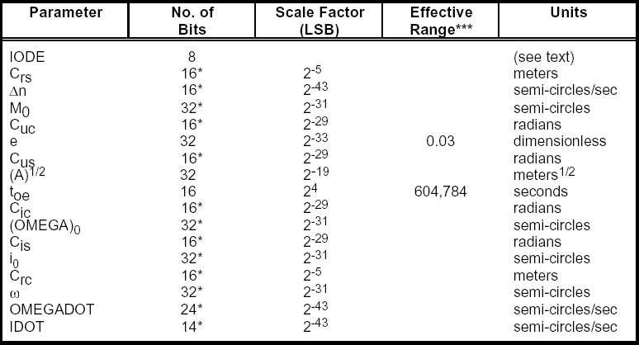
Decode navigation messages
Data in subframe 2 and 3

Slide 39
Status
✓ Acquisition
✓ Code tracking
✓ Carrier tracking
✓ Bit synchronization
✗ Decode navigation messages
✗ Calculate satellite positions
✗ Calculate pseudoranges
✗ Calculate receiver position
✓ Acquisition
✓ Code tracking
✓ Carrier tracking
✓ Bit synchronization
✓ Decode navigation messages
✗ Calculate satellite positions
✗ Calculate pseudoranges
✗ Calculate receiver position

Slide 40
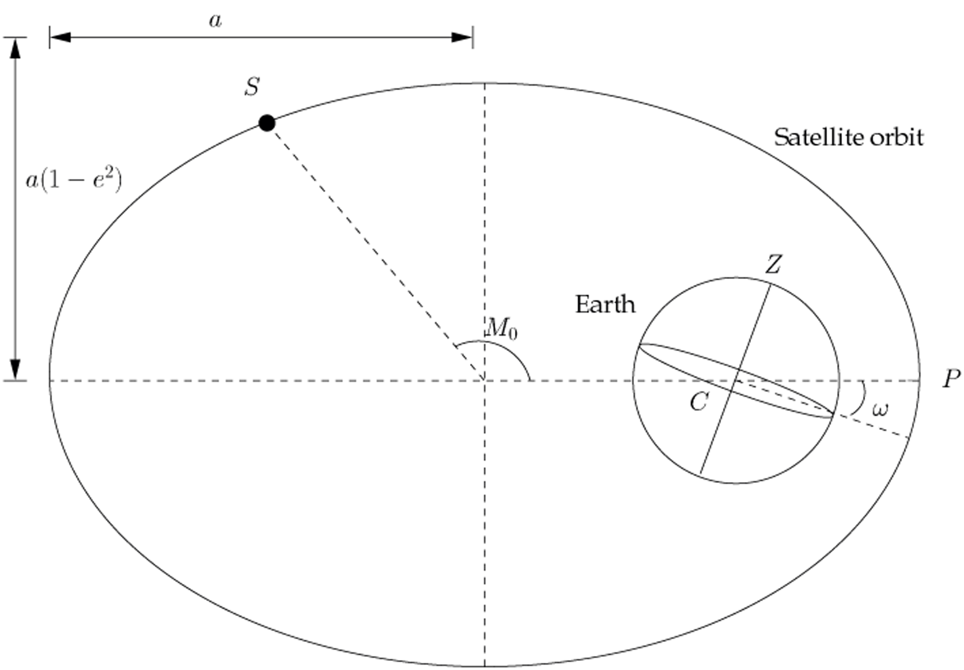
Calculate satellite positions
All the information in subframe 2 and 3 tells in which orbit the satellite is moving

Slide 41
Status
✓ Acquisition
✓ Code tracking
✓ Carrier tracking
✓ Bit synchronization
✓ Decode navigation messages
✗ Calculate satellite positions
✗ Calculate pseudoranges
✗ Calculate receiver position
✓ Acquisition
✓ Code tracking
✓ Carrier tracking
✓ Bit synchronization
✓ Decode navigation messages
✓ Calculate satellite positions
✗ Calculate pseudoranges
✗ Calculate receiver position

Slide 42
Calculate pseudoranges
The start of a subframe is found for all channels
The accuracy of the pseudoranges with a time resolution of 1 ms is 300.000m
The code tracking loop can tell the precise start of the C/A code
Pseudorange accuracy of 25m
Channel 1
Channel 2
Channel 3
68 ms
Channel 4
Time
409807

Slide 43
Calculate pseudoranges
Traditional calculations of the satellite positions
Software receiver calculations
More precise satellite positions
Channel 1
71 ms
Channel 2
Channel 3
Channel 4
Time
(Epoch Time)
Channel 1
71 ms
Channel 2
Channel 3
Channel 4
Time
(Transmit Time)

Slide 44
Calculate pseudoranges
Calculations of more pseudoranges
1000Hz pseudorange calculations
68 ms
68.50 ms
68.82 ms
Channel 1
Channel 2
Channel 3
Channel 4
Time
409807
409807.1
409807.2

Slide 45
Status
✓ Acquisition
✓ Code tracking
✓ Carrier tracking
✓ Bit synchronization
✓ Decode navigation messages
✓ Calculate satellite positions
✗ Calculate pseudoranges
✗ Calculate receiver position
✓ Acquisition
✓ Code tracking
✓ Carrier tracking
✓ Bit synchronization
✓ Decode navigation messages
✓ Calculate satellite positions
✓ Calculate pseudoranges
✗ Calculate receiver position

Slide 46
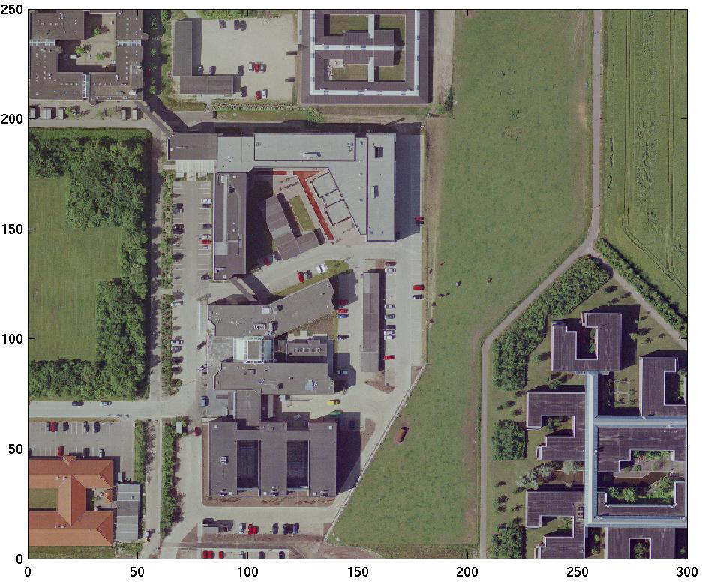
Calculation of receiver position
The university area

Slide 47
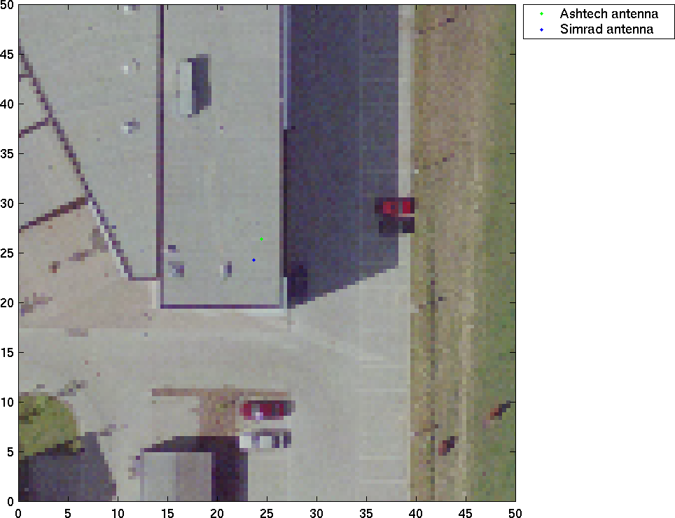
Calculation of the receiver position
Antenna positions

Slide 48
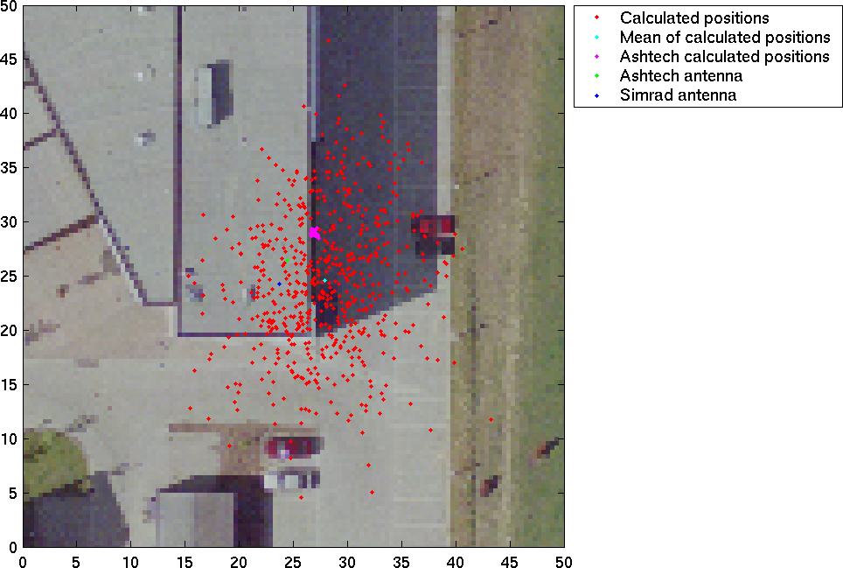
Calculation of receiver position

Slide 49
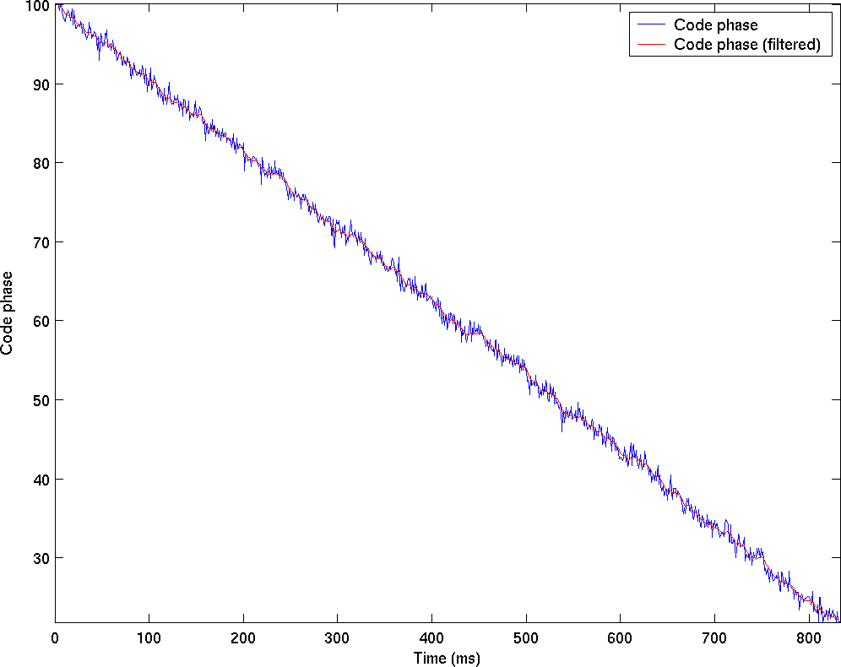
Calculation of receiver position
The start of the C/A code for each millisecond of data

Slide 50
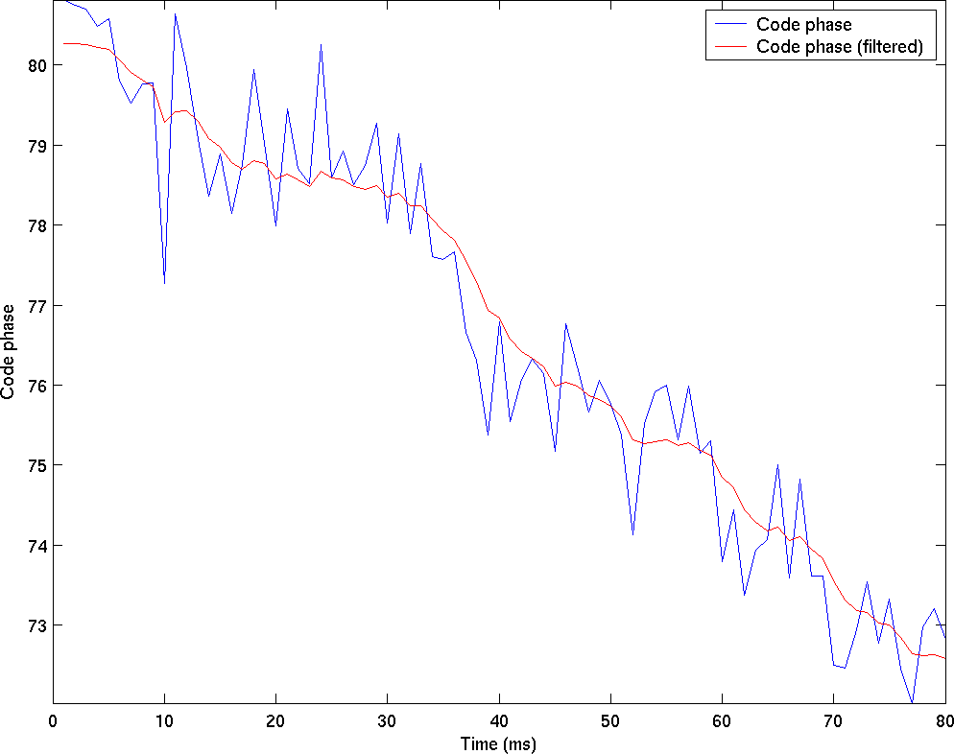
Calculation of receiver position
Pseudorange smoothing

Slide 51
Calculation of receiver position

Slide 52
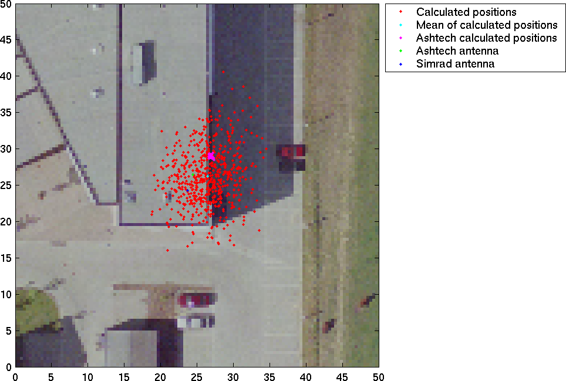
Calculation of receiver position

Slide 53
Status
✓ Acquisition
✓ Code tracking
✓ Carrier tracking
✓ Bit synchronization
✓ Decode navigation messages
✓ Calculate satellite positions
✓ Calculate pseudoranges
✗ Calculate receiver position
✓ Acquisition
✓ Code tracking
✓ Carrier tracking
✓ Bit synchronization
✓ Decode navigation messages
✓ Calculate satellite positions
✓ Calculate pseudoranges
✓ Calculate receiver position

Slide 54
Future improvements
Analyze the multipath impact on pseudorange calculations
The software receiver is using post processing
For real-time implementations it is necessary to switch programming language from Matlab → C or C++
Phase measurements
P code measurements

Slide 55
Conclusion
Obtain RF hardware
  Front-end from Simrad
  NI 5911 A/D converter
  NI 5102 A/D converter
  ICS-652 from Interactive Circuits and Systems
Analyze the hardware and GPS signals
Design and implement a GPS signal simulator
Analyze different methods of acquisition and tracking
Implement receiver in Matlab
Design and implemented a post processing standalone GPS C/A code software receiver

