Slide 1

Getting Started With Java
Sisoft Technologies Pvt Ltd
SRC E7, Shipra Riviera Bazar, Gyan Khand-3, Indirapuram, Ghaziabad
Website: www.sisoft.in Email:info@sisoft.in
Phone: +91-9999-283-283

Slide 2
Java Virtual Machine
Provides hardware platform specifications
• Reads compiled byte codes.
• Is implemented as software or hardware
• Is implemented in a Java technology development tool or a web browser

Slide 3
JVM
JVM provides definitions for the:
• Instruction set (central processing unit [CPU])
• Register set
• Class file format
• Stack
• Garbage-collected heap
• Memory area
• Fatal error reporting
• High-precision timing support

Slide 4
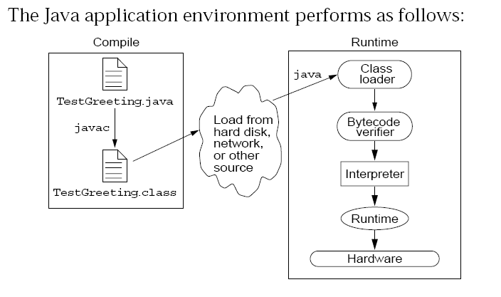
Java Runtime Environment

Slide 5
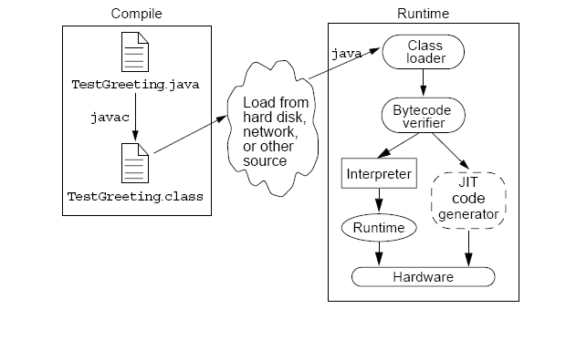
Just In Time compiler

Slide 6
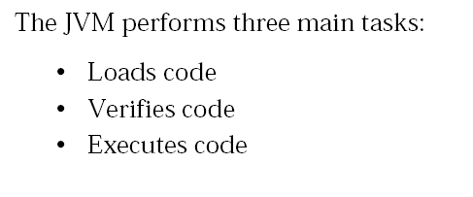
JVM tasks

Slide 7
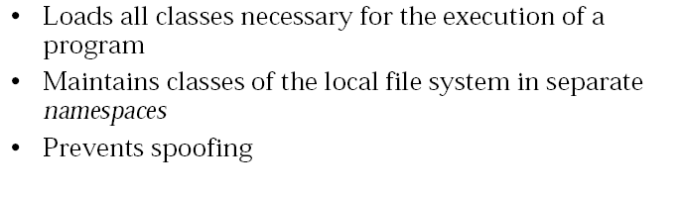
The Class Loader

Slide 8
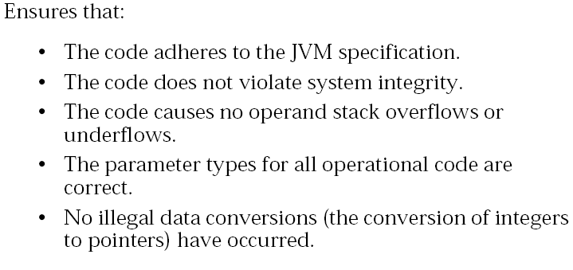
The Bytecode Verifier

Slide 9
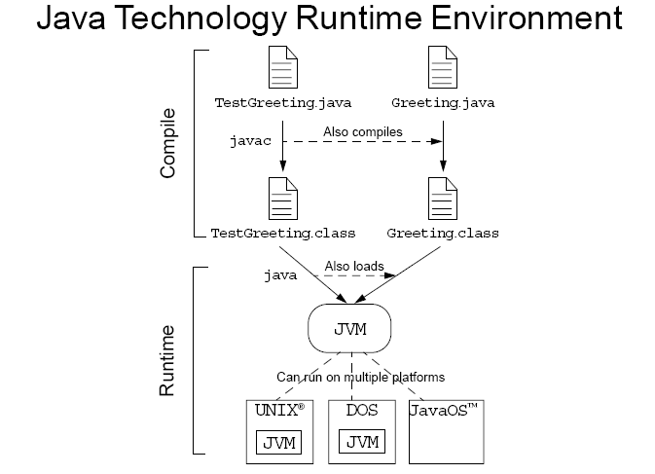
JRE

Slide 10
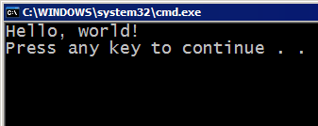
A basic Java program
public class Hello {
public static void main(String[] args) {
System.out.println("Hello, world!");
}
}
code or source code: The sequence of instructions in a program.
The code in this program instructs the computer to display a message of Hello, world! on the screen.
output: The messages printed to the user by a program.
console: The text box onto which output is printed.
Some editors pop up the console as an external window, and others contain their own console window.

Slide 11



Compiling/running a program
Before you run your programs, you must compile them.
compiler: Translates a computer program written in one language into another language.
Java Development Kit includes a Java compiler.
byte code: The Java compiler converts your source code into a format named byte code that can be executed on many different kinds of computers.
compile
execute
source code
Hello.java
byte code
Hello.class
output

Slide 12
Another Java program
public class Hello2 {
public static void main(String[] args) {
System.out.println("Hello, world!");
System.out.println();
System.out.println("This program produces");
System.out.println("four lines of output");
}
}
The code in this program instructs the computer to print four messages on the screen.
Its output:
Hello, world!
This program produces
four lines of output

Slide 13
Structure of Java programs
public class <name> {
public static void main(String[] args) {
<statement>;
<statement>;
...
<statement>;
}
}
Every executable Java program consists of a class
that contains a method named main
that contains the statements (commands) to be executed

Slide 14
System.out.println
System.out.println : A statement to instruct the computer to print a line of output on the console.
pronounced "print-linn"
sometimes called a "println statement" for short
Two ways to use System.out.println :
System.out.println("<Message>");
Prints the given message as a line of text on the console.
System.out.println();
Prints a blank line on the console.

Slide 15
Comments
comment: A note written in the source code by the programmer to make the code easier to understand.
Comments are not executed when your program runs.
Most Java editors show your comments with a special color.
Comment, general syntax:
/* <comment text; may span multiple lines> */
or,
// <comment text, on one line>
Examples:
/* A comment goes here. */
/* It can even span
multiple lines. */
// This is a one-line comment.

Slide 16
Using comments
Where to place comments:
at the top of each file (also called a "comment header"), naming the author and explaining what the program does
at the start of every method, describing its behavior
inside methods, to explain complex pieces of code (more useful later)
Comments provide important documentation.
Later programs will span hundreds of lines with many methods.
Comments provide a simple description of what each class, method, etc. is doing.
When multiple programmers work together, comments help one programmer understand the other's code.

Slide 17
Comments example
/* Suzy Student
CS 101, Fall 2019
This program prints lyrics from my favorite song! */
public class MyFavoriteSong {
/* Runs the overall program to print the song
on the console. */
public static void main(String[] args) {
sing();
// Separate the two verses with a blank line
System.out.println();
sing();
}
// Displays the first verse of the theme song.
public static void sing() {
System.out.println("Now this is the story all about how");
System.out.println("My life got flipped turned upside-down");
}
}

Slide 18
How to comment: methods
Do not describe the syntax/statements in detail.
Instead, provide a short English description of the observed behavior when the method is run.
Example:
// This method prints the lyrics to the first verse
// of my favorite TV theme song.
// Blank lines separate the parts of the verse.
public static void verse1() {
System.out.println("Now this is the story all about how");
System.out.println("My life got flipped turned upside-down");
System.out.println();
System.out.println("And I'd like to take a minute,");
System.out.println("just sit right there");
System.out.println("I'll tell you how I became the prince");
System.out.println("of a town called Bel-Air");
}

