Slide 1

Data Types, Literals, Operators
Sisoft Technologies Pvt Ltd
SRC E7, Shipra Riviera Bazar, Gyan Khand-3, Indirapuram, Ghaziabad
Website: www.sisoft.in Email:info@sisoft.in
Phone: +91-9999-283-283

Slide 2
Java Data Types

Slide 3
Java Data Types
There are two data types available in Java:
Primitive Data Types
Reference/Object Data Types
1. Primitive Data Types:
There are eight primitive data types supported by Java. Primitive data types are predefined by the language and named by a key word

Slide 4
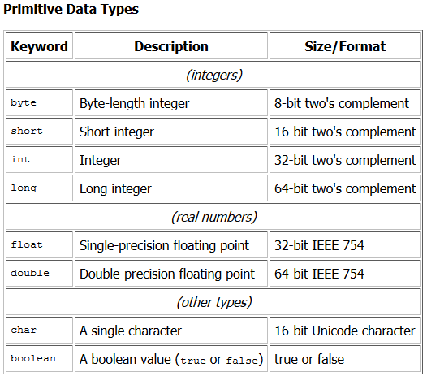
Primitive Data Types

Slide 5
Reference Data Types
Reference variables are created using defined constructors of the classes. They are used to access objects. These variables are declared to be of a specific type that cannot be changed. For example, Employee, Puppy etc.
Class objects, and various type of array variables come under reference data type.
Default value of any reference variable is null.
A reference variable can be used to refer to any object of the declared type or any compatible type.
Example :
Animal animal = new Animal("giraffe");

Slide 6
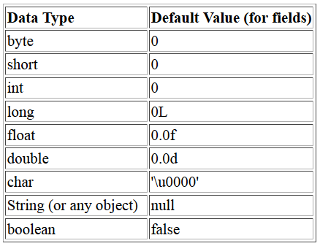
Data Types: Default Values
Rule :- Every data types in java got default value

Slide 7
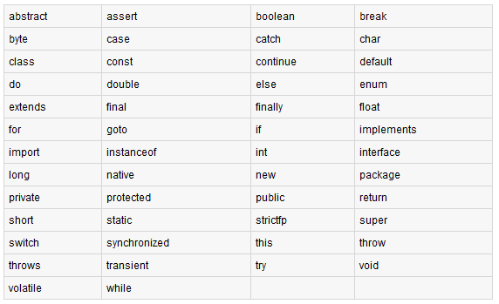
Java Keywords

Slide 8
Legal and Illegal Identifiers
The identifiers are the names of the variables, methods, classes, packages and interfaces.
The identifiers must be composed of the letters, numbers, the underscore _ and the dollar sign $.
The identifiers may only begin with the letter, underscore or dollar sign.
The following are legal variable names:
MyVariable, myvariable , MYVARIABLE, x, I, _myvariable , $myvariable , _9pins, andros
The following are not the legal variable names
My Space // Contains a space
9pin6s // Begins with a digit
k+h // The plus sign is not an alphanumeric character testing
61-72-83 // The hyphen is not an alphanumeric character
O'Reilly_this'my // Apostrophe is not an alphanumeric character
OReilly_&_Associates // ampersand is not an alphanumeric character>

Slide 9
Literals
A constant value in a program is denoted by a literal. Literals represent numerical (integer or floating-point), character, boolean or string values. Example of literals: Integer literals: 33 0 -9 Floating-point literals: .3 0.3 3.14 Character literals: '(' 'R' 'r' '{' Boolean literals:(predefined values) true false String literals: "language" "0.2" "r" ""

Slide 10
Integer Literals
Any whole number value is an integer literal.
Octal values are denoted in Java by a leading zero. Eg 056
A hexadecimal constant with a leading zerox,
(0x or 0X)
To specify integer literals using binary, prefix the value with 0b or 0B eg x = 0b1010 (JDK7.0 +)
To specify a long literal, it must be appended with an upper- or lowercase L to the literal
Underscores can only be used to separate digits. int x = 123___456___789 (JDK7.0 +)

Slide 11
Floating Literals
Can be represented in standard or scientific notation
Standard eg 2.0, 3.145
Scientific eg 6.022E23
Floating-point literals in Java default to double precision
To specify a float literal, append an F or f to the constant.
To specify a double literal, append a D or d to the constant

Slide 12
Boolean, Character and String
Boolean
Only two values (true and false)
Character
A character is quoted in single quote (')
String
A string literal is a sequence of characters which has to be double-quoted (") and occur on a single line

Slide 13
Variables
Variable: A piece of your computer's memory that is given a name and type and can store a value.
Usage:
compute an expression's result
store that result into a variable
use that variable later in the program
Unlike a calculator, which may only have enough to store a few values, we can declare as many variables as we want.

Slide 14
Declaring variables
Variable declaration statement: A Java statement that creates a new variable of a given type.
A variable is declared by writing a statement that says its type, and then its name.
Variables must be declared before they can be used.
Declaration statement syntax:
<type> <name> ;
The <name> can be any identifier.
Examples: int x; double myGPA;

Slide 15
More on declaring variables
Declaring a variable sets aside a piece of memory in which you can store a value.
int x;
int y;
Part of the compute
x y
(The memory has no values in it yet.)
Notes:
It doesn't matter where in memory the variable goes, nor how much memory is used. Java takes care of that for us.

Slide 16
Java Basic Operators :
Java provides a rich set of operators to manipulate variables.
We can divide Java operators into the following
groups:
Arithmetic Operators
Relational Operators
Bitwise Operators
Logical Operators
Assignment Operators
Misc Operators
operator
operand
a + b
operand

Slide 17
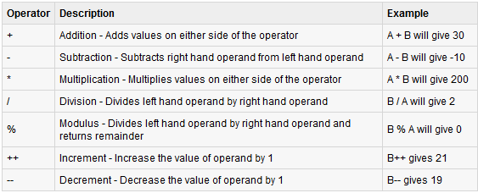
The Arithmetic Operators:
Arithmetic operators are used in mathematical expressions in the same way that they are used in algebra. The following table lists the arithmetic operators:
Assume integer variable A holds 10 and variable B holds 20 then:

Slide 18
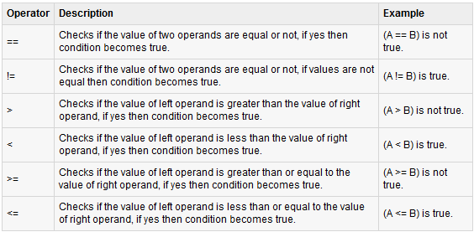
The Relational Operators:
There are following relational operators supported by Java language
Assume variable A holds 10 and variable B holds 20 then:

Slide 19
The Bitwise Operators:
Java defines several bitwise operators which can be applied to the integer types, long, int, short, char, and byte.
Bitwise operator works on bits and perform bit by bit operation. Assume if a = 60; and b = 13; Now in binary format they will be as follows:
a = 0011 1100
b = 0000 1101
-----------------
a&b = 0000 1100
a|b = 0011 1101
a^b = 0011 0001
~a = 1100 0011

Slide 20
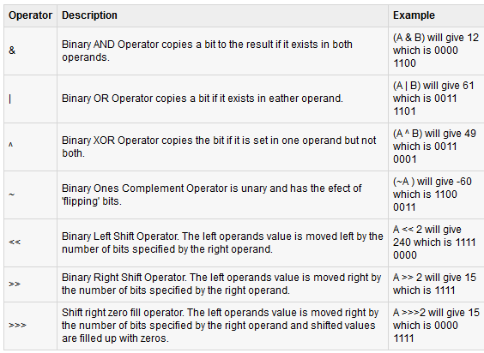
The Bitwise Operators:

Slide 21
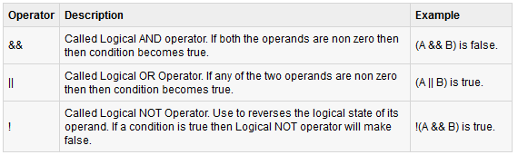
The Logical Operators:
The following table lists the logical operators:
Assume boolean variables A holds true and variable B holds false then:

Slide 22
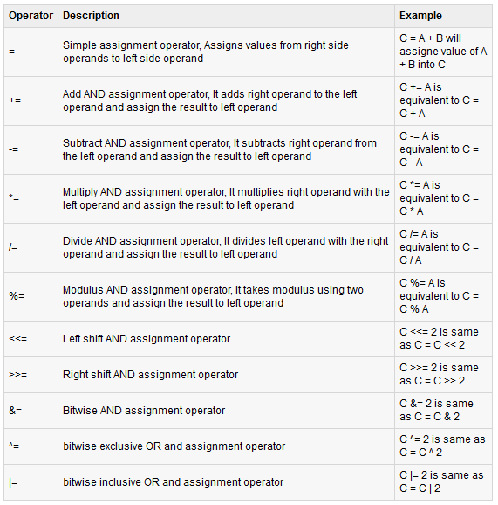
The
Assignment Operators:
There are following assignment operators supported
by Java
language:

Slide 23
Misc Operators
There are few other operators supported by Java Language.
Conditional Operator ( ? : ):
Conditional operator is also known as the ternary operator. This operator consists of three operands and is used to evaluate boolean expressions. The goal of the operator is to decide which value should be assigned to the variable. The operator is written as :
variable x = (expression) ? Value if true : value if false

Slide 24
Following is the example:
This would produce following result:
public class Test
{
public static void main(String args[])
{
int a , b; a = 10; b = (a == 1) ? 20: 30;
System.out.println( "Value of b is : " + b );
b = (a == 10) ? 20: 30;
System.out.println( "Value of b is : " + b );
} }
Value of b is : 30
Value of b is : 20

Slide 25
Instance Of Operator:
This operator is used only for object reference variables. The operator checks whether the object is of a particular type(class type or interface type). instanceOf operator is wriiten as:
( Object reference variable ) instanceOf (class/interface type)
If the object referred by the variable on the left side of the operator passes the IS-A check for the class/interface type on the right side then the result will be true.

Slide 26
Type Casting

Slide 27
Type casting
Conversion of one data type into another data type is called type casting
int m=10; int m=10;
int f=3; int f=3;
int r=m/f; float r=float m/f;

Slide 28
Types
Implicit type casting
Byte b=10;
Int c=b;
Explicit type casting
int x=10;
Byte b=(byte)x;

