Slide 1

Concurrency - Threads
Sisoft Technologies Pvt Ltd
SRC E7, Shipra Riviera Bazar, Gyan Khand-3, Indirapuram, Ghaziabad
Website: www.sisoft.in Email:info@sisoft.in
Phone: +91-9999-283-283

Slide 2
What is a Thread?
Individual and separate unit of execution that is part of a process
  multiple threads can work together to accomplish a common goal
Video Game example
  one thread for graphics
  one thread for user interaction
  one thread for networking

Slide 3
What is a Thread?
Video Game
Process
video
networking
interaction

Slide 4
Advantages
easier to program
  1 thread per task
can provide better performance
  thread only runs when needed
  no polling to decide what to do
multiple threads can share resources
utilize multiple processors if available

Slide 5
Disadvantage
multiple threads can lead to deadlock
  much more on this later
overhead of switching between threads

Slide 6
Creating Threads (method 1)
extending the Thread class
  must implement the run() method
  thread ends when run() method finishes
  call .start() to get the thread ready to run

Slide 7
Creating Threads (method 2)
Create thread by implementing Runnable interface:
  The simplest way to make a thread is to make a class that implements the runnable interface.
  To implement the runnable, a class require only implement a single method called 'run( )', which is declared as following : public void run( )
  After you make a class that implements 'Runnable', you will instantiate an Object of type 'Thread' from within that class. The thread defines various constructors. The one that we shall use is representing here: Thread(Runnable threadObj, String threadname);
  After the new thread is made, it will not start running until you call it 'start( )' method, which is declared within the Thread. The 'start( )' method is representing here: void start( );

Slide 8
Advantage of Using Runnable
remember - can only extend one class
implementing runnable allows class to extend something else

Slide 9
Threads Class Reference
currentThread(): Returns reference to the currently running thread
_.getName(): returns the Thread Name
_.setName(): set the Thread Name
getPriority()
setPriority()
getState()

Slide 10
Controlling Java Threads
_.start(): begins a thread running
wait() and notify(): for synchronization
  more on this later
_.stop(): kills a specific thread (deprecated)
_.suspend() and resume(): deprecated
_.join(): wait for specific thread to finish
_.setPriority(): 0 to 10 (MIN_PRIORITY to MAX_PRIORITY); 5 is default (NORM_PRIORITY)

Slide 11
Java Thread Scheduling
highest priority thread runs
  if more than one, arbitrary
yield(): current thread gives up processor so another of equal priority can run
  if none of equal priority, it runs again
sleep(msec): stop executing for set time
  lower priority thread can run

Slide 12
States of Java Threads
  new: just created but not started
  runnable: created, started, and able to run
  blocked: created and started but unable to run because it is waiting to acquire lock
  timed_waiting: waiting to complete sleep
  waiting: waiting for some action to finish
  terminated: thread has finished or been stopped

Slide 13
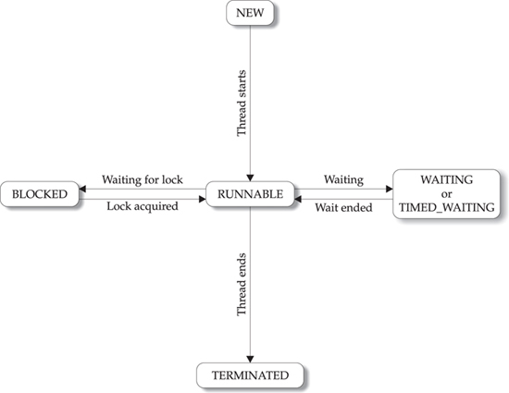
States of Java Threads

Slide 14
Java Thread Example 1
class Job implements Runnable {
private static Thread [] jobs = new Thread[4];
private int threadID;
public Job(int ID) {
threadID = ID;
}
public void run() { do something }
public static void main(String [] args) {
for(int i=0; i<jobs.length; i++) {
jobs[i] = new Thread(new Job(i));
jobs[i].start();
}
try {
for(int i=0; i<jobs.length; i++) {
jobs[i].join();
}
} catch(InterruptedException e) { System.out.println(e); }
}
}

Slide 15
Java Thread Example 2
class Schedule implements Runnable {
private static Thread [] jobs = new Thread[4];
private int threadID;
public Schedule(int ID) {
threadID = ID;
}
public void run() { do something }
public static void main(String [] args) {
int nextThread = 0;
setPriority(Thread.MAX_PRIORITY);
for(int i=0; i<jobs.length; i++) {
jobs[i] = new Thread(new Job(i));
jobs[i].setPriority(Thread.MIN_PRIORITY);
jobs[i].start();
}
try {
for(;;) {
jobs[nextThread].setPriority(Thread.NORM_PRIORITY);
Thread.sleep(1000);
jobs[nextThread].setPriority(Thread.MIN_PRIORITY);
nextThread = (nextThread + 1) % jobs.length;
}
} catch(InterruptedException e) { System.out.println(e); }
}
}

Slide 16
Thread Synchronization
When two or more threads require access to the shared resource, they require some way to ensure that the resource will be used by one thread at a time.
A process by which this synchronization is obtained is called the thread synchronization.
The 'synchronized' keyword in Java makes a block of code referred to as the critical section. Each Java object with the critical section of code gets a lock associated with the object. To enter the critical section, a thread requires to obtain the corresponding object's lock.
This is the general form of the 'synchronized' statement:
    synchronized(object) {
    // Statements to be synchronized
    }
Here, Object is a reference to the object being 'synchronized'. A 'synchronized' block ensures that the call to a method that is a member of object happens only after the current thread has successfully entered monitor of object.

Slide 17
Executors
Objects that encapsulate thread management and creation from the rest of the application are known as executors .
The java.util.concurrent package defines three executor interfaces:
  Executor, a simple interface that supports launching new tasks.
  ExecutorService, a subinterface of Executor, which adds features that help manage the lifecycle, both of the individual tasks and of the executor itself.
  ScheduledExecutorService, a subinterface of ExecutorService, supports future and/or periodic execution of tasks.

