Slide 1

Internationalization and Localization
with Java...

Slide 2
Introduction
  Internationalization (i18n) is the process of designing an application so that it can be adapted to different languages and regions, without requiring engineering changes.
  Localization (l10n) is the process of adapting software for a specific region or language by adding locale-specific components and translating text.

Slide 3
Organization of Presentation
What is i18n?
Java example of messages
What is a “locale”?
Formatting data in messages
Translation issues
Date/Time/Currency/etc
Unicode and support in Java
Iteration through text

Slide 4
Why is i18n important?
Build once, sell anywhere…
Modularity demands it!
  Ease of translation
“With the addition of localization data, the same executable can be run worldwide.”
$$$

Slide 5
Characteristics of i18n...
    Textual elements such as status messages and the GUI component labels are not hardcoded in the program. Instead, they are stored outside the source code and retrieved dynamically.
    Support for new languages does not require recompilation.
    Other culturally-dependent data, such as dates and currencies, appear in formats that conform to the end-user's region and language.

Slide 6
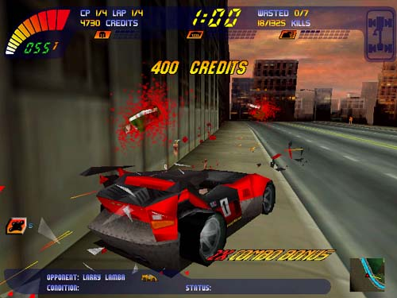
Really why…
Carmaggedon

Slide 7
The rest is Java… why?
Java:
  is readable!
  has most complete built-in i18n support.
  easily illustrates correct implementation of many i18n concepts.
  concepts can be extended to any language.
For more info see:
    www.coolest.com/i18n
    java.sun.com/docs/books/tutorial/i18n

Slide 8
Java Example: Messages...
Before:
System.out.println("Hello.");
System.out.println("How are you?");
System.out.println("Goodbye.");

Slide 9
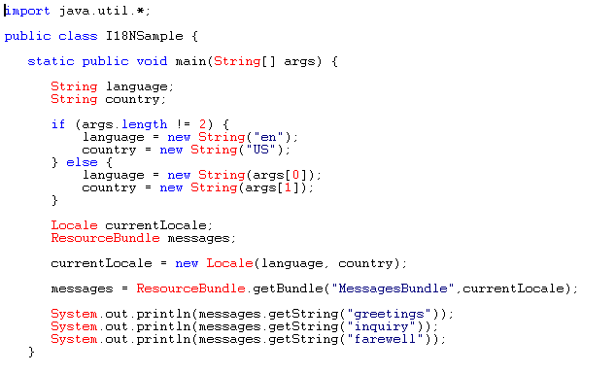

Too much code!
AAAHHHHhhh....
After:

Slide 10
Sample Run…
% java I18NSample fr FR
Bonjour.
Comment allez-vous?
Au revoir.
% java I18NSample en US
Hello.
How are you?
Goodbye.

Slide 11
1. So What Just Happened?
Created MessagesBundle_fr_FR.properties, which contains these lines:
    (What the translator deals with.)
In the English one?
  greetings = Bonjour.
  farewell = Au revoir.
  inquiry = Comment allez-vous?

Slide 12
2. Define the locale...
Look!

Slide 13
3. Create a ResourceBundle...
Look!

Slide 14
4. Get the Text from the
ResourceBundle...
Look!

Slide 15
What is a “locale”?
    Locale objects are only identifiers.
    After defining a Locale, you pass it to other objects that perform useful tasks, such as formatting dates and numbers.
    These objects are called locale-sensitive, because their behavior varies according to Locale.
    A ResourceBundle is an example of a locale-sensitive object.

Slide 16
Did you get that?
currentLocale = new Locale(language, country);
message = ResourceBundle.getBundle("MessagesBundle",currentLocale);
“fr” “FR”
MessagesBundle_en_US.properties
MessagesBundle_fr_FR.properties
MessagesBundle_de_DE.properties
greetings = Bonjour.
farewell = Au revoir.
inquiry = Comment allez-vous?
message.getString(“inquiry”)

Slide 17
Got a program… need to…
Internationalize!
What do I have to change?
What’s easily translatable?
What’s NOT?
  “It said 5:00pm on that $5.00 watch on May 5th!”
  “There are 5 watches.”
Unicode characters.
Comparing strings.

Slide 18
What do I have to change?
Just a few things…
    messages
    labels on GUI components
    online help
    sounds
    colors
    graphics
    icons
    dates
    times
more...
    numbers
    currencies
    measurements
    phone numbers
    honorifics and personal titles
    postal addresses
    page layouts

Slide 19
What’s easily translatable? Isolate it!
Status messages
Error messages
Log file entries
GUI component labels
  BAD!
  GOOD!
Button okButton = new Button(“OK”);
String okLabel = ButtonLabel.getString("OkKey");
Button okButton = new Button(okLabel);

Slide 20
Numbers and Currencies!
What’s wrong with my numbers?
  We say:
  Germans say:
  French say:
345,987.246
345.987,246
345 987,246

Slide 21
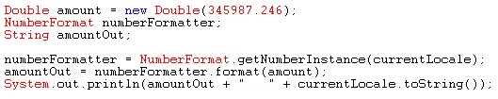
Numbers...
1 2 3 4 5 6...
Supported through NumberFormat!
        Shows what locales are available. Note, you can also create custom formats if needed.
Locale[] locales = NumberFormat.getAvailableLocales();
345 987,246 fr_FR
345.987,246 de_DE
345,987.246 en_US

Slide 22
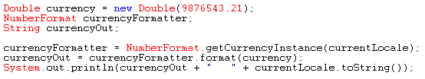
Money!
$99.95...
Supported with: NumberFormat.getCurrencyInstance!
9 876 543,21 F fr_FR
9.876.543,21 DM de_DE
$9,876,543.21 en_US

Slide 23

Percents?
100%...
Supported with: NumberFormat.getPercentInstance!

Slide 24
“A Date and Time…
to kill..."
Supported with:
  DateFormat.getDateInstance
  DateFormat.getTimeInstance
  DateFormat.getDateTimeInstance
DateFormat dateFormatter =
DateFormat.getDateInstance(DateFormat.DEFAULT, currentLocale);
DateFormat timeFormatter =
DateFormat.getTimeInstance(DateFormat.DEFAULT, currentLocale);
DateFormat dateTimeFormatter = DateFormat.getDateTimeInstance(
DateFormat.LONG, DateFormat.LONG, currentLocale);

Slide 25
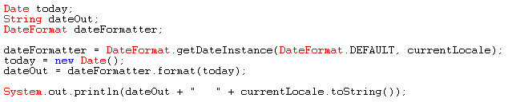
Date example...
8/5/77...
Supported with: DateFormat.getDateInstance!
9 avr 98 fr_FR
9.4.1998 de_DE
09-Apr-98 en_US

Slide 26


Slide 27
What’s NOT (easily translatable)?
“At 1:15 PM on April 13, 1998, we attack the 7 ships on Mars.”
MessageBundle_en_US.properties
template = At {2,time,short} on {2,date,long}, we attack \
the {1,number,integer} ships on planet {0}.
planet = Mars
The time portion of a Date object. The "short" style specifies the DateFormat.SHORT formatting style.
A Number object, further qualified with the "integer" number style.
The date portion of a Date object. The same Date object is used for both the date and time variables. In the Object array of arguments the index of the element holding the Date object is 2.
The String in the ResourceBundle that corresponds to the "planet" key.

Slide 28
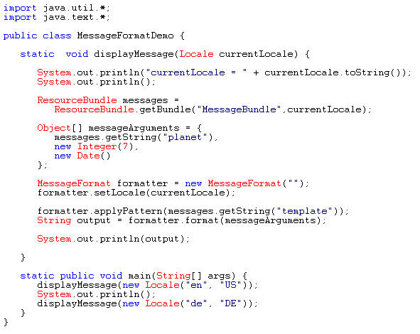
What’s NOT =
“Compound Messages”
Example!

Slide 29
1. Compound Messages: messageArguments...
Set the message arguments…
Remember the numbers in the template refer to the index in messageArguments!

Slide 30
2. Compound Messages: create formatter...
Don’t forget setting the Locale of the formatter object...

Slide 31
3. Compound Messages:
Format it!
Get the template we defined earlier…
Then pass in our arguments!
And finally RUN...

Slide 32
Sample Run…
currentLocale = en_US
At 1:15 PM on April 13, 1998, we attack the 7 ships on the
planet Mars.
currentLocale = de_DE
Um 13.15 Uhr am 13. April 1998 haben wir 7 Raumschiffe auf dem
Planeten Mars entdeckt.
(Note: I modified the example and don’t speak German so couldn’t translate my changes so the German does not match.)

Slide 33
What’s NOT (easily translatable)?
Take 2...
Answer = Plurals!
There are no files on XDisk.
There is one file on XDisk.
There are 2 files on XDisk.
Also variable...
3 possibilities for output templates.
Possible integer value in one of the templates.

Slide 34
Plurals(s)’ses!?!
ChoiceBundle_en_US.properties
pattern = There {0} on {1}.
noFiles = are no files
oneFile = is one file
multipleFiles = are {2} files
noFiles = are no files
oneFile = is one file
multipleFiles = are {2} files
There are 2 files on XDisk.

Slide 35
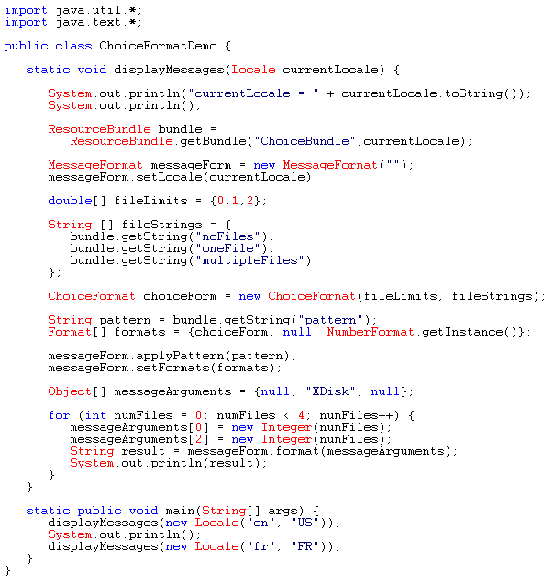
Plurals!
What’s different?
Now we even index our templates… see fileStrings, indexed with fileLimits.
First create the array of templates.

Slide 36
How =
ChoiceFormat
Not just a pattern...
Now we have formats too...

Slide 37
And...
setFormats
Before we just called format directly after applyPattern...
Now we have setFormats too.
This is required to give us another layer of depth to our translation.

Slide 38
Sample Run…
currentLocale = en_US
There are no files on XDisk.
There is one file on XDisk.
There are 2 files on XDisk.
There are 3 files on XDisk.
currentLocale = fr_FR
Il n' y a pas des fichiers sur XDisk.
Il y a un fichier sur XDisk.
Il y a 2 fichiers sur XDisk.
Il y a 3 fichiers sur XDisk.

Slide 39
Characters...
UNICODE
16 bit!
65,536 characters
Encodes all major languages
In Java Char is a Unicode character
See unicode.org/
Future Use
Greek
Kana
Internal
ASCII
Symbols
0x0000
0xFFFF
etc...

Slide 40
Java support for the Unicode Char...
Character API:
      isDigit
      isLetter
      isLetterOrDigit
      isLowerCase
      isUpperCase
      isSpaceChar
      isDefined
Unicode Char values accessed with:
String eWithCircumflex = new String("\u00EA");

Slide 41
Java support for the Unicode Char...
Example of some repair…
  BAD!
  GOOD!
if ((ch >= 'a' && ch <= 'z') || (ch >= 'A' && ch <= 'Z'))
// ch is a letter
if (Character.isLetter(ch))
// ch is a letter

Slide 42

Java support for the Unicode Char...
getType
Get the Unicode category for a Char:
      LOWERCASE_LETTER
      UPPERCASE_LETTER
      MATH_SYMBOL
      CONNECTOR_PUNCTUATION
      etc...
if (Character.getType('_') == Character.CONNECTOR_PUNCTUATION)
// ch is a “connector”

Slide 43
Comparing Strings
in Java
Called “string collation”
Collation rules provided by the Collator class
Rules vary based on Locale
Note:
  can customize rules with RuleBasedCollator
  can optimize collation time with CollationKey
Strings of the world unite!

Slide 44
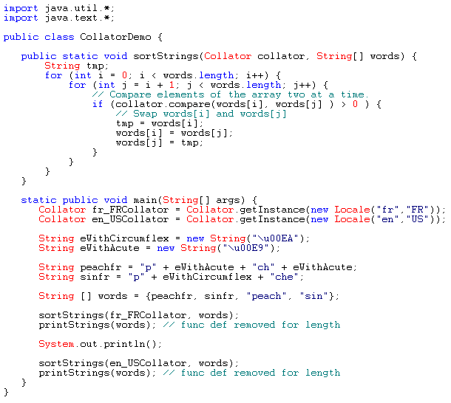
Collator!
As always make a new class...
Note the Unicode char definitions.
Finally note the use of the collator.compare

Slide 45
Sample Run!
    The English Collator returns:
    According to the collation rules of the French language, the preceding list is in the wrong order. In French, "pêche” should follow "péché" in a sorted list. The French Collator thus returns:
peach
pêche
péché
sin
peach
péché
pêche
sin

Slide 46

Detecting Text Boundaries
Important for?
      Word processing functions such as selecting, cutting, pasting text… etc. (double-click and select)
BreakIterator class (imaginary cursor)
  Character boundaries getCharacterInstance
  Word boundaries getWordInstance
  Sentence boundaries getSentenceInstance
  Line boundaries getLineInstance
Beware!!! The END of the word is coming!

Slide 47
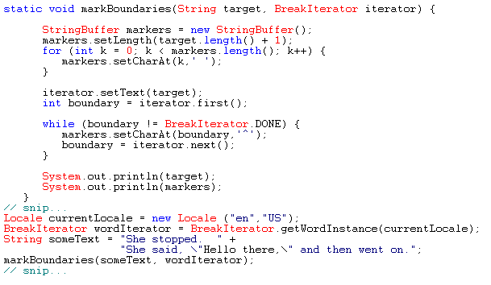
BreakIterator:
getWordInstance
First we create our wordIterator.
Then attach the iterator to the target text.
Loop through the text finding boundaries and set them to carrets in our footer string.
She stopped. She said, "Hello there," and then went on.
^ ^^ ^^ ^ ^^ ^^^^ ^^ ^^^^ ^^ ^^ ^^ ^

Slide 48

BreakIterator:
getCharacterInstance
You see this
Although this word contains three user characters, it is composed by six Unicode characters:
Really only 3 user characters…
(Imagine the characters masked on top of each other…)
I only speak English...
=
Arabic for “house”
String house = "\u0628" + "\u064e" + "\u064a" +
"\u0652" + "\u067a" + "\u064f";

Slide 49
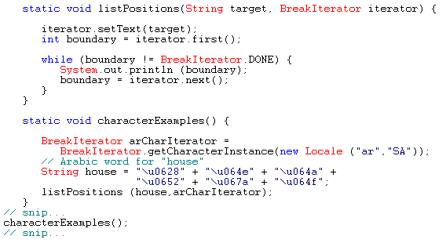
BreakIterator:
getCharacterInstance
First note creating the Arabic/Saudi Arabia Locale.
Then notice our 6 Unicode char of text.
Looping through the text finding boundaries yields only 3 breaks after the beginning.
0
2
4
6

Slide 50
BreakIterator:
getSentenceInstance
It works with:
Problems with:
Please add 1.5 liters to the tank! “It’s up to us.”
^ ^ ^
"No man is an island . . . every man . . . "
^ ^ ^ ^ ^ ^^
My friend, Mr. Jones, has a new dog. The dog's name is Spot.
^ ^ ^ ^

Slide 51
BreakIterator:
getLineInstance
Returns places where you can split a line (good for word wrapping):
According to a BreakIterator, a line boundary occurs after the end of a sequence of whitespace characters (space, tab, newline).
She stopped. She said, "Hello there," and then went on.
^ ^ ^ ^ ^ ^ ^ ^ ^ ^ ^

Slide 52
BreakIterator:
Unicode Conversion
Java provides:
InputStreamReader
OutputStreamWriter
Non-Unicode
Unicode chars
Unicode chars
Non-Unicode
FileInputStream fis = new FileInputStream("test.txt");
InputStreamReader defaultReader = new InputStreamReader(fis);
String defaultEncoding = defaultReader.getEncoding();
FileOutputStream fos = new FileOutputStream("test.NEW");
Writer out = new OutputStreamWriter(fos, "UTF8");
Output encoding format

Slide 53

THE END.
www.coolest.com/i18n
For more info on i18n and:
  W3C and i18n
    The future of HTTP, HTML, XML, CSS2…
  GUIs
  The OTHER character sets…
    Scary stuff… those ISO standards
  UNIX/clones
    C programming for i18n
    X/Open I18N Model
Go forth and internationalize...

