Slide 1
Reflection
CMSC 432

Slide 2
Issues
What is reflection
History of reflection
How to use reflection
Myths about reflection
Advanced reflection issues
Improvements to reflection
Conclusion

Slide 3
What Is Reflection
Java™ Technology provides two ways
to discover information about an object
at runtime
  Traditional runtime class identification
    The object’s class is available at compile
    and runtime
    Most commonly used
  Reflection
    The object’s class may not be available
    at compile or runtime

Slide 4
What Is Reflection
“Reflection in a programming language context refers to the ability to observe and/or manipulate the inner workings of the environment programmatically.”¹
“The reflection API represents, or reflects, the classes, interfaces, and objects in the current Java™ virtual machine.”²
Not the only definition
  Introspection
  Intercession
1. J. R. Jackson, A. L. McClellan, Java™ 1.2 By Example, Sun Microsystems, 1999.
2. M. Campione, et al, The Java™ Tutorial Continued, Addison Wesley, 1999.

Slide 5
The History of Reflection
Introduced in JDK™ 1.1 release to support the JavaBeans™ specification
Used throughout the JDK™ software and Java runtime environment (JRE)
  Java™ Foundation Classes API (JFC)
  Jini™ connection technology
  JavaMail™ API
  JDBC™ API
Improved in Java 1.2 SDK
Further refined in Java 1.3 SDK

Slide 6
Why Runtime Class Identification
Java™ technology takes advantage
of polymorphism
  New subclasses easily added
  Bulk of behaviors inherited from
  its superclass
  No impact on other subclasses of
  the superclass
  At runtime, the JVM™ takes advantage
  of late dynamic binding
  Messages are directed to the
  correct method

Slide 7
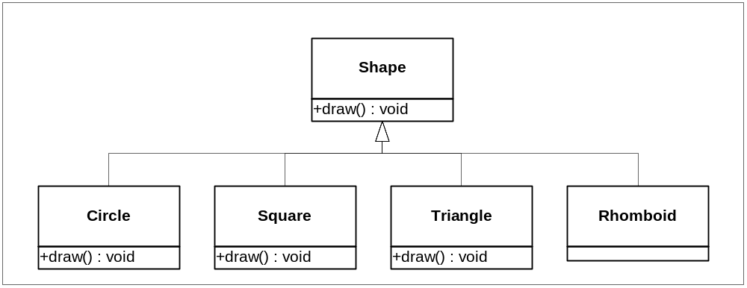
Example UML

Slide 8
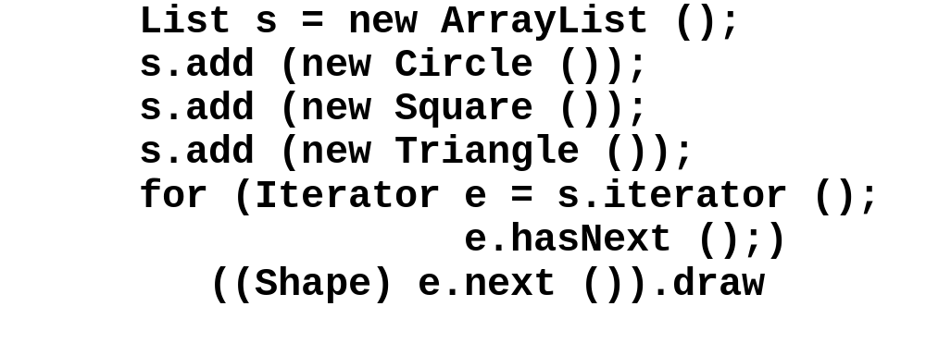
Runtime Class Identification Example Code
Class loading occurs at first instantiation
When the object is retrieved from the list, it is cast to the superclass, Shape
The object remembers its class and responds with the correct draw method

Slide 9
How the Class Object Works
Every class loaded into the JVM™ has a Class object
  Corresponds to a .class file
  The ClassLoader is responsible for finding and loading the class into the JVM™
At object instantiation…
  The JVM™ checks to see if the class is already loaded into the virtual machine
  Locates and loads the class if necessary
  Once loaded, the JVM™ uses the loaded
  class to instantiate an instance

Slide 10
Late Dynamic Binding
The JRE does not require that all classes are loaded prior to execution
  Different from most other environments
Class loading occurs when the class is first referenced
Late Dynamic Binding is…
  Important for polymorphism
    Message propagation is dictated at runtime
    Messages are directed to the correct method
  Essential for reflection to be possible

Slide 11
Class Literals
Using Class Literals is the second way to reference an object’s class
  Added in the JDK™ 1.1 release
All classes, interfaces, arrays, and primitive types have class literals
Primitive types have corresponding wrapper classes
Examples:
    Triangle.CLASS
    int.TYPE

Slide 12
The instanceof Keyword
The instanceof keyword is the third way to reference an object’s class
Used with both classes and interfaces
Returns true if the object is a species of a
specified class
  Subclasses will also answer true
  Code becomes structurally bound to the class hierarchy
Several limitations on the referenced class
  Must be a named class or interface
  The class constant cannot be the Class class
Example:
  if (x instanceof Circle)
    ((Circle) x).setRadius (10);

Slide 13
The Reflection API
The reflection API is the fourth way to reference an object’s class
Reflection allows programs to interrogate and manipulate objects at runtime
The reflected class may be…
  Unknown at compile time
  Dynamically loaded at runtime

Slide 14
Reflection (Introspection) in Java
If permitted by security policy, the Java Reflection API can be used to:
  Construct new class instances and arrays
  Access and modify fields (attributes) of objects and classes
  Invoke methods on objects and classes
  Access and modify elements of arrays

Slide 15
Reflection (Introspection) in Java
The Java Reflection API consists of:
  The class java.lang.Class
  The interface java.lang.reflect.Member
  The class java.lang.reflect.Field
  The class java.lang.reflect.Method
  The class java.lang.reflect.Constructor
  The class java.lang.reflect.Array
  The class java.lang.reflect.Modifier
  The class java.lang.reflect. AccessibleObject.

Slide 16
import java.lang.reflect.Field;
public class Test6 {
public static void main(String args[])
throws Exception {
final Field fields[] =
FieldTest.class.getDeclaredFields();
for (int i = 0; i < fields.length; ++i) {
if ("privateString".equals(fields[i].getName())) {
fields[i].setAccessible(true);
System.out.println(
fields[i].get(new FieldTest()));
break;
}
}
}
}

Slide 17
Reflection Applications (Java)
Applications getting run-time information about objects, use:
  getField[s]
  getMethod[s]
  getConstructor[s]
Applications getting compile-time information about objects (at the level provided by .class files), use:
  getDeclaredField[s]
  getDeclaredMethod[s]
  getDeclaredConstructor[s]

Slide 18
Using Reflection
Reflection allows programs to interrogate an object at runtime without knowing the object’s class
How can this be…
  Connecting to a JavaBean™ technology- based component
  Object is not local
    RMI or serialized object
  Object dynamically injected

Slide 19
What Can I Do With Reflection
Literally everything that you can do if you know the object’s class
  Load a class
  Determine if it is a class or interface
  Determine its superclass and implemented interfaces
  Instantiate a new instance of a class
  Determine class and instance methods
  Invoke class and instance methods
  Determine and possibly manipulate fields
  Determine the modifiers for fields, methods, classes,
  and interfaces
  Etc.

Slide 20
Advanced Reflection Issues
Why use reflection
Using reflection with object-oriented design patterns
Common problems solved using reflection
  Misuse of switch/case statements
  User interface listeners

Slide 21
Why Use Reflection
Reflection solves problems within
object-oriented design:
  Flexibility
  Extensibility
  Pluggability
Reflection solves problems
caused by…
  The static nature of the class hierarchy
  The complexities of strong typing

Slide 22
Use Reflection With Design Patterns
Design patterns can benefit
from reflection
Reflection can …
  Further decouple objects
  Simplify and reduce maintenance

Slide 23
Design Patterns and Reflection
Many of the object- oriented design patterns can benefit from reflection
Reflection extends
the decoupling of objects that design patterns offer
Can significantly simplify design patterns
Factory
Factory Method
State
Command
Observer
Others

Slide 24
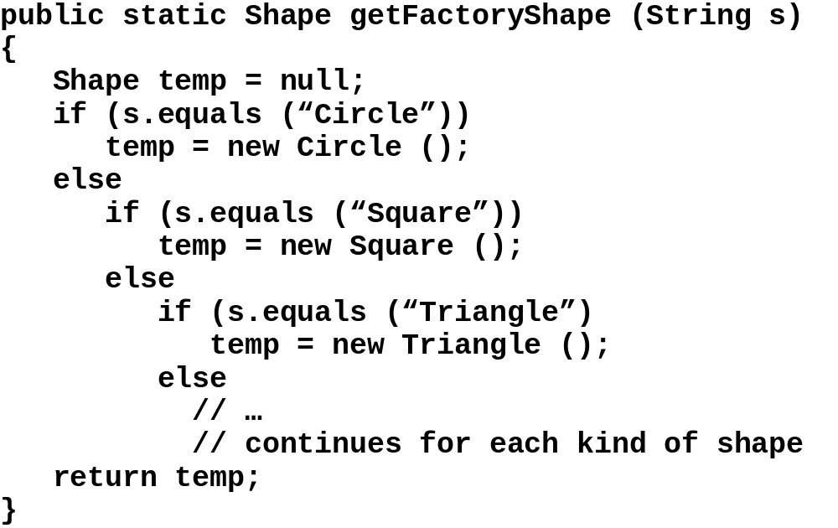
Factory Without Reflection

Slide 25
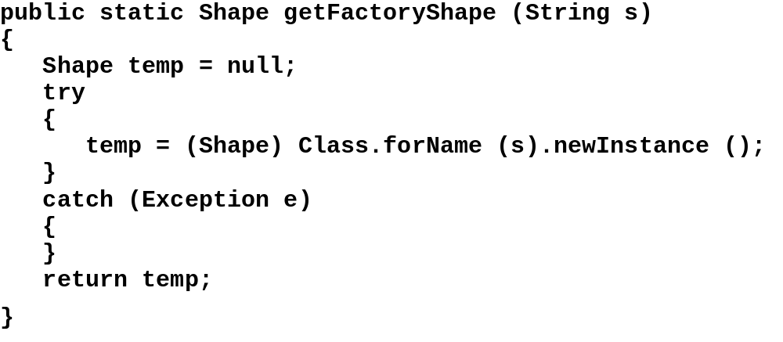
Factory With Reflection

Slide 26
Design Pattern Implications
Product classes can be added, changed, or deleted without affecting the factory
  Faster development (one factory fits all)
  Reduced maintenance
  Less code to develop, test, and debug

Slide 27
Design Strategies for Using Reflection
Challenge switch/case and cascading
if statements
  Rationale
    The switch statement should scream “redesign me” to the developer
    In most cases, switch statements perform pseudo subclass operations
  Steps
    Redesign using an appropriate class decomposition
    Eliminate the switch/case statement
    Consider a design pattern approach
  Benefits
    High level of object decoupling
    Reduced level of maintenance

Slide 28
Challenge UI Listeners
Can a generalized listener function for several components or does each component need a unique listener?
  Consider using the Command design pattern
  Steps
    Use the setActionCommand method to set the method to reflect upon for each component
    Instantiate only one instant of the listener
  Benefits
    Smaller program memory footprint
    Faster performance due to less class loading
    Behavior placed in the appropriate place

Slide 29
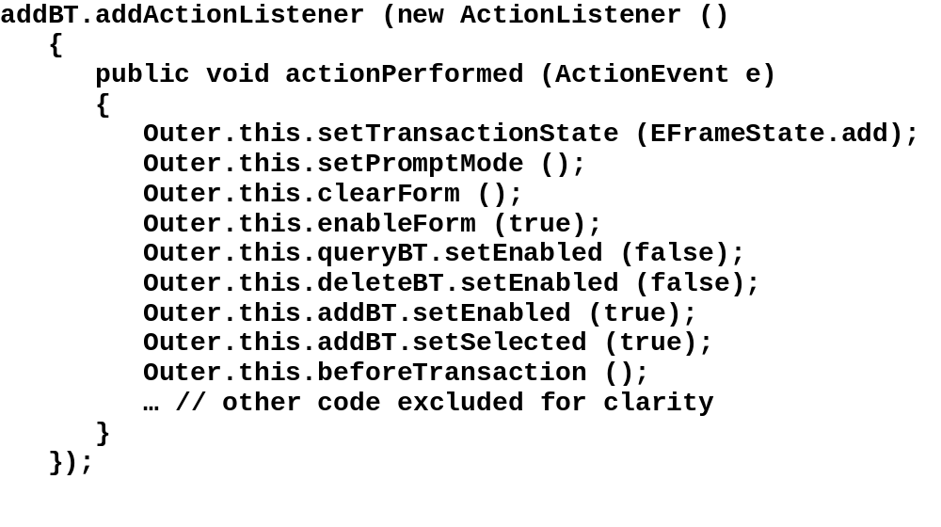
Listener Without Reflection

Slide 30
Listener With Reflection
protected ActionListener actionAdapter = new ActionListener ()
{
final static Class[] emptyClass = new Class[] {};
final static Object[] emptyObject = new Object[] {};
public void actionPerformed (ActionEvent e)
{
try
{
Outer.this.getClass ().getMethod (e.getActionCommand (),
emptyClass).invoke (Outher.this, emptyObject);
// alternatively
// Outer.class.getMethod (e.getActionCommand (),
// emptyClass).i
nvoke (Outer.this, emptyObject);
}
catch (Exception ee)
{
}
}
};

Slide 31
Capabilities Not Available Using Java Reflection
What are a class’ subclasses?
  Not possible due to dynamic
  class loading
What method is currently executing
  Not the purpose of reflection
  Other APIs provide this capability

Slide 32
Review
Solves several design issues
  Simplifies the static complexity of methods by providing elimination of…
    Nested if/else constructs
    The switch/case construct
  Improves user interface code by…
    Reducing application footprint
    Placing behaviors where they belong
  Extends the power of classic
  object-oriented design patterns

Slide 33
Benefits of Reflection
Reflection provides…
  High level of object decoupling
  Reduced level of maintenance
  Programs become…
    Flexible
    Extensible
    Pluggable
  Software becomes “soft”

Slide 34
Java Reflection - What’s missing
Reflection is ‘read only’
  Cant add / modify fields, methods
Implementation is not available
  Program logic is not reflected
Major performance impact
  May be much slower then doing the same operations directly…
Complex code

Slide 35
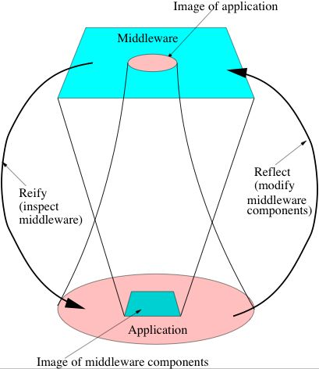
Reflection
A system is reflective if it can inspect part of its execution state while it is running.
Introspection only reads internal state, without modifying it (also called reification)
Reflection enables modifying execution state, and thereby changing system semantics (e.g. Lisp)

Slide 36
Meta Object Protocols
Reflection applied to Object-Oriented systems
The description of how an object system works at a basic level is called a Meta Object Protocol.
The ability to change meta-object protocol is a powerful way to modify an object system
For example, examine (or change) inheritance hierarchy while running
Examine (or change) how inheritance works
  How method lookup is done in the class hierarchy
  How methods are called
Applications in debugging, customizing, separation of concerns (aspects)
Invented in the context of Common Lisp Object System (CLOS).

Slide 37
References
OOP - Reflection www.cs.rpi.edu/academics/courses/spring05/proglang/handouts/Section7.5.ppt
Using Java™ Technology Reflection to Improve Design ( se2c.uni.lu/tiki/se2c-bib_download.php?id=472 )
Reflection In Java ( http://webcourse.cs.technion.ac.il/236703/Winter2006-2007/ru/ho.html )

