Slide 1
Uganda Climate Policy Chatbot

Slide 2
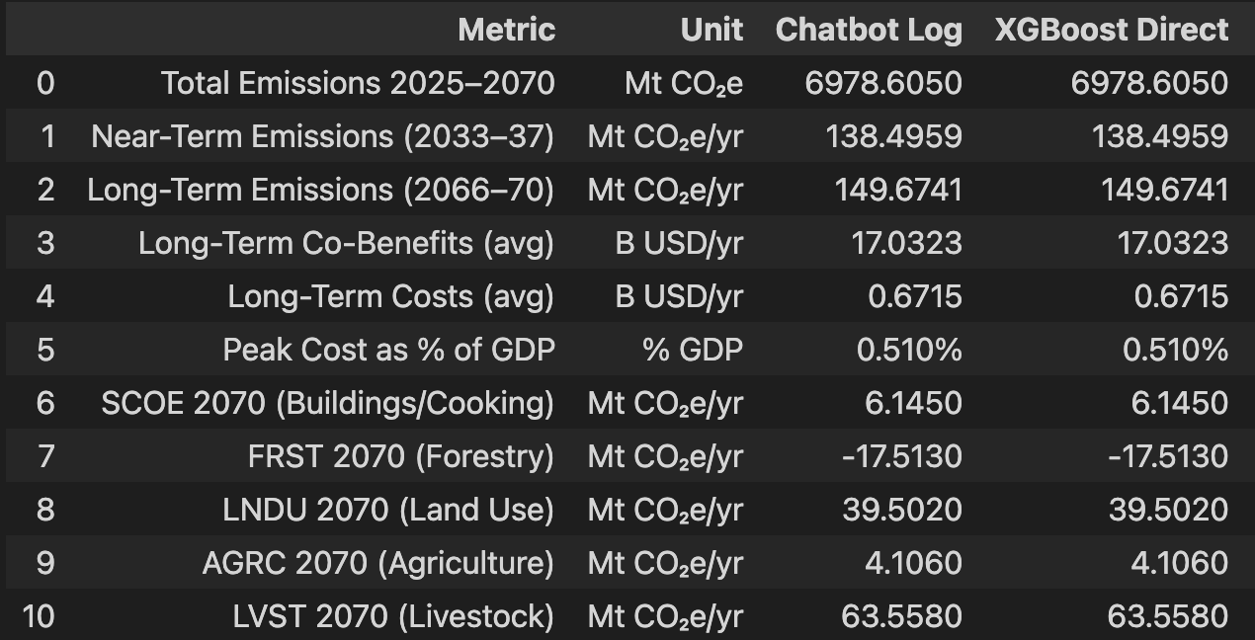
PART 1 — What the Chatbot Ran (from interaction log)
User question:
"What happens if there is a strong policy for clean cooking, an increase in reforestation, and better practices in agriculture?"
Levers activated by the agent (10 groups):
Group ID | Policy Lever | Sector | LHS value
34 | Building Fuel Mix Shift to Clean Fuels | Buildings | 0.9
33 | Biomass Cooking Stove Efficiency | Buildings | 0.9
31 | Building Heat Energy Demand Reduction | Buildings | 0.9
21 | Reforestation (Active Forest Expansion) | Land Use | 0.9
19 | Deforestation Reduction | Land Use | 0.9
3 | Conservation Agriculture (No-Till) | Agriculture | 0.9
4 | Crop Yield Improvement | Agriculture | 0.9
36 | Nitrogen Fertilizer Reduction | Agriculture | 0.9
2 | Agricultural Food Loss Reduction | Agriculture | 0.9
1 | Rice Paddy Methane Reduction | Agriculture | 0.9
The agent selected the group of variables that needed to change based on the user question.
The comparison with the manual run of the xgboost led to the same results shown in the logs.

Slide 3
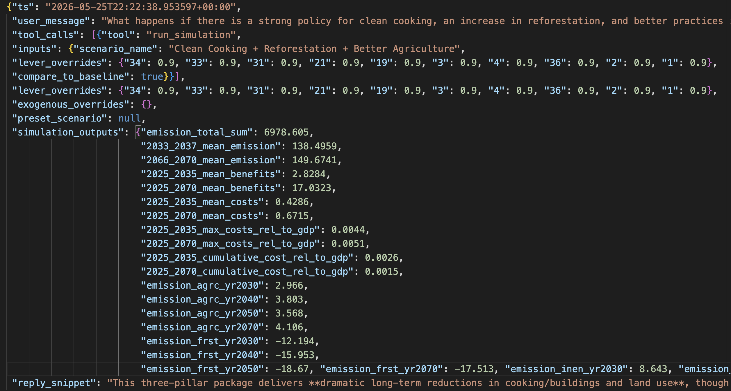
Logs results example
An example of the information saved for each question asked of the chatbot.
This helps evaluate the results and compare them manually with the xgboost.

Slide 4
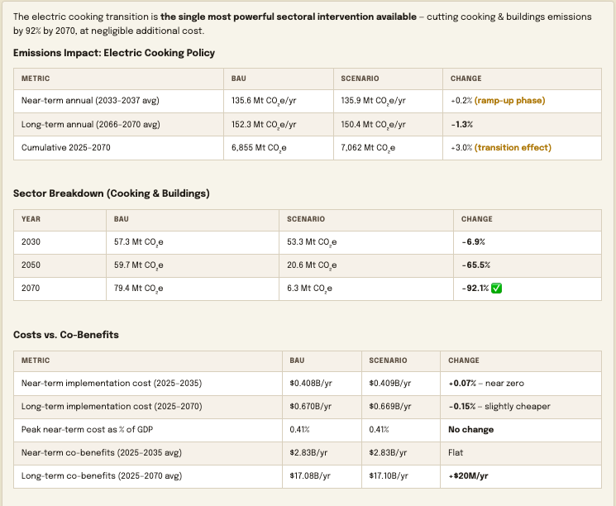
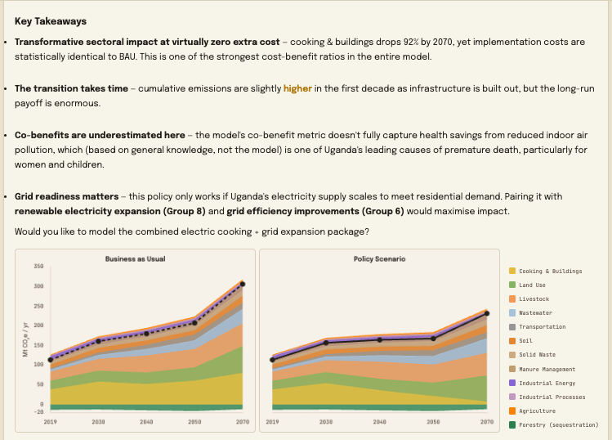
PART 2 — Current Limitation: Cost & Benefit Analysis is Aggregated Only
User question:
What are the costs and benefits of implementing a policy to replace current stoves with electric ones?
Note the mention of the use of
general knowledge of the
model in this part of the
answer
Although the current model does not predict costs and benefits by sector, the agent runs the model,
keeping all other factors constant and changing only the variables related to the policy mentioned in the question,
and then evaluates the change in the aggregate costs and benefits.

Slide 5
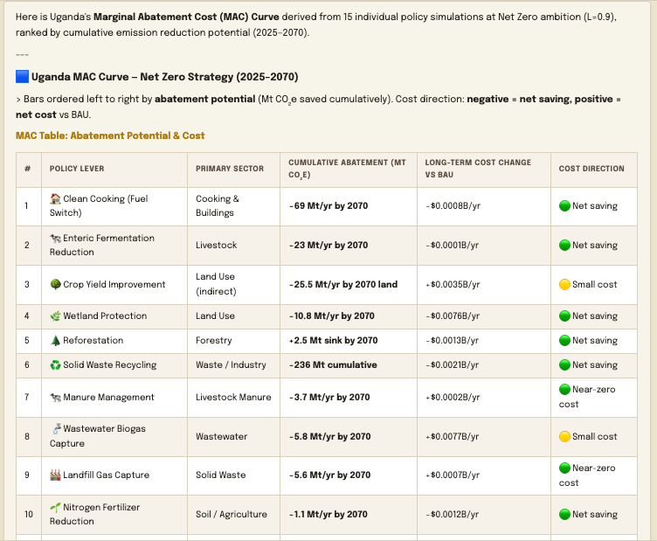
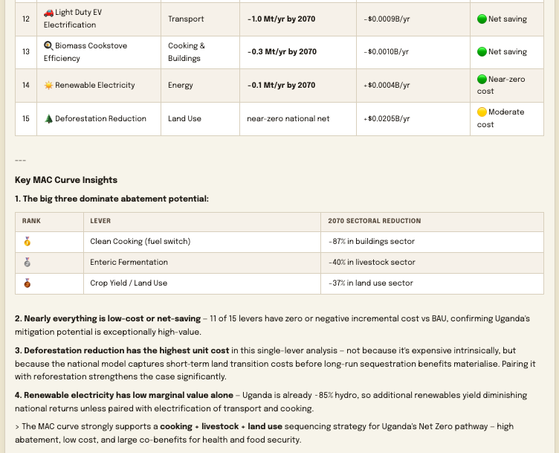
User question:
Can you produce a MAC curve for the net zero strategy?
The agent has not instruction on how to create the MAC curve

Slide 6
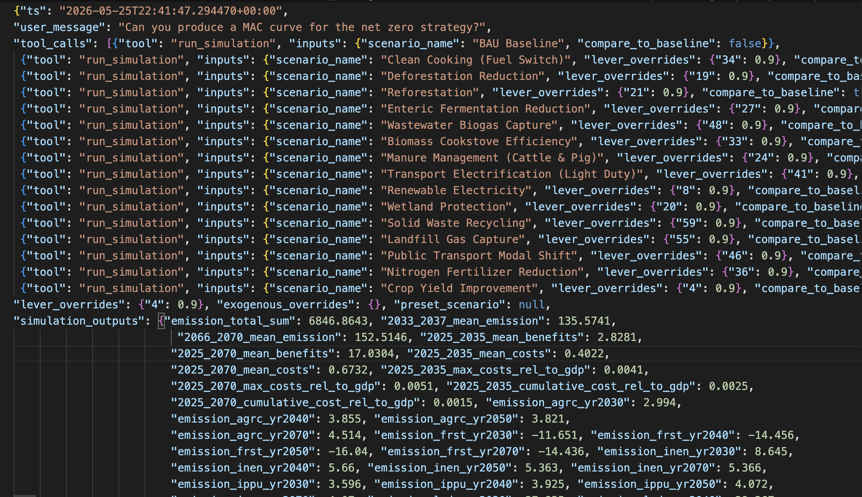
The logs confirmed that all 15 runs were completed, but only the results from the last run are saved, which is part of the design for what should be saved in the logs

Slide 7
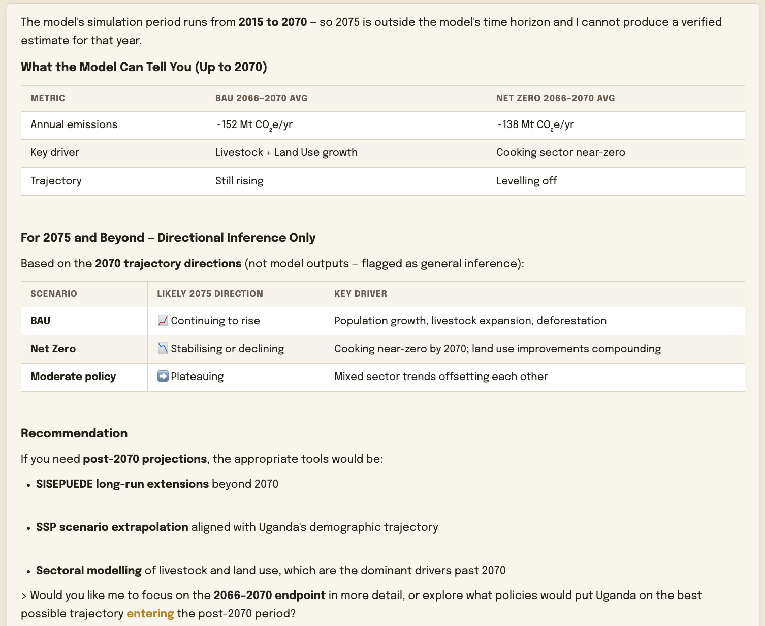
User question:
How will emissions behave in 2075?
Our predictions only last until 2070, the chatbot flags it

Slide 8
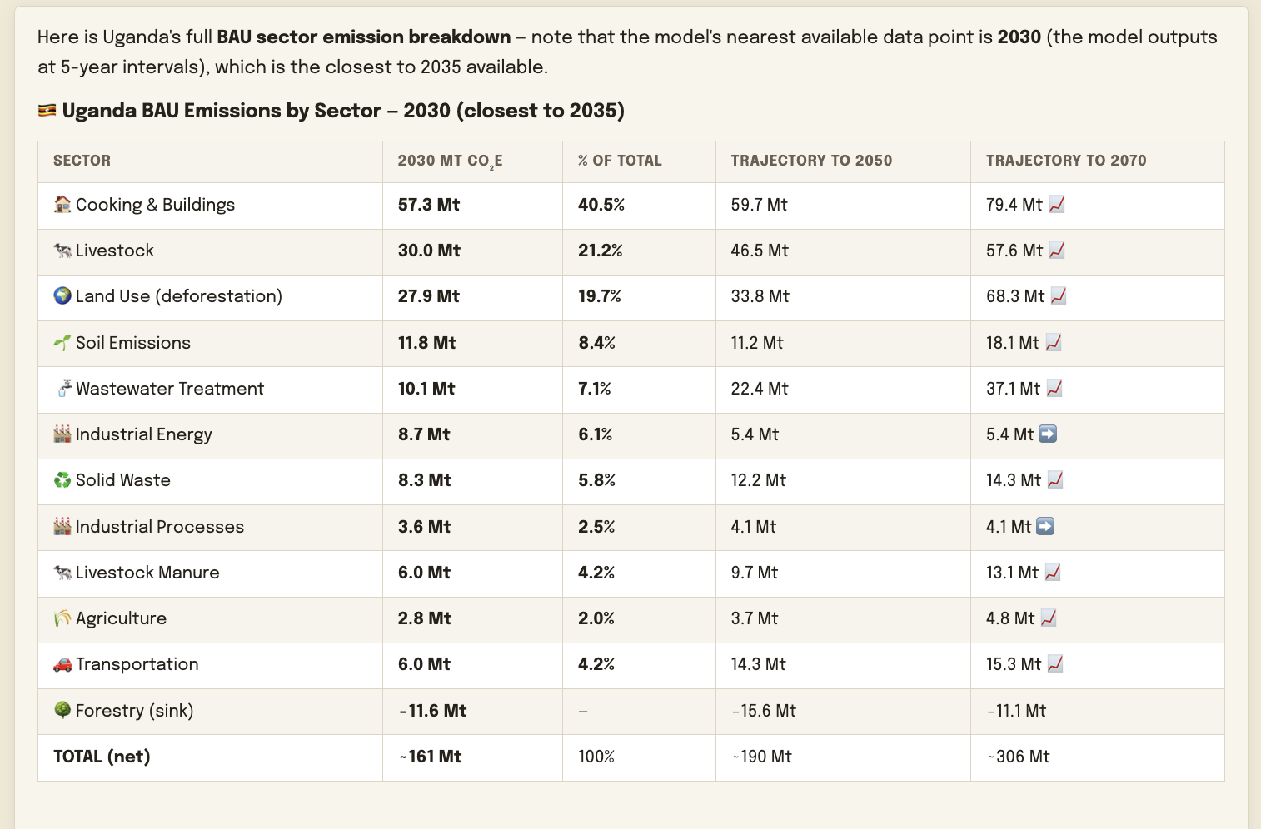
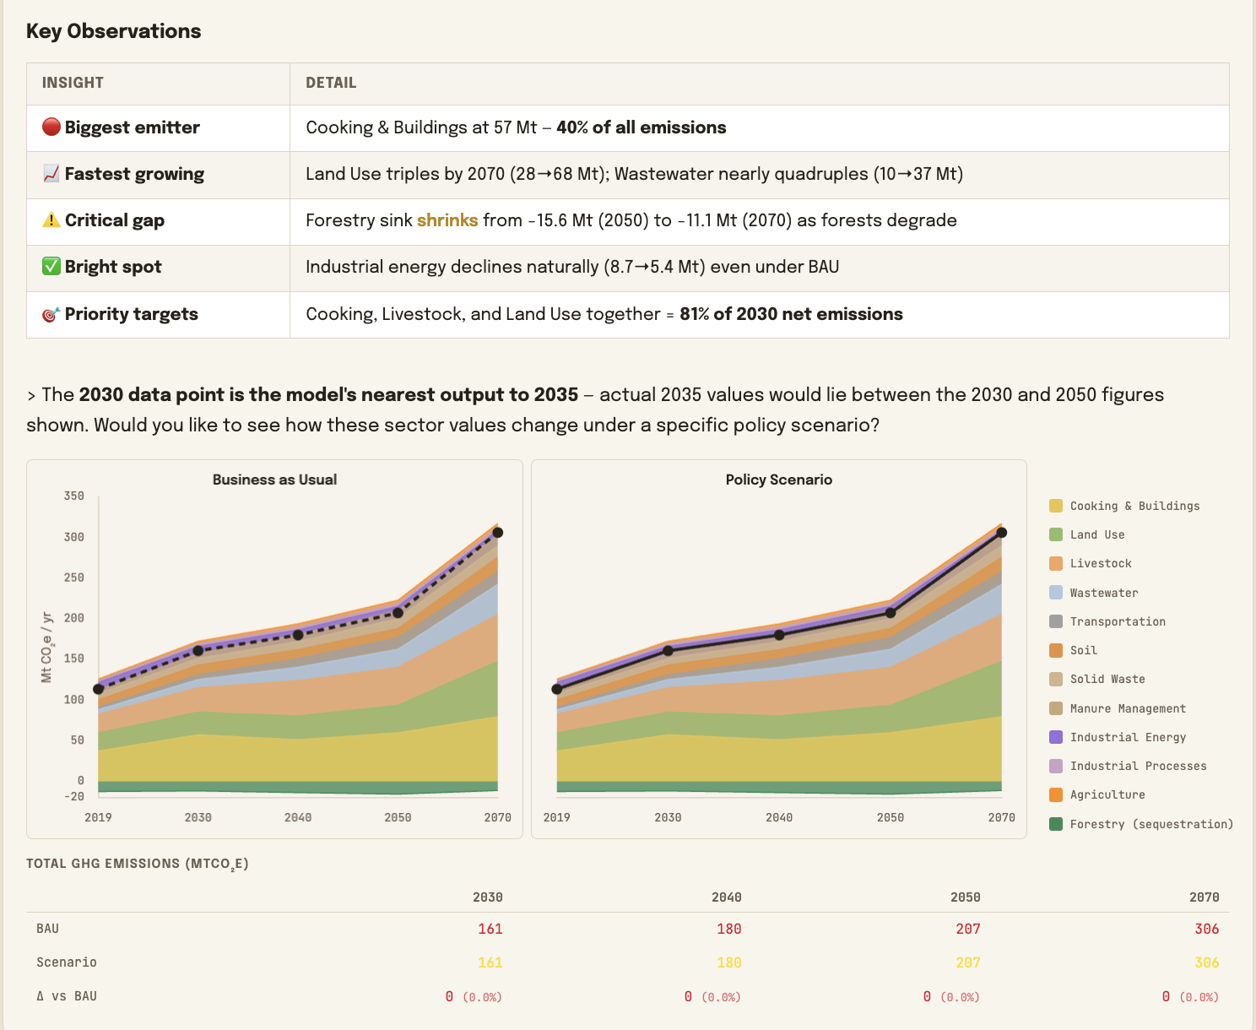
User question:
What will be the emissions by sector in 2035??
Currently the model predict by sector for 2030, 2040, 2050 and 2070

