Slide 1
Introduction to the Surrogate Model

Slide 2
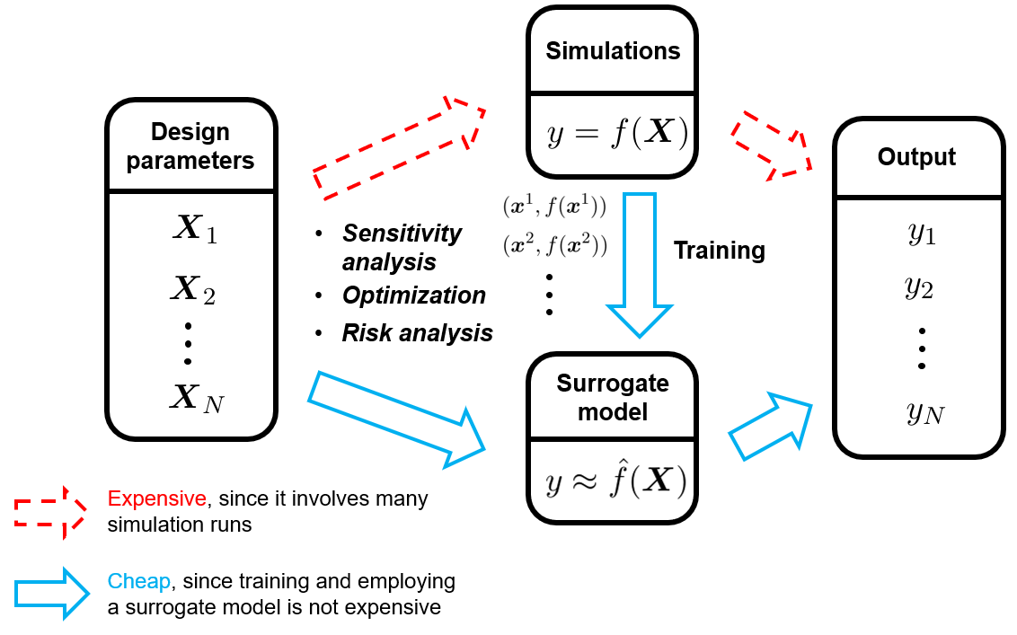
What is a surrogate model or metamodel
Image from: https://towardsdatascience.com/an-introduction-to-surrogate-modeling-part-i-fundamentals-84697ce4d241/

Slide 3
Let’s talk about the design parameters or input data

Slide 4
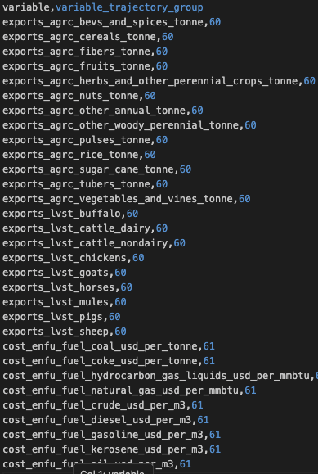
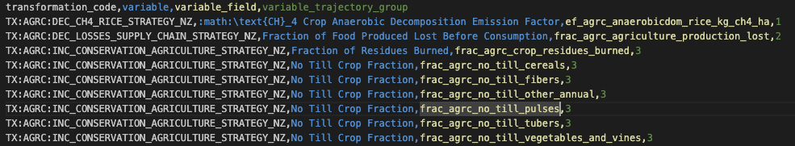
In SiSePuede we have levers and uncertainties
Uncertainties
Levers

Slide 5
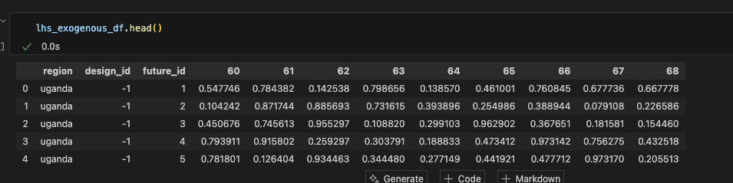
An ensemble of simulations is created
by stressing the levers and uncertainties variable trajectory groups using LHS sampling

Slide 6
Now, let’s talk about the output

Slide 7
In SiSePuede we have several outputs
Emissions
Cost and benefits
Jobs

Slide 8
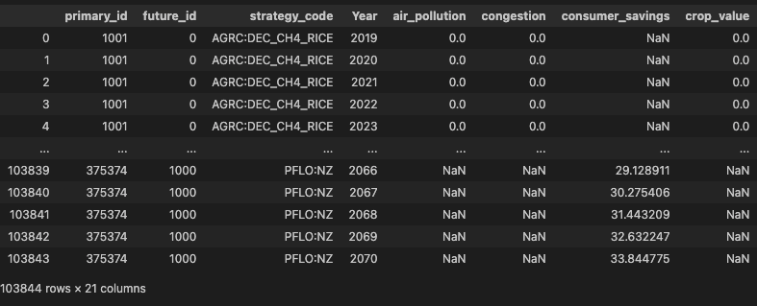
The simulation ensemble generates multiple future outptus

Slide 9
So... What can we do with this ensemble data?

Slide 10
We can train an ML model
that learns the patterns between the levers, uncertainties, and the different model outputs

Slide 11
Why would we want to do this?
A good model could allow us to predict the sisepuede outputs given a set of levers and uncertainties in a much faster way than running the simulation

Slide 12
The current workflow we have
Pull the ensemble data from AWS S3
Prepare the training data (ETL, data cleaning, etc.)
Train and evaluate the models.
Save the trained model in a .pkl file that can be reload and use for production

