Slide 1

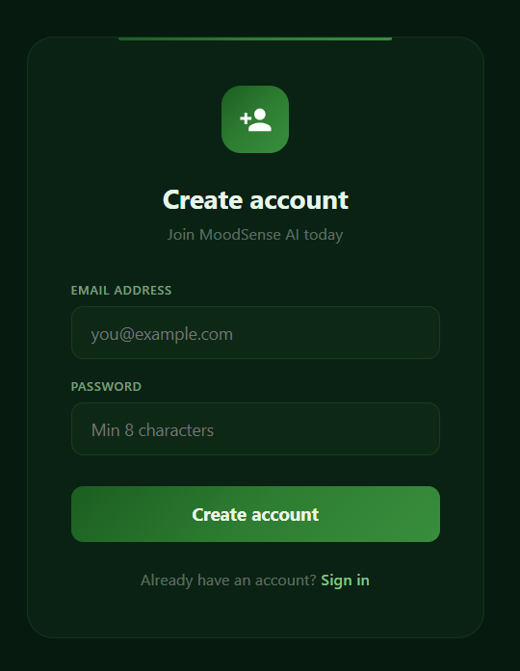
MoodSense AI:
Emotion & Mood Analyzer
Presented By
SISH MOHAMMAD MOSNOBI
Student ID
98171124

Slide 2
Idea & Vision
Understanding Human Emotions Using AI
Many systems cannot interpret human emotions in real-time
Emotional awareness is important in:
Mental health
User experience
Smart applications
Vision:
Create an AI-powered system that detects emotions from faces using images or live webcam.

Slide 3
Key Features Overview
WHAT THIS SYSTEM CAN DO
Secure user login & registration (JWT authentication)
Upload images or use live webcam
Detect 7 human emotions instantly
Store scan results in the database
View past emotion history

Slide 4
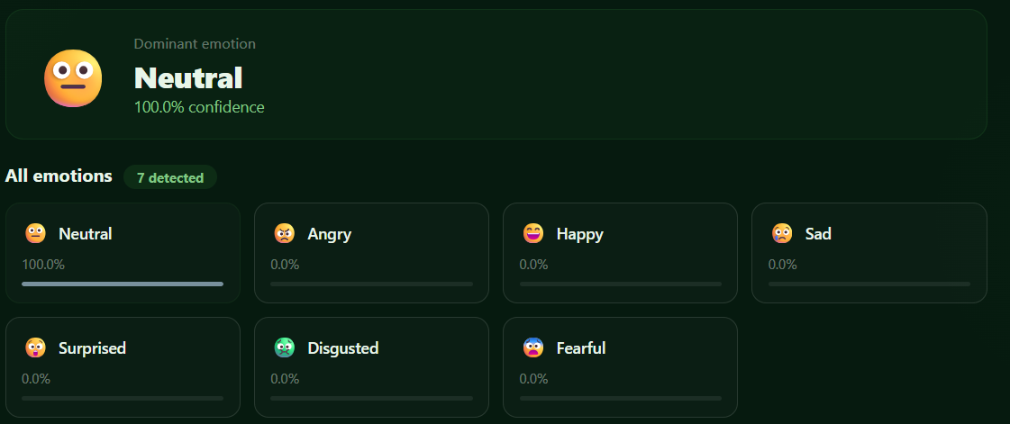
AI Emotion Detection
Core Intelligence of the System
Internal fragmentation due to fixed partition use
Uses face-api.js
Detects emotions:
Happy 😄
Sad 😢
Angry 😠
Fearful 😨
Disgusted 🤢
Surprised 😲
Neutral 😐
⚙️ Process:
Detect face → Analyze expressions → Rank emotions → Show dominant mood

Slide 5
System Architecture
How the System Works
Frontend (React):
UI interaction
Webcam & image upload
Backend (Node.js):
API handling
Authentication
Database:
Stores users & scan history
AI Layer:
Runs emotion detection model
Flow:
User → React UI → API → AI Model → Database → Results

Slide 6
Technical Stack
Technologies Used
Frontend: React (fast UI, component-based)
Backend: Node.js + Express
Database: MongoDB
AI Engine: face-api.js
Authentication: JWT (secure login system)
Why this stack?
Fast development
Scalable
Real-time AI processing

Slide 7
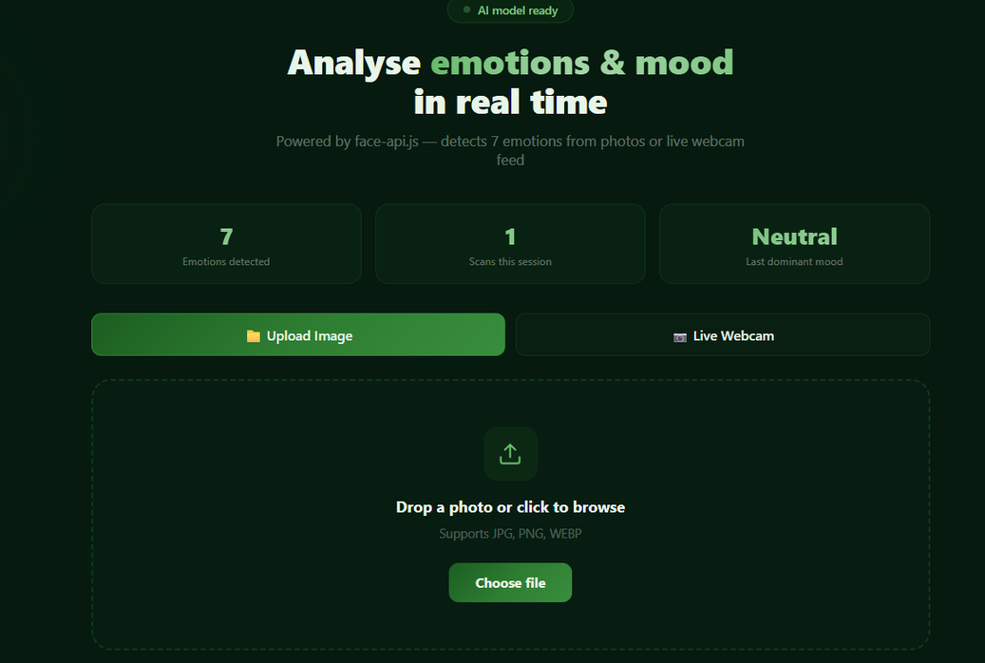
User Experience Flow
How Users Interact
Register / Login
Open Emotion Detector
Choose:
Upload image OR
Use webcam
AI analyzes face
Results displayed instantly
Data saved to history

Slide 8
Challenges & Solutions
Real Problems We Faced
🔴 Challenge 1: AI model loading delay
✅ Solution: Preload models before detection
🔴 Challenge 2: Face not detected
✅ Solution: User guidance (clear image, lighting)
🔴 Challenge 3: Secure authentication
✅ Solution: JWT token-based system

Slide 9
Future Improvements
What Can Be Added Next
Real-time emotion tracking graphs
Mobile app version
Voice + emotion combined analysis
Cloud deployment (AWS / Vercel)
AI accuracy improvements

Slide 10
Thank You

