Slide 1
How to mess up with git
Samin Ishtiaq
SAIC Informal Talk (Votes=6)
1 Sept 2021

Slide 2
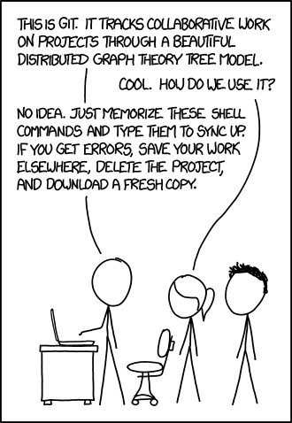

Slide 3
The big picture
commit object
tree object
blob object

Slide 4
Another big picture
checkout
working
tree
repo
commit
add
index

Slide 5
Simples

Slide 6
Branches, 1

Slide 7
Branches, 2

Slide 8
reset

Slide 9
reset --soft

Slide 10
reset --hard

Slide 11
cherry-pick, 1

Slide 12
cherry-pick, 2

Slide 13
Combining branches

Slide 14
Combining branches: merge

Slide 15
Combining branches: rebase

Slide 16
rebase onto

Slide 17
rebase onto parent’=d, parent=1, until=3

Slide 18
stash
checkout
working
tree
repo
WIP2
WIP1
commit
add
WIP0
index

Slide 19
reflog
Everything you ever did is kept in reflog
Repeat: everything (reset –hard, branch –d, etc)

Slide 20
fin

