Slide 1
Genomics of Drug Sensitivity in Cancer (GDSC)
Database presentation

Slide 2
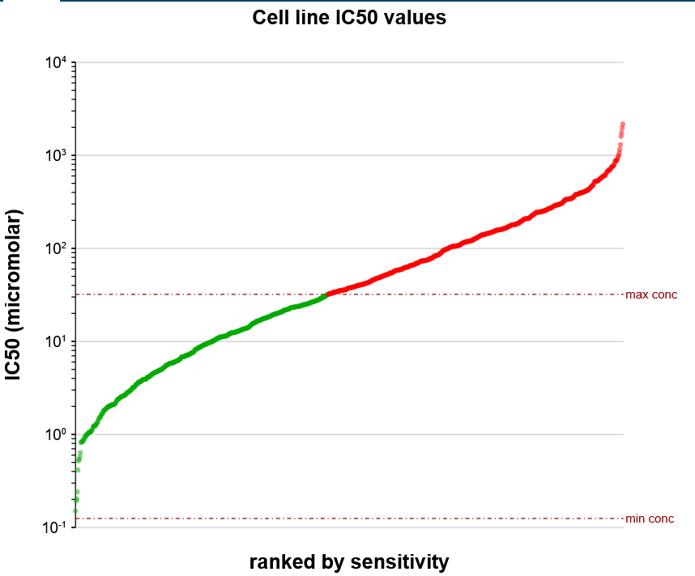
RESEARCH OBJECTIVES
Develop a machine learning framework to predict drug responsiveness by integrating multiple layers of biological information (genomics, transcriptomics, structural data, …).
GDSC
IC50 sensitivity predictions
PUBCHEM
ML model
EXTRACT FEATURES
Genomics, transcriptomics, proteomics, …
CCLE/
CRTP
other datasets

Slide 3
Review of the literature
Understand the GDSC Database in Detail:
Documentation, authors, objectives, data, statistical analysis, accessibility.
Compare Prediction Algorithms on GDSC Data:
Critically compare features, results, and methods used across different models.
Identify Similar Databases / Models
Find and analyze databases or models similar to GDSC and its applications.

Slide 4
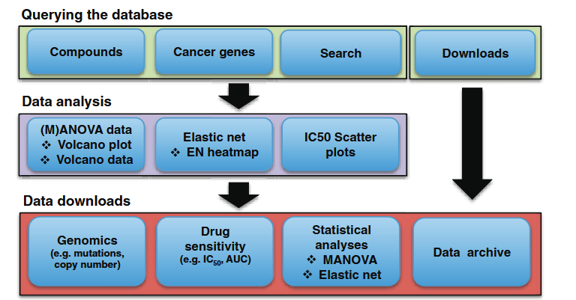
Genomics of Drug Sensitivity in Cancer (GDSC)
80-95 % of new drugs failing clinical trials => lack of efficacy, unacceptable toxicity.
GDSC database: Large datasets on drug sensitivity (IC50) in cancer cells and detailed genomic information to facilitate the discovery of molecular biomarkers of drug response.
GDSC contains drug sensitivity data for almost 75 000 experiments, describing response to 138 anticancer drugs across 700 cancer cell lines. (in 2012)
Cell line drug sensitivity data are integrated with multi-omics datasets: somatic mutations in cancer genes, gene amplification and deletion, tissue type and transcriptional data
all datasets are fully downloadable
A schematic representation of the GDSC database structure and content.
Genomics of Drug Sensitivity in Cancer (GDSC): a resource for therapeutic biomarker discovery in cancer cells (Wanjuan Yang, 2012, Nucleic Acids Research).

Slide 5
Data structure
 | DRUG A | DRUG B | DRUG C | DRUG D | DRUG E
CELL LINE 1 | IC50 value
CELL LINE 2 |  | High IC50 (RESISTANCE)
CELL LINE 3 |  |  |  | Low IC50 (SENSITIVITY)
CELL LINE 4
CELL LINE 5

Slide 6
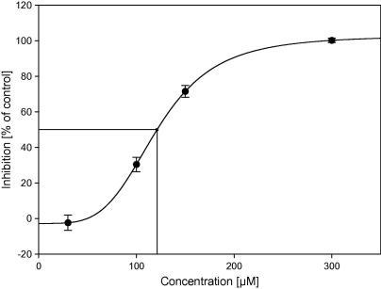
IC50 as a drug sensitivity/resistance indicator
IC50: Concentration of a drug needed to reduce a biological activity by 50%
(example cancer cell growth). Lower IC50 = the drug is more effective at lower doses.
Sensitivity: how strongly a cell line or tumor responds to a drug. High sensitivity = strong response Low sensitivity = weak or no response (resistance)
https://en.wikipedia.org/wiki/IC50

Slide 7
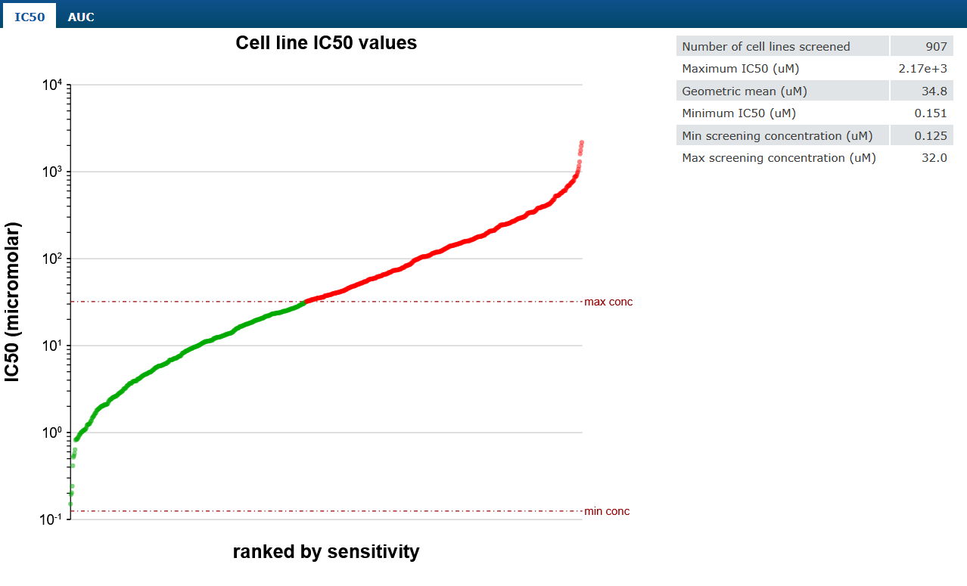
72 hours of drug treatment to derive multi-parametric description of drug sensitivity including IC50

Slide 8
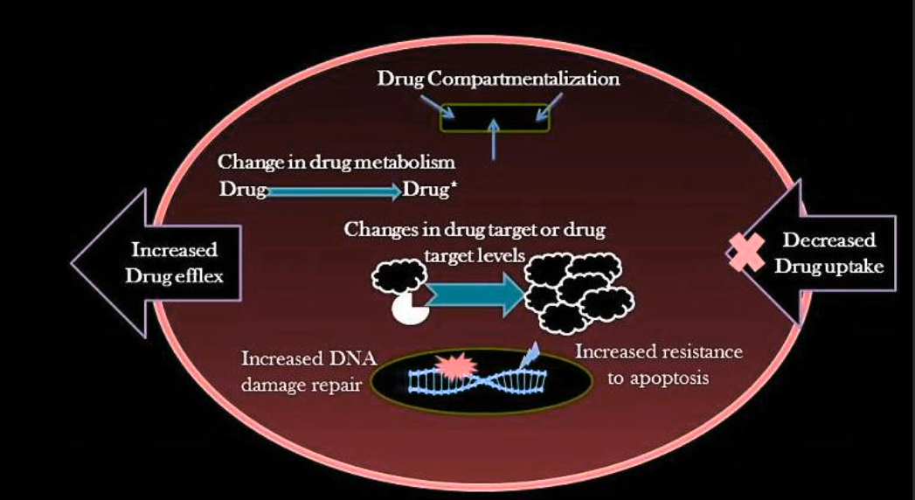
Mechanisms of cell line drug resistance
The Different Mechanisms of Cancer Drug Resistance: A Brief Review, (Mansoori et al., 2017)

Slide 9
Database evolution
March 2012: cell line drug sensitivity data for 130 drugs representing >48,000 cell line-drug interactions
November 2012:
elastic net (EN) modeling: scan across the genome to identify genomic, transcriptomic and tissue-type features associated with drug sensitivity or resistance
scatter plots of cell line IC50 values for significant drug-gene associations
Total number drugs: 140, Total number cell lines: 714
July 2016: Total number drugs: 265, Total IC50 values 224 510 ,Total number cell lines: 1074
July 2019: Total number drugs: 453, Total IC50 values 386 294, Total number cell lines: 989
July 2022: Total number drugs: 624, Total IC50 values 576 758, Total number cell lines: 979

Slide 10
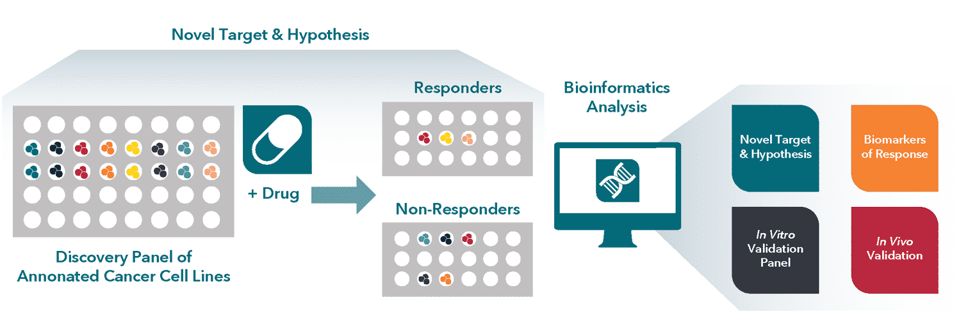
Cell line: context and definitions
Over 1,000 cell lines of adult and childhood cancers of epithelial, mesenchymal and haematopoietic origin(rare and common) categorized using TCGA tumor type description and linked by unique COSMIC IDs.
Cell Culture: Cell lines were grown in RPMI or DMEM/F12 media with 5–10% FBS and antibiotics, under standardized conditions (37°C, 5% CO₂) to support consistency in drug sensitivity assays and high-throughput screening.

Slide 11
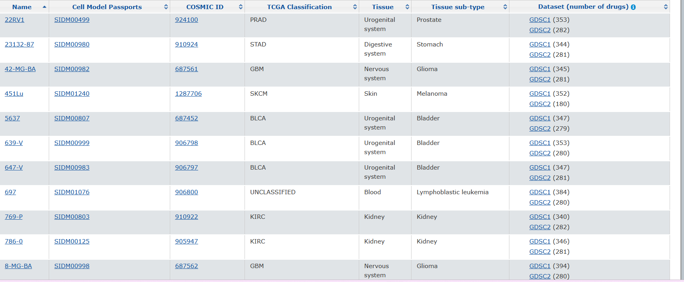
Cell line: features and data
In total 624 cell lines were listed in the GDSC cell lines page

Slide 12
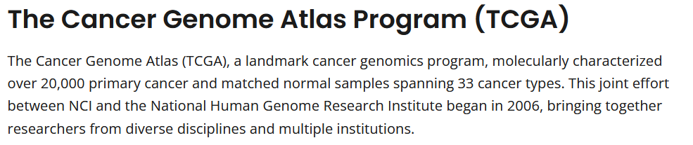
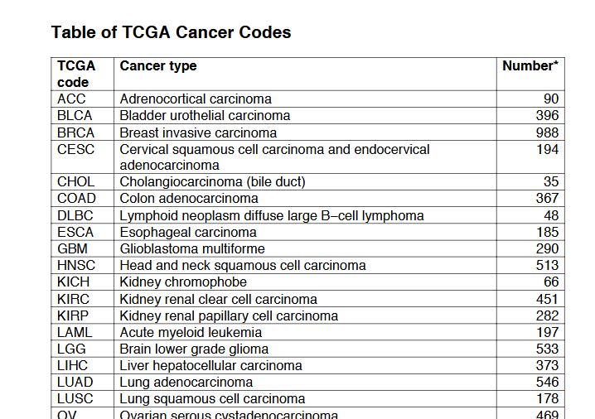
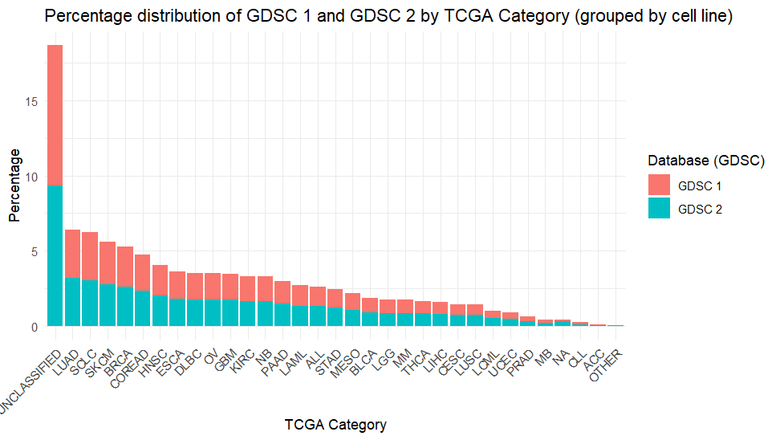
https://www.cancer.gov/ccg/research/genome-sequencing/tcga
https://www.cancer.gov/nras.pdf

Slide 13
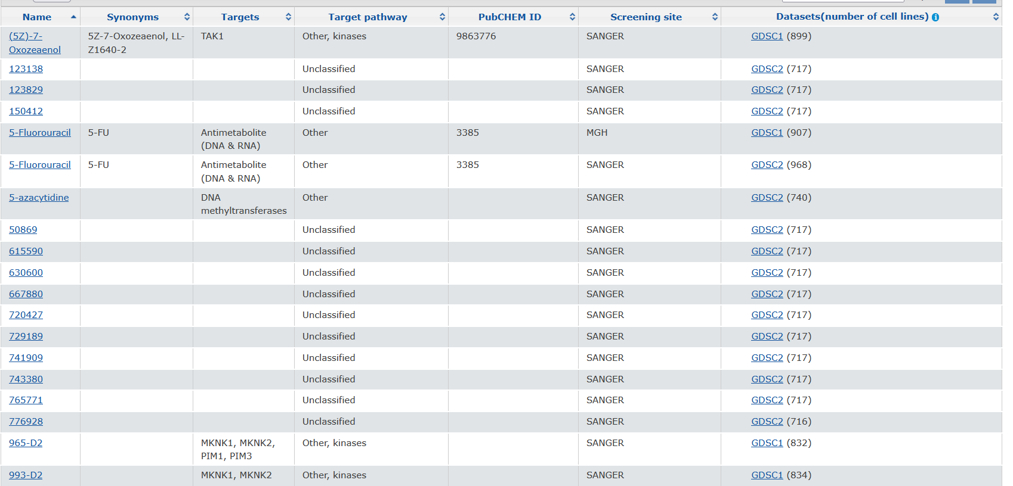
Drugs: features and data
In total 624 compounds are listed in the GDSC compounds page

Slide 14
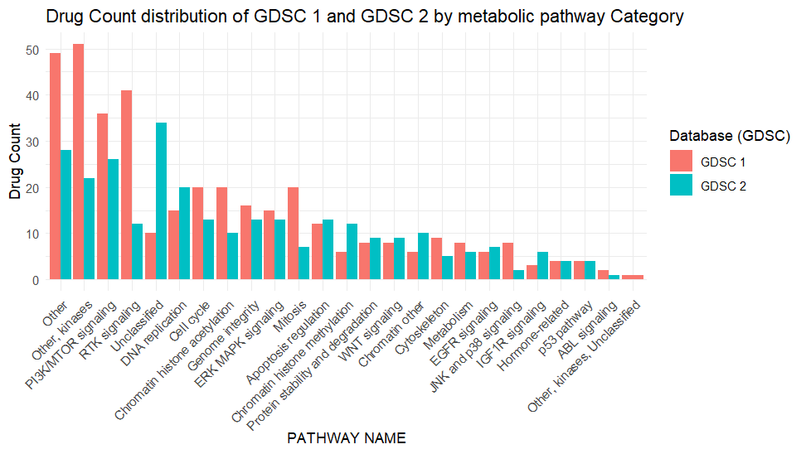
Distribution of target metabolic pathways

Slide 15
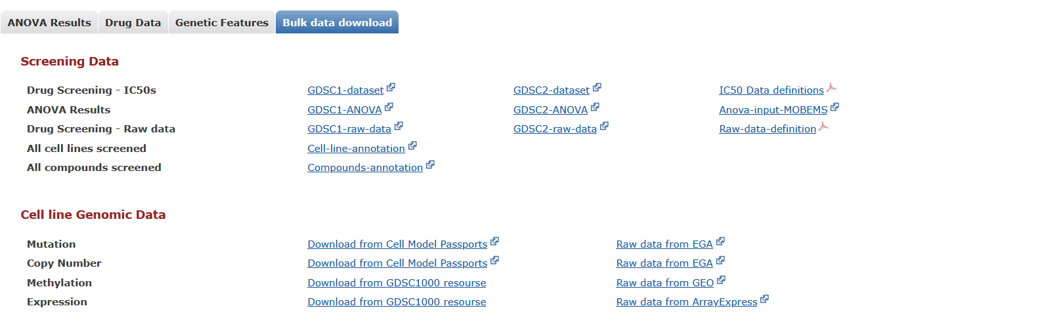
Data accessibility

Slide 16
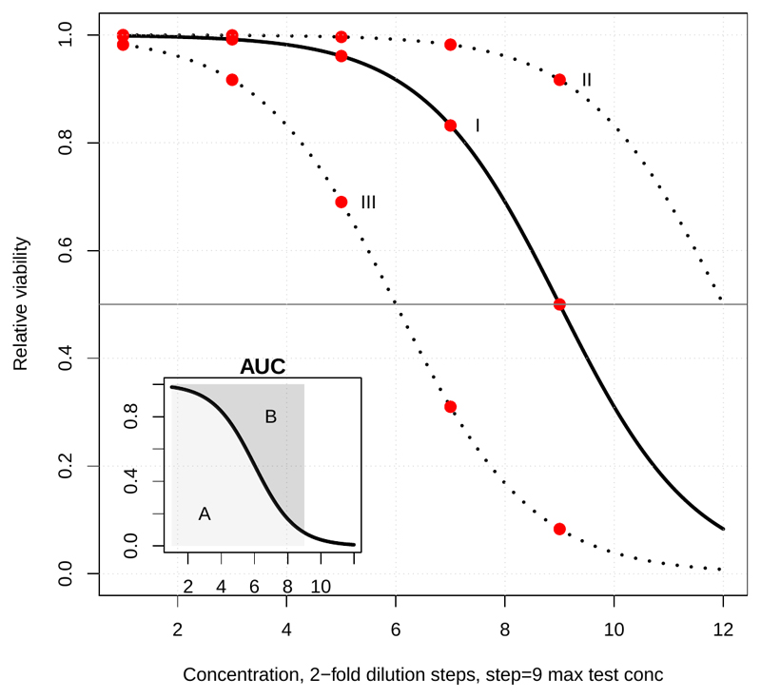
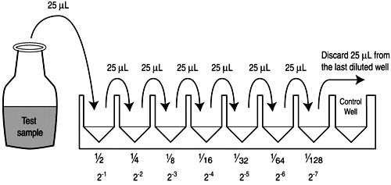
Database composition
GDSC1:
Wellcome Sanger Institute and Massachusetts General Hospital
Between 2009 and 2015 using set of cancer cell lines (the GDSC1000)
Standard dose response format: 9-point dose curve incorporating a 2-fold dilution step (256-fold range)
GDSC2:
Wellcome Sanger Institute since 2015
Improvements to the screen design and assay
7-point dose curve incorporating a half-log dilution step (1000-fold range)

Slide 17
Database features
Genomic features associated with drug response based on analysis of variance (ANOVA) :
1. Cancer genes (CG): 461 unique pan-cancer genes, 9 tumor suppressor genes
2. Copy number alterations (RACS): 851 cancer-specific RACS, 286 amplifications, 565 deletions
3. DNA methylation (iCpGs): 6,166 tumor samples across 21 cancer types
4. Gene fusions: targeted PCR sequencing or split probe FISH analysis
5. Microsatellite Instability: markers BAT25, BAT26, D5S346, D2S123 and D17S250

Slide 18
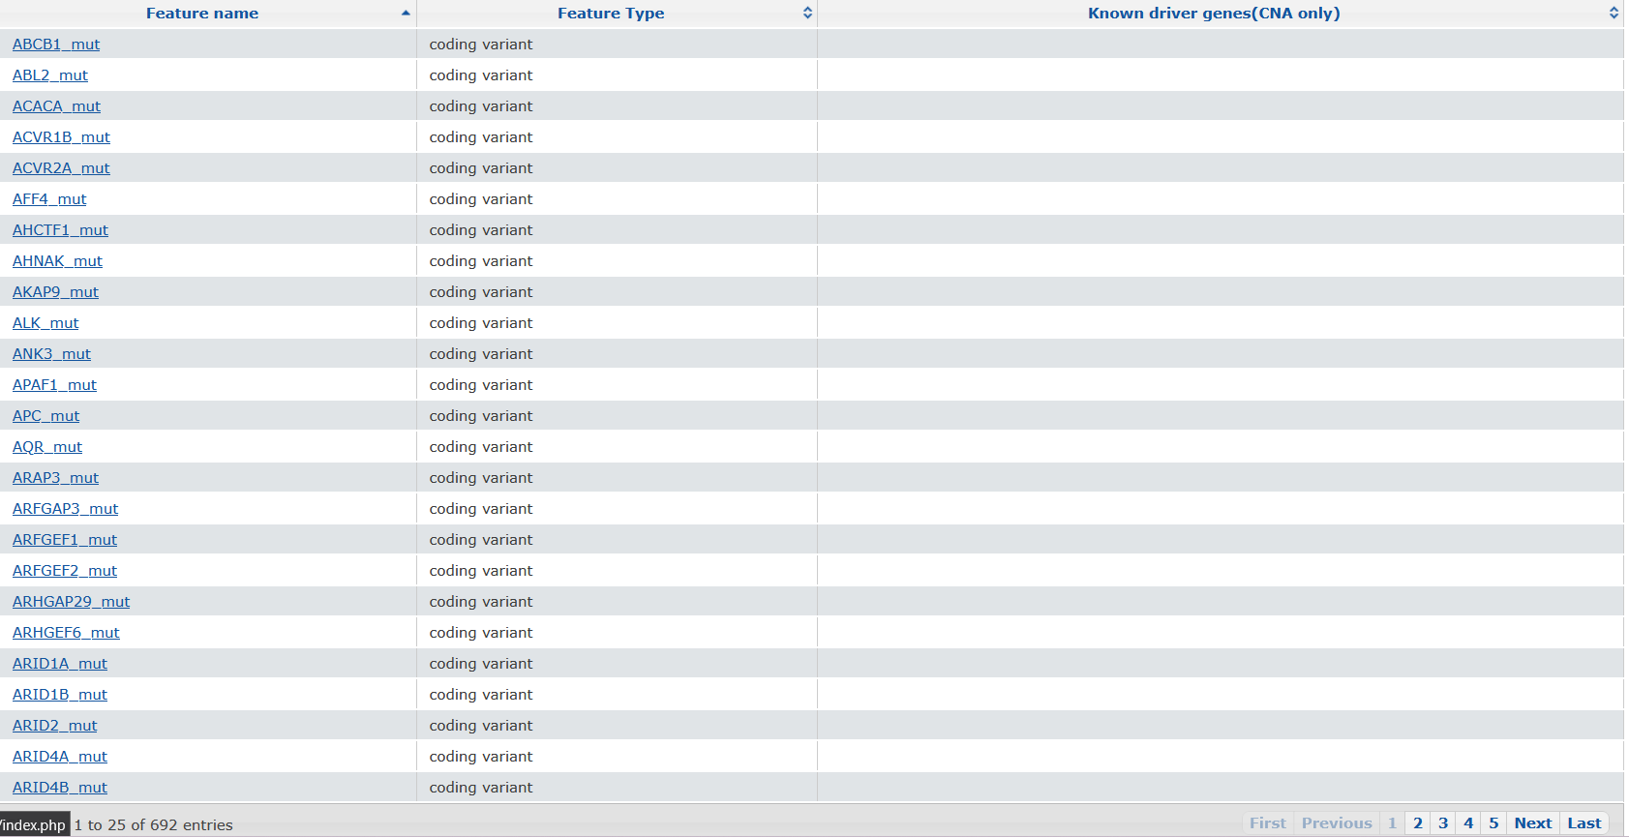
Database features
692 features were correlated with drug sensitivity in at least 3 cell lines including coding variants and copy number alterations

Slide 19


Database features: multi-omics features
CELL MODEL PASSPORT online resource: https://cellmodelpassports.sanger.ac.uk/downloads
Model Annotations: cancer type, tissue, identifiers, availability, growth rate
Gene annotations: driver genes, predisposition variants
Mutation data: driver mutations, whole exome seq, whole genome seq
Expression data: RNA-seq
Copy Number variants: CNV gene data (WES/WGS), CNV segment data (WES/WGS), copy number (SNP6)
CRISPR KO: fitness score, priority scores
Fusion data: gene fusions
Proteomics data: Protein intensity values (DIA-MS)
Synthetically augmented multi-omics dataset: Machine learning model to fill missing data across multiple datasets
Notes:
DIA-MS = data-independent acquisition mass spectrometry

Slide 20
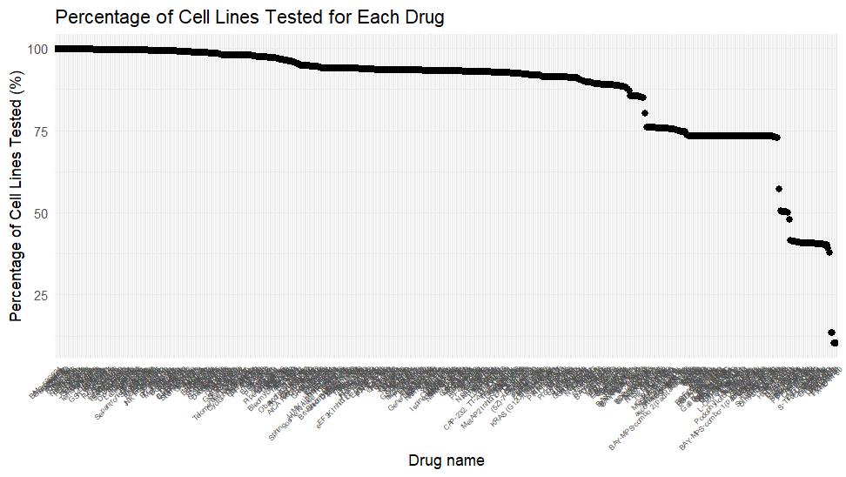
Data analysis

Slide 21
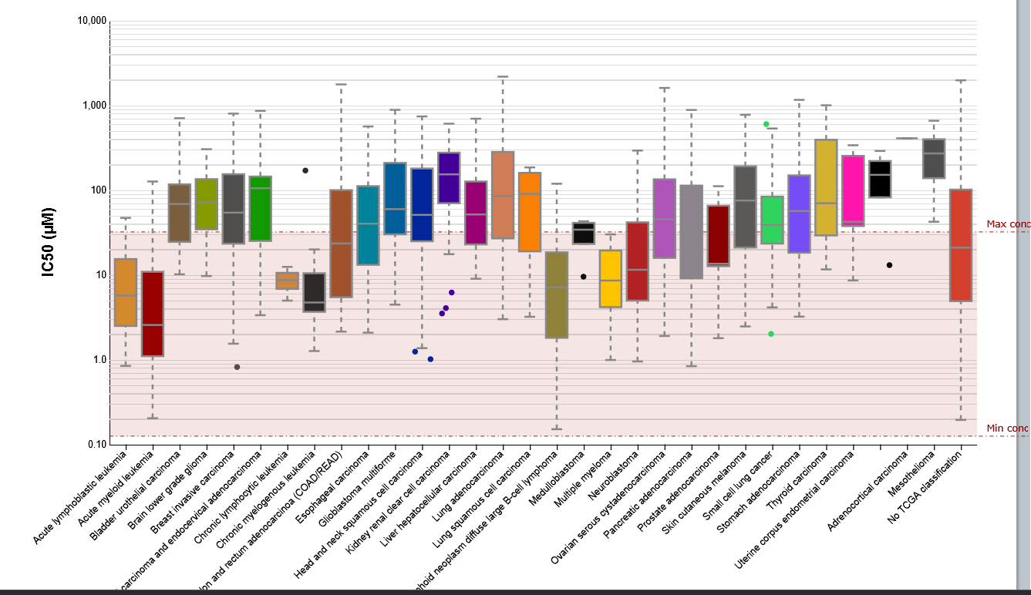
Tissue specific IC50: IC50 measured for a specific tissue type or cancer type

Slide 22
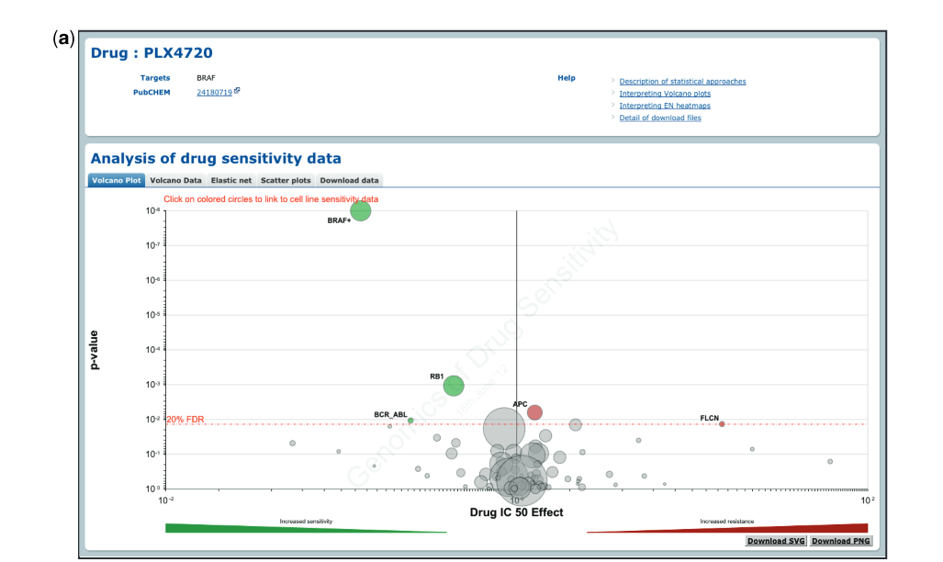
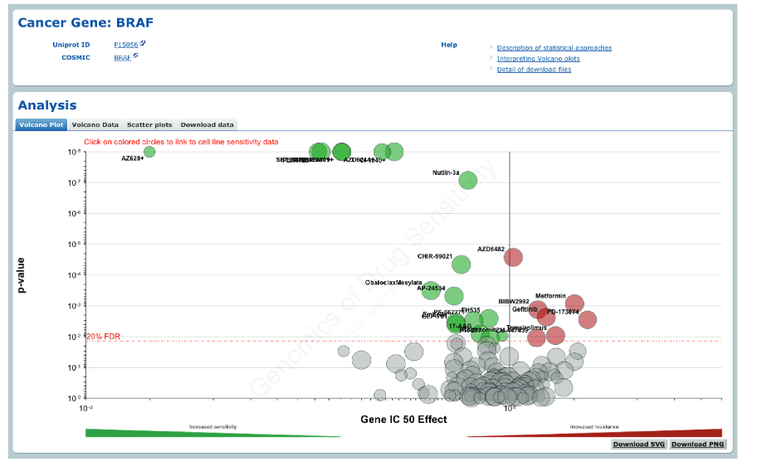
Statistical analysis
Volcano plot: MANOVA results, magnitude (x-axis) and significance (P-value) for each cancer gene association for one drug.
Benjamini–Hochberg multiple testing correction (red line)
Volcano plot: MANOVA analysis for drug sensitivity associated with one cancer gene/mutations.

Slide 23
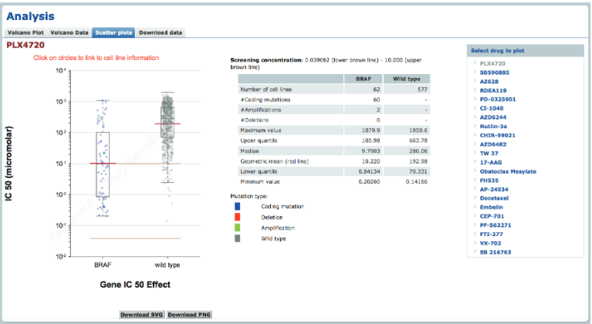
Statistical analysis
Scatter plot of cell line IC 50 values for a drug split into two populations (cell lines mutational status) Each circle represents the IC50 value for an individual cell line plotted on a logarithmic scale and the red line is the geometric mean of the population.

Slide 24
Other databases
CCLE (cancer cell line encyclopedia):
> 1000 cancer cell lines
RNA sequencing, WES, WGS, reverse-phase protein array, reduced representation bisulfite sequencing, microRNA expression profiling, global histone modification profiling, and metabolomics
NCI-60:
over 21,000 compounds
wide range of molecular profiling data (gene expression, mutations, copy number, methylation, and protein expression)
CellMinerCDB:
web-based resource (https://discover.nci.nih.gov/cellminercdb/)
integrating multiple forms of pharmacological and genomic analyses,
unifying cancer cell line datasets (NCI-60, NCI-SCLC, Sanger/MGH GDSC, and Broad CCLE/CTRP)

Slide 25
Limitations
Analysis done using in vitro cell lines, some other cancer detection/protection mechanism are not included (for ex.PD-L1 inhibitors in immune system)
Homogeneity of cell lines, interaction or symbiosis of cancer cell lines
Genetic drift of cancer cell lines can reduce reproducibility

Slide 26
Genomics of Drug Sensitivity in Cancer (GDSC)
Detailed feature overview

Slide 27
Genomic mutation

Slide 28
Copy number variations

Slide 29
Don

Slide 30
Genomics of Drug Sensitivity in Cancer (GDSC)
Literature overview for predictor models

Slide 31
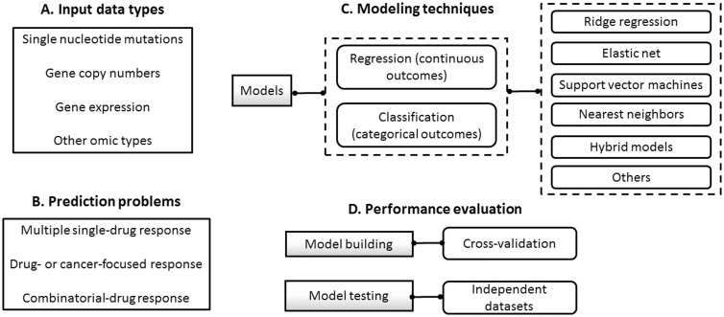
‘Computational models for predicting drug responses in cancer research’, 2017, Francisco Azuaje, Brief Bioinformatics

Slide 32
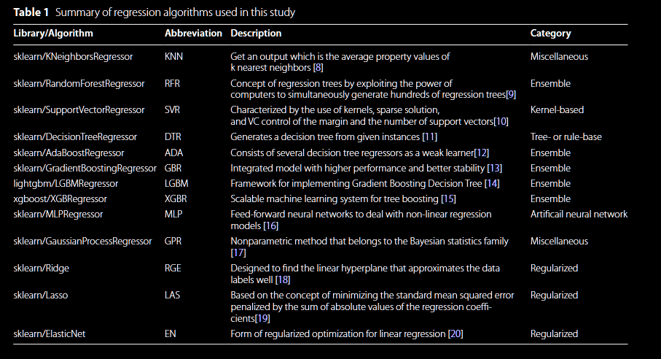
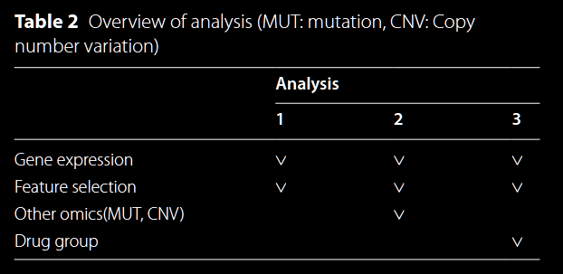
Comparative analysis of regression algorithms for drug response prediction using GDSC dataset, (Ha, Park and Jo, 2025)
Notes:
Feature selection methods: mutual information (MI), variance treshhold (VAR), select kbest (SKB) from python scikit-learn, L1000
L1000 (Library of Integrated Network-Based Cellular Signatures) -> list 1000 major genes with significant response in drug screening

Slide 33
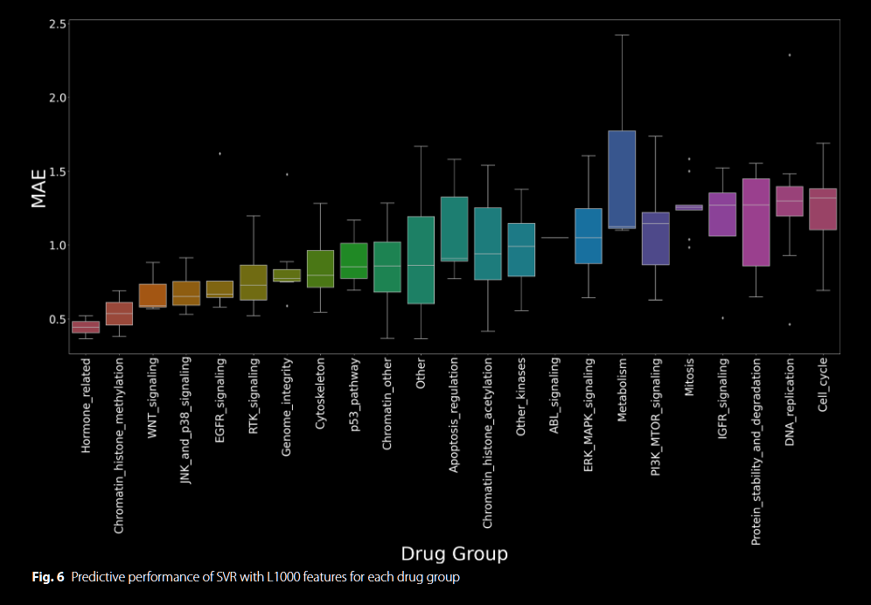
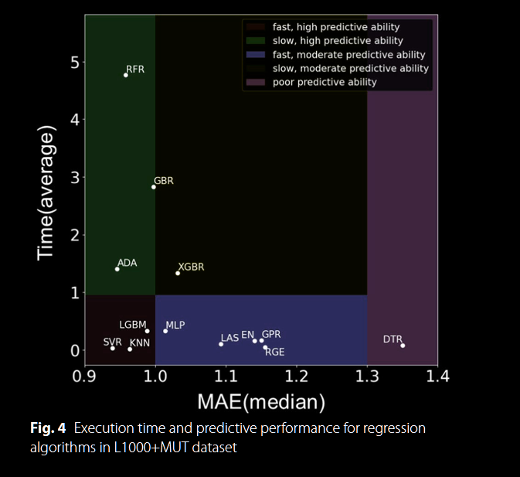
Results
Notes:
MAE mean absolute error -> average absolute deviation between expected and observed

Slide 34
Limitations
Only focusing on regression ML approaches (no DL, graph or transformers models)
No hyperparameter tuning (default)
Naïve integration of multi-omic data (for example CNV), simple concatenation
Only one evaluation metric (Mean absolute error) , no feature importance ranking for interpretability
No validation with other datasets (ex CCLE)

