Slide 1
Mechanism of Drug Sensitivity and resistance in Cancer (mdrDB)
Theoretical presentation

Slide 2
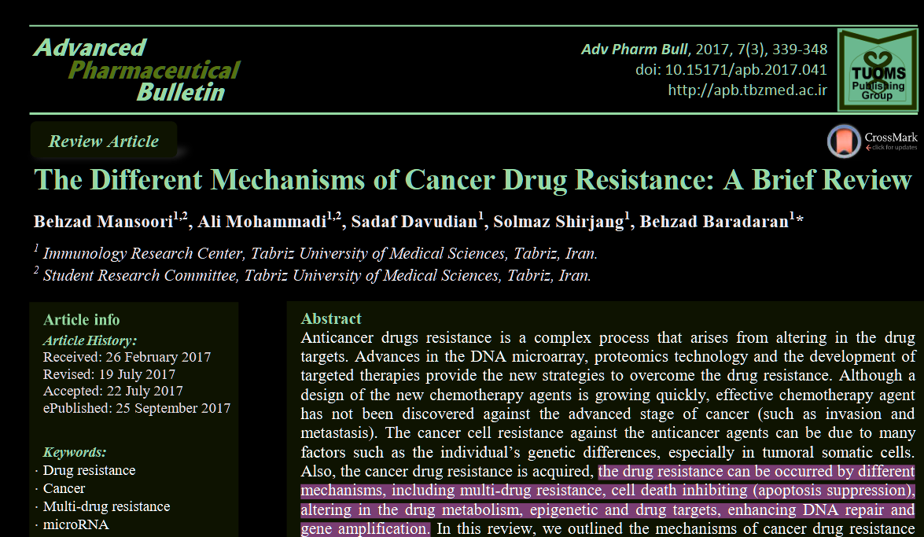

Slide 3
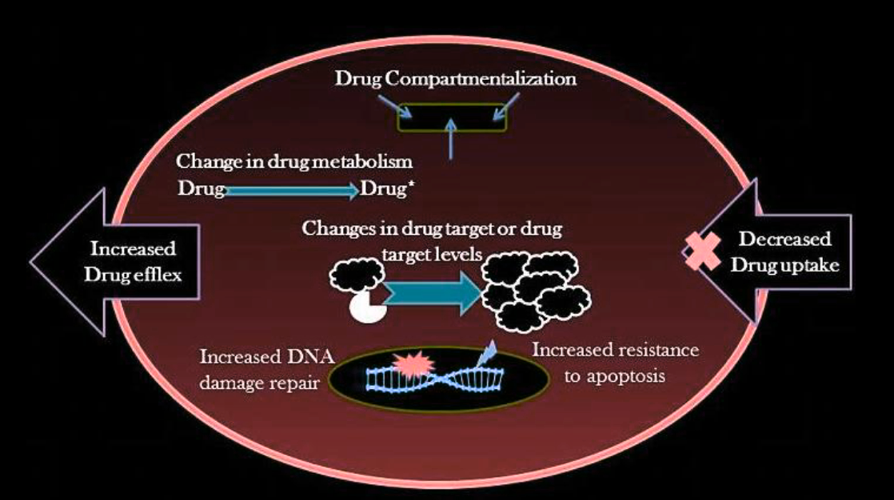

Slide 4
Tumor heterogeneity
mutations, gene amplifications, deletions, chromosomal rearrangements, transposition of the genetic elements, translocations and microRNA alteration
Epigenetic factors including miRNA, transcriptomic and proteomic heterogeneity may rise due to primary genotypic variations, but can also reflect cell cycle stage, stochastic variations between cells, or hierarchical organization of cells according to the cancer stem cell theory
These alterations known as intrinsic factors cause tumor heterogeneity. Extrinsic factors include pH, hypoxia, and paracrine signaling interactions with stromal and other tumor cells. These factors change, increase, or diminish gene products which directly are involved in the generation of drug resistance and poor prognosis
Related features: Genomics (SNV, CNV, gene fusion, rearrangement), Transcriptomics, Proteomics

Slide 5
Tumor microenvironment
Growing evidence supports the important role of tumor microenvironment in drug resistance discussion as the main reason for the relapse and incurability of various cancers.
The tumor microenvironment involves normal stromal cells (SC), extracellular matrix (ECM), and several soluble factors include cytokines and growth factors (GF).
growth factor (GF), cytokines produced in the tumor microenvironment provide additional signals for tumor cell growth and survival
Related features: Proteomics, Transcriptomics

Slide 6
Cancer stem cells
Cancer stem-cell populations have been detected in a variety of hematopoietic and solid tumors, and might be the cell of origin of hematopoietic and solid tumors.
chemotherapy agents are removed from cancer stem cells with the special mechanism
overexpression of the ATP-binding cassette (ABC), drug transporters such as ABCB1, which encodes Pglycoprotein, and the ABCG2
Cancer stem cells share several of normal stem cells possession that provides for a long lifetime, including the relative silence, resistance to drugs and toxins through the expression of drug efflux transporters, an active DNA-repair capacity and a resistance to apoptosis, vascular niche, dormancy, hypoxic stability and enhance activity of repair enzymes.
Related features: Gene expression (markers), Proteomics (ABC overexpression), Genomics (DNA repair variants, BRCA1)

Slide 7
Inactivation of the anticancer drugs
The interaction between drugs and different types of proteins (in vivo) can alter the molecular characteristics of drugs and ultimately activate them. Cancer cells become resistant by reducing the activity of drugs
Mutations or down regulations of drug activation pathways (ex. AraC phosphorylations)
Detoxification of anti-cancer drugs (MAPEG ezymes for anti-cancer drugs is glutathione S-transferase family (GST))
Related features: Genomics (mutations in activating enzymes), Proteomics (detox enzymes expression)
Notes:
mitogen-activated protein kinase (MAPK)

Slide 8
Multi-drug resistance (MDR)
Multi-drug resistance (MDR) is the ability of cancer cells to survive against a wide range of anticancer drugs
MDR mechanism may be developed by increased release of the drug outside the cells. So the drug absorption is reduced in these cells
Related features: Proteomics (efflux pomps), Transcriptomics (ABC transporters)

Slide 9
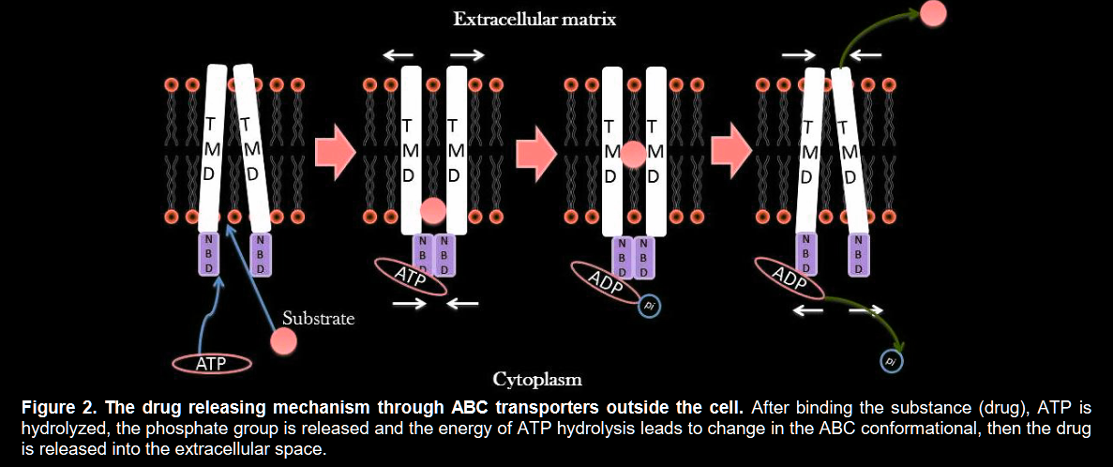
Increasing the release of drugs outside the cell
The ABC transporters are composed of two cytoplasmic domains that bind to ATP known as ATP-binding cassette (ABC)
ABC Family has three members, including 1. P-glycoprotein (PGP), 2. multi-drug Resistance-associated Protein 1 (MRP1) and 3. Breast Cancer Resistance Protein (BCRP/ABCG2).
Related features: Proteomics, genomics (mut in ABCB1, ABCG2), transcriptomics

Slide 10
Reducing the absorption of the drugs
The cytotoxic agents are able to enter the cells via direction of the concentration gradient by the three ABC transporter
Reducing the absorption of the drugs can occur at two main ways:
1. reducing the tendency to drugs binding and/or
2. Reducing the numbers of transporters.
Mutations in these transporters inhibit them and reduce the absorption of the drugs
Example: Methotrexate in lymphoblastic leukemia, The mutation of G point at nucleotide 133 and the substitution of lysine by glutamic acid in the first transmembrane domain of hRFC protein reduces the tendency of the drugs to bind the transporter.
Related features: Structural biology, Genomics, Transcriptomics

Slide 11
Inhibition of the cell death (apoptosis pathway blocking)
The cell death is mediated by the three important events such as necrosis, apoptosis, and autophagy.
up-regulation of the antiapoptotic genes (Bcl2, AKT and etc) and downregulation of pre-apoptotic genes (Bax, Bclxl and etc) in tumor cells are associated with increased resistance to chemotherapy
Mutations in p53 could impair the connection between DNA damage (which caused by chemotherapeutic agents) and the activation of apoptosis
Related features: Genomics, Transcriptomics

Slide 12
Changing the drug metabolism
Enzyme driven metabolism protect normal cells via detoxification and promotes cancer resistance
Enzymes drive resistance via two opposing mechanisms:
Reduced Pro-Drug Activation
Mechanism: Downregulation of activating enzymes
Increased Drug Inactivation
Mechanism: Overexpression of detoxifying enzymes
Example: Cisplatin resistance due to glutathione conjugation.
Related features: Genomic, transcriptomics, Proteomics

Slide 13
Changing the chemotherapeutic agents targets
The effect of chemotherapeutic agents could have been depended on the modifications such as the mutations and changes in the expression levels of their targets.
The point mutations and amino acid substitution in the kinase domain of BCR-ABL lead to altered structure in the proteins and prevent the proper binding of the drugs
Related features: Structural biology, genomics

Slide 14
Enhancing the DNA repair
The chemotherapeutic agents damage directly or/and indirectly the cancer cells DNA, so, there are mechanisms that can repair the damage of DNA
The resistance to these agents occurs by the DNA repair systems, including nucleotide excision repair system (NER) and homologous recombination repair mechanisms (RRM) in the cancer cells. So, the efficiency of these agents is dependent on the inhibition of the DNA repair systems in the cancer cells.
The inhibition of DNA repair systems sensitizes the cancer cells to these drugs and thus the effectiveness of the chemotherapy will increase.
The defects in the DNA repair systems in the cancerous cells could be one of the therapeutic targets which can be possible by mutations and epigenetic silencing in these systems.
Related features: Genomics, Transcriptomics

Slide 15
Gene amplification
Gene amplification is a mechanism of the drug resistance in 10% of the cancers, especially in leukemias.
The gene amplification increases the copy numbers of the oncogenes per cells, this mechanism cause to the production of larger amounts of oncoproteins.
Related features: CNV, Transcriptomics, Proteomics

Slide 16
Epigenetic altering caused drug resistance
There are two types of the epigenetic altering such as 1. methylation of DNA and 2. histone alterations.
The DNA methylation is a major epigenetic phenomenon that occurs with the methylation of the cytosine by methyltransferase in 5’ carbon in the CpG islands (an upstream of the promoters).
For example, the tumor suppressor genes often silenced by methylation, in contrast, the hypermethylation of oncogenes induced their expression
combination of epigenetic and conventional chemotherapeutic agents are effective in the treatment of resisted tumors and cancerous cells.
Related features: Proteomics, Transcriptomics, Epigenomics

Slide 17
MicroRNA in cancer drug resistance
MicroRNAs (miRNAs) are ~22 nucleotide RNAs processed from RNA hairpin structures. MicroRNAs are much too short to code for protein and instead play important roles in regulating gene expression
There are three mechanisms involved in gene silencing with miRNA process: 1. Cleavage of the mRNA strand into two pieces, 2. Destabilization of the mRNA through shortening of its poly(A) tail and, 3. Less efficient translation of the mRNA into proteins by ribosomes
Recent studies in miRNA profiling confirmed that these small molecules play an important role in the development of chemosensitivity or chemoresistance in different types of cancer
Related features: Transcriptomics (miRNA expression profiling), Genomics (CNV or mut)

Slide 18
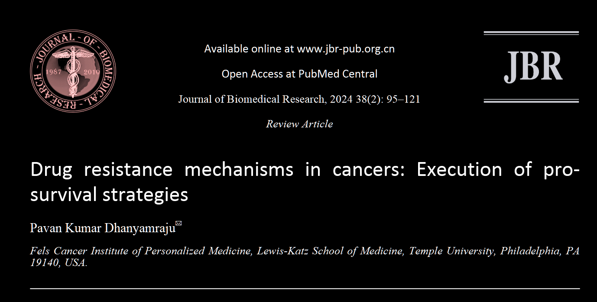
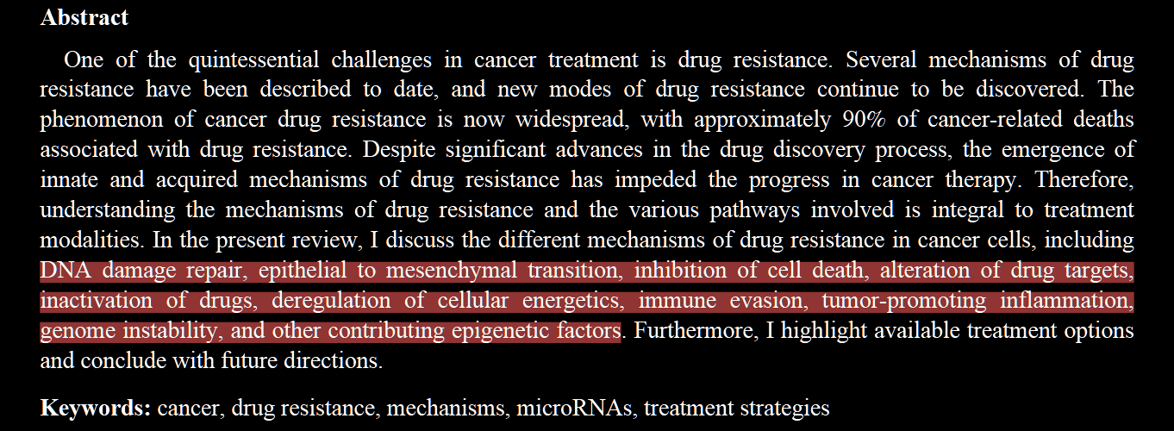

Slide 19
Mechanism of Drug Sensitivity and resistance in Cancer (mdrDB)
Theoretical presentation

