Slide 1
Automating boltz-2 and AF3 analysis on GDSC cell lines
Master Thesis project implementation

Slide 2
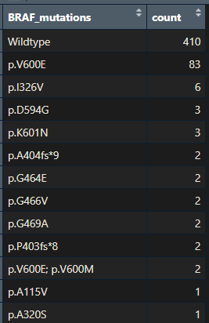
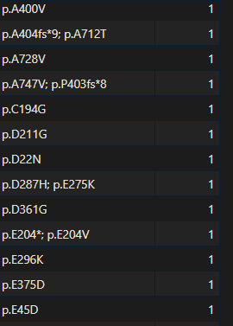
Automatization
We want to automatically generate AF3 and boltz2 templates for every detected variant of braf gene in the GDSC database
Extract distinct genetic profiles in GDSC
Create function to mutate the wildtype sequence of BRAF according to profile
Organize resulting templates for accessibility and integration

Slide 3
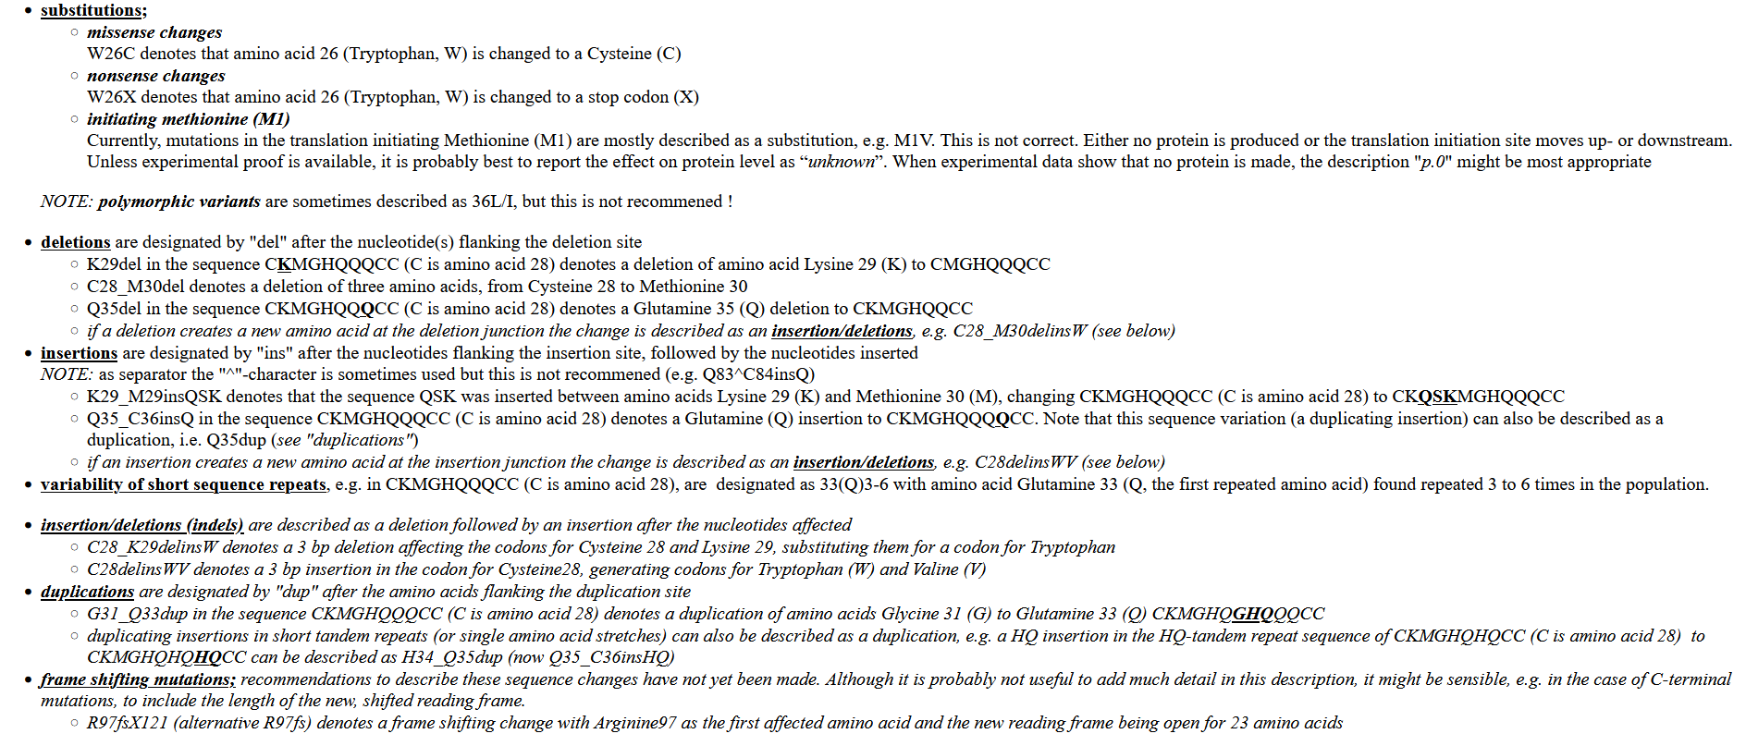
Protein mutation nomenclature

Slide 4
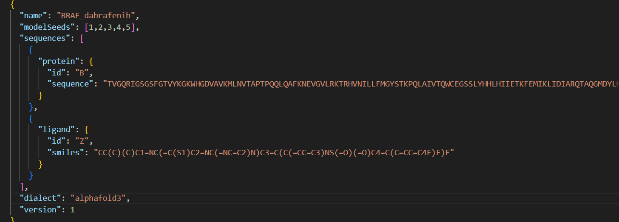
Alpha Fold 3 input: protein-ligand complex
Json file:

Slide 5
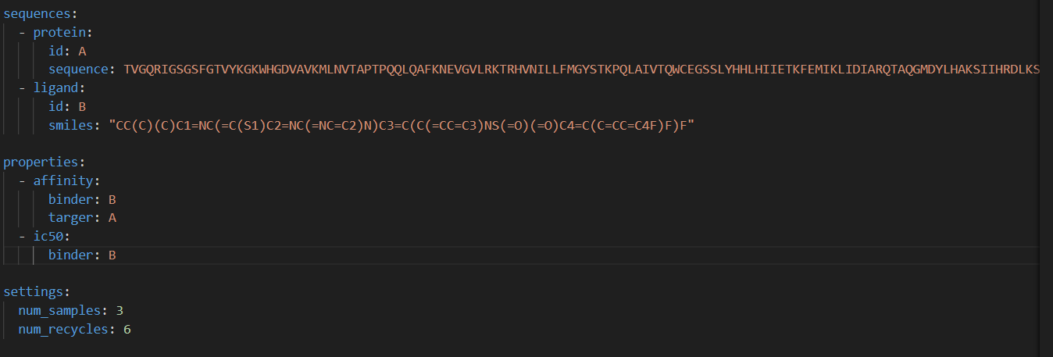
Boltz2 input: protein-ligand affinity
Yaml file:
Notes:
Num_sample: nombre de conformations demandées num_recycles:

Slide 6
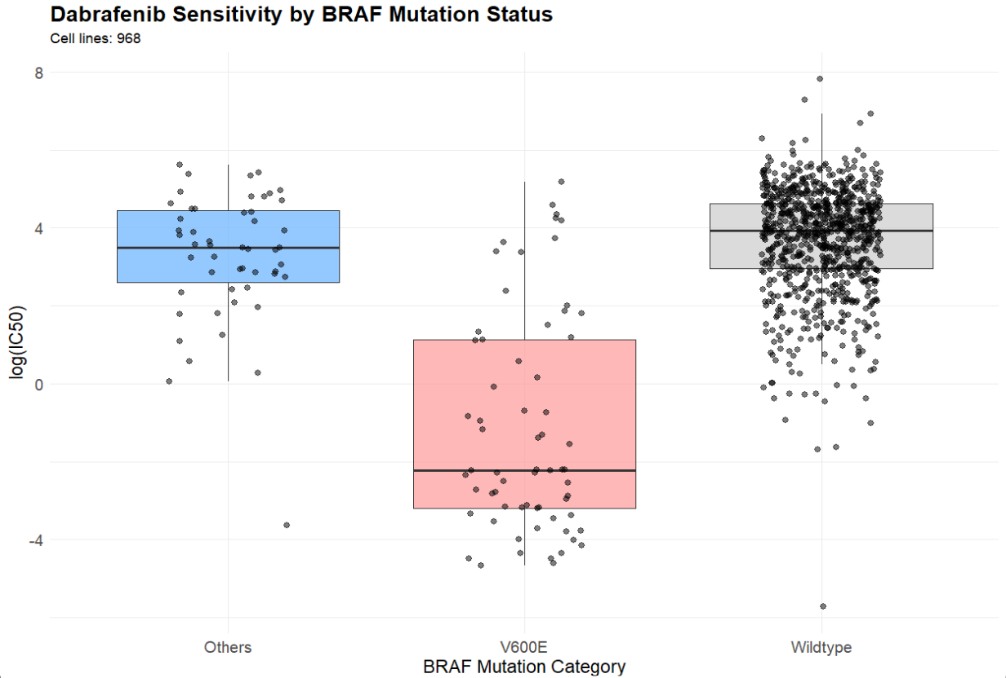
GDSC cell line sensitivity to Dabrafenib

Slide 7
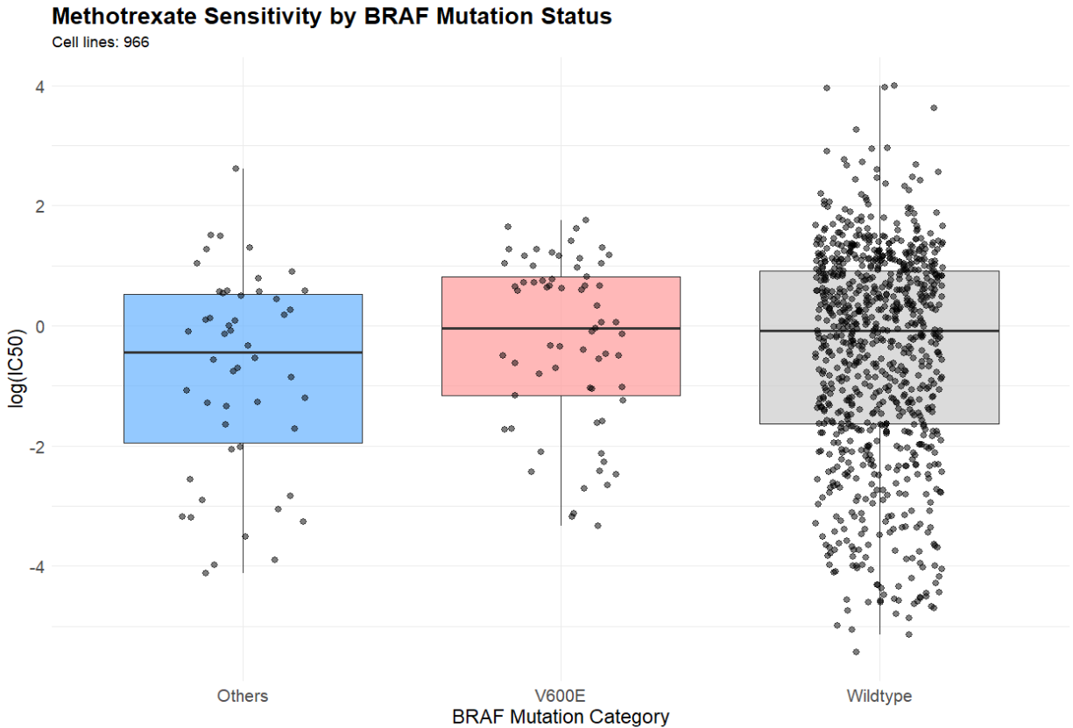
GDSC cell line sensitivity to Methotrexate (Control)

Slide 8
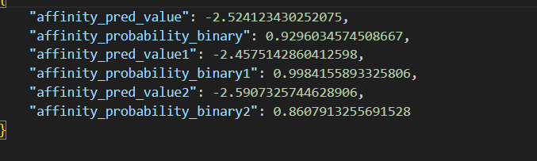
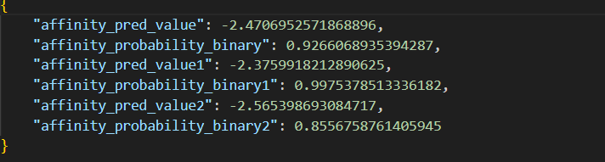
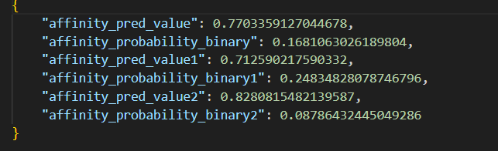
Boltz results for BRAF(wt/v600e) + dabrafenib
BRAF wt +dabrafenib
BRAF V600E +dabrafenib
CONTROL: BRAF wt +methotrexate

Slide 9
Boltz results for BRAF(wt/v600e) + dabrafenib
WHY?
Dabrafenib might binds differently to BRAF V600E monomers vs. V600E dimers
WT BRAF is subject to auto-inhibitory intramolecular interactions, Modeling the kinase domain only leads to dabrafenib binding WT BRAF.
WT BRAF is subject to inhibitory intermolecular interactions, especially with 14-3-3 protein and with itself (homo or hetero-dimer). Modeling BRAF only leads to dabrafenib binding WT BRAF as well as V600E.
Boltz approach assumes a similar conformational distribution for WT and V600E unless told otherwise. If the same conformational ensemble is used for both proteins, this key biological difference might be lost in prediction.

Slide 10
Boltz results for BRAF(wt/v600e) + dabrafenib
SOLUTIONS?
Try to give full length sequence of BRAF instead of domain only
Add structural template in boltz-2
Add molecular environment for more accurate braf conformations (14-3-3, CRAF, MEK, RAS, dimer, …)
Find another predictor (MIGHT HAVE SAME ISSUE)
Test boltz2 on another gene/drug pair with simple mechanism

Slide 11
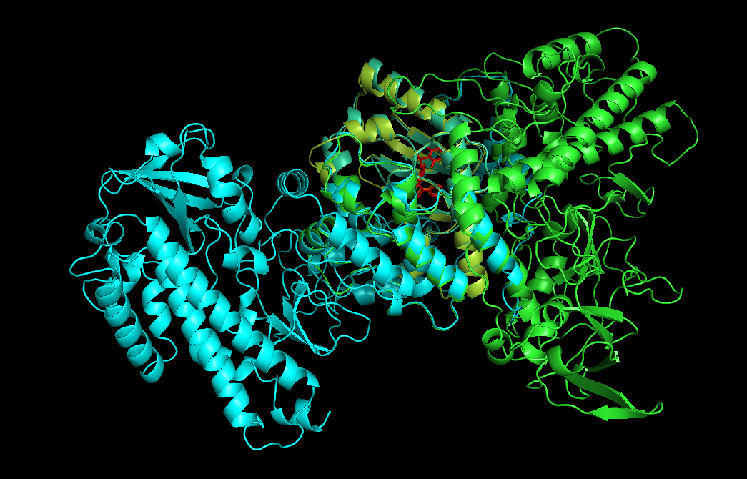
Full length sequence of BRAF solution
Notes:
Aligned on the 464- 610 (mek binding) domain, when trying to align on another domain we have no perfect match Might suggest 2 braf orentations (left and right part of braf dimer) ??

Slide 12
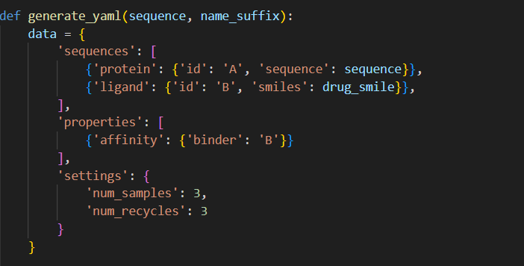
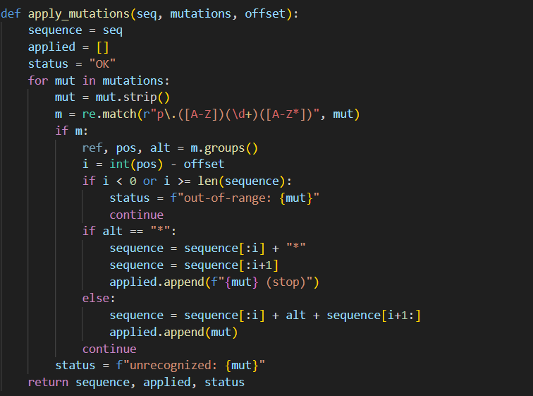
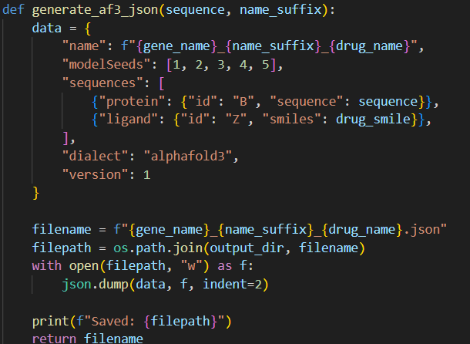
Template creation scripts
Notes:
We keep only mutations that are in the correct domain and only substitutions or misssence

Slide 13
IC50 for dabrafenib (literature)
Vemurafenib and dabrafenib are more selective for BRAF^{mut} than other kinases, including BRAF^{wt}.
Dabrafenib:
IC50 BRAF(V600E) = 0.6 nM
IC50 BRAF(WT) = 0.6/0.05 = 12 nM
IC50 CRAF = 5 nM
Dabrafenib has similar potency for inhibition of BRAF^{V600E} and BRAF^{V600K}
https://pmc.ncbi.nlm.nih.gov/articles/PMC3523565/

Slide 14
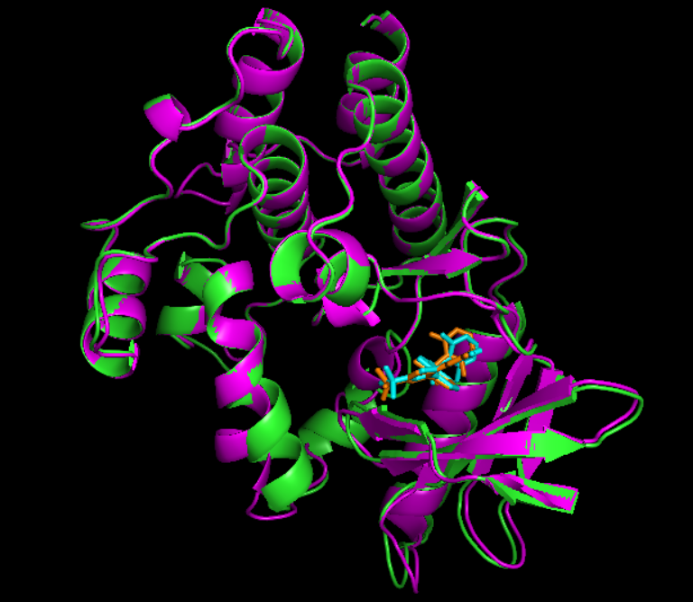
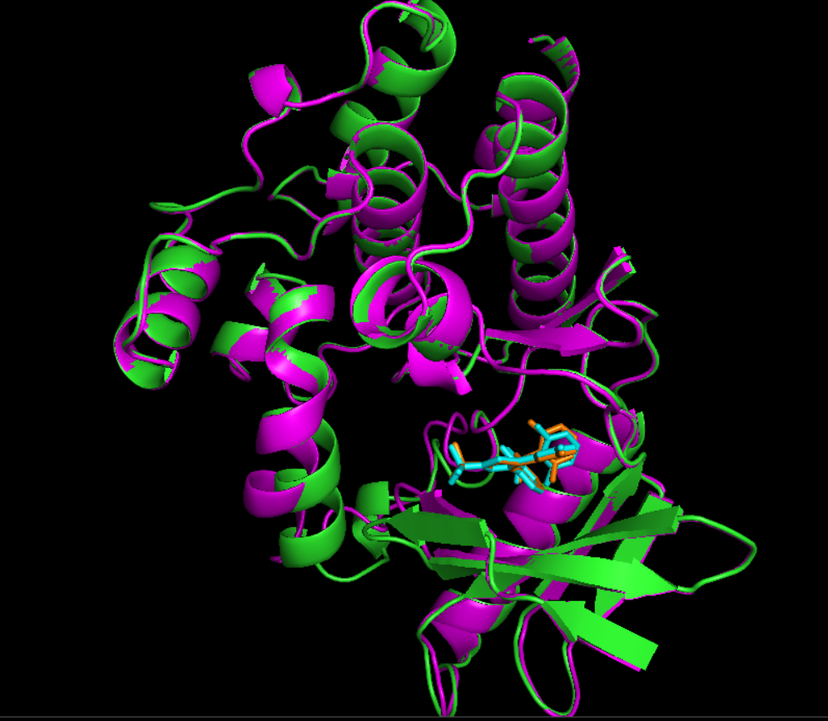
Boltz vs AF3 models
BRAF Wildtype
BRAF V600E
Notes:
Purple/orange is AF3 and green/blue is boltz2

Slide 15
Trying on another drug/protein pair
FLT3 kinase
Mutation: Activation-loop mutants such as D835Y/H/E
Effect:
WT IC₅₀ ≈ 1.3 nM
D835Y mutant, IC₅₀ ≈ 8.8 nM
The D835H mutation causes about 26-fold resistance to quizartinib (AC220), compared to much higher resistance to sorafenib (~295-fold) and ponatinib (~100-fold)
D835F/I/V/Y mutations showed the highest resistance to type II TKIs, with resistance increasing 107 to 2600-fold.
D835E/N mutations caused low resistance (<20-fold) to all inhibitors tested.
Drugs: Quizartinib (AC220)
https://ashpublications.org/blood/article/122/21/3929/14297/Mutations-At-The-FLT3-Activation-Loop-D835-Residue
https://pmc.ncbi.nlm.nih.gov/articles/PMC4675689/
https://onlinelibrary.wiley.com/doi/10.1111/ejh.14383

Slide 16
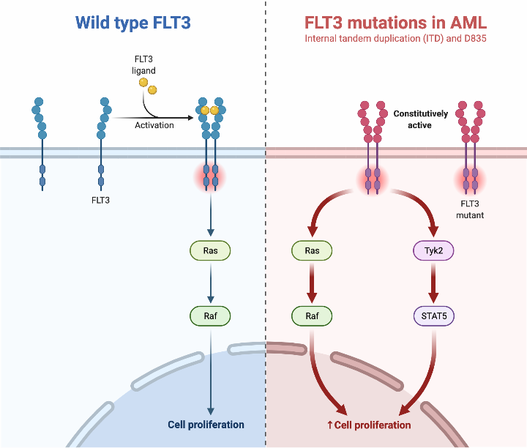
Trying on another drug/protein pair: FLT3
https://www.biorender.com/template/flt3-mutations-in-acute-myeloid-leukemia-aml

Slide 17
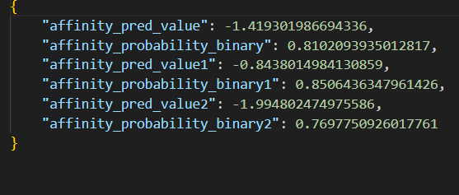
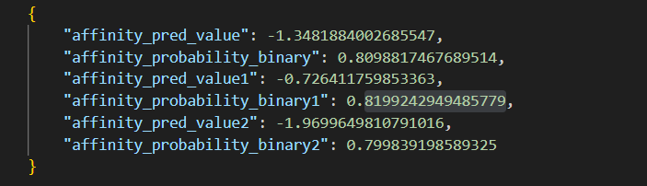
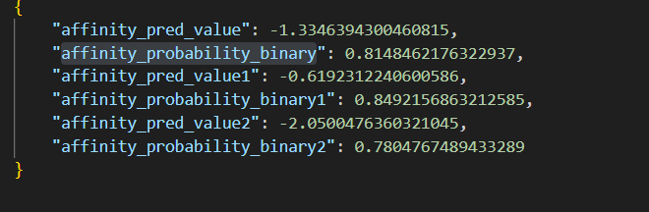
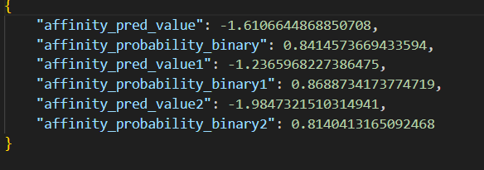
Boltz results for FLT3 (WT/D835Y/H/E) + quizartinib
FLT3 wt
FLT3 D835Y
FLT3 D835E
FLT3 D835H

Slide 18
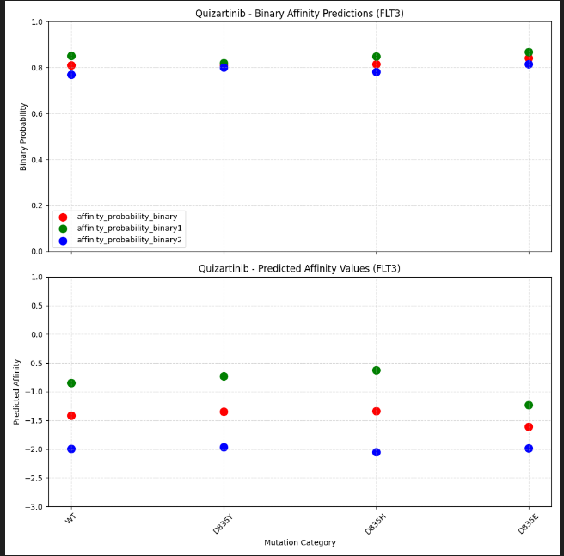
NOT SIGNIFICANT RESULTS

Slide 19
Problem
Multiple boltz runs on same model gives different results :’(
Impossible to use small differences in IC5O predictions (too random)
No seeding available in boltz
Boltz was designed to detect changes in binding affinity based on small changes in drug (adding/remove chemical group) not for small protein mutations

Slide 20
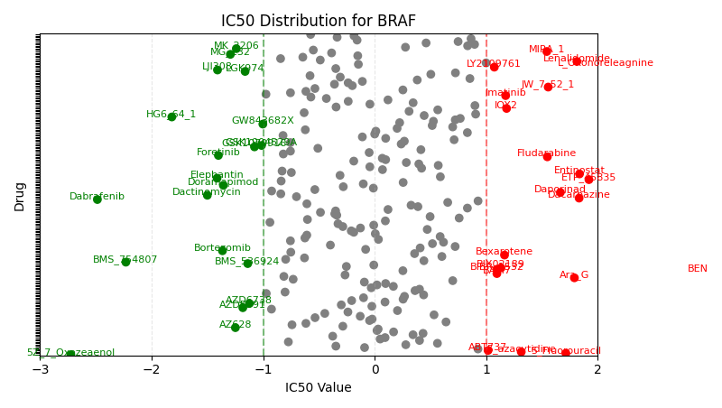
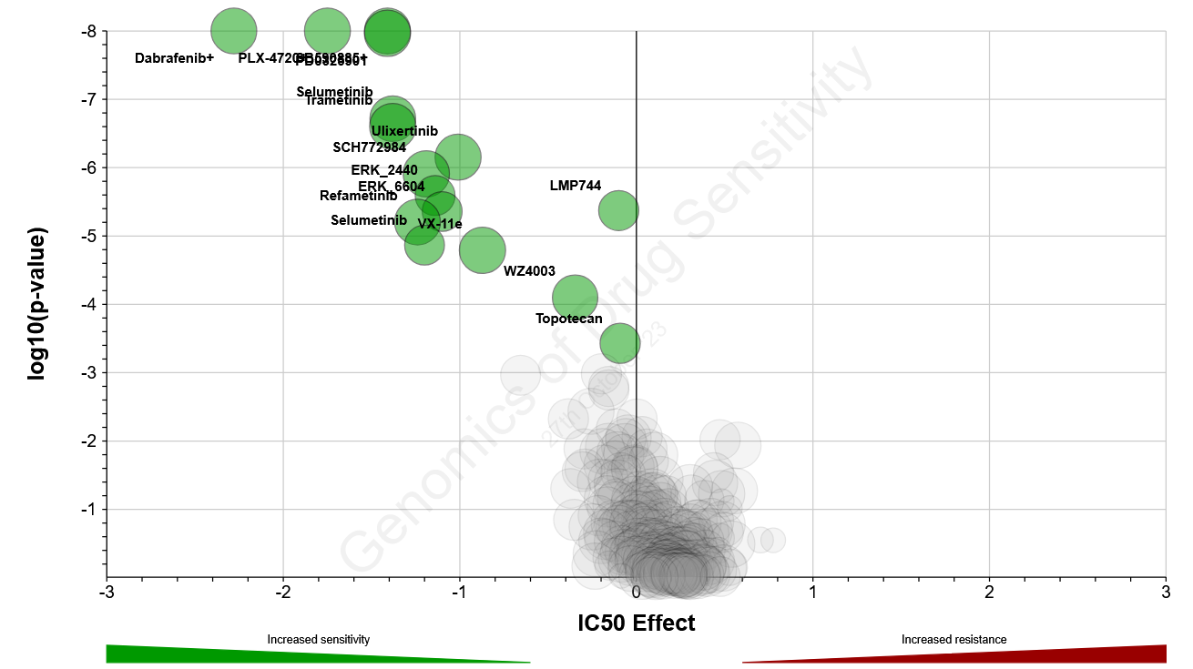
Drug binding predictor using BOLTZ 2
Notes:
NOT ALL DRUGS ARE PRESENT (ONLY 244 ATM)

Slide 21
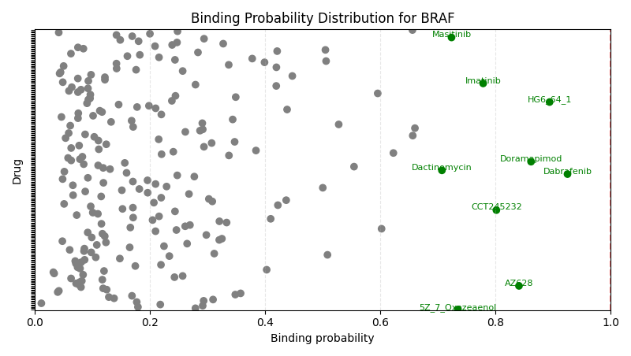

Slide 22
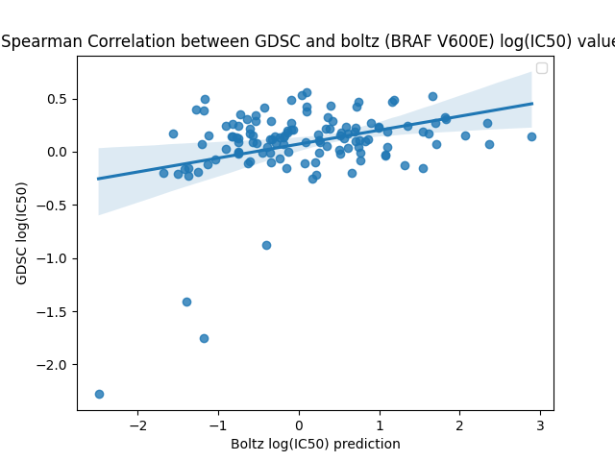
Spearman correlation GDSC/Boltz
Notes:
Correlation is 0.248 P-value: 7.4122e-03

Slide 23
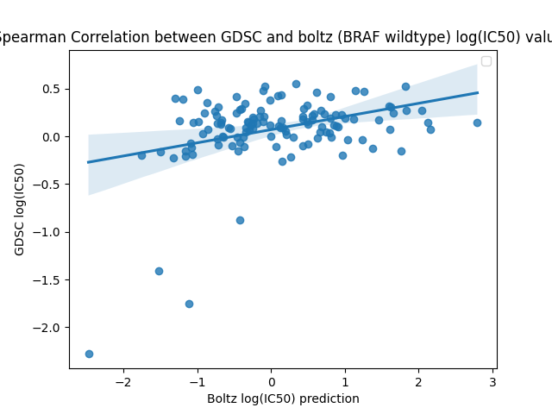
Spearman correlation GDSC/Boltz
Notes:
Correlation sperman: 0.2375
P-value: 7.4122e-03

Slide 24
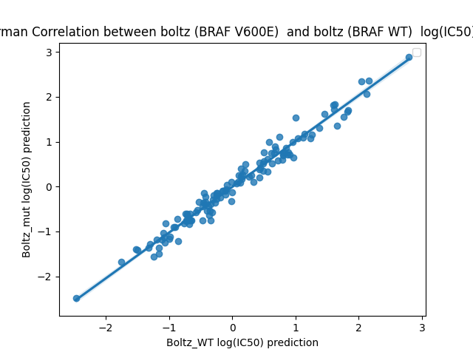
Spearman correlation Boltz (BRAF WT)/Boltz (BRAF V600E)
Notes:
Spearman correlation: 0.9842
P-value: 3.7212e-95

Slide 25
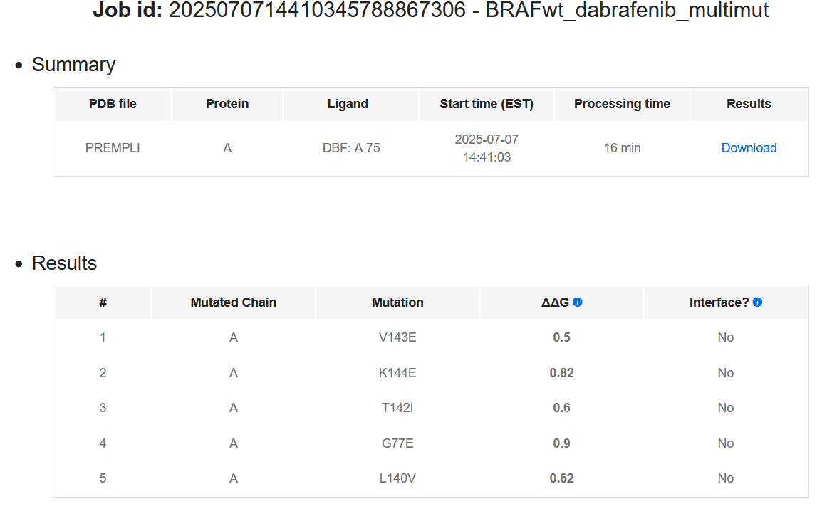
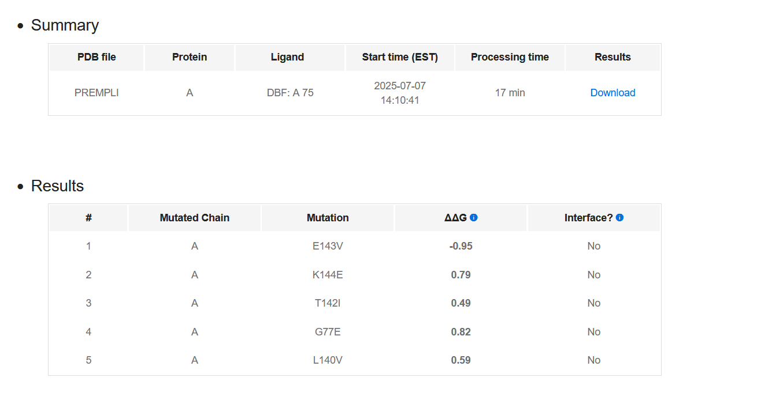
Other Tool: PremPLI

