Slide 1
SISIG FACTORY INVENTORY OF PRODUCTS AND SALES
October 10, 2017

Slide 2
This project will print the summary of products and sales.

Slide 3
TEAM ROLES
Joseph Custodio
- document expert
Michael Angello Tabacon
- back end
Carlo Shane Prado
-Project Manager

Slide 4
Project Development Platform
Netbeans/JFrame (For our front-end)
SQLite (for our back-end)
Netbeans (For the development environment)

Slide 5
Project Scope
It has the ability to monitor sales and stocks as requested by the client/owner of the bakeshop
Create an entry if the owner desires to add new products
Read a data entry if required for monitoring purposes
Update a data entry if needed to change price, description, etc.. if the owner desires to do so
Delete data entry in the event of multiple entry

Slide 6
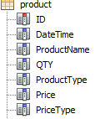
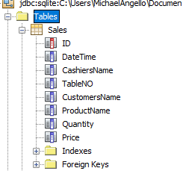
Database Schema

Slide 7
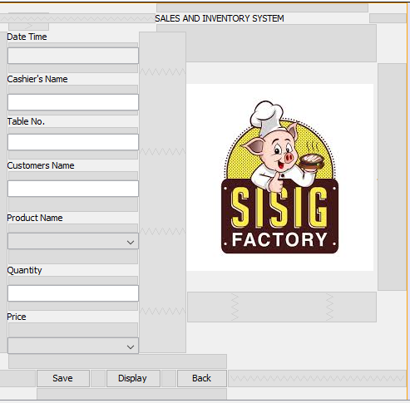
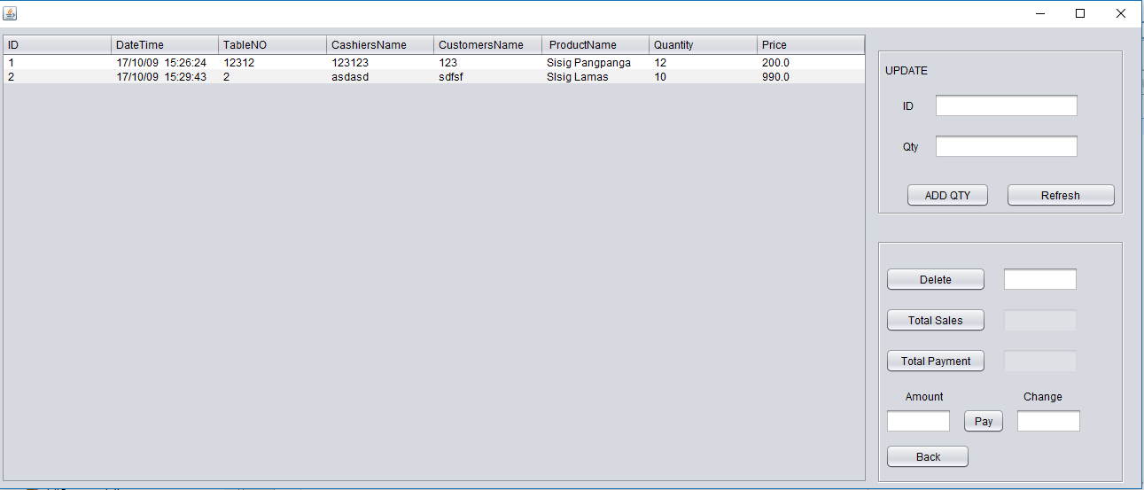

Slide 8
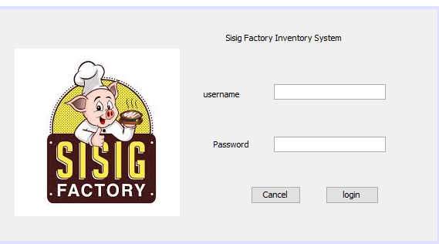
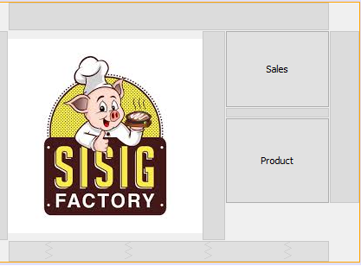

Slide 9
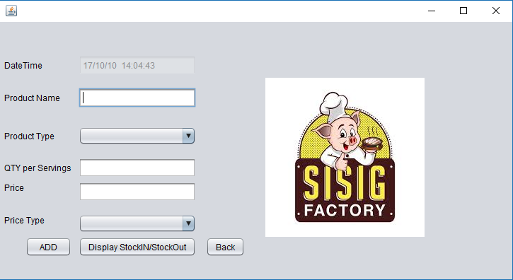

Slide 10
