Slide 1
Lending Club
How to Get a Loan: An Exploration with Logistic Regression
By Tianhong Ding & William Raikes

Slide 2

“Lending Club’s platform has the potential to profoundly transform traditional banking over the next decade.”
- Larry Summers, Former US Treasury Secretary
“The math pitch involves the increased efficiency of cutting out the banks, allowing relatively lower rates for borrowers and good returns for lenders.”
- New York Times
What is the lending Club?
DESCRIPTION:
A peer-to-peer lending company, headquartered in San Francisco, California and founded in 2006.
The world’s largest online credit marketplace, facilitating personal loans, business loans, medical financing, etc.
Loans funded to date: over $22 billion
HOW IT WORKS:
Potential customers complete brief application online.
Lending Club digitally assesses the risk, credit rating and interest rates, and then sends qualified applicants an offer.
Investors ranging from individuals to institutions select loans in which to invest.

Slide 3
Inference: Which Factors Matter Most?

Slide 4
Data Descriptions
How to Get a Loan
Variable | Description | Notes
Status | Granted a Loan or Rejected | Outcome Variable
Loan Amount | Amount Requested (and Granted) by Borrower | Full Amounts are Usually Granted
Date | Date of Application or Loan Granted | ~ 7 Days Difference
Debt-to-Income Ratio | Monthly Debt Payments / Monthly Income | Excludes Mortgage
Employment Length | Employment Length in Years
State | State
Zip Code | Zip Code
Notes:
4

Slide 5
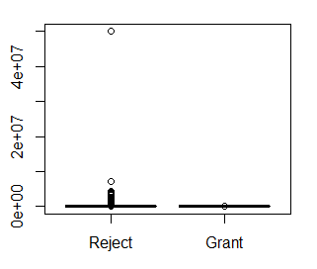
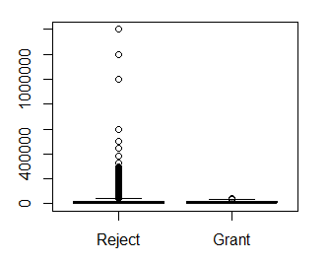
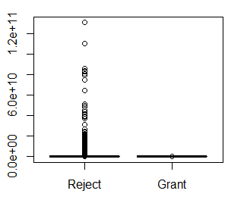
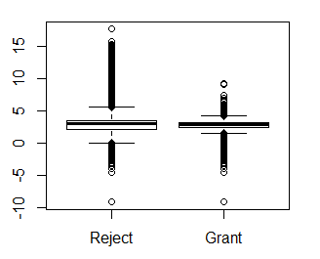
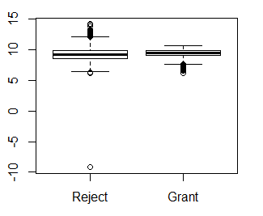
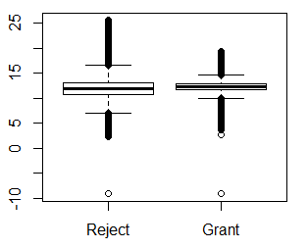
Exploratory Data analysis
How to Get a Loan
Interaction
(DTI x Loan Amount)
Original
DTI
Loan Amount
Log
Notes:
5

Slide 6
Exploratory Data analysis
How to Get a Loan
Employment Length
Month
Year
< 1 year
1 year
2 years
3 years
4 years
5 years
6 years
7 years
8 years
9 years
10+ years
Jan
Feb
March
April
May
June
July
Aug
Sept
Oct
Nov
Dec
2007
2008
2009
2010
2011
2012
2013
2014
2015
2016
Notes:
6

Slide 7
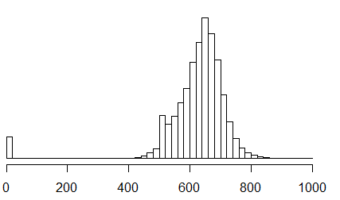
Exploratory Data analysis
How to Get a Loan
A Confounder: FICO Score
Average National FICO Score: 695
Notes:
7

Slide 8
Logistic Regression (Logit) - Interpretation
How to Get a Loan
 | Coefficient | exp(B) | p-value | Interpretation
DTI | -0.0032 | 0.996 | < 0.001 | One unit increase in DTI decreases the odds-ratio by 0.4%. May seem small, but DTI unit can very (range is 0-9999 for grants).
Loan Amount | < 0.0001 | 0.0 | 0.704 | The loan amount is not indicative of the probability of receiving a loan.
Interaction | < 0.0001 | 0.0 | < 0.001 | The interaction term is statistically significant, but holds no practical significance (very small effect size).
Notes:
8

Slide 9
Logistic Regression (logit) - Interpretation
How to Get a Loan
 | Coefficient | exp(B) | p-value | Interpretation
Employment (Baseline: < 1 years) | 1 year: 4.774 2 years: 4.832 3 years: 4.850 4 years: 4.980 5 years: 2.129 6 years: 4.898 7 years: 4.976 8 years: 5.039 9 years: 5.138 10+ years: 5.016 | 118.4 125.5 127.7 145.5 8.4 134.0 144.9 154.3 170.4 150.8 | < 0.001 < 0.001 < 0.001 < 0.001 < 0.001 < 0.001 < 0.001 < 0.001 < 0.001 < 0.001 | Having less than 1 year of work experience is detrimental to your chances of receiving a loan. At least 1 year(s) worth of experience increases the odds-ratio by a multiple of 118 to 170 (with the exclusion of the 5-year anomaly). This variable has statistical and practical significance.
Month (Baseline: January) | Feb. 0.135 Mar. 0.286 Apr. 0.177 May 0.230 Jun. 0.180 Jul. 0.325 Aug. 0.310 Sep. 0.040 Oct. 0.478 Nov. 0.345 Dec. 0.021 | 1.1 1.3 1.2 1.3 1.2 1.4 1.4 1.0 1.6 1.4 1.0 | 0.004 < 0.001 < 0.001 < 0.001 < 0.001 < 0.001 < 0.001 0.469 < 0.001 < 0.001 0.661 | Seasonality plays a very small, almost trivial role in the chances of obtaining a loan. Very slight differences between winter vs. summer months. Summer months increase odds-ratio by 0.4%. Although there is statistical significance, there is no practical significance.
Notes:
9

Slide 10
Diagnostics – Fitting A Logistic Regression
How to Get a Loan
Multicollinearity
Goodness of Fit
Interaction LR Test: p-value < 0.001
McFadden’s R2: 0.503
 | VIF
DTI | 1.42
Loan Amount | 1.54
Interaction | 1.85
Year | 1.02
State | 1.00
Employment Length | 1.01
Month | 1.02
Influential Points (Cook’s Distance)
Zero data points with D_{i} > 1.
~7% of data points with D_{i} > 4/n
Removing influential pts. decrease AIC by 6.3%.
Practical and statistical significance remain unchanged.
Notes:
10

Slide 11
Prediction: What About the Performance?

Slide 12
Prediction
5 Fold Cross Validated ROC Metrics
(Means)
How to Get a Loan
XGBoost performs the best, with the highest ROC.
Random Forest comes in a close second.
Logistic Regression is not far behind.
Generalized Additive Model and LDA perform slightly worse.
XGBoost
Random Forest
Logistic Regression
Generalized Additive Model
Linear Discriminant Analysis
Notes:
12

Slide 13
Validation: Did They Get it Right?

Slide 14
validation
Percentage Increase (Decrease) in Odds-Ratio for Likelihood to Default
How to Get a Loan
DTI*
Loan Amount*
Debt-to-Income ratio seems to have a similar impact on default rate as it does to rejection status.
Employment length does have a negative impact on default rates.
Could be an opportunity for more loans to people with less than a year’s worth of employment. (Less than 1% of people in this category were not rejected).
1 year*
2 years*
3 years*
4 years*
5 years*
6 years*
7 years*
8 years*
9 years*
10+ years*
* Indicates significant difference at 95% confidence level.

Slide 15
Diagnostics – Fitting A Logistic Regression (again)
How to Get a Loan
Multicollinearity
Goodness of Fit
Interaction LR Test: XXX
McFadden’s R2: 0.503
 | VIF
DTI | 1.0
Loan Amount | 1.0
Employment Length | 1.0
Influential Points (Cook’s Distance)
Zero data points with D_{i} > 1.
~7% of data points with D_{i} > 4/n
Removing influential pts. decrease AIC by 6.3%.
Practical and statistical significance remain unchanged.
Notes:
15

Slide 16
Conclusion

Slide 17
conclusion
How to Get a Loan
Limitations
FICO is most likely a confounder. Obtaining this data would significantly improve the analysis.
How does one get a loan?
Have a job:
Be employed for at least 1 full year.
And if it’s 5 years, then lie.
Your odds-ratio increases by a factor of at least 118!
Be reasonable:
Debt-to-Income Ratio < 10,000 (likely automatic cap).
Requested Loan Amount <= $40,000.
Interaction (DTI * Loan Amt) < 249,725,025.
Increase your income, lower your debt.
There could be some untapped potential in consumers who have < 1 year of employment; or the LC could be vetting wisely.
Notes:
17

Slide 18
How to Get a Loan: Appendix

Slide 19
Appendix
Hosmer-Lemeshow - large sample: p-value < 0.001
Hosmer-Lemeshow* - small sample: p-value 0.29
* REFERENCE

Slide 20
 | % Applied | % Have Loan
< 1 year | 74% | 8%
1 year | 1% | 7%
2 years | 2% | 9%
3 years | 2% | 8%
4 years | 1% | 6%
5 years | 8% | 7%
6 years | 1% | 5%
7 years | 1% | 5%
8 years | 1% | 5%
9 years | 1% | 4%
10+ years | 6% | 31%

