Slide 1
Lending Club
How to Get a Loan &
Tips to Lessen Default Rates
By Tianhong Ding & William Raikes

Slide 2

What is the lending Club?
“Lending Club’s platform has the potential to profoundly transform traditional banking over the next decade.”
- Larry Summers, Former US Treasury Secretary
“The math pitch involves the increased efficiency of cutting out the banks, allowing relatively lower rates for borrowers and good returns for lenders.”
- New York Times
Founded in 2006, LC is a US peer-to-peer lending company, headquartered in San Francisco, California. It was the first peer-to-peer lender to register its offerings as securities with the Securities and Exchange Commission (SEC), and to offer loan trading on a secondary market.
The world’s largest online credit marketplace, facilitating personal loans, business loans, and financing for elective medical procedures.
Loans funded to date: $22,659,522,884; Loans funded last quarter $1,972,033,973
HOW IT WORKS:
“Customers interested in a loan complete a simple application at LendingClub.com”
“We leverage online data and technology to quickly assess risk, determine a credit rating and assign appropriate interest rates. Qualified applicants receive offers in just minutes and can evaluate loan options with no impact to their credit score”
“Investors ranging from individuals to institutions select loans in which to invest and can earn monthly returns”

Slide 3
How to Get a Loan: Inference

Slide 4
Data Descriptions
How to Get a Loan
Variable | Description | Notes
Loan Amount | Amount Requested (and Granted) by Borrower | Full Amounts are Usually Granted
Date | Date of Application or Loan Granted | ~ 7 Days Difference
Debt-to-Income Ratio | Monthly Debt Payments / Monthly Income | Excludes Mortgage
Employment Length | Employment Length in Years
Status | Granted a Loan or Rejected | Outcome Variable
State | State
Zip Code | Zip Code
Notes:
4

Slide 5
Exploratory Data analysis
How to Get a Loan
Loan Amount
DTI
Interaction
(DTI x Loan Amount)
boxplots
Notes:
5

Slide 6
Exploratory Data analysis
How to Get a Loan
Employment Length
Month
Year
< 1 year
1 year
2 years
3 years
4 years
5 years
6 years
7 years
8 years
9 years
10+ years
Jan
Feb
March
April
May
June
July
Aug
Sept
Oct
Nov
Dec
2007
2008
2009
2010
2011
2012
2013
2014
2015
2016
Notes:
6

Slide 7
Exploratory Data analysis
How to Get a Loan
FICO Score (A Confounder)
histogram
Notes:
7

Slide 8
Logistic Regression
How to Get a Loan
Quasi-Perfection Separation
Model Transformation (LOG OR REMOVAL; DO NOT HAVE LOANS GREATER THAN X)
AIC
Notes:
8

Slide 9
Logistic Regression
How to Get a Loan
Quasi-Perfection Separation
Model Transformation (LOG OR REMOVAL; DO NOT HAVE LOANS GREATER THAN X)
AIC
Check Residuals and Diagnostics
Notes:
9

Slide 10
Logistic Regression
How to Get a Loan
 | DTI | Loan Amount | Interaction (DTI * LA)
Coefficient
95% CI
P-value
Interpretation
Notes:
10

Slide 11
Logistic Regression
How to Get a Loan
MONTH
EMPLOYMENT LENGTH
Notes:
11

Slide 12
How to Get a Loan: Prediction

Slide 13
Prediction
5 Fold Cross-Validated ROC Metric (Mean)
How to Get a Loan
Logistic Regression
Random Forests
Linear Discriminant Analysis
Generalized Additive Model
Show ROC prediction rates for different models; select best model.
Fdafd
Fdsafdas
Fdsafdsa
Fdafdsa
Notes:
13

Slide 14
Prediction
How to Get a Loan
Assumption: Inference from Logistic carries over to “Black Box” predictive models. Use Some Comparisons – Simulations Perhaps
Notes:
14

Slide 15
conclusion
How to Get a Loan
Any implications / limitations?
Confounders
Time Series
Prediction & Inference Comparisons
How does one get a loan?
Notes:
15

Slide 16
How to lessen defaults

Slide 17
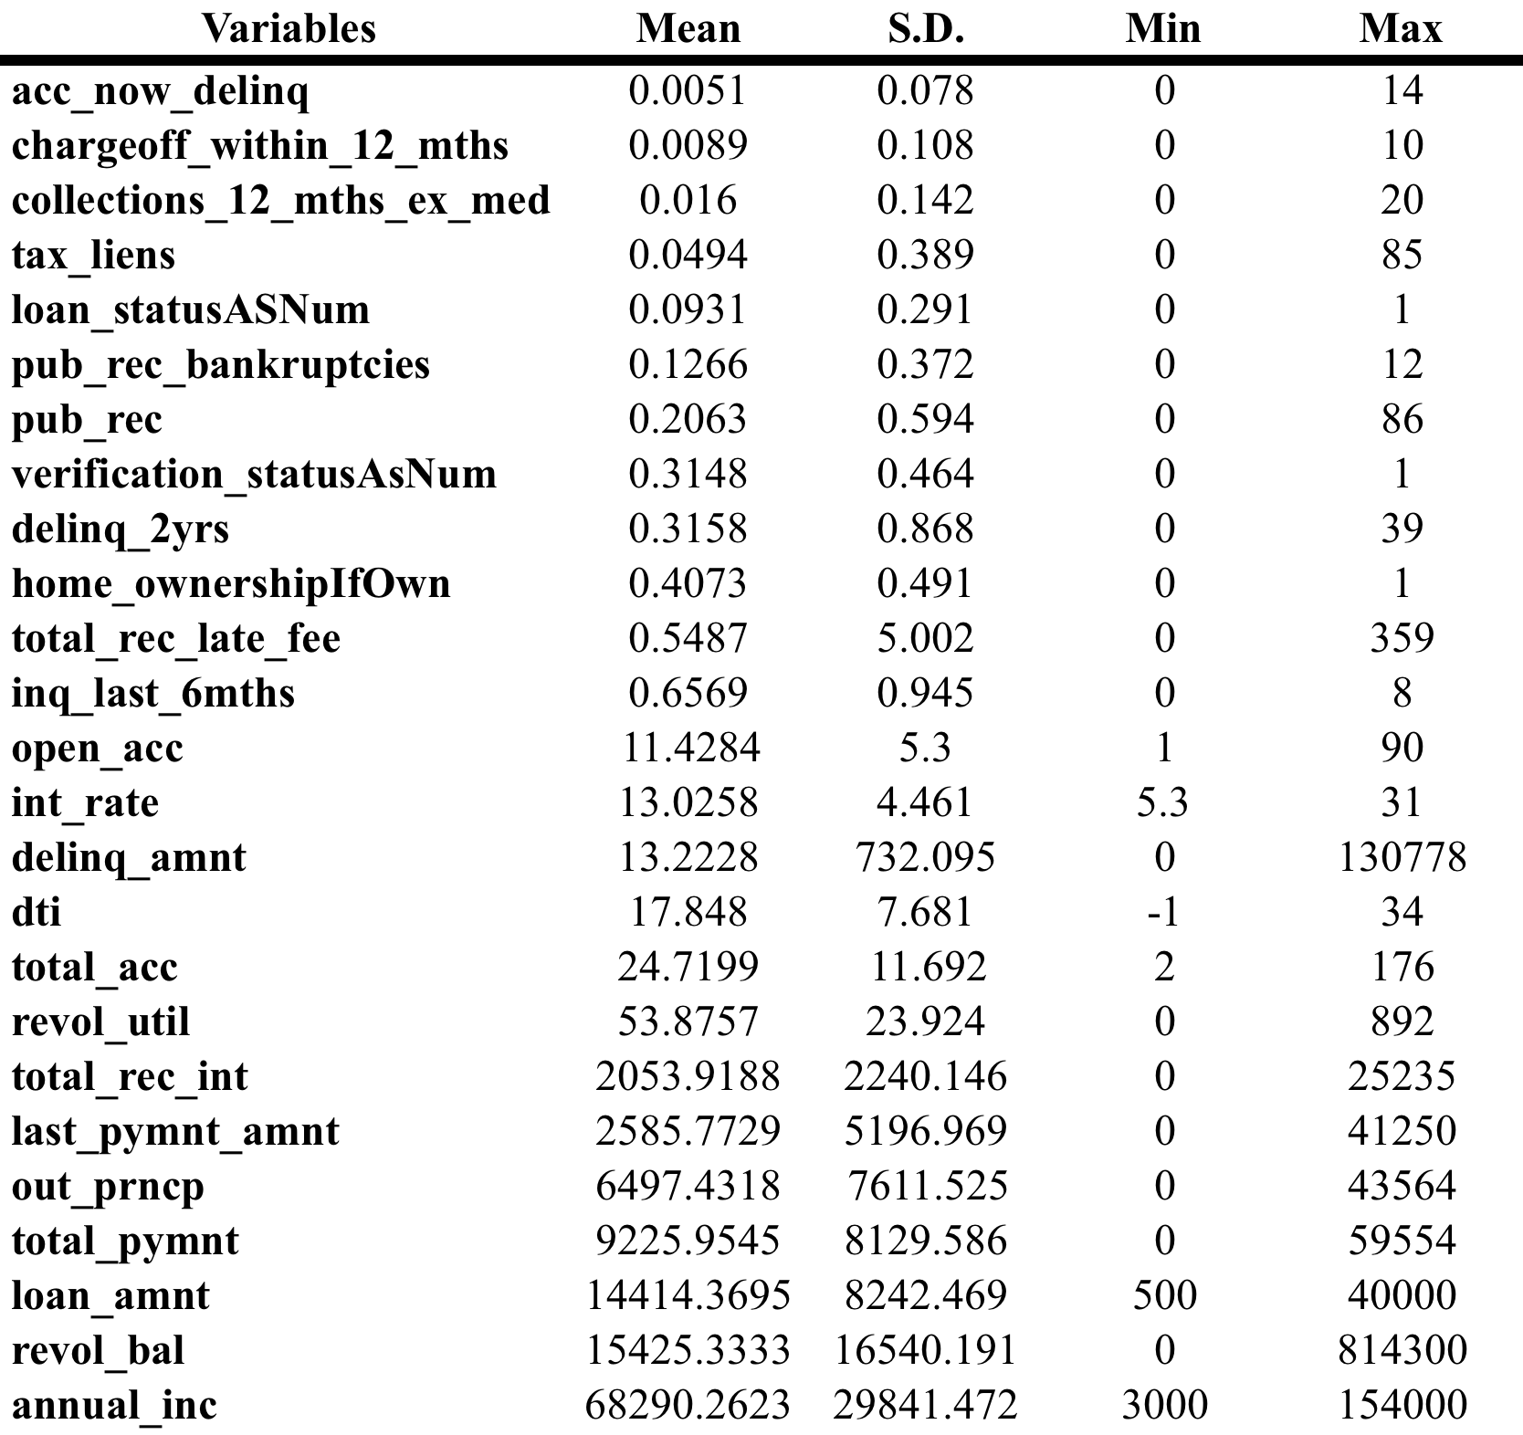
Data Descriptions
How to Lessen Defaults
Notes:
17

Slide 18
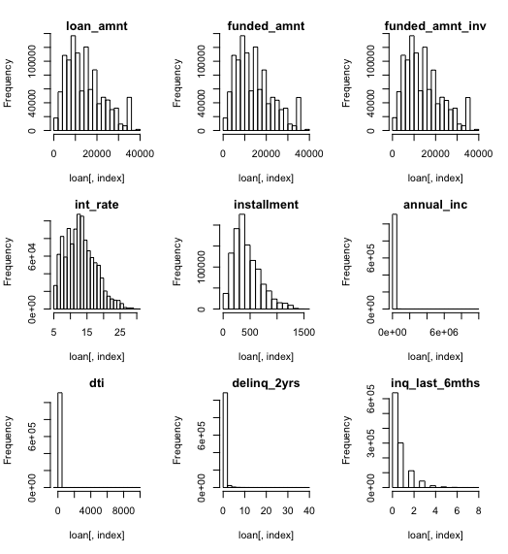
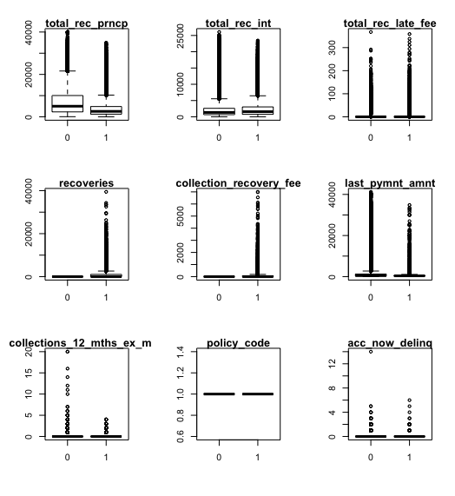
Exploratory Data analysis
How to Lessen Defaults
Notes:
18
1.Perfect separation
2. Always the same. Meaning not much deviance

Slide 19
Logistic Regression
How to Lessen Defaults
Correlation plot
Logistic regression
Sensitivity analysis
Notes:
19

Slide 20
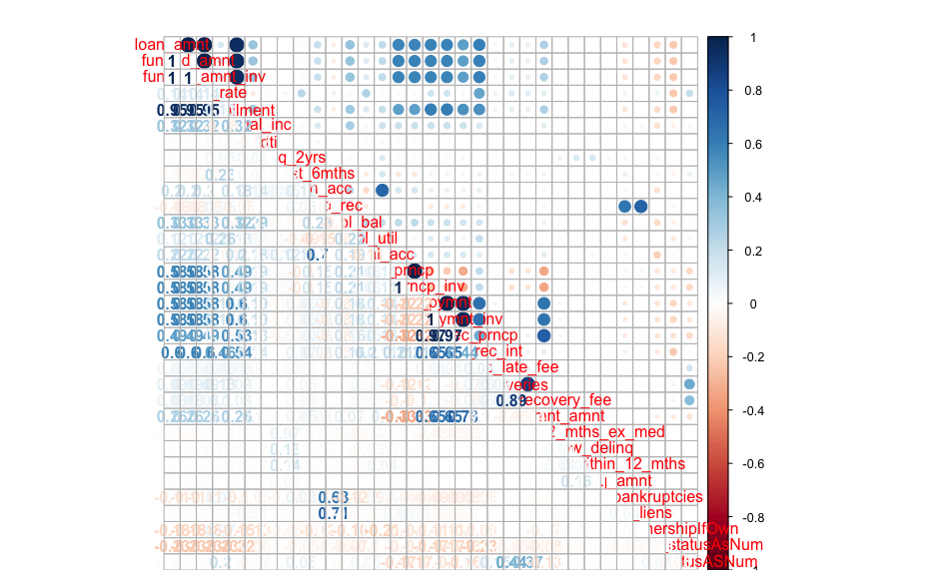
Logistic Regression
How to Lessen Defaults
Only leave one of the highly correlated variables because we need to make sure predictor variables are independent.
Notes:
20

Slide 21
Logistic Regression
How to Lessen Defaults
StepAIC to choose variables
VIF()
Outliers analysis
Fit Test
ROC
Notes:
21

Slide 22
Logistic Regression
How to Lessen Defaults
Residual analysis
Coefficients explanations
What can Lending Club do
Notes:
22

Slide 23
Logistic Regression
How to Lessen Defaults
Limitation of the model
Notes:
23

