Slide 1

CMR COLLEGE OF ENGINEERING & TECHNOLOGY
Kandlakoya,Medchal,Hyderabad-501401
Department of Computer Science and Engineering
Batch Num: 61
CardioVascular Disease Prediction Using Machine Learning Algorithms
Under esteemed Guidance of
Mr.A.Vivekanand
Associate Professor
Prajnaya.B-20H51A0507
Sri Vidya.V-20H51A0524
Sharanya.B-20H51A05K2
Batch:2020-2024
Major Project phase II

Slide 2
OVERVIEW OF PRESENTATION
1.MOTIVATION
2.PROBLEM DEFINITION
3. SCOPE
4.INTRODUCTION
5.LITERATURE REVIEW
6.MATERIALS
7.METHODS
ARCHITECTURE
7.1 Solo machine learning

Slide 3
OVERVIEW OF PRESENTATION
7.2 Ensembling learning
7.3 Ensemble methods
8.RESULTS
8.1 Data preprocessing
8.2 Data spliting
8.3 Model selection
8.4 Model evaluation
9.CONCLUSION

Slide 4
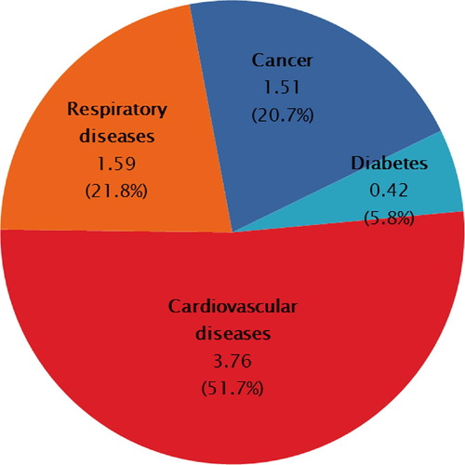
1.MOTIVATION
Predictive models can help identify individuals at risk of developing cardiovascular diseases before symptoms manifest.
CVDs are a leading cause of mortality worldwide and impose a substantial economic burden on healthcare systems.
ML algorithms can integrate diverse data sources and detect complex patterns that may not be apparent to human clinicians. This can enhance the accuracy of CVD risk assessment compared to traditional risk scoring systems, which often rely on a limited set of risk factors.
Fig1: Economic losses of non-communicative diseases in low and middle income countries 2011-2025

Slide 5

2.PROBLEM DEFINITION
Given a dataset containing information about individuals' demographics, medical history, lifestyle factors, and possibly genetic data.
The task is to build a machine learning model that can predict the likelihood of an individual developing cardiovascular disease (CVD) accurately

Slide 6
3.SCOPE
Healthcare Providers Physicians, nurses, and other healthcare professionals can use machine learning predictions to make more informed decisions about patient care.
Individual users can also benefit from machine learning model and web application in managing their health and making informed decisions.

Slide 7
4.INTRODUCTION
As per WHO CVD is the most deadliest disease almost 1/3rd of all deaths are caused due to cardiovascular disease it takes over 17 million lives over a year [1].
In the year 2023 it took over 20.5 million lives. advance knowledge can help us to prevent deaths caused by cardiovascular diseases [2].
To identify cardiac diseases there are symptoms like chest pain, chest pressure, shortness of breathing, fainting.
There are different types of cardiovascular diseases like coronary heart disease, peripheral heart disease, stroke, heart failure .

Slide 8

5.LITERATURE REVIEW

Slide 9
Vickey Singh et al[3] In their research work, they have applied machine learning algorithms to them CVD dataset and proposed a recommendation system based on basic information like age, cholesterol level, blood pressure. This research gives an accuracy of 88%.
Karthikeyan et al[4]They have researched the probability of cardiac arrest based on various regulated or unregulated variables in specific data set machine learning algorithms. implementation of help Vector Machine, Random Forest , Decision Tree, Logistic Regression and Artificial Neural Network algorithm on a dataset, it was observed that the Artificial Neural Network precision is higher (~85%) to predict the frequency of cardiac arrest.

Slide 10
T.M. Nithya et al[5] , In this proposed research work 14 necessary features were taken into consideration. Also, this paper presents a comparative analysis of machine learning By the comparative analysis, machine learning algorithm Random Forest has proven to be the most accurate and reliable algorithm and hence used in the proposed system. It gives an accuracy of 84%
Jasmine et al[6] ,The combination of logistic regression analysis and neural network they provided a novel approach in predicting the heart disease. Initially logistic regression is applied to select the major risk factors for predicting the disease. It gives 88% accuracy.
Lucia et al[7] , this paper proposes an ensemble-based approach that uses machine learning (ML) and deep learning (DL) models to predict cardiovascular disease. they employed 6 classification algorithms to predict cardiovascular disease. the ML ensemble model achieves the best disease prediction accuracy of 88.70%.

Slide 11



6.MATERIALS
We have collected our dataset from Kaggle which is a tabular data.
This collected dataset contains 19 variables in which 12 are numerical and 7 are categorical variables.
Number of instances are 308854 and dataset does not contain missing values.

Slide 12
Serial Number | Attribute | Description
1 | General Health | Well-being, fitness
2 | Check-up | Examination to ensure health or wellness
3 | Exercise | Activity for fitness and health.
4 | Heart Disease | Cardiac condition
5 | Skin_cancer | Describe different parts of your skin or conditions that can affect it.
6 | Other_Cancer | Those who indicated they have experienced any other forms of cancer
7 | Depression | Feeling sad, hopeless, or down for a long time.
8 | Diabetics | Having too much sugar in your blood for a long time.
9 | Arthritis | Pain and swelling in your joints that makes it hard to move.

Slide 13
Serial Number | Attribute | Description
10 | Gender | 0-Female,1-Male
11 | Age | In days
12 | Height | In Cent Meter
13 | Weight | Kilo Grams
14 | BMI | It is a number that shows if a person is a healthy weight for their height.
15 | Smoking History | Whether Patient Smokes or Not
16 | Alcohol consumption | Whether patient smokes or not
17 | Fruit Consumption | Recording patients' fruit intake
18 | Green Vegetables Consumption | Recording patients' green vegetables intake
19 | Friedpotato Vegetables Consumption | Recording patients' potato intake
Table1: CVD Dataset

Slide 14
7.METHODS
Supervised learning trains algorithms on labelled datasets, used for tasks like classification (e.g., logistic regression) and regression (e.g., linear regression).
Unsupervised learning discovers patterns in unlabelled data, with techniques like clustering (e.g., k-means) .
Reinforcement learning teaches agents to interact with environments to maximize rewards (e.g., Q-learning).

Slide 15
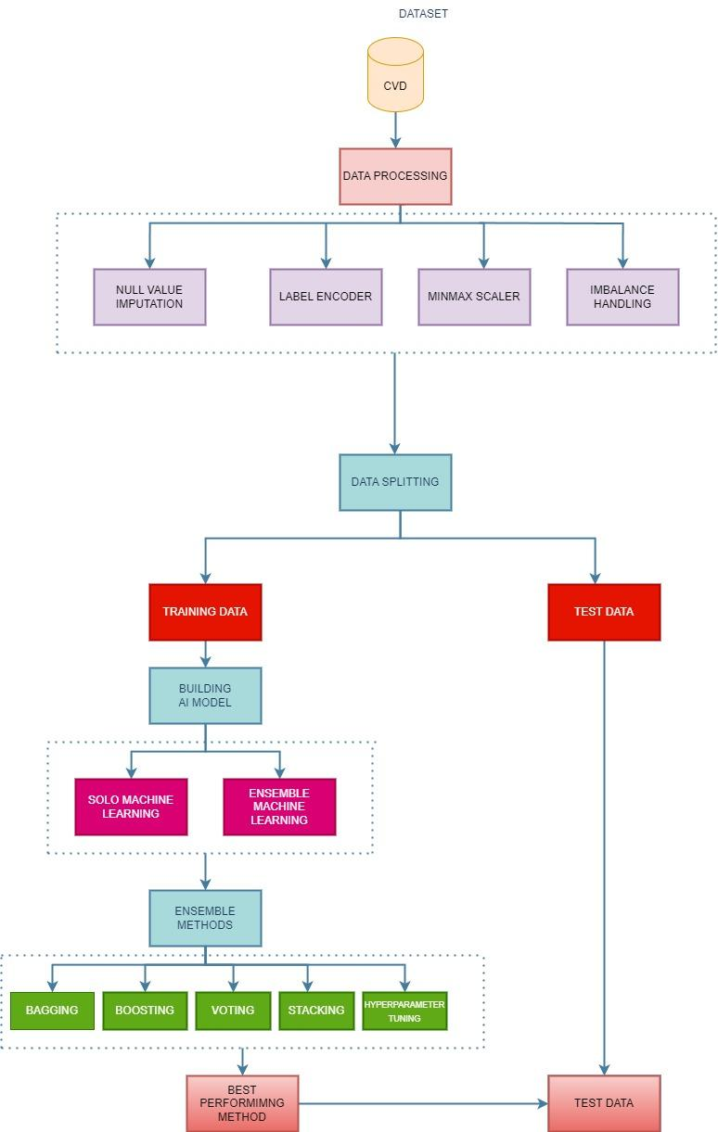
Fig2: Architecture Diagram

Slide 16
7.1 Solo machine learning
Logistic Regression used for binary classification tasks, predicts the probability of occurrence of a categorical outcome based on one or more independent variables, applying a logistic function to linear regression.
Decision trees are hierarchical structures that recursively partition data into subsets based on the values of input features, facilitating classification or regression tasks by making decisions at each node.
SVMs are supervised learning models used for classification and regression tasks, particularly effective in high-dimensional spaces by finding the hyperplane that best separates classes or approximates a function.

Slide 17
7.2 Ensemble learning
Ensemble learning combines multiple models to enhance predictive accuracy and robustness.
Gradient Boosting is a powerful technique that iteratively improves weak models by minimizing errors.
Random Forest constructs multiple decision trees and aggregates their predictions.
XGBoost, based on gradient boosting, handles classification, regression, and ranking tasks efficiently, with built-in cross-validation.
LightGBM, with its leaf-wise tree growth and gradient-based sampling, efficiently trains models, particularly for large datasets and distributed environments.

Slide 18
7.3 Ensemble Methods
Bagging involves creating subsets of the original dataset through bootstrap sampling, training a base model on each subset, and combining predictions to mitigate overfitting and improve accuracy.
Stacking, on the other hand, trains a meta-model to optimize the combination of predictions from underlying models, advancing beyond simple averaging or majority voting.
Boosting iteratively trains weak learners, like shallow decision trees, to create a strong predictive model, often surpassing single models or bagging in accuracy.
Hyperparameter tuning, crucial for maximizing model performance, involves adjusting predetermined variables to balance model quality with computational resources .

Slide 19

8.RESULTS

Slide 20
8.1 Data Preprocessing
Dataset Contain 12 Categorical values so we used Label Encoder to convert Categorical to Numerical values
We used MIN MAX Scaler to proportionate the nominal value from 0 to 1.
In handling imbalanced data, we experimented with two techniques, SMOTE and ADASYN.

Slide 21
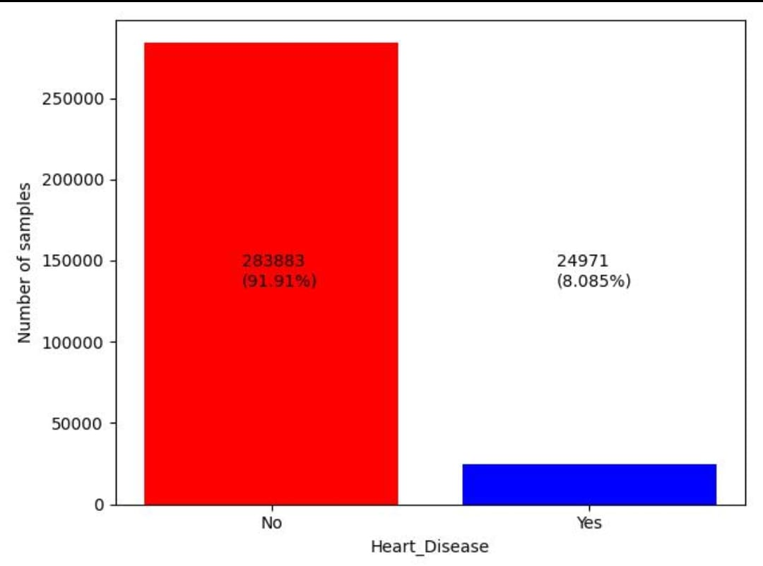
Fig3: Target Variable distribution before using imbalance techniques

Slide 22
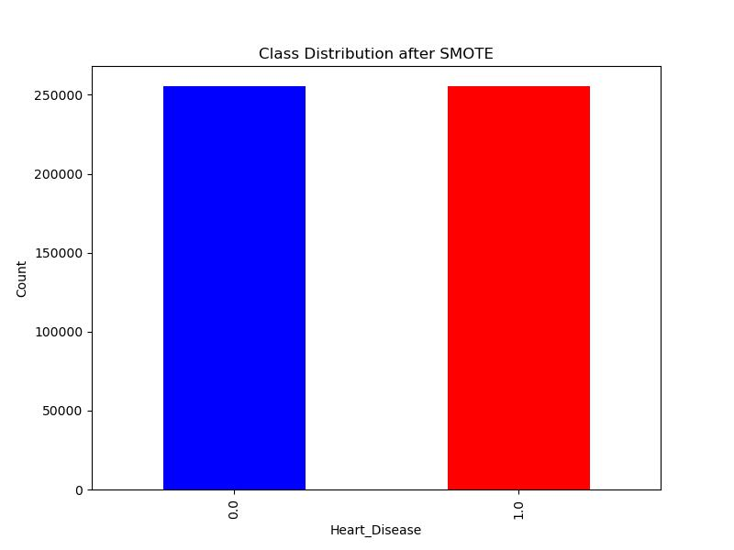
Fig4: Target Variable distribution after using smote

Slide 23
8.2 Data Splitting
We used K fold Cross Validation technique and test our set of results with 10 folds,4 folds,2folds,5 folds.
Took the model with the validation that gives more performance metrics and k=10 with Extreme Gradient Boosting gives superlative rightness .

Slide 24
Model | Accuracy | AUC | Recall | Precision | F1Score
xgboost | 0.917 | 0.8288 | 0.9013 | 0.8858 | 0.883
lightgbm | 0.9003 | 0.8182 | 0.836 | 0.8884 | 0.8863
random forest | 0.8832 | 0.8064 | 0.9171 | 0.8805 | 0.8865
ada | 0.8502 | 0.8065 | 0.9 | 0.8801 | 0.8835
et | 0.8256 | 0.7929 | 0.854 | 0.8781 | 0.8883
gbc | 0.8256 | 0.8304 | 0.8456 | 0.8894 | 0.8883
dt | 0.8613 | 0.5739 | 0.8613 | 0.8719 | 0.897
dummy | 0.7892 | 0.6595 | 0.7892 | 0.8448 | 0.8664
svm | 0.7508 | 0 | 0.7592 | 0.9074 | 0.8804
lr | 0.7476 | 0.8358 | 0.7508 | 0.9125 | 0.7951
ridge | 0.7413 | 0 | 0.7476 | 0.9127 | 0.803
Table2: Performance Metrics of different algorithms(k=10 folds)

Slide 25
8.3 Model Selection
We divided our data into training and testing sets and decided to use XGBoost as our main model due to its accuracy and reliability.
We're using K-Fold Cross-Validation to ensure our model works well across different parts of the data.
To make our XGBoost model even better, we're doing things like adjusting its settings through hyperparameter tuning, training multiple models on different parts of the data to reduce overfitting (Bagging), teaching the model to learn from its mistakes (Boosting).
Each step we take is aimed at improving the performance of our XGBoost model for our specific problem.

Slide 26
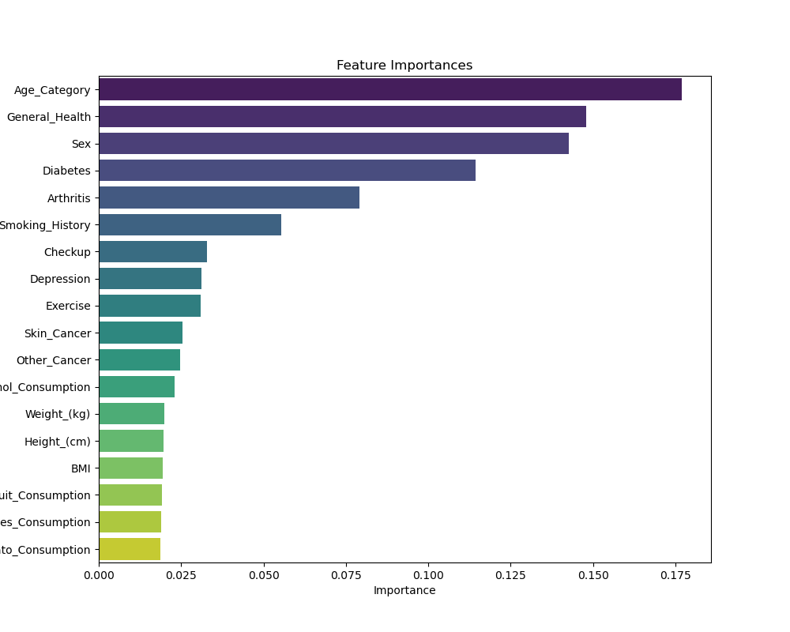
Fig 5: Feature importance

Slide 27
8.4 Model Evaluation
After fine-tuning our XGBoost model, we achieved impressive performance results.
The accuracy reached an outstanding 92%, demonstrating the overall accuracy of our predictions.
Additionally, with a precision of 0.89, we were able to effectively reduce false positives, which is crucial in many applications.
The recall of 0.92 indicates the model's ability to accurately identify the majority of true positive cases . We believe these results validate our model's capability to meet the objectives of our machine learning task effectively.

Slide 28
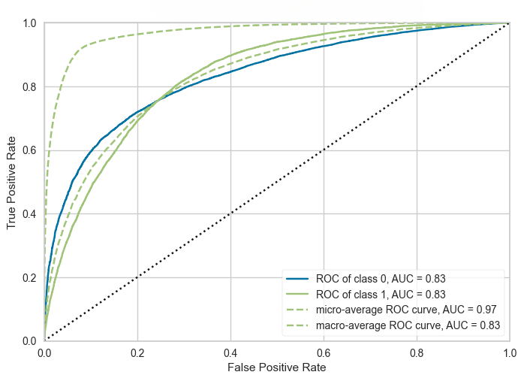
Fig 6 : AUROC performance curve of XGBoost Hypertuning.

Slide 29
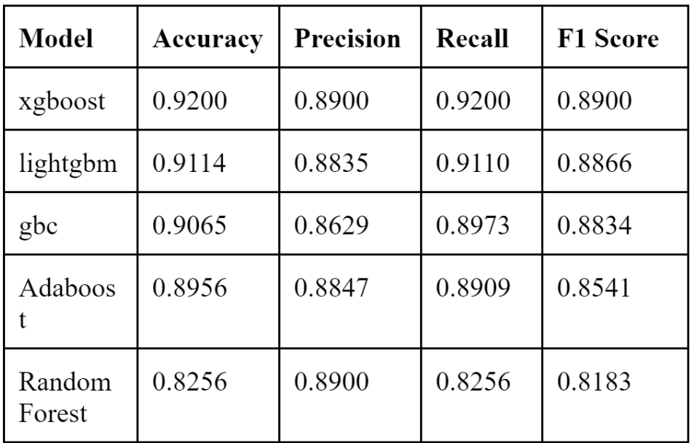
Performance Metrics

Slide 30
9.CONCLUSION
In conclusion, our study on predicting Cardiovascular Disease (CVD) using advanced ensembling techniques leads us to the hypothesis that combining multiple machine learning models results in higher accuracy.
Through our exploration of various ensembling methods, including Random Forests, AdaBoost, Gradient Boosting, and XGBoost.
we successfully created an ensemble model with an accuracy of 92%.
This finding suggests that the hypothesis holds true – ensembling techniques contribute to improved predictive accuracy in the context of CVD.The ensemble approach,blending the strengths of different models, played a crucial role in achieving this high accuracy.

Slide 31

REFERENCES
[1]WHO, Geneva. "WHO methods and data sources for country- level causes of death." (2014)
[2]https://www.jacc.org/doi/10.1016/j.jacc.2012.11.002
[3]Singh, Vicky, and Brijesh Pandey. "Prediction of Cardiac Arrest and Recommending Lifestyle Changes to Prevent It using Machine Learning." In International Conference on Intelligent Technologies & Science, pp. 1-6. 2021.
[4]Karthikeyan, R., D. Vijendra Babu, R. Suresh, M. Nallathambi, and S. Dinakaran. "Cardiac Arrest Prediction using Machine Learning Algorithms." In Journal of Physics: Conference Series, vol. 1964, no. 6, p. 062076. IOP Publishing, 2021

Slide 32
REFERENCES
[5]Rubini, P. E., C. A. Subasini, A. Vanitha Katharine, V. Kumaresan, S. Gowtham Kumar, and T. M. Nithya. "A cardiovascular disease prediction using machine learning algorithms." Annals of the Romanian Society for Cell Biology (2021): 904-912.
[6]Arun Kumar, N., and P. Uma Maheshwari. "Neural Network Based Approach in Identifying Cardiovascular Disease-A Survey."
[7]Alqahtani, Abdullah, Shtwai Alsubai, Mohammed Sha, Lucia Vilcekova, and Talha Javed. "Cardiovascular disease detection using ensemble learning." Computational Intelligence and Neuroscience 2022 (2022).

