Slide 1

Clinic Management System
Submitted by: Anvitha KS Sisira Pathakamuri School of Information Studies-Applied Data Science

Slide 2

Project Overview:
This project focuses on developing a database for Clinics. It helps automate the booking of appointments and maintaining patient records. We will include the doctor details, patient details and calculating the bill for the charges as well.

Slide 3
Specifications
Entity Relationship Data Requirements/Business Rules
Conceptual Data Model
Logical Data Model
SQL/Up/Down Script to create/drop tables, keys constraints*
User Stories
External data model satisfying user stories
Stored Procedure
User Interface Design

Slide 4
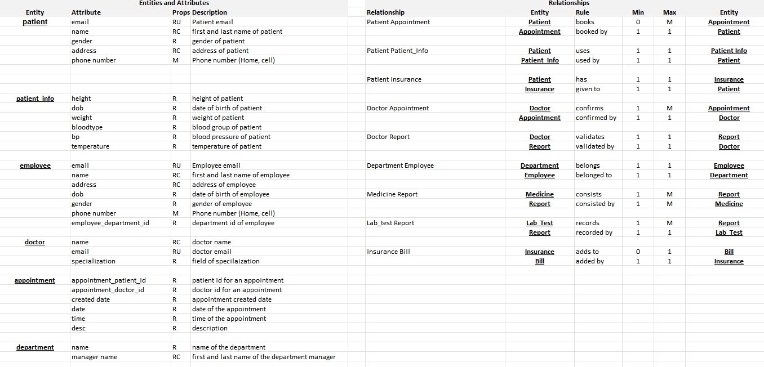
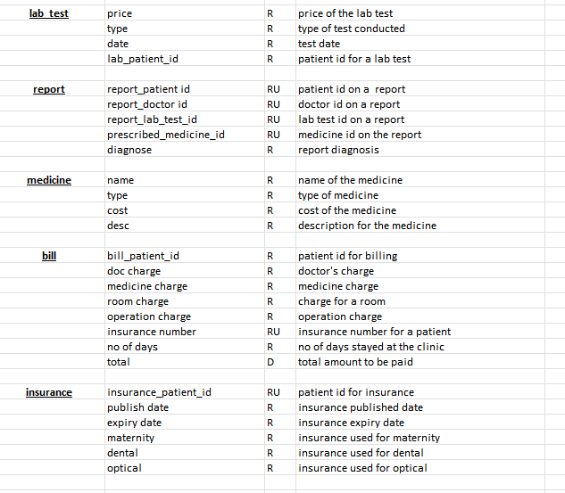
ERD DATA REQUIREMENTS/Business rules

Slide 5
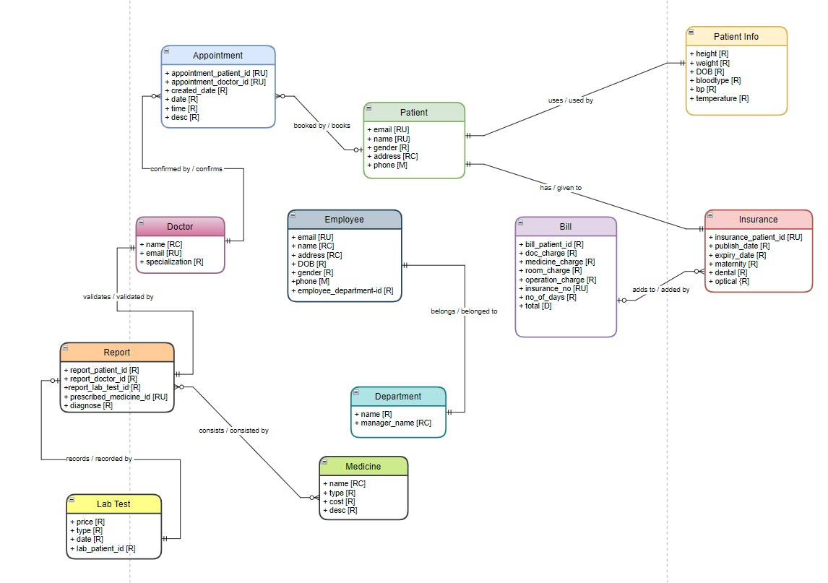
Conceptual Model

Slide 6
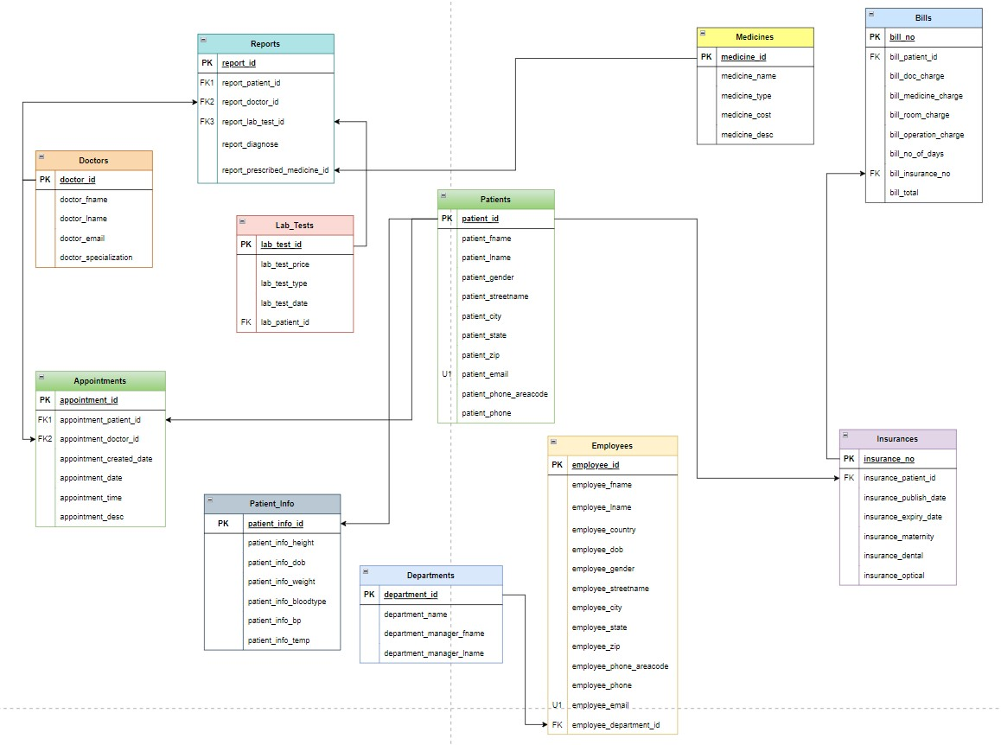
Logical model

Slide 7
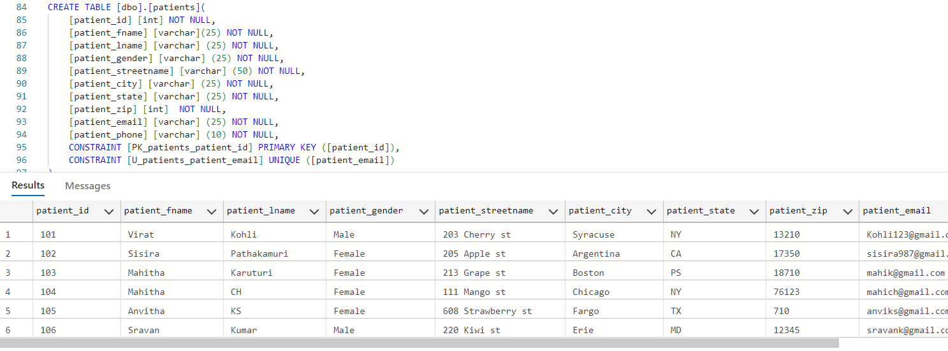
Creating the patient table and after Inserting values

Slide 8
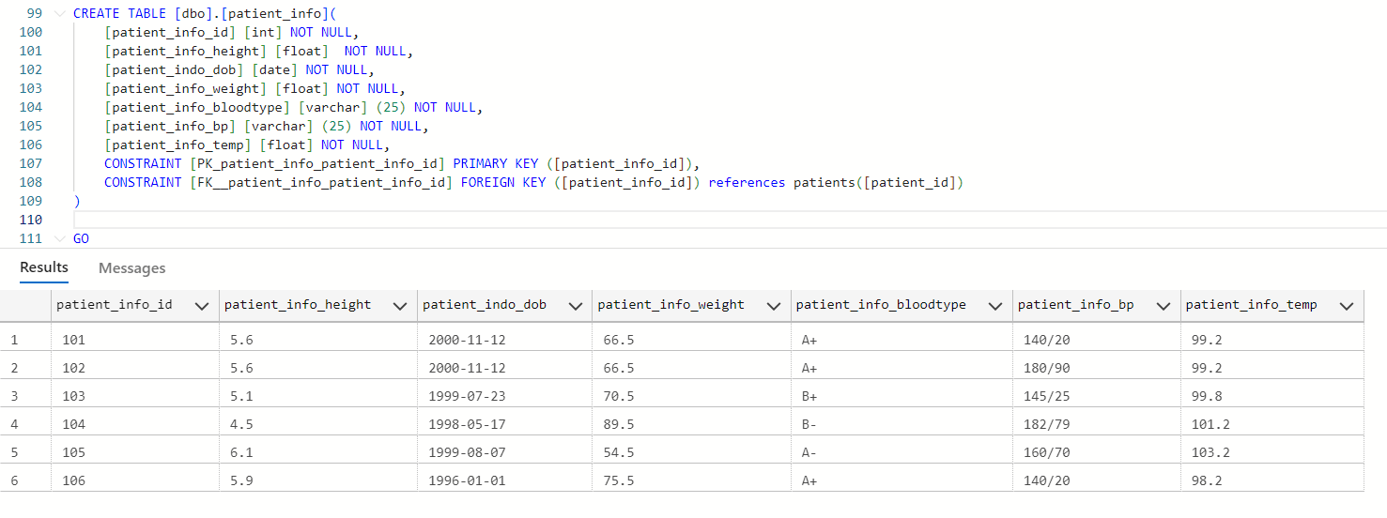
Creating the patient INFO LOOKUP TABLE and after Inserting values

Slide 9
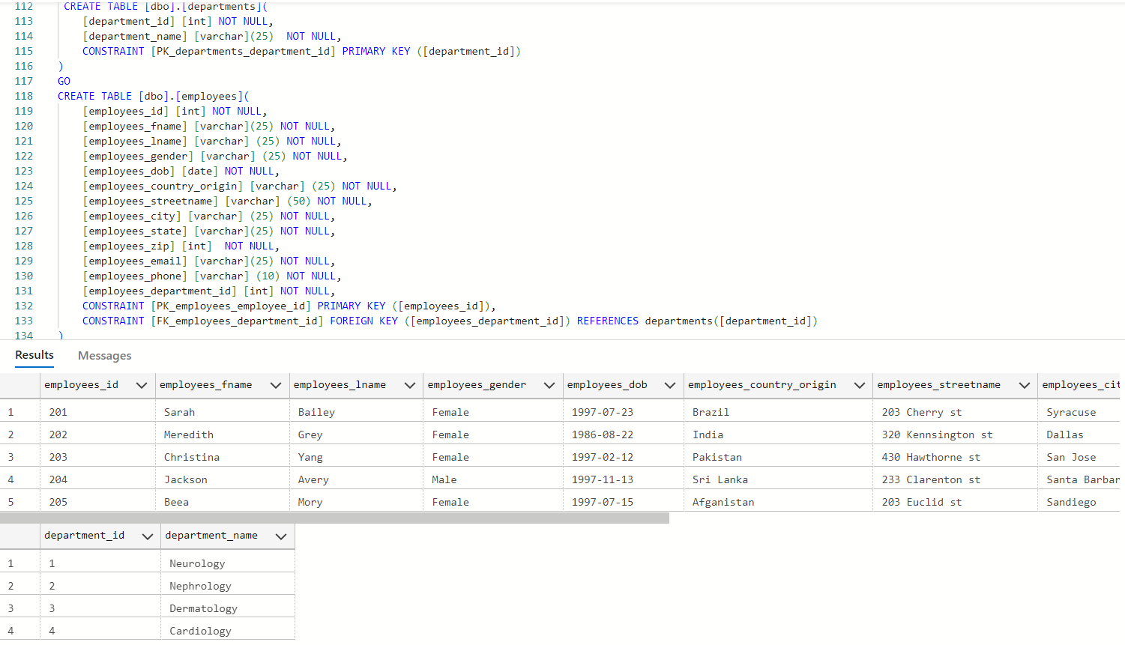
Creating the Department and employees TABLE and after Inserting values

Slide 10
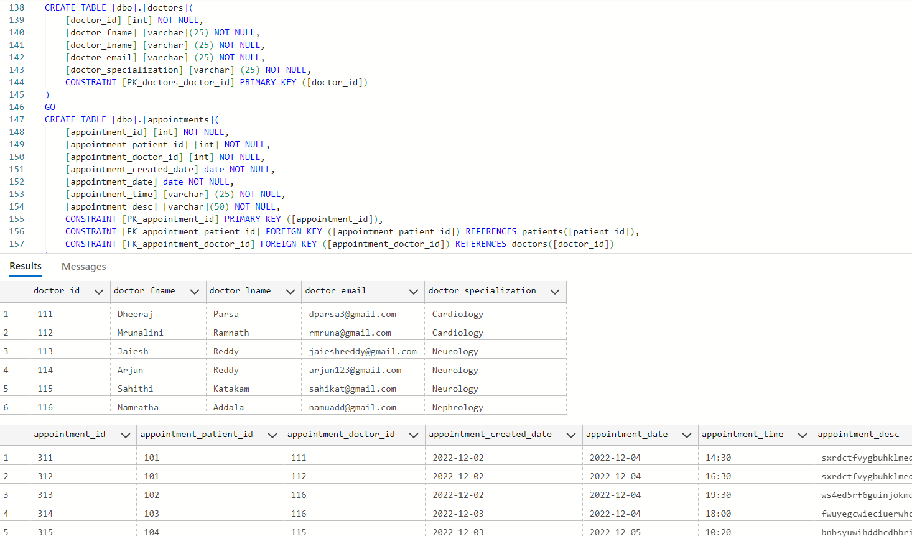
Creating the DOCTOR and APPOINTMENT TABLE and after Inserting values

Slide 11
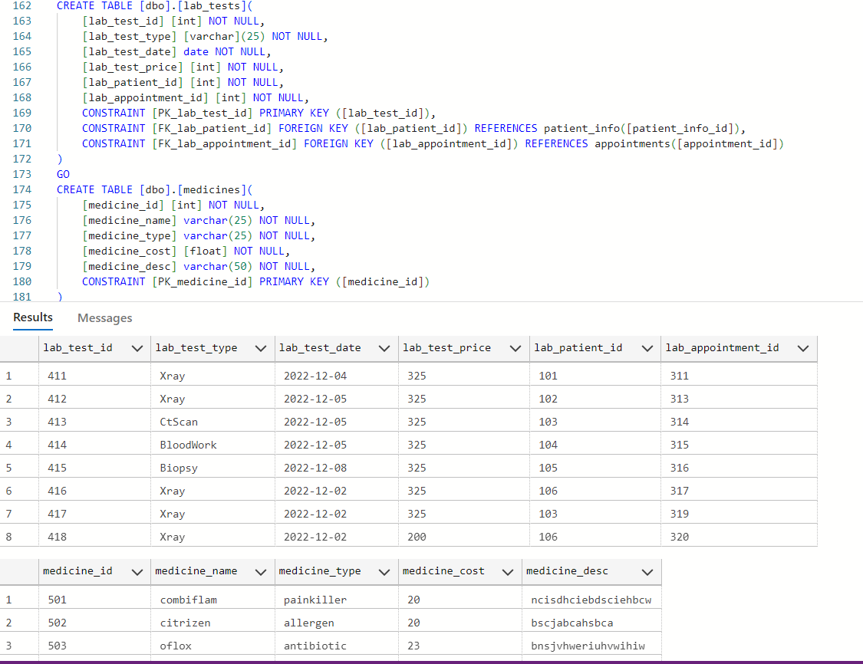
Creating the LAB TEST and MEDICINE TABLE and after Inserting values

Slide 12
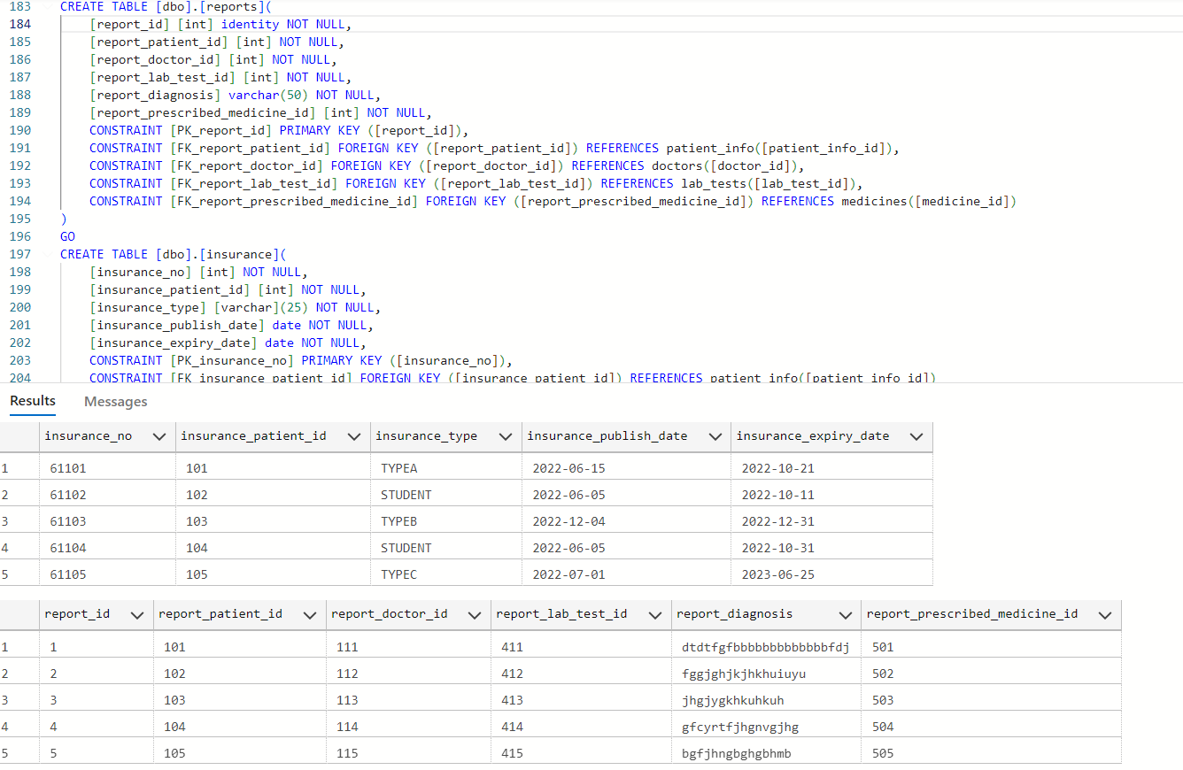
Creating the REPORTS and INSURANCE TABLE and after Inserting values

Slide 13
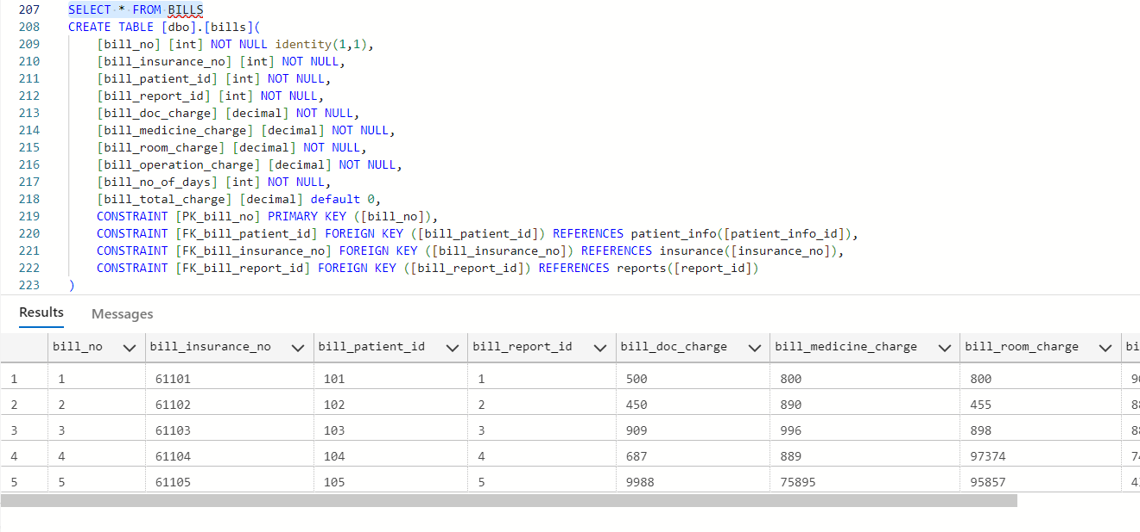
Creating the bills TABLE and after Inserting values

Slide 14
The stored procedure is created to calculate the total bill
create procedure update_bill_total_charge as
begin
update bills set bill_total_charge = bill_doc_charge + bill_medicine_charge + bill_room_charge + bill_operation_charge
end
exec update_bill_total_charge

Slide 15
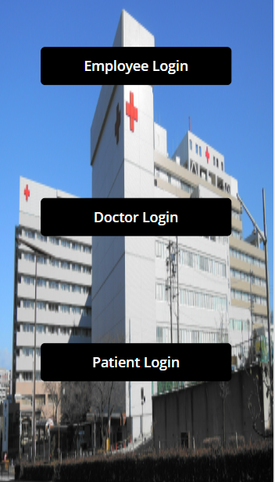
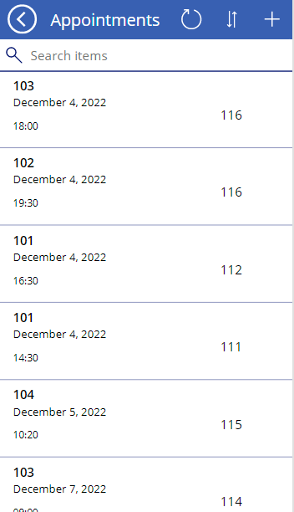
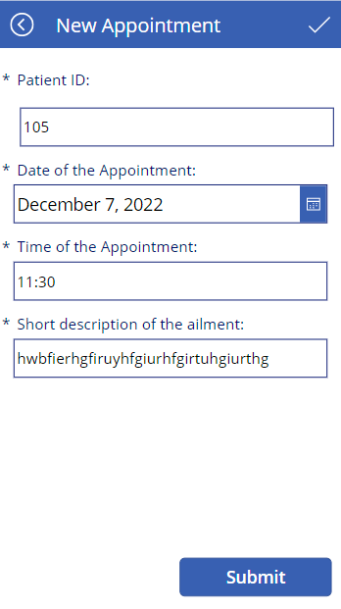
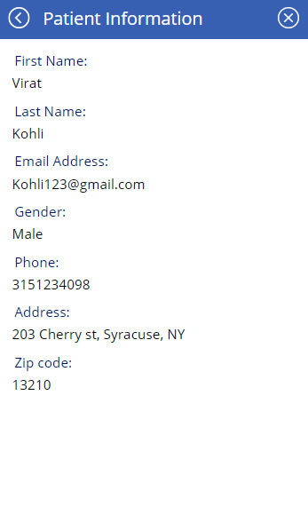
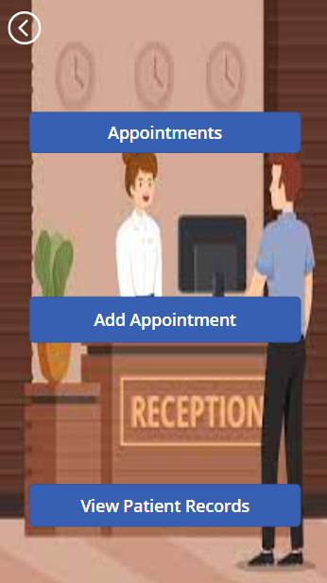
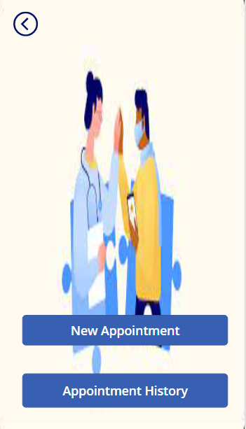
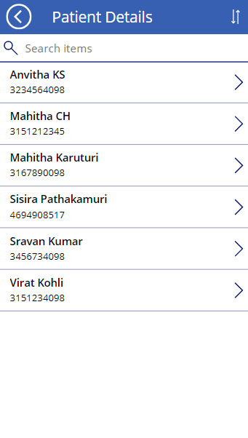

Slide 16
Thank you, Professor!
Anvitha KS SISIRA

