Slide 1
Predictive Customer Churn Model for a Telecom Company
July 2026
Presented by: Sisira T S

Slide 2
Problem Statement
Customer churn is a major challenge in the telecom industry, leading to significant revenue loss and reduced customer loyalty.
Retaining existing customers is more cost-effective than acquiring new ones, making churn prediction an important business objective.
Traditional approaches identify customer churn only after customers have already left, limiting opportunities for timely intervention.
There is a need for an intelligent, data-driven solution that can accurately identify customers at risk of churn and support proactive retention strategies.
Objective
Develop a machine learning-based customer churn prediction model using the IBM Telco Customer Churn dataset.
Analyze customer behavior and identify the key factors that influence churn through exploratory data analysis and feature engineering.
Compare the performance of Logistic Regression, Random Forest, and XGBoost models to determine the most effective prediction model.
Improve model transparency and interpretability using SHAP (SHapley Additive exPlanations).
Provide actionable business recommendations to help telecom companies reduce customer churn and improve retention.

Slide 3
Telco Customer Churn Dataset
Source
Total Records
Kaggle — IBM Telco Customer Churn Dataset
7,043 customers
Features
Target Variable
21 attributes per record
Churn — Yes / No
Key Predictive Features
Contract Type
Tenure
Month-to-month, one-year, two-year
Number of months with the company
Monthly Charges
Total Charges
Amount billed per month
Cumulative billing amount
Internet Service
Payment Method
DSL, Fiber Optic, or None
Electronic check, mailed check, bank transfer, credit card

Slide 4
Methodology
01
02
03
Dataset Collection
Data Preprocessing
Exploratory Data Analysis (EDA)
Collected the IBM Telco Customer Churn dataset from Kaggle.
Cleaned missing values, converted data types, encoded categorical features, and standardized numerical features.
Analyzed customer behavior and identified patterns influencing churn.
04
05
06
Feature Engineering
Model Training
Hyperparameter Tuning
Selected and transformed important features to improve model performance.
Trained Logistic Regression, Random Forest, and XGBoost models.
Applied GridSearchCV with K-Fold Cross Validation to optimize model performance.
07
08
09
Model Evaluation
SHAP Explainability
Deployment
Compared models using Accuracy, Precision, Recall, F1-Score, and ROC-AUC.
Used SHAP analysis to explain feature importance and prediction outcomes.
Developed a Streamlit web application and REST API for real-time churn prediction.

Slide 5
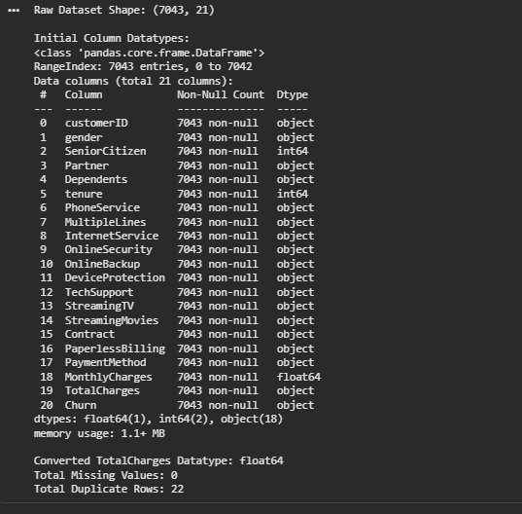
Data Preprocessing
Missing Value Handling
Identified missing values in the TotalCharges column.
Handled missing values to ensure data quality.
Data Transformation
Converted TotalCharges from string to numeric format.
Corrected data types for accurate analysis.
Feature Encoding
Applied One-Hot Encoding to categorical features such as Contract Type, Internet Service, and Payment Method.
Feature Scaling
Standardized numerical features (Tenure, MonthlyCharges, TotalCharges) using StandardScaler.
80%
20%
Train / Test Split
Split the dataset into 80% training and 20% testing sets using stratified sampling.
Test Data
Training Data

Slide 6
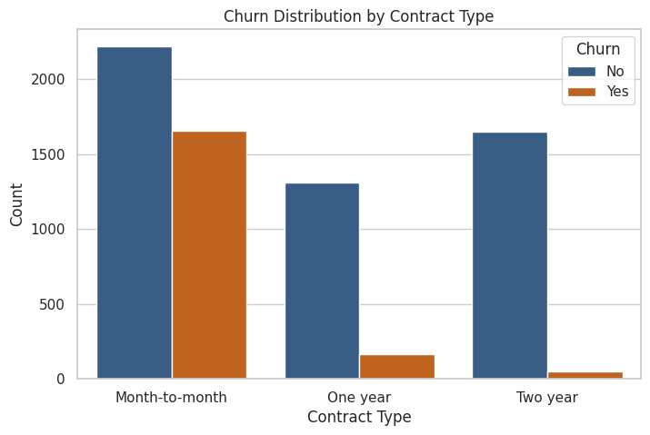
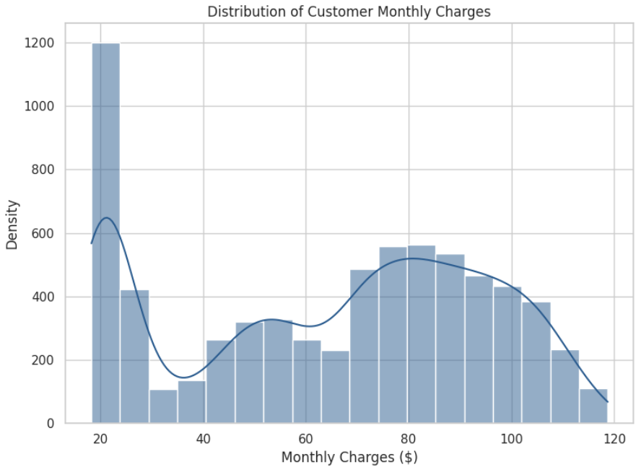
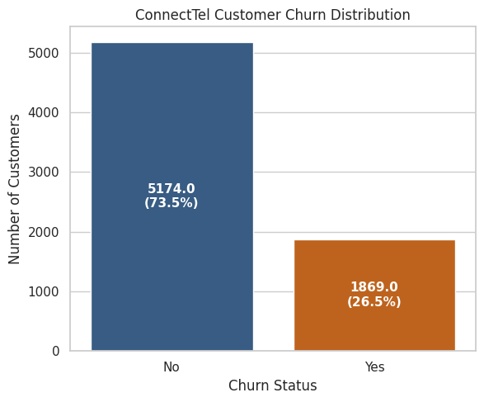
Exploratory Data Analysis
Contract Type
Monthly Charges
Tenure
Customers with Month-to-Month contracts had the highest churn rate.
Customers with higher monthly charges were more likely to churn.
Customers with shorter tenure showed a significantly higher risk of churn.
Key Charts

Slide 7
Machine Learning Models
Logistic Regression
Random Forest
XGBoost
Simple and interpretable baseline model for binary classification
Ensemble learning model capable of capturing complex relationships in the data.
Gradient boosting algorithm known for high predictive performance and robustness.
Model Optimization
GridSearchCV
K-Fold Cross Validation
Hyperparameter Tuning
Optimized model hyperparameters to improve predictive performance.
Ensured reliable evaluation and minimized overfitting.
Fine-Tuned Random Forest and XGBoost for better accuracy.

Slide 8
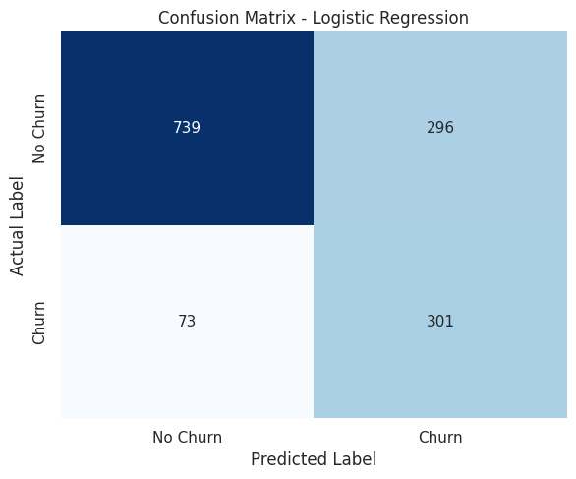
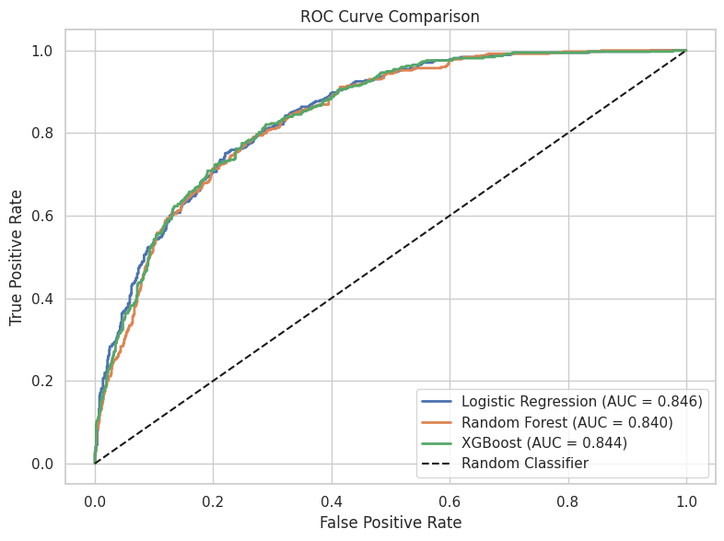
Results & Model Comparison
Model
Accuracy
ROC-AUC
Logistic Regression
73.81%
84.61%
Tuned Random Forest
75.30%
83.99%
Tuned XGBoost
74.38%
84.43%
Final Selected Model:
Highest ROC-AUC (84.61%) .
Reliable churn prediction performance .
Easy to interpret and deploy .
Suitable for binary classification problems

Slide 9
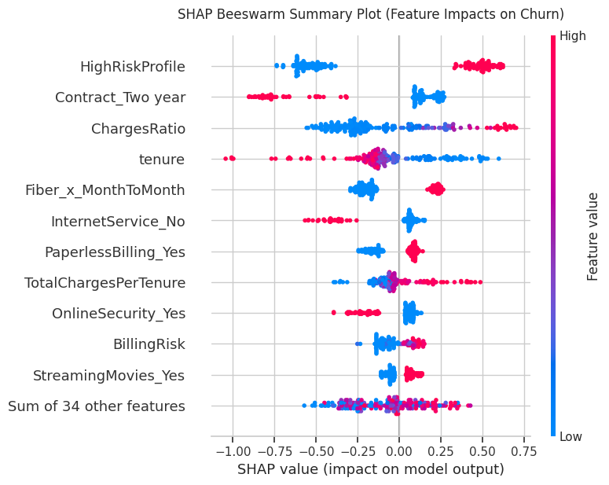
Model Interpretability Using SHAP
What is SHAP?
SHAP (Shapley Additive explanations) is an Explainable AI technique that interprets machine learning predictions by measuring the contribution of each feature to the model's output.
Why SHAP?
Explains how individual features influence model predictions. Improves model transparency and interpretability. Helps identify the key factors driving customer churn. Supports data-driven business decision-making and customer retention strategies.
Key Insight
The SHAP summary plot highlights the relative importance of features influencing customer churn, enabling better understanding of the model's predictions.

Slide 10
Business Recommendations
Conclusion
Encourage customers to switch from month-to-month plans to long-term contracts through attractive offers.
Provide personalized discounts and loyalty rewards to customers identified as having a high churn risk.
Improve the quality of Fiber Optic services and strengthen customer support to enhance satisfaction.
Use AI-driven churn predictions to launch timely and targeted customer retention campaigns.
Developed an end-to-end machine learning solution for predicting customer churn in the telecom industry.
Logistic Regression was selected as the final model, achieving the highest ROC-AUC of 84.61%.
SHAP analysis improved model transparency by explaining the key factors influencing churn predictions.
The proposed solution can help telecom companies proactively retain customers and improve long-term business performance.

