Slide 1

Perspective from a developer about mobile competition
James (Jung-haeng) Lee,
Co-Founder and Developer at VCNC
Notes:
1

Slide 2
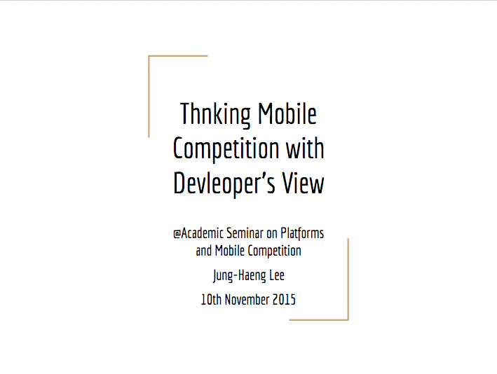
@Academic Seminar on Platforms and Mobile Competition
Jung-Haeng Lee
10th November 2015

Slide 3
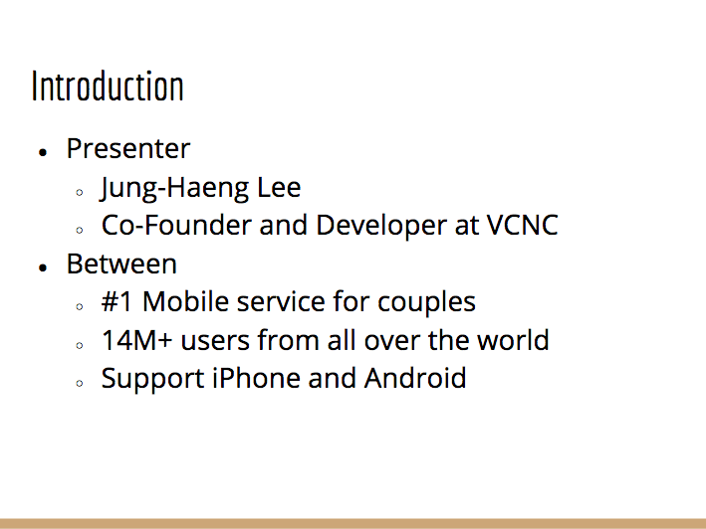
Introduction
Presenter
Jung-Haeng Lee
Co-Founder and Developer at VCNC
Between
#1 Mobile service for couples
14M+ users from all over the world
Support iPhone and Android

Slide 4
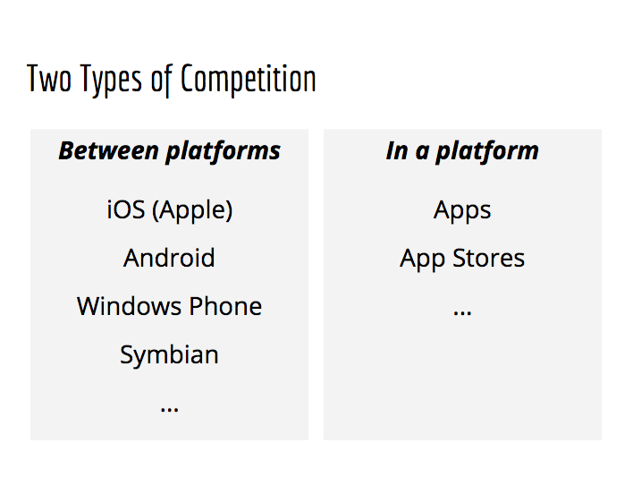


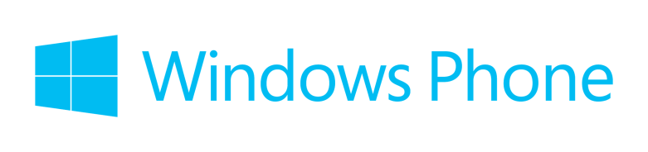

Two Types of Competition
Between platforms
iOS (Apple)
Android
Windows Phone
Symbian
...
In a platform
Apps
App Stores
...

Slide 5
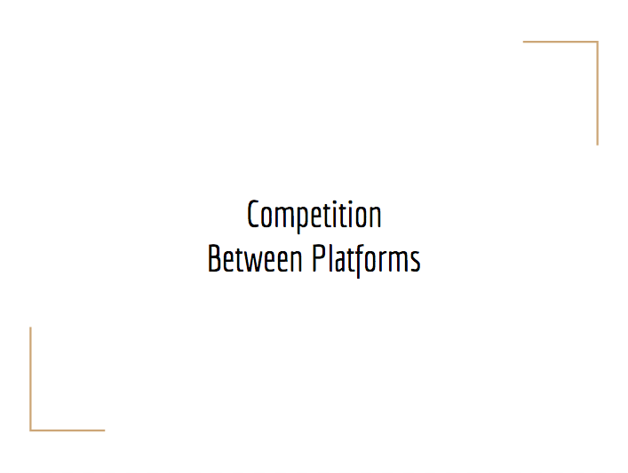
Competition
Between Platforms

Slide 6
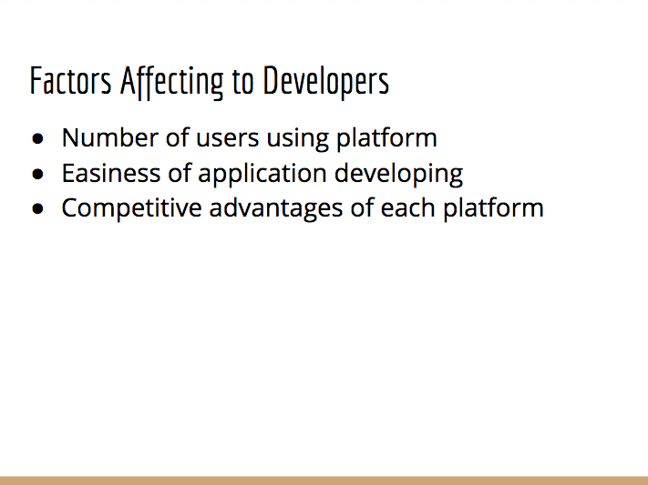
Factors Affecting to Developers
Number of users using platform
Easiness of application developing
Competitive advantages of each platform

Slide 7
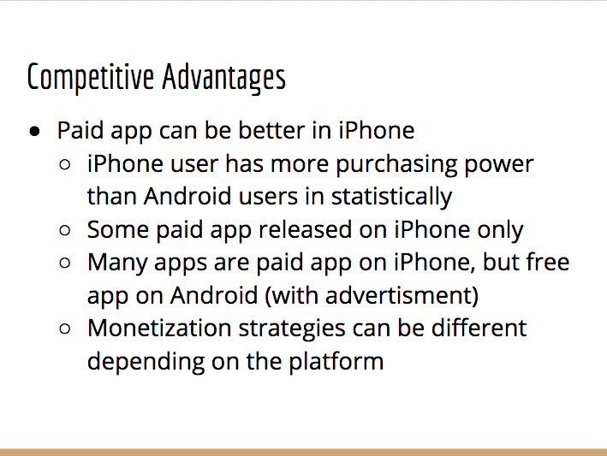
Competitive Advantages
Paid app can be better in iPhone
iPhone user has more purchasing power than Android users in statistically
Some paid app released on iPhone only
Many apps are paid app on iPhone, but free app on Android (with advertisment)
Monetization strategies can be different depending on the platform

Slide 8
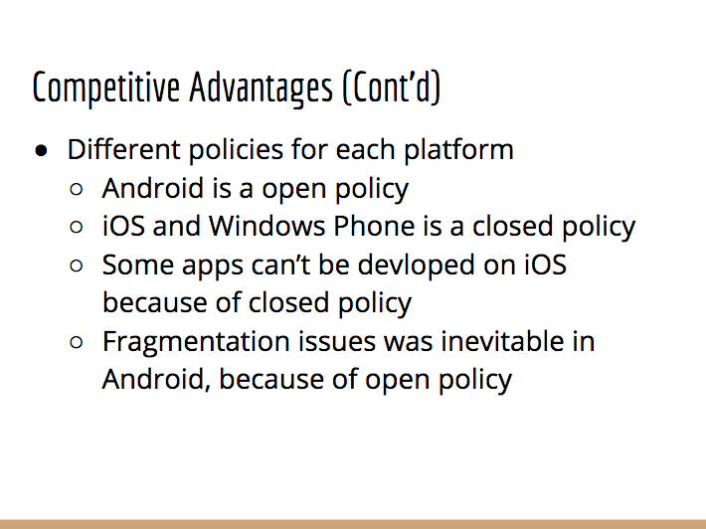
Competitive Advantages (Cont'd)
Different policies for each platform
Android is a open policy
iOS and Windows Phone is a closed policy
Some apps can’t be devloped on iOS because of closed policy
Fragmentation issues was inevitable in Android, because of open policy

Slide 9
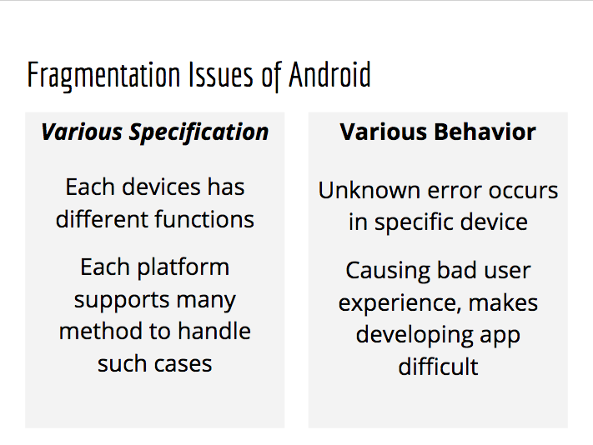
Fragmentation Issues of Android
Various Specification
Each devices has different functions
Each platform supports many method to handle such cases
Various Behavior
Unknown error occurs in specific device
Causing bad user experience, makes developing app difficult

Slide 10
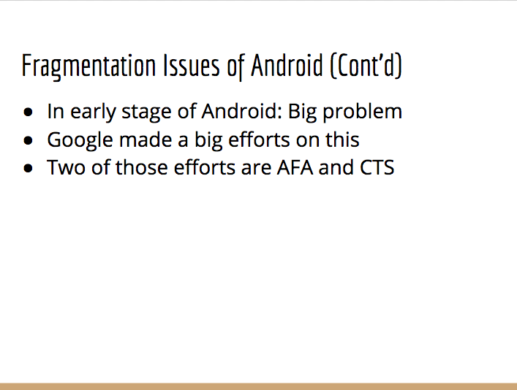
Fragmentation Issues of Android (Cont’d)
In early stage of Android: Big problem
Google made a big efforts on this
Two of those efforts are AFA and CTS

Slide 11
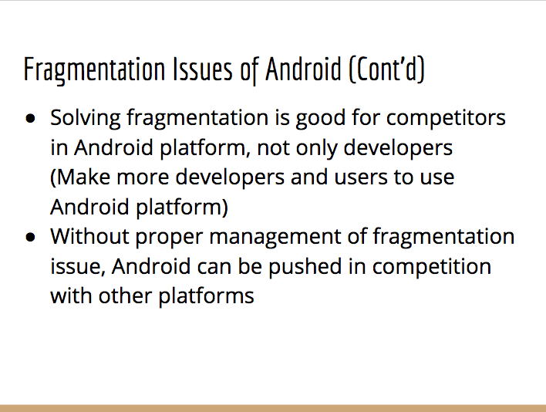
Fragmentation Issues of Android (Cont’d)
Solving fragmentation is good for competitors in Android platform, not only developers (Make more developers and users to use Android platform)
Without proper management of fragmentation issue, Android can be pushed in competition with other platforms

Slide 12
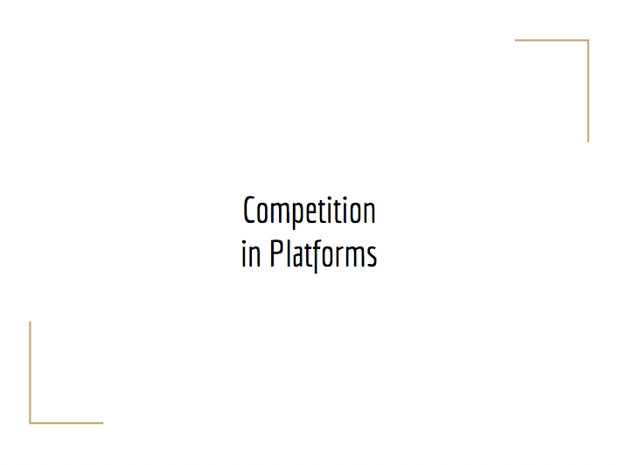
Competition
in Platforms

Slide 13
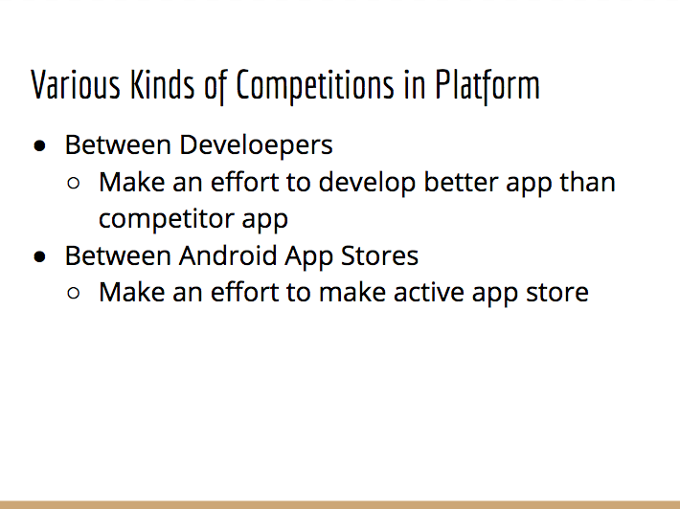
Various Kinds of Competitions in Platform
Between Develoepers
Make an effort to develop better app than competitor app
Between Android App Stores
Make an effort to make active app store

Slide 14
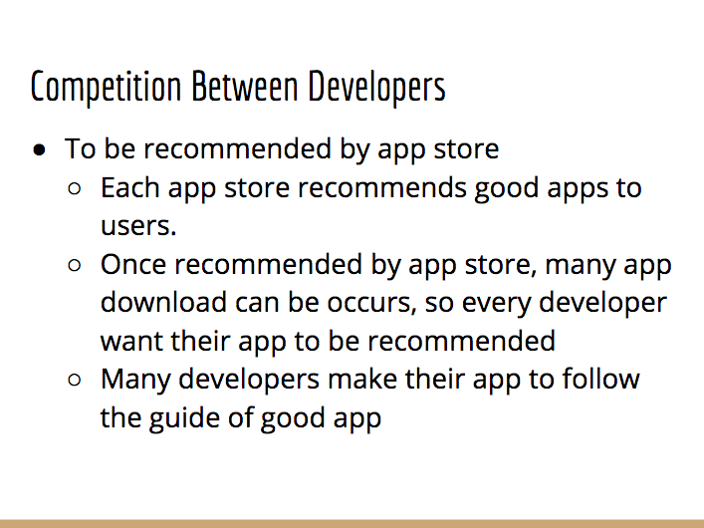
Competition Between Developers
To be recommended by app store
Each app store recommends good apps to users.
Once recommended by app store, many app download can be occurs, so every developer want their app to be recommended
Many developers make their app to follow the guide of good app

Slide 15
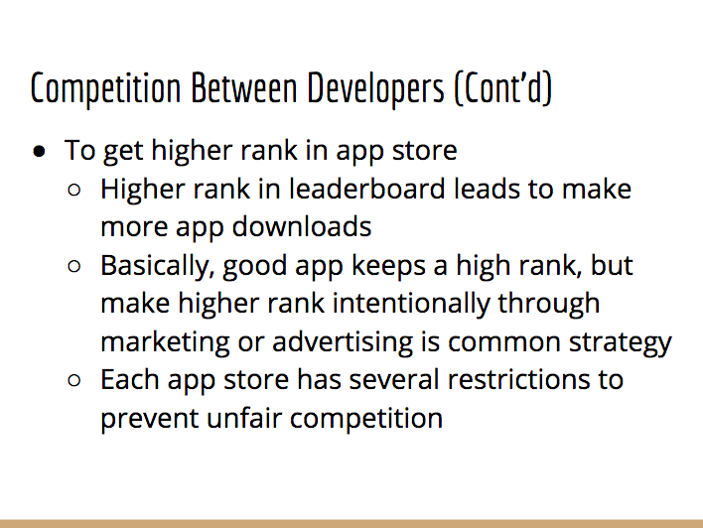
Competition Between Developers (Cont’d)
To get higher rank in app store
Higher rank in leaderboard leads to make more app downloads
Basically, good app keeps a high rank, but make higher rank intentionally through marketing or advertising is common strategy
Each app store has several restrictions to prevent unfair competition

Slide 16
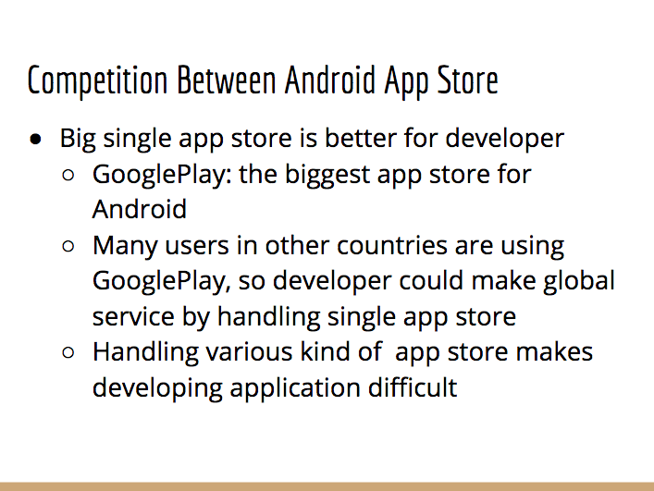
Competition Between Android App Store
Big single app store is better for developer
GooglePlay: the biggest app store for Android
Many users in other countries are using GooglePlay, so developer could make global service by handling single app store
Handling various kind of app store makes developing application difficult

Slide 17
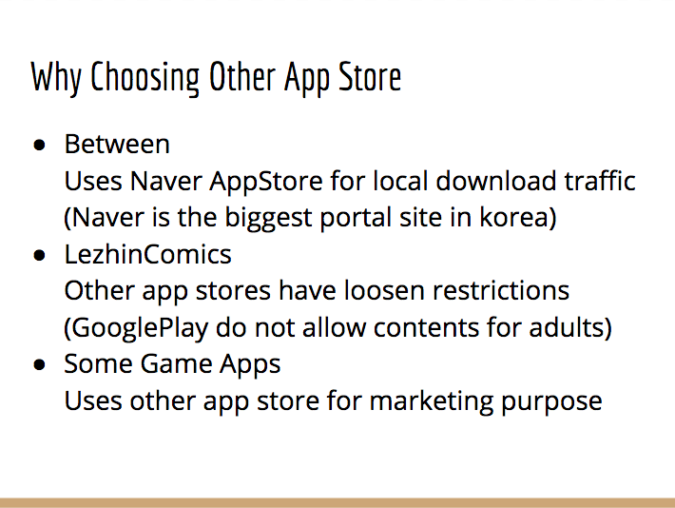
Why Choosing Other App Store
Between Uses Naver AppStore for local download traffic (Naver is the biggest portal site in korea)
LezhinComics Other app stores have loosen restrictions (GooglePlay do not allow contents for adults)
Some Game Apps Uses other app store for marketing purpose

Slide 18
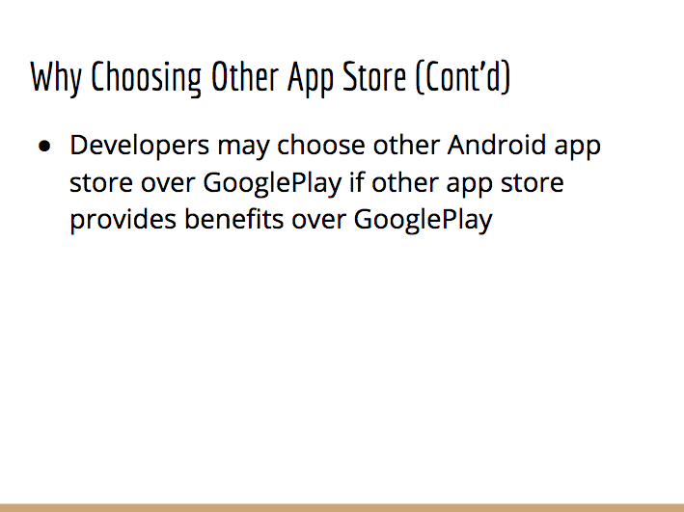
Why Choosing Other App Store (Cont’d)
Developers may choose other Android app store over GooglePlay if other app store provides benefits over GooglePlay

Slide 19
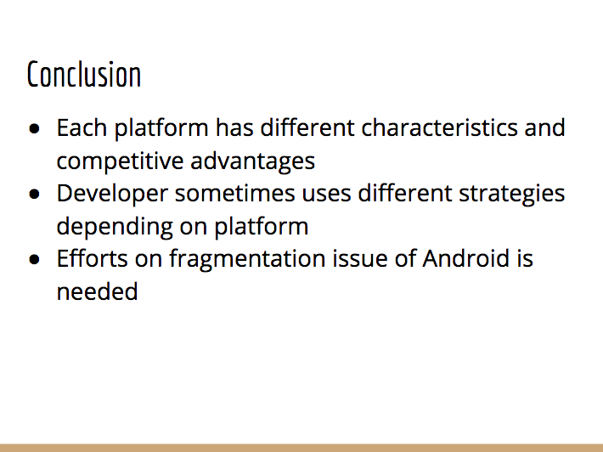
Conclusion
Each platform has different characteristics and competitive advantages
Developer sometimes uses different strategies depending on platform
Efforts on fragmentation issue of Android is needed

Slide 20
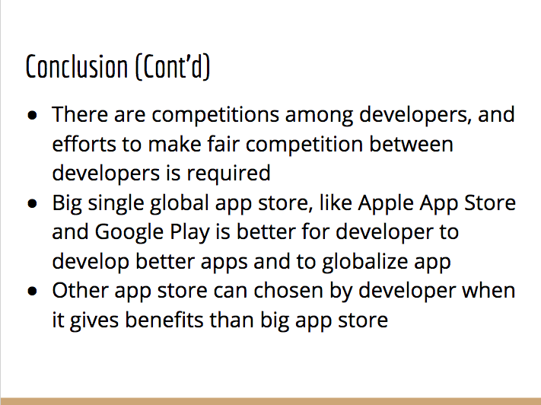
Conclusion (Cont'd)
There are competitions among developers, and efforts to make fair competition between developers is required
Big single global app store, like Apple App Store and Google Play is better for developer to develop better apps and to globalize app
Other app store can chosen by developer when it gives benefits than big app store

Slide 21
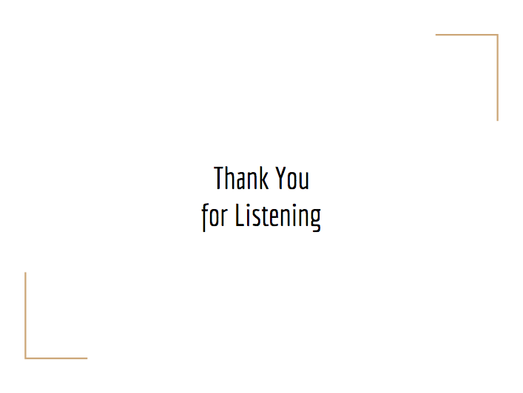
Thank You
for Listening

