Slide 1

Setting the Scene:
Overview of current debates about antitrust and platforms
Maurits Dolmans
Cleary Gottleib
Notes:
1

Slide 2
Setting the Scene: Questions for Today’s Discussion on Antitrust and Platforms
Maurits Dolmans and his firm represent clients in pending abuse allegations. These comments have not been approved by, and are not made on behalf of, the firm, any colleague, or any client, and are not binding on them.
Maurits Dolmans
Academic Seminar on Platforms and Mobile Competition, Sogang University
10th November 2015

Slide 3
Some points for discussion today
What are platforms?
Do we need special regulation for platforms?
Do we need new competition law principles for platforms?
How to define market power in two-sided markets?
What kind of platform conduct raises competition concerns?
How to take account of dynamic competition?
Conclusion

Slide 4
1. What are “platforms”?

Slide 5
What are two-sided platforms?
A place that brings together economic actors who want to transact
Customers on the two sides are complements for producing value
A market is two-sided if the platform can affect the volume of transactions by charging more to one side of the market and reducing the price paid by the other side by an equal amount; in other words, the pricing structure matters, and platforms must design it so as to bring both sides on board. Rochet and Tirole (2006)
suppliers
advertisers
Platform
users
users

Slide 6







What are two-sided platforms? – Nothing new, and a huge diversity of businesses
Old examples: marketplaces; newspapers; stock exchange; ad-funded TV and radio; payment systems
IT examples: operating systems (Unix, Windows, Linux, iOS, Android, Tizen, etc); middleware
Online examples: the world-wide web, social media, online marketplaces, search engines, video sharing websites, app stores, crowd-funding platforms, etc.

Slide 7
2. Do we need special regulation for platforms?

Slide 8
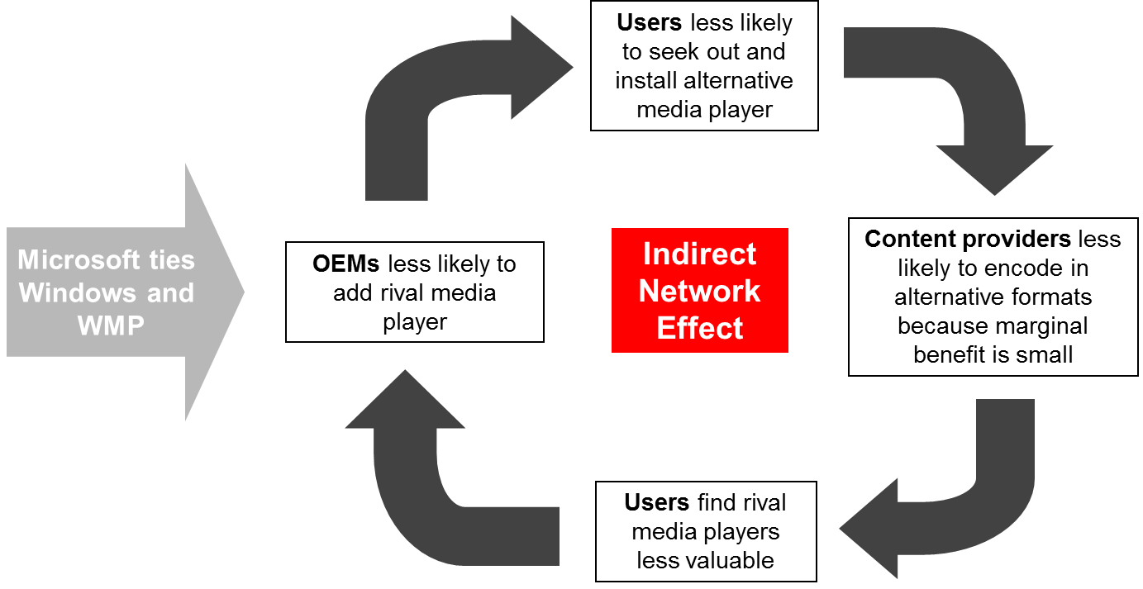
1. In two-sided platforms, Do network effects lead to natural monopoly justifying regulation?
Some – but not all – two-sided platforms may create direct or indirect network effects / feed-back loop
Usage on Side A increases value and usage on Side B, which in turn increases value and usage on Side A
Example: social networks; telecom network; OS
Contrast with search (value to user does not depend on how many others use the service)
Contrast with ad-funded platforms: No feedback loop: More users increase value for advertisers, but more ads do not increase value for users.
Feedback may be negative. Example: free TV with too many ads…
And even if network effects exist: competition law has been able to deal with it – examples: Microsoft Media Player case; EU Cartes Bancaires case

Slide 9
















2. In two-sided platforms, even if network effects exist, do they lead to tipping or natural monopolies?
Social Media example of diversity, new entry, and innovation
“while network effects exist in the market for [messaging] apps, in the present case, on balance, they are unlikely to shield the merged entity from competition from new and existing consumer communications apps.” (EU decision in Facebook/Whatsapp; Microsoft/Skype)

Slide 10
3. In two-sided platforms, do big data barriers lead to natural monopoly?
Is Big Data even inherently capable of being a true barrier to entry or enabling foreclosure?
Ubiquitous | Non-rivalrous | Substitutable
Duplicable | Portable | Tradable
Sourced online and offline | No finite “shares” | Cheap to acquire/store
Subject to user controls | Transient value | Dispersed ownership
Not an “essential input” | Users multi-home | No exclusivity
Largely variable rather than fixed cost
Subject to diminishing returns…

Slide 11
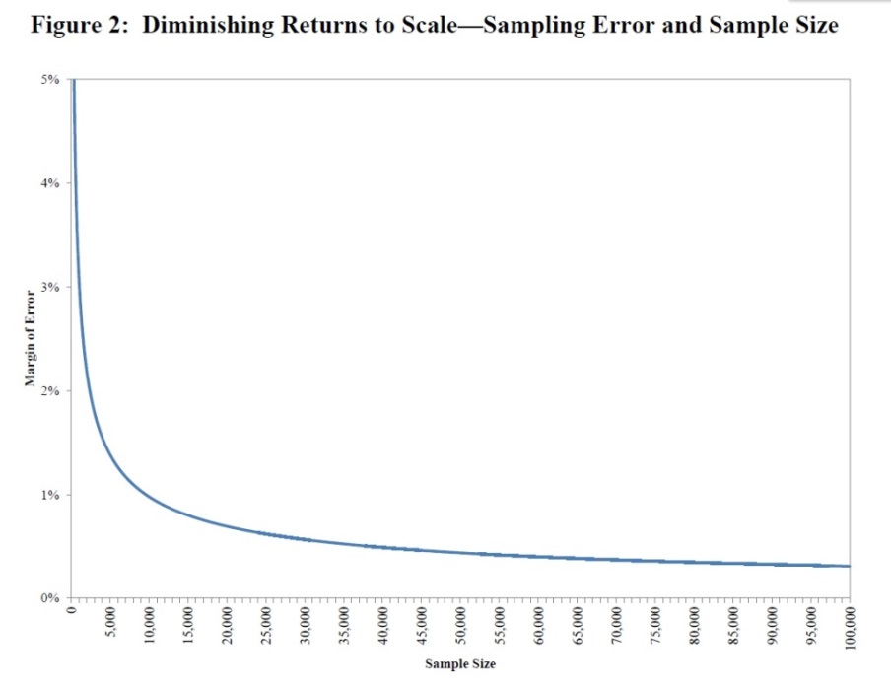
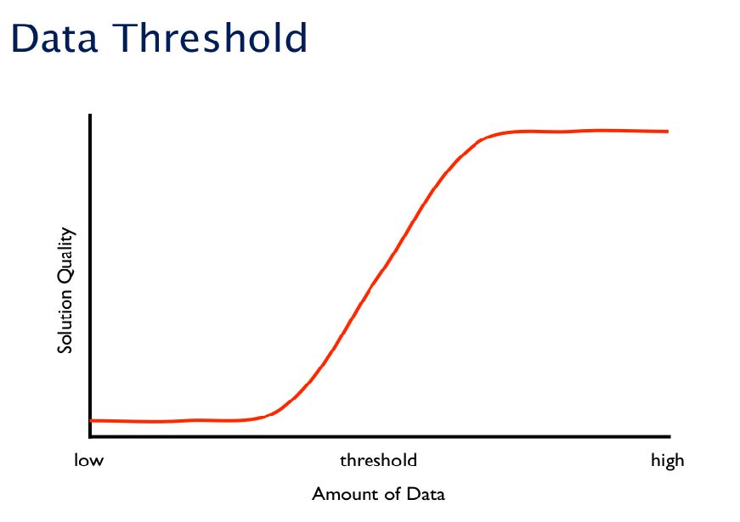
3. In two-sided platforms, do we see big data barriers or diminishing returns?
Marginal value of data for statistical analysis and deriving predictions is inherently subject to diminishing returns
UK CMA Report on Big Data: Facebook and Google, for example, emerged through “more functionality or a better service” in spite of incumbent (MySpace, Yahoo) having an advantage
The commercial use of consumer data, Report on the CMA’s call for information, CMA38, June 2015, para. 3.25
Internet-scale Data Analysis, Peter Norvig, 2010
The role of “Big Data” in Online Platform Competition, Andres V. Lerner, 2014

Slide 12
4. In two-sided platforms, is it even possible to regulate consistently?
Many different businesses; different markets
Is Uber a transport service supplier or a “consumer platform”?
Does the business compete with traditional business models?
Many different strategies -- How is the platform monetised? Is service free? Who pays?
Ad-funded services (e.g., social networks, search, free-TV)
Freemium (e.g., apps, games, anti-virus software …)
Open source (add-on service-funded, e.g., Linux, Android, etc…)
Tip-funded (Wikipedia)
“Different platform characteristics will give rise to different issues, and regulation must remain case-specific if we are to minimise the risk of applying the wrong rule to a novel situation.”
Alex Chisholm, Chief Executive of the UK CMA

Slide 13
Tentative Conclusion
German Monopoly Commission Special Report: digital markets are highly dynamic, thriving innovation, low barriers to entry – avoid regulation
UK CMA (Chisholm): “ex post enforcement better than ex ante regulation”
No “digital one size fits all” - given significant differences in business models
CMA/French Autorité de la Concurrence report found that openness is not necessarily always good for competition; nor are closed systems always bad
Significant risks associated with ex ante legislation
Risk of freezing existing market structures / blocking disruptive innovations
Risks being outdated when adopted -- consumer preferences change quickly
Increased compliance costs for smaller firms / potential entrants
Existing regulation is enough
Regulators and competition authorities have been able to deal with a combination of competition law, privacy, media diversity rules, consumer protection, workers protection, etc

Slide 14
3. When applying competition law, how do we define market power for platforms?

Slide 15
1. How to find power on the free side of a platform?
Competition law is concerned about consumer welfare: providing the best product at the lowest price. Dominance is defined in that light:
“Dominance is in essence the power to fix prices” (United Brands; AKZO)
“an undertaking which is capable of profitably increasing prices above the competitive level for a significant period of time does not face sufficiently effective competitive constraints and can thus generally be regarded as dominant.” (EU 2009 Guidelines, note 1 para 11)
But how can we find power over a free product?
Can we say that absence of a price is evidence of absence of power?
Proof of the pudding is in the eating: If a rational supplier of free product were truly dominant, it would have charged for the free side for the 2-sided product?
Is power possible if demand is inelastic and users cannot switch?

Slide 16
2. Do we need to look at the other side of the market?
Can platforms be found to have power if they would lose more than they gain when introducing a fee for the free side of the platform?
Introducing a charge on the free side normally means losing ad revenue because users would leave (Microsoft/Skype)
This applies even when there is dominance on the ad side! Indeed, even more so if ad prices are high! No dominance in that case?
So we must look also at the paid side of a platform:
Academics agree: “platforms enable interactions between end-users, and try to get the two (or multiple) sides “on board” by appropriately charging each side. That is, platforms court each side …” Rochet and Tirole.
Courts now agree: EU judgment in Cartes Bancaires : need to look at both sides; Hamburg Wetterdienstleister judgment: “necessary to at least take into account the area of online advertising …”

Slide 17
3. Can a platform be dominant when users can switch?
German Monopoly Commission Special Report: Users and advertisers often multi-home and switching is easy
Mobile multihoming: “Search is not where it’s at. … When people want to find a place to go out to dinner, they’re not searching; … They’re using apps to get to data on the Internet” (Steve Jobs)
users spend 60% of their time on mobile vs. 40% on desktop,
more than 80% of time spent by mobile users with major Internet properties occurs via apps, and less than 20% via browser-based search (ComScore)
Developing, distributing and downloading new apps is easy
Many free online services providers compete for users’ attention, preventing tipping in online ad market (Evans “Attention Rivalry”)

Slide 18
4. Can we use usage shares to determine dominance on the free side of a platform?
Can the Akzo presumption (50% share = dominance) apply to “usage share”?
But usage shares for a free product are not sales shares:
they do not reflect power over price – the service is free
they do not reflect investment or commitment by user – users can switch
they do not reflect supply constraints – many rivals attract user attention
Microsoft/Skype: no EC concerns despite 80%-90% share in video calls
“market shares” of free product “not the best proxy to evaluate the market power of providers”. “If a provider starts charging for a service which was used for a long time free of charge and there exist alternative services offered for free, it can be expected that consumers would immediately switch” (see also Facebook/WhatsApp)
Do long-term high usage shares reflect power?
If barriers to entry on free side are substantial, economic profits on ad side may be persistent (assuming users need the service and cannot switch)
But reverse not true: persistence is not proof of barriers to entry – can indicate a constant innovator who is and stays ahead of the curve

Slide 19

5. Should we not use innovation as the litmus test for competition on the free side of a platform?
“the expression ‘increase prices’ … is used as short-hand for the various ways in which the parameters of competition – prices, output, innovation, the variety or quality of goods – can be influenced to the advantage of the dominant undertaking and to the detriment of consumers.” (Art 82 Guidelines)
Raising prices = lowering quality and reducing innovation. But there is no power if platforms have to innovate constantly to stay ahead:
Lower quality => fewer users => less “attention” => lower ad / app revenues
In Microsoft/Skype, the EC recognizes “critical role” of “innovation” to drive revenues from apps and ads
Microsoft browser : Dominance = ability to stop innovation and not lose revenues

Slide 20

6. Innovation as the test: is it even possible to find dominance in a dynamic mobile environment?
Example: Pete Cashmore, Feeding the MySpace Beast, April 2006:
“Believe me: you can’t build the next MySpace. You may think you can, but you can’t. And don’t go thinking you can win by having more features: social software doesn’t work like that.”
Now people say the same about Facebook, Google, etc
But we see old and new online advertising alternatives – eBay, Pinterest, Twitter, Snapchat, Etsy…
Innovation is rampant and new apps are being introduced constantly
Hard to find dominance in such a dynamic environment
Notes:
On MySpace, industry commentators noted that “MySpace failed, for many, many years, to truly innovate its design aspects.”, and articles titled “How MySpace’s failure to innovate and cater towards their consumers resulted in their eventual failure”
http://www.msmdesignzblog.com/myspace-how-others-can-learn-from-its-failure/
MySpace’s failure was also directly attributed to it showing too many ads: shows the negative—not positive—feedback effects you can get on ad funded services.

Slide 21
Tentative Conclusion: Difficult to find a platform dominant
Platforms must: (1) compete on free side for users’ attention by offering a good product; and (2) compete on the ad side on price / quality
Need to analyse both sides of the market => does effect on ad revenues constrain power on the free side?
1. Charge for free service => users switch, causing ad revenue loss
2. Lower quality of free service => same effect (ad revenue loss)
Innovation is the litmus tests for absence of power on free side:
Innovation: If player is dominant it would have stopped paying for innovation, without losing revenues on the ad side
Free service: If player is dominant it would have charged for the free side, without losing revenues on the ad side
Persistent innovation in a free service by firm accused of dominance should create presumption of dynamically competitive environment

Slide 22
4. Do we need new conduct principles for platforms?

Slide 23
1. What competition concerns exist in 2-sided markets?
Two-sided nature of business relevant to assess whether
Conduct is “competition on the merits”
Conduct forecloses “equally efficient” competitors
Two-sided nature of a platform often changes the analysis – may even lead to the opposite conclusion
Predatory pricing
Tying
Refusal to supply – distinguish “creating barriers to entry” from “refusing to assist rival for free”
MFN clauses, anti-fragmentation clauses, etc

Slide 24
2. Is predatory pricing a concern in a 2-sided market?
Predatory pricing
Business model analysis: in two-sided market giving product away for free on one side can be rational, long-run strategy consistent with competition on the merits
Foreclosure analysis: Giving away product on one side should not foreclose equally efficient competitors (who can also offer free service)
Bottin case (France): Should it matter whether platform covers its costs by ads? Case still on appeal:
Increase of ad fees would not “help” rivals on free side
Development of effective monetization model – getting users’ attention and building up ad supply – may require time
What remedy? It is not possible to begin charging for free service
Only remedy = charging enough for ads to cover AVC/LRAIC?

Slide 25
3. Is tying ads to a free service a competition concern?
Is it an abuse to insist that a user of a free app (or an OEM taking a free OS) also takes ads (or a monetized app)?
Combining free product with ads is not tying, but monetization mechanism or advertising, and that is justified competition on the merits. Users “pay” attention
Tying paid product to free product = charging a price
Tying monetized app to a free product = legitimate indirect monetization
But tying “free” product to paid product can raise concerns if it excludes other products that could develop into rival platform (see Microsoft Media Player)

Slide 26
4. Can product design of a platform be an abuse?
Example: Platform Governance model: Closed iOS v open Android
Android is open and other app stores allowed, but app developers and device makers must meet the compatibility tests
Platform design is competition on the merits if it either improves quality or if there is another rational business reason;
“product improvement without more is protected and beyond antitrust challenge.” (Areeda) Allied Orthopedic/Tyco; CalComp;
Proportionality test?: US v Microsoft (DC Cir 2011, tying)
EU: Decca/Racal
Rational business reason for including one’s own ads or apps on one’s own free platform: need to monetize, desire to advertise
direct monetization if ads are favoured
indirect monetization if free content carrying ads is favoured

Slide 27
5. Can refusing to help rival platforms be an abuse?
EC considering whether it is abusive for a platform to favour its own products
Distinguish between (a) creating obstacles for rivals, which can be an abuse for any dominant firm, and (b) not assisting rivals, which is only an abuse if platform is essential facility (Sealink; Microsoft Media Player)
AG in Cartes Bancaires: “In the present case, it is true that the level of fees charged or the difficulties encountered by some operators […] may have the effect of excluding operators that do not pay the charges imposed by the measures at issue. However, unless reliance is placed on the ‘essential facilities’ theory, which is not invoked at all by the Commission in the present case and whose applicability seems doubtful in any event, this does not appear to be objectionable from the point of view of competition.”
And even if the platform is essential facility, is proportionate monetization/self-advertising not allowed?
No essential facility if there are other ways to access consumers, alone or via others (Bronner)

Slide 28
7. Other antitrust concerns arising in online platforms
MFN clauses
may go too far if they raise barriers to entry or raise prices ?
Or may be justified non-discrimination clauses to avoid opportunistic hold-up by customers, after platform has sunk investments?
When are exclusivity obligations justified?
relationship-specific investments or desire to build scale?
Or do they exclude competition?
Important to look at the facts: “By nature” restrictions can only be found where the conduct “reveals in itself in a sufficient degree of harm to competition” such as to render an effect analysis “redundant” (Cartes Bancaires)
In dynamic markets, competition arises from unexpected directions
See analysis in German Monopolies Commission Special Report On “Competition Policy: The Challenge Of Digital Markets”

Slide 29
Conclusion

Slide 30
To discuss today: some tentative conclusions
Platforms are simply a way for businesses to reach out to users.
Ex ante regulation is not only unnecessary – it is dangerous.
Many types of online platforms – there is no one rule that fits all
And regulation can stifle the dynamic environment and freeze innovation.
There is no need for changes in competition law
When applying competition law, look at all sides of the market
It is not easy to find dominance on the free side of the market.
Usage share is not equivalent to market power
Ease of switching and multi-homing incompatible with market power
German Monopolies Commission: some competitors appear to use EU competition law to protect outdated business models

