Slide 1
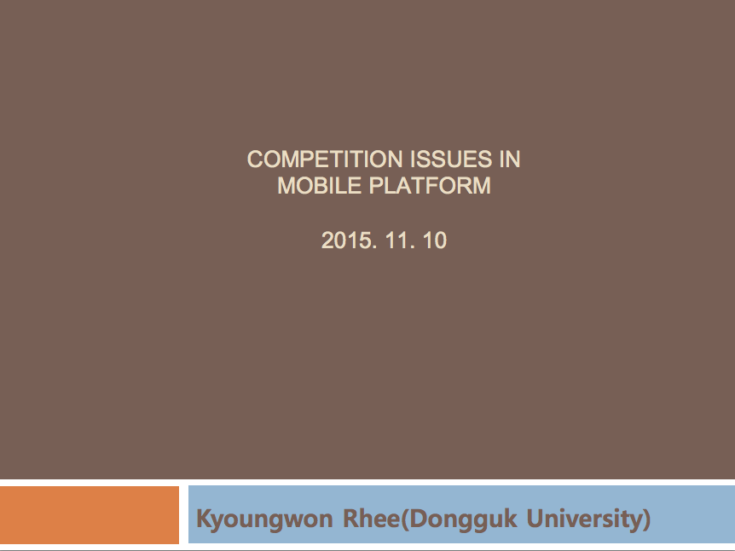
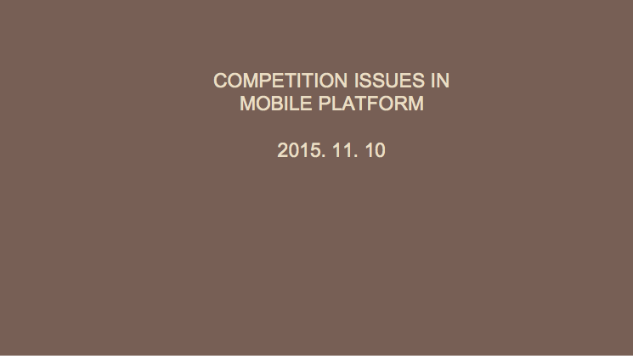

Slide 2
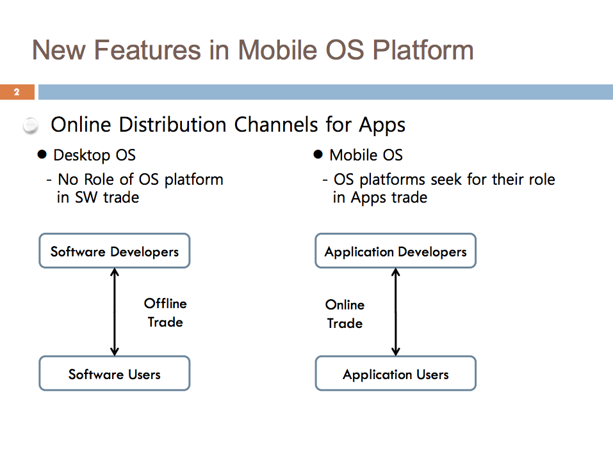

Slide 3
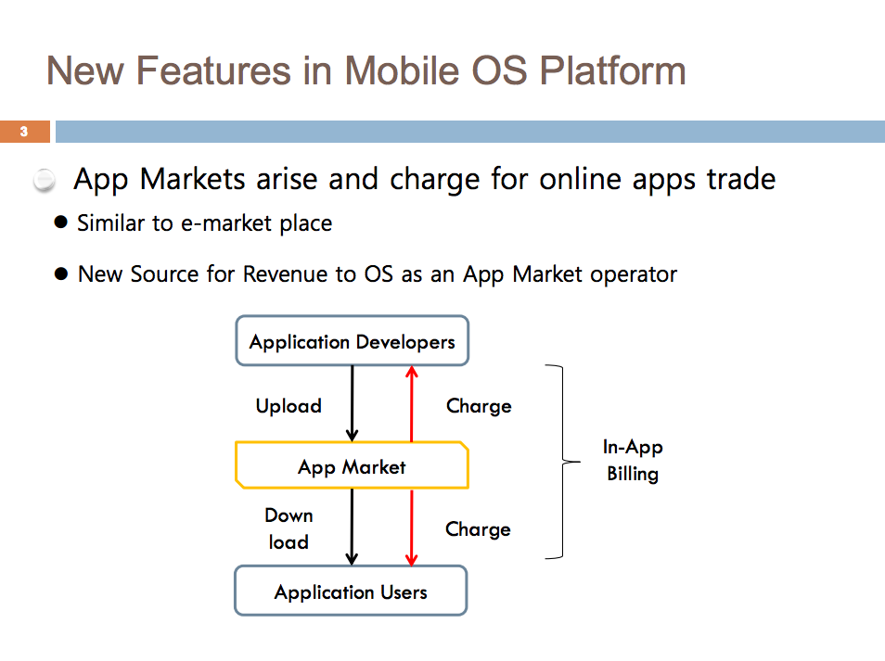

Slide 4
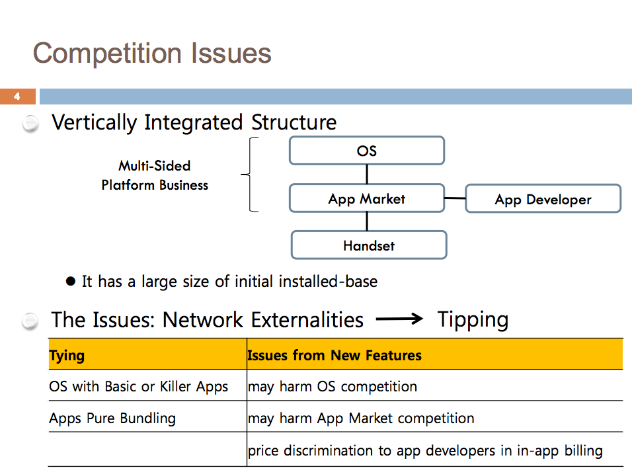

Slide 5

Panel 1:
Key characteristics of and recent trends in internet competition
Moderated by:
Maurits Dolmans,
Partner at Cleary Gottlieb and well-known internet competition expert
Participants:
Elizabeth Wang, Charles River Associates
Darren Tucker, Partner at Morgan Lewis and former US Federal Trade Commission regulator
Prof. Sung-Hwan Kim, Economics, Ajou University
Prof. Kyoungwon Rhee, Economics, Dongkuk University
Notes:
5

Slide 6
Remarks by internet policy expert Marvin Ammori:
Perspectives on ‘neutrality’ in internet policymaking
Moderated by:
Maurits Dolmans,
Partner at Cleary Gottlieb and well-known internet competition expert
Participants:
Marvin Ammori, Affiliate Scholar of the Stanford Law School Center for Internet & Society, prominent First Amendment lawyer and well-known Internet policy expert advocating for Internet freedom.
Prof. SangKyu Rhee, Economics, Chungang University
Jeong Seo, Attorney, Kim & Chang
Notes:
6

Slide 7
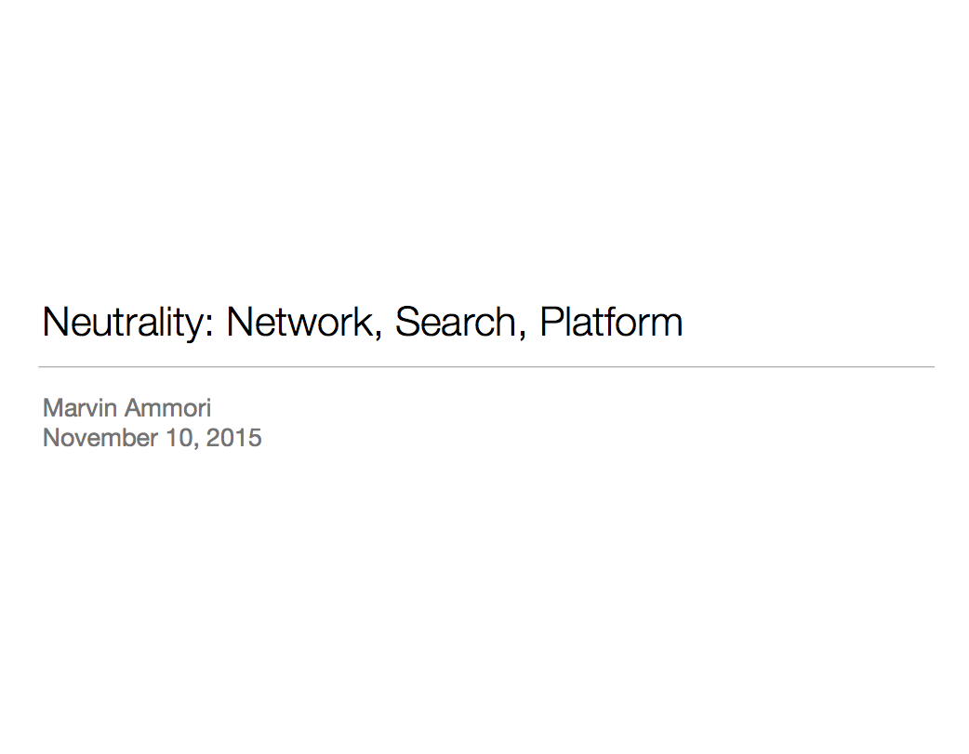

Slide 8
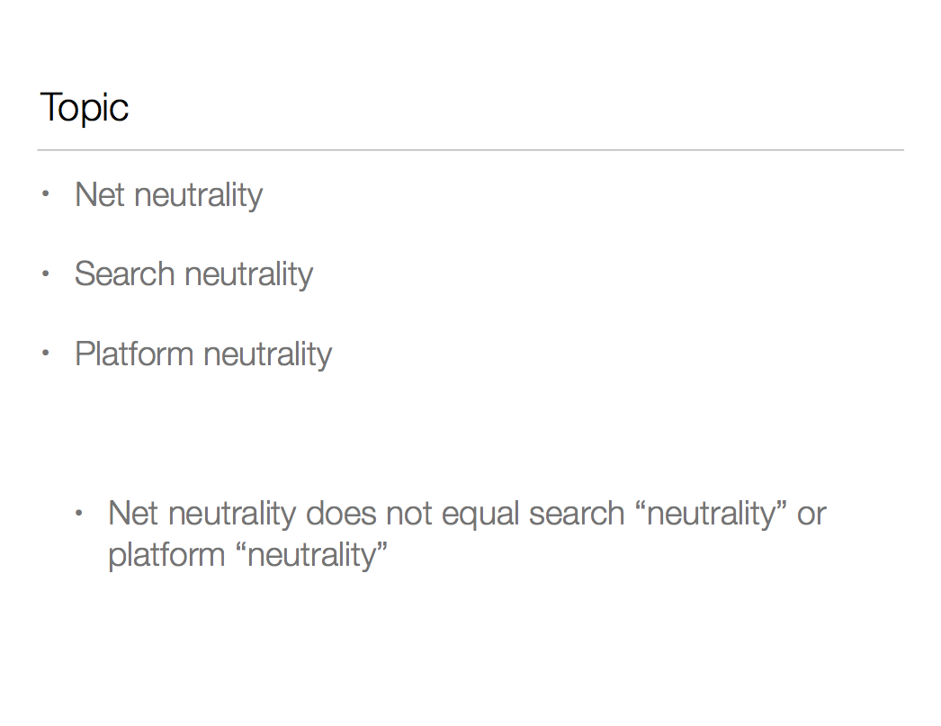

Slide 9
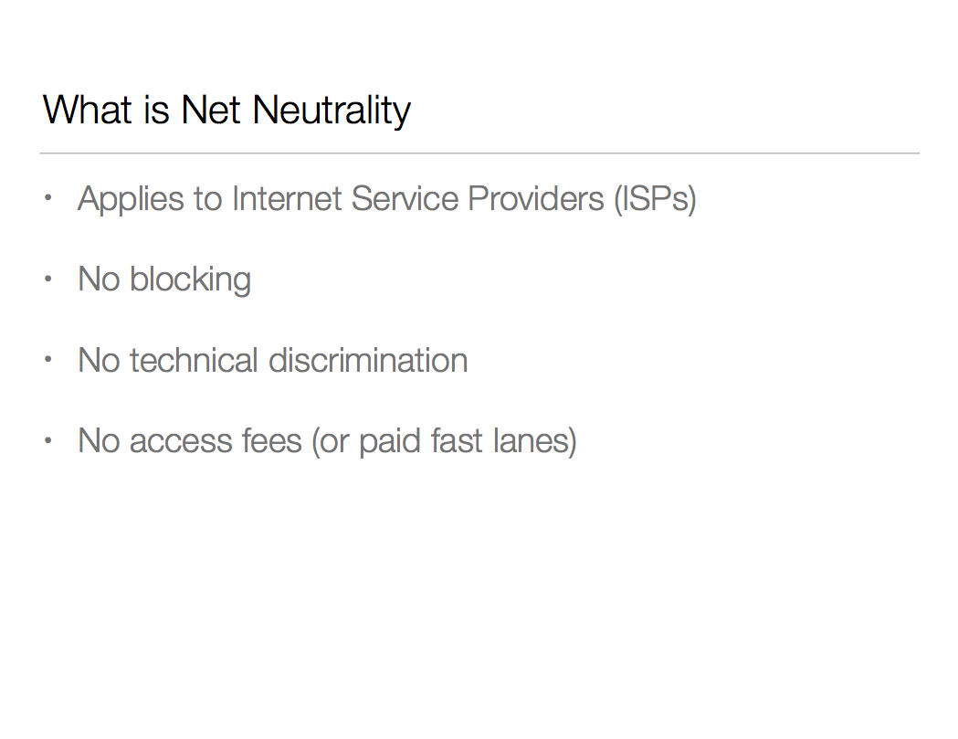

Slide 10
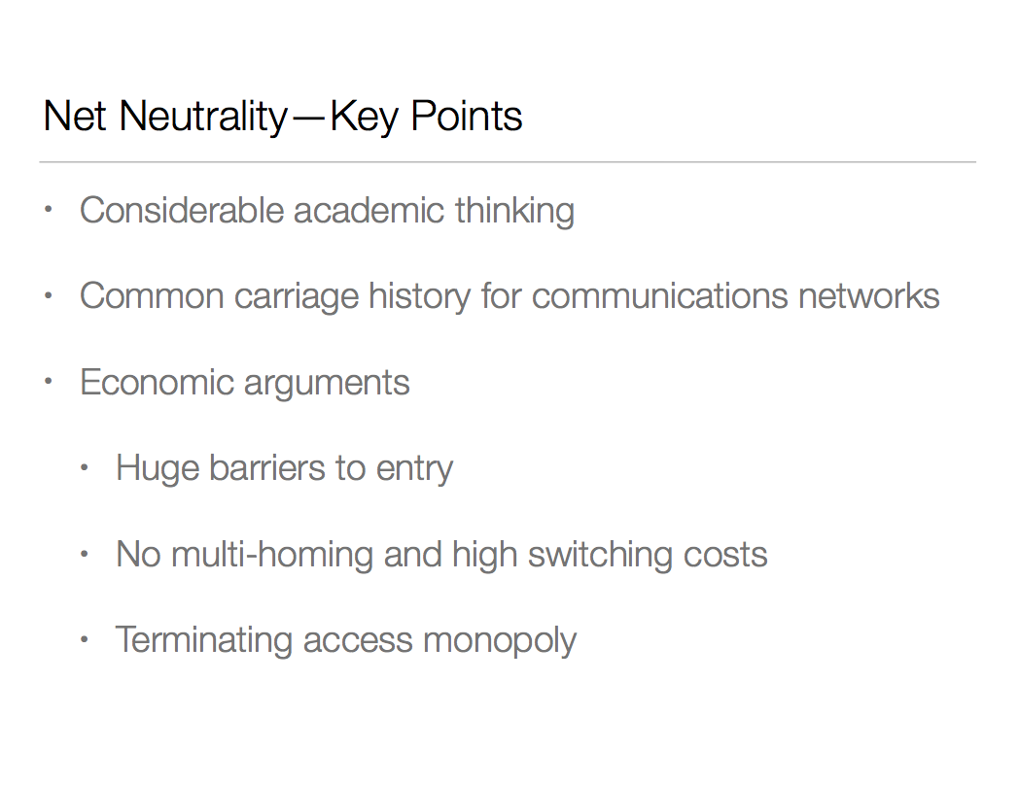

Slide 11
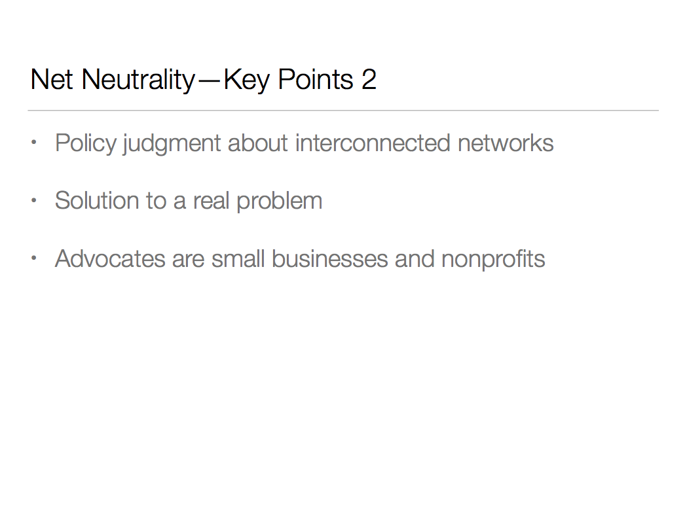

Slide 12
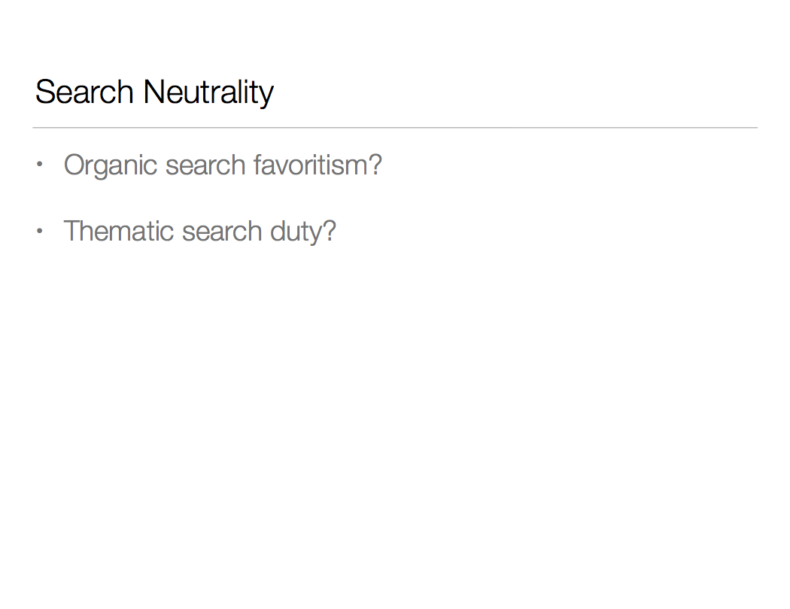

Slide 13
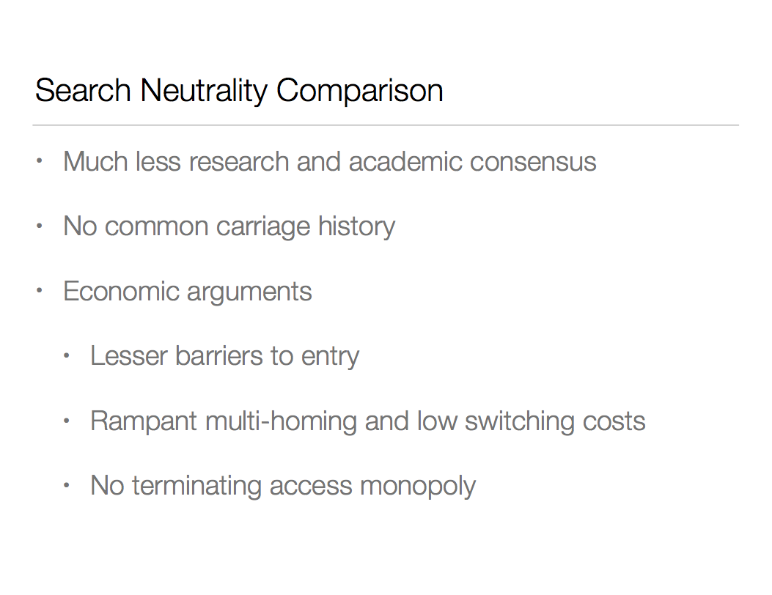

Slide 14
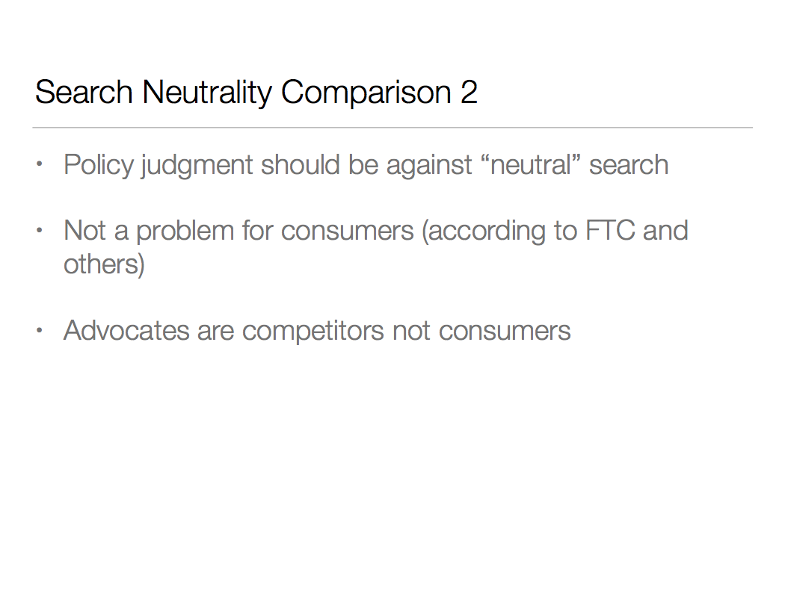

Slide 15
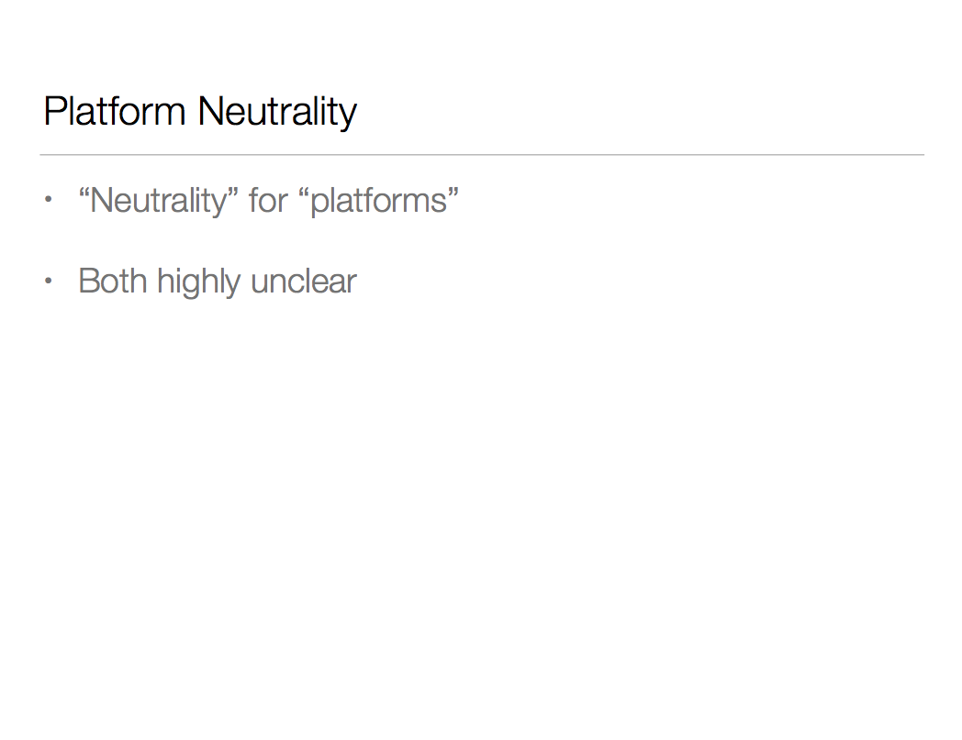

Slide 16
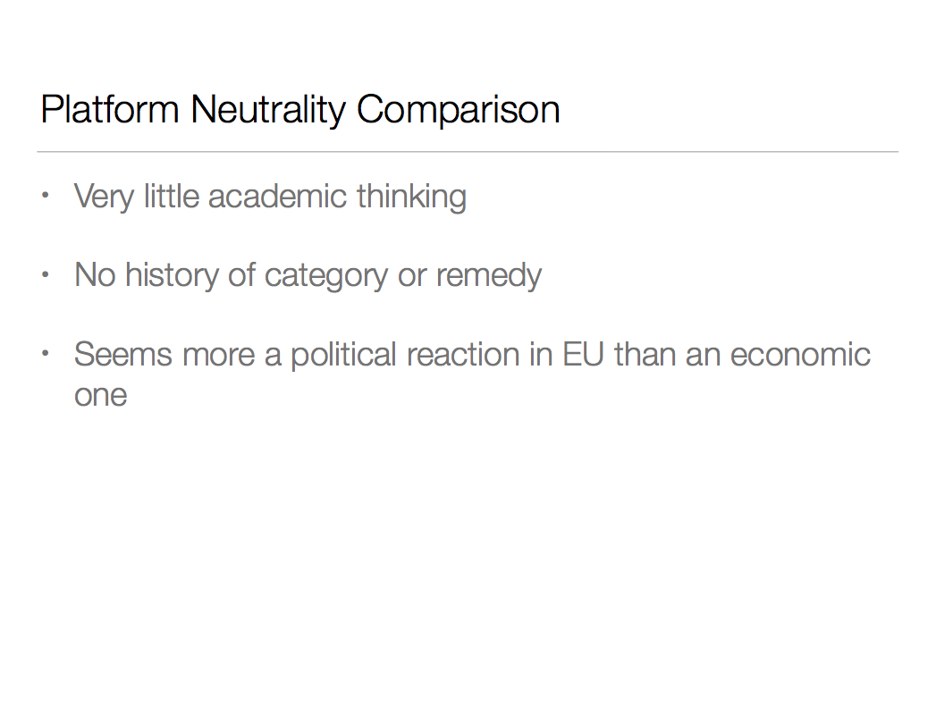

Slide 17
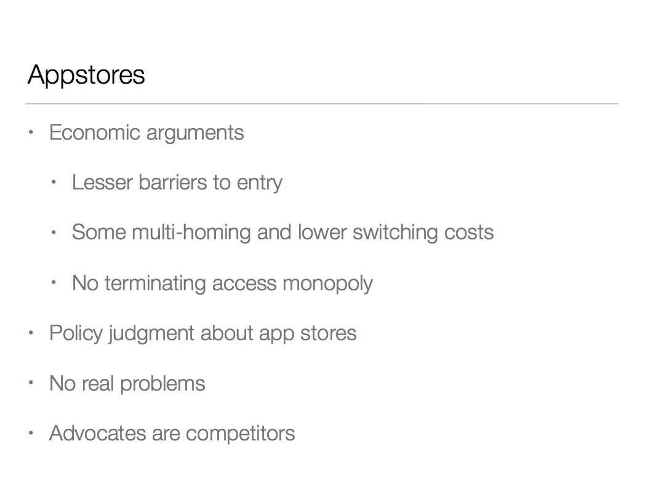

Slide 18
