Slide 1

Big Data & Issues in Competition Laws
2016. 11. 11.
이황
ICR센터 부소장
고려대학교 법학전문대학원 교수

Slide 2

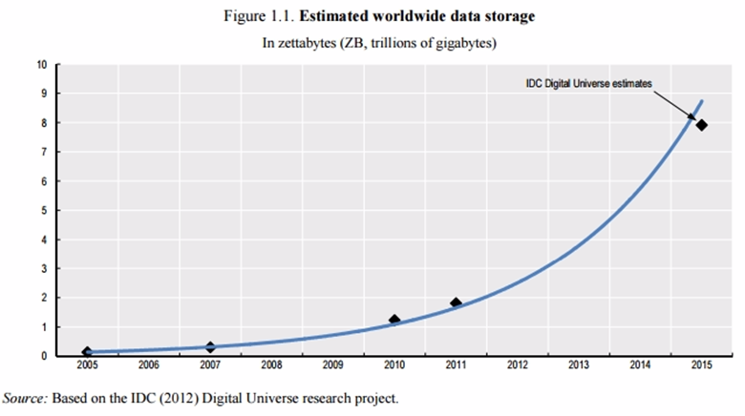
What is Big Data?
Big Data: Hard to define
Data subject: Data sets for which volume becomes an issue in management and processing
Analytics: What matters is the way data is used and the resulting complexity
Example of Personal Data aggregated - Android smartphone https://www.google.com/maps/timeline?pb=!1m2!3m1!1s2016

Slide 3
Significance
4 “V”s
Volume of data, Velocity at which data is collected, used, and disseminated, Variety of information aggregated, Value of the data
Importance of Big Data - Data-driven innovation(DDI)
Data is an infrastructural resource(un-exclusivity): unlimited users, purposes as an input, increasing returns to scale and scope, etc.
Value Creation Mechanisms of Data Analytics
Gain insights(natural phenomena or individuals’ conducts)
Decision automation(Google’s driverless car)
Industries benefited
ICT: Google, Apple, Amazon, Samsung, 네이버, 카카오톡, etc.
Non-ICT: Finance, transportation, utilities, retail, healthcare, etc.

Slide 4
Competitive Significance(Stucke & Grunes)
Companies are increasingly adopting business models that rely on personal data as a key(e.g. two-sided market)
As 4Vs increase, companies will undertake data-driven strategies to obtain and sustain a competitive advantage
Network effect, entry barrier, etc.
As data-driven mergers increase, one might expect the merging parties to raise as a defense data-driven efficiencies(e.g. TomTom/Tele Atlas Merger, Microsoft/Yahoo! joint venture)
Business have strong incentives to:
Limit their competitors’ access to data
Prevent others from sharing the data, and
Oppose data-portability policies that threaten their data-related competitive advantage.

Slide 5
Antitrust Implications
Every step about Big Data can be problematic in enforcement due to strong inherent incentive to become big and dominant
Data Production – Different capabilities to produce
Data Collection – Availabilities of data collected, Salability of Data set
Data Analysis – Arbitrary processing
Data Transfer – portability of data leading to level playing field
Great opportunity for innovation and business BUT also Great risks to harm consumer welfare and industry development in unprecedented manner and magnitude
Calls for careful balancing and quick & strong regulation when needed

Slide 6
Antitrust Implications
Traditional antitrust principles are valid but need to be improved to address the complexity and work not too late
All categories of infringements are applicable that means arsenal is ready to react
Merger, Refusal to deal, Group boycott, Foreclosure, Exclusive dealing, Predatory Pricing, Raising rival’s cost(customer’s switching cost), etc.
Privacy – hard to evaluate non-price factors(Value, harm, balancing) BUT a critical factor of consumer welfare which antitrust aims to advocate
Cost of false negative and late intervention is expected high
Need to analyze issues and find right time to regulate esp. in Korea with high share of ICT industries and high industry concentration
Any differences between US and EU?

Slide 7
Thanks.
Q & A

