Slide 1
Tying or a New Business Model? Google’s MADA Controversy
Namhoon Kwon (Konkuk University)

Slide 2
Introduction
Tying claims abound against Google’s Android mobile licensing, while mixed decisions are made.
FTC(2010~2013): rejected the claim on tying
KFTC (2011~2013): dropped
Feitelson v. Google(2014): class-action dismissed
Canada Competition Bureau (2013~2016): dropped
Russia FAS (2014~2015): ruled against and fined (settled 2017)
EC investigations(2013~ ): Statement of Objection issued on April 20, 2016
What makes the judgement difficult? Is Google evil after all, or is this all just a misunderstanding?
Studying of the issue might shed light on platform business model and antitrust
I will focus on EC claims (although details are not released)

Slide 3
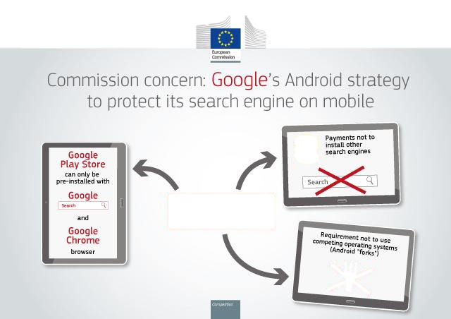
EC Claim of Antitrust Violations
Requiring to pre-install Google Search and Chrome and make Search as default.
Preventing manufacturers from selling “Android-forks”
Giving financial incentives to manufacturers and mobile network operators to set Google Search as ‘exclusive’ default engine.

Slide 4
Background Facts
MADA(Mobile Application Distribution Agreement )
Google-HTC contract 2010 (provided by Ben Edelman)
"Devices may only be distributed if all Google Applications [listed elsewhere in the agreement] ... are pre-installed on the Device." See MADA section 2.1.
The phone manufacturer must “preload all Google Applications approved in the applicable Territory … on each device.” See MADA section 3.4(1).
The phone manufacturer must place “Google's Search and the Android Market Client icon [Google Play] ... at least on the panel immediately adjacent to the Default Home Screen,” with "all other Google Applications ... no more than one level below the Phone Top." See MADA Section 3.4(2)-(3).
The phone manufacturer must set “Google Search ... as the default search provider for all Web search access points.” See MADA Section 3.4(4).
Google's Network Location Provider service must be preloaded and the default. See MADA Section 3.8(c).

Slide 5
Background Facts
Understanding of Android varieties
AOSP: truly open source (true Android forks)
Amazon(Kindle Fire), Barnes & Nobles(nook), Nokia X
OHA(open handset alliances): Google endorses the compatibility (CTS; compatibility test suites)
Should follow Anti Fragmentation Agreement(AFA) that prohibits making devices with an incompatible version of Android
Compatible forks are possible (Xiaomi, Gionee, etc.)
GMS(Google Mobile Services) through MADA
Free pre-loading for manufacturers, but not “open”
Should follow certain pre-loading rules (previous slide)
How about Apple OS and its pre-installed apps?
Vertically integrated to the device (no freedom)

Slide 6
Google’s Business Model
Google is basically an online advertising company
more than 90% of revenue comes from advertising
To attract eyeballs, Google wants to distribute GMS as much as possible
GMS apps are 3-side products linking OEMs, app developers/adverisers, and consumers
Effectively negative pricing for OEMS (‘loosely’ bundled with Android OS and its support)
Ad revenues (Search, YouTube), Revenue sharing(Google Play)
No charge for consumers
Pre-installation clauses of MADA might be considered as the implicit price for Android OS
Google could have chosen to pay for pre-installation, while separately charging for the Android OS (no difference for OEMs)
Note: Apple receives $3 billion to make Google Search default, and it is reported that Samsung is about to get paid similar amount.

Slide 7
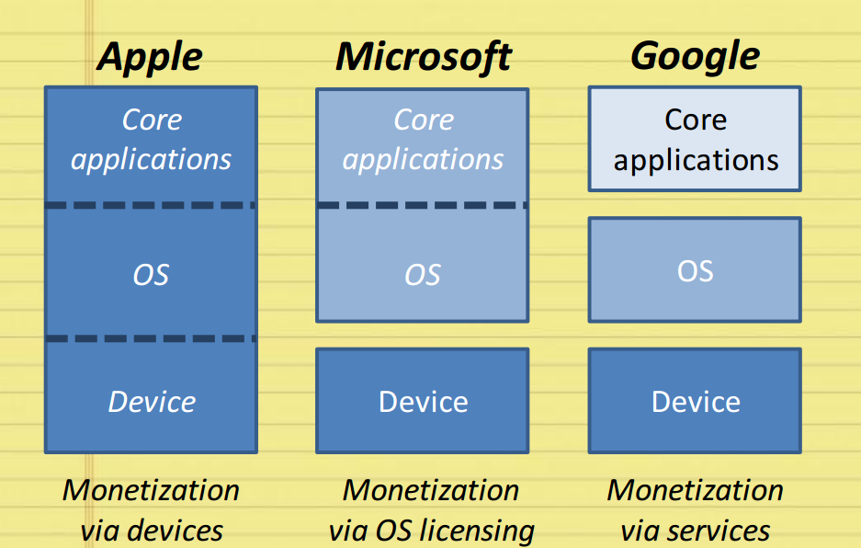
Google’s Business Model
Source Lamadrid (2014)

Slide 8
Checking the Claims
Claim 1: Tying
EC seems to claim that Google Play is the tying product, and Search/Chrome are tied products
Why Play?
Essential for installing Android OS
Doesn’t this mean that Android is the real tying product? But Android is open and free
You may condemn that Android is not so free after all, but tying?
Most dominant (compared to Search, Chrome, Maps, etc.)
Play was never licensed alone (separate product?)
Search could have been the reason for licensing GMS (at least for early Android devices)
Equally efficient competitors being foreclosed?
Naver search never lost the dominance in Korea despite all those Google pre-installs
If this is tying, what is the remedy?
Separate licensing of GMS products probably, but would that make real difference if Google offers bundling discount instead?

Slide 9
Checking the Claims
Korea is a counter-example for MADA’s exclusionary power
Search Query Share (PC)
Search Query Share (Mobile)
Source: Korean Click
Note: yearly average of monthly shares except for 2012(3~12), 2016(1~3)

Slide 10
Checking the Claims
Claim 2: Preventing from selling Android forks
Two separate issues are involved
Android OEMs cannot sell incompatible Android products
Google is not licensing GMS for incompatible Android products
Justification of 1) depends upon the seriousness of fragmentation
But OEMs can sell non-Android devices (e.g. Samsung Bada/Tizen) and compatible Android forks (Xiaomi MIUI)
2) is basically an essential facility issue
Difficult to prove, and was there any dealing attempt?

Slide 11
Checking the Claims
Claim 3: Financial rewards to pre-install Google Search exclusively
Seems to claim exclusive dealing (otherwise, it’s just paying of the price)
If true, however, doesn’t this support that MADA requirements are not quite exclusionary?
Showing that rival apps can be also pre-installed and be competitive without exclusive dealing
Pre-installation competition is good, but ‘exclusive’ pre-installation competition is bad?
EC is worrying that MADA reduces competition for good spaces for pre-installation (So preferential treatment itself is OK)
Consumers seem to hate too much pre-installation because they can easily download apps they want

Slide 12
Concluding Remark
No new antitrust principles are needed for platform economy, but we should improve our understanding of new business models
How to treat ‘free’ products and increased bundling practices are two important challenges
But we should always bear in mind Coase’s(1972) remark
“if an economist finds something—a business practice of one sort or other—that he does not understand, he looks for a monopoly explanation. And as in this field we are very ignorant, the number of ununderstandable practices tends to be rather large, and the reliance on a monopoly explanation, frequent.”

