Slide 1
Platform Economy and Competition Policy
Sung-Hwan Kim (Ajou University)
August, 2017

Slide 2
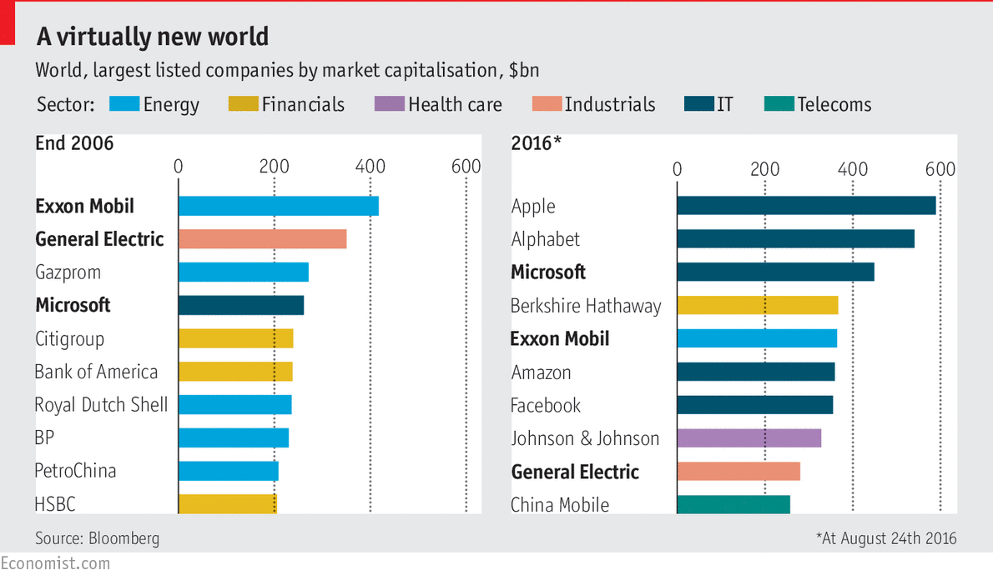
Platform Economy and Regulation
For a brief friendly introduction to the antitrust issues of platform economy, please look at my recent writing(link).
Chapter 3 of “2045 미래사회@인터넷플러스-신뢰를 세우다(인터넷진흥원, 2017)”

Slide 3
Does Platform Economics Help?
[Question] Does economics (such as two-sided market theory) help competition policy of platform economy?
The answer is yes and no.
It helps in that it makes us understand better how platforms work and make profits.
But, it tortures competition authorities by showing how different platform business models are from the conventional ones for which the current competition policy framework is designed.

Slide 4
Does Platform Economics Help?
In fact, it will take long to see economics really help competition policy of platform economy
Platform economics is not prepared enough yet to answer the specific policy questions.
Policy framework and legal standards tend to be too sticky
Until then, we will observe disagreement of economics and policy, which will lead to either of two failures.
Competition authority fails to do much to address the issues raised.
Or it does something absurd, ignoring the insights from economics and industry experts.

Slide 5
Challenges for Competition Policy
Two Questions
1. Can the current policy framework address the competition issues of platform economy appropriately?
2. If not, what should we do?
Van Gorp and Batura (2015) provides some reasonable answers to these questions. I will summarize them first and add my comments and thoughts.
“Challenges for Competition Policy in a Digitalized Economy” (Van Gorp and Batura, 2015) published by European Parliament

Slide 6
Challenges for Competition Policy (VG&B, 2015)
Problems with market definition: (1) multiple related markets served by a platform, (2) absence of nominal prices, (3) fluid market boundaries
➔ Need to focus on actual business models
Analyze how platforms generate profits and what/who may steal them.
Identify the potential forces of innovation, entry and contestability.

Slide 7
Challenges for Competition Policy (VG&B, 2015)
Problem with assessing dominance: use of static indicators (e.g., market share, price level, profit margin) is often misleading.
➔ Need to find indicators that inform about contestability and entry barrier
Analyze the strength of competitive constraints, including whether the incumbent firm is facing disruptive innovations
Analyze vertical power relations throughout the value web, including the identification of current and future bottlenecks

Slide 8
Challenges for Competition Policy (VG&B, 2015)
Problem with benchmark tests: equally-efficient-competitor test fails when multi-sided platforms charge multiple prices (or when digital rivals are not comparable in cost structures)
➔ Need to avoid using such tests in platform economy cases
Pre-emptive merger: It is a big concern in digital markets, but it is still hard to identify potentially anti-competitive mergers.
➔ Need to stick to a prudent enforcement of merger control
But, guard against the chances of tipping effects given the importance of scale economies and network effects

Slide 9
Challenges for Competition Policy (VG&B, 2015)
Leveraging of market power into adjacent markets
➔ Need to be careful to avoid an automatic conclusion
Applying digital technologies in other industries expands the innovation frontier, which means offensive leveraging can have positive effects when it is based on merits
But, defensive leveraging (as in Microsoft cases) needs to be regulated

Slide 10
Comments and Thoughts
Market definition and assessing dominance
I agree that analyzing business models and dynamic indicators would be important. (Forget about SSNIP and HHI or anything similar to them, please)
It is better to see market definition and assessing dominance as an integrated analysis, not separate steps, in platform economy.
Identification of bottlenecks
It is not even clear whether competition between platforms actually increases welfare (Monopolkommission, 2015)
Still, it is clear that we can identify bottlenecks in platform economy, which should be regulated. (And bottlenecks can arise without dominance!!)
In fact, we already have some experiences of regulating bottleneck fees of platform, e.g., termination access in telecom, payment card merchant fee.

Slide 11
Comments and Thoughts
Pre-emptive merger and tipping effect
Pre-emptive mergers should be regulated to keep the market open to innovation as well as competition.
But, I doubt that tipping effect is a major concern. As tipping and network effects are natural consequences of given demand structure and come along with efficiency, it is not clearly justified (or even impossible) to reject them.
Offensive leveraging
It is worth emphasizing that offensive leveraging on basis other than merits should be regulated.
Question: If a platform exploits data obtained through serving a firm to outperform it, can it be a competition on merits?

Slide 12
Comments and Thoughts
Current policy is the mixture of 2 approaches – structure and effect.
But, either of them does not work right in platform economy. (→ next slide)
In structural approach, keywords are market share, concentration, dominance.
It is the original foundation of antitrust and still preferred by many for its transparency in practice.
But, economists tend not to like it since it is often wrong (especially in differentiated markets).
In effects-based approach, keywords are price, consumer/social welfare.
Preferred by economists, it has increasing influence in the policy.

Slide 13
Comments and Thoughts
Dynamic efficiency is much more important in platform economy.
➔ It is much harder to evaluate welfare effects.
➔ Some (e.g., Kahn (2017)) argue that we need to turn back to the original structural approach. But, traditional structural approach can’t do better because it considers only ‘static’ structure.
Ultimately, we will have to aim at finding a totally new approach focusing on dynamic structure
The keyword of this new approach should be ‘market openness’ to innovation and discovery rather than market dominance or (static) efficiency.
“I wish now to consider competition systematically as a procedure for discovering facts which would remain unknown or at least would not be used.” (Hayek, 1968: translated from German in 2002)

