Slide 1
Platform Competition
Hill Wellford
Morgan Lewis & Bockius LLP
Washington, DC
Sogang University
31 August 2017

Slide 2
Topics
How platforms compete
Threats to the “health” of platforms
Common errors by competition authorities

Slide 3
What is a “platform?”
Users
Platform
An underlying technology base upon which other technologies – typically applications, other software, or processes – are developed and used.
Key feature: two-sided or multi-sided
Each side finds or interacts with others via the platform
One side may receive free or discounted access, attracting more customers for the sides that pay more
Role of a “sponsor”
Establishes rules to define and maintain the platform
App Publishers
Device Makers

Slide 4
The platform “virtuous cycle”
More Apps & Content
More
Users
More
Accessories
More
Devices

Slide 5
What is “platform competition?”
Competition between platforms
Microsoft NT vs. Unix, for server OS
Microsoft vs. Apple, for desktop and laptop computer OS
Apple iOS vs. Android OS, for mobile devices
Competition within platforms
Two platform participants, in the same “side” of the platform compete against each other
Examples:
Retailers bid against each other to buy Facebook ads
Device manufacturers compete to sell Android phones

Slide 6
Key threats to “health” of platforms
Fraud and safety concerns
Participants will depart if they aren’t safe
Fragmentation
Consumers like consistent “out of the box” function
Software developers need technical compatibility
Interference with “sponsorship”
If sponsor cannot maintain compatibility and safety, costs rise, and participants may leave the platform

Slide 7
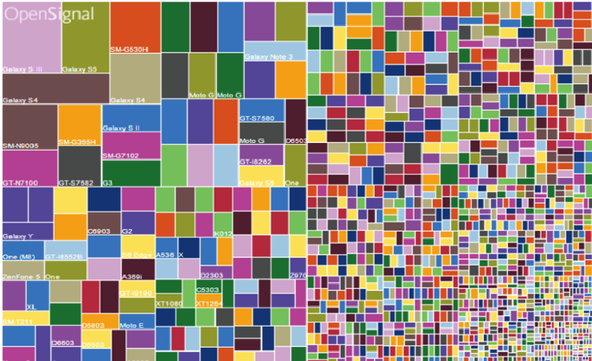
Potential for fragmentation is real
Source: Open Signal, Android Fragmentation Report (August 2015)

Slide 8
Common errors by authorities
Objecting to pricing differently to each side
Different pricing to different sides is normal and necessary
Below-cost or “freemium” pricing to one side is common, and not typically predatory or anticompetitive
Interfering with antifragmentation & safety efforts
Business participants have the incentive to push boundaries, because they receive 100% of the gain but the reputational risk is shared by the entire platform
Platform sponsor must be able to enforce rules; only the sponsor represents the platform as a whole
Fragmentation is cited as the reason Unix servers declined

