Slide 1
One plus and Samsung mobile divergence
What are you solving for?
Approach
To find out if Samsung’s eminence is at risk with mobiles like one plus
Getting perspective of what consumers think
Look for data driven insights to find out and substantiate factors
Use latest data analytics / text analytics techniques to explore and derive insights
By:
Vikaskasyap Konda (11915047)
Saurabh Sisodia(11915035)

Slide 2


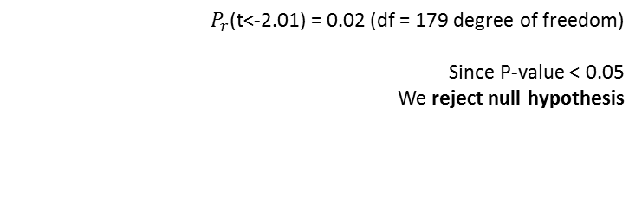
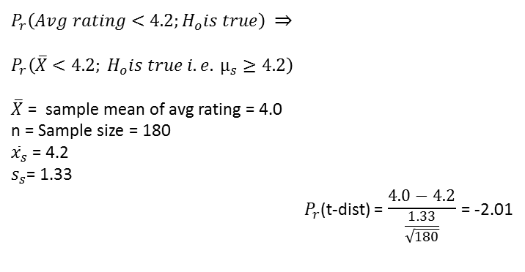
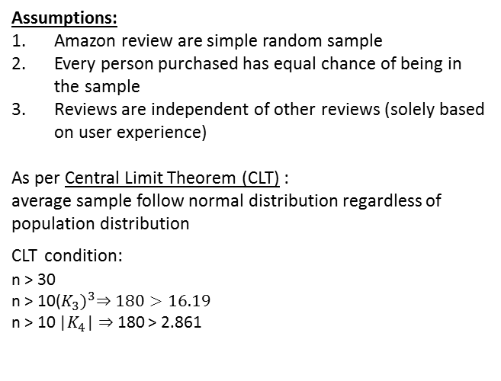
Statistical Analysis
Ho : Samsung is better phone with average rating ($µ_{r}$) >= 4.2
$P_{r}\left(Avg rating<4.2;H_{o}is true\right)$ $⇒$
$$P_{r}\left(\overline{X}<4.2; H_{o}is true i.e. µ_{s}≥4.2\right)$$
$\overline{X}$ = sample mean of avg rating = 4.0
n = Sample size = 180
${\overline{x}}_{s}$ = 4.2
$s_{s}$= 1.33
$P_{r}$(t-dist) = $\frac{4.0 − 4.2}{\frac{1.33}{\sqrt{180}}}$ = -2.01
Hypothesis testing
Ha: One plus 7 pro is better phone than Samsung ($µ_{r}$) < 4.2
Assumptions:
Amazon review are simple random sample
Every person purchased has equal chance of being in the sample
Reviews are independent of other reviews (solely based on user experience)
As per Central Limit Theorem (CLT) :
average sample follow normal distribution regardless of population distribution
CLT condition:
n > 30
n > 10${\text{(}K_{3})}^{3}⇒180>16.19$
n > 10 |$K_{4}$| $⇒$180 > 2.861
-2.01
0
$P_{r}$(t<-2.01) = 0.02 (df = 179 degree of freedom)
Since P-value < 0.05
We reject null hypothesis

Slide 3
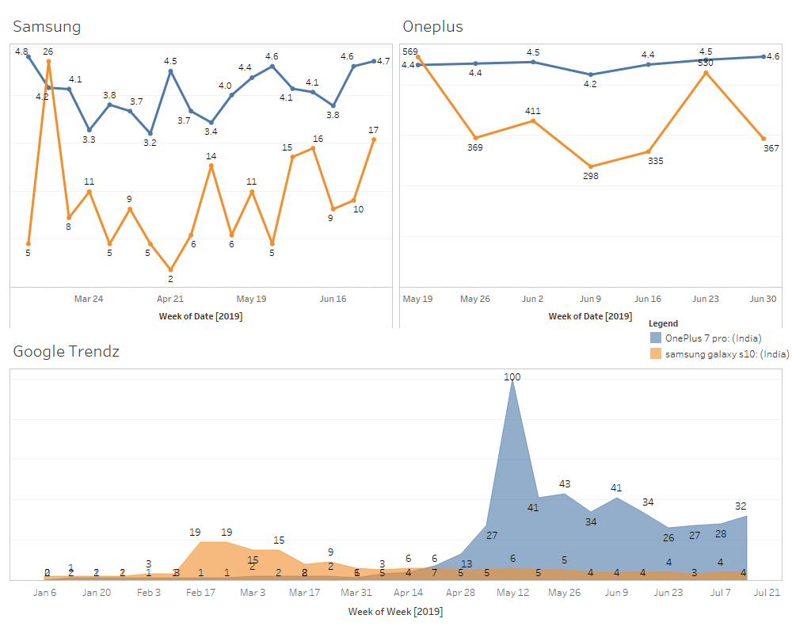
Initial Study

Slide 4

Web Scraping
01
Amazon Reviews
02
News API and Twitter
YouTube Subtitles
and Comments
04
03
Tech reviews
(GSM Arena)

Slide 5
Process flow
Data collection
Scraped reviews data from :
Text Analytics
Sentiment Analysis
performed sentiment analysis on YouTube reviews , Amazon & GSM arena separately
Topic Modelling LDA
Identified the most common topics discussed among the users of these 2 smartphones
Collected review articles information from NewsAPI
Removed emoticons and extra punctuations from the reviews
Word cloud
TF
ITF
Natural Language Processing (NLP)
Created co-occurrence graph to substantiate our findings
Searched for ‘OnePlus Vs Samsung’ and scarped YouTube subtitles from the video result
Amazon
YouTube
GSM arena
Created Document Term Matrix (DTM)
Removed most common stop words from the corpus
Corpus Tokenization to create Bag-of- Words (BOW)
Created Bigrams & Trigrams
Analysed the basic perception of these two brands among the user base
Identified the important features from the user perception
Analysed what features are more important and inter related

Slide 6
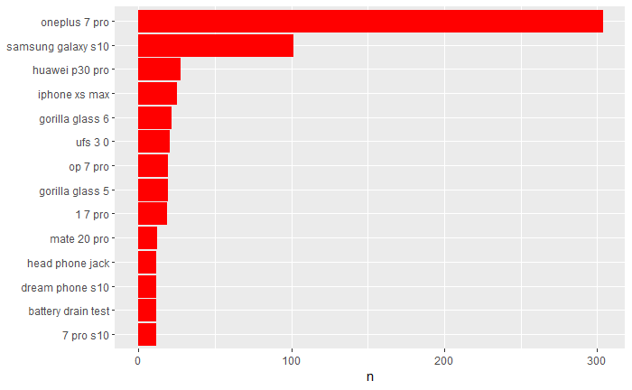
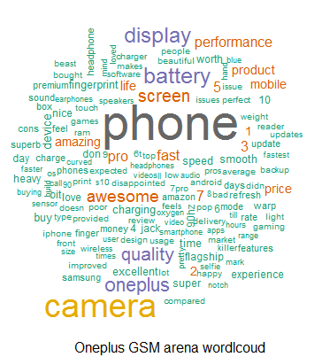
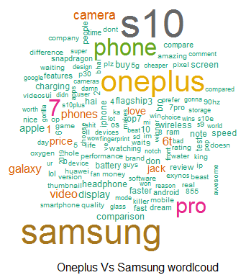
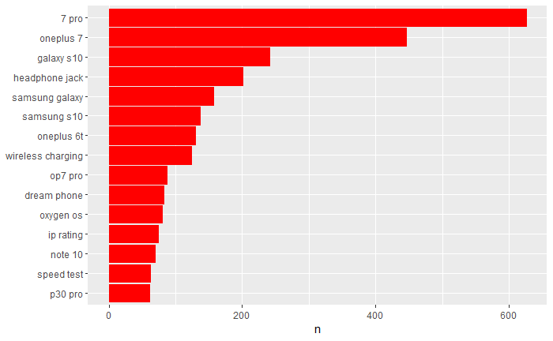
Word cloud & N-grams
From the word cloud and N-gram token frequency we observe battery, display and price as important factors, which users is concerned about. An additional feature user is concerned about is the headphone jack

Slide 7
Sentiment Analysis
Using Valence Shifters
Samsung galaxy S10
Oneplus 7 Pro
Amazon reviews - 0.28(0.15)
GSM Arena - .08
News Portals - 0.15
Amazon reviews - 0.37 (0.26)
GSM Arena - 0.97
News Portals - 0.23
The sentiment for Samsung is consistently less across corpora amazon reviews, techreviews and news

Slide 8
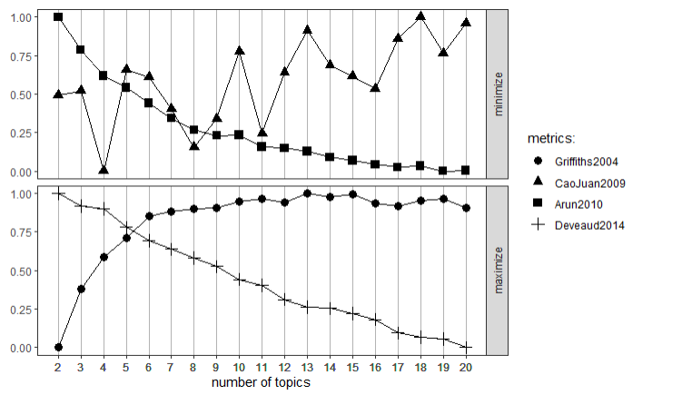
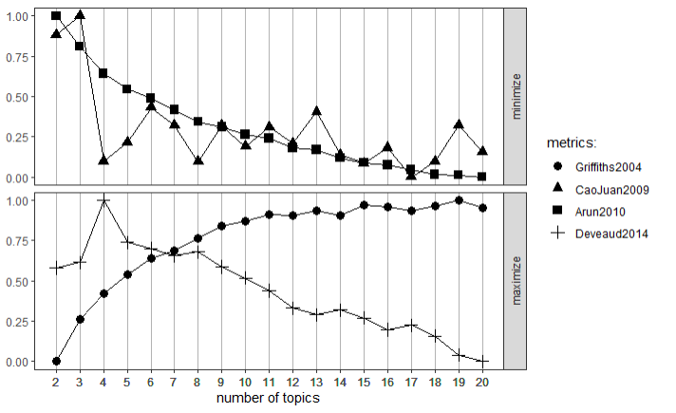
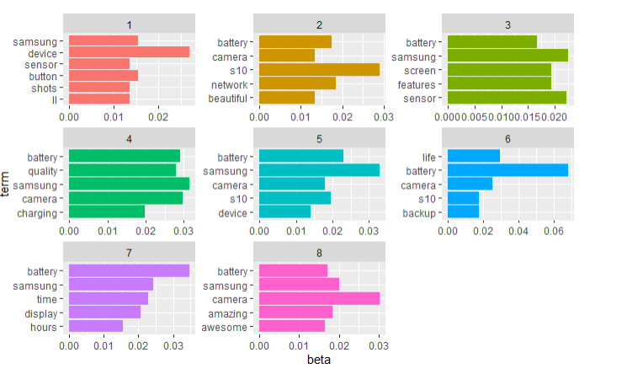
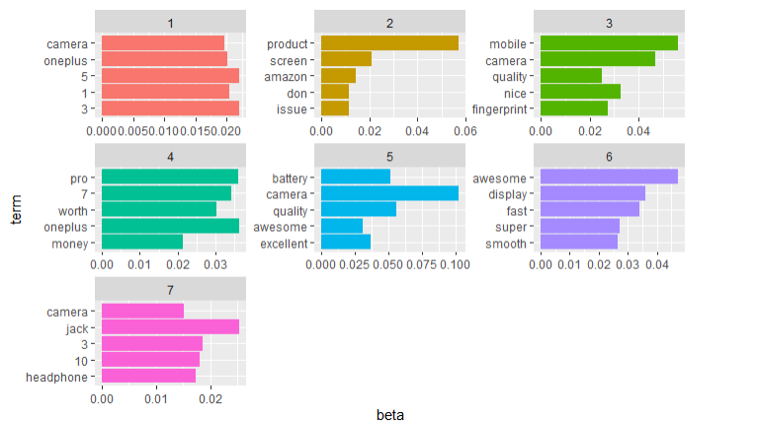
Topic Mining
Using LDA
Optical Topics – 8 (amazon samsung)
Optical Topics – 7 (amazon oneplus)
Samsung galaxy S10
Amazon reviews
Topics are predominant about battery in samsung reviews and audiojack, fingerprint sensors in oneplus

Slide 9
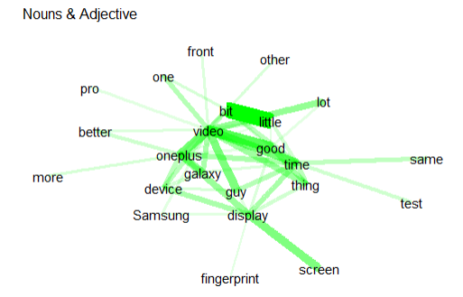
NLP
YouTube Subtitles
 | keyword | ngram | freq
160 | 90 Hertz refresh rate | 4 | 20
165 | 12 gigabytes of RAM | 4 | 20
204 | 60 frames per second | 4 | 18
236 | 12 gigs of ram | 4 | 16
243 | 8 gigs of ram | 4 | 16
291 | 8 gigabytes of RAM | 4 | 14
320 | eight gigs of ram | 4 | 13
365 | Huawei P 30 Pro | 4 | 12
439 | 4 k 60 frames | 4 | 10
442 | three times optical zoom | 4 | 10
Keyword phrases
Morphological featuring
PosTagging
lemmatization
The output of keyword phrase extraction, most of them are better features of Oneplus over Samsung

Slide 10
Conclusion
Samsung flagships phones to equip phones with advanced feature over Oneplus flagship
Samsung's wining strategy should include revived pricing and advanced specs
Gain positive sentiment with value for money phones in Indian market
Thankyou !!!

