Slide 1

Basic on storage and FileSystem
Stefano Cozzini
CNR-IOM and eXact lab srl

Slide 2
Agenda
Basic concepts on storage
Basic concept on File Systems

Slide 3
Storage 101

Slide 4
Storage Hierarchy
Same as with the memory hierarchy of Register -> Cache (L1->L2->L3) -> RAM storage follows a hierarchy with multiple levels:
  RAM disk, I/O buffers or file system cache
  Local disk (flash based, spinning disk) (SATA, SAS, RAID, SSD, JBOD, ... )
  Local network attached device or file system server (NAS, SAN, NFS, CIFS, PFS,Lustre, GPFS, …)
  Tape based archival system (often with disk cache)
  External, distributed file systems (Cloud storage)

Slide 5
Storage Hierarchy (2)
Physical Memory
Swap
Cache
Page Swapping
Generic Block Layer
Logical Block
Address
I/O Scheduler
RAM Disk
Hard Disk
Flash
Block Device
Drivers
RAM
Disk
HDD
Flash
Disk
FTL

Slide 6
Key metrics
Bandwidth: volume of data read/written in a second
  → throughput metric
IOPs: number of IO request processed by second
  → Is it a latency or a throughput metric ?
Order of magnitudes
  Intel v2/v3 CPU-DRAM: 80/100 GB/s
  IB link: 5-10 GB/s
  Hard Drive: ~100- 400 MB/s

Slide 7
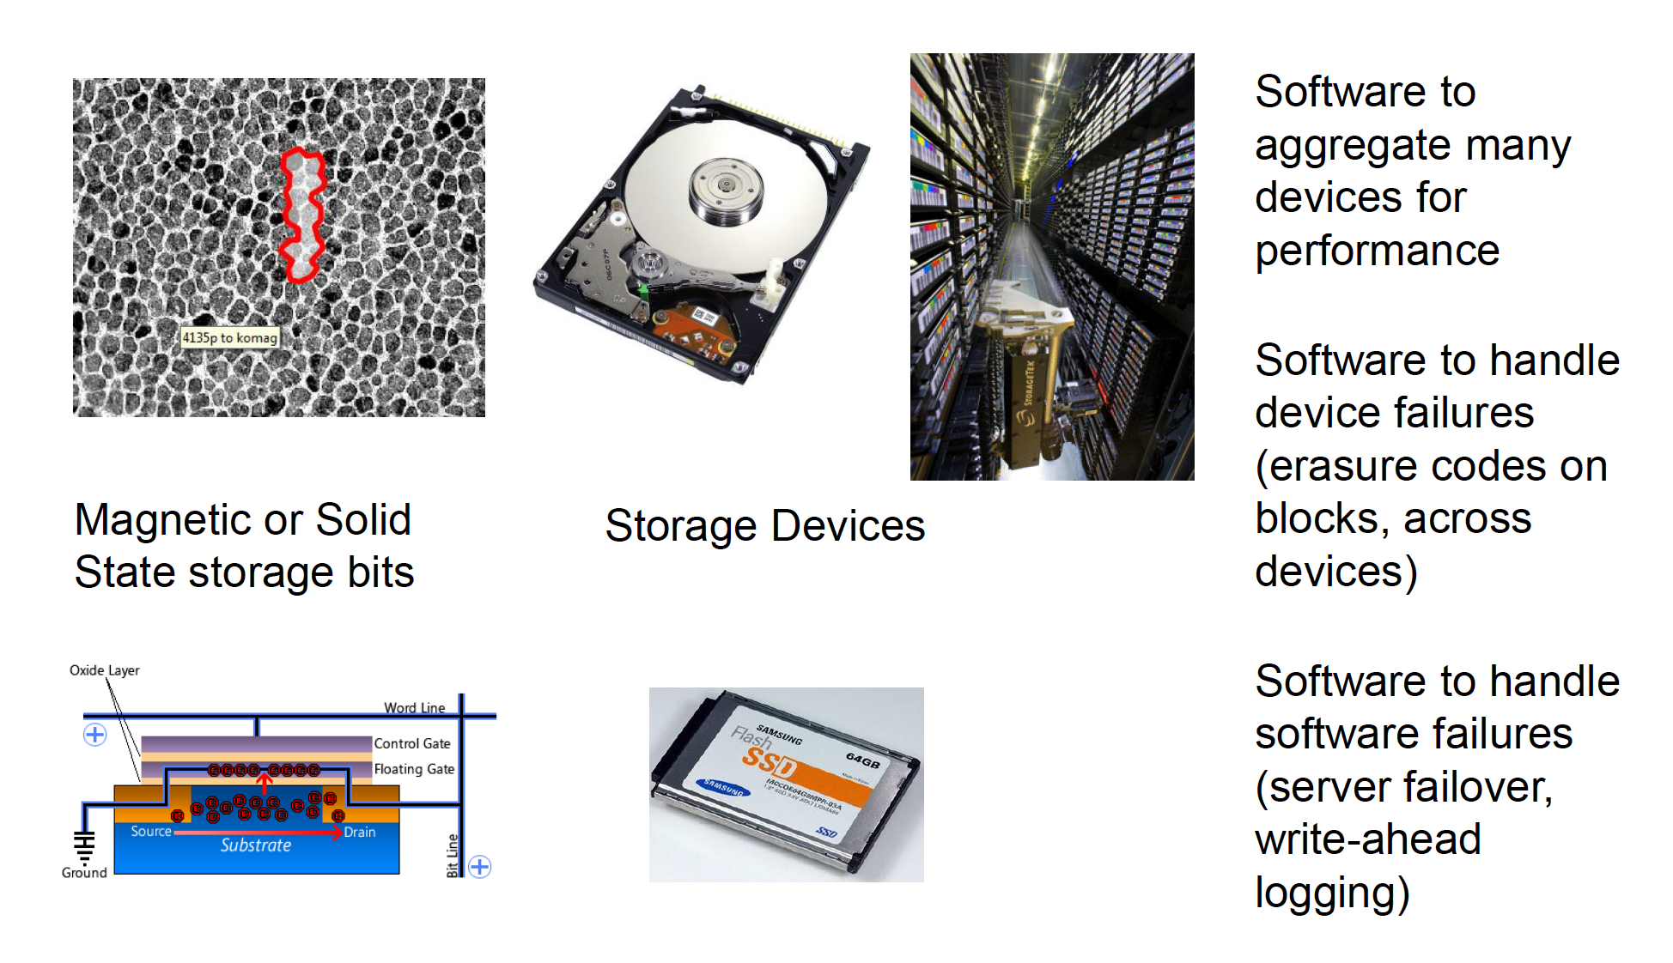
Building storage system from bits

Slide 8
RAM Disk / Solid State Drive
Unix-like OS environments very frequently create (small) temporary files in /tmp, etc.
  faster access and less wear with RAM disk
Linux provides “dynamic RAM disk” (tmpfs)
  only existing files consume RAM
  automatically cleared on reboot (-> volatile)
Solid state drive is a non-volatile RAM disk
  uses same interface as (spinning) hard drive
    Battery buffered DRAM (fast, no wear, expensive)
    Flash based (varied speed, wears out, varied cost)

Slide 9

HDD
Rotating mechanical device
  7200, 1000, 15000 rpm.
Head on the right track
  (seek time) 4 ms
Head on the right sector
  (latency) 2ms
Capacity: 4-12 TB
Bandwidth: Read / Write ~ 150/250 MB/s
At constant rotating speed, where should I put my data to get max bandwidth ?

Slide 10
Current HDD technology
We can find several magnetic hard disk technologies today:
Serial Advanced Technology Attachment (SATA)
Serial Attached SCSI (SAS)
Advanced Technology Attachment ([P]ATA/[E]IDE) (obsoleted by SATA)
Small Computer System Interface (SCSI) (obsoleted by SAS)

Slide 11
Solid-State Drive (SSD)
pros:
  lower access time and latency
  no moving parts (silent, less susceptible to physical shock, low power consumption and heat production)
  available over SATA, SAS, PCIe, FC buses
cons:
  expensive, low capacity; usage limited to special purposes only (hardly used for big data-servers)
  limited write-cycle durability (depending on technology and ... price)
      SLC NAND flash ~ 100K erases per cell
      MLC NAND flash ~ 5K-30K erases per cell
      TLC NAND flash ~ 300-500 erases per cell

Slide 12
SSD technology
SLC – Single Level Cell
  One threshold, one bit
  10⁵ to 10⁶ write cycles per page
MLC – Multi Level Cell
  Multiple thresholds, multiple bits (2 bits)
  10⁴ write cycles per page
  Denser and cheaper, but slower and less reliable
TLC – Triple Level Cell
  Cheapest, slowest writes
  500 write cycles per page!

Slide 13
SSD vs HDD
Latency ÷ 40: 0.1 ms vs 4 ms
Bandwidth x3: 450 MB/s vs 150 MB/s
Capacity ÷ 8/6 : 2 TB X SSD vs 12 TB (2018)
Price /Byte x10: $0.4 / GB vs $0.05 / GB

Slide 14
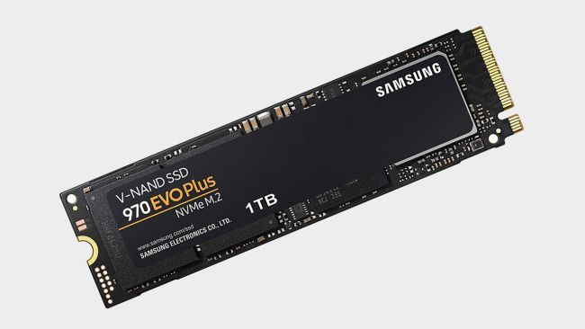
Some recent comparison
UltraStar DC HC620 with SAS 12GB/s interface
  Sustained transfer rate: 255 MBps read and write
Samsung 970 Evo with PCIe 3 interface
  Read speed 3,500 MBps
  Write speed 2,500 MBps
https://www.enterprisestorageforum.com/storage-hardware/ssd-vs-hdd-speed.html

Slide 15
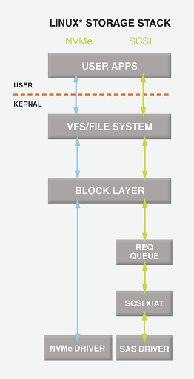
NVMe (Non-volatile Memory express)
SSD that can be connected on PCIe bus
SATA /SAS protocols designed for mechanical drive and are now the bottleneck
SAS SSD: 100 μsec - 450 MB/s
NVMe SSD: 20 μsec - 2500 MB/s

Slide 16
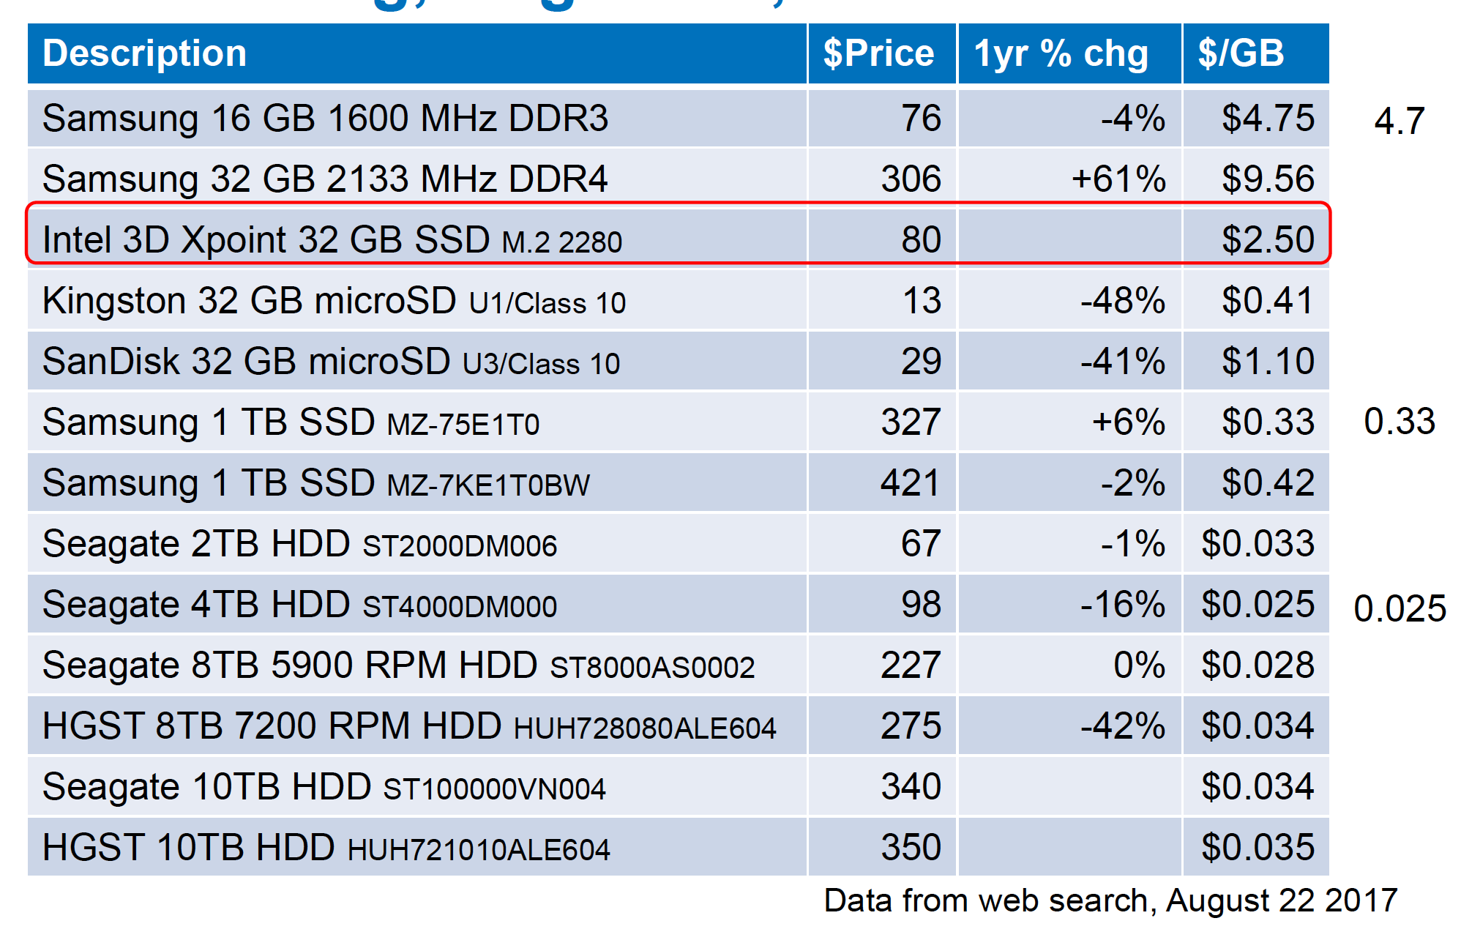
Memory/Disk prices

Slide 17
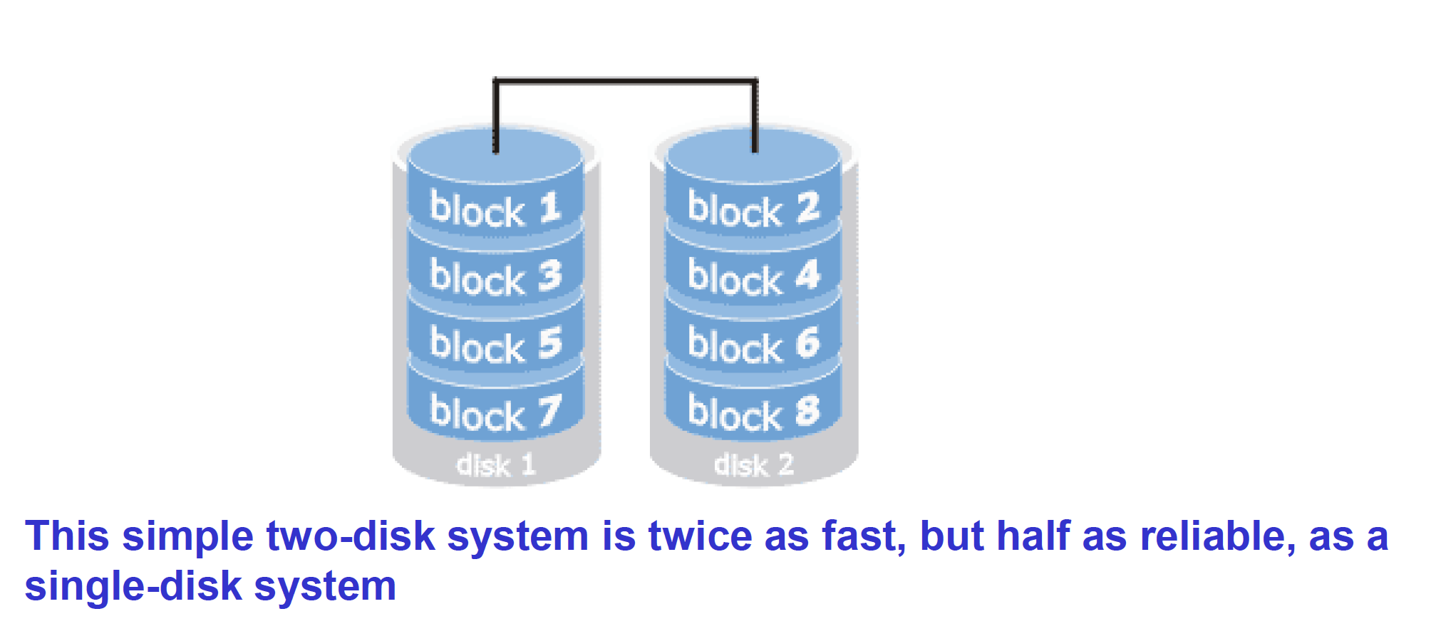
The Disk Bandwidth/Reliability Problem
Disks are slow: use lots of them in a parallel file system
However, disks are unreliable, and lot’s of disks are even more unreliable

Slide 18
RAID
RAID is a way to aggregate multiple physical devices into a larger virtual device
  Redundant Array of Inexpensive Disks
  Redundant Array of Independent Devices
Invented by Patterson, Gibson, Katz, et al
  http://www.cs.cmu.edu/~garth/RAIDpaper/Patterson88.pdf
Redundant data is computed and stored so the system can recover from disk failures
  RAID was invented for bandwidth
  RAID was successful because of its reliability

Slide 19
RAID reliability and performance..
Reliability or performance (or both) can be increased using different RAID “levels”.
Let us examine some of the most important:
Definitions:
S: Hard disk drive size.
N: Number of hard disk drives in the array.
P: Average performance of a single hard disk drive (MB/sec).

Slide 20
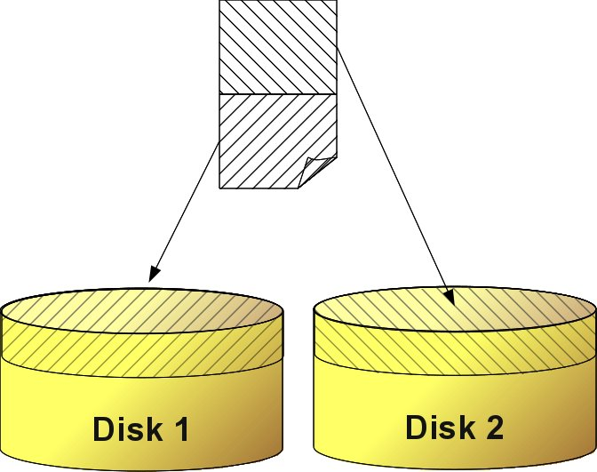
RAID 0 : striping
Performance = P * N
Capacity = N * S

Slide 21
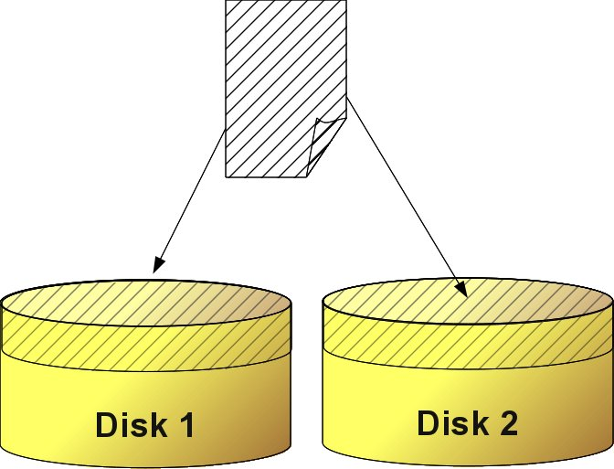
RAID 1 : redundancy
Write Perf. = P
Read Perf. = P * N
Capacity = S

Slide 22
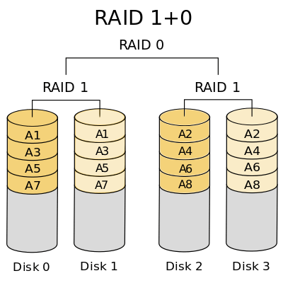
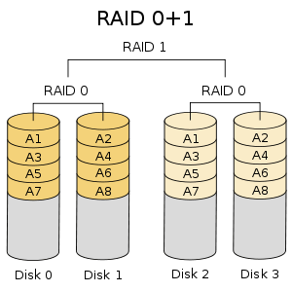
RAID 10 : striping +redundancy (1+0 / 0+1)
Raid 1+0 / 10: mirrored sets in a striped set
  the array can sustain multiple drive losses so long as no mirror loses all its drives
Raid 0+1: striped sets in a mirrored set
  if drives fail on both sides of the mirror the data are lost

Slide 23
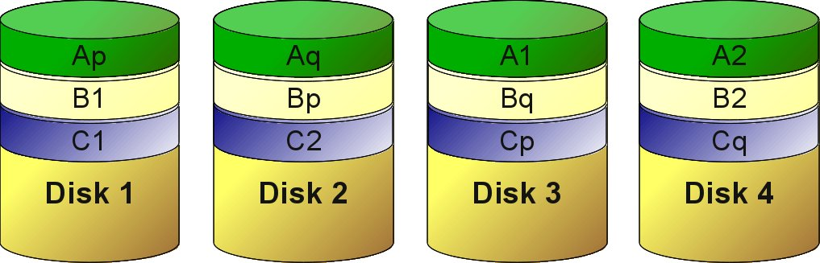
RAID 5
One disk can fail
Distributed parity code

Slide 24
RAID 6
Two disks can fail
Double distributed parity code

Slide 25
Notes on redundancy
Computing and updating parity negatively impact the performance. Upon drive failure, though, lost data can be reconstructed, and any subsequent read can be calculated from the distributed parity such that the drive failure is masked to the end user.
However, a single drive failure results in reduced performance of the entire array until the failed drive has been replaced and the associated data rebuilt.
The larger the drive, the longer the rebuild takes (up to several hours on busy systems or large disks/arrays).

Slide 26
Hot spare
Both hardware and software RAIDs with redundancy may support the use of a hot spare drive, a drive physically installed in the array which is inactive until an active drive fails, when the system automatically replaces the failed drive with the spare, rebuilding the array with the spare drive included. A hot spare can be shared by multiple RAID sets.
Subsequent additional failure(s) in the same RAID redundancy group before the array is fully rebuilt can cause data loss.
RAID 6 without a spare uses the same number of drives as RAID 5 with a hot spare and protects data against failure of up to two drives, but requires a more advanced RAID controller and may not perform as well.

Slide 27
RAID Parameters
Level | Description | Minimum # of drives | Space Efficiency | Fault Tolerance | Read Benefit | Write Benefit
RAID 0 | Block-level striping without parity or mirroring. | 2 | 1 | 0 (none) | nX | nX
RAID 1 | Mirroring without parity or striping. | 2 | 1/n | n-1 drives | nX | 1X
RAID 5 | Block-level striping with distributed parity. | 3 | 1-1/n | 1 drive | (n-1)X | (n-1)X
RAID 6 | Block-level striping with double distributed parity. | 4 | 1-2/n | 2 drives | (n-2)X | (n-2)X
RAID 1+0/10 | Striped set of mirrored sets. | 4 | * | needs 1 drive on each mirror set | * | *
RAID 0+1 | Mirrored set of striped sets. | 4 | * | needs 1 working striped set | * | *
http://en.wikipedia.org/wiki/RAID

Slide 28
Basic on file systems
Local file system structures as a building block
Requirements and Challenges
Metadata management

Slide 29
Filesystem
A file system is a set of methods and data structures used to organize, store, retrieve and manage information in a permanent storage medium, such as a hard disk.
Its main purpose is to represent and organize resources storage.

Slide 30
File System: elements
Namespace: is a way to assign names to the items stored and organize them hierarchically.
API: is a set of calls that allow the manipulation of stored items
Security Model: is a scheme to protect, hide and share data.
Implementation: is the code that couples the logical model to the storage medium.

Slide 31
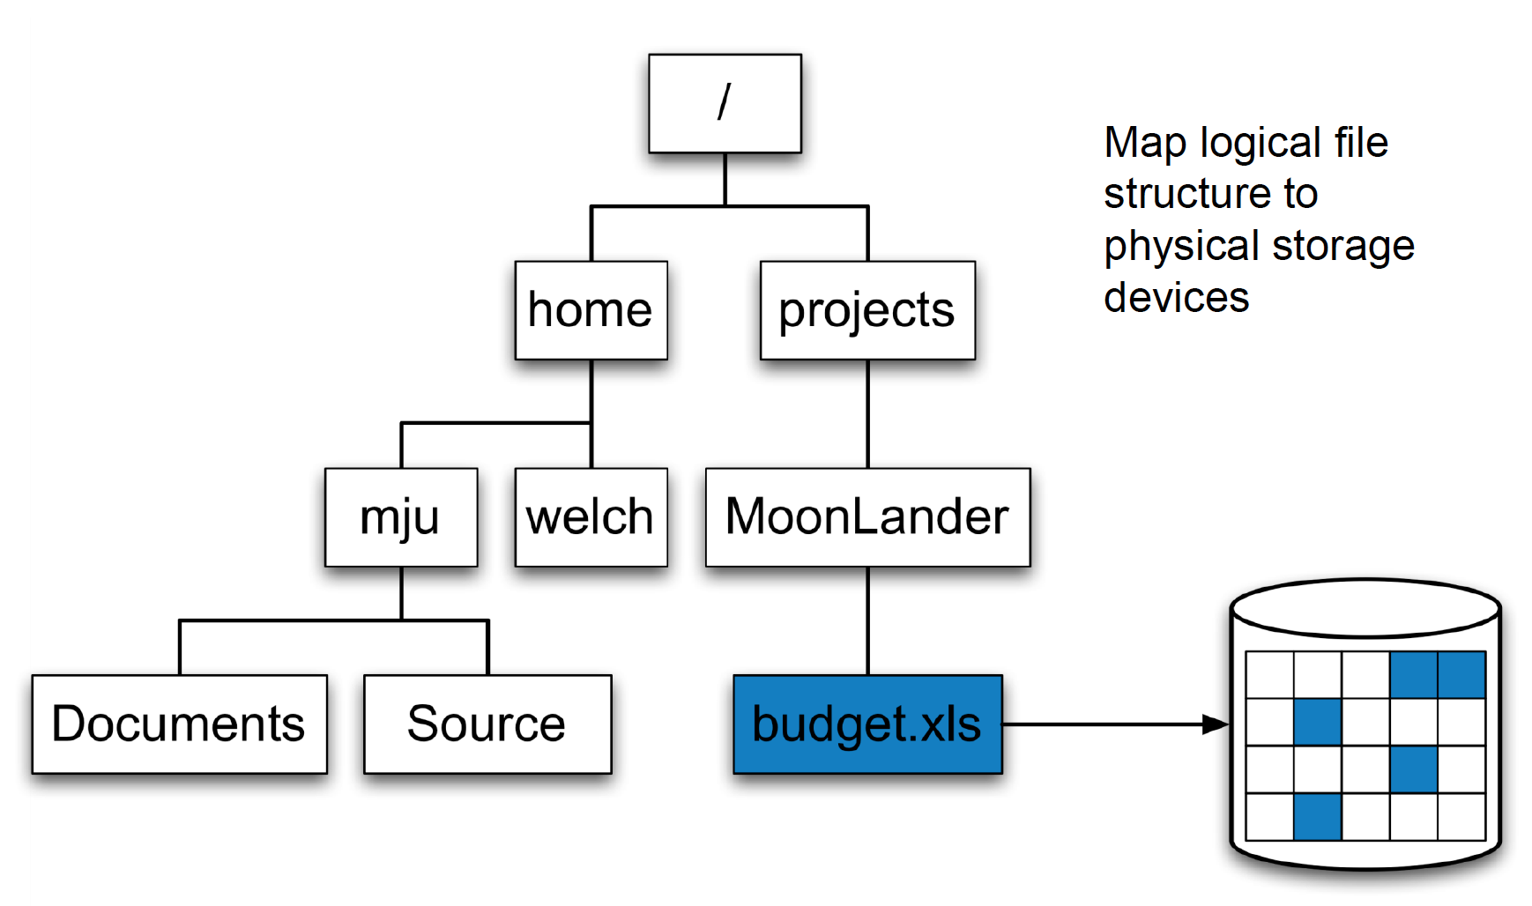
Role of the filesytem: (1)
Provide an unique namespace
Store your data on the medium (disk/array of disks etc)

Slide 32
File Systems: Basic Concepts
Disk: A permanent storage medium of a certain size.
Block: The smallest unit writable by a disk or file system. Everything a file system does is composed of operations done on blocks.
Partition: A subset of all the blocks on a disk.
Volume: The term is used to refer to a disk or partition that has been initialized with a file system.
Superblock: The area of a volume where a file system stores its critical data.

Slide 33
File Systems: Basic Concepts (2/2)
Metadata: A general term referring to information that is about something but not directly part of it.
Journaling: A method of insuring the correctness of file system metadata even in the presence of power failures or unexpected reboots (atomic write).
Attribute: A name and value associated with the name. The value may have a defined type (string, integer, etc.).

Slide 34
File System for O.S.
Linux
  EXT family: ext4/ext3/ext2
  XFS/ RaiserFS
  …
Mac
  HFS+ (MacOs extended)
  Apple File System (APFS)
Windows
  NTFS

Slide 35
Data and metadata
Metadata : Data to describe data attribute (and extended attribute)
size, owner, creation date..etc..
Implementation of metadata data structures and access algorithms affects performance, as much as the physical devices and data layout
Meta-data are the bottleneck of scalability
How many times do you type ls in a day?
How many times to you write a file?
ls is scanning all the files in the directory !

Slide 36
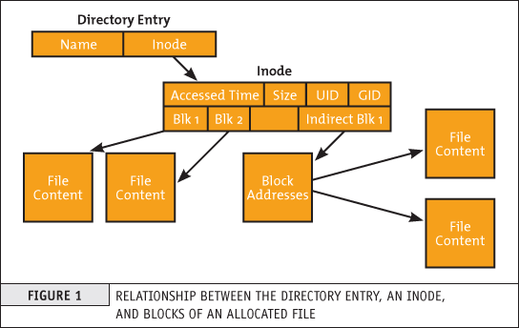
File system : data layout and inode
Data structure pointed by the inode number, a unique identifier of a file in the file system
  address of data block on the storage media
  description of the file (POSIX)
    Size of the file
    Storage device ID
    User ID of the file's owner.
    Group ID of the file.
    File type
    File access right
    Inode last modification time (ctime)
    File content last modification time (mtime),
    Last access time (atime).
    Count of hard links pointed to the inode.
    Pointers to the disk blocks that store the file's contents

Slide 37
FS useful command to check inodes
ls -i
Df -i
stat filename
[exact@login ~]$ stat hello.c
File: ‘hello.c’
Size: 219 Blocks: 8 IO Block: 4096 regular file
Device: fd07h/64775d Inode: 1572988 Links: 1
Access: (0664/-rw-rw-r--) Uid: ( 669/ exact) Gid: ( 999/ exact)
Access: 2019-12-01 10:25:29.521223433 +0100
Modify: 2019-11-26 15:03:26.740781336 +0100
Change: 2019-11-26 15:03:26.740781336 +0100
Birth: -

Slide 38
Posix interface
API to access data and metadata (1988)
POSIX interface is a useful, ubiquitous interface for building basic I/O tools.
Standard I/O interface across many platforms.
  open, read/write, close functions in C/C++/Fortran
It allows buffered file I/O (streams) within (c/sdtio)

Slide 39
Buffered I/O
Posix allows buffered I/O (libc/stdio)
typically applications use this approach
In typical workloads certain data is accessed repeatedly beyond an application lifetimes:
  OS maintains buffer of recently used data
  buffer competes with applications for RAM
  OS can substitute swap disk for RAM
Memory management unit (MMU) organizes address space in pages

Slide 40
Posix API (1)
Retrieve the list of all files in a directory: 1 call
readdir
Retrieve the attribute of the all files from this directory:
fstat 1 call per file !
Questions:
What happens if the content of a directory is modified by another process?

Slide 41
Scaling the Filesystem...
Original POSIX environment was unshared, direct-attached storage
RAID and Volume Managers aggregate devices safely
  Scale performance within the same machine !

Slide 42
Posix API (2)
Posix assumes atomicity and ubiquity
Changes are visible immediately to all clients
Problem for parallel accesses:
  POSIX requires a strict consistency to sequential order : lock
  (Create a directory is an atomic operation with immediate global view)
  No support for non-contiguous I/O !!
MPI-IO can be useful here..

Slide 43
Measure (raw) performance
dd: to measure storage system performance
$dd if=/dev/zero of=/dev/null count=1
1+0 records in
1+0 records out
512 bytes (512 B) copied, 0.000242478 s, 2.1 MB/s
$dd if=/dev/zero of=~/big-write count=1M
1048576+0 records in
1048576+0 records out
536870912 bytes (537 MB) copied, 3.43889 s, 156 MB/s
Questions:
1- Why such a difference between the two runs?
2 Why copying unit of 512B ?

Slide 44
Blocksize on FS
512 byte is a typical block size of the disk:
  IT cannot read less than 512 bytes, if you want to read less, read 512 bytes and discard the rest.
File System blocksize can be different :
[exact@login ~]$ stat -f .
File: "."
ID: 9d0420af3cbc070e Namelen: 255 Type: ext2/ext3
Block size: 4096 Fundamental block size: 4096
Blocks: Total: 372561982 Free: 51012529 Available: 32646449
Inodes: Total: 94633984 Free: 90641935

Slide 45
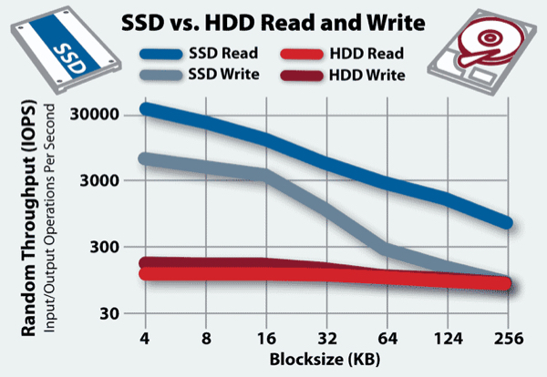
Blocksize effect in the Random access
The performance DISK is not a single number

Slide 46
Proposed exercises
Identify your FileSystem and its properties
Measure/Estimate the rough performance of your hard-drive
Compare it with the ramfs on your linux box and on your cluster system
exact@login ~]$ df
Filesystem 1K-blocks Used Available Use% Mounted on
/dev/mapper/SysVG-Root 51474912 33126208 15710880 68% /
devtmpfs 16358128 0 16358128 0% /dev
tmpfs 16371480 501024 15870456 4% /dev/shm

