Slide 1

Parallel storage and Parallel FS
Stefano Cozzini
CNR-IOM and eXact lab srl

Slide 2
Agenda
I/O infrastructure for HPC
Distributed FS
  NFS
Parallel File System
Lustre
How to use Lustre FS

Slide 3
Building block for HPC I/O systems
A HPC I/O system should:
  Present storage as a single, logical storage unit
    We do not want to look for different storage on different nodes
  Tolerate failures (in conjunction with other HW/SW)
    We do not want to stop production when a disk/server/inc card) breaks
  Provide a standard interface (i.e. Posix compliant)
    We do not want to change your code when you use an HPC
  Stripe files across disks and nodes for performance
    We do want to get parallel performance on parallel system

Slide 4
HPC I/O infrastructure
HW:
  Disks/ disk enclosure/ disk controllers
  Server,
  Networks etc..etc..
Software:
  distribute/parallel Filesystem,
  libraries
  some parts of O.S.

Slide 5
Scaling the Filesystem...
Original POSIX environment was unshared, direct-attached storage
RAID and Volume Managers aggregate devices safely
  Scale performance within the same machine
Distributed FS introduces a Network (Ethernet) between clients and server
  Able to coordinate access from multiple clients: scales over many client
Parallel FS coordinates many clients and many servers
  A special kind of networked file system that provides high-performance I/O when multiple clients share the file system
  Able to scale in both capacity and performance

Slide 7
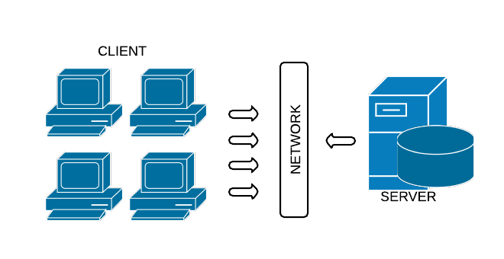
Distributed file system
  Distributed file systems are file systems that are capable of handling I/O requests issued by multiple clients over the network.
  FS is “mounted” by several clients (compute nodes/login nodes..)
  Example: Network File System
    Parallel access is possible but:
    Network bandwith limited..
    Locking issues
SPOF!
bottleneck!

Slide 8
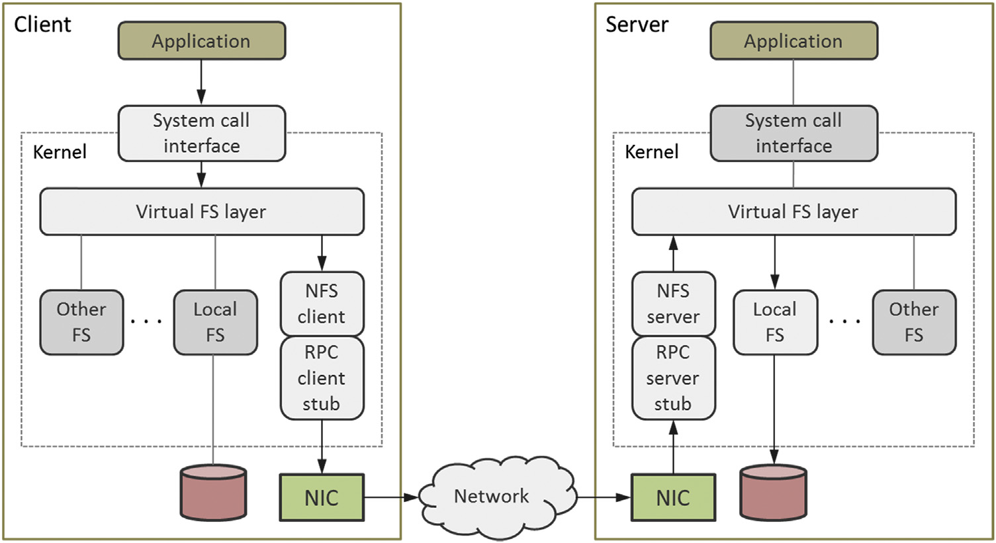
NFS architecture

Slide 9
NFS I/O server (poor man PFS)
Channel 1
Data
Channel 2
I/O server with
RAID arrays
Exported over
NFS
Channel 3
Switch
Channel Bound Interface
w 3 cards
I/O performance can be obtained/ increased by combing RAID (for I/O and/or security and channel bonding (for increased bandwidth).
Good: cheap and easy to maintain and configure.
Bad:
  performance is marginal (N disks give N I/O speedup at best), .
  Need a high end network switch.
  Performance degrades fast as the function of the number of users.
  Needs lots of memory on I/O server to allow for good buffering.
  Needs good UPS/Shutdown solution, to prevent disk corruption.

Slide 10
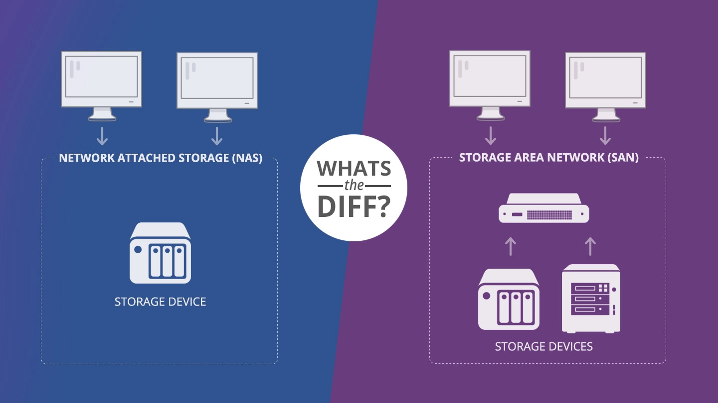
SAN vs NAS:
Picture from: https://www.backblaze.com/blog/whats-the-diff-nas-vs-san/

Slide 11
SAN vs NAS
SAN
  Block level data access
  Fiber channel is the primary media used with SAN.
  SCSI is the main I/O protocol
  SAN storage appears to the computer as its own storage NAS
NAS
  File Level Data access
  Ethernet is the primary media used with NAS
  NFS is used as the main I/O protocol in NAS
  appears as a shared partition to the computer

Slide 12
Issues in building HPC I/O systems
“Management problem”: many disks/ HW around our cluster but not easy to make them available to user in a clean/safe/cheap way.
“Performance problems” : large dataset requires high performance I/O solutions

Slide 13
Scalability Limitation of I/O
I/O subsystems are typically very slow compared to other parts of a supercomputer
  You can easily saturate the bandwidth
Once the bandwidth is saturated scaling in I/O stops
  Adding more compute nodes increases aggregate memory bandwidth and flops/s, but not I/O

Slide 14
Parallel File System

Slide 15
Parallel FS solution
A parallel solution usually is made of
  several Storage Servers that hold the actual filesystem data
  one or more Metadata Servers that help clients to identify/manage data stored in the ﬁle system
  a redundancy layer that replicates in some way information in the storage cluster, so that the ﬁle system can survive the loss of some component server
and optionally:
  monitoring software that ensures continuous availability of all needed components

Slide 16
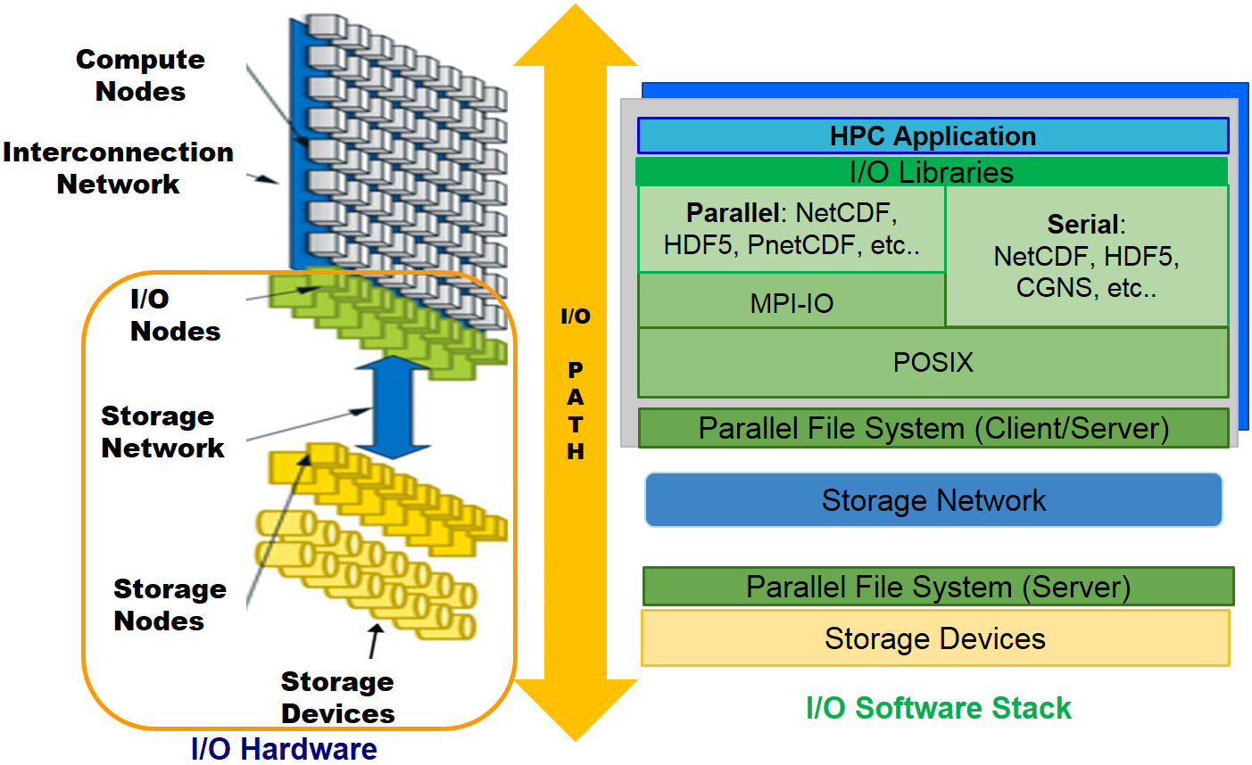
A graphical view:
Picture from: http://www.prace-ri.eu/best-practice-guide-parallel-i-o/#id-1.3.5

Slide 17
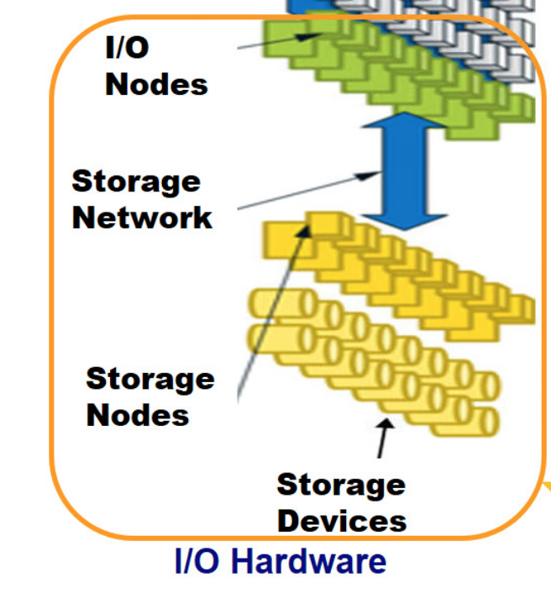
Parallel File System: I/O hardware
I/O nodes = Storage Nodes (Ulysses)
Metadata server hosted on I/O server (dedicated and/ or shared)
Storage nodes hosts some data:
Metadata server coordinates access by the clients to the data

Slide 18
Parallel filesystem approach
In a parallel solution..
  you add storage servers, not only disk space
  each added storage server brings in more memory, more processor power, more bandwidth
  software complexity however is much higher
there is no «easy» solution, like NFS...

Slide 19
A disclaimer...
Parallel File Systems are usually optimized for high performance rather than general purpose use,
Optimization criteria:
–Large block sizes (≥ 64kB)
–Relatively slow metadata operations (eg. fstat()) compared to reads and writes.. )
–Special APIs for direct access and additional optimizations

Slide 20
Hardware to build a PFS
Disks, controllers, and interconnects
Hardware defines the peak performance of the I/O system:
  raw bandwidth
  Minimum latency
At the hardware level, data is accessed at the granularity of blocks, either physical disk blocks or logical blocks spread across multiple physical devices such as in a RAID array
Parallel File Systems takes care of
  managing data on the storage hardware,
  presenting this data as a directory hierarchy,
  coordinating access to files and directories in a consistent manner

Slide 21
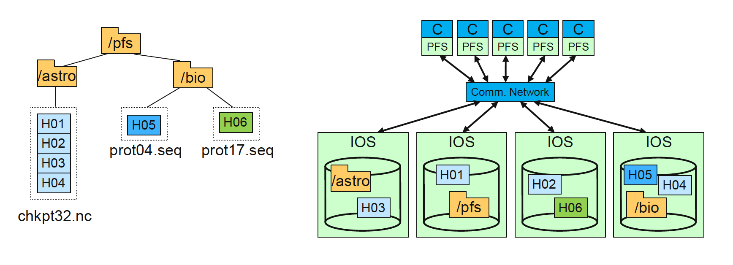
Parallel FS
An example parallel file system, with large astrophysics checkpoints distributed across multiple I/O servers (IOS) while small bioinformatics files are each stored on a single IOS

Slide 22
What is available on the market ?
BeeGFS
  Developed at Fraunhofer Institute, freely available not open
  http://www.fhgfs.com/cms/
Lustre
  open and Free owned by Intel DDN
  Intel no longer sells tools to manage and support ($$$)
  http://lustre.opensfs.org/
GPFS ( now known as Spectrum Scale )
  IBM proprietary $$$
  Very nice solution and expensive ones !
And many others (WekaIO/MooseFS/Panasas... etc)

Slide 23
Comparing parallel FS
Sys Adm:
  Block Management
  How Metadata is stored
  What is cached and where
  Fault tolerance mechanisms
  Management/Administration
User:
  Performance
  Reliability
  Manageability
  Cost

Slide 24
Recap on Metadata
Metadata names files and describes where they are located in the distributed system
  Inodes hold attributes and point to data blocks
  Directories map names to inodes
Metadata updates can create performance problems
Different approaches to metadata are illustrated via the File Create operation

Slide 25
Create a file on local FS
4 logical I/Os
  Journal update
  Inode allocation
  Directory insert
  Inode update
Performance determined by journal updates
  Details vary among systems

Slide 26
Lustre File System

Slide 27
Lustre Principles
Lustre is centralized
  No copy of data or metadata.
  Metadata stored on a shared storage called Metadata Target (MDT)
  Attached to two Metadata Servers (MDS)
MDS provides the illusion of shared name space
Lustre is an overlay file system
Data are stored on back-end file-systems: Object Storage Target (OST)
  Attached to several Object Storage Servers (OSS) for active/active failover.
  OSS are the servers that handle I/O requests.
Remote clients that can mount the Lustre filesystem, e.g. your Linux cluster Compute nodes.

Slide 28
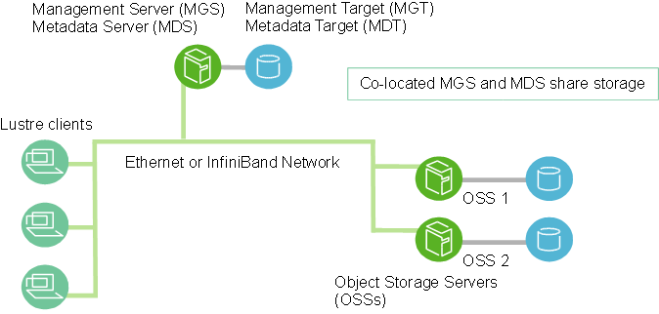
Lustre layout (simple cluster)

Slide 29
Building blocks of Lustre FS
Metadata Servers (MDS) :
  The MDS makes metadata stored in one or more Metadata Targets (MDTs) available to Lustre clients. Each MDS manages the names and directories in the Lustre file system(s) and provides network request handling for one or more local MDTs. Operations such as opening and closing a file can require dedicated access to the MDS and it can become a serial bottleneck in some circumstances.
Metadata Targets (MDT) : .
  The MDT stores metadata (such as filenames, directories, permissions and file layout) on storage attached to an MDS. An MDT on a shared storage target can be available to multiple MDSs, although only one can access it at a time. If an active MDS fails, a standby MDS can serve the MDT and make it available to clients. This is referred to as MDS failover.
Object Storage Servers (OSS) :
  The OSS provides file I/O service and network request handling for one or more local Object Storage Targets (OSTs). Typically, an OSS serves between two and eight OSTs, up to 16 TB each. A typical Lustre configuration consists of an MDT on a dedicated node, two or more OSTs on each OSS node
Object Storage Target (OST) :
  User file data is stored in one or more objects, each object on a separate OST in a Lustre file system. Each OST can write data at around 500 MB/s. You can think of an OST as being equivalent to a disk, although in practice it may comprise multiple disks, e.g. in a RAID array. An individual file can be stored across multiple OSTs; this is called striping. The default is dependent on the particular system (1 is a common choice), although this can be changed by the user to optimize performance for a given workload.

Slide 30
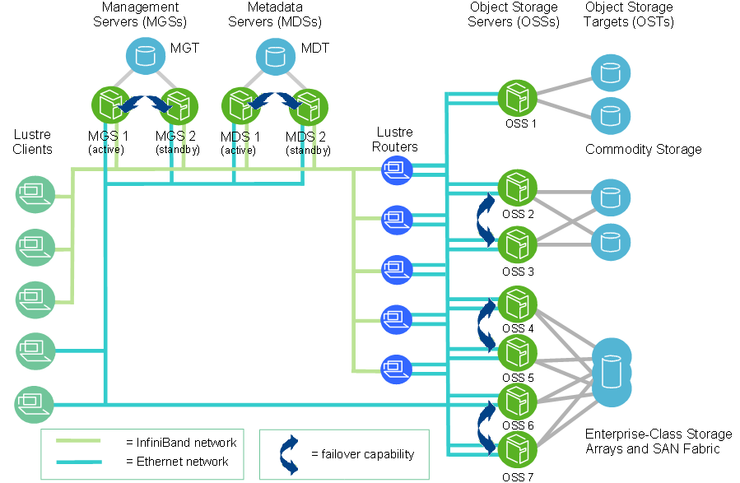
Lustre layout (complex infrastructure)

Slide 31
Lustre component characteristics
Clients
  1 - 100,000 per system
  Data bandwidth up to few GB/s; 1000’s of metadata ops/s
  No particular hardware or attached storage characteristics required
Object Storage Servers (OSS)
  1 - 1000 per system
  500 MB/s..2.5 GB/s I/O bandwidth
  Require good network bandwidth and adequate local storage capacity coupled with sufficient number of OSSs in the system
Metadata Servers (MDS)
  2 (for redundancy) per system
  3,000 - 15,000 metadata ops/s
  Utilize 1 – 2% of total file system capacity
  Require memory-rich nodes with lots of CPU processing power

Slide 32
Create a File on Lustre
Client to Server RPC (remote procedure call)
Server creates local file to store metadata
  Journal update, local disk I/O
Server creates container object(s)
  Object create transaction with OSS
  OSS creates local file for object
Performance dependent on
  Local file systems on metadata server and OSS/OST

Slide 33
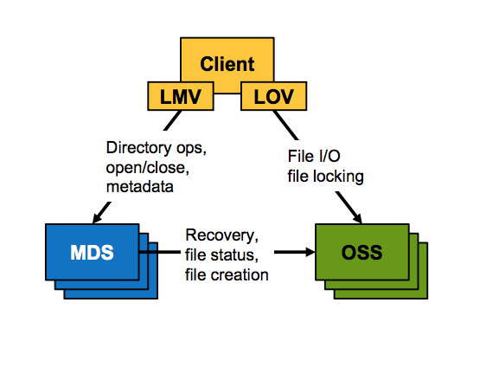
Lustre operations
LMV:
  Logical Metadata Volume
LOV:
  Logical Object Volume

Slide 34
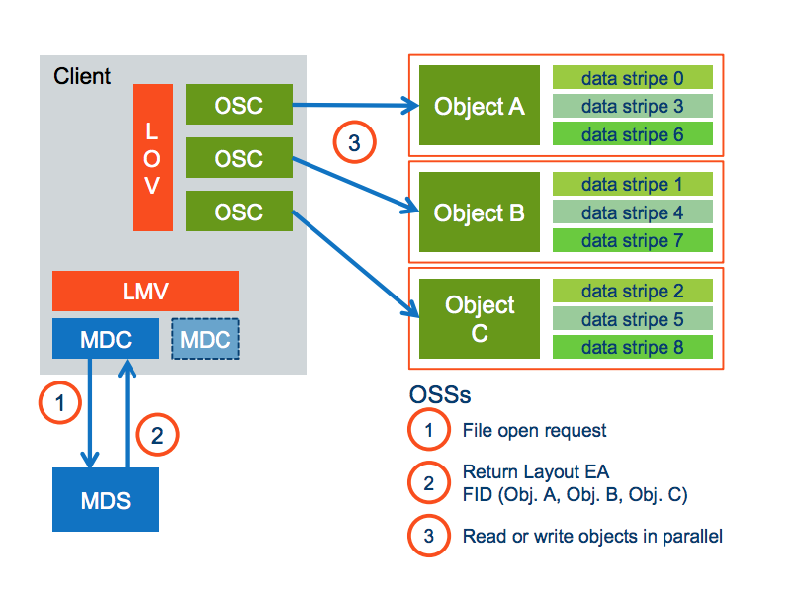
Lustre operations

Slide 35
Lustre example

Slide 36


HPC infrastructure @ CRIBI
32 blades
(2x6 cores,
24,48,96GB
RAM)
masternode
I/O srv
STORAGE
12x600GB
36x2TB
I/O srv
I/O srv
STORAGE
12x600GB
36x2TB
GPU node
I/O srv
GPU node
FAT node
(2TB RAM)
1 GB Ethernet (SP/iLO/mgmt)
1 GB Ethernet (NFS)
40 GB Infiniband (LUSTRE/MPI)
10 GB Ethernet (iSCSI)
1 GB (LAN)

Slide 37
LUSTRE and storage solution
enclosures
controllers
hard drives
HP p2000
I/O servers
clients
OST
OST
OSS
MDS
MDT
OST
OST
OSS
HD
OST
enclosure
+
controller
/lustre
(113 TB)
OSS
/lustre
(113 TB)
OST
OSS
OST
OST
OST
OST

Slide 38
accessing LUSTRE filesystem
enclosures
controllers
hard drives
HP p2000
I/O servers
clients
OST
OST
OSS
MDS
MDT
OST
OST
OSS
HD
OST
RAID
/lustre
(113 TB)
enclosure
+
controller
OSS
/lustre
(113 TB)
OST
OSS
OST
OST
OST
OST

Slide 39
why “parallel” filesystem?
enclosures
controllers
hard drives
HP p2000
I/O servers
clients
OST
OST
OSS
MDS
MDT
OST
OST
OSS
HD
OST
RAID
/lustre
(113 TB)
enclosure
+
controller
OSS
/lustre
(113 TB)
RAID
OST
OSS
OST
OST
OST
OST

Slide 40
Expected performance
Elements of the infrastructure:
  Network Speed: Infiniband QDR :3.2GB/sec for server
    Network aggregate bandwith: 3.2 x 4 ~ 12GB/se
  4 IO-SRV
    two OST each
      Each OST: RAID 6 6 disks
        OST Aggregate bandwith: (6-2)*120 = 400 Mb/seconds
        Disk speed: 120 Mb/seconds
    Node Aggregate bandwith 400x 2 = 800 Mb/sec
  Peak performance : 4 GB/sec read/write

Slide 41
How to use Lustre

Slide 42
Lustre file striping
Each file in Lustre has its own unique file layout, comprised of 1 or more objects in a stripe equivalent to RAID
File layout is allocated by the MDS
Layout is selected by the client, either
  by policy (inherited from parent directory)
  by the user or application
Layout of a file is fixed once created

Slide 43
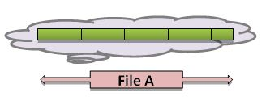
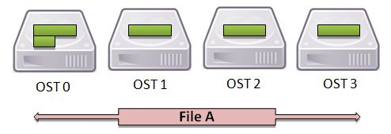
Lustre file striping
Distribute a file over several OST..

Slide 44
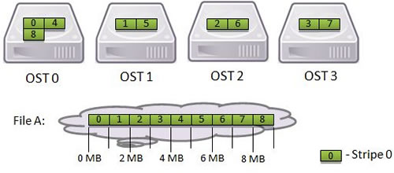
Aligned stripes
A file large 9Mb
Stripe size: 1Mb
Four OST to stripe:

Slide 45
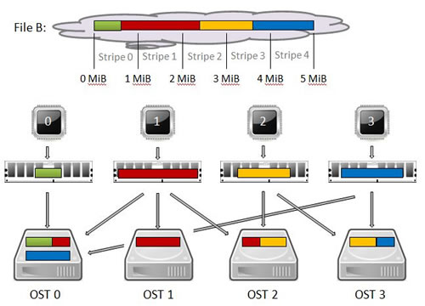
Non aligned stripes
A file B 5Mb
Written in parallel with different offset:

Slide 46
Basic Lustre User command
Lustre's lfs utility provides several options for monitoring and configuring your Lustre environment.
You can:
  List OSTs in the File System
  Search the Directory Tree
  Check Disk Space Usage
  Get Striping Information
  Set Striping Patterns
>lfs -help

Slide 47
lfs commands: check FS size
[exact@login ~]$ lfs df -h
UUID bytes Used Available Use% Mounted on
lustre-MDT0000_UUID 26.3G 9.4G 16.9G 36% /lustre[MDT:0]
lustre-OST0000_UUID 7.3T 4.9T 2.3T 68% /lustre[OST:0]
lustre-OST0001_UUID 7.3T 5.6T 1.7T 77% /lustre[OST:1]
lustre-OST0002_UUID 7.3T 5.6T 1.7T 77% /lustre[OST:2]
lustre-OST0003_UUID 7.3T 5.7T 1.6T 78% /lustre[OST:3]
filesystem_summary: 29.1T 21.8T 7.3T 75% /lustre

Slide 48
lfs commands: getstripe
[exact@login exact]$ lfs getstripe striped2
striped2
stripe_count: 4 stripe_size: 1048576 stripe_offset: -1
striped2/striped_over_how-many
lmm_stripe_count: 4
lmm_stripe_size: 1048576
lmm_pattern: 1
lmm_layout_gen: 0
lmm_stripe_offset: 3
obdidx objid objid group
3 39804142 0x25f5cee 0
1 40327224 0x2675838 0
0 34000522 0x206ce8a 0
2 41127105 0x2738cc1 0
striped2/striped_over_2
lmm_stripe_count: 2
lmm_stripe_size: 1048576
lmm_pattern: 1
lmm_layout_gen: 0
lmm_stripe_offset: 2
obdidx objid objid group
2 41127104 0x2738cc0 0
0 34000521 0x206ce89 0

Slide 49
What you can do with setstripe ?
setting striping on a single file
setting stripe on a directory
  Files within directory inherits the same striping policy
Note: you cannot change the striping policy of a file..
  To do this:
    create a new file with appropriate striping policy and then move the original file over this.

Slide 50
lfs commands: setstripe
$ lfs setstripe -c 2 striped_over2/
$ lfs getstripe striped_over2
striped_over2
stripe_count: 2 stripe_size: 1048576 stripe_offset: -1

Slide 51
Lustre – some advices to check
Use ls -l only where absolutely necessary
Avoid using wild cards with GNU commands,
Place small files on single OST
Place directories containing many small files on single OSTs
Set the stripe count and size appropriately for shared files
Set the stripe count appropriately for applications which utilize a file-per-process

Slide 52
tips to use Lustre at best
identify bottlenecks
  HDs, RAID, controllers, volumes and virtual disks, 10GE, iscsi, LUSTRE fs, local caching/buffers, InfiniBand or Gigabit network, LUSTRE client, access patterns
when accessing files:
  read/write in large chunks, not line by line
when running multiple I/O operations:
  optimize data distribution and disk access (i.e. mpi-i/o)

