Slide 1
Introduction to data management and storage for HPC
(part 1)
Stefano Cozzini
CNR/IOM and eXact-lab srl

Slide 2
Agenda
Introducing the big-data problem
Data intensive science
Data management considerations
Data infrastructures and tools
Basic concepts on storage

Slide 3
storage 101
April 14, 2011

Slide 4
Memory Hierarchy
Primary Storage
Computers architectures try to keep data close to the processors in order to feed them continuously.
However, while the capacity of storage devices increases, the distance to the processors also increases.
Processor
Core 1
Core 2
Registers
Registers
L1 Cache
L1 Cache
L2 Cache
L2 Cache
L3 Cache
RAM
Internal Memory - processor registers and cache
Main Memory - system RAM and controller cards
On-line mass storage - secondary storage
Off-line bulk storage - tertiary and off-line storage
Swap Disks
FS Disks

Slide 5
Storage Hierarchy
Same as with the memory hierarchy of
Register -> Cache (L1->L2->L3) -> RAM
storage follows a hierarchy with multiple levels:
  RAM disk, I/O buffers or file system cache
  Local disk (flash based, spinning disk)
  (SATA, SAS, RAID, SSD, JBOD, ... )
  Local network attached device or file system server
  (NAS, SAN, NFS, CIFS, Lustre, GPFS, ...)
  Tape based archival system (often with disk cache)
  External, distributed file systems (Cloud storage)

Slide 6
Key metrics
Bandwidth: volume of data read/written in a second
  → throughput metric
IOPs: number of IO request processed by second
  → Is it a latency or a throughput metric ?
Order of magnitudes
  Intel v2/v3 CPU-DRAM: 60 GB/s
  IB link: 5-10 GB/s
  Hard Drive: ~100- 150 MB/s

Slide 7
Cache/Swap
Disk I/O is much slower than main memory I/O,
typically about a 100x (varied with hardware):
  typically applications use buffers (libc/stdio)
In typical workloads certain data is accessed repeatedly beyond an application lifetimes:
  OS maintains buffer of recently used data
  buffer competes with applications for RAM
  OS can substitute swap disk for RAM
Memory management unit (MMU) organizes address space in pages

Slide 8
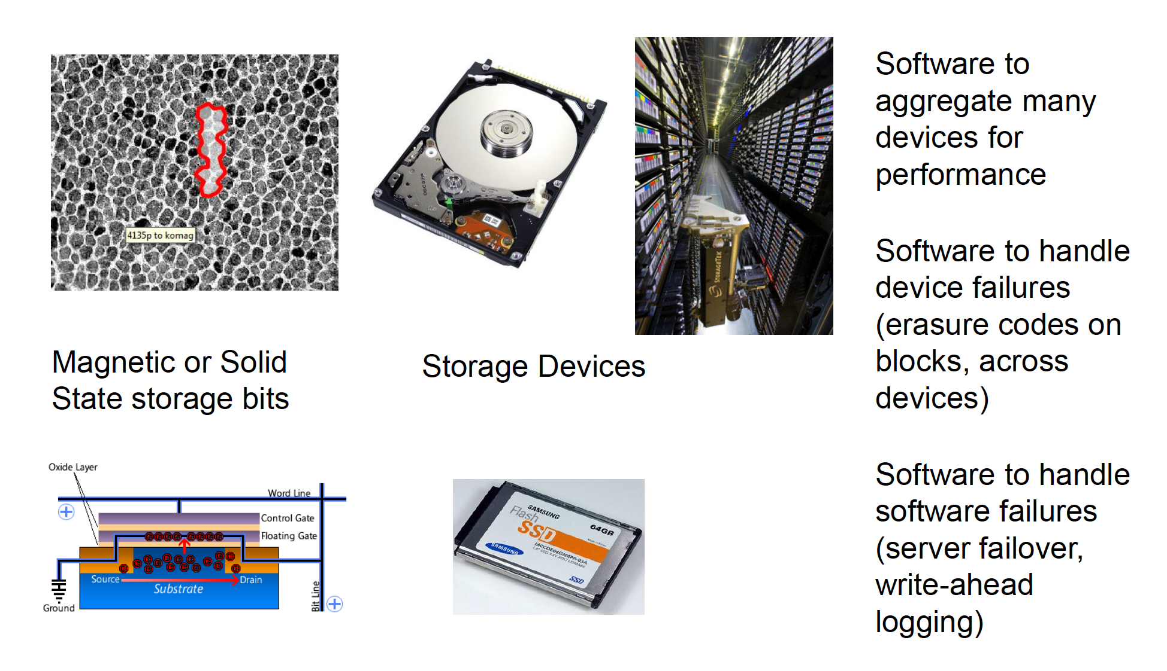
Building storage system from bits

Slide 9
RAM Disk / Solid State Drive
Unix-like OS environments very frequently create (small) temporary files in /tmp, etc.
  faster access and less wear with RAM disk
Linux provides “dynamic RAM disk” (tmpfs)
  only existing files consume RAM
  automatically cleared on reboot (-> volatile)
Solid state drive is a non-volatile RAM disk
  uses same interface as (spinning) hard drive
    Battery buffered DRAM (fast, no wear, expensive)
    Flash based (varied speed, wears out, varied cost)

Slide 10
Storage Hierarchy
Physical Memory
Swap
Cache
Page Swapping
Generic Block Layer
Logical Block
Address
Intercept
I/O Scheduler
Pseudo Driver
RAM Disk
Hard Disk
Flash
Block Device
Drivers
User-Space
FS
RAM
Disk
HDD
Flash
Disk
FTL

Slide 11

HDD
Rotating mechanical device
  7200, 1000, 15000 rpm.
Head on the right track (seek time) 4 ms
Head on the right sector (latency) 2ms
Capacity: 4-12 TB
Bandwidth: Read / Write ~ 150/200 MB/s
At constant rotating speed, where should I put my data to get max bandwidth ?

Slide 12
Current HDD technology
We can find several magnetic hard disk technologies today:
Serial Advanced Technology Attachment (SATA)
Serial Attached SCSI (SAS)
Advanced Technology Attachment ([P]ATA/[E]IDE) (obsoleted by SATA)
Small Computer System Interface (SCSI) (obsoleted by SAS)

Slide 13
Solid-State Drive (SSD)
pros:
  lower access time and latency
  no moving parts (silent, less susceptible to physical shock, low power consumption and heat production)
  available over SATA, SAS, PCIe, FC buses
cons:
  expensive, low capacity; usage limited to special purposes only (hardly used for data-servers)
  limited write-cycle durability (depending on technology and ... price)
      SLC NAND flash ~ 100K erases per cell
      MLC NAND flash ~ 5K-30K erases per cell
      TLC NAND flash ~ 300-500 erases per cell

Slide 14
SSD technology
SLC – Single Level Cell
  One threshold, one bit
  10⁵ to 10⁶ write cycles per page
MLC – Multi Level Cell
  Multiple thresholds, multiple bits (2 bits)
  10⁴ write cycles per page
  Denser and cheaper, but slower and less reliable
TLC – Triple Level Cell
  Cheapest, slowest writes
  500 write cycles per page!

Slide 15
SSD vs HDD
Latency ÷40: 0.1 ms vs 4 ms
Bandwith x3: 450 MB/s vs 150 MB/s
Capacity ÷8: 1 TB X SSD vs 8 TB (2016)
Price / Byte x10: $0.4 / GB vs $0.05 / GB

Slide 16
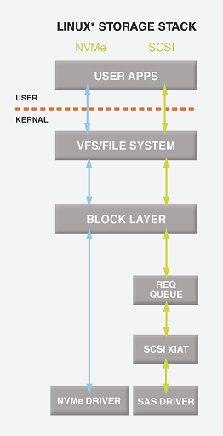
NVME
None-volatile Memory Express (NVMe)
SSD can be connected on PCIe bus
SATA /SAS protocols designed for mechanical drive and are now the bottleneck
SAS SSD: 100 μsec - 450 MB/s
NVMe SSD: 20 μsec - 2500 MB/s

Slide 17
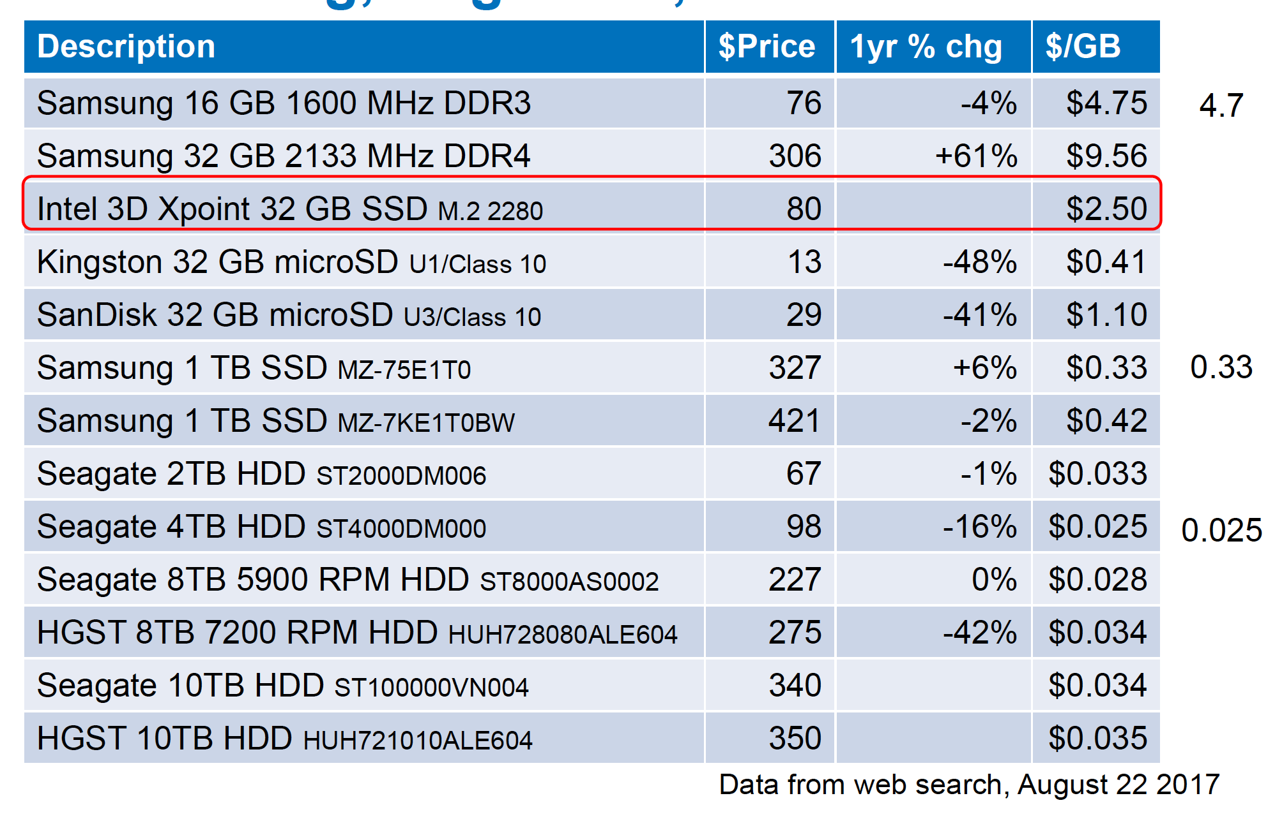
Memory/Disk prices

Slide 18
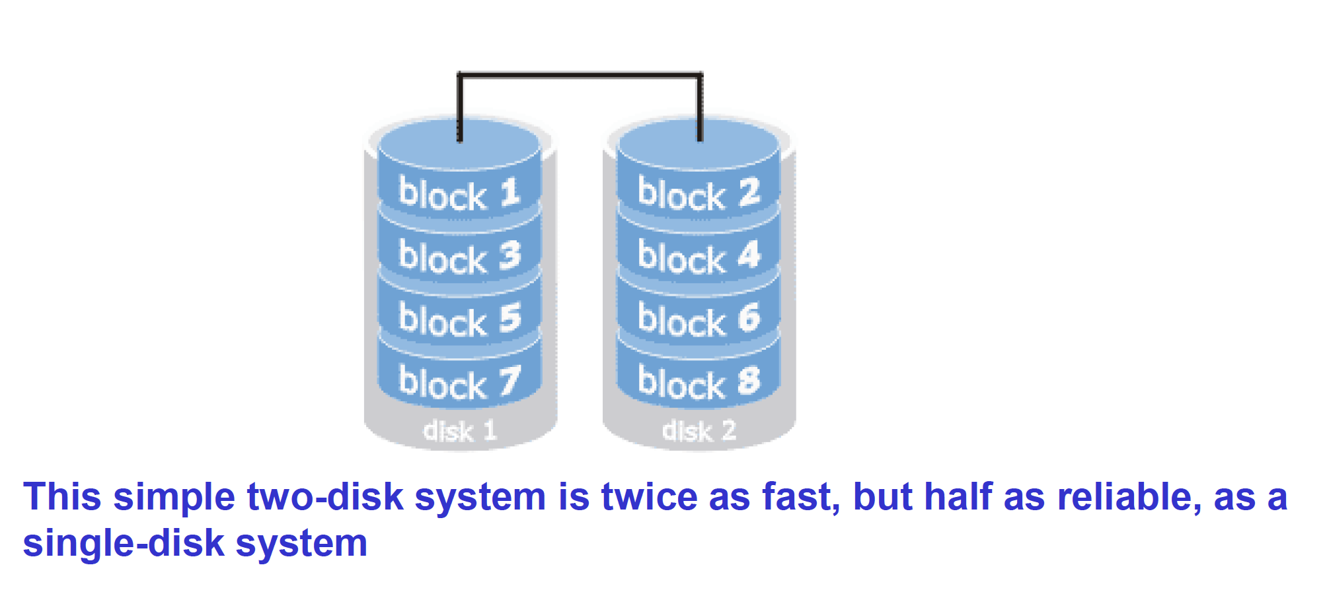
The Disk Bandwidth/Reliability Problem
Disks are slow: use lots of them in a parallel file system
However, disks are unreliable, and lot’s of disks are even more unreliable

Slide 19
RAID
RAID is a way to aggregate multiple physical devices into a larger virtual device
  Redundant Array of Inexpensive Disks
  Redundant Array of Independent Devices
Invented by Patterson, Gibson, Katz, et al
  http://www.cs.cmu.edu/~garth/RAIDpaper/Patterson88.pdf
Redundant data is computed and stored so the system can recover from disk failures
  RAID was invented for bandwidth
  RAID was successful because of its reliability

Slide 20
RAID reliabilty and performance..
Reliability or performance (or both) can be increased using different RAID “levels”.
Let us examine some of the most important:
Definitions:
S: Hard disk drive size.
N: Number of hard disk drives in the array.
P: Average performance of a single hard disk drive (MB/sec).

Slide 21
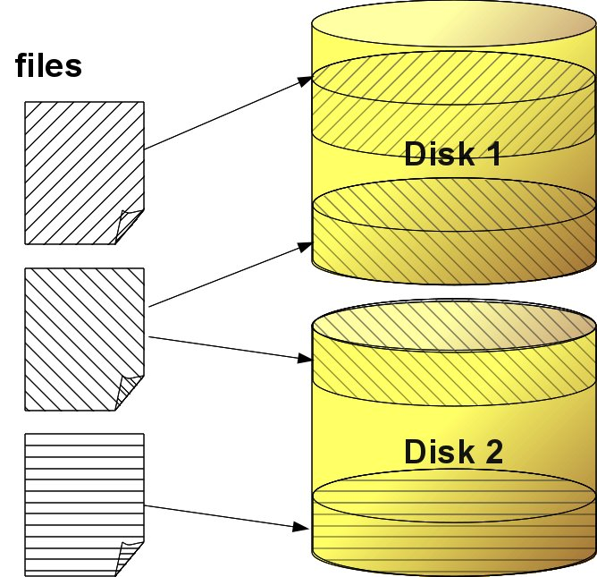
LINEAR RAID
Performance = P
NO REDUNDANCY
Capacity = N * S

Slide 22
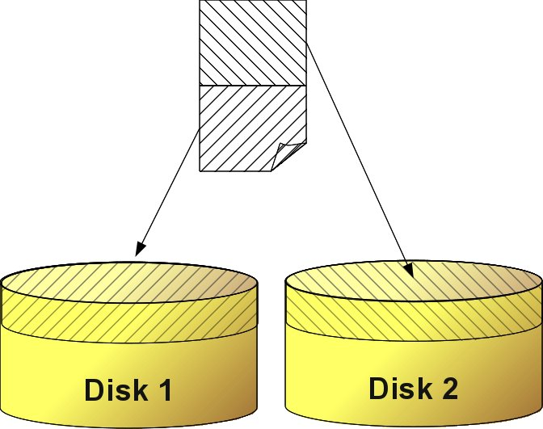
RAID 0
Performance = P * N
STRIPING
Capacity = N * S

Slide 23
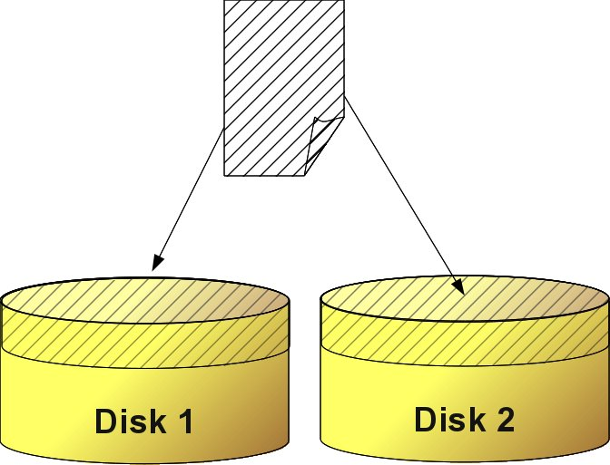
RAID 1
Write Perf. = P
Read Perf. = P * N
REDUNDANCY
Capacity = S

Slide 24
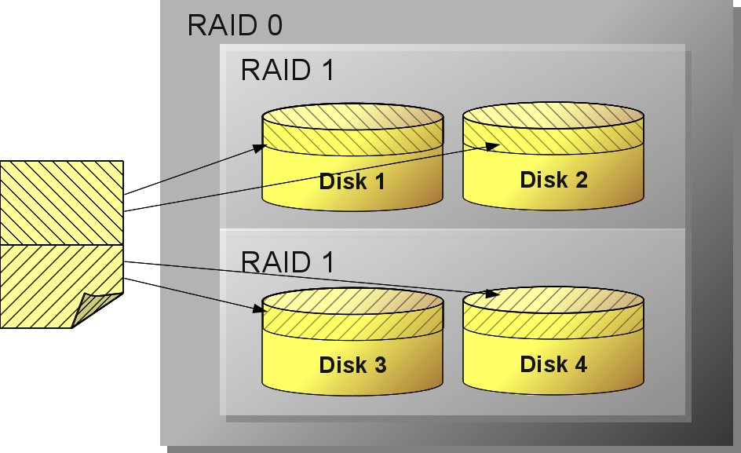
Nested RAID levels
RAID 10 / RAID 1+0 and RAID 0+1
REDUNDANCY
STRIPING
Raid 1+0 / 10: mirrored sets in a striped set
the array can sustain multiple drive losses so long as no mirror loses all its drives
Raid 0+1: striped sets in a mirrored set
if drives fail on both sides of the mirror the data on the RAID system is lost

Slide 25
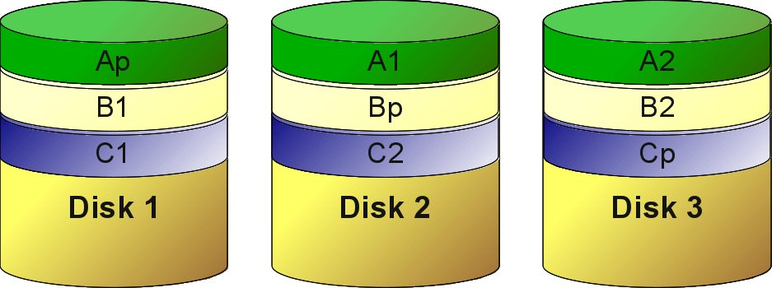
RAID 5
One disk can fail
Distributed parity

Slide 26
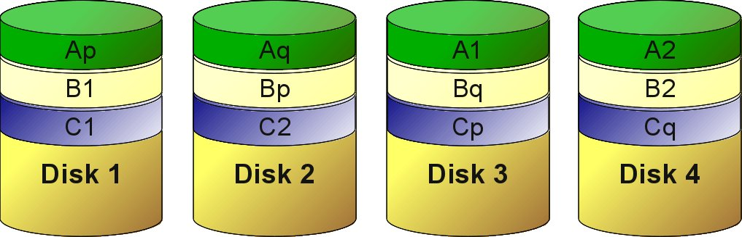
RAID 6
Two disks can fail
Double distributed parity code

Slide 27
Notes on redundancy
Computing and updating parity negatively impact the performance. Upon drive failure, though, lost data can be reconstructed, and any subsequent read can be calculated from the distributed parity such that the drive failure is masked to the end user.
However, a single drive failure results in reduced performance of the entire array until the failed drive has been replaced and the associated data rebuilt.
The larger the drive, the longer the rebuild takes (up to several hours on busy systems or large disks/arrays).

Slide 28
Hot spare
Both hardware and software RAIDs with redundancy may support the use of a hot spare drive, a drive physically installed in the array which is inactive until an active drive fails, when the system automatically replaces the failed drive with the spare, rebuilding the array with the spare drive included. A hot spare can be shared by multiple RAID sets.
Subsequent additional failure(s) in the same RAID redundancy group before the array is fully rebuilt can cause data loss.
RAID 6 without a spare uses the same number of drives as RAID 5 with a hot spare and protects data against failure of up to two drives, but requires a more advanced RAID controller and may not perform as well.

Slide 29
RAID Parameters
Level | Description | Minimum # of drives | Space Efficiency | Fault Tolerance | Read Benefit | Write Benefit
RAID 0 | Block-level striping without parity or mirroring. | 2 | 1 | 0 (none) | nX | nX
RAID 1 | Mirroring without parity or striping. | 2 | 1/n | n-1 drives | nX | 1X
RAID 5 | Block-level striping with distributed parity. | 3 | 1-1/n | 1 drive | (n-1)X | (n-1)X
RAID 6 | Block-level striping with double distributed parity. | 4 | 1-2/n | 2 drives | (n-2)X | (n-2)X
RAID 1+0/10 | Striped set of mirrored sets. | 4 | * | needs 1 drive on each mirror set | * | *
RAID 0+1 | Mirrored set of striped sets. | 4 | * | needs 1 working striped set | * | *
http://en.wikipedia.org/wiki/RAID

Slide 30
Measure performance
dd: to measure storage system performance
# dd if=/dev/zero of=/tmp/toto bs=1k count=1k oflag=sync
1024+0 records in
1024+0 records out
1048576 bytes (1.0 MB, 1.0 MiB) copied, 1.17594 s, 892 kB/s
# dd if=/dev/zero of=/tmp/toto bs=1k count=1k
1024+0 records in
1024+0 records out
1048576 bytes (1.0 MB, 1.0 MiB) copied, 0.00291734 s, 359 MB/s
Questions:
1- Why such a difference between the two runs?
2 - How to measure Read bandwidth?

