Slide 1
Using high performance libraries
Stefano Cozzini
CNR-IOM and eXact lab srl

Slide 2
7 Motifs in HPC..
Phil Colella (LBL) identified 7 kernels of which most simulation and data analysis program are composed:
Dense Linear Algebra
  Ex: solve Ax=B or Ax=lambdax where A is a dense matrix
Sparse Linear Algebra
  Ex: solve Ax=B or Ax=lambdax where A is a sparse matrix (mostly zero)
Operation on structured Grids:
  Ex: ANEWj()=4*(A(i,j)-A(i-1,j)-A(i+1,j) -A(i,j-1)-A(i,j+1)
Operation on unstructured Grids:
  Ex; similar but list of neighbours varies from entry to entry
Spectral Methods
  Ex: Fast Fourier Transform (FFT)
Particle Methods
  Ex: Compute electrostatic forces on n-particles
Monte Carlo
  Ex: many independent simulation using different inputs

Slide 3
Where should you start optimizing your application ?

Slide 4
Optimization Techniques
There are basically three different categories:
  Improve memory performance (the most important)
  Improve CPU performance
  Use already highly optimized libraries/subroutines
    The easiest and more efficient way..
09/12/19

Slide 5
What are Performance libraries ?
Routines for common (math) functions such as vector and matrix operations, fast Fourier transform etc. written in a specific way to take advantage of capabilities of the CPU.
Each CPU type normally has its own version of the library specifically written or compiled to maximally exploit that architecture

Slide 6
What are Performance libraries ?
Routines for common (math) functions such as vector and matrix operations, fast Fourier transform etc. written in a specific way to take advantage of capabilities of the CPU.
Each CPU type normally has its own version of the library specifically written or compiled to maximally exploit that architecture

Slide 7
Why use performance libraries ?
Compilers can optimize code only to a certain point. Effective programming needs deep knowledge of the platform
Performance libraries are designed to use the CPU in the most efficient way, which is not necessarily the most straightforward way.
It is normally best to use the libraries supplied by or recommended by the CPU vendor
On modern hardware they are hugely important, as they most efficiently exploit caches, special instructions and parallelism

Slide 8
Any other reason apart from optimization ?
Usage of libraries
  Make coding easier. Complicated math operations can be used from existing routines
  Increase portability of code as standard (and well optimized) libraries exist for ALL computing platforms.
Lego approach: build your own code using already available bricks..

Slide 9
What is available ?
Linear Algebra: BLAS/LAPACK/SCALAPACK
FFT:
  FFTW
ODE/PDE
  PETSC
Machine Learning:
  Tensorflow / Caffe etc..

Slide 10
Should I write my own algorithm for L. A. ?
99.99% of time NO
  Tons of libraries out there
  Well tested
  Extremely efficient in 99.99% of the case
  With some “de facto” standard implemented
PORTABILITY IS COMING (almost) FOR FREE

Slide 11
Why Linear algebra ?
3 Basic Linear Algebra Problems in
  Linear Equations: Solve Ax=b for x
  Least Squares: Find x that minimizes ||r||₂ ≡ √Σ r_{i}² where r=Ax-b
    Statistics: Fitting data with simple functions
  3a. Eigenvalues: Find λ and x where Ax = λ x
    Vibration analysis, e.g., earthquakes, circuits
  3b. Singular Value Decomposition: A^{T}Ax=σ²x
    Data fitting, Information retrieval
  Lots of variations depending on structure of A
    A symmetric, positive definite, banded, …

Slide 12
Why dense Linear Algebra ?
Many large matrices are sparse, but …
  Dense algorithms easier to understand
  Some applications yields large dense matrices
  LINPACK Benchmark (www.top500.org)
    “How fast is your computer?” = “How fast can you solve dense Ax=b?”
  Large sparse matrix algorithms often yield smaller (but still large) dense problems

Slide 13
BLAS: Basic Linear Algebra Subprograms

Slide 14
BLAS history (1/3)
In the beginning it was libraries like EISPACK (for eigenvalue problems)
Then the BLAS-1 were invented (1973-1977)
  Create a standard library of 15 operations (mostly) on vectors
  “AXPY” ( y = α·x + y ), dot product, scale (x = α·x ), etc
  Up to 4 versions of each (S/D/C/Z), 46 routines, 3300 LOC
  Language: FORTRAN
Goals
  Common “pattern” to ease programming, readability
  Robustness, via careful coding (avoiding over/underflow) --> Accuracy
  Portability (common interface)
  Efficiency via machine specific implementations
  Maintaibility
Why BLAS-1 ? They do O(n) ops on O(n) data
  Used in libraries like LINPACK (for linear systems)
  Source of the name “LINPACK Benchmark” (not the code!)

Slide 15
BLAS history (2/3)
But the BLAS-1 weren’t enough
  Consider AXPY ( y = α·x + y ): 2n flops on 3n read/writes
  Computational intensity = (2n)/(3n) = 2/3
  Too low to run near peak speed (read/write dominates)
So the BLAS-2 were developed (1984-1986)
  Standard library of 25 operations (mostly) on matrix/vector pairs
  “GEMV”: y = α·A·x + β·x, “GER”: A = A + α·x·yT, x = T-1·x
  Up to 4 versions of each (S/D/C/Z), 66 routines, 18K LOC
Why BLAS-2 ?
  They do O(n²) ops on O(n²) data
  So computational intensity still just ~(2n²)/(n²) = 2
  OK for vector machines, but not for machine with caches

Slide 16
BLAS history (3/3)
The next step: BLAS-3 (1987-1988)
  Standard library of 9 operations (mostly) on matrix/matrix pairs
    “GEMM”: C = α·A·B + β·C, C = α·A·A^{T} + β·C, C = T⁻¹·B
    Up to 4 versions of each (S/D/C/Z), 30 routines, 10K LOC
  Why BLAS 3 ? They do O(n³) ops on O(n²) data
  So computational intensity (2n³)/(4n²) = n/2 – big at last!
    Good for machines with caches, other mem. hierarchy levels
  Performing implementations left to others..

Slide 17
Where are BLAS ?
http://www.netlib.org/blas
Source: 142 routines, 31K LOC,
Testing: 28K LOC
Reference (unoptimized) implementation only !
  http://www.netlib.org/blas/#_reference_blas_version_3_5_0
  Ex: 3 nested loops for GEMM

Slide 18
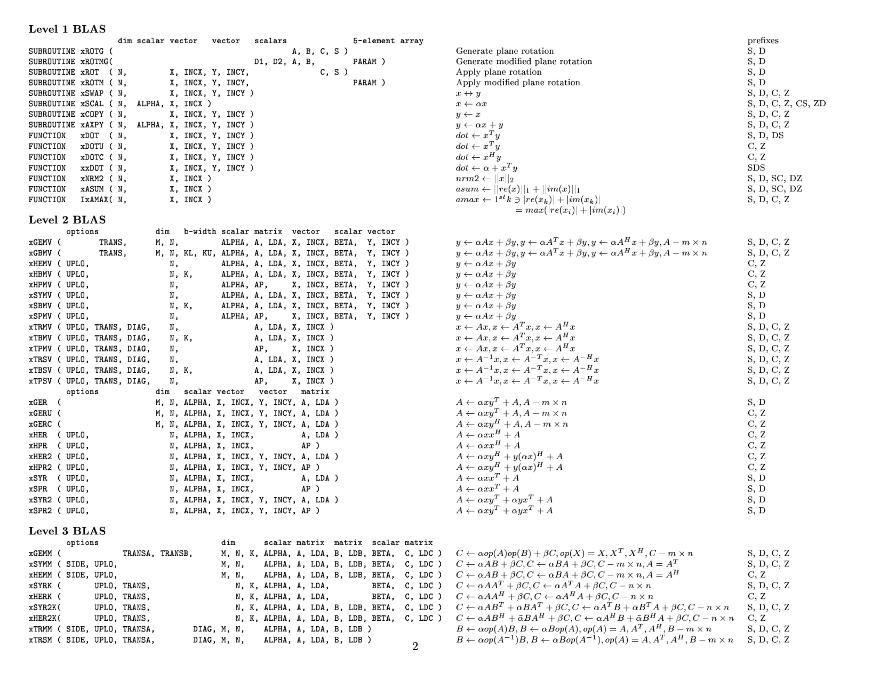
BLAS list

Slide 19
Level 1, 2 and 3 BLAS
Level 1 BLAS Vector-Vector operations
y
y
y
α
x
+
α
x^{T}
y
2n FLOP
2n memory reference
RATIO: 1
AXPY:
DOT:
Level 2 BLAS Matrix-Vector operations
y
α
x
+
y
2n² FLOP
n² memory references
RATIO: 2
GEMV:
A
Level 3 BLAS Matrix-Matrix operations
GEMM:
C
A
B
C
2n³ FLOP
4n² memory references
RATIO: 2 n
α
+ β

Slide 20
Why BLAS so important?
Because the BLAS are efficient, portable, parallel, and widely available, they are commonly used in the development of high quality linear algebra software.
Performance of lot of applications depends a lot on the performance of the underlying BLAS

Slide 21
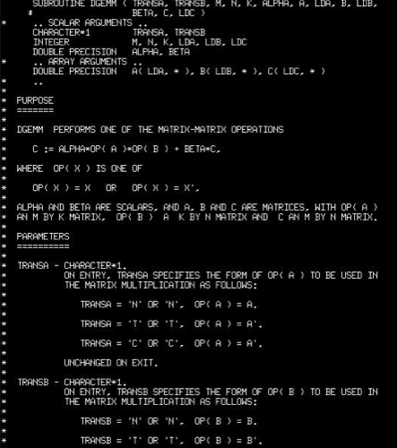
Standardization (BLAS example)
Each BLAS Subroutines have a standardized layout
BLAS is documented in the source code
Man pages exist
Vendor supplied docs
Different BLAS implementations have the same calling sequence

Slide 22
  Vendor/Optimized BLAS libraries
ACML
  The AMD Core Math Library, supporting the AMD processors
ATLAS
  Automatically Tuned Linear Algebra Software, an open source implementation of BLAS APIs for C and Fortran 77
Intel MKL
  The Intel Math Kernel Library, supporting x86 32-bits and 64-bits. Includes optimizations for Intel Pentium, Core and Intel Xeon CPUs and Intel Xeon Phi; support for Linux, Windows and Mac OS X
cuBLAS
  Optimized BLAS for NVIDIA based GPU cards
clBLAS
  An OpenCL implementation of BLAS
ESSL
  IBM's Engineering and Scientific Subroutine Library, supporting the PowerPC architecture under AIX and Linux
GotoBLAS
  Kazushige Goto's BSD-licensed implementation of BLAS, tuned in particular for Intel Nehalem/Atom, VIA Nanoprocessor, AMD Opteron
BLIS
  BLAS-like Library Instantiation Software framework for rapid instantiation
OpenBLAS
  Optimized BLAS based on Goto BLAS hosted at GitHub, supporting Intel platform and other

Slide 23
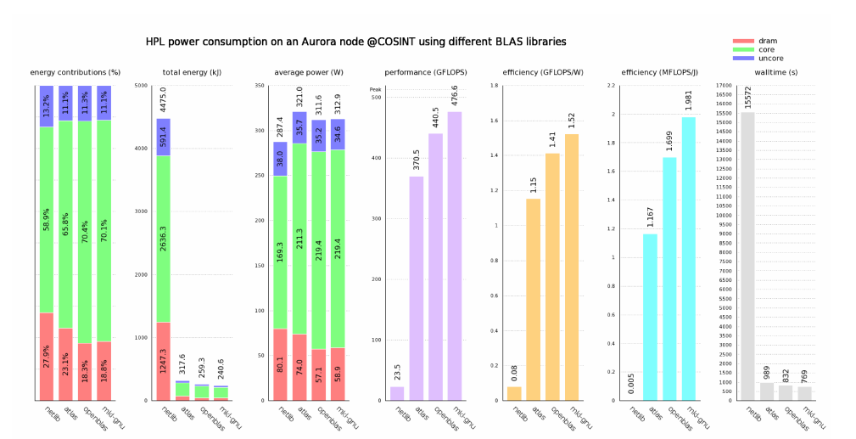
Blas efficiency: (from Moreno B. MHPC's thesis)

Slide 24
What about my C++/C program ??
BLAS routines are Fortran-style, when calling them from C-language programs, follow the Fortran-style calling conventions:
  Pass variables by address, not by value.
  Store your data in Fortran style, that is, column-major rather than row-major order.
be aware that because the Fortran language is case-insensitive, the routine names can be both upper-case or lower-case, with or without the trailing underscore. For example, the following names are equivalent:
  dgemm, DGEMM, dgemm_, and DGEMM_

Slide 25
Use CBLAS
C-style interface to the BLAS routines (http://www.netlib.org/blas/blast-forum/cblas.tgz)
You can call CBLAS routines using regular C-style calls.
The header file specifies enumerated values and prototypes of all the functions.
For details and examples:
https://software.intel.com/en-us/mkl-tutorial-c-multiplying-matrices-using-dgemm

Slide 26
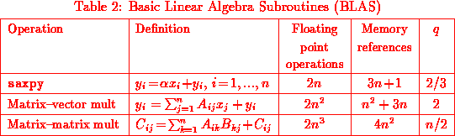
Efficiency: q parameter (aka computational efficiency)
The parameter q is the ratio of flops to memory references.
Generally:
1.Larger values of q maximize useful work to time spent moving data.
2.The higher the level of the BLAS, the larger q.

Slide 27
It follows..
BLAS1 are memory bounded ! (for each computation a memory transfer is required)
BLAS2 are not so memory bounded (can have good performance on super-scalar architecture)
BLAS3 can be very efficient on super-scalar computers because not memory bounded

Slide 28
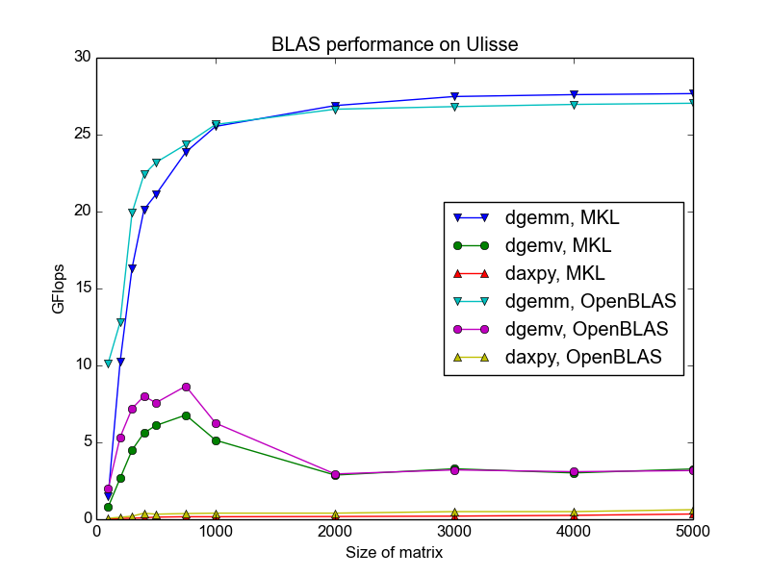
Blas Performance on ULISSE

Slide 29
Proposed Exercise
Create the previous graph for the HW/software we are using:
  Using MKL
  Using OpenBLAS
  On a Ulisse old/new nodes
Steps:
  Install, if missing needed libraries in your directory
  Write a small program to call the three routines
  Write a script to collect all sizes of interest
  Make nice plots

Slide 30
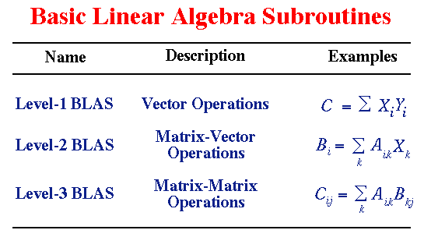
comment on BLAS

Slide 31
How to link optimized libraries?
Reference implementation: order matters !
  LAPACK uses BLAS
  => -L/usr/local/lib -llapack -lblas
OpenBLAS:
  Automatically includes lapack reference implementation so no need to specify anything else. Please check !
ATLAS is written C with f77 wrappers:
  -L/opt/atlas/lib -lf77blas -latlas
MKL:
  Generally complex and highly dependent on version and/or HW/SW implementation
  https://software.intel.com/en-us/articles/intel-mkl-link-line-advisor

Slide 32
Exercise 2: Running HPL on our clusters
Check the README on github account

Slide 33
A few notes:
Standard input file should be present
Beware of threads
  How to control them ?

Slide 34
What about N ?
N should be large enough to take ~75% of RAM..
  N = sqrt ( 0.75 * Number of Nodes * Minimum memory of any node / 8 )
You can compute it via:
  http://www.advancedclustering.com/act-kb/tune-hpl-dat-file/

Slide 35
HPL benchmark input file HPL.dat
HPLinpack benchmark input file
Innovative Computing Laboratory, University of Tennessee
HPL.out output file name (if any)
6 device out (6=stdout,7=stderr,file)
1 # of problems sizes (N)
50000 Ns
1 # of NBs
768 NBs
0 PMAP process mapping (0=Row-,1=Column-major)
1 # of process grids (P x Q)
4 1 2 1 Ps
4 2 2 4 Qs
16.0 threshold
1 # of panel fact
0 1 2 PFACTs (0=left, 1=Crout, 2=Right)
1 # of recursive stopping criterium
2 8 NBMINs (>= 1)
1 # of panels in recursion
2 NDIVs
1 # of recursive panel fact.
0 1 2 RFACTs (0=left, 1=Crout, 2=Right)
1 # of broadcast
0 2 BCASTs (0=1rg,1=1rM,2=2rg,3=2rM,4=Lng,5=LnM)
1 # of lookahead depth
1 0 DEPTHs (>=0)
1 SWAP (0=bin-exch,1=long,2=mix)
192 swapping threshold
1 L1 in (0=transposed,1=no-transposed) form
1 U in (0=transposed,1=no-transposed) form
1 Equilibration (0=no,1=yes)
8 memory alignment in double (> 0)

Slide 36
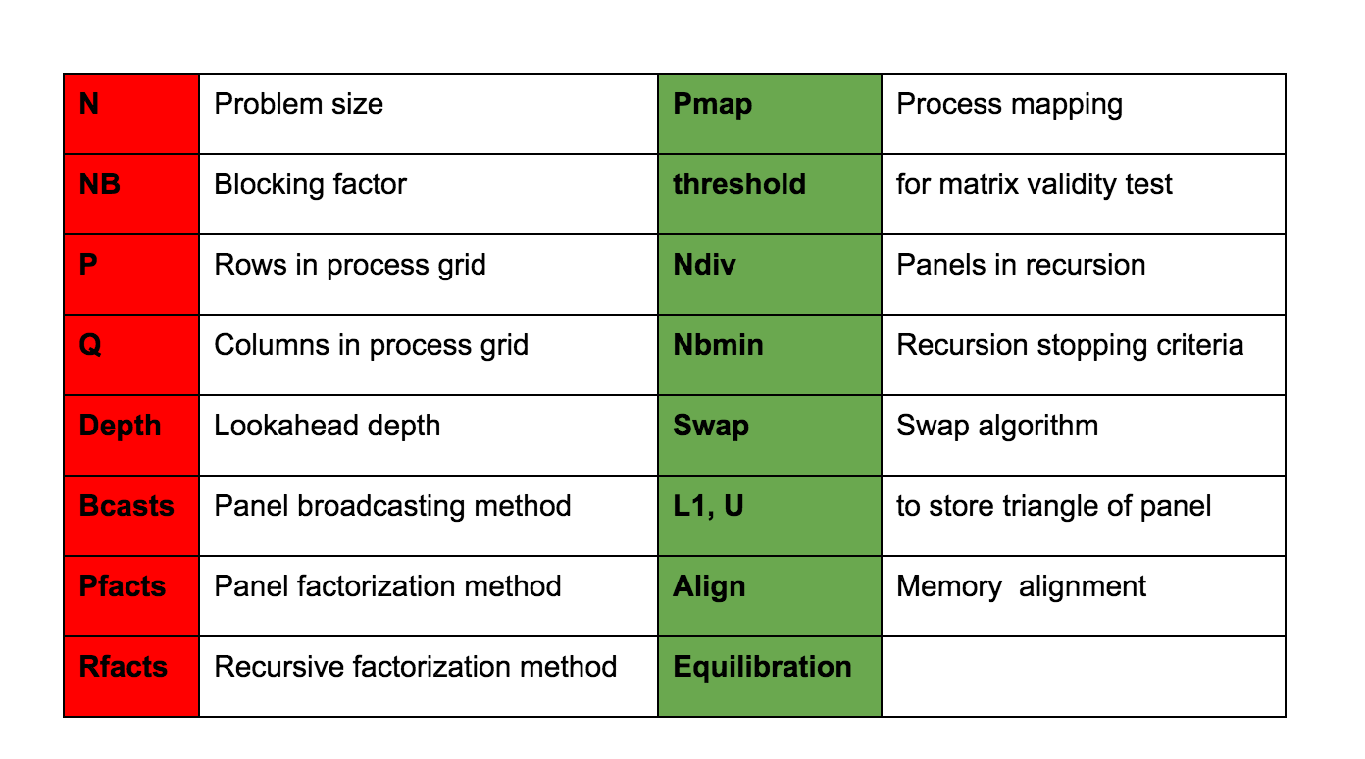
Parameters for HPL.dat input file

Slide 37
Tips to get performance..
Figure out a good block size (NB) for the matrix multiply routine. The best method is to try a few out. If you happen to know the block size used by the matrix-matrix multiply routine, a small multiple of that block size will do fine. This particular topic is discussed in the FAQs section.
The process mapping should not matter if the nodes of your platform are single processor computers. If these nodes are multi-processors, a row-major mapping is recommended.
HPL likes "square" or slightly flat process grids. Unless you are using a very small process grid, stay away from the 1-by-Q and P-by-1 process grids.

Slide 38
What are you supposed to do ?
Let us read together the readme file.

Slide 39
Thank you …

