Slide 1
The art of benchmarking HPC systems

Slide 2
Agenda
Give you the feeling how much is important to know how your system/ application/computational experiment is performing..
Name a few standard benchmarks that can help you in making/taking a decision
Discuss in some details some of them:
HPL/ HPCG​/ STREAM/Graph500
Show you some tricks and tips how to make your own benchmarking procedure

Slide 3
benchmark: a definition
a benchmark is the act of running a computer program, a set of programs, or other operations, in order to assess the relative performance of an object, normally by running a number of standard tests and trials against it
from wikipedia

Slide 4
A first important statements
Benchmarking is absolutely essential
no single number can reflect overall performance
You needs several representative benchmarks
the only benchmark that matters is the intended workload.
The purpose of benchmarking is not to get the best results, but to get consistent repeatable accurate results that are also the best results.

Slide 5
The art of benchmarking:
Should be done by people who know the application, the hardware, and the operating system
Be careful with artificial benchmarks or marketing myths

Slide 6
Do not be fooled..
Measuring and reporting performance is the basis for scientific advancement in HPC.
Not always scientific papers/reports guarantee reproducibility
A lack of standards/rule is actually present in benchmarking arena.

Slide 7
Interpreting benchmarking numbers
extraordinarily difficult:
  Vendors tend to tune their products specifically for industry-standard benchmarks. Use extreme caution in interpreting their results.
  Many benchmarks focus entirely on the speed of computational performance, neglecting other important features of a computer system.
  Benchmarks seldom measure real world performance of mixed workloads

Slide 8
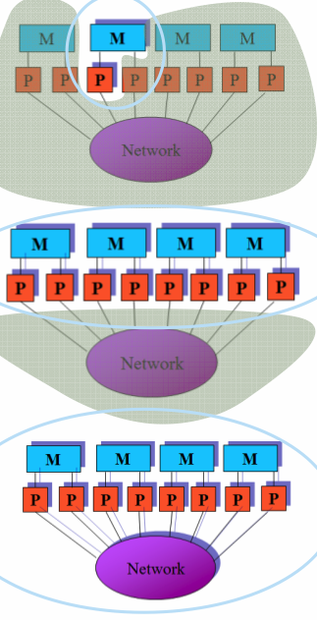
What we need to benchmark on a modern system
Single core : only a single processor (core) is performing computations.
Single node each node in the entire system is performing computations but they do no communicate with each other explicitly.
Global -all processors/nodes in the system are performing computations and they explicitly communicate with each other.

Slide 9
Type of code for benchmark
Synthetic codes
  Basic hardware and system performance tests
  Meant to determine expected future performance and serve as surrogate for workload not represented by application codes
  useful for performance modeling
Application codes
  Actual application codes as determined by requirements and usage
  Meant to indicate current performance
  Each application code should have more than one real test case

Slide 10
A good benchmark is
Relevant and meaningful to the target application domain
Applicable (portable) to a broad spectrum of hardware architecture
Adopted both by users and by vendors to enable comparative evaluation

Slide 11
Some freely available benchmark (1)
General benchmark:
  HPL Linpack (for Top500)
  HPC Challenge Benchmark:
    a collection of basic benchmark beyond HPL
  NAS benchmark suite
    math kernel implemented both in MPI and openMP
    (http://www.nas.nasa.gov/publications/npb.html)
  HPCG
    A recently introduced benchmark to “fix” the HPL one
  Stream
    Memory benchmark
  Graph500:
    Data intensive application (used for Graph500 list)

Slide 12
Some freely available benchmarks (2)
Network benchmark:
  Netpipe /Netperf (http://www.netperf.org/netperf/)
    tcp/ip protocol and more
  IMB-4.0 (now IMB2017) (INTEL MPI benchmark)
    MPI protocol ()
    https://software.intel.com/en-us/articles/intel-mpi-benchmarks
  OSU benchmarks: http://mvapich.cse.ohio-state.edu/benchmarks/
I/O benchmarks:
  Iozone/b_eff_io/IOR/ Mdbench/

Slide 13
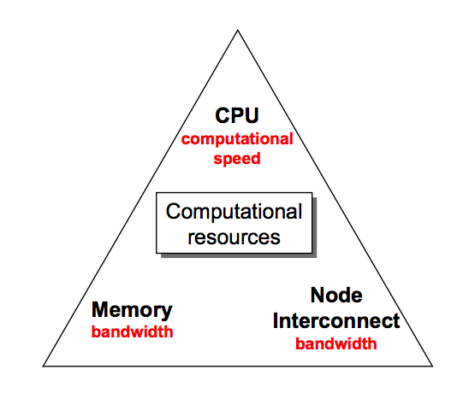
resources to benchmark

Slide 14
HPCC benchmark
7 tests:
1. HPL - the Linpack TPP benchmark which measures the floating point rate of execution for solving a linear system of equations.
2. DGEMM - measures the floating point rate of execution of double precision real matrix-matrix multiplication.
3. STREAM - a simple synthetic benchmark program that measures sustainable memory bandwidth (in GB/s) and the corresponding computation rate for simple vector kernel.
4. PTRANS (parallel matrix transpose) - exercises the communications where pairs of processors communicate with each other simultaneously. It is a useful test of the total communications capacity of the network.
5. RandomAccess - measures the rate of integer random updates of memory (GUPS).
6. FFT - measures the floating point rate of execution of double precision complex one-dimensional Discrete Fourier Transform (DFT).
7. Communication bandwidth and latency - a set of tests to measure latency and bandwidth of a number of simultaneous communication patterns; based on b_eff (effective bandwidth benchmark).

Slide 15
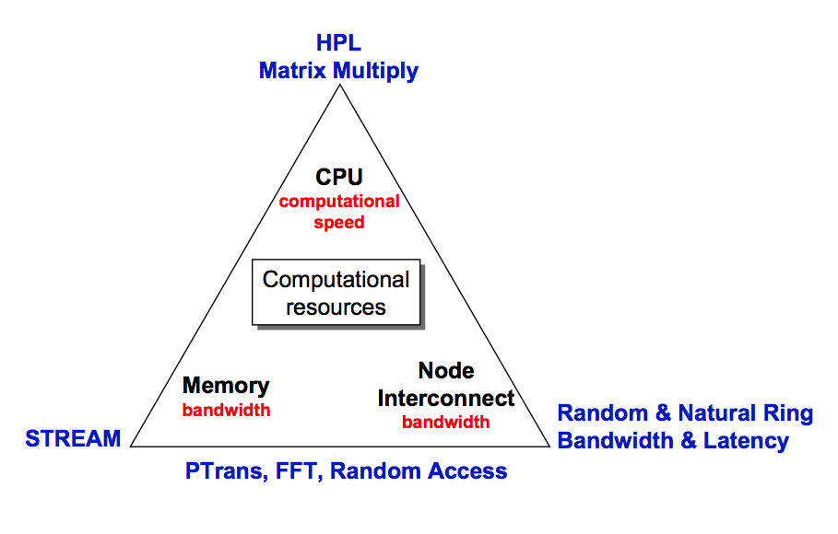
HPCC components
http://icl.cs.utk.edu/hpcc/

Slide 16
Scientific application as benchmarks
HPC benchmarks so far presented are not able to be too much representative of actual workload in specific scientific domain
However running a complex application as standard benchmark could be difficult and sometime almost impossible.
There are also the so called Mini-applications: smaller version of the real production scientific package
They provide time to solution for several kernels and strong/weak scalability information

Slide 17
Some examples of mini applications
CloverLeaf: CloverLeaf is a miniapp that solves the compressible Euler equations on a Cartesian grid, using an explicit, second-order accurate method.
CoMD: A simple proxy for the computations in a typical molecular dynamics application. The reference implementation mimics that of SPaSM. In addition, we provide an OpenCL implementation which allows testing on multicore and GPU architectures, with both array-of-structures and structure-of-arrays data layouts. More information can be found at https://github.com/exmatex/CoMD.
MiniFE: MiniFE is an proxy application for unstructured implicit finite element codes. It is similar to HPCCG and pHPCCG but provides a much more complete vertical covering of the steps in this class of applications. MiniFE also provides support for computation on multicore nodes, including pthreads and Intel Threading Building Blocks (TBB) for homogeneous multicore and CUDA for GPUs. Like HPCCG and pHPCCG, MiniFE is intended to be the "best approximation to an unstructured implicit finite element or finite volume application, but in 8000 lines or fewer."
MiniMD: A simple proxy for the force computations in a typical molecular dynamics applications. The algorithms and implementation used closely mimics these same operations as performed in LAMMPS.
MiniGhost: A Finite Difference proxy application which implements a difference stencil across a homogenous three dimensional domain.
MiniXyce: A portable proxy of some of the key capabilities in the electrical modeling Xyce.

Slide 18
Let us play with benchmarks !
Graph500
STREAM
HPL
HPCG
NAS benchmarks

Slide 19
Graph500 :
from Graph500.org: This is the first serious approach to augment the Top 500 with data-intensive applications.
Available from 2010
It builds a graph and then it transverse it implementing a so called Breadth-First Search (BFS) algorithms
Other algorithm is also implemented: Single Source Shortest Path (SSSP)
Separated lists are constructed for the two algorithms from 2017 on..
Easy to compile and run: it requires just one parameter: number of vertices

Slide 20
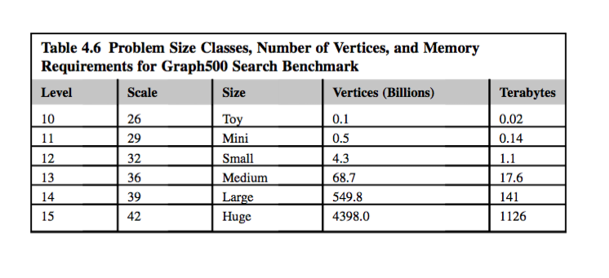
Graph 500 Problems size classes

Slide 21
Graph500 in action..
…
Running BFS 63
Time for BFS 63 is 5.458120
TEPS for BFS 63 is 1.96721e+08
Validating BFS 63
Validate time for BFS 63 is 19.377711
SCALE: 26
edgefactor: 16
NBFS: 64
graph_generation: 40.991
num_mpi_processes: 16
construction_time: 23.9508
bfs min_time: 5.40125
..
bfs max_time: 5.53835
bfs mean_time: 5.46142
bfs stddev_time: 0.0277278
bfs min_TEPS: 1.93871e+08
bfs median_TEPS: 1.96633e+08
..

Slide 22
Graph500
Performance is measure in TEPS:
  Transversed edge per seconds
comparison against HPL and HPCG difficult
two important trends for this benchmark:
  Graph500 search benchmark performance has gone flat.
  The effective giga-traversed edges per second (GTEPS) per core is much lower for distributed-memory architectures than for shared memory.

Slide 23
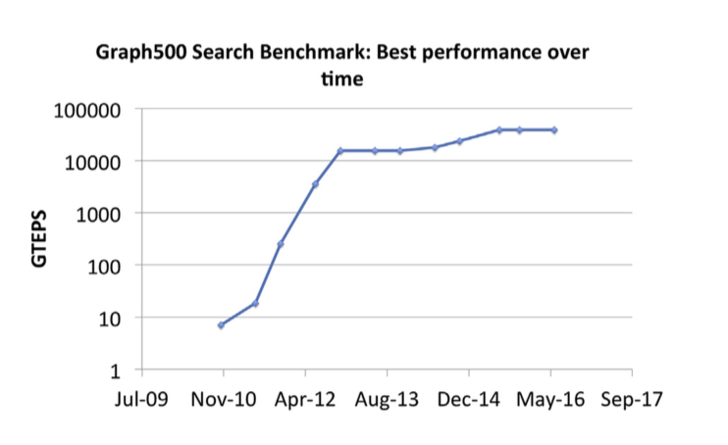
GTEPS goes flat...

Slide 24
STREAM benchmark
Created in 1991
Intended to be a oversimplified representation of low-computing intensity and long vector operations
Widely used, more 1100 results in the database
Hosted at www.cs.virginia.edu/stream
Compilation and execution trivial

Slide 25
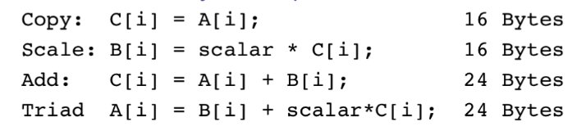
STREAM benchmark
Four kernels, separately timed:
N chosen to make each array >> cache size
Repeated several times, first iteration ignored
Min/Max/Avg reported and the best time used to compute Bandwidth

Slide 26
Stream at work:
-------------------------------------------------------------
STREAM version $Revision: 5.10 $
-------------------------------------------------------------
This system uses 8 bytes per array element.
-------------------------------------------------------------
Array size = 120000000 (elements), Offset = 0 (elements)
Memory per array = 915.5 MiB (= 0.9 GiB).
Total memory required = 2746.6 MiB (= 2.7 GiB).
Each kernel will be executed 20 times.
The *best* time for each kernel (excluding the first iteration)
will be used to compute the reported bandwidth.
-------------------------------------------------------------
Number of Threads requested = 40
Number of Threads counted = 40
-------------------------------------------------------------
Your clock granularity/precision appears to be 1 microseconds.
Each test below will take on the order of 101043 microseconds.
(= 101043 clock ticks)
Increase the size of the arrays if this shows that
you are not getting at least 20 clock ticks per test.
-------------------------------------------------------------
WARNING -- The above is only a rough guideline.
For best results, please be sure you know the
precision of your system timer.
-------------------------------------------------------------
Function Best Rate MB/s Avg time Min time Max time
Copy: 17007.8 0.116517 0.112889 0.123725
Scale: 17055.9 0.120043 0.112571 0.130133
Add: 20137.6 0.148766 0.143016 0.159369
Triad: 20329.5 0.147540 0.141666 0.152015
-------------------------------------------------------------
Solution Validates: avg error less than 1.000000e-13 on all three arrays
-------------------------------------------------------------

Slide 27
How is memory organized ?
[root@b11 ~]# dmidecode --type memory | grep BRANCH
Bank Locator: BRANCH 0 CHANNEL 0 DIMM 0
Bank Locator: BRANCH 0 CHANNEL 0 DIMM 1
Bank Locator: BRANCH 0 CHANNEL 0 DIMM 2
Bank Locator: BRANCH 0 CHANNEL 1 DIMM 0
Bank Locator: BRANCH 0 CHANNEL 1 DIMM 1
Bank Locator: BRANCH 0 CHANNEL 1 DIMM 2
Bank Locator: BRANCH 0 CHANNEL 2 DIMM 0
Bank Locator: BRANCH 0 CHANNEL 2 DIMM 1
Bank Locator: BRANCH 0 CHANNEL 2 DIMM 2
Bank Locator: BRANCH 0 CHANNEL 3 DIMM 0
Bank Locator: BRANCH 0 CHANNEL 3 DIMM 1
Bank Locator: BRANCH 0 CHANNEL 3 DIMM 2
...

Slide 28
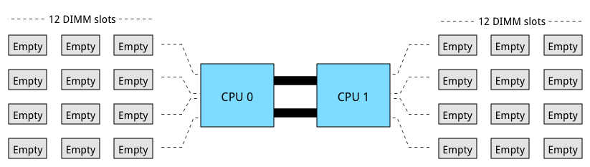
The official layout

Slide 29
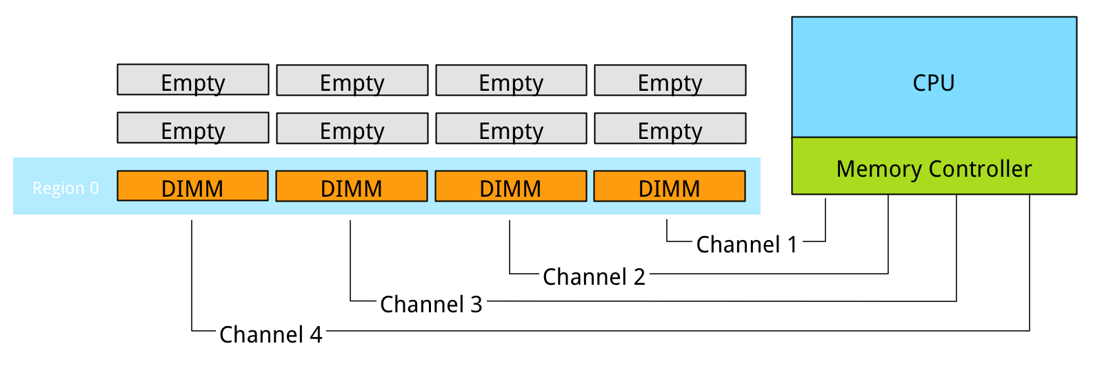
The data layout on C3HPC nodes
E5 v2 processor

Slide 30
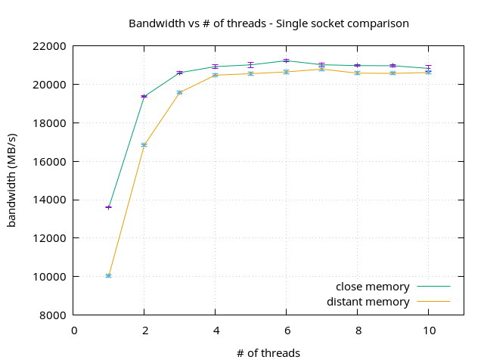
STREAM results on Ulysses

Slide 31
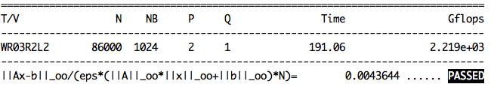
HPL
From http://icl.cs.utk.edu/hpl/index.html:
  The code solves a uniformly random system of linear equations and reports time and floating-point execution rate using a standard formula for operation count.
  Number_of_floating_point_operations = 2/3n³ + 2n² (n=size of the system)

Slide 32
HPL has some problems
HPL performance of computer systems are no longer so strongly correlated to real application performance, especially for the broad set of HPC applications governed by partial differential equations.
Designing a system for good HPL performance can actually lead to design choices that are wrong for the real application mix, or add unnecessary components or complexity to the system.

Slide 33
Concerns
The gap between HPL predictions and real application performance will increase in the future.
A computer system with the potential to run HPL at an Exaflop is a design that may be very unattractive for real applications.
Future architectures targeted toward good HPL performance will not be a good match for most applications.
This leads us to a think about a different metric

Slide 34
HPCG benchmark
High Performance Conjugate Gradient (HPCG).
  Solves Ax=b, A large, sparse, b known, x computed.
  An optimized implementation of PCG contains essential computational and communication patterns that are prevalent in a variety of methods for discretization and numerical solution of PDEs
Patterns:
  Dense and sparse computations.
  Dense and sparse collective.
  Data-driven parallelism (unstructured sparse triangular solves).
Strong verification and validation properties (via spectral properties of CG)
http://www.hpcg-benchmark.org/index.html

Slide 35
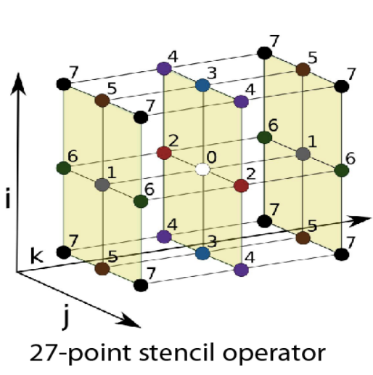
Model problem description
Synthetic discretized 3D PDE (FEM, FVM, FDM).
Local domain: nx ny nz (see hpcg.dat)
Process layout: px*py*pz (px*py*pz=N of processor)
Global domain: (px* nx ) X (py* ny) X (pz* nz)
Sparse matrix:
  27 nonzeros/row interior.
  8 – 18 on boundary.
Symmetric positive definite

Slide 36
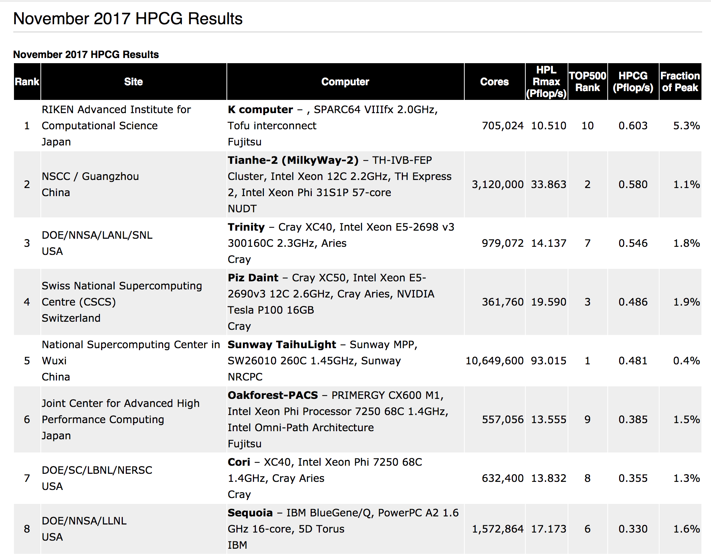

Slide 37
HPCG benchmark
Balanced BW and compute:
HPCG is memory BW bound in modern processors
  6 Byte/FLOP
  HPCG can utilize at most x/6 of peak FLOP
Scalable collectives: HPCG uses all-reduce
Efficient parallelization of Gauss-Seidel: HPCG spends 2/3 of time in GS

Slide 38
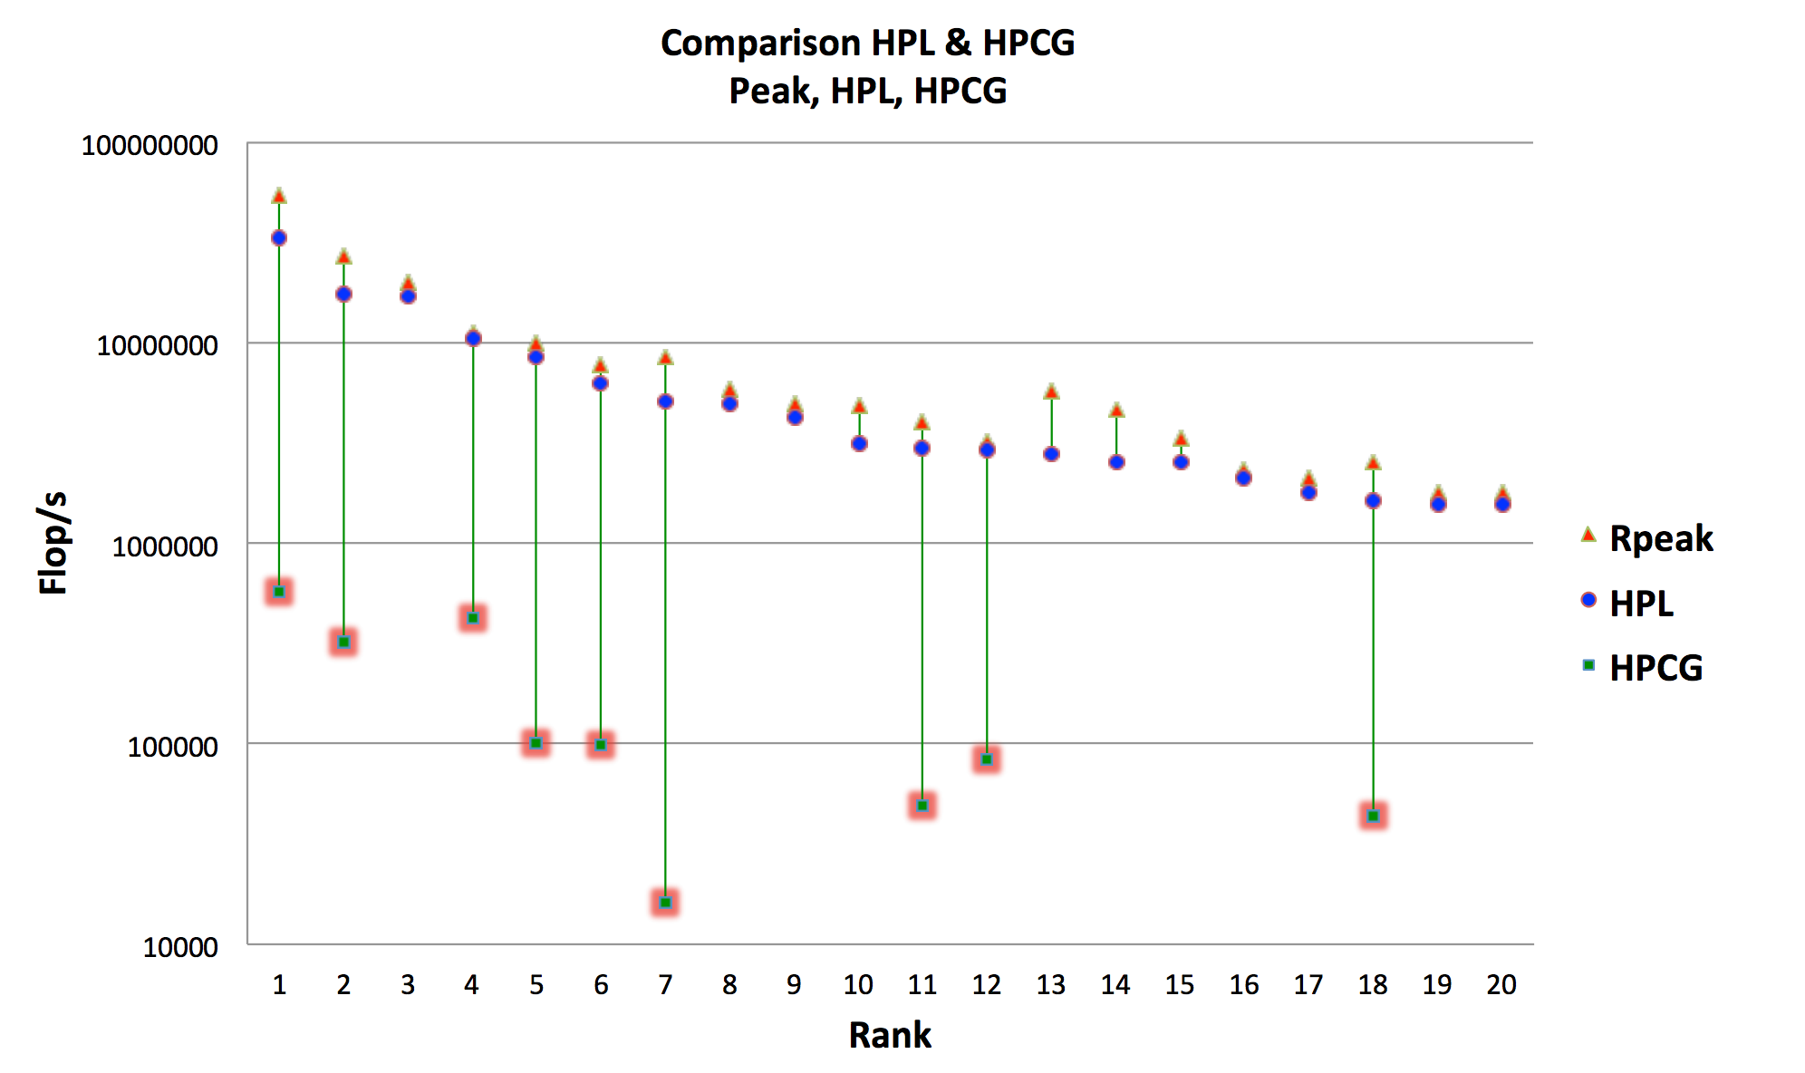
Comparison HPL vs HPCG

Slide 39
Remember:
THERE IS NO BENCHMARK THAT SUBSTITUTES your own code on your dataset
Measurement should be done by you on your code !

Slide 40
Tips to benchmark
use /usr/bin/time and take note of all times
wall time/ user time /sys time
repeat the same run at least a few time to estimate the fluctuations of the numbers (this should be generally within a few percent)
be sure to be alone on the system you are using and with no major perturbation on your cluster
execution runs should be at least in the order of tens of minutes
always check the correctness of your scientific output

Slide 41
Performance Evaluation process
Monitoring your System:
  Use monitoring tools to better understand your machine’s limits and usage
    is the system limit well suited to run my application ?
  Observe both overall system performance and single-program execution characteristics. Monitoring your own code
    Is the system doing well ? Is my program running in a pathological situation ?
Monitoring your own code:
  Timing the code:
    timing a whole program (time command :/usr/bin/time)
    timing a portion (all portions) of the program
  Profiling the program (already seen)

Slide 42
Optimization Techniques
There are basically three different categories:
  Improve memory performance (The most important)
  Improve CPU performance
  Use already highly optimized libraries/subroutines
07/12/19

Slide 43
What are performance libraries ?
Routines for common (math) functions such as vector and matrix operations, fast Fourier transform etc. written in a specific way to take advantage of capabilities of the CPU.
Each CPU type normally has its own version of the library specifically written or compiled to maximally exploit that architecture

Slide 44
Why use performance libraries ?
Compilers can optimize code only to a certain point. Effective programming needs deep knowledge of the platform
Performance libraries are designed to use the CPU in the most efficient way, which is not necessarily the most straightforward way.
It is normally best to use the libraries supplied by or recommended by the CPU vendor
On modern hardware they are hugely important, as they most efficiently exploit caches, special instructions and parallelism

Slide 45
Any other reason apart from optimization ?
Usage of libraries
  Make coding easier. Complicated math operations can be used from existing routines
  Increase portability of code as standard (and well optimized) libraries exist for ALL computing platforms.
Lego approach: build your own code using available bricks..

Slide 46
What is available ?
Linear Algebra: BLAS/LAPACK/SCALAPACK
FFT:
  FFTW
ODE/PDE
  PETSC
Machine Learning:
  Tensorflow / Caffe etc..

Slide 47
Should I write my own algorithm for L. A. ?
99.99% of time NO
  Tons of libraries out there
  Well tested
  Extremely efficient in 99.99% of the case
  With some “de facto” standard implemented
PORTABILITY IS COMING (almost) FOR FREE

Slide 48
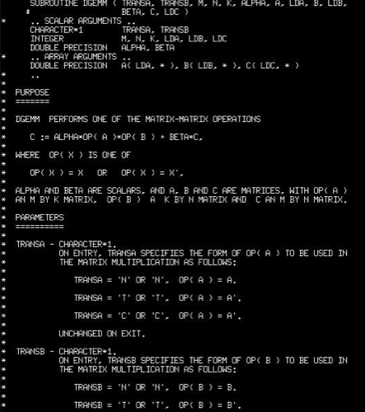
Standardization (BLAS example)
Subroutines have a standardized layout
BLAS is documented in the source code
Man pages exist
Vendor supplied docs
Different BLAS implementations have the same calling sequence

Slide 49
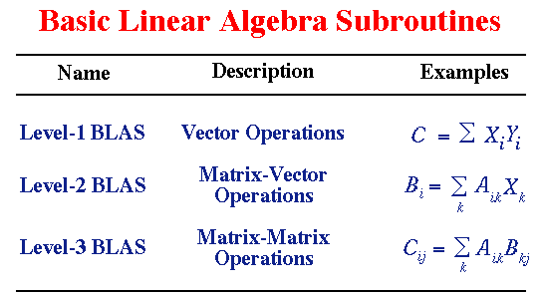
comment on BLAS

Slide 50
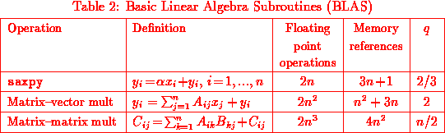
Efficiency: q parameter (aka computational effiency)
The parameter q is the ratio of flops to memory references. Generally:
1.Larger values of q maximize useful work to time spent moving data.
2.The higher the level of the BLAS, the larger q.

Slide 51
It follows..
BLAS1 are memory bounded ! (for each computation a memory transfer is required)
BLAS2 are not so memory bounded (can have good performance on super-scalar architecture)
BLAS3 can be very efficient on super-scalar computers because not memory bounded

Slide 52
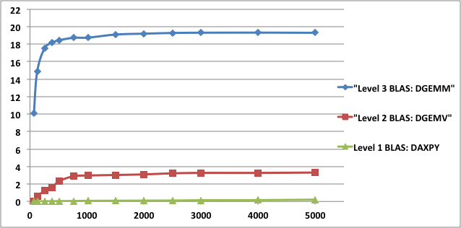
BLAS performance
1 core Intel Xeon E5-2670 (Sandy Bridge), 2.6 GHz.
24 MB shared L3 cache, and each core has a private 256 KB L2 and 64 KB L1.
The theoretical peak for this architecture in double precision is 20.8 Gflop/s per core.
Compiled with gcc 4.4.6 and using MKL_composer_xe_2013.3.163
19.3
Gflops
3.3
Matrix size
0.2

Slide 53
  Vendor/Optimized BLAS libraries
ACML
  The AMD Core Math Library, supporting the AMD processors
ATLAS
  Automatically Tuned Linear Algebra Software, an open source implementation of BLAS APIs for C and Fortran 77
Intel MKL
  The Intel Math Kernel Library, supporting x86 32-bits and 64-bits. Includes optimizations for Intel Pentium, Core and Intel Xeon CPUs and Intel Xeon Phi; support for Linux, Windows and Mac OS X
cuBLAS
  Optimized BLAS for NVIDIA based GPU cards
clBLAS
  An OpenCL implementation of BLAS
ESSL
  IBM's Engineering and Scientific Subroutine Library, supporting the PowerPC architecture under AIX and Linux
GotoBLAS
  Kazushige Goto's BSD-licensed implementation of BLAS, tuned in particular for Intel Nehalem/Atom, VIA Nanoprocessor, AMD Opteron
BLIS
  BLAS-like Library Instantiation Software framework for rapid instantiation
OpenBLAS
  Optimized BLAS based on Goto BLAS hosted at GitHub, supporting Intel Sandy Bridge and MIPS_architecture Loongson processorss

Slide 54
How to link optimized libraries?
Reference implementation: order matters !
  LAPACK uses BLAS
  => -L/usr/local/lib -llapack -lblas
OpenBLAS:
  Automatically includes lapack reference implementation so no need to specify anything else. Please check !
ATLAS is written C with f77 wrappers:
  -L/opt/atlas/lib -lf77blas -latlas
MKL:
  Generally complex and highly dependent on version and/or HW/SW implementation
  https://software.intel.com/en-us/articles/intel-mkl-link-line-advisor

Slide 55
Running HPL on our clusters
Check the README on github account

Slide 56
A few notes:
Standard input file should be present
Beware of threads
  How to control them ?

Slide 57
What about N ?
N should be large enough to take ~75% of RAM..
  N = sqrt ( 0.75 * Number of Nodes * Minimum memory of any node / 8 )
You can compute it via:
  http://www.advancedclustering.com/act-kb/tune-hpl-dat-file/

Slide 58
HPL benchmark input file HPL.dat
HPLinpack benchmark input file
Innovative Computing Laboratory, University of Tennessee
HPL.out output file name (if any)
6 device out (6=stdout,7=stderr,file)
1 # of problems sizes (N)
50000 Ns
1 # of NBs
768 NBs
0 PMAP process mapping (0=Row-,1=Column-major)
1 # of process grids (P x Q)
4 1 2 1 Ps
4 2 2 4 Qs
16.0 threshold
1 # of panel fact
0 1 2 PFACTs (0=left, 1=Crout, 2=Right)
1 # of recursive stopping criterium
2 8 NBMINs (>= 1)
1 # of panels in recursion
2 NDIVs
1 # of recursive panel fact.
0 1 2 RFACTs (0=left, 1=Crout, 2=Right)
1 # of broadcast
0 2 BCASTs (0=1rg,1=1rM,2=2rg,3=2rM,4=Lng,5=LnM)
1 # of lookahead depth
1 0 DEPTHs (>=0)
1 SWAP (0=bin-exch,1=long,2=mix)
192 swapping threshold
1 L1 in (0=transposed,1=no-transposed) form
1 U in (0=transposed,1=no-transposed) form
1 Equilibration (0=no,1=yes)
8 memory alignment in double (> 0)

Slide 59
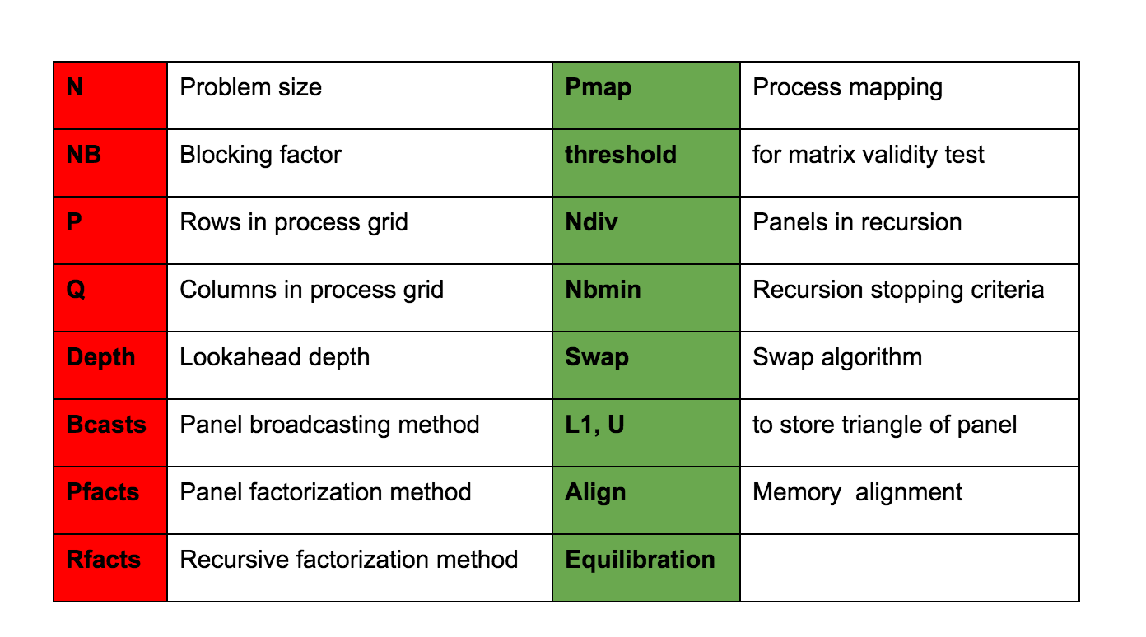
Parameters for HPL.dat input file

Slide 60
Tips to get performance..
Figure out a good block size (NB) for the matrix multiply routine. The best method is to try a few out. If you happen to know the block size used by the matrix-matrix multiply routine, a small multiple of that block size will do fine. This particular topic is discussed in the FAQs section.
The process mapping should not matter if the nodes of your platform are single processor computers. If these nodes are multi-processors, a row-major mapping is recommended.
HPL likes "square" or slightly flat process grids. Unless you are using a very small process grid, stay away from the 1-by-Q and P-by-1 process grids.

Slide 61
What are you supposed to do ?
Let us read together the readme file.

Slide 62
Some interesting documents/links
http://crd-legacy.lbl.gov/~dhbailey/dhbpapers/twelve-ways.pdf
http://www.hpcwire.com/2011/12/13/ten_ways_to_fool_the_masses_when_giving_performance_results_on_gpus/
http://htor.inf.ethz.ch/publications/img/hoefler-scientific-benchmarking.pdf
  Scientific Benchmarking of Parallel Computing Systems )Twelve ways to tell the masses when reporting performance results)
http://www.sandia.gov/~maherou/docs/HPCG-Benchmark.pdf
Twelve Ways to Fool the Masses When Giving Performance Results on Parallel Computers
David H. Bailey June 11, 1991

