Slide 1
A group project for visualization of supercharger stations in California
to navigate best locations to implement supercharger stations
based on current saturations and EV populations.
Supercharger Location Analysis
By
Charissa Hoxie Toshi Torihara Michael Farm

Slide 2
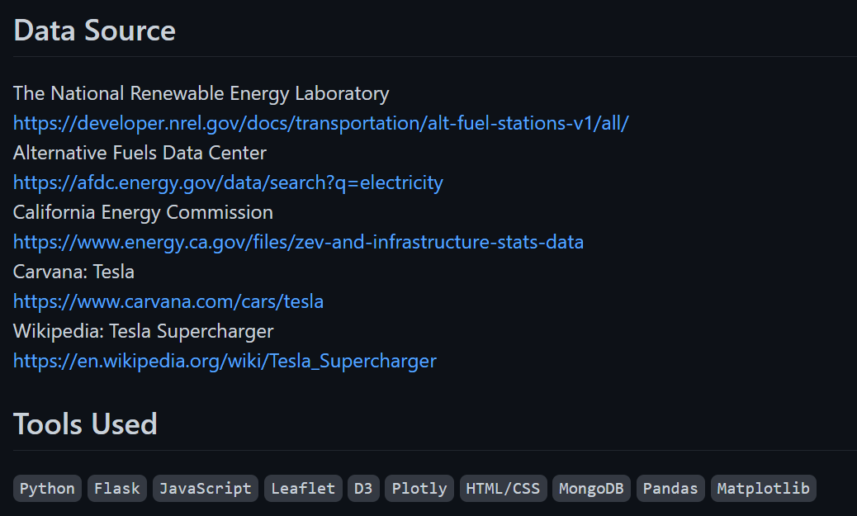

Slide 3
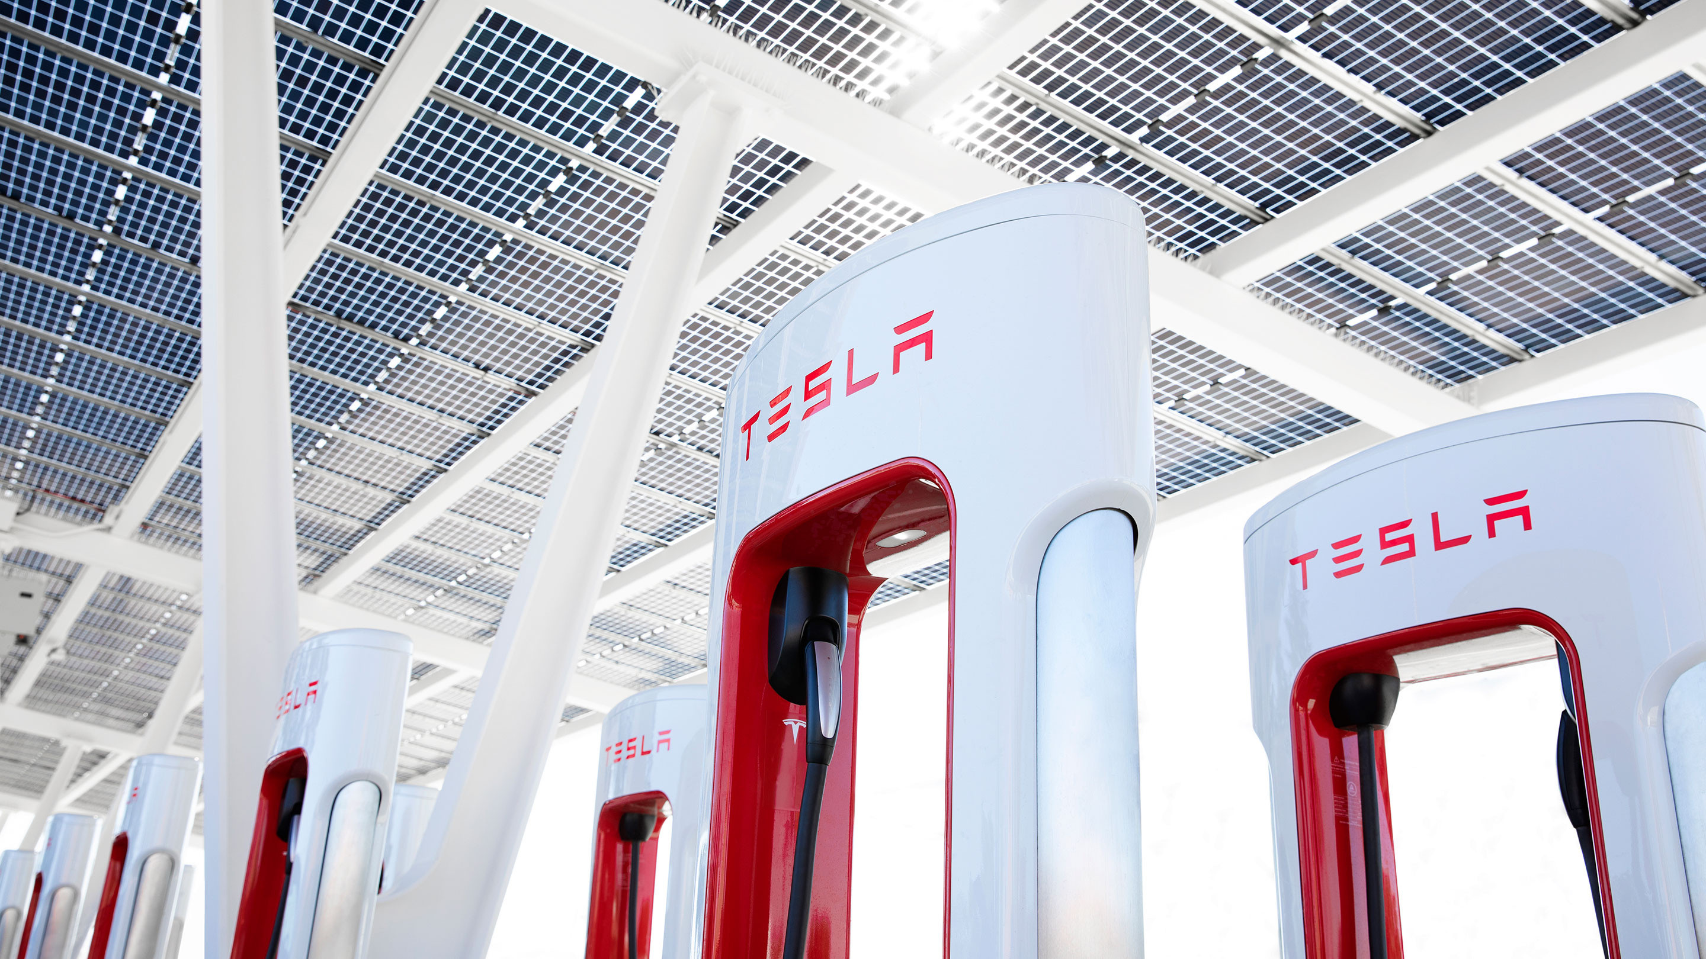
Extract, Transform, Load (ETL) Phase

Slide 4
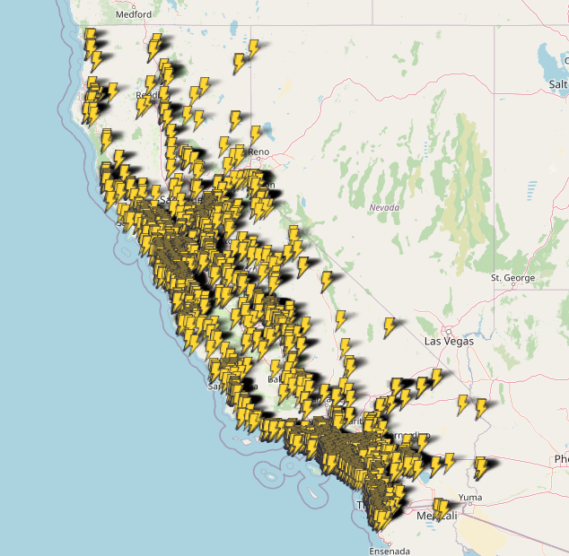
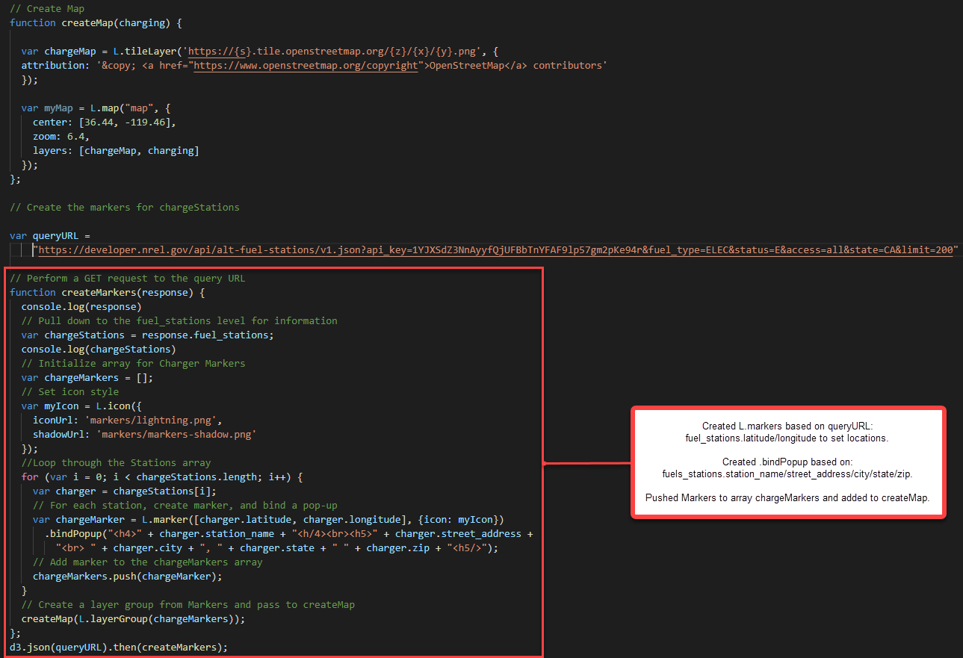
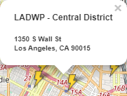
Interactive Map of Available EV Charging Stations in California

Slide 5
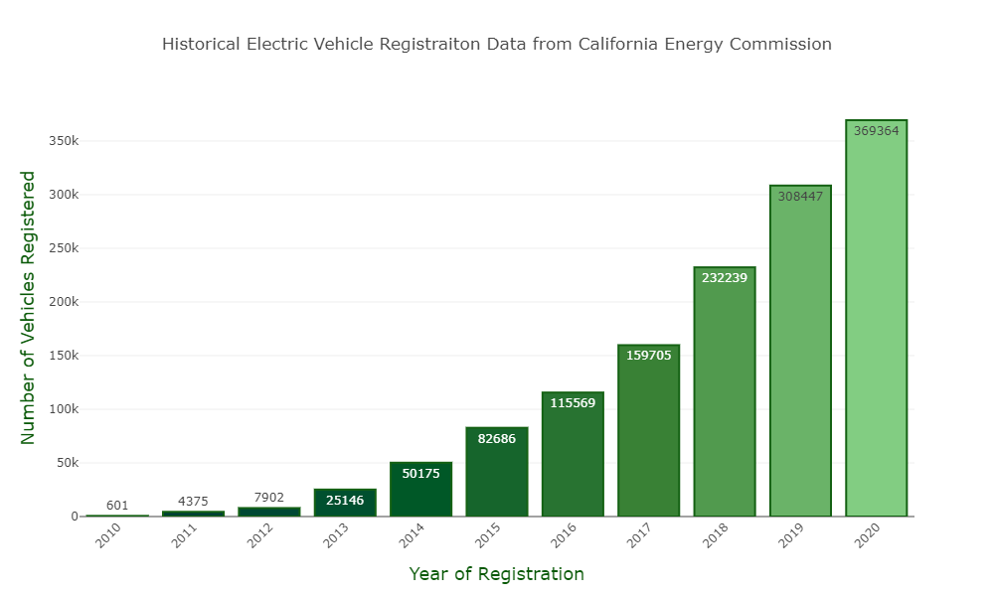
Chart of Electronic Vehicles Registered in California for 2010 - 2020

Slide 6
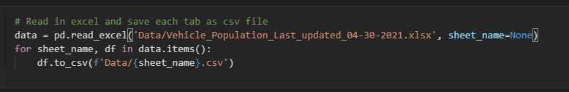
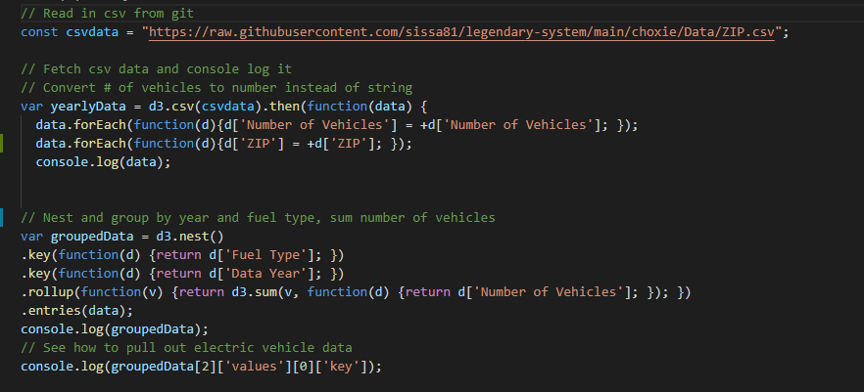
data.ipynb / ev_population.js

Slide 7
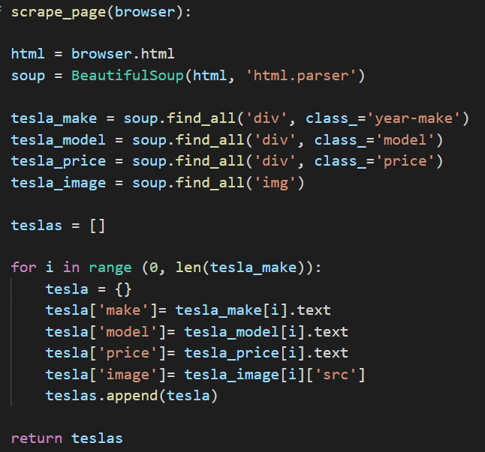
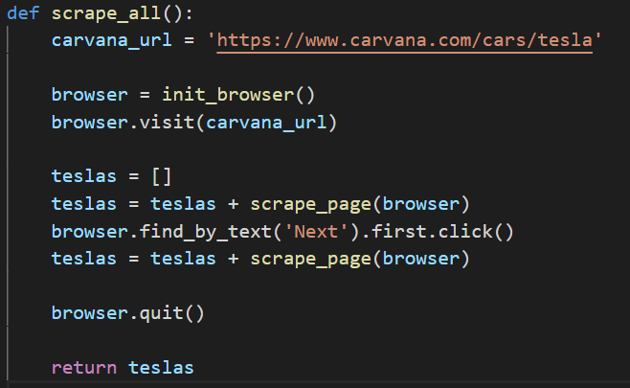
Using Splinter, get information of Tesla models by web-scraping off of Carvana site. Created functions as below.
scrape_page(browser):
Using BeautifulSoup and ‘find_all’ function and for loop to extract the make, model, price, and images of Teslas
scrape_all():
Further look into next page by ‘find_by_text’ and repeat scrape_page

Slide 8
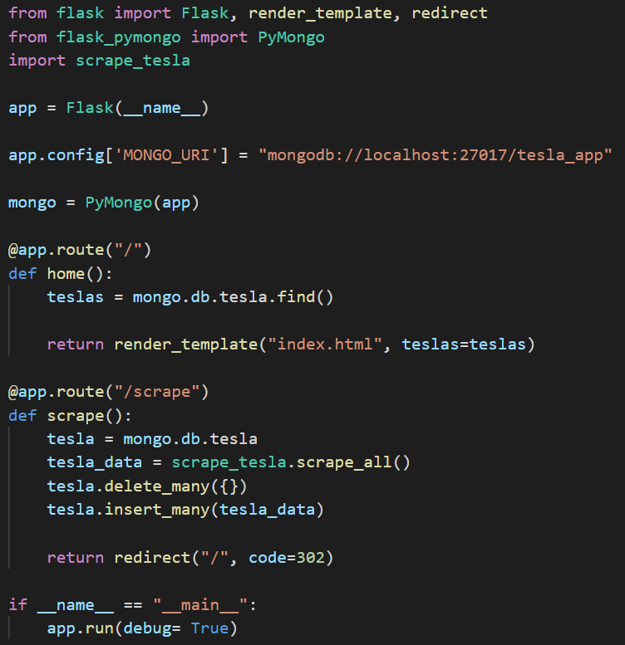
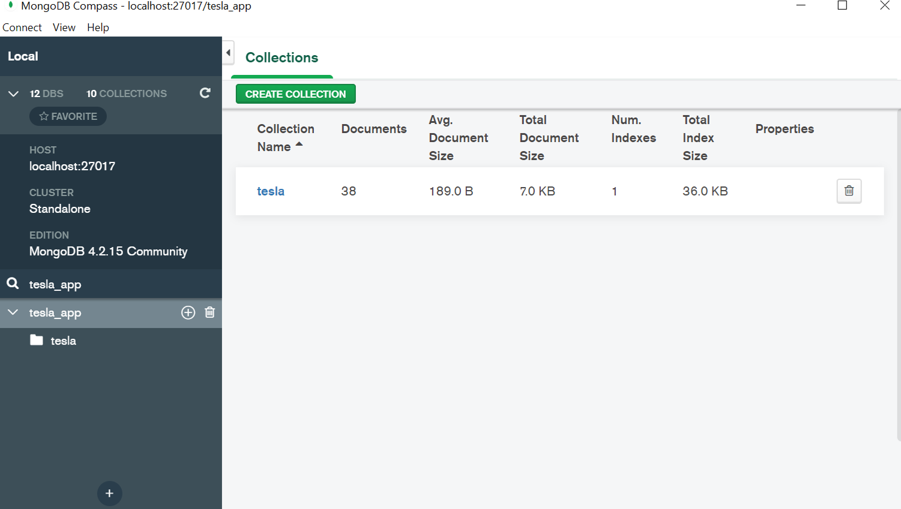
Using FlaskApp/PyMongo to store extracted Tesla data and connect to a MongoDB database named tesla_app

Slide 9
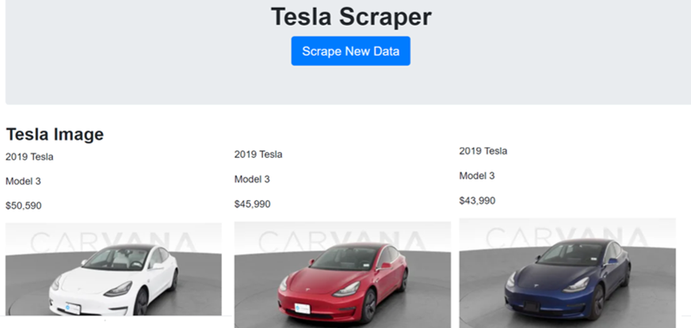
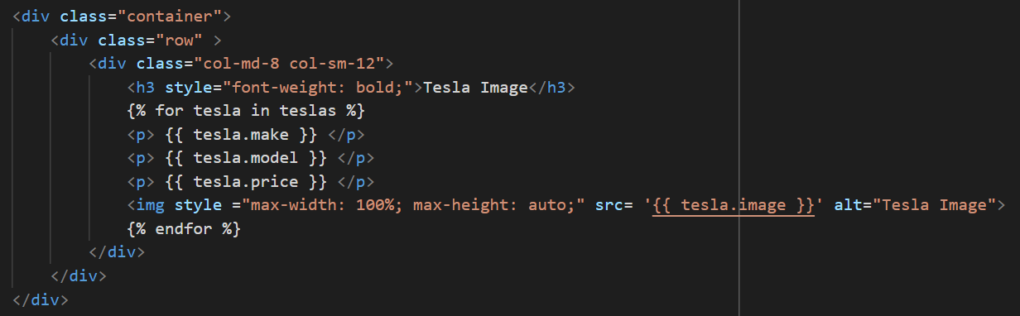
Create HTML with connection to python apps to generate Tesla Scraper to display all the data

Slide 10
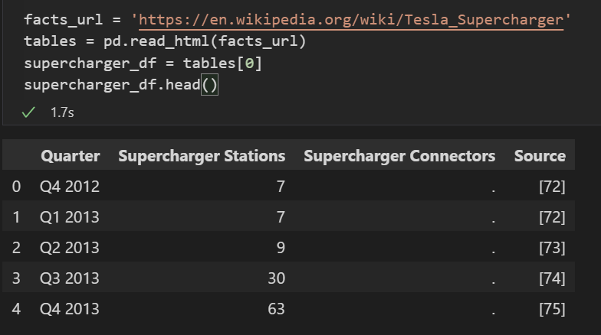
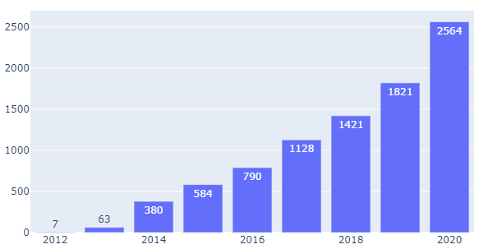
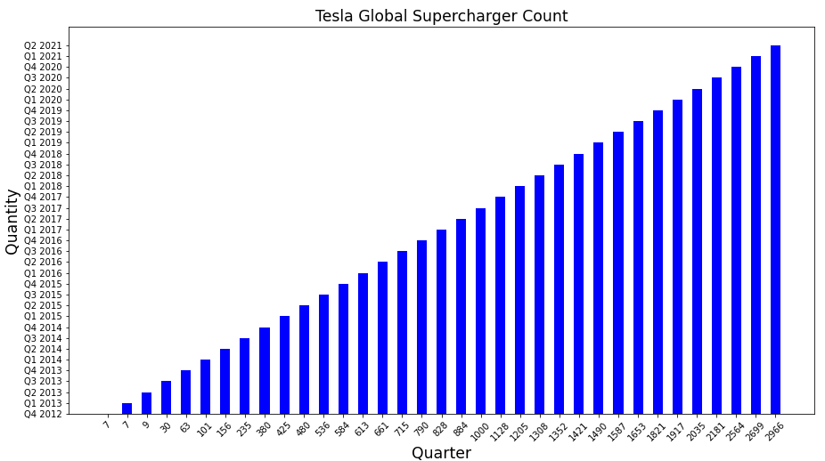
Scraping the third visual by extracting a table data from Wikipedia (Tesla_Supercharger)
Tesla Global Supercharger Count
Quantity
Year
Created bar chart by converting matplotlib.pyplot to plotly.graph_object

