Slide 1
A group project for visualization of supercharger stations in California
and current state of EV populations and latest Tesla models
Supercharger Location Analysis
By
Charissa Hoxie Toshi Torihara Michael Farm

Slide 2
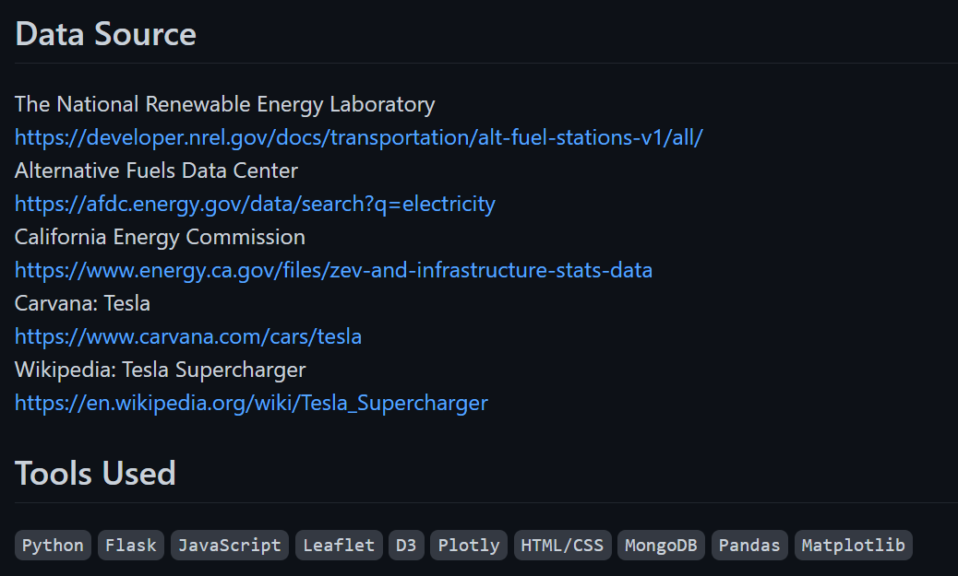

Slide 3
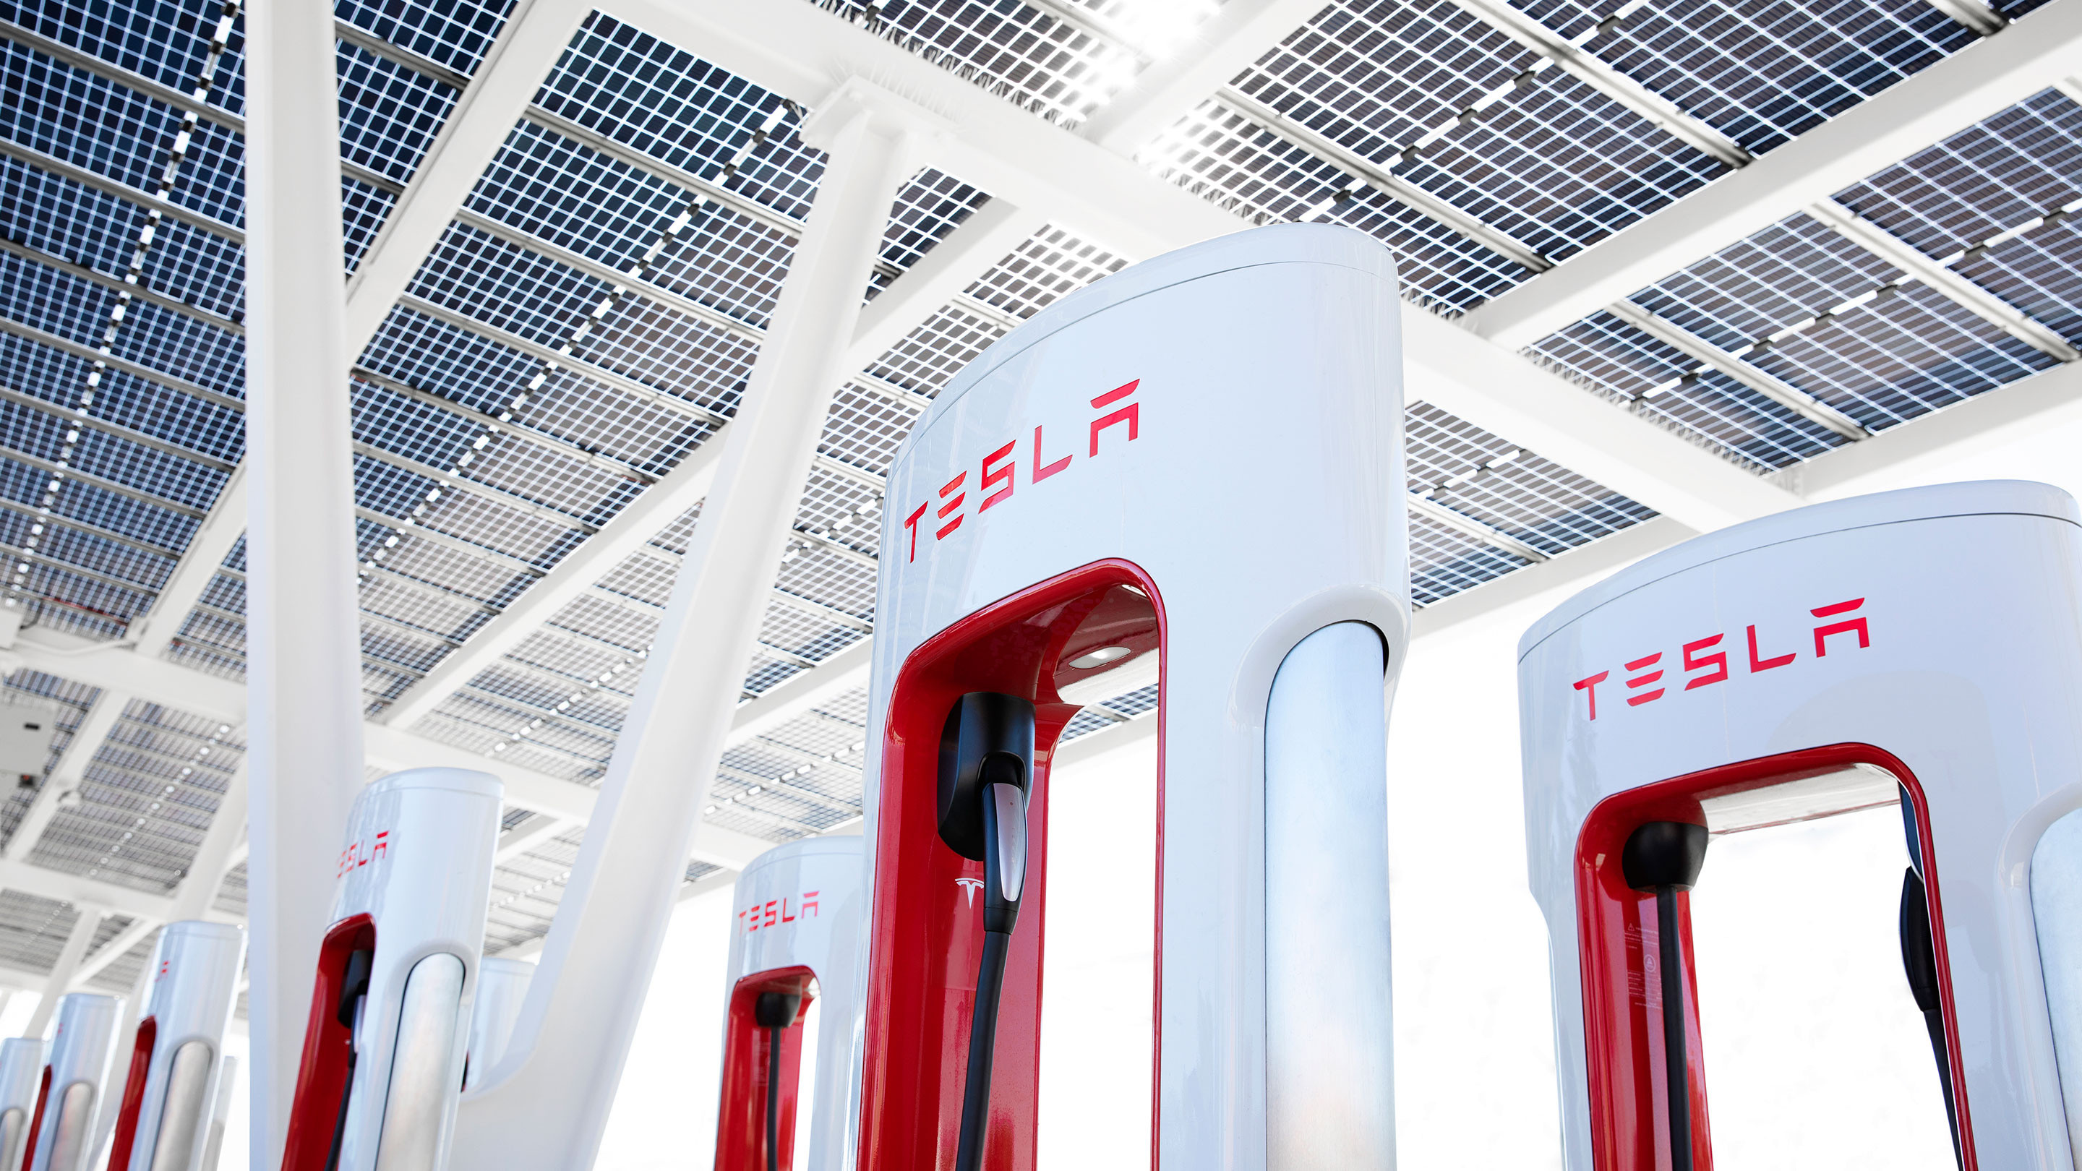
Extract, Transform, Load (ETL) Phase

Slide 4
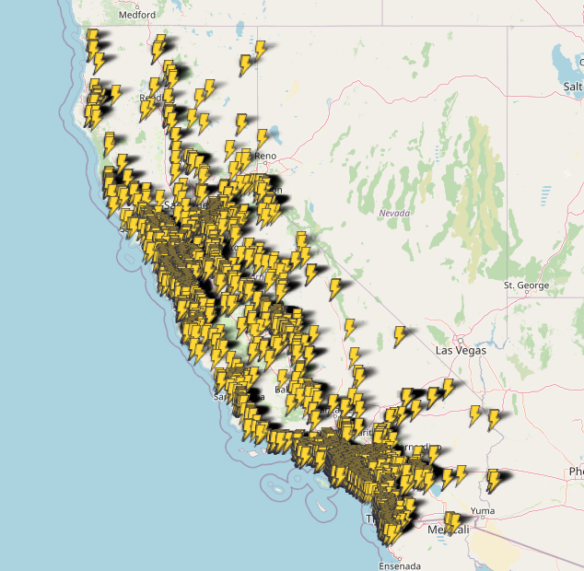
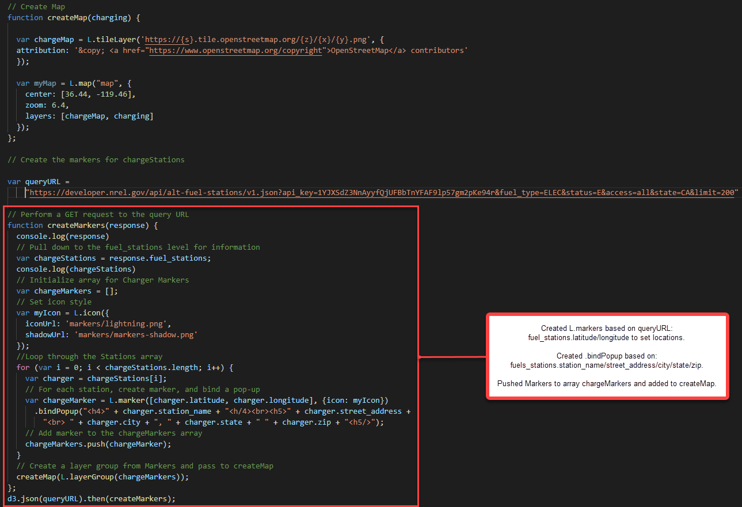
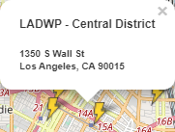
Interactive Map of Available EV Charging Stations in California

Slide 5
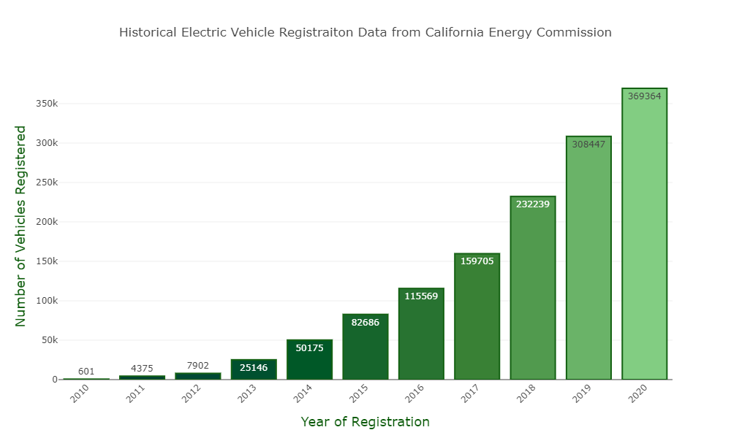
Chart of Electronic Vehicles Registered in California for 2010 - 2020

Slide 6
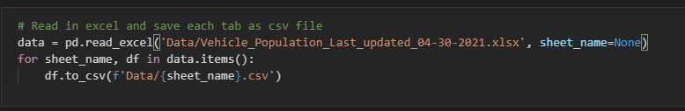
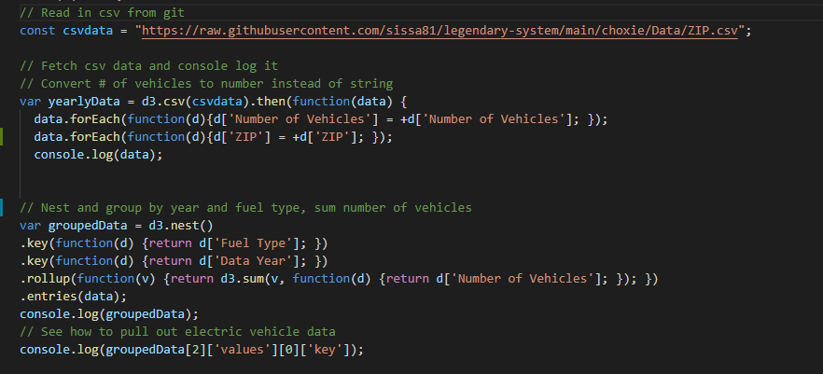
data.ipynb / ev_population.js

Slide 7
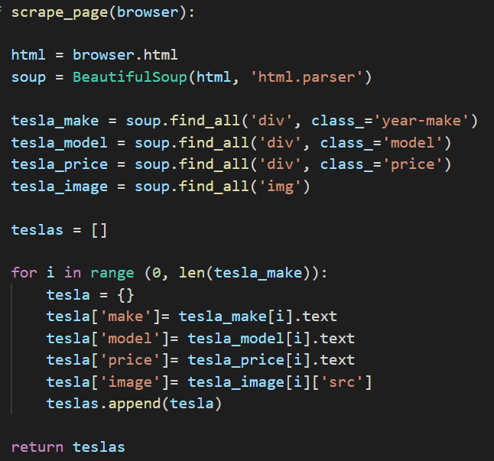
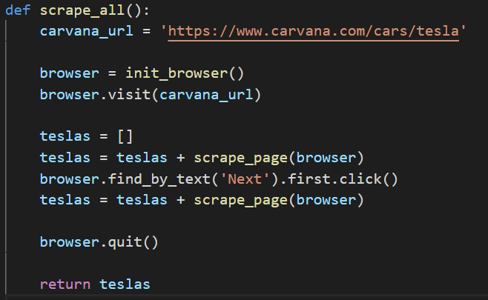
Using Splinter, get information of Tesla models by web-scraping off of Carvana site. Created functions as below.
scrape_page(browser):
Using BeautifulSoup and ‘find_all’ function and for loop to extract the make, model, price, and images of Teslas
scrape_all():
Further look into next page by ‘find_by_text’ and repeat scrape_page

Slide 8
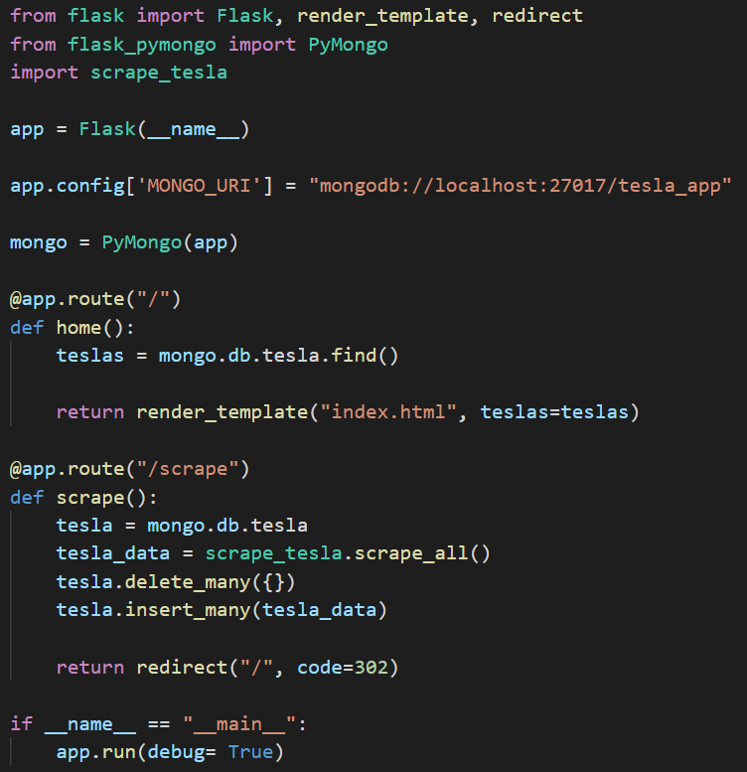
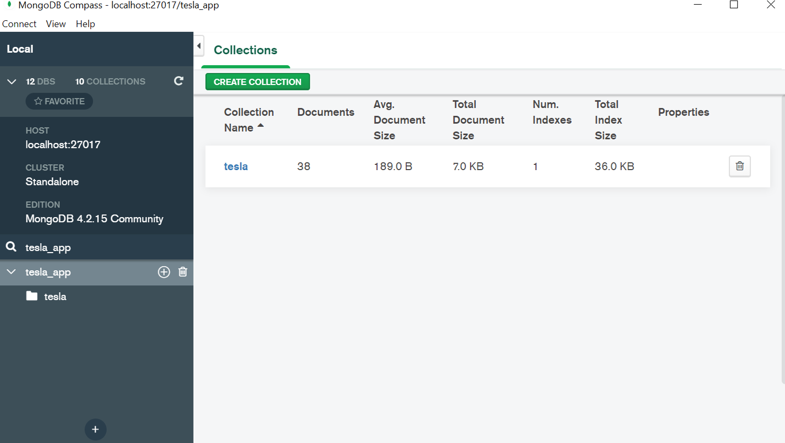
Using FlaskApp/PyMongo to store extracted Tesla data and connect to a MongoDB database named tesla_app

Slide 9
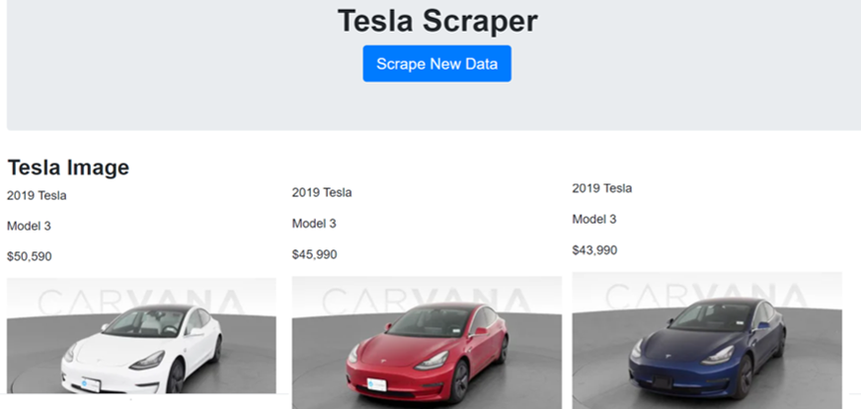
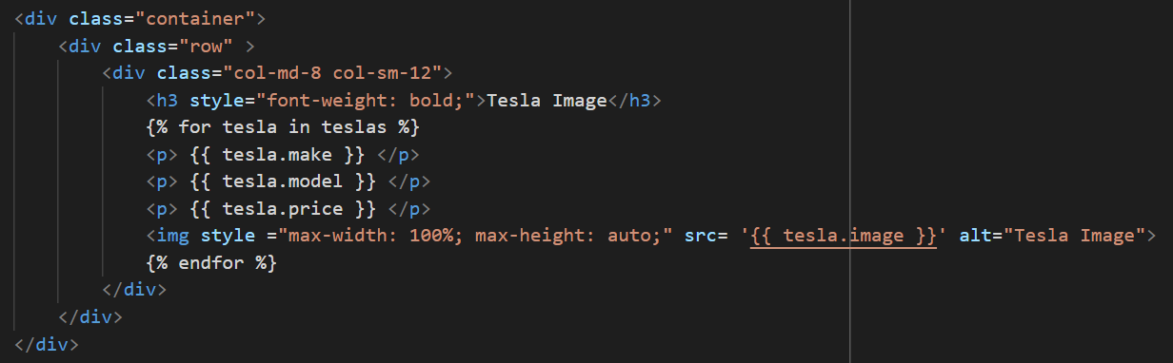
Create HTML with connection to python apps to generate Tesla Scraper to display all the data

Slide 10
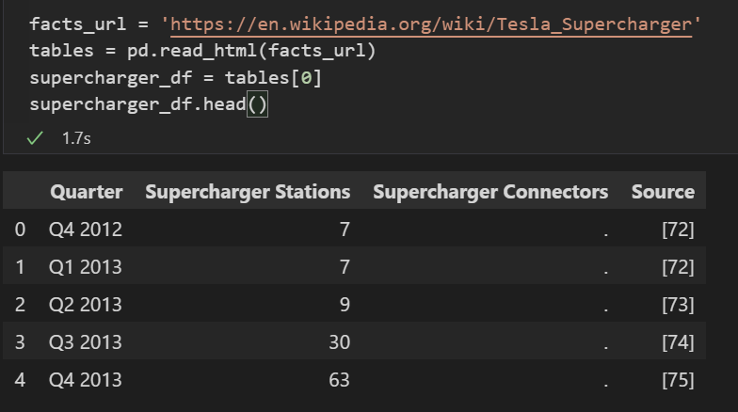
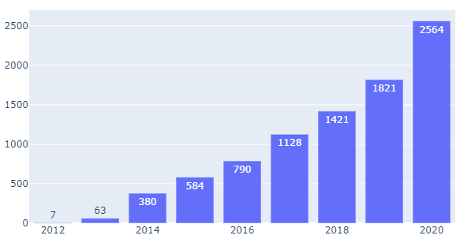
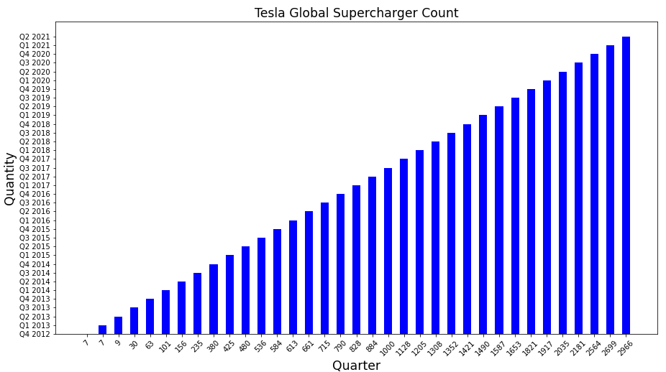
Scraping the third visual by extracting a table data from Wikipedia (Tesla_Supercharger)
Tesla Global Supercharger Count
Quantity
Year
Created bar chart by converting matplotlib.pyplot to plotly.graph_object

