Slide 1
Global Name Resolution Service
Project Status Report
Jan 29, 2013

Slide 2
GNRS Concepts
Distributed Hash Table for ID to Network Address bindings
Low latency (sub-second) insert and retrieval
Independent of underlying networking (overlay)

Slide 3
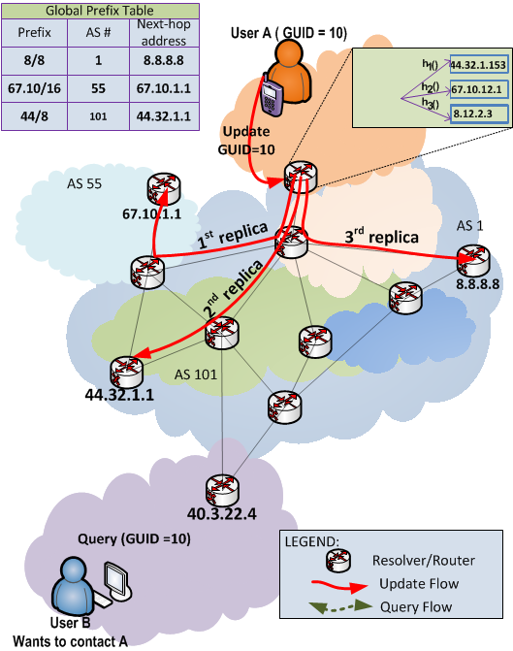
DMap Insert
GUID
(00101100……10011001)
Consistent hash
Consistent hash
Consistent hash
K
IPx
IPx
IPx
IPx = (44.32.1.153)
Global Prefix Table
{e.g. BGP)
IP to AS# lookup
Prefix | AS# | Nexhop
... | ... | ...
IP to AS# lookup
IP to AS# lookup
K
Storage AS#
Storage AS#
Storage AS#
K replicas
Mapping Update

Slide 4
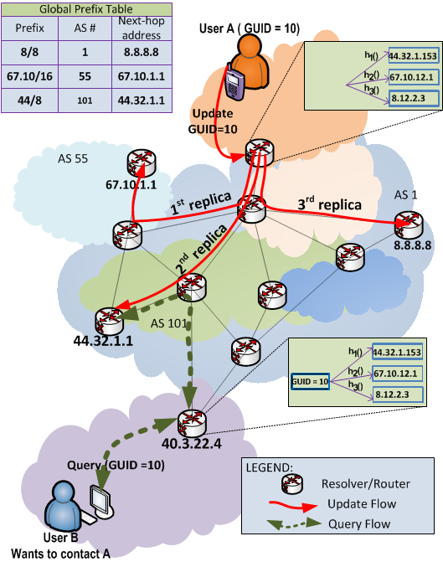
DMap Lookup
GUID
(00101100……10011001)
Consistent hash
Consistent hash
Consistent hash
K
IPx
IPx
IPx
IPx = (44.32.1.153)
Global Prefix Table
{e.g. BGP)
IP to AS# lookup
Prefix | AS# | Nexhop
... | ... | ...
IP to AS# lookup
IP to AS# lookup
K
Storage AS#
Storage AS#
Storage AS#
K replicas
Mapping Lookup

Slide 5
GNRS Prototype
Server supports PUT and GET
IPv4+UDP networking
Configurable parameters
All components modular
Implemented in Java for portability
Automated testing framework through OMF + ORBIT
Initial results are promising

Slide 6
GNRS Server Components
In-Memory DB
GUID → NA[]
In-Memory Map
Status
Ext. GNRS
GNRS
Engine
Complete
Data Access Obj
Partial
Ext. DB
Near future
Cache
Far future
Network Access Obj
IPv4/UDP
IPv6/UDP
MF Route
. . .
Network

Slide 7
Lines of Code
Apache MINA NIO Library
PATRICIA Trie Library
Berkeley DB Library

Slide 8
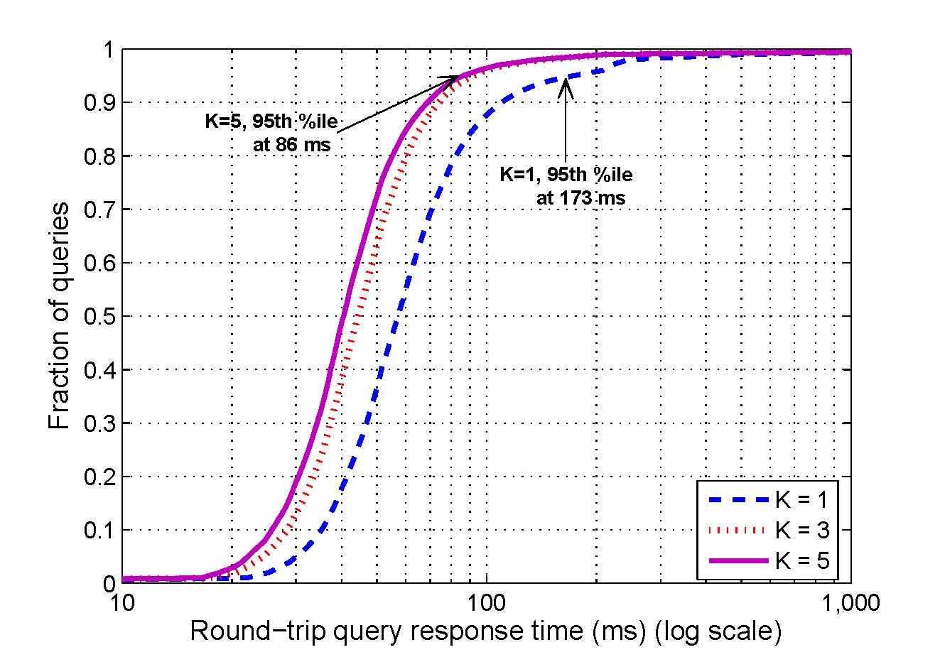
DMap Latency Predictions

Slide 9
GNRS Latency Measurements
Top-50 AS by degree
6 clients insert 100K GUID values (disjoint)
1000 msg/sec
Wait for 5 replicas to ACK

Slide 10
GNRS Latency Measurements
Top-50 AS by degree
6 clients retrieve 100K GUID values (disjoint)
1000 msg/sec
Select 2 replicas at random

Slide 11
Next Steps
Scale to 200+ nodes
Emulating 200 servers, 150+ clients
Explore effect of caching and TTL
Interaction with MF routing
GUID “chaining”
Coordinated client traces
Automatic logging and analysis of statistics
Workloads available for evaluation/replay
AS emulation by degree, IP allocation, geography

Slide 12

Thank you!
Image courtesy of Portland Independent Media Center
http://portland.indymedia.org/en/2006/09/345821.shtml

