Slide 2
Athernet Node
Athernet Gateway
TCP/UDP
NAT
Internet
WiFi Access Point
IP
IP
IP
Audio
Cable
Radio
Ethernet Nodes
Athernet
Athernet
WiFi
WiFi Nodes

Slide 3
Athernet Node
Athernet Gateway
FTP Client
TCP
NAT
FTP Server
IP
IP
IP
Audio
Cable
Internet
Athernet
Athernet
WiFi

Slide 4
AP: BSSID:
ShanghaiTech
Radio
Radio
Audio
Cable
NODE1
NODE2
NODE3

Slide 5
AP: BSSID:
ShanghaiTech
Radio
Internet
Audio
Cable
NODE1
NODE2
NODE3
FTP Client
NAT
FTP Server

Slide 6
AP: BSSID:
ShanghaiTech
Radio
Radio
Audio
Cable
Radio
Audio
Cable
NODE1a
NODE2a
NODE2c
NODE1c
NODE2b
Audio
Cable
NODE1b

Slide 7
NODE
File Helper
INPUT.TXT
OUTPUT.TXT
Bitstream
Bitstream
FIFO
FIFO
Bitstream
Bitstream
Physical Layer
Tx Thread
Rx Thread
Coding
Decoding
Modulation
Demodualtion
Add Header
Packet Detection and Synchronization
DAC
ADC
Speaker
MIC

Slide 8
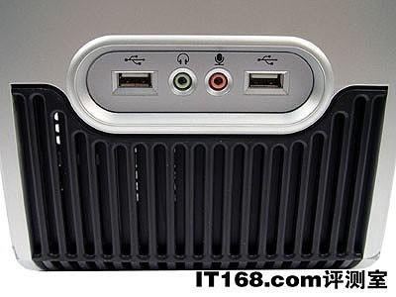
NODE
IO Helper
Files
macperf
macping
Packet
Packet
MAC Layer
MAC Thread
Queue Management
Input
Queue
Output
Queue
MAC State Machine
Frame
Frame
Physical Layer
Tx Thread
Rx Thread
Coding
Decoding
Modulation
Demodualtion
Add PHY Header
Synchronization
DAC
ADC

Slide 9
NODE3
NODE1
NODE2

Slide 10
Jamming
src
Tx1
Tx2
Tee
Tee
NODE1
NODE2

Slide 11
Jamming
src
Tx
Tee
Tee
Tee
NODE1
NODE2

Slide 12
Frame
Detection
PACKET_DETECTED
RX_DONE
TxPending
Rx
TX_DONE
Tx

Slide 13
Frame
Detection
PACKET_DETECTED
TX_DONE
No Need ACK
TxPending
Rx
TX_DONE
Need ACK
TxACK
Tx

Slide 14
Frame
Detection
PACKET_DETECTED
TX_DONE
No Need ACK
TxPending
Rx
TX_DONE
Need ACK
TxACK
Tx

Slide 15
Frame
Detection
TxPending &&
CHANNEL_FREE
PACKET_DETECTED
Backoff Pending
(~CHANNEL_FREE)
TX_DONE
No Need ACK
BackOff
Rx
TX_DONE
Backoff done
Need ACK
TxACK
Tx

Slide 16
Frame
Detection
TxPending &&
CHANNEL_FREE
COLLISION_DETECTED
PACKET_DETECTED
Backoff Pending
(~CHANNEL_FREE)
TX_DONE
No Need ACK
BackOff
Rx
TX_DONE
Backoff done
Need ACK
TxACK
Tx

Slide 17
NODE1
NODE2
ADC
DAC
MIC
Speaker

Slide 18
Header
Data
Header
Data
or
Header
Data
Header
Data

Slide 19
MAC Frame:
Dest
Src
Type
MAC Payload
PHY Frame:
Preamble
PHY Payload
CRC

Slide 20
TCP/IP Segment:
IP
UDP
Payload
MAC Frame:
Dest
Src
Type
MAC Payload
PHY Frame:
Preamble
PHY Payload
CRC

Slide 21
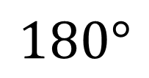
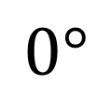
bit 0
bit 1
$$0°$$
$$180°$$
1/1000 s

