Slide 1
CHAPTER FIVE
OSCILLATIONS, WAVES AND OPTICS

Slide 2
Periodic Motion
Periodic motion is any motion that repeats on a regular time basis
Example
Rotation of a bicycle wheel
Rising of the sun and Change of the seasons
The tides and Bird songs

Slide 3
Oscillatory Motion
Is periodic
The particle oscillates back and forth about a equilibrium position.
the force always acts in a direction to restore the system to its equilibrium position.
Such a force is called a “restoring force”
Oscillators are the basic building blocks of waves.

Slide 4
Common Terminologies
Period (T(s)): the time necessary for one complete cycle (a complete repetition of the motion).
Frequency(Hz or cycle/s): the number of cycles per unit time.
Equilibrium (0): the spot the mass would come to rest when not disturbed ( F_{net} = 0.)
Displacement: (s or x): distance from equilibrium.
Amplitude: the magnitude of the maximum displacement from equilibrium position.

Slide 5
Period, T
A

Slide 6

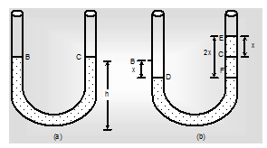
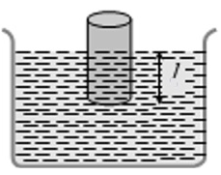
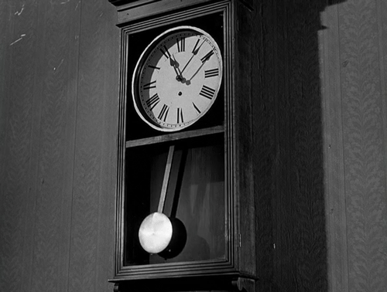

Types of oscillatory motion:
Linear oscillation and circular oscillation.

Slide 7
Oscillatory systems are of two types,
mechanical and non- mechanical systems
MECHANICAL
two things are specially responsible i.e Inertia & Restoring force.
NON- MECHANICAL
The body itself doesn't change its
position but its physical property varies periodically.

Slide 8
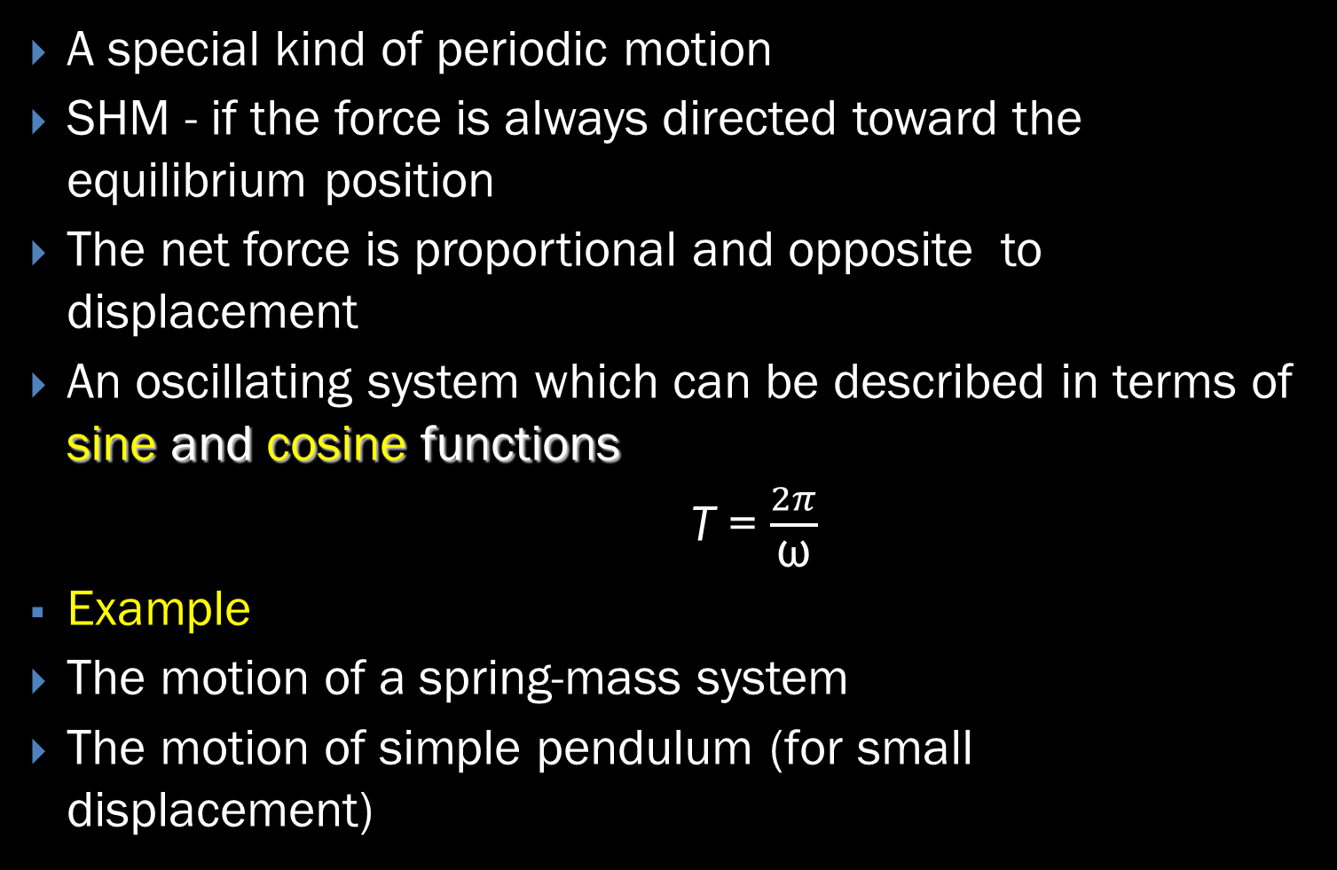
Simple Harmonic Motion
A special kind of periodic motion
SHM - if the force is always directed toward the equilibrium position
The net force is proportional and opposite to displacement
An oscillating system which can be described in terms of sine and cosine functions
T = $\frac{2π}{\text{ω}}$
Example
The motion of a spring-mass system
The motion of simple pendulum (for small displacement)

Slide 9
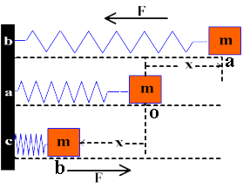
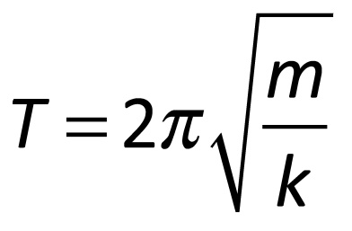
Spring-mass system
obeys Hooke’s Law

Slide 10
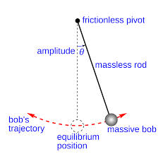
Simple Pendulum
In general, the motion of a pendulum is not SHM However, for small angles (< 10°), it becomes SHM
sin θ ≈ θ F_{t} = - mg sin θ = - mg θ
obeys Hooke’s Law

Slide 11

This shows that the period is independent of the amplitude A and the mass m
The period depends on:
the length of the pendulum, L
and the freefall acceleration, g
VERY IMPORTANT: frequency and period of oscillations DO NOT depend on the amplitude

Slide 12
Discuss, in pairs
Where is the mass moving fastest, slowest?
Where is the mass’s acceleration maximum, zero?
What forces act on the mass? When is the unbalanced force at a maximum value, zero?

Slide 13

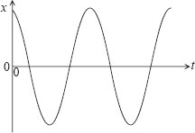
Displacement in SHM
Motion starts from equilibrium
Displacement against time
x(t) = A sin(ωt)
Motion starts from the limit of the oscillation
Displacement against time
x(t) = A cos(ωt)

Slide 14
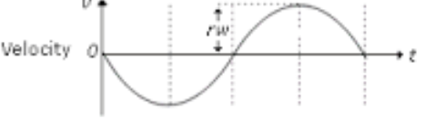

Velocity in SHM
Motion starts from equilibrium
Maximum velocity occurs at equilibrium position
Velocity against time
V(t)= ωΑ cos(ωt)
Motion starts from the limit of the oscillation
Displacement against time
V(t) = -ωΑ sin(ωt)

Slide 15
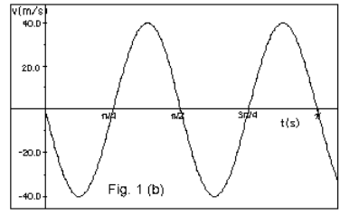
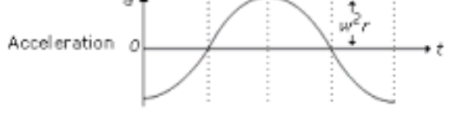

Acceleration in a SHM
Motion starts from equilibrium
Maximum acceleration is observed at x = ±A;
Displacement against time
a(t) = -$ω^{2}$A sinωt
Motion starts from the limit of the oscillation
Displacement against time
a(t) = -$ω^{2}$A cos(ωt)

Slide 16

Velocity and Displacement
V = $±ω\sqrt{A^{2}−X^{2}}$
The particle has $±$V at a single point in the path
Maximum when the object passes the equilibrium

Slide 17
Energy of the SHM
In free oscillation the total energy is constant
E = PE + KE
The kinetic energy can be found by
K = ½ mv ²
Kmax = ½ kA² - object passes the equilibrium position
The elastic potential energy can be found
U = ½ kx ²
Umax = ½ kA² - object is at the limit of oscillation
The total energy is K + U = ½ kA ²

Slide 18
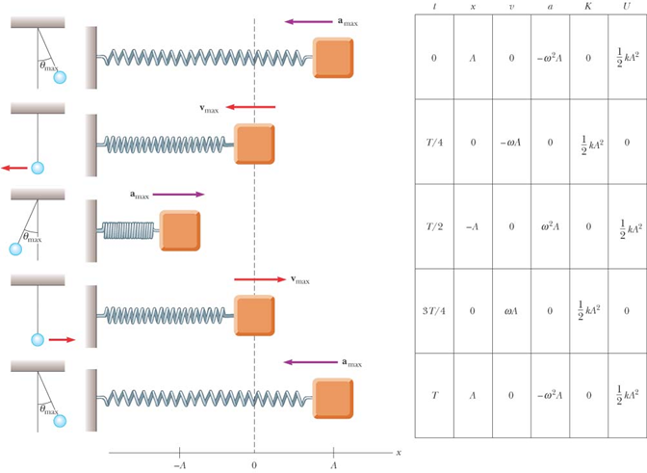

Slide 19
Wave and Its Characteristics

Slide 20
What do Waves transfer?
What are the two main types of waves?
Which type of wave requires a medium?
What are the colors of Visible Light? Which color is the HIGHEST energy wave?

Slide 21
Waves
rhythmic disturbances that carry energy through matter or space
carry energy and momentum but no material or substance is transferred outward from the source
Information can be sent via matter or waves.

Slide 23
Crest; Highest point of a transverse wave
Trough; lowest point of a transverse wave
Amplitude; The maximum vertical distance that particles vibrate from their normal position when a wave passes
measures the intensity of wave. (Loudness, brightness)
Wavelength; The distance between any two successive identical parts of a wave
Frequency; the number of full wavelengths that pass a point in a particular period of time (rate). Determines energy and color(Red is the easiest to see, violet is the hottest (most energetic)

Slide 24
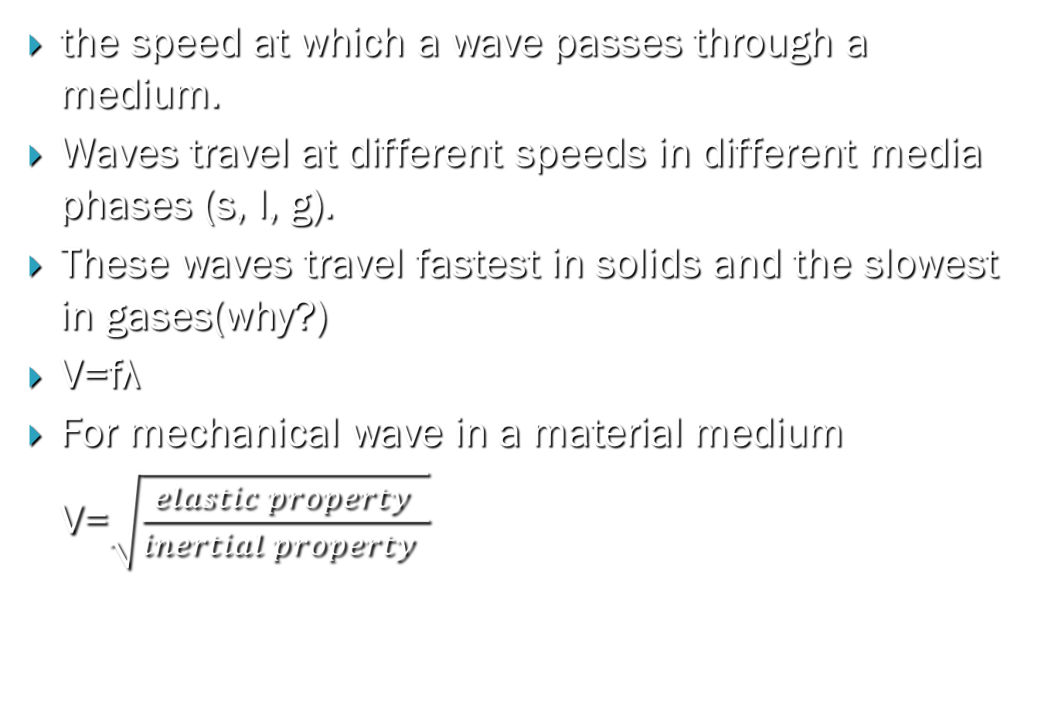
Wave Speed
the speed at which a wave passes through a medium.
Waves travel at different speeds in different media phases (s, l, g).
These waves travel fastest in solids and the slowest in gases(why?)
V=fλ
For mechanical wave in a material medium
V=$\sqrt{\frac{elastic property }{inertial property }}$

Slide 25
TYPES OF WAVES
Wave
Mechanical
Transverse
longitudinal
Electromagnetic
Transverse

Slide 26
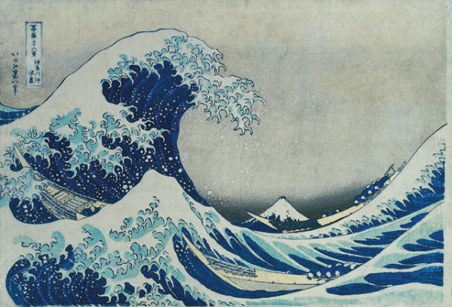
Mechanical Waves
Must travel through a material medium
Cannot travel through a vacuum
Examples: sound, ocean waves
Electromagnetic Waves
Does not require a material medium
Can be transferred through a vacuum
Examples: light, UV rays, Visible light

Slide 27
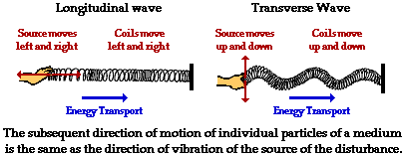
Longitudinal Transverse
medium moves in the same direction as the wave’s motion
Examples: sound waves, springs, slinky
medium vibrates perpendicular to the direction of wave motion
Examples: electromagnetic waves

Slide 28
Wave Behavior
  Reflection
  Refraction
  Diffraction
  Interference
  Doppler effect

Slide 29

Reflection
The bouncing back of a wave as it meets a surface or boundary
Normal
incident beam
reflected beam

Slide 30
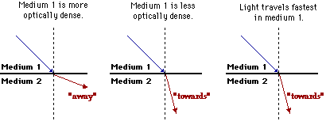
Refraction
  bending of waves when passing from one medium to another
  caused by a change in speed
    slower (more dense) ⇒ light bends toward the normal
    faster (less dense) ⇒ light bends away from the normal
SLOWER
FASTER

Slide 31
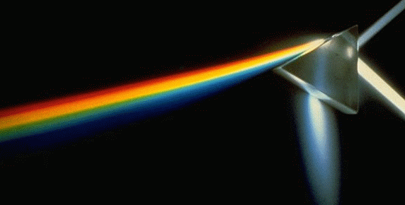
Refraction depends on…
speed of light in the medium
wavelength of the light - shorter wavelengths (blue)
bend more

Slide 32
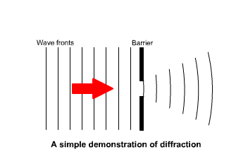
Diffraction
is the spreading of waves around a slit or an obstacle.
This effect is only significantly noticeable if the slit width is approximately the same size as the wavelength of the waves.
  longer wavelengths (red) spread more

Slide 33
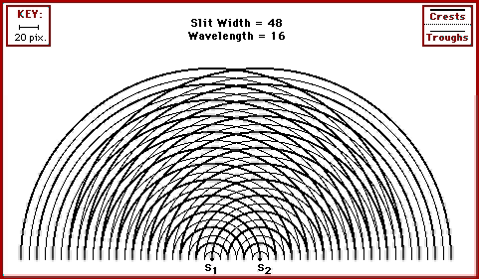
Interference
The combination of two or more waves that exist in the same place at the same time.
Once waves pass, they return to original shape

Slide 34
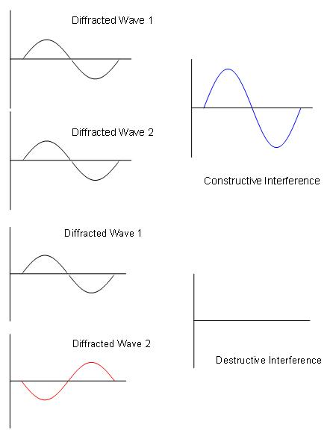
Two types of Interference
constructive ⇒ brighter light
destructive ⇒ dimmer light
Both are caused by two or more waves interacting, but…
Constructive interference combines the energies of the two waves into a greater amplitude
Destructive interference
reduces the energies of the two waves into a smaller amplitude.

Slide 35
When light waves interfere with each other, colorful displays are produced.
When two waves with different frequencies interfere with each other, beats are produced

Slide 36
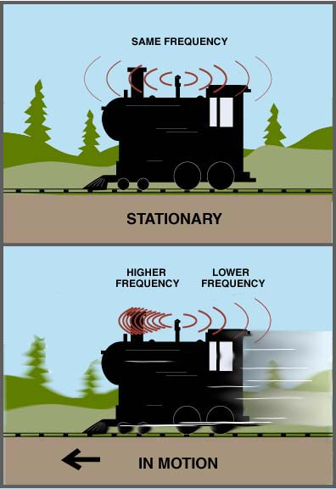
Doppler Effect
Frequency shift
The Doppler effect is the apparent change in frequency of a wave due to the motion of the source or the observer.
The observed frequency is higher when the source and observer are getting closer.
The observed frequency is lower when the source and observer are getting farther away.

Slide 37

The Doppler Effect
When the source and observer are approaching each other.
$f_{o}=f_{s} \frac{v+v_{o}}{v−v_{s}}$ The observed frequency of wave is increased
when they are receding from each other.
$f_{o}=f_{s} \frac{v−v_{o}}{v+v_{s}}$ The observed frequency of wave is decreased
Generally
$f_{o}=f_{s} \frac{v±v_{o}}{v∓v_{s}}$

Slide 38
Applications of Doppler effect
police microwave speed units
measuring the speed of a tennis ball
measuring the speed of blood flowing through an artery
monitoring the heart-beat of a developing fetus
sonar: ships & submarines to detect submerged objects
detecting distance planets
observing the motion of oscillating stars

Slide 39
Resonance
It is the phenomenon occurs When the frequency of the driving force is equal to the natural frequency
Causes dramatic increase in amplitude
This dramatic increase in the amplitude is called resonance
At resonance, the applied force is in phase with the velocity
So, the power transferred to the oscillator is maximum
Energy transferred easily

Slide 40
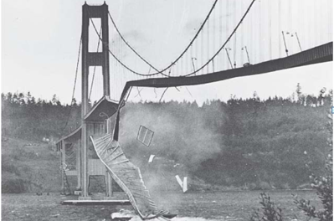
Desirable resonance:- tuning the radio, tuning musical instruments, etc
Undesirable resonance : safety of buildings, bridges, airplanes etc.
The Tacoma Narrows Bridge suffered spectacular structural
failure after absorbing too much resonant

Slide 41
Image Formation by Thin Lenses and Mirrors

Slide 42
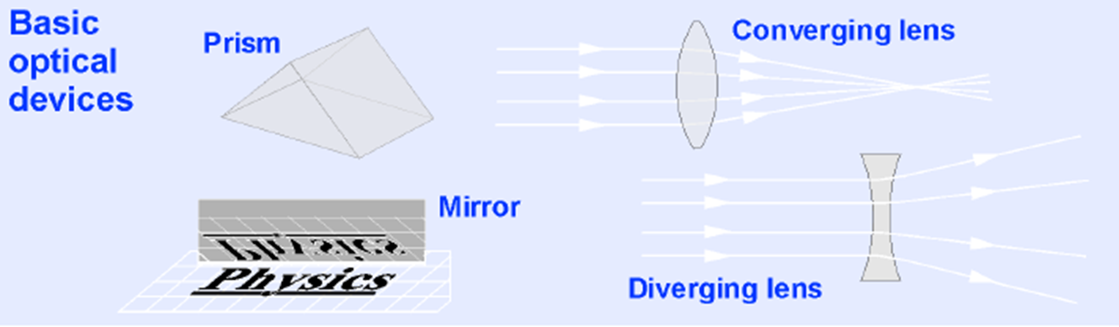
optics.
The overall study of how light behaves
The branch of optics that focuses on the creation of images is called geometric optics, because it is based on relationships between angles and lines that describe light rays.

Slide 43
Images Formed by Plane Mirrors
object
(the ray reaching your eye doesn’t really come from the image). But…. the brain thinks the ray came from the image
If light energy doesn't flow from the image, the image is "virtual".
image
virtual image

Slide 44
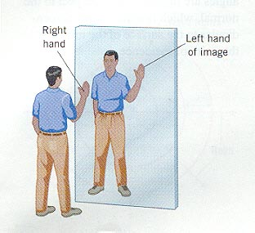
Properties of the Image Formed by a plane Mirror
The image is as far behind the mirror as the object is in front.
So= Si
The image is unmagnified.
The image is virtual.
The image is upright. It has the same orientation as the object.
There is a front-back reversal in the image.
AMBULANCE

Slide 45
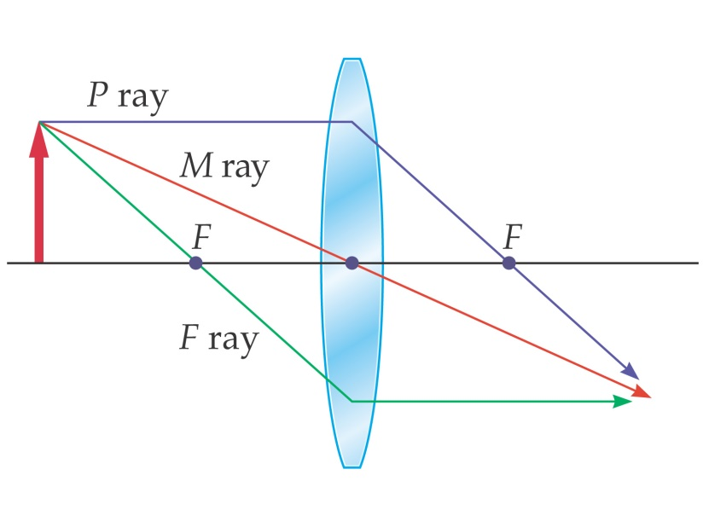
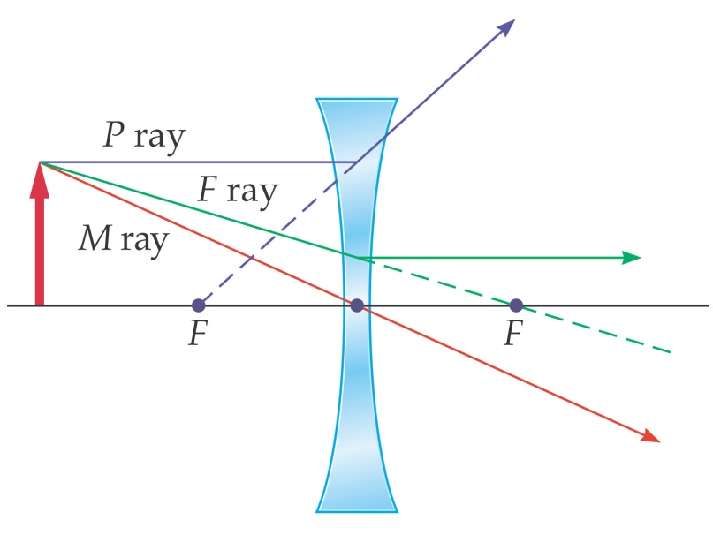
Images formed by Lenses
The three basic light rays used in ray tracing:
1. A ray which leaves the object parallel to the axis,
is refracted to pass through the focal point (P).
2. A ray which passes through the lens’s center is
un deflected (M).
3. A ray passing through the focal point (as shown)
is refracted to end up parallel to the axis (F).

Slide 46
Lenses
Lenses are commonly used to form images
by refraction
– All is a result of Snell’s law and can be derived
from that.
• Lenses are used in optical instruments
– Cameras
– Telescopes
– Microscopes

Slide 47
Images Formed by a Convex (Converging )Lens
f
2f
Object between 2f and f
2f
f
Image is inverted, real
enlarged.
f
2f
Object between f and lens
2f
f
Image is upright, virtual,
and enlarged.

Slide 48
Images Formed by a Concave Lens(Diverging )
f
2f
Object beyond 2f.
2f
f
Image is upright,
virtual, reduced.
Object between
f and lens.
f
2f
f
Image is upright,
virtual, reduced.
2f

Slide 49
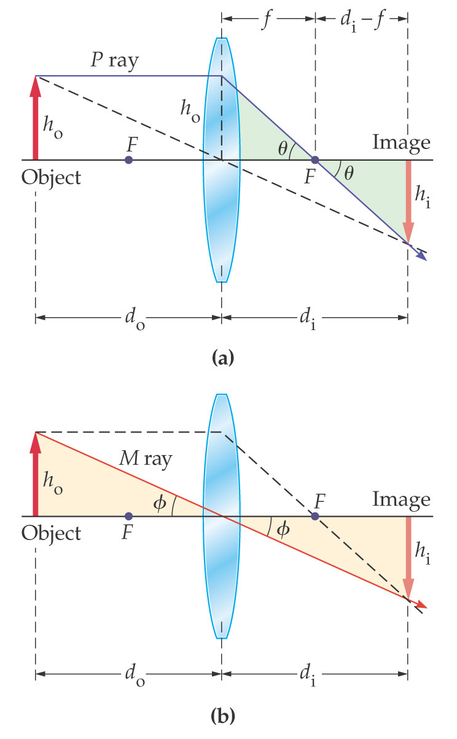
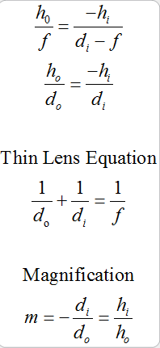
The Thin Lens Equation

Slide 50
Sign Conventions
Converging or convex lens
• focal length is positive
• image distance is positive when on the other side
of the lens (with respect to object)
• height upright is positive, inverted is negative
Diverging or concave lens
• focal length is negative
• image distance is always negative
(on the same side of the lens as the object)
• height upright is positive, inverted is negative

Slide 51
The End!.

