Slide 1
Commit-Feature Interactions
Analyzing Structural and Dataflow Relations between Commits and Features
Simon Steuer, 26.01.2024
Notes:
- Topic of my thesis are commit-feature interactions
- Specifically structural and dataflow relations of commits and features

Slide 2
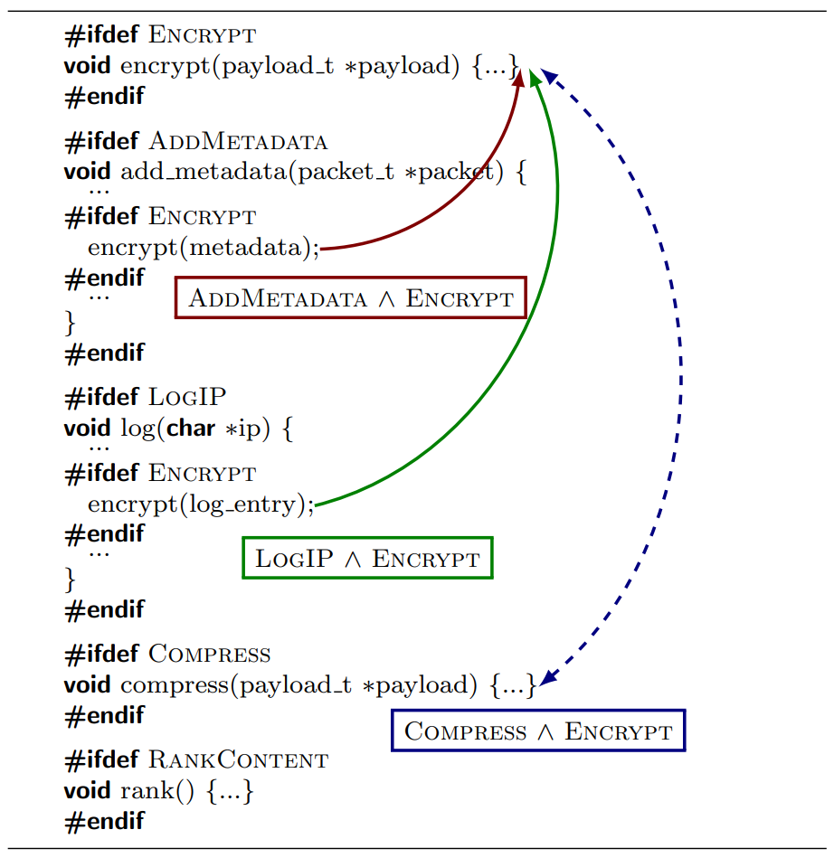
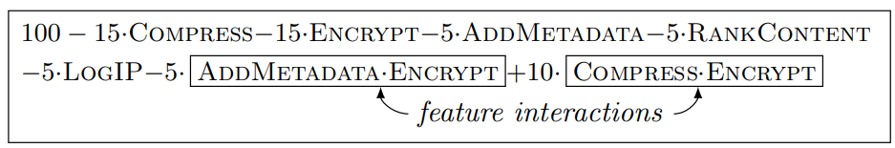
Motivation – Feature Interactions
01/22/2024
External
Internal
Performance=
predict
e.g. Performance Interactions Siegmund (2012)
control-flow
dataflow
Kolesnikov (2019)
01/22/2024
Universität des Saarlandes
Notes:
- Unlike commit-feature interactions, interactions between features have been researched for quite some time
- There are external interactions, for example performance interactions between features studied by Siegmund et al. in 2012
- They occur when the performance of a system exhibits specific increases or decreases only when a certain set of features are selected
- On the other hand, features can also interact internally inside a program
- For example through control or dataflow between the code implementing their functionality
- Previous studies by Kolesnikov et al. used these internal interactions to help predict external interactions between features

Slide 3
Motivation
01/22/2024
Configurable Program
{
Commit 2
→ Dataflow-based CFI
→ Seemingly unrelated commits still connected with features
DF
{
{
FeatureA
Commit 1
→ Structural commit-feature interaction (CFI)
→ Involvement in implementing features
01/22/2024
Universität des Saarlandes
Notes:
- As we have seen for internal feature interactions, we can assign code the feature it belongs to inside a configurable program
- In modern software projects, commits are used to iteratively update the project, thus a commit can also add or change code of features
- We call such an occurrence a structural commit-feature interaction (CFI), giving us information about the involvement of a commit in implementing a feature
- However, there also exist commits not directly affecting feature-code
- They can still change or add data that is later used inside a feature, making them connected via dataflow
- We call this occurence a dataflow-based CFI between the respective commit and feature
- They can show us seemingly unrelated commits that still affect the functionality features

Slide 4
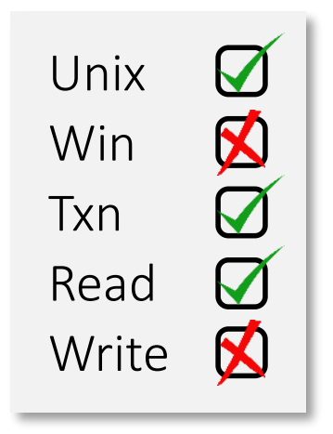

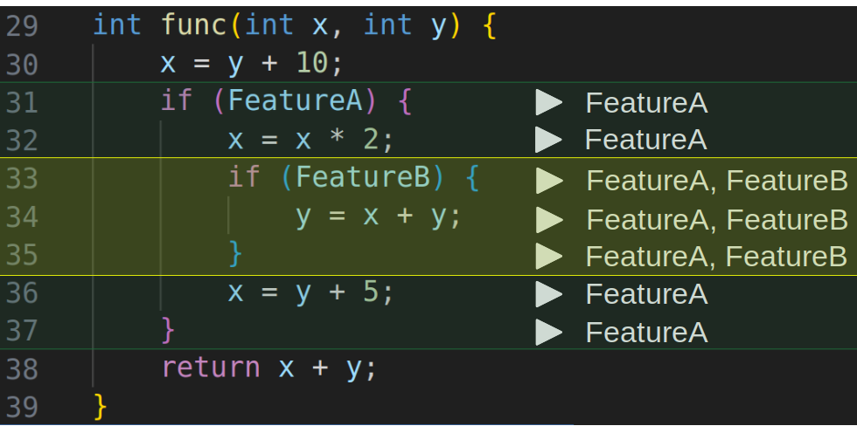
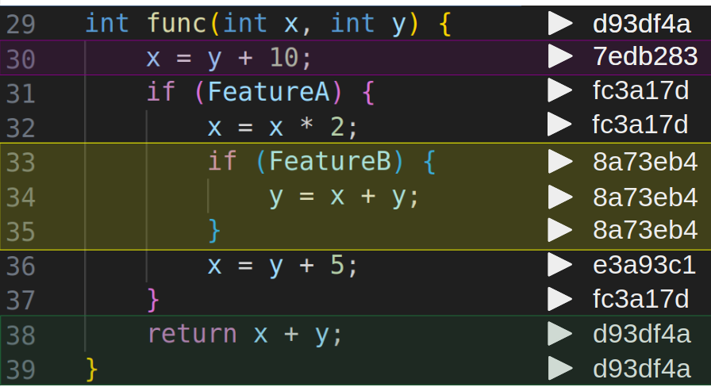
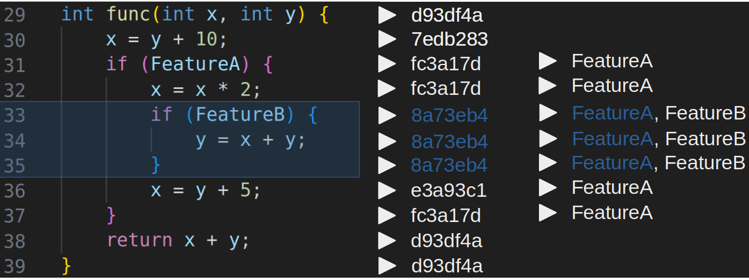

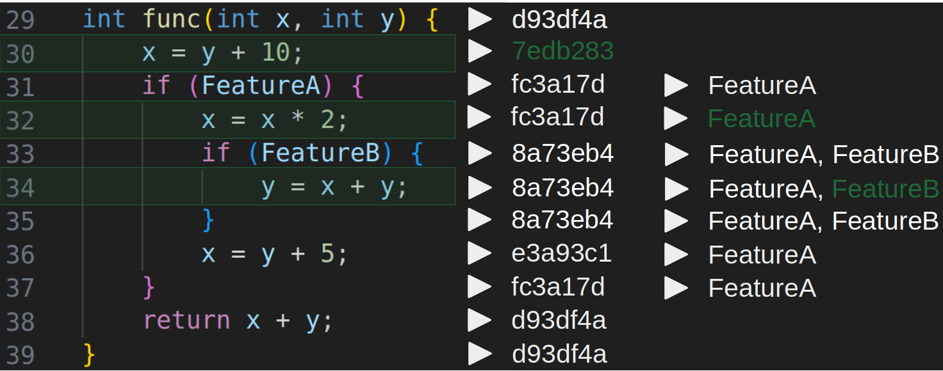
Implementation
Features
Commits
represented by
Feature Regions
Commit Regions
Structural CFIs
Dataflow-based CFIs
detected by
Overlap
Dataflow
between
CRs and FRs
from
CRs to FRs
01/22/2024
Universität des Saarlandes
Notes:
- In our work, the concrete representations of features and commits are called feature and commit regions
- We assign code to a feature if its execution depends on the feature’s respective config variablae
- Regarding commit regions, we assign a commit to a source-code line if the commit last changed or added said line
- We use the analysis framework to detect these regions inside a program
- This directly allows us to collect Structural CFIs when we encounter overlapping commit and feature regions
- VaRA is also able to compute dataflow between regions, which means that by looking for dataflow from commit to feature regions, we can compute dataflow-based CFIs

Slide 5
Research Questions
01/22/2024
RQ1: How do commits and features structurally interact with each other?
RQ2: How do commits interact with features through dataflow?
RQ3: How do authors interact with features?
01/22/2024
Universität des Saarlandes
Notes:
- In total we pose 3 RQs, where we investigate structural CFIs in RQ1
- In the second RQ, we examine how commits interact with features through dataflow, whereas in the third RQ we link commits to their authors in the previously examined CFIs
- This can tell us how authors interact with features

Slide 6
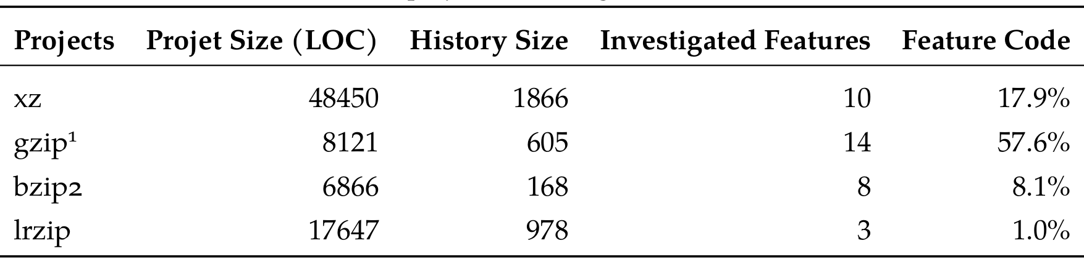
Operationalization
01/22/2024
Examine four real world software projects
Compression tools
Relatively small project and history size
01/22/2024
Universität des Saarlandes
Notes:
- For our thesis, we examine four real world software projctes
- All of them are of a compression domain, which is rather by coincident than by choice, as these were the only projects fit for investigation for our use-case in VaRA
- The projects are xz, gzip, bzip2 and lrzip
- Their project and history size are relatively small compared to related studies
- The number of investigated features varies quite a bit, where the small number of features in lrzip has to with the fact that we could not detect feature regions for all features and therefore had to leave the respective features out
- The determined extent of feature-code is therefore the lowest in lrzip with 1% and the highest in gzip with 57%

Slide 7
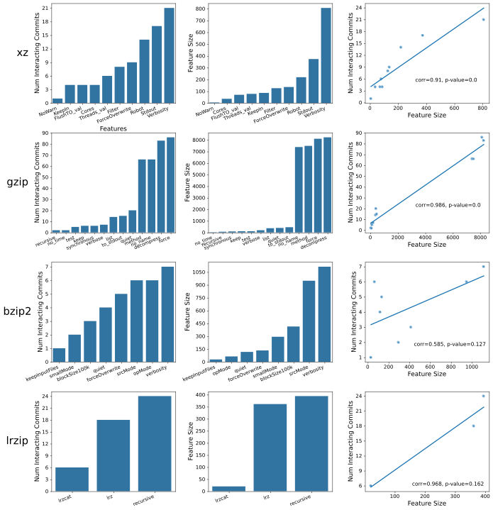
RQ1: Insights into Feature Development
01/22/2024
Wide range of implementing commits and feature size
Feature size strong predictor of implementing commits in a project
01/22/2024
Universität des Saarlandes
Notes:
- In the first part of RQ1, we focus on the development process of features
- The first plot shows us the number of structurally interacting commits for each feature of a project, meaning the commits that implement a feature
- We can see that the number of implementing commits varies greatly between the features in a project
- The same is true for the second plot where we display the different feature sizes
- We define the size of a feature as the number of IR instructions that belong to its regions as measure of the amount of code needed for its functionality and as a measure to compare features with each other
- We also compare the number of commits struct. Interacting with a feature and its size with each other, which we find to be strongly positively correlated with very low p-values giving us strong confidence for significant correlation
- As for the two other projects bzip2 and lrzip, we find similar results to xz and gzip, but due to them having less features and thus less datapoints their correlations have high p-values
- Still, we find that...

Slide 8
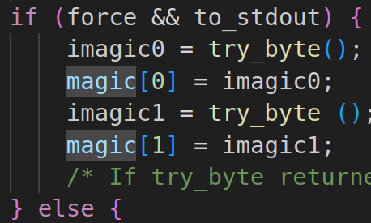
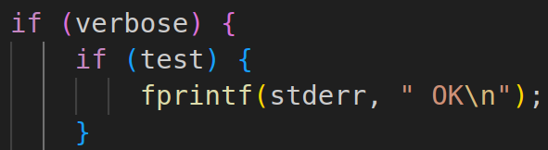
RQ1: Usage of commits in feature development
01/22/2024
Focus on the number of feature-related concerns a commit deals with, instead of the number of features a commit changes
As long as a commit affects code belonging to the same set of features, the commit only deals with one concern
More accurately reflects a commit’s usage in the case of:
- Feature Nesting
- Feature Interplay
Examples:
    → 1 concern
    → 2 CFIs
01/22/2024
Universität des Saarlandes
Notes:
- Coming to the second part of RQ1, we now investigate the usage of commits in feature development
- While we could simply examine the number of features a commit structurally interacts with, we decide to examine the number of feature-related concerns a commit deals with
- Here, we say that…
- We argue that this measure reflects a commit’s usage more accurately, especially when regions of different features overlap
- Like in the case of feature nesting, when for example in gzip the test feature is nested inside the verbose feature
- When a commit changes only the code framed in red, the commit has a single feature-related concerns, as it affects belonging to the same set of feature regions, but structurally interactions with two features
- This is also applies in the case of feature interplay, when a commit introduces code implementing the interplay of multiple features, in our example of the force and to_stdout features

Slide 9
RQ1: Usage of commits in feature development
01/22/2024
Best practices surrounding commits
Commits should usually deal with a single responsibility
Applies to commits affecting feature-code as well
Commits should only have one feature-related concern
01/22/2024
Universität des Saarlandes
Notes:
- The usage of commits in feature dev. is especially interesting when taking into account best practices surrounding commits
- …
- We use the number of feature-related concern as a measure for the number of responsibilities a commit deals with in relation to features

Slide 10
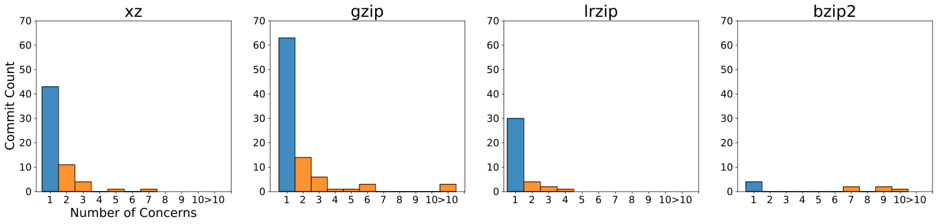
RQ1: Usage of commits in feature development
01/22/2024
Import project to Git
Update to newer versions
→ not representative
    > 69% of commits
→ Most commits only deal with a single responsibility
→ Best practice of feature development largely enforced in examined projects
01/22/2024
Universität des Saarlandes
Notes:
- We plot the distribution of the number of concerns commits have for all commits structurally interacting with features in a project
- For xz, gzip and lrzip we recognize similar distributions.
- In contrast to this, bzip2 only encompasses very few commits, which are also distributed differently
- That is because most of them were used to import the project to Git and then update it to newer versions
- We therefore argue that they are not representative of the common usage of commit
- For the three other projects however, we see that the vast majority of commits only have a single feature-related concerns, at least 69%
- We see this as strong evidence that most commits only deal with a single responsibility...

Slide 11
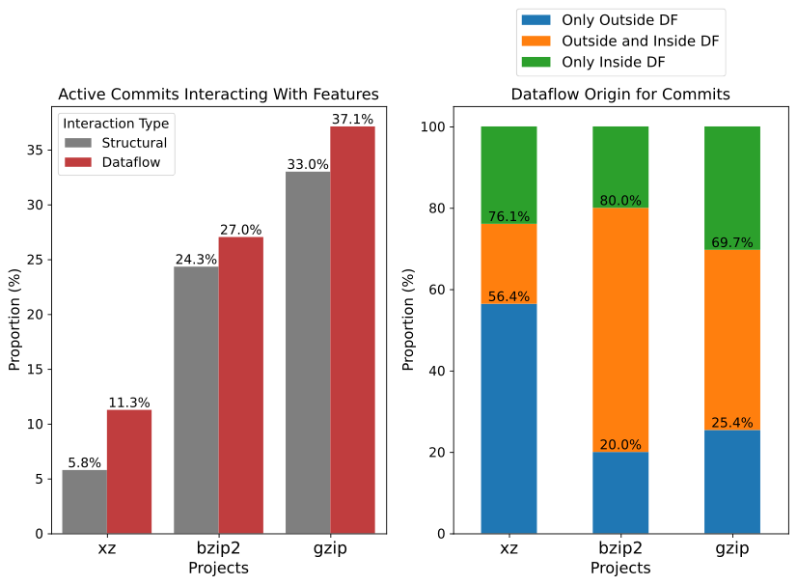
RQ2: Commit Side – Proportion and Dependencies
Only consider active commits
→ Still represented by commit regions
→ Required to be part of any CFI
Likelihood for commit to be part of DF-based CFI given that it is part of structural CFI: 88-100%
Wide range
Lower bound
01/22/2024
Universität des Saarlandes
Notes:
- In RQ2, we investigate dataflow-based CFIs, where we first focus on the commit side of these interactions
- We first determine the proportion of commits affecting features through dataflow in a project
- We only consider so called active commits here, namely comits that are represented by commit regions inside a program, as this is necessary for them to be part of any CFI
- In this plot we show the proportion of commits with dataflow interactions in a red bar for each project
- We see a wide range of proportions from 11% in xz to gzip in 37% showing us that such commits can be rather common
- Here it is important to be aware of the fact that a commit that already structurally interacts with features has a very high likelihood to be part of a dataflow-based CFI as well
- We can therefore say that the commits part of structural interactions shown in the grey bar form a lower bound for the commits part of dataflow interactiosn

Slide 12
RQ2: Dataflow Origin - Outside vs Inside
01/22/2024
{
Commit 2
→ Located outside of feature
→ Outside dataflow origin
→ Can only be discovered through dataflow analysis
DF
{
{
FeatureA
Commit 1
→ Located inside of feature
→ Inside dataflow origin
→ Already discovered by
previous structural analysis
DF
01/22/2024
Universität des Saarlandes
Notes:
- Another important concept regarding dataflow-based CFIs is the origin of said dataflow
- On the one hand a commit can be…
- On the other hand, a commit can be fully located outside..

Slide 13
RQ2: Commit Side: Dataflow Origin
Every category with significant proportions
Surprisingly high percentage of commits with outside and inside DF
More than 69% of commits have outside DF origins
→ Dataflow analysis discovers unique interactions for the majority of commits i

Slide 14
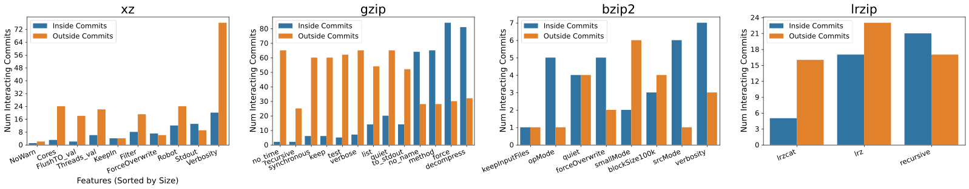
RQ2: Feature Side – Distribution of Outside/Inside Commits
01/22/2024
Generally: More outside than inside commits that affect a feature via DF
→ underlines importance of DF analysis
However: ~50% of outside commits part of other features
→ Commits part of other features have a 2.6 – 4.8x higher likelihood to affect features through outside dataflow than any active commit
01/22/2024
Universität des Saarlandes
Notes:
- In the second part of RQ2, we focus on the feature side of dataflow interactions
- Here, we show the distribution of the number of commits affecting a feature through dataflow and differentiate between features that are located inside or outside of the feature they interact with
- Outside commits are shown in the orange bar and inside commits in the blue bar for each feature
- Except for bzip2, we see that features in a project are generally affected by more outside than inside commits
- This underlines the importance of a DF analysis, as we know that inside commits are also the features structurally interacting with features meaning that a dataflow analysis uniquely discovers the majority of commits interacting with features
- Interestingly, we determined that around half of all outside commits are part of other features, which implies that a lot of the examined dataflow stems from other features indicating that features can be strongly connected
This also means that commits ...

Slide 15
RQ3: Types of Authors
{
Commit 2
→ Outside DF Author
Do developers that implement a feature also author such outside commits?
Can our dataflow analysis discover many unique interacting authors?
DF
{
{
FeatureA
Commit 1
→ Structural Author
01/22/2024
Universität des Saarlandes
Notes:
- In the last RQ, we investigate how authors interact with features, specifically according to two types
- From commits structurally interacting with a feature, we can extract the authors that implement a feature
- Then we also look at commits affecting a feature through outside dataflow in order to determine the authors that are not directly related in the implementation of a feature, but whose changes still affect its functionality
- Here, it is especially interesting to check whether the developers implementing a feature are also the ones introducing these outside commits and whether our dataflow analysis can discover many unique interacting authors

Slide 16
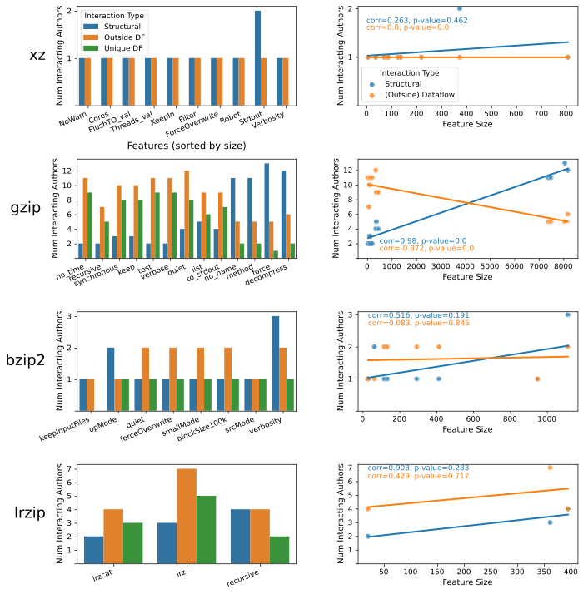
RQ3: Distribution of Authors
01/22/2024
Distributions of structural /outside DF authors are very similar to distributions of structural/outside DF commits
01/22/2024
Universität des Saarlandes
Notes:
- So… as a head off… we do not include or show the project xz in RQ3, because the project itself and its features are almost entirely implemented by a single author, meaning that its features also interact with one and the same authors
- For the other projects, we show the distribution of structural in blue and outside DF authors in orange for each feature
- We note that the distributions are very similar to previously shown distributions of structural and outside DF commits, which is not surprising given that we extract the respective authors of a feature from its interacting commits

Slide 17
RQ3: Distribution of Authors
01/22/2024
Significant number of unique DF authors, often heavily exceeding number of implementing authors
~½ of authors that implement a feature introduce commits affecting them via outside DF
01/22/2024
Universität des Saarlandes
Notes:
- In the green bar, we display the number of unique DF authors that interact with a feature exclusively through dataflow
- There is a significant number of unique DF authors often exceeding the number of implementing underlining that a dataflow analysis is also essential to discover all authors influencing the functionality of a feature
- Besides that, we determine that the developers implementing a feature are likely but do not always author commits affecting them via outside dataflow with a likelihood of about 50% on average

Slide 18
Structural CFIs
DF-based CFIs
Author-Feature
Interactions
RQ1
RQ2
RQ3
>69% in:
xz
gzip
lrzip
Lower bound
DF analysis
is essential for a complete overview of CFIs
Project choice to be improved
01/22/2024
Universität des Saarlandes
Notes:
- Lastly, I summarize the most important results from this presentation and my thesis
- We investigate two types of commit-feature interactions, structural and datfaflow-based CFIs
- Structural CFIs are examined in RQ1, where we derived a best practice for commits in feature development, namely that they should only deal with a single feature-related concern, which we find enforced for most commits in the examined projects
- We also find that there is a wide range in the number implementing commits between the features of a project, where the size of a feature is a strong predictor
- Dataflow-based CFIs are then examined in RQ2, where we first focus on the commit side of dataflow interactions
- We find that the proportion of commits affecting features through dataflow varies a lot and can be rather common depending on the project
- The proportion of commits structurally interacting with features plays an important role here, as it can be considered as a lower bound
- That is because structural and datflow-based CFIs heavily coincide with each other
- We also investigate the number of commits affecting features through dataflow, where we find that majority of them are located outside of the feature they interact with
- Overall we find strong evidence that a dataflow analysis is essential for a complete overview of how commits and features interact with each other

Slide 19
Commit-Feature Interactions
Analyzing Structural and Dataflow Relations between Commits and Features
Simon Steuer, 26.01.2024

Slide 20
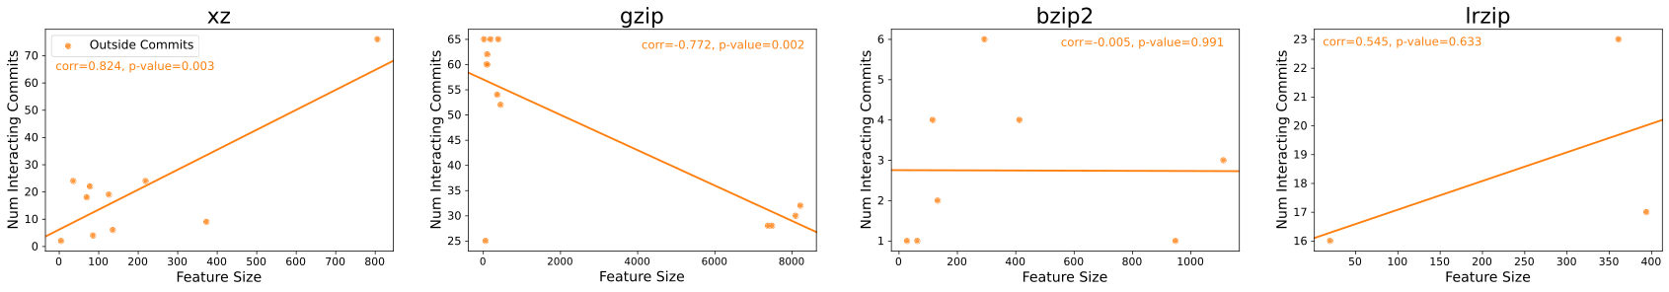
RQ2: Dataflow-based CFIs – Appendix
01/22/2024
2) Feature side: Relating outside commits to feature size
No trend for outside commits among the projects
→ Other properties of features to consider?
Two clusters in gzip
- Features of similar size have similar number and set of outside commits
→ Cause: High degree of feature overlap
01/22/2024
Universität des Saarlandes
Notes:
in the last RQ we show how we can enrich CFI-data by, for example linking commits to their authors, providing us with more information

