Slide 1
Commit-Feature Interactions
Analyzing Structural and Dataflow Relations between Commits and Features
Simon Steuer, 22.09.2023
Notes:
Topic of this presentation are commit-feature interactions
Specifically structural and dataflow relations of commits and features

Slide 2
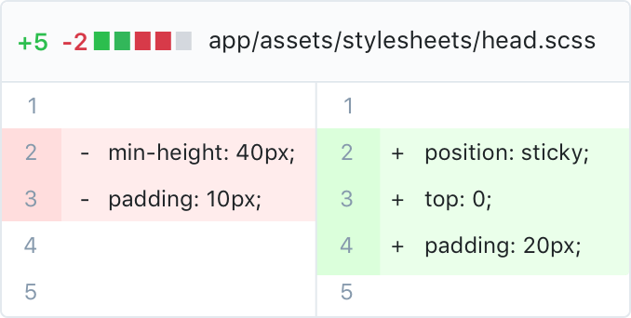
Motivation
Commits are an essential part of software development
Represent the latest source-code changes
in a repository
Used to incrementally built software applications
and its components
Notes:
first of I want to give a quick overview of commits and features
and motivate how they can interact with each other
commits are an essential of developing software in a git repository
where they are used to contribute the latest source-code changes
there they incrementally built the application and its components

Slide 3
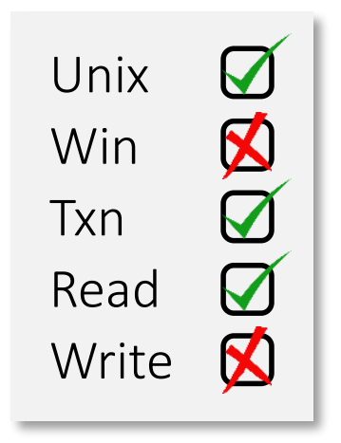
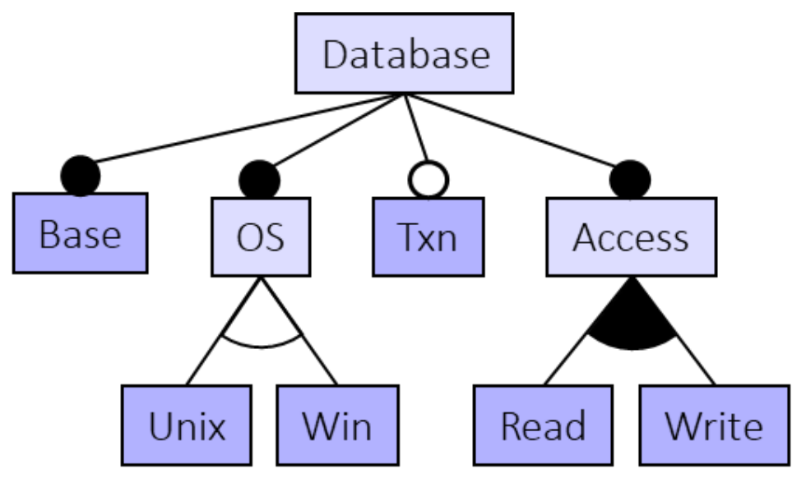
Motivation
Features play an important role in many software applications
Used to implement specific functionalities
Can be turned on or off, adding configurability
Notes:
one such compoment are features, which play an important role in many software applications
by implementing specific functionalities, such as the read and write features of a database
as they can be activated or deactivated they make applications configurable
which is shown in feature models, which also highlight the dependencies among features

Slide 4
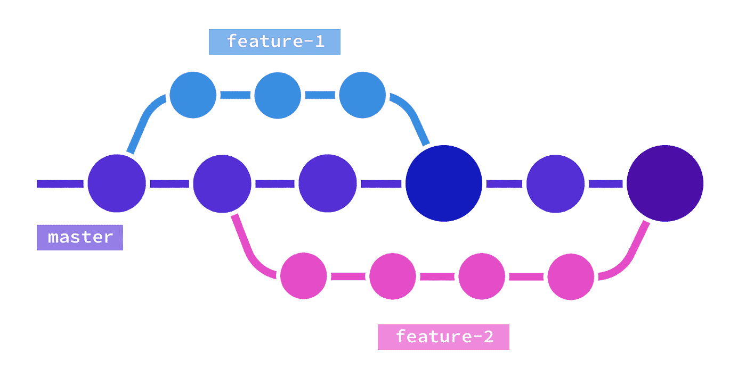
Motivation
Certain source code segments of a program
implement a feature
→ Features are also incrementally built by commits
→ Commit-Feature Interactions (CFIs) can give insights into feature development
Notes:
the functionality of features is implemented by certain code segments inside a program
and since commits were used to introduce this code
we can say that features are also incrementally by a set of commits as is shown on the right
this means that commit-feature interactions, specifically structural CFIs
can provide insights into feature developments

Slide 5
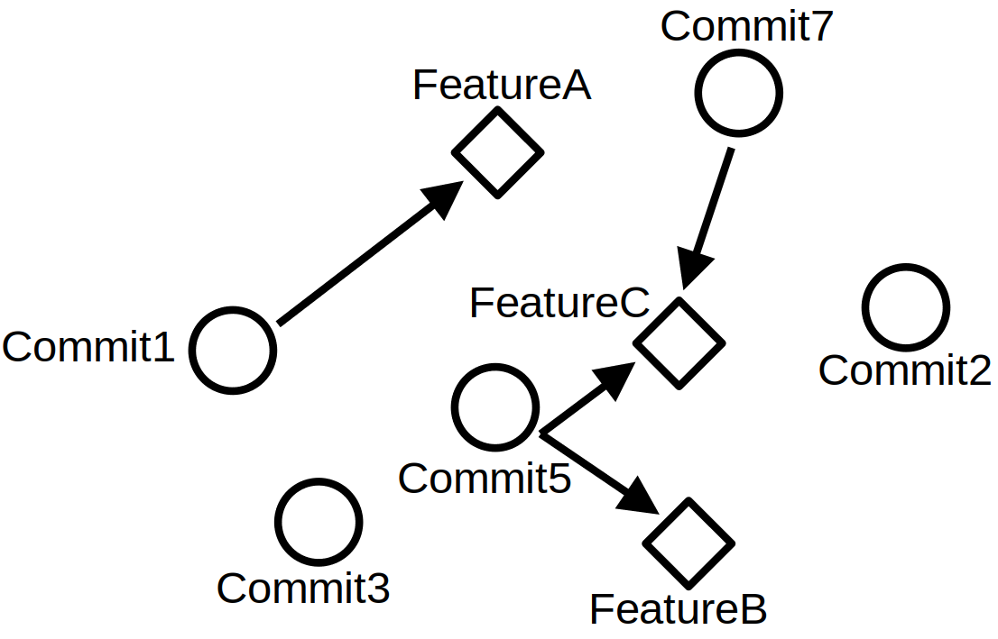
Motivation
Still, there are commits not changing/adding
source-code of any feature
Can still change/add data that is later used
inside a feature
→ Dataflow CFIs can show how connected
seemingly unrelated commits and features are
Notes:
still, there are commits that don't contribute source-code to a feature
the data changed or added by these commits can still be used inside a feature
thus influencing it through dataflow
these dataflow cfis can show how connected seemingly unrelated commits and features are

Slide 6
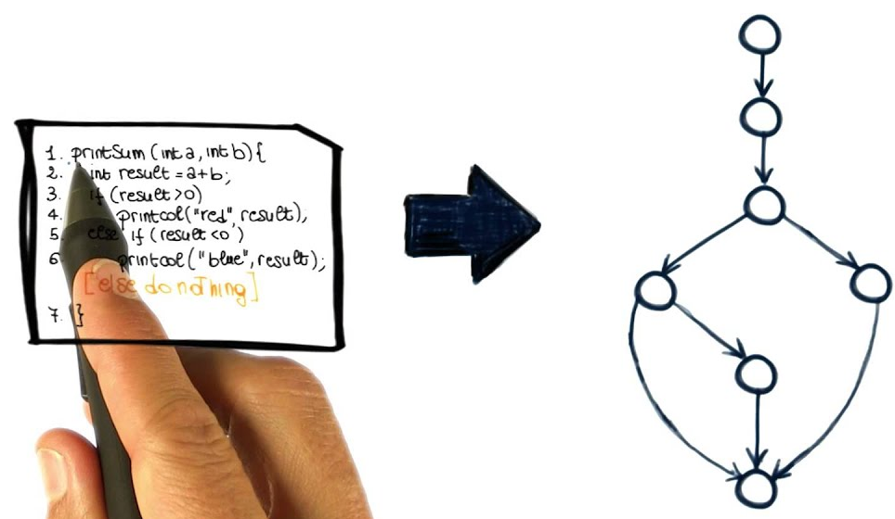
Background – Code Regions
01/15/2024
Consist of source-code consecutive in their control flow
Represent abstract entities of a software project, such as
commits and features
→ Commit and feature regions
Commit Region 1
Feature
Region A
01/15/2024
Universität des Saarlandes
Notes:
an essential aspect of defining and detecting CFIs and other types of interactions are code regions
each code region consists of consecutive source and represents some abstract entity of a software project
in our case commits and features, such that we divide code regions into commit and feature regions

Slide 7
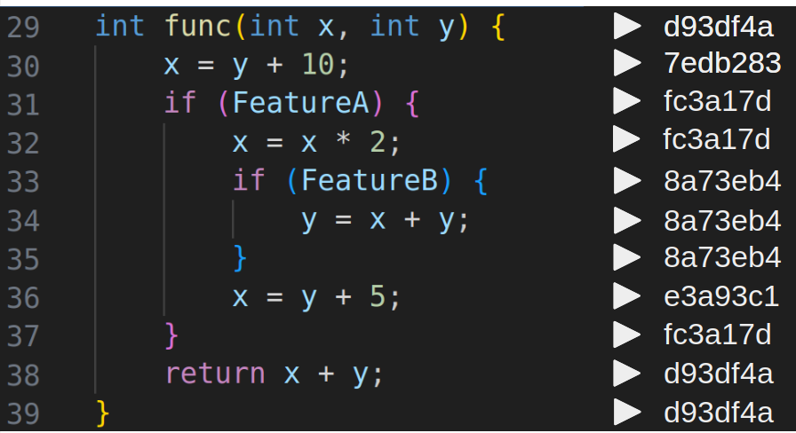
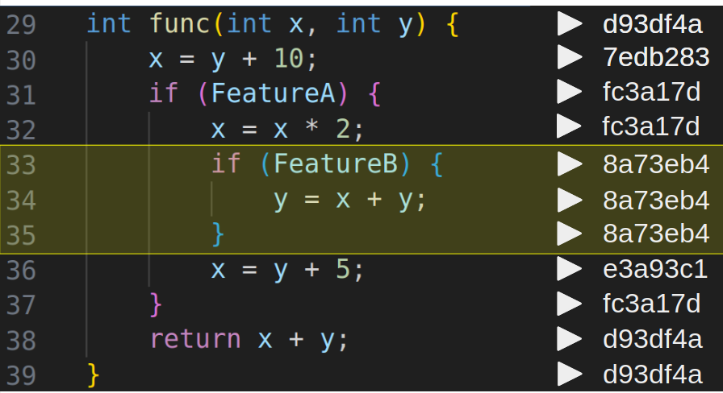
Background – Commit Regions (CRs)
01/15/2024
We say: a source code line belongs to a commit, if it
was last changed/added by said commit
01/15/2024
Universität des Saarlandes
Notes:
to define commit regions we first have to assign each soure-code line a commit
which is just the last commit that changed or added it
for a quick example for commit regions we can look at this code snippet
there, lines 33-35 are consecutive in their program flow and last changed by commit 8a73eb4
it follows that they from a commit region belonging to this commit

Slide 8
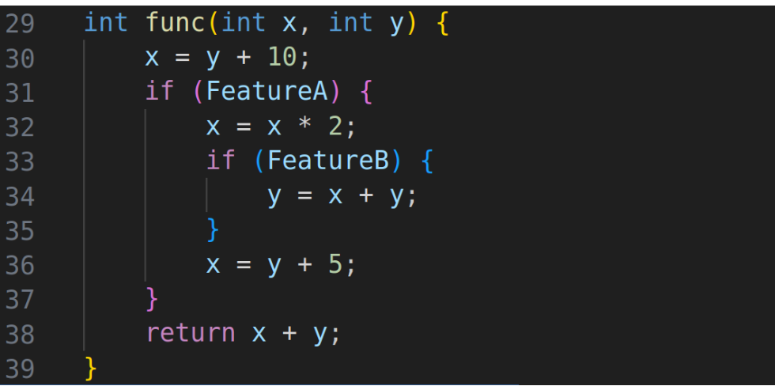
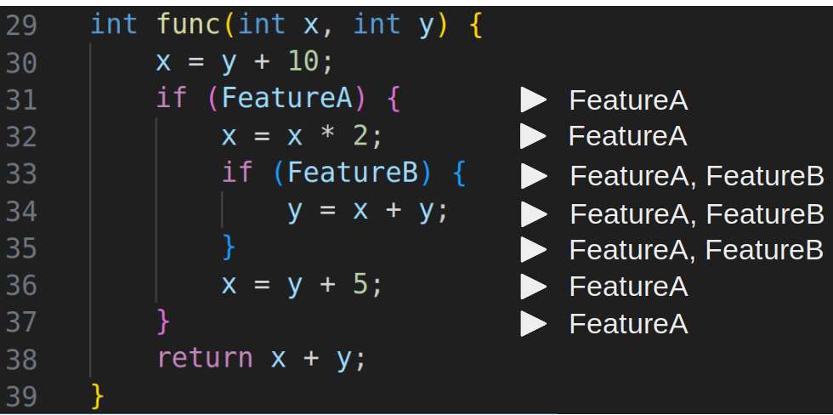
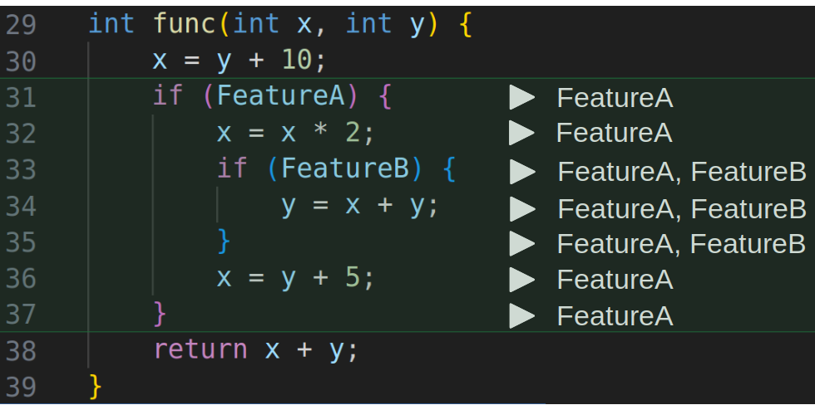
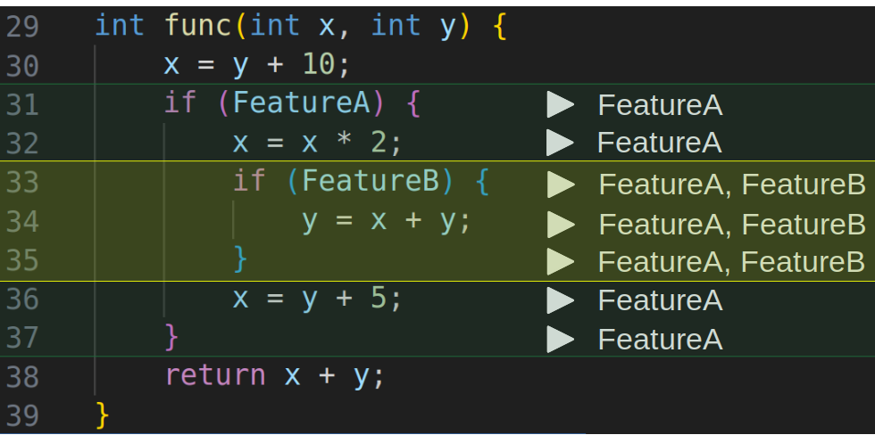
Background – Feature Regions (FRs)
01/15/2024
Only consider features implemented via configuration variables
Code belongs to a feature if its execution depends on the feature’s
configuration variable
01/15/2024
Universität des Saarlandes
Notes:
in this work we only consider features that are implemented via configuration variables
they also allow us to assign source-code lines to features
where we say that code belongs to a feature if its execution depends on the feature's config variable
in the code snippet we can assign source-code lines the following features
allowing us to define two feature-regions, one for FeatureA and for FeatureB

Slide 9
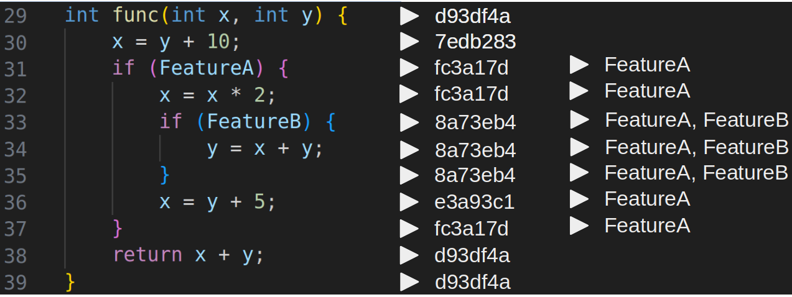
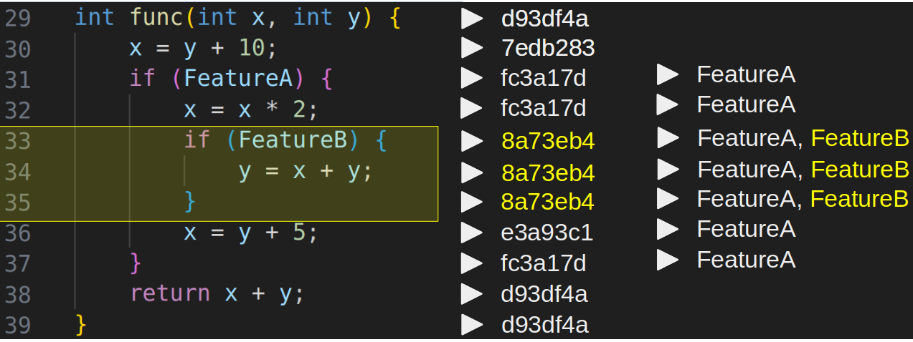
Commit-Feature Interactions
01/15/2024
Structural Interactions between commits and features occur when their regions overlap
Commit was used to implement functionality of the feature
01/15/2024
Universität des Saarlandes
Notes:
we already mentioned that structural interactions between commits and features occur
when there exists source-code that was contributed by a commit and implements a feature
well, that is the case when their respective regions overlap
in this code snippet we already specified commit region of commit 8a73eb4 and the feature region of FeatureB
where we can see that they overlap meaning that the commit and FeatureB structurally interact
logically, the commit of the structural interaction was used to implement functionality of the feature

Slide 10
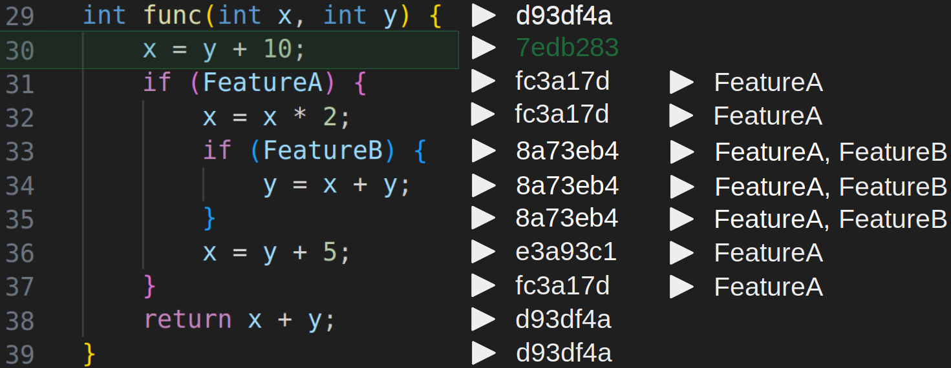
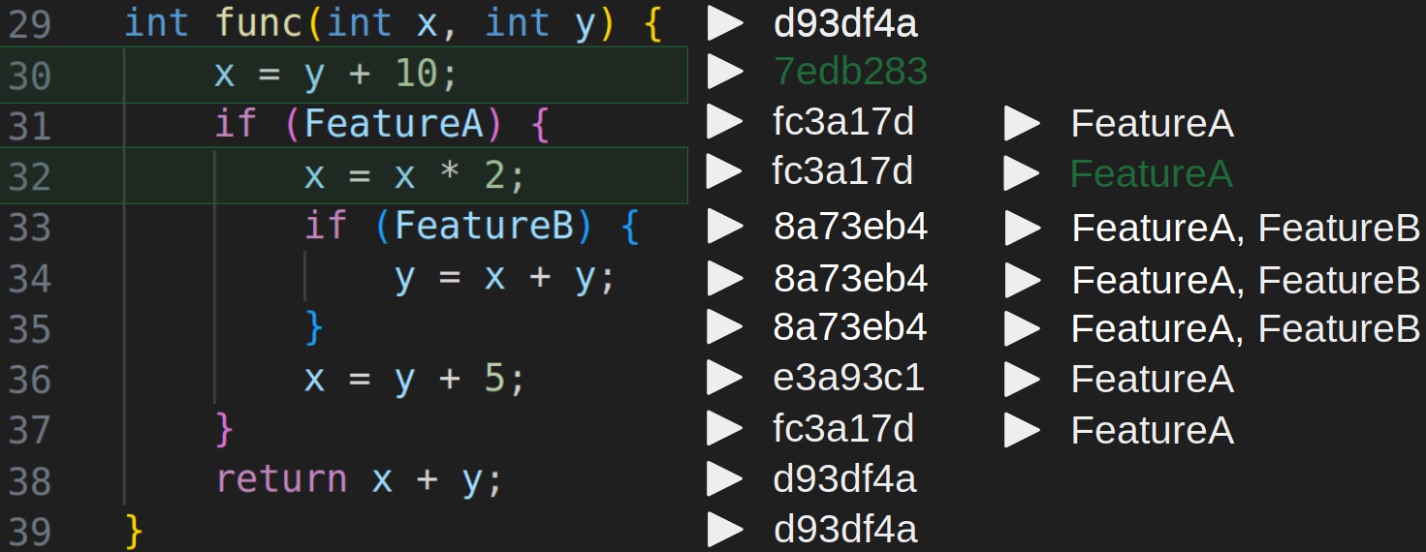
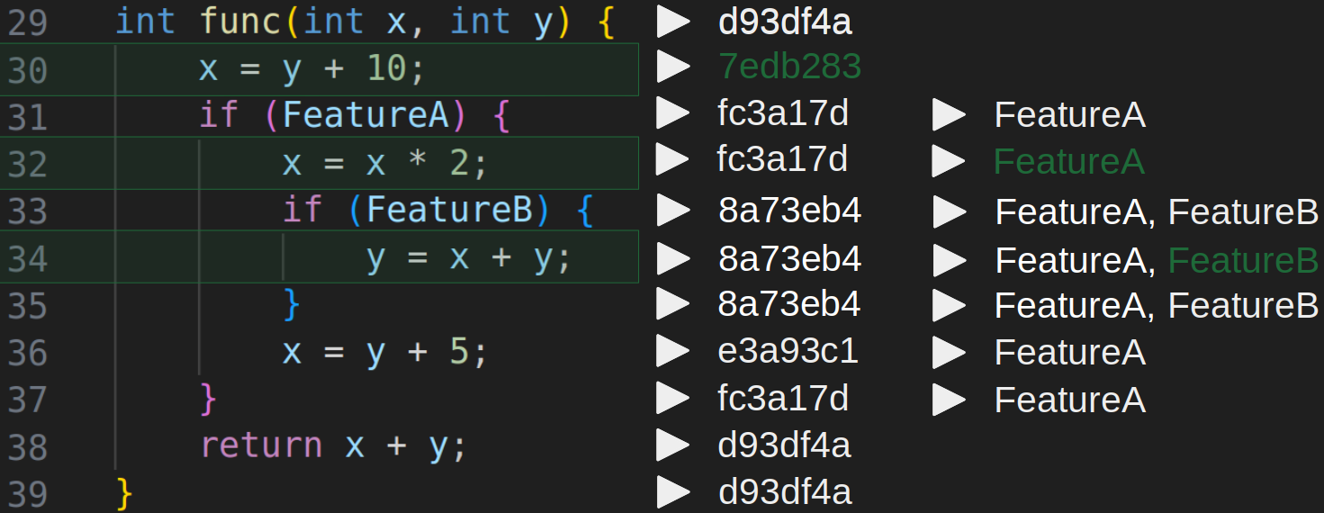
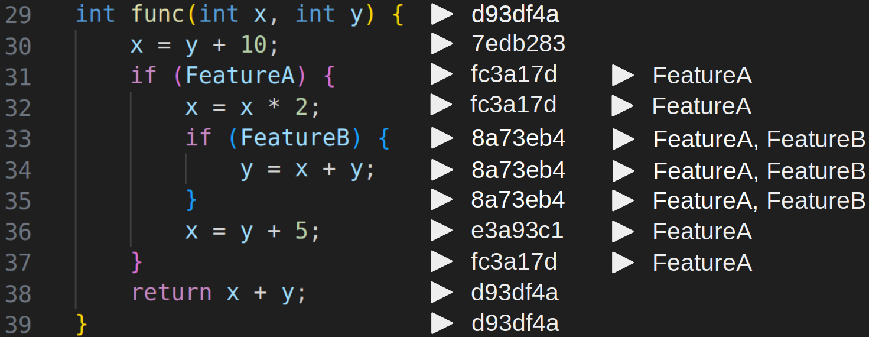
Commit-Feature Interactions
01/15/2024
Dataflow interactions occur when data flows as input from a commit to a feature region
Structural CFIs often coincide with dataflow CFIs
01/15/2024
Universität des Saarlandes
Notes:
we also talked about dataflow CFIs interactions that occur
when data changed by a commit is used inside a feature
this can be matched to data flow from a commit to a feature region
again, we can find an example for it in this code snippet,
where the variable x is changed inside commit region of commit 7edb283
and is used as input in line 32 part of feature region of FeatureA
as well as in line 34 that belong to FeatureB
thus the commit interacts with FeatureA and FeatureB through dataflow
Having defined both structural and dataflow-based CFIs, it’s important to note that structural CFIs often coincide with dataflow CFIs
Which we will take into account for our research questions

Slide 11

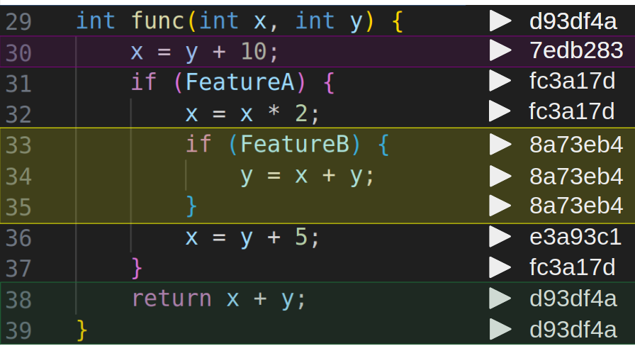
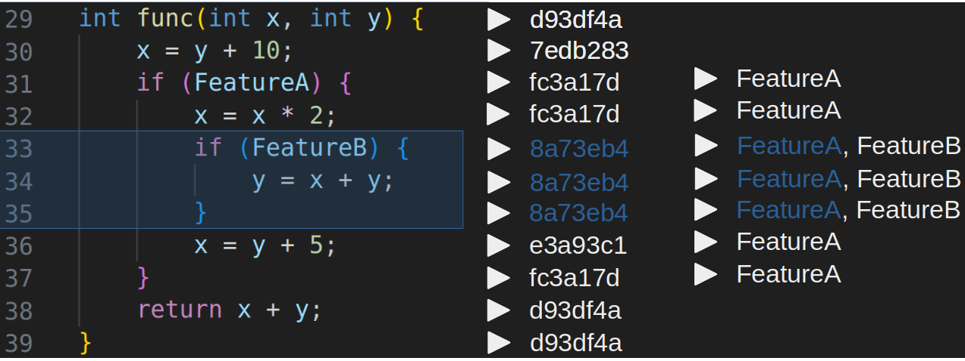

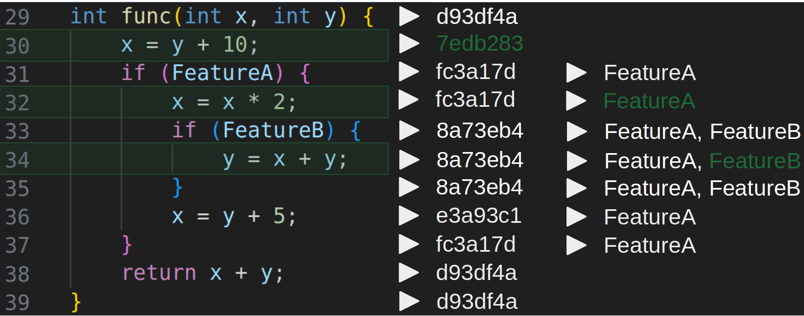
Features
Commits
represented by
Feature Regions
Commit Regions
Structural CFIs
Dataflow CFIs
detected by
Overlap
Dataflow
between
CRs and FRs
from
CRs to FRs
01/15/2024
Universität des Saarlandes
Notes:
we have talked about what commits and features are and how they are represented by feature and commit regions
we use the interaction analysis tool VaRA to automatically detect them inside a program
this already allows us to collect the structural CFIs of a software project through overlaping CRs and FRs
VaRA is also able to detect datflow between code regions, which allows us collect dataflow-based CFIs
by focusing on dataflow from commit regions to feature regions

Slide 12
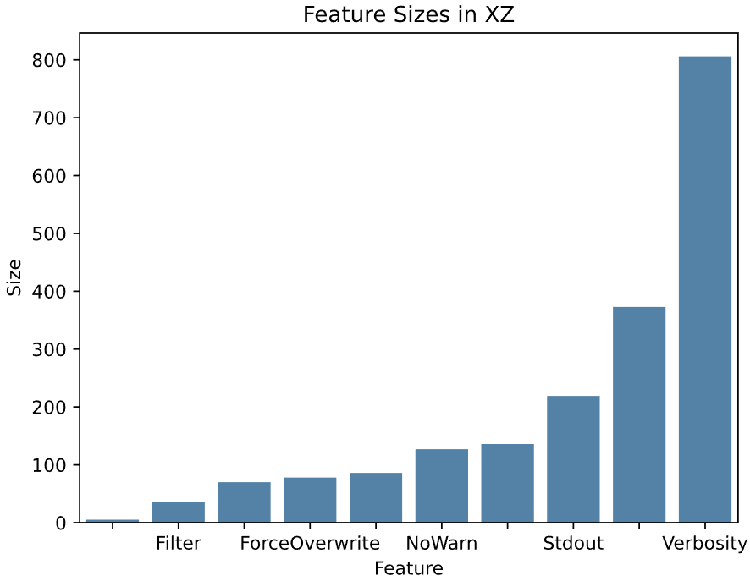
Feature Size
01/15/2024
Measure to compare features with each other
→ Put the number of their interactions into
perspective
How to measure: All IR instructions that stem
from a feature’s regions
01/15/2024
Universität des Saarlandes
Notes:
before talking about my research questions I want to introduce the concept of feature size
which we use to compare features with each other
and putting the number of interactions into perspective, as we naturally expect
larger features to be part of more interactions
in the compression tool xz for which we will also present some initial results of our research
we have already found a large variance between the sizes of different features
here, the size of a feature is the sum of all IR instructions stemming from the regions of a feature
encompassing all instructions implementing its functionality

Slide 13
Research Questions
01/15/2024
RQ1: How do commits and features structurally interact with each other?
RQ2: How do commits interact with features through dataflow?
RQ3: How do authors implement features?
01/15/2024
Universität des Saarlandes
Notes:
in total we pose 3 RQs, the first one being "how do commits and features structurally interact with each other"
where we investigate properties of structural CFIs
the second RQ investigates dataflow interactions whereas in the third RQ we link commits to their authors for structural CFIs
to gain some data on how authors implement features

Slide 14
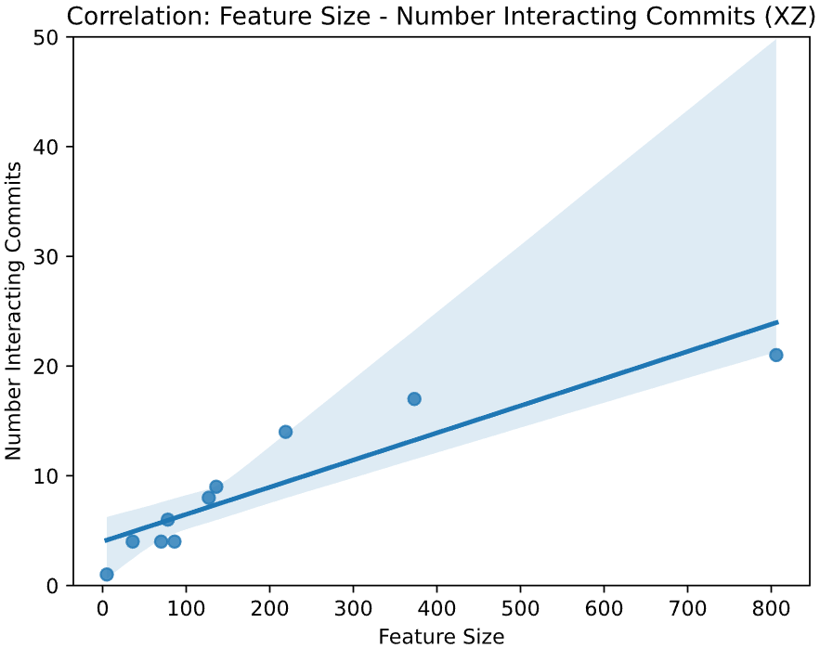
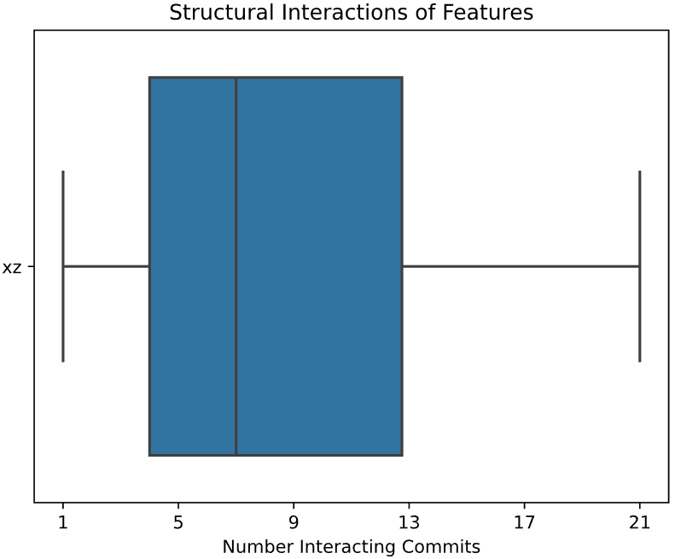
RQ1: Structural CFIs
01/15/2024
Number of commits used to implement a feature
→ Calculate mean/variance and plot the distribution
→ In relation to the size of a feature: regression plot
Correlation: 0.91
(p-value = 2.5*10
01/15/2024
Universität des Saarlandes
Notes:
the first property extracted from structural CFIs is the number of commits used to implement a features
in our code snippet FeatureA is implemented by four different commits and FeatureB by only one
we can already see that this property is especially interesting if we relate it with size of a feature
which allows us insights into feature development

Slide 15
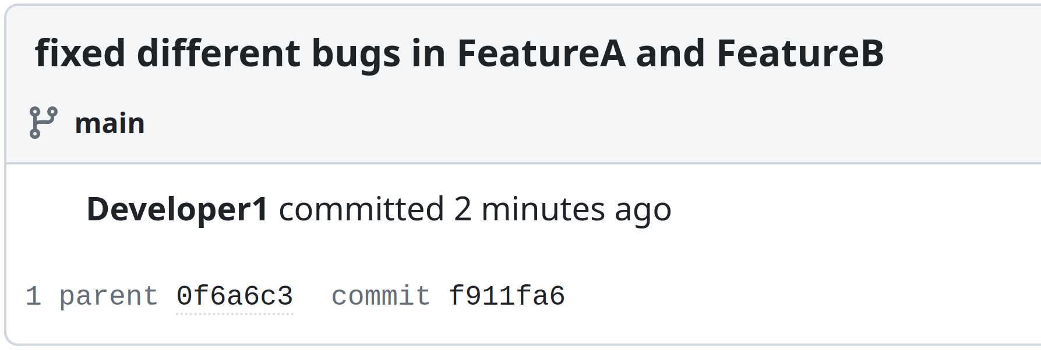
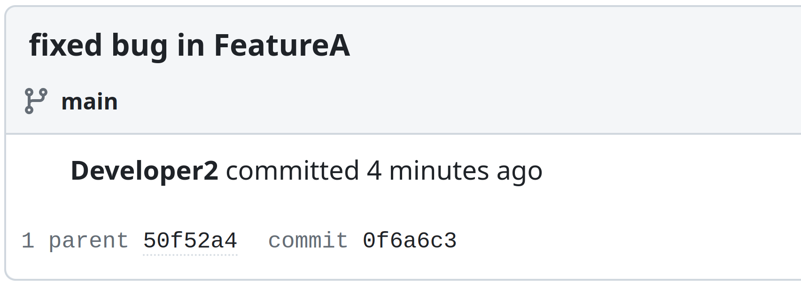

RQ1: Structural CFIs
01/15/2024
2) Number of features changed by a commit
→ Best practices surrounding commits
→ Commits should only deal with a single concern
→ Features implement specific functionality
→ Commits should only change a single feature
01/15/2024
Universität des Saarlandes
Notes:
the second property examined in RQ1 is the number of features changed by a commit
This is especially interesting when taking into account best practices surrounding commits
as they should normally only affect or change a single functionality and since features are used
to implement separate functionality we expect commits to only change code of a single feature as well
For example we propose that a commit should not be used to fix different bugs in multiple features and rather be used to fix a single bug in a single feature

Slide 16
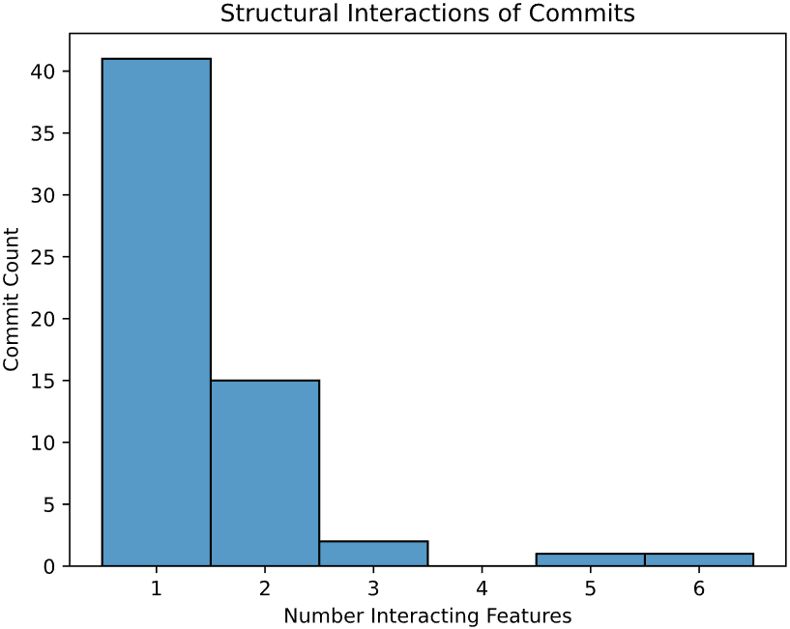
RQ1: Structural CFIs
01/15/2024
2) Number of features changed by a commit (xz)
- Plot the distribution
- Average number of features changed: ~1.5
- Percent of commits changing more
than one feature: ~32%
01/15/2024
Universität des Saarlandes
Notes:
to investigate this, we first plot the distribution showing us what number of commits structurally interact with what number of features
for the compression tool xz, we see that most commits were used to only change a single feature with an average of 1.5
which is rather close to the best practice of one feature changed per commit as proposed by us
in particular, around 32% of commits structurally interacting with features do so with more than one feature
For XZ not as enforced as expected
it will be interesting if our derived best practic for commits is more or less enforced in other projects

Slide 17
Research Questions
01/15/2024
RQ1: How do commits and features structurally interact with each other?
RQ2: How do commits interact with features through dataflow?
RQ3: How do authors implement features?
01/15/2024
Universität des Saarlandes
Notes:
now, we come to RQ2, which is called "How do commits interact with features through dataflow"
where we investigate properties of dataflow-based CFIs

Slide 18
RQ2: Dataflow CFIs
01/15/2024
Unveil interactions between commits and features that cannot be discovered with a structural analysis
The number of features a commit affects through dataflow
→ How likely are new changes to affect the data of a feature
01/15/2024
Universität des Saarlandes
Notes:
dataflow CFIs can help us discover additional features and commits that interact with each other we missed in our structural analysis
here, we examine the number of features a commit affects through dataflow
for example does commit 7edb283 have df-based interactions with both FeatureA and FeatureB
this can also tell us how likely new changes, in the form of commits, are to affect the data of a feature

Slide 19
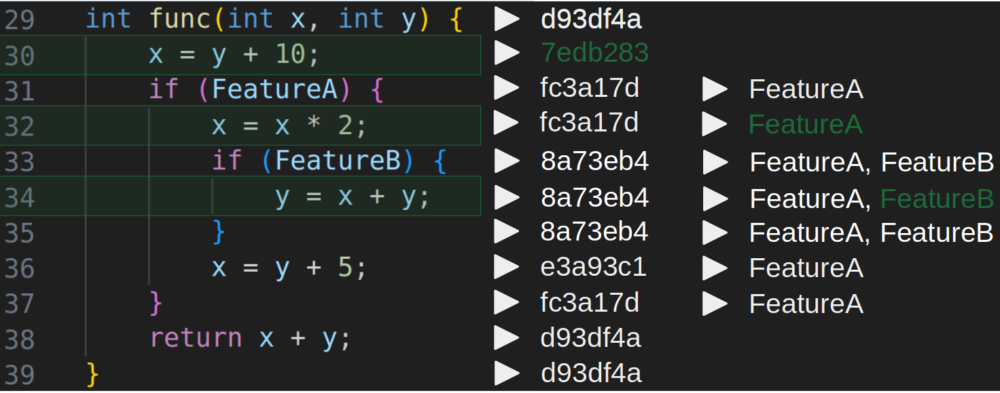
RQ2: Dataflow CFIs
01/15/2024
Commits part of structural CFIs are very likely to affect the feature of that interaction through dataflow as well (90%)
→ There, dataflow occurs inside a feature
→ Commits whose dataflow stems from outside more interesting
01/15/2024
Universität des Saarlandes
Notes:
when investigating this property we need to pay attention to the fact that structural CFIs often coincide with dataflow CFIs
meaning that commits part of structural CFIs are very likely to affect the features of these structural interactions through dataflow as well
Which is true for 90% of commits in XZ
We can say that the dataflow occurs inside the regions of a feature for these interactions
Since these interactions are quite obvious and we already discovered them in our structural analysis
we especially focus on commits whose dataflow stems from outside the regions of a feature
i.e. commits that have no structural interactions with the features they affect through dataflow
which we can see in our code snippet for commit 7edb283

Slide 20
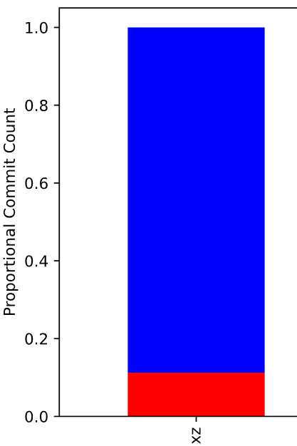
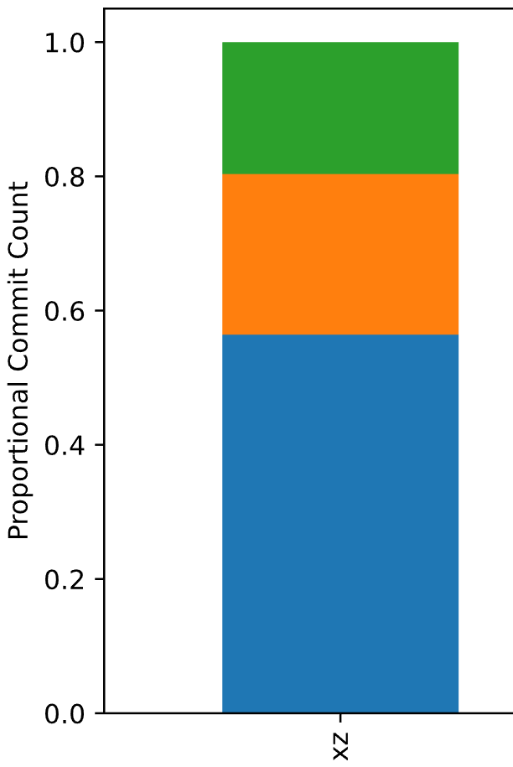
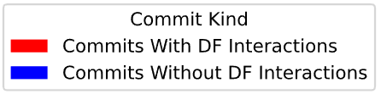
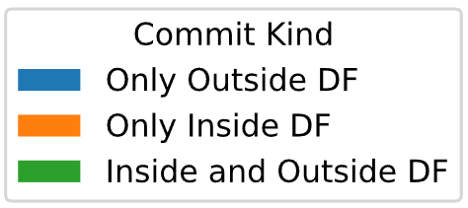
RQ2: Dataflow CFIs
01/15/2024
Percentage of commits affecting data of a feature (xz)
- Only consider active commits
- For them: ~11%
- Considering only commits with outside dataflow: ~8%
01/15/2024
Universität des Saarlandes
Notes:
for xz we have already calculated what fraction of commits affect data of a feature
we only consider active commits, namely commits that are still represented by commit regions, because they couldn't be part of any interactions otherwise
11% of all active commits are part of dataflow-based CFIs, so only a small proportion of all active commits
if we only consider commits who are part of interactions where dataflow stems from outside the regions of a feature, this number drops to around 8%
Therefore this division makes sense since it gives us a more accurate number on how likely seemingly unrelated commits are to affect data of a feature

Slide 21
Research Questions
01/15/2024
RQ1: How do commits and features structurally interact with each other?
RQ2: How do commits interact with features through dataflow?
RQ3: How do authors implement features?
01/15/2024
Universität des Saarlandes
Notes:
in the last RQ we show how we can enrich CFI-data by, for example linking commits to their authors, providing us with more information

Slide 22
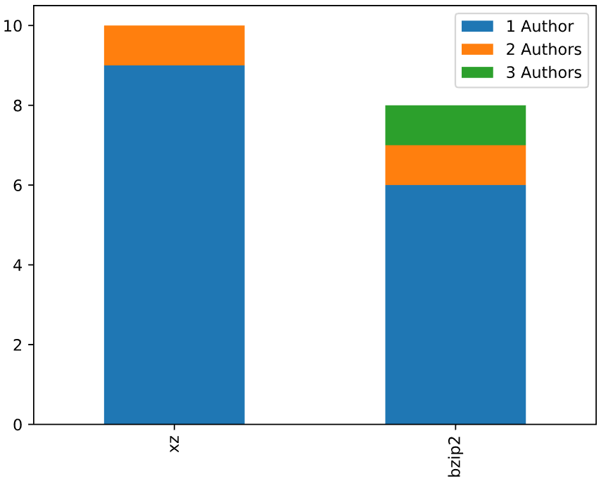
RQ3: Authors of Features
01/15/2024
Provide additional insights into feature development
Number of authors that developed a feature
Current investigation results (xz, bzip2):
85% of features are implemented by one author
→ Todo: Relate the size of a feature
to the number of implementing authors
01/15/2024
Universität des Saarlandes
Notes:
the main intention here is to gain some additional insights into feature development
the only property we investigate in this work is the number of authors that developed a feature
here you can see the distribution for the projects xz and bzip2
in xz only one feature is implemented by more than one author where as two features are implemented by more than one author in bzip2
overall our current investigation results show that 85% of features are implemented by only one author
in this context it doesn't make much sense to relate the number of authors to the size of a feature

Slide 23


Structural CFIs
Dataflow CFIs
investigated by
RQ1
How do commits and features structurally interact with each
other?
RQ3
How do authors implement features
RQ2
How do commits and features interact through dataflow?
allow insights into
Feature Development
Connectivity between features and commits
Authors?
?
Enforced in
other projects?
?
01/15/2024
Universität des Saarlandes
Notes:
where our main intention is to provide insights into feature development and usage of commits therein
we propose a best practice of commits in feature development, where say that they should mostly change a single feature
where we check to what extent this is upheld in the examined software projects
We also try to detect certain patterns in feature development by relating properties such as the number of commits used to implement a feature to the size of feature
Which we also aim to examine for authors
dataflow-based CFIs are investigated via our second RQ
here we show how connected the data of features and commits are by determining what fraction of commits affect features through dataflow
At least for XZ this fraction is relatively low, which could potentially be higher for different projects
We also specify the origin of the dataflow, namely from inside or from outside the regions of a feature
Giving us a better estimation on how likely seemingly unrelated commits are to affect data of a feature

Slide 24
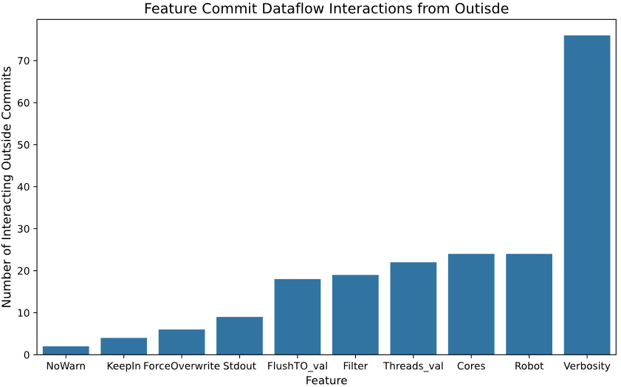
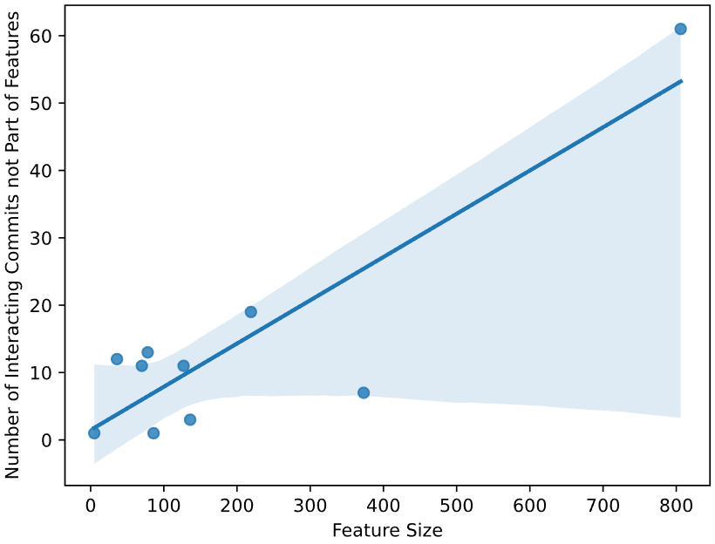
RQ2 - Appendix: Dataflow CFIs
01/15/2024
2) Number of outside commits affecting a feature through dataflow (xz)
→ Is feature-size the driving factor in this?: regression plot
→ Which feature contains central code?
Correlation: 0.88
01/15/2024
Universität des Saarlandes
Notes:
another property we examine is the number of outside commits, meaning commits not part of that feature, affecting it through dataflow
here we aim to check whether feature-size is the driving factor in the number of interacting commits or there might be another property of features affecting this
we plot this in a regression to show how strongly they are correlated
for xz we have found a clear positive correlation of around .88 so far, which will be interesting to see if this is confirmed by other projects
Which features are affected by many outside commits through dataflow could potentially tell us which features contain central code
Especially if we consider smaller features with many interactions
Maybe we can also detect certain kinds of features that often contain central code

Slide 25
Commit-Feature Interactions
Analyzing Structural and Dataflow Relations between Commits and Features
Simon Steuer, 22.09.2023

