Slide 1
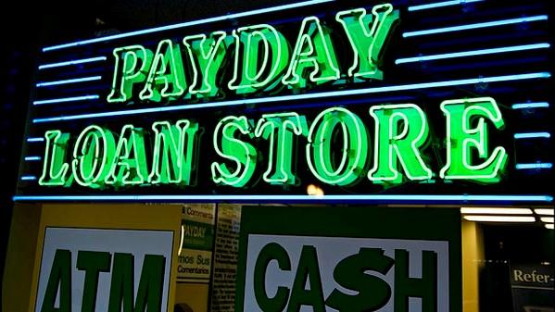
ARE PAY DAY LENDERS TARGETING LOW INCOME COMMUNITIES?
MASKED MAPPING MANDRELS

Slide 2
Masked Mapping Mandrels
Sean Istre
Isabelle Sanford
Chuck Medina
Alice Martin
Alex Reyes

Slide 3
What we did
Centralized efforts to California
Defined Payday Lenders
Defined Census poverty calculation
Pulled census data from 2017
Poverty rates by zip code
Minority populations by zip code
Plotted this information in a choropleth
Collected all payday lender locations in CA using Google API
Removed any traditional lending agencies
Plotted this information in a choropleth
Performed regression analysis
Plotted census data against payday lender locations in CA

Slide 4

What is a Pay Day Lender
A company that lends customers small amounts of money at high interest rates, on the agreement that the loan will be repaid when the borrower receives their next paycheck.

Slide 5
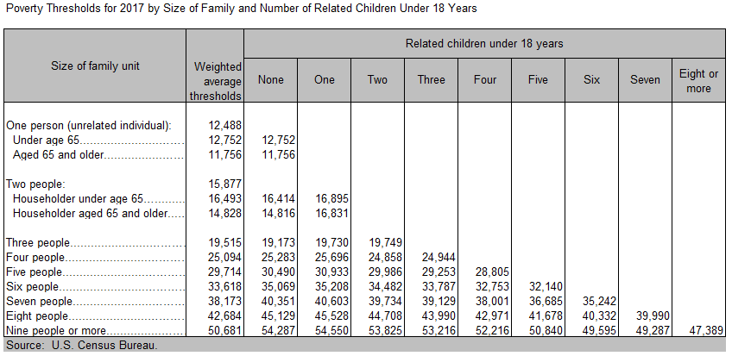
Calculating Poverty (Census)
To calculate total family income, the incomes of all related family members that live together are added up to determine poverty status. If an individual or group of individuals (such as housemates) are not living with family members, their own individual income is compared with their individual poverty threshold.
Thus, all family members have the same poverty status, and some families may be composed of single unrelated individuals.
If total family income:
Is less than the poverty threshold for that family - that family and everyone in it is considered to be in poverty.
Equals or is greater than the poverty threshold - the family is not considered to be in poverty.

Slide 6
Reading the data

Slide 7
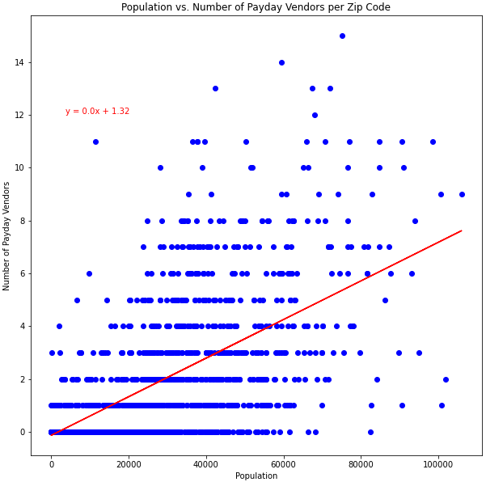
Statement
r-value or the correlation coefficient = 0.6389121702396012

Slide 8
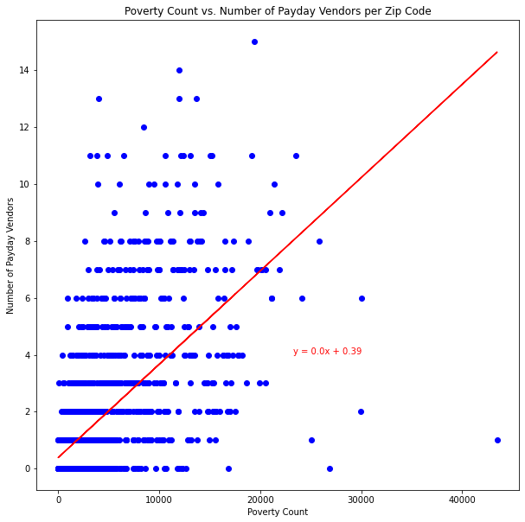
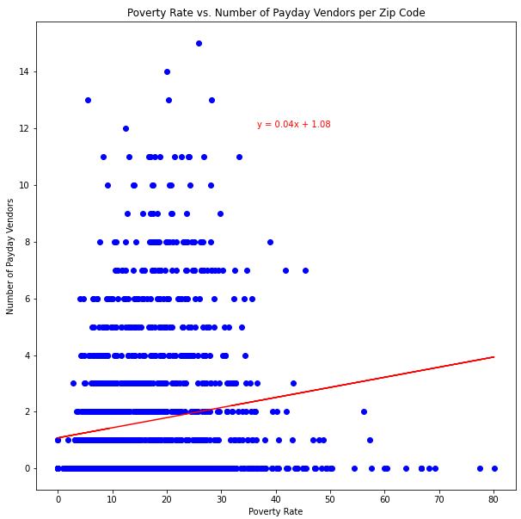
r-value or the correlation coefficient = 0.6209661060908946
r-value or the correlation coefficient = 0.1524339311059148

Slide 9
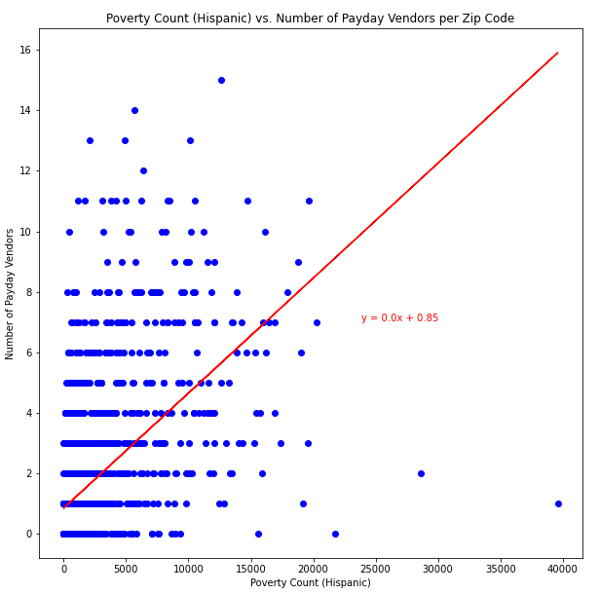
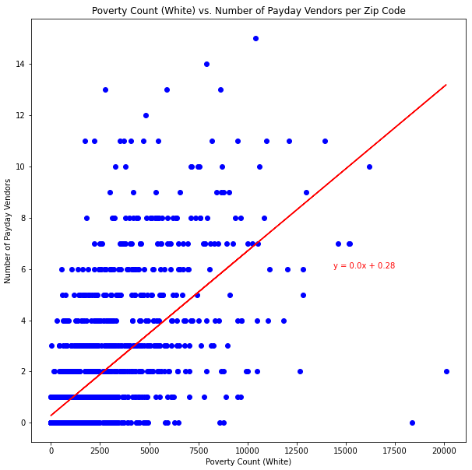
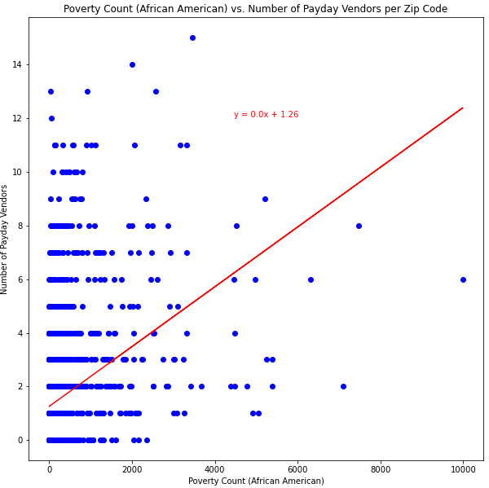
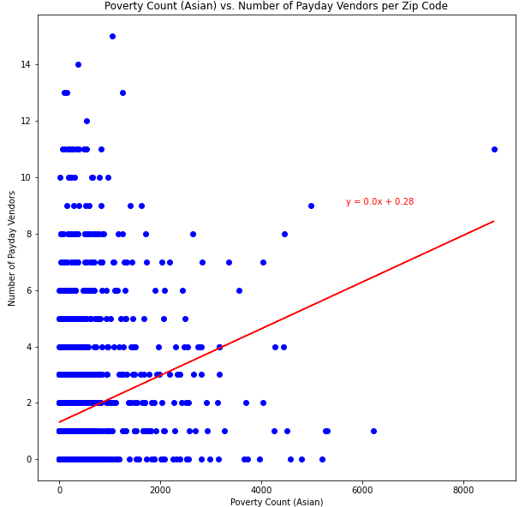
r-value = 0.6505843404347365
r-value = 0.2511347691057071
r-value = 0.5413786416171631
r-value = 0.35642516695504534

Slide 10
Visualizing the data

Slide 11
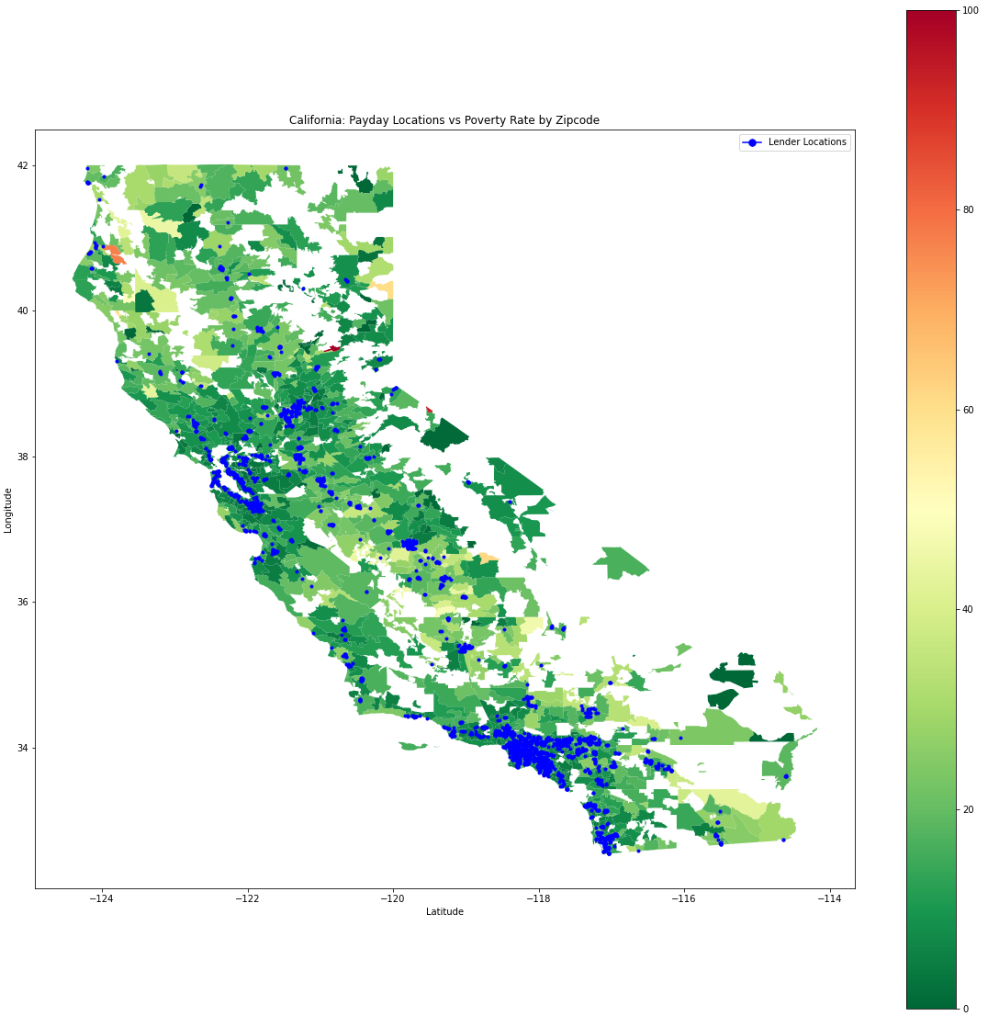
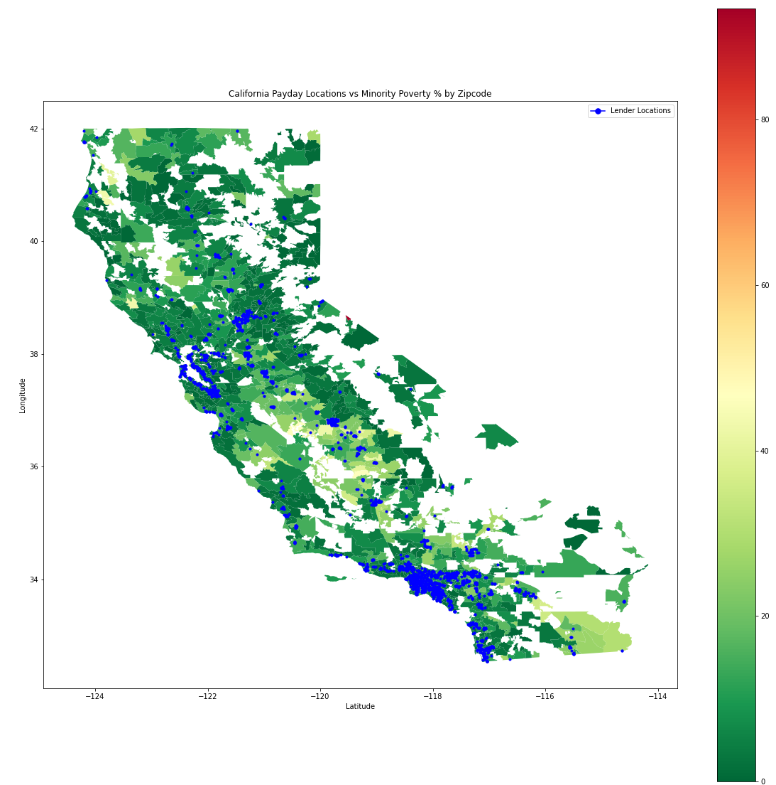
California: Payday Locations v. Minority Poverty % by Zipcode
California: Payday Locations v. Poverty Rate % by Zipcode

Slide 12
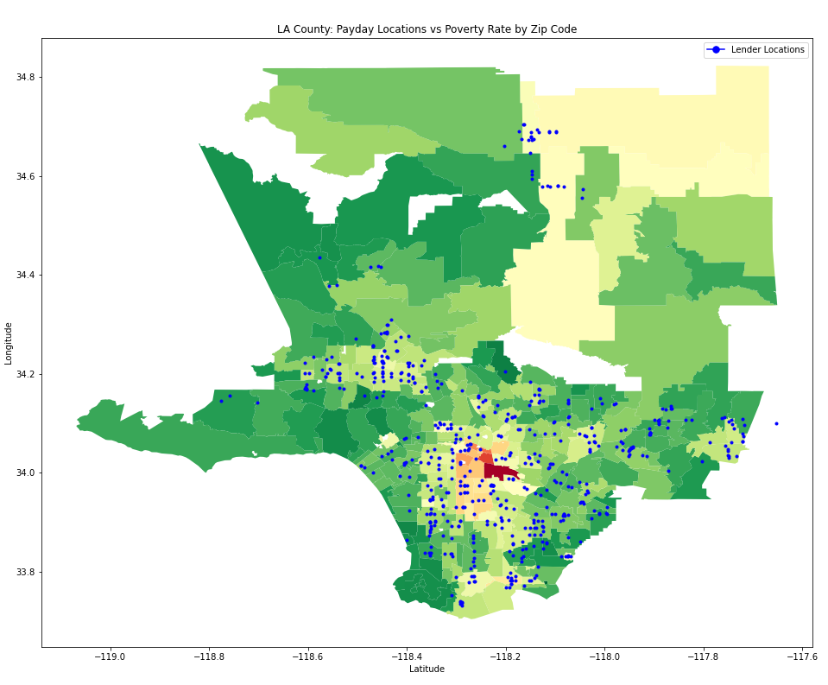
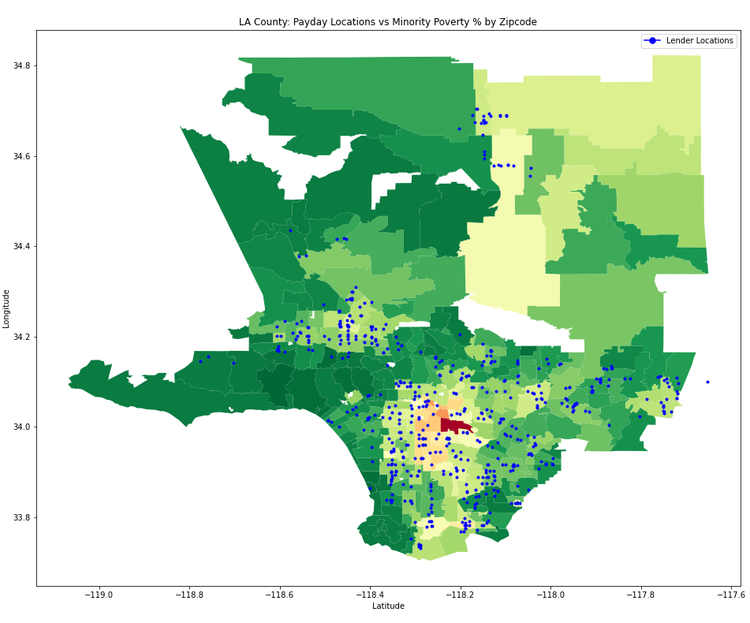
LA County: Payday Locations v. Minority Poverty % by Zipcode
LA County: Payday Locations v. Poverty Rate % by Zipcode

Slide 13
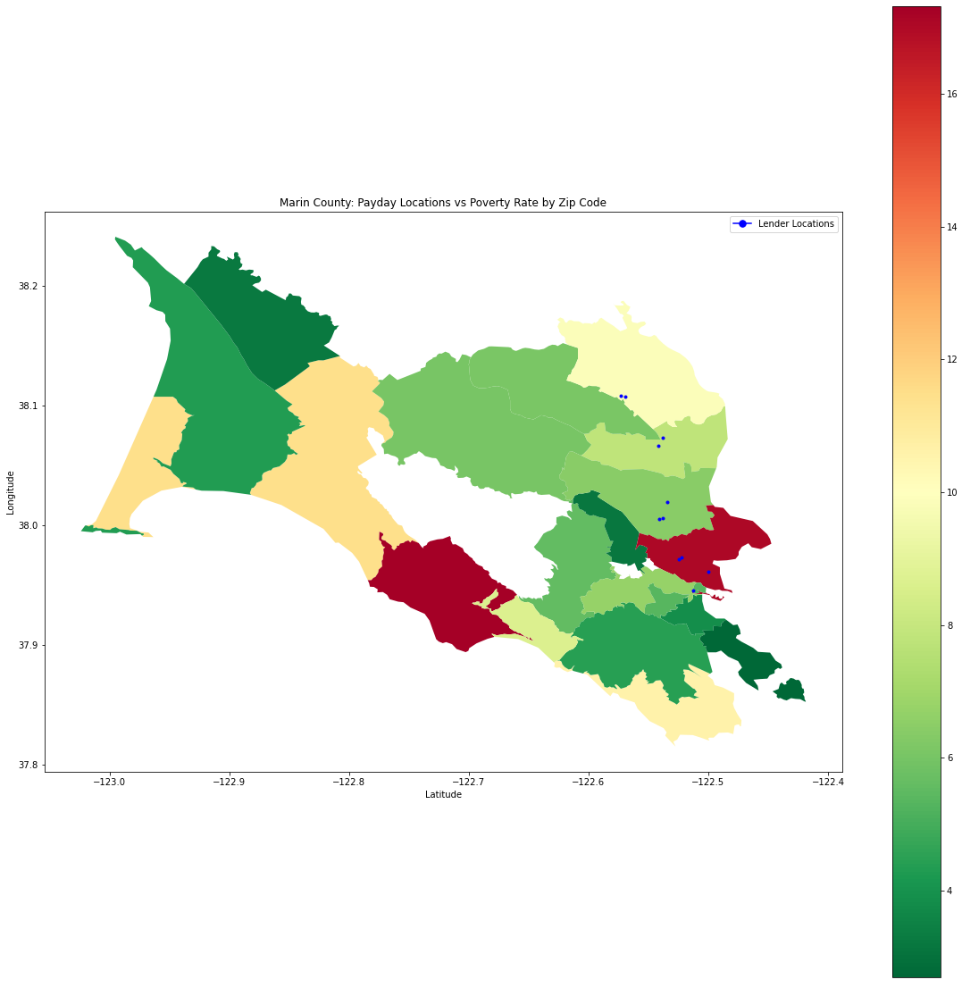
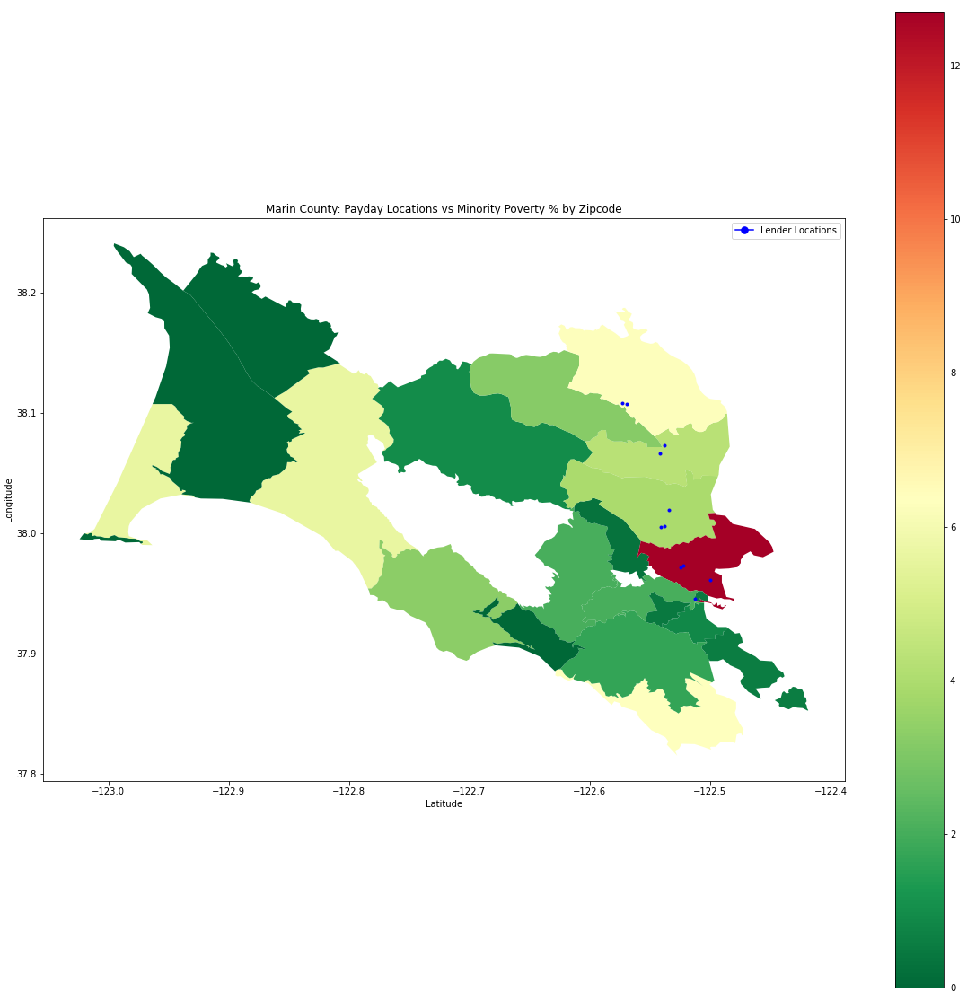
Marin County: Payday Locations v. Poverty Rate % by Zipcode
Marin County: Payday Locations v. Minority Poverty % by Zipcode

Slide 14
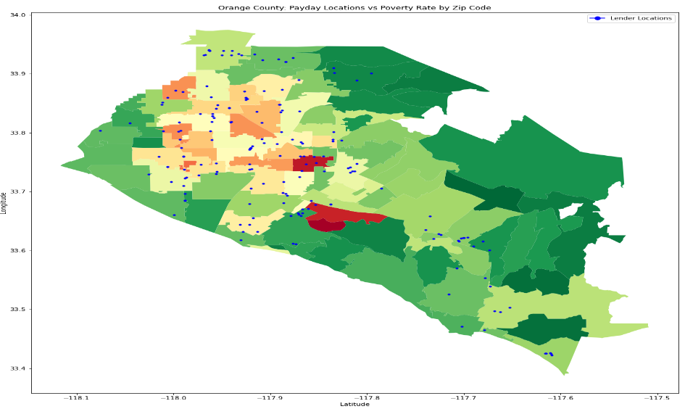
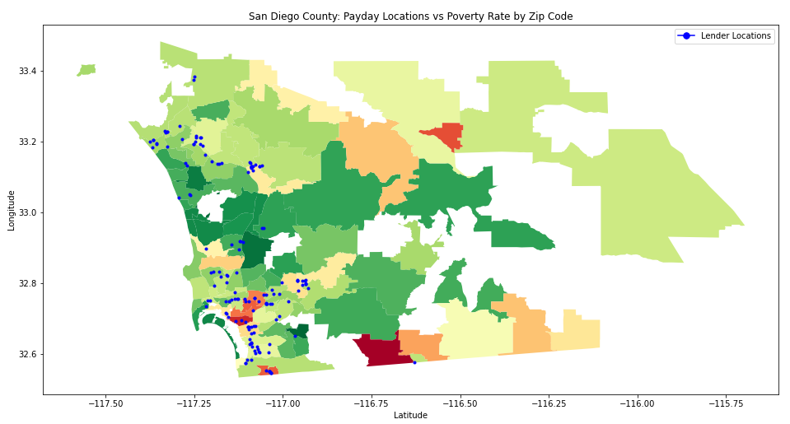
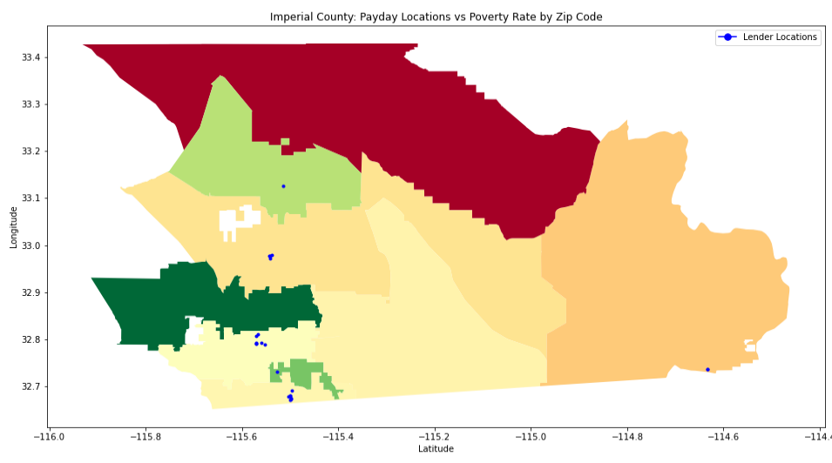
Payday Locations v. Poverty Rate by Zip code
San Diego County
Orange County
Imperial County

Slide 15
Conclusion

