Slide 1
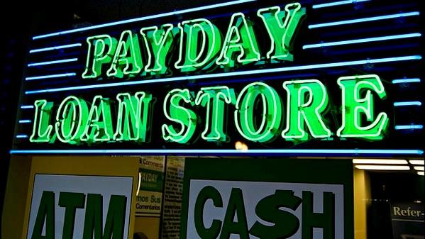
ARE PAY DAY LENDERS TARGETING LOW INCOME COMMUNITIES?
MASKED MAPPING MANDRELS
Notes:
Alice

Slide 2
Masked Mapping Mandrels
Sean Istre
Isabelle Sanford
Chuck Medina
Alice Martin
Alex Reyes
Notes:
Alice

Slide 3
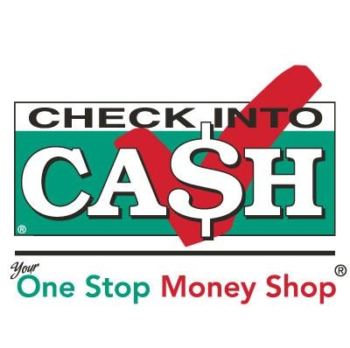
What is a Pay Day Lender
A company that lends customers small amounts of money at high interest rates, on the agreement that the loan will be repaid when the borrower receives their next paycheck.
Notes:
Alice

Slide 4
What we did
Centralized efforts to California
Defined Payday Lenders
Defined Census poverty calculation
Pulled census data from 2017
Poverty rates by zip code
Minority populations by zip code
Plotted this information in a choropleth
Collected all payday lender locations in CA using Google API
Removed any traditional lending agencies
Plotted this information in a choropleth
Performed regression analysis
Plotted census data against payday lender locations in CA
Notes:
Isabelle

Slide 5
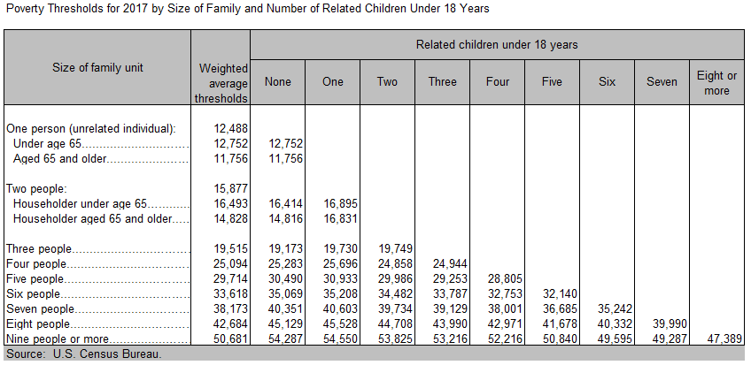
Calculating Poverty (Census)
To calculate total family income, the incomes of all related family members that live together are added up to determine poverty status. If an individual or group of individuals (such as housemates) are not living with family members, their own individual income is compared with their individual poverty threshold.
Thus, all family members have the same poverty status, and some families may be composed of single unrelated individuals.
If total family income:
Is less than the poverty threshold for that family - that family and everyone in it is considered to be in poverty.
Equals or is greater than the poverty threshold - the family is not considered to be in poverty.
Notes:
Isabelle

Slide 6
Reading the Data
Notes:
Sean

Slide 7
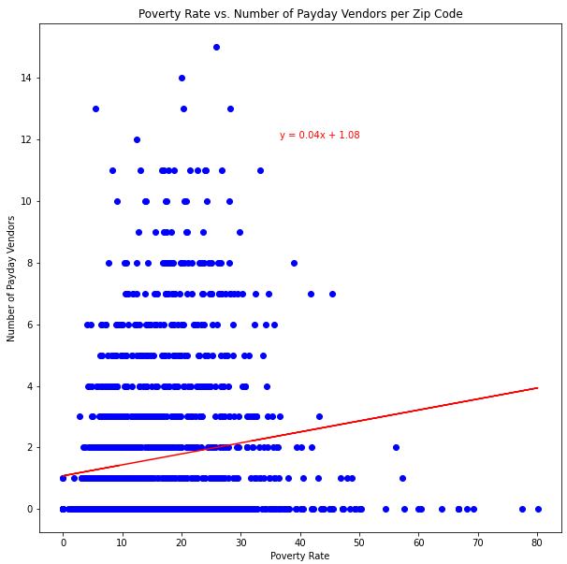
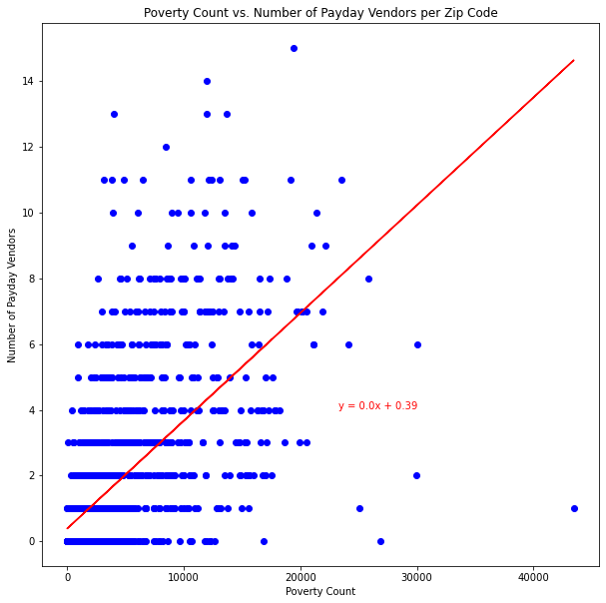
r-value or the correlation coefficient = 0.15
r-value or the correlation coefficient = 0.62
Notes:
Sean

Slide 8
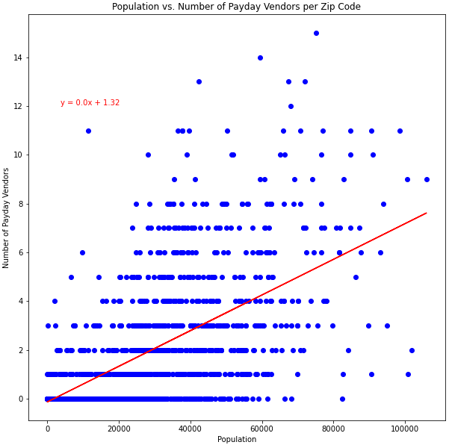
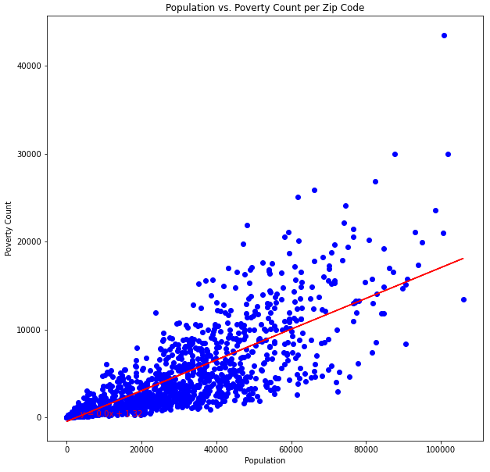
r-value or the correlation coefficient = 0.64
r-value or the correlation coefficient = 0.81
Notes:
Sean

Slide 9
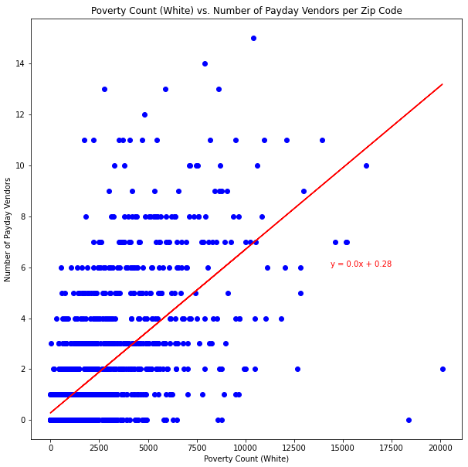
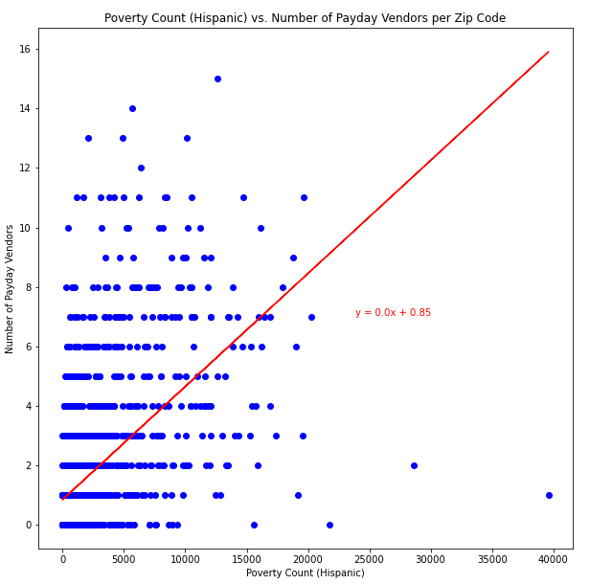
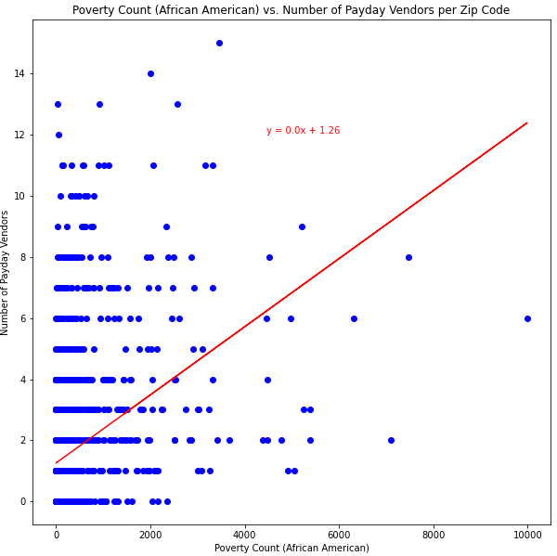
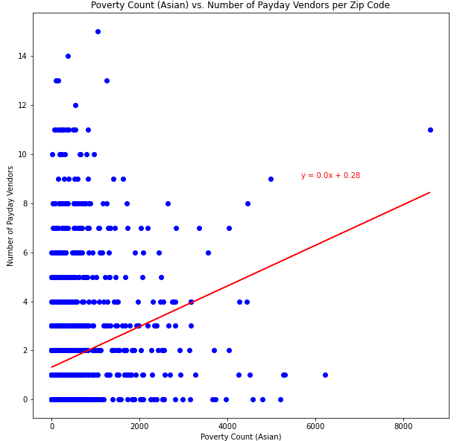
Hispanic Community
r-value = 0.54
Asian Community
r-value = 0.25
Caucasian Community r-value = 0.65
African American Community
r-value = 0.36
Notes:
Sean

Slide 10
Visualizing the Data
Notes:
Chuck

Slide 11
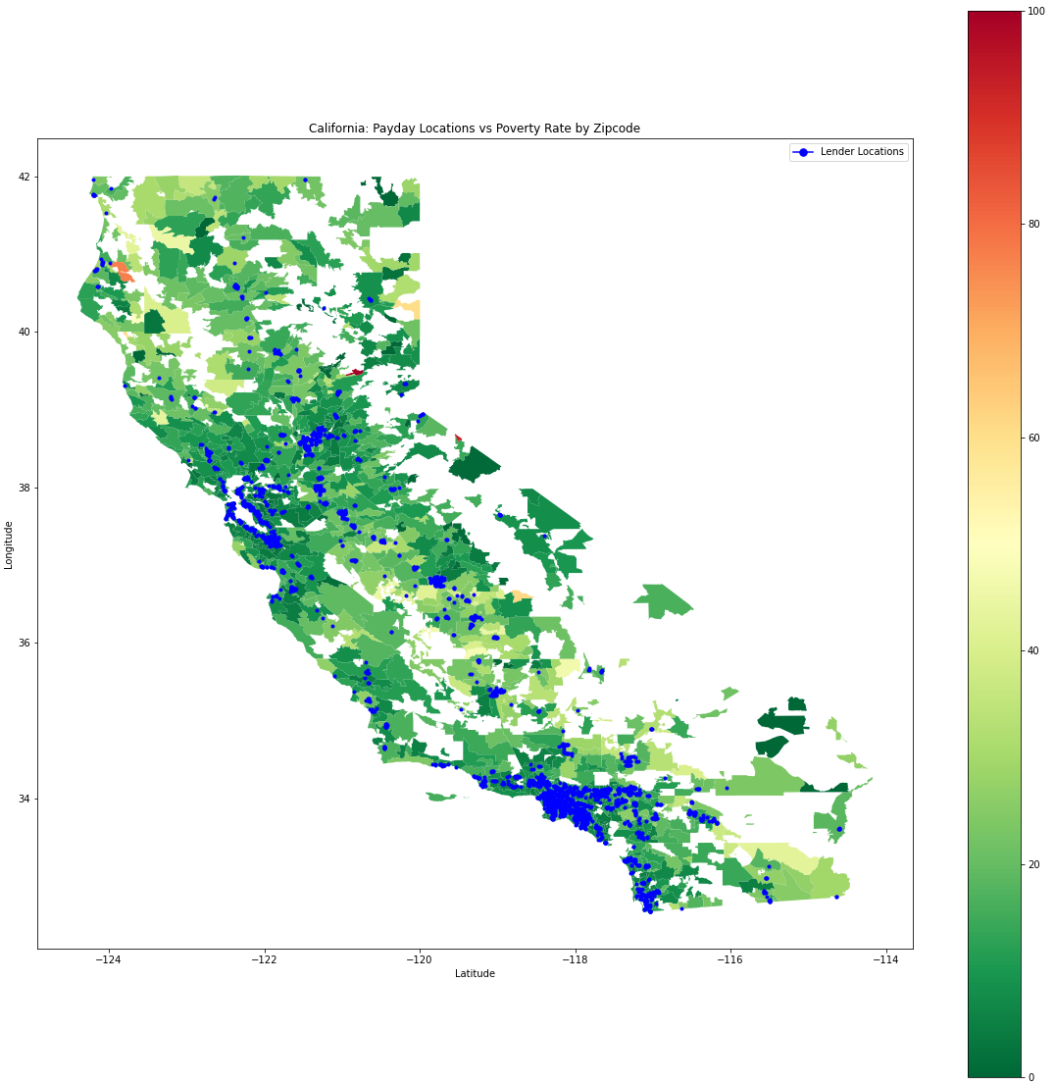
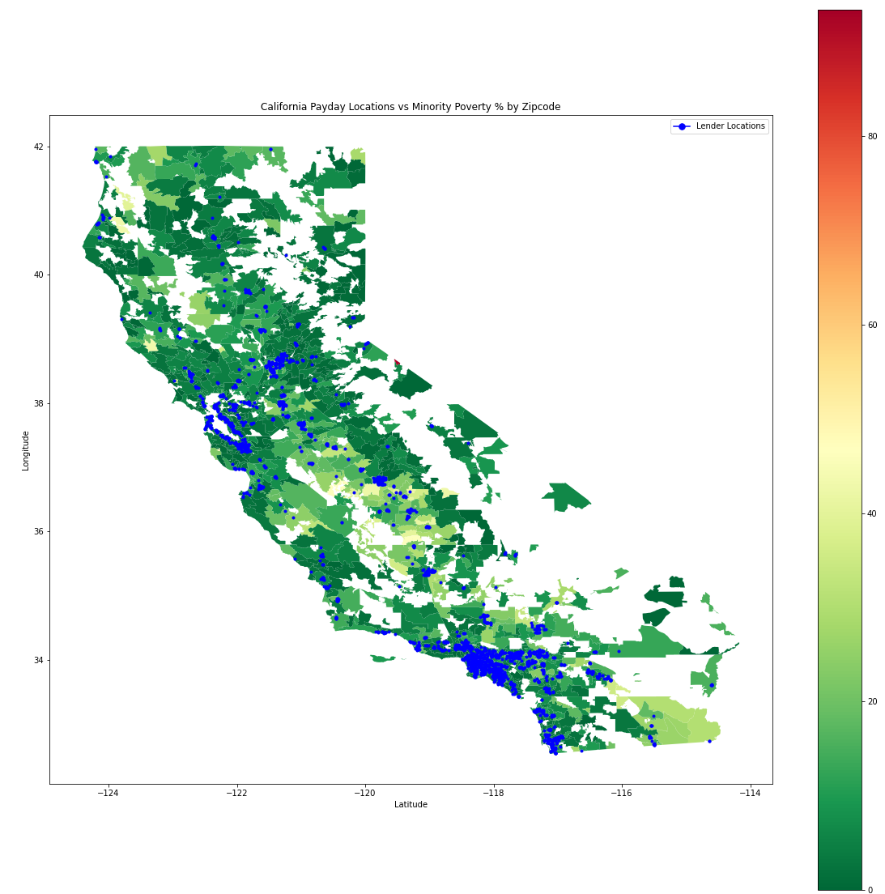
California: Payday Locations v. Minority Poverty % by Zip Code
California: Payday Locations v. Poverty Rate % by Zip Code
Notes:
Chuck

Slide 12
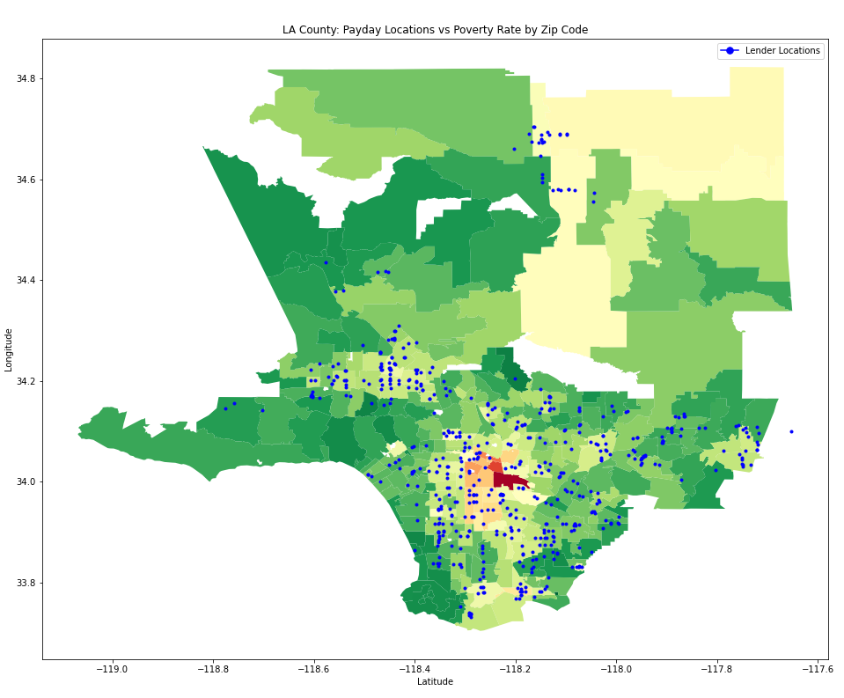
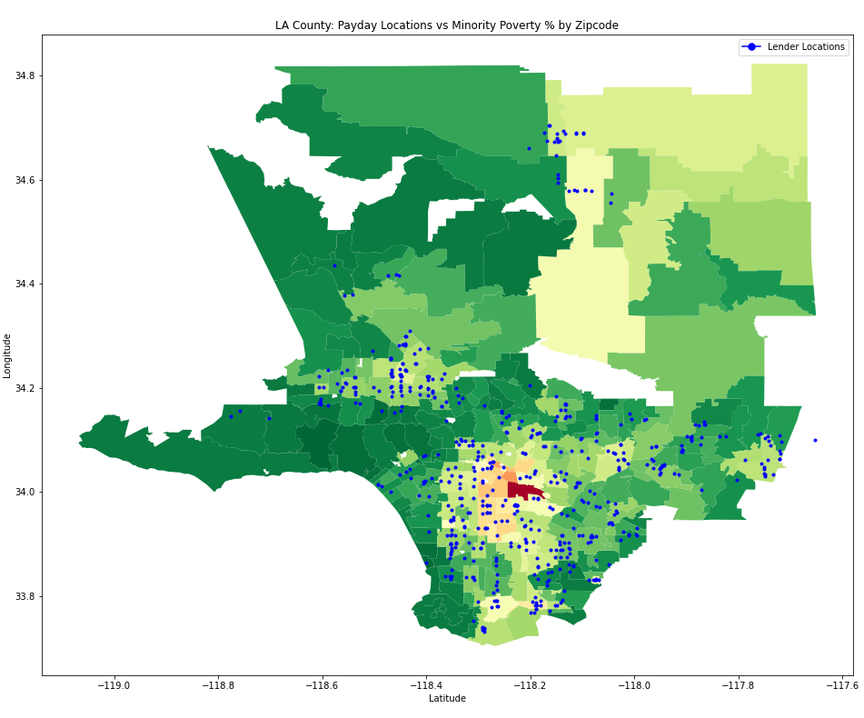
LA County: Payday Locations v. Minority Poverty % by Zip code
LA County: Payday Locations v. Poverty Rate % by Zip code
Notes:
Chuck

Slide 13
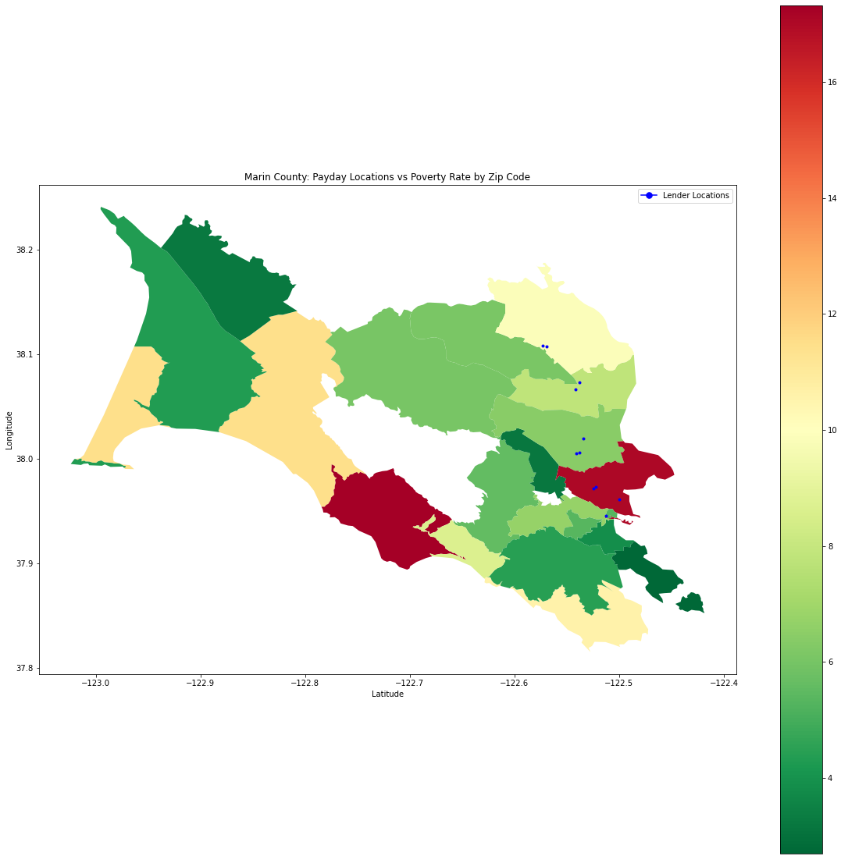
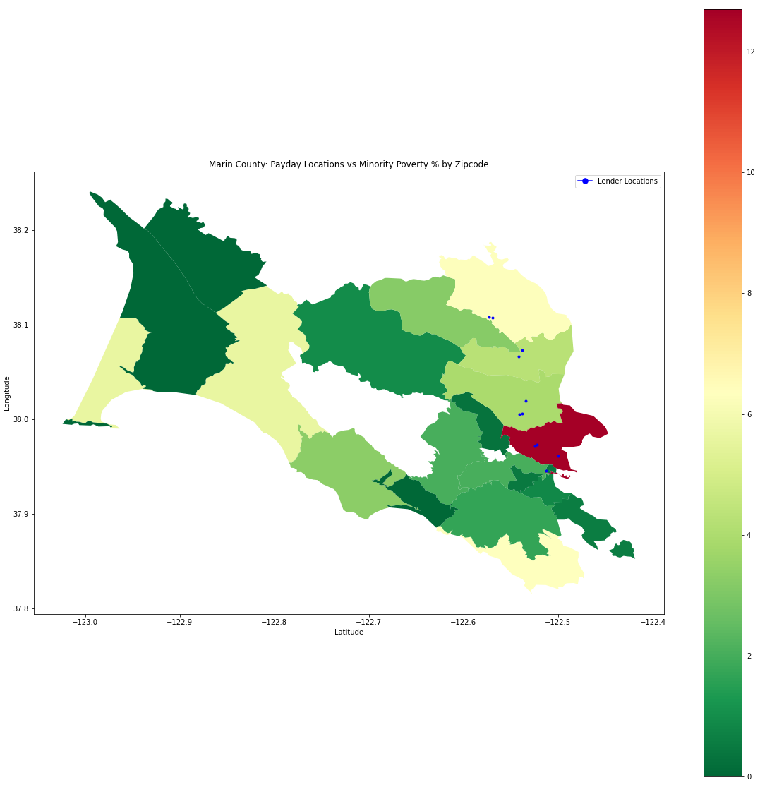
Marin County: Payday Locations v. Poverty Rate % by Zip Code
Marin County: Payday Locations v. Minority Poverty % by Zip Code
Notes:
Alex

Slide 14
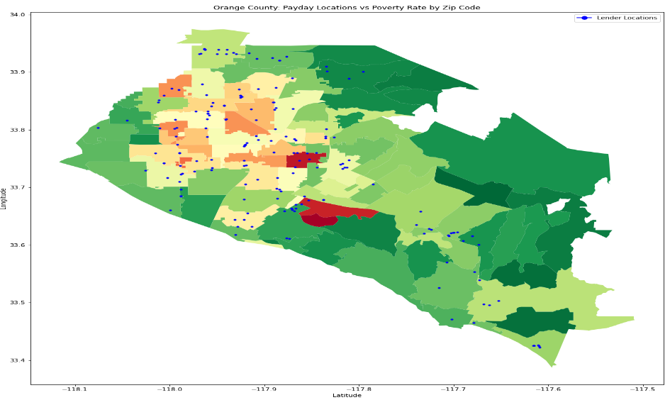
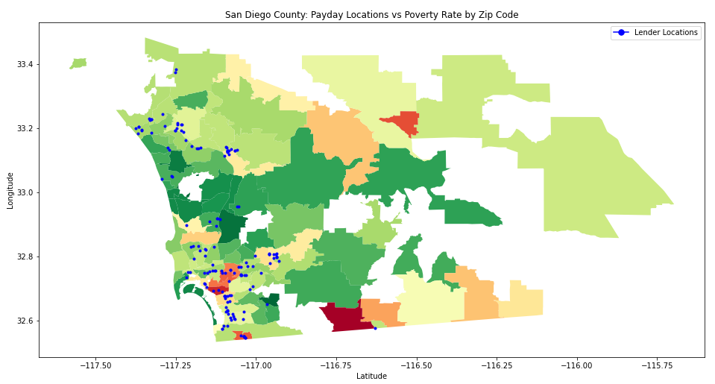
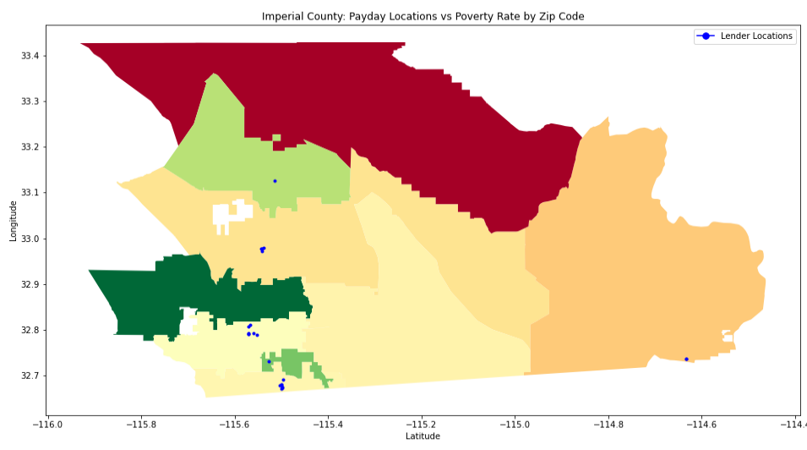
Payday Locations v. Poverty Rate by Zip Code
San Diego County
Orange County
Imperial County
Notes:
Alex

Slide 15


Are payday lenders targeting low income communities?
In conclusion, Payday loan venders target areas with large counts of impoverished White and Hispanic people.
Payday loan venders stay away from areas where the poverty rate is above 35-40%.
Notes:
Alex

